Slide 1
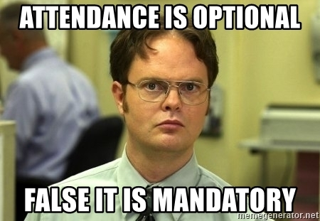

Slide 2
Text & Un-Supervised Learning
Ted Kwartler

Slide 3
Machine Learning Supervised Learning
Goal: Predict a single “target” or “outcome” variable
Training data, where target value is known
Score to data where value is not known
Methods: Classification and Prediction

Slide 4
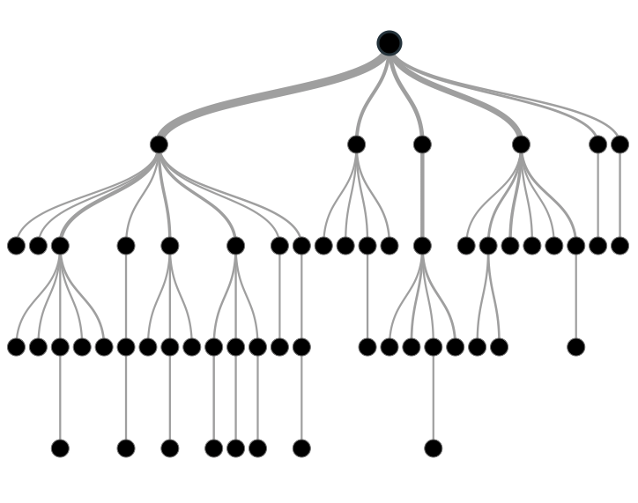

Supervised Learning
Inferring a function from labeled data.
“Learn from telling”, “Look at my data and I will tell you what to predict”
Data Setup
Method
Business Examples
Application
Marketing-Will a customer buy yes or no? How much will a customer spend?
Operations- Will an applicant default? When will a machine break?
Flat “Excel” file. Each row is a record or observation. Each column is an attribute of the record.
One column is the outcome, y or target attribute.
Modeling e.g. K-NN, linear regression, decision tree, random forest etc.
Make predictions for the target on the new data.

Slide 5
Supervised Learning in NLP
Is this email SPAM Vs non-Spam?
Is this document making fraudulent claims or not?
Using tweet mentions or financial documents predict a company’s revenue?

Slide 6
Machine Learning: Unsupervised Learning
Goal: Segment data into meaningful segments; detect patterns
There is no target (outcome) variable to predict or classify
Methods: Association rules, clustering, data reduction & exploration, visualization

Slide 7
Unsupervised Learning
Trying to find hidden structure in unlabelled data.
“Learn from observing”, “Look at my data and tell me about it”
Data Setup
Method
Business Examples
Application
Marketing-Find customer segments for specific marketing campaigns.
Operations-Identify locations for cell towers based on population density and area characteristics.
Text Analysis- Topic modeling of articles
Flat “Excel” file. Each row is a record or observation. Each column is an attribute of the record.
Clustering e.g. K-Means, Hierarchical Clustering etc
For new data assign to similar cluster

Slide 8
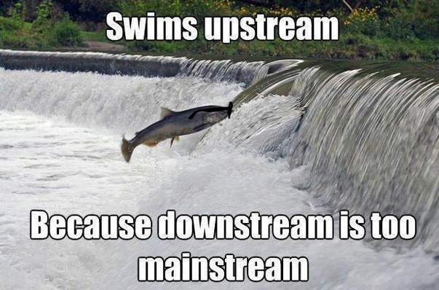
Your turn…
Methods
Scenario
Supervised or
Unsupervised
How many fish did each vessel catch?

Slide 9
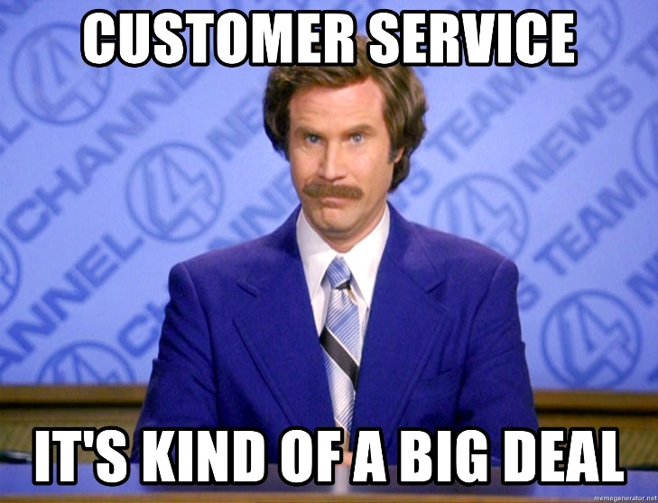
Your turn…
Methods
Scenario
Supervised or
Unsupervised
What observed customer personas exist in our customer data?

Slide 10

Your turn…
Methods
Scenario
Supervised or
Unsupervised
How many patients should we expect in the urgent care tomorrow?

Slide 11
Unsupervised Learning: Latent Dirichlet Allocation
Observe term frequency within documents
Identify “k” topics or clusters with similar frequency
A document may be more than one topic and is assigned to a cluster topic by probability
If K= 4, each document would get 4 probabilities

Slide 12

Unsupervised: Latent Dirichlet Allocation (LDA)
Latent – identify concealed topics e.g. not explicitly declared
Dirichlet – used in stats to represent multi-variate (multi-word) distributions
Instead of actual values it’s a “beta” distribution of probabilities 0-1
No “tails” values include 0 and 1
Beta distributions do not have to be symmetrical
Dirichlet will give k probabilities from beta distributions that generalize and sum to 1
Don’t worry about it!

Slide 13
K = 3: Three vectors & Three corresponding probabilities
{1,0,0 }
{0,0,1 }
{0,1,0 }

Slide 14
K = 3: vectors & 3 corresponding probabilities
{0.33, 0.33, 0.33}
{0.50,0.50,0 }

Slide 15
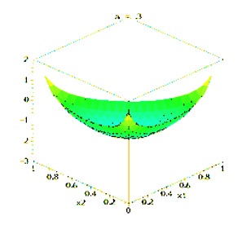
Dirichlet Function…
{0.33,0.33,0.33} each of the 3 vectors have equal likelihood among K represented as highest points
K can be more than 3 but can’t be visualized

Slide 16
Dirichlet Function…
Alpha is a parameter adjusts the probability distribution, adjusted through observed frequencies

Slide 17
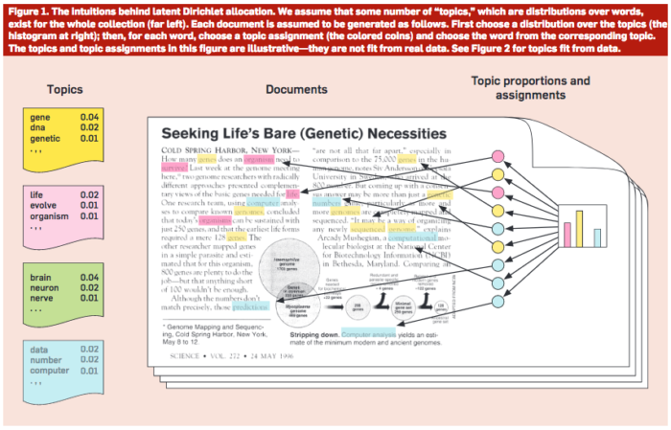
Common Sense Explanation
http://www.cs.columbia.edu/~blei/papers/Blei2012.pdf

Slide 18
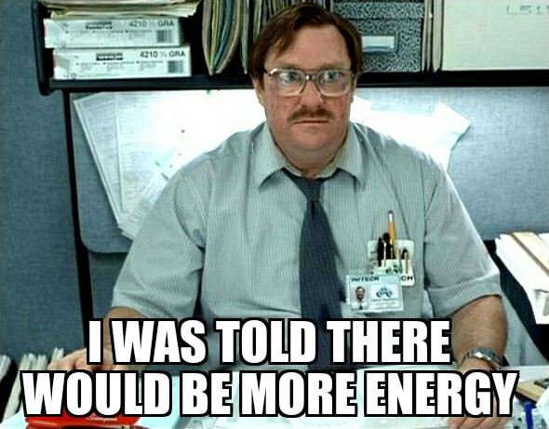
Open A_topicModeling.R

Slide 19
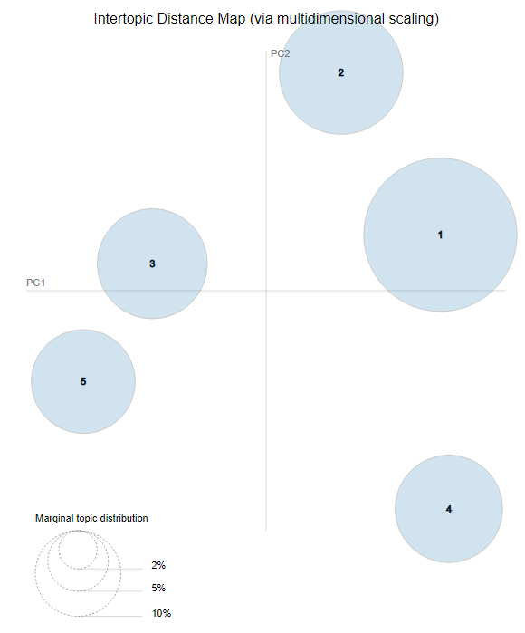
LDAvis: PCA of topics need to be interpreted
England-ness?
Non-Cricket
Cricket
Pakistan-ness?

Slide 20
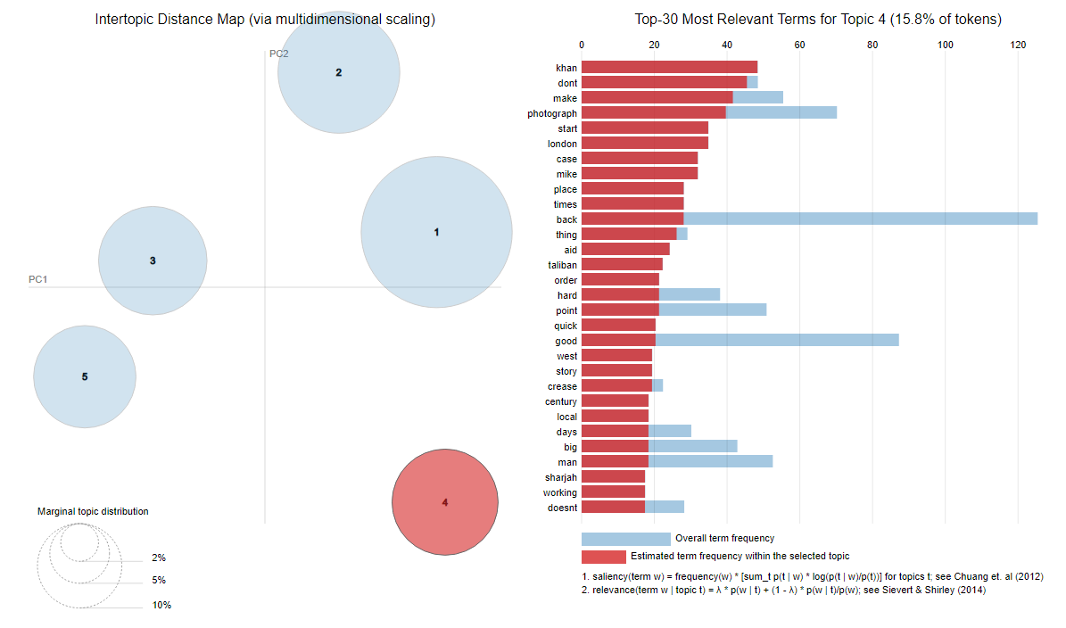
LDAvis: Interactive to show term distribution

Slide 21
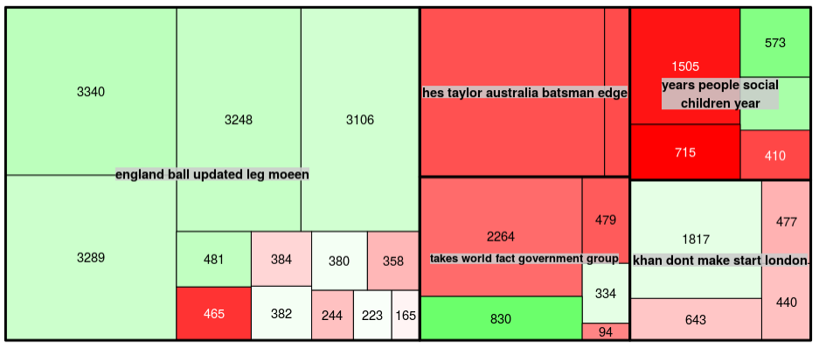
Interpreting a TreeMap: Multi-dimensional
Thick black lines: LDA defined Topic; named by 5 most typical words
Color: Polarity
Area: individual doc area is proportional to number of words
This shows the Guardian write positive and longer articles about Pakistan related to cricket than other topics.

