Slide 1
Text Mining & NLP Syntactic Parsing Universal Dependencies
Ted Kwartler

Slide 2
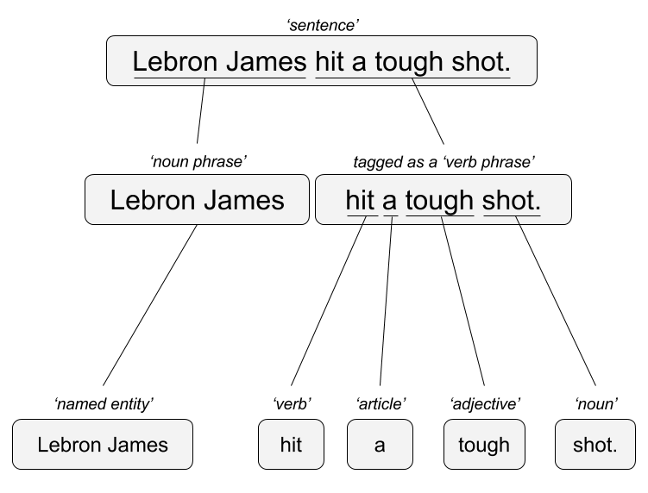
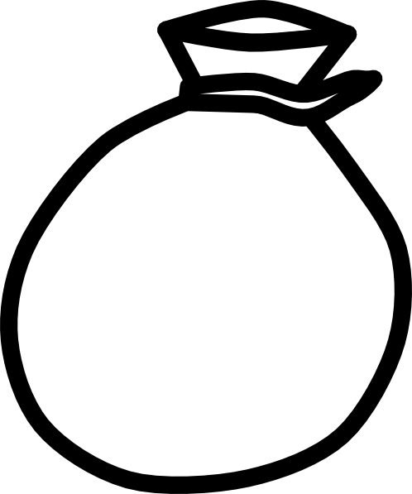
Remember this?!
“Lebron James hit a tough shot.”
Syntactic Parsing
Bag of Words
Lebron
a
James
hit
tough
shot
*There are other approaches usually based on DNN, that I refer to “abstractive”

Slide 3
Within Syntactic Parsing, 2 example methods.
Syntactic Parsing
Universal Dependencies
StanfordOpenNLP
Kwartler

Slide 4
Context Free Grammars
A phrase is made up of child or constituent words
Noun Phrase
The university
Kwartler

Slide 5
Context Free Grammars
A phrase is made up of child or constituent words
Noun Phrase
The university
Article constituent
Noun
the
the
university
Kwartler

Slide 6
Context Free Grammars
A phrase is made up of child or constituent words
Noun Phrase
The university has great coffee
Article constituent
Noun
Determiner constituent
the
university
has great coffee
Kwartler

Slide 7
Context Free Grammars
A phrase is made up of child or constituent words
Noun Phrase
The university has great coffee
Article constituent
Noun
Determiner constituent
the
university
has great coffee
article constituent
adjective constituent
Another noun constituent
has
great
coffee
The constituents are optional ie noun constituent starts the process over again…
Kwartler

Slide 8
Context Free Grammars
A phrase is made up of child or constituent words
Noun Phrase
The university has great hot coffee with cream.
Article constituent
Noun
Determiner constituent
the
university
has great coffee
article constituent
adjective constituent
Another noun constituent
has
great
coffee
hot
with cream
adj noun constituent
Another noun constituent
The constituents are optional ie noun constituent starts the process over again…
Kwartler

Slide 9
Dependency View
Which word is it dependent upon (modifier)?
Grab
the
large
coffee
on
the
counter
near
the
pot
Grab what? Coffee
Kwartler

Slide 10
Dependency View
Which word is it dependent upon (modifier)?
Grab
the
large
coffee
on
the
counter
near
the
pot
Grab what? Coffee
What about the coffee? It’s the large one
Kwartler

Slide 11
Dependency View
Which word is it dependent upon (modifier)?
Grab
the
large
coffee
on
the
counter
Near
the
pot
Grab what? Coffee
What about the coffee? It’s the large one
What is on the counter? Coffee
Kwartler

Slide 12
Dependency View
Which word is it dependent upon (modifier)?
Grab
the
large
coffee
on
the
counter
near
the
pot
Grab what? Coffee
What about the coffee? It’s the large one
What is on the counter? Coffee
“On the” is context for what? Counter
Kwartler

Slide 13
Dependency View
Which word is it dependent upon (modifier)?
Grab
the
large
coffee
on
the
counter
near
the
pot
Grab what? Coffee
What about the coffee? It’s the large one
What is on the counter? Coffee
“On the” is context for what? Counter
What is near the pot? Coffee
Kwartler

Slide 14
Dependency View
Which word is it dependent upon (modifier)?
Grab
the
large
coffee
on
the
counter
near
the
pot
Grab what? Coffee
What about the coffee? It’s the large one
What is on the counter? Coffee
“On the” is context for what? Counter
What is near the pot? Coffee
“near the” is context for what? Pot
Kwartler
Notes:
Good discussion on this course https://www.youtube.com/watch?v=PVShkZgXznc

Slide 15
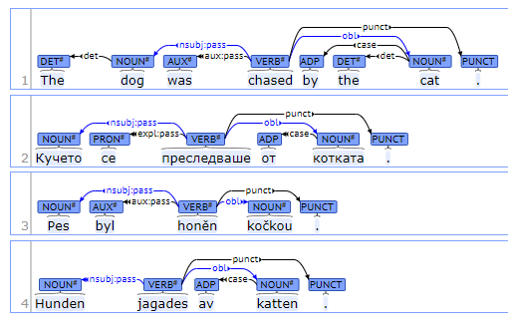
Universal Dependencies
Open Source Project w/200 Contributors
Uses annotated texts to parse to learn these tree structures
100 treebanks created
70 languages supported
“universal” in label types
Best interactive graphic: https://universaldependencies.org/introduction.html

Slide 16
Institute of formal & applies linguistics: UDPipe
Ported the use of UD into multiple software languages
UDPipe is a trainable pipeline for tokenization, tagging, lemmatization and dependency parsing of CoNLL-U (universal dependency format) files.
Most of the UD treebanks are supported
Multiple software languages: Linux, Window, OS X, C++, Python, Perl, Java, C#, API service and R
http://ufal.mff.cuni.cz/udpipe

Slide 17
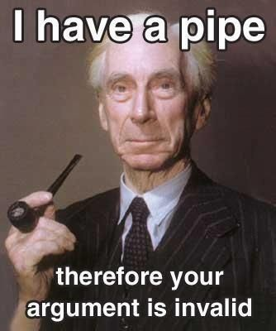
Open A_UD_syntacticParsing.R
Great use of lemmatization as a preprocessing step even if you don’t use the POS tags

