Slide 1
Text2vec – Text to Vector Analysis
Previously we measured mean Euclidean distance, and Manhattan Median Distance for clustering.
Limited because distance measures are only between terms or ngram tokens.
Text2vec looks at the co-occurence of terms from document to document in the entire corpus.

Slide 2
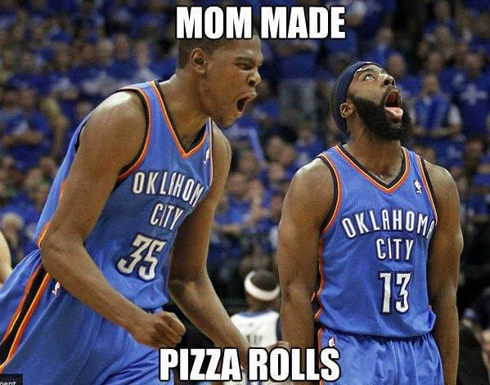
Text2vec – Text to Vector Analysis
Basketball & Football may have similar usage and therefore small distance. On one hand that makes sense since they are both about sports. On another hand they have very different meanings.
Beyond sports there is a lot different in their “meaning” i.e. number of players, rules, shape of ball, pitch…

Slide 3
Text2vec – Text to Vector Analysis
Instead of individual term relationships, the co-occurrence is reviewed. Co-occurrence of terms is represented as vectors.
A book about text mining may be exactly equidistant to the co-occurrence vectors.
“Text” document terms shared with “mining” document terms.
“Mining” Document Terms shared with “Text” document terms

Slide 4
Word Embeddings
First_Place
[word embeddings] have learned representations of text in an n-dimensional space where words that have the same meaning have a similar representation. Meaning that two similar words are represented by almost similar vectors that are very closely placed in a vector space.
Second_Place
Gold_medal
Silver_medal

Slide 5
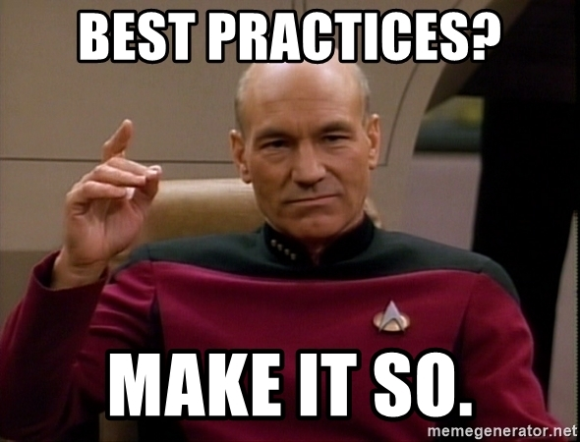
Text2vect Suggestions.
Large corpora
Ngram 1 & 2

Slide 6
Open G_text2vec

Slide 7
What is a skip gram and why it differs from BOW?
Cleaned Text
after fouling out steph curry complained to the referee and threw his mouthpiece in frustration
Skip gram of 1: Context for “fouling”
Before – 1 word before “after”
After – 1 word after ”out”
The context for “fouling” is both “after” and “out”. Larger skipgram windows expand the number of tokens to contextualize. BOW tokenization words are isolated without context.

Slide 8
Co-Occurrence among tokens
https://www.mygreatlearning.com/blog/word-embedding/#sh4
GloVe (Global Vectors for Word Representation) is an alternate method to create word embeddings. It is based on matrix factorization techniques on the word-context matrix. A large matrix of co-occurrence information is constructed and you count each “word” (the rows), and how frequently we see this word in some “context” (the columns) in a large corpus.
The context is a predefined context cluster known as “skipgram” window.
Both terms and their contexts are massive ie. windows of 5 will have an exponentially increasing number of combinations
Glove uses matrix factorization and gradient dissent to optimize the dimension reduction into predefined vector “rank”

Slide 9
Cleaned Text
After fouling out of the game, Steph Curry complained…
Target | Preceding skipgram -1 | Proceeding skipgram +1
Fouling | After | Out
Out | Fouling | Of
Of | Out | the
The | Of | game
Game | The | Steph
Steph | game | Curry
Skipgram models try to predict context words based on the target word. Given ”Curry” in a large basketball corpus, a skipgram model would have high probability for “Steph” and ”complained” compared to “red” i.e. “red curry”
Mechanics of the loss function are on pg 175 of the book.

