Slide 1
Text Mining & NLP R Script Workflow

Slide 2
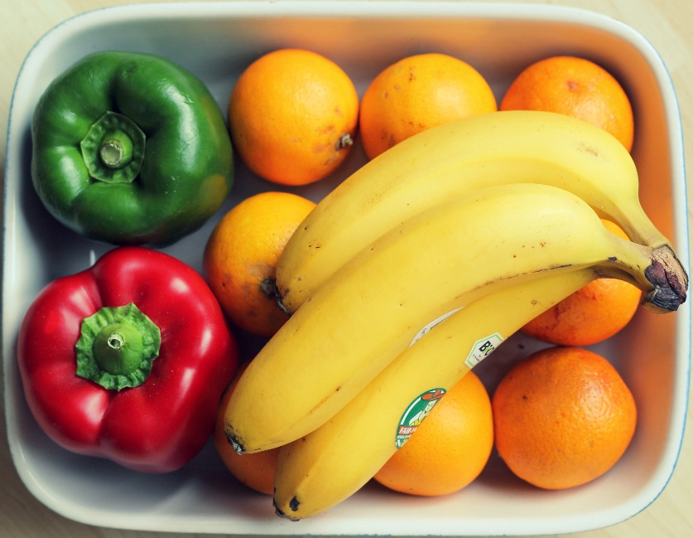
A basic R workflow
Let’s eat a banana for breakfast. Where is the fruit?
setwd(‘ted/fruit/basket’)
The item of interest needs to be in the “working directory”

Slide 3
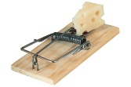
R Trap!
WINDOWS (local laptop):
In setwd() the slashes have to be switched (or “escaped”)!
setwd("~/desktop")
> setwd("~\desktop")
Error: '\d' is an unrecognized escape in character string starting ""~\d"

Slide 4

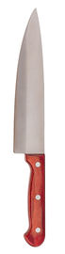
R uses functions, libraries & objects
Found the fruit basket! What tools do I need?
setwd(“ted/fruit/basket”)
library(knife)
library(peel)
Change R into a breakfast preparing machine with specialized libraries.

Slide 5

Another trap!
Before loading a library use
install.packages(“name of package”).
You only need to do this once per environment
But, will need to repeat it w/each new environment!

Slide 6
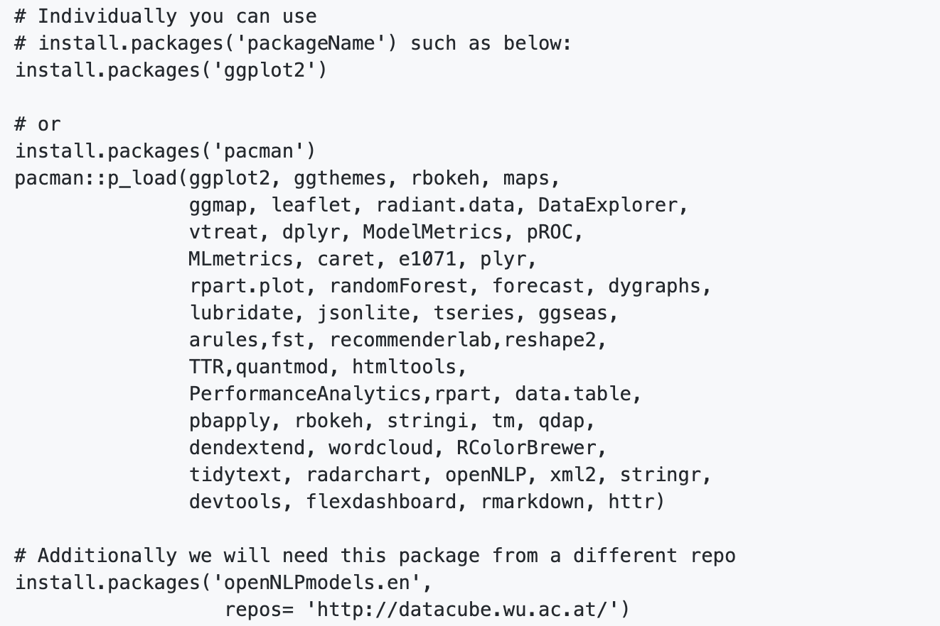
The course readme has the packages to install.
https://github.com/kwartler/Hult_NLP_student_intensive
Don’t install them now, it takes awhile.

Slide 7

R uses functions, libraries & objects
Now R is a cutting & peeling machine, let’s pick our fruit.
setwd(“ted/fruit/basket”)
library(knife)
library(peel)
banana <- read.fruit(“Banana.csv”)
Must
Be In the working directory or full path declared
Be inside quotes
Have correct capitalization, spacing & spelling matter.
R now has the object called banana in memory ie “opening a spreadsheet”

Slide 8

What if my file is Excel or ???
R can open many files types with different functions
CSV
Excel
SaS
SPSS
Rds, rda, fst etc
Connections
Databases (SQL, mongoDB)
S3 Buckets
APIs
Recommendation: to get started stick with CSV. Most software can export CSV. Most class files are CSV.

Slide 9
R uses functions, libraries & objects
Function
Input
Output
R uses predefined functions to accomplish things.

Slide 10

R uses functions, libraries & objects
halfBanana <- cutinhalf(banana )
Output
Function
(
Input
)
“ <- ” is the assignment operator

Slide 11
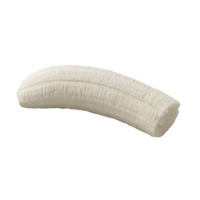

R uses functions, libraries & objects
setwd(“ted/fruit/basket”)
library(knife)
library(peel)
banana <- read.fruit(“Banana.csv”)
halfBanana <- cutinhalf(banana )
halfBanana <- peel ( halfBanana)
Output
Function
(
Input
)
Results of an object can be used in the next function.

Slide 12
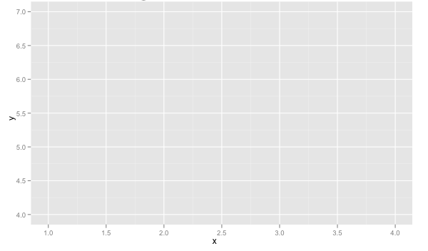
R uses functions, libraries & objects
setwd(“ted/fruit/basket”)
library(knife)
library(peel)
banana <- read.fruit(“Banana.csv”)
halfBanana <- cutinhalf(banana)
halfBanana <- peel(halfBanana)
plot(halfBanana)
Function
(
Input
)
You don’t always have to declare an output object & you can also save items to disk.

Slide 13




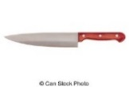

Workflow review
1
Use setwd() to point to your files & where to save outputs.
2
Load some customized libraries with library() for your specific analysis and methodology. Sometimes we will also create customized functions not in a library to aid our analysis.
3
Read in the file so the object is “in-memory” with read.csv() or similar.
4
Apply a function(s) from a library to adjust or create new objects in memory. The pseudo code for this is:
object<-function(applied to object)
5
Consume the results by saving, plotting etc.

