Slide 1
Non-Traditional Market Making

Slide 2
Non-Traditional Markets
Traditional
Non-Traditional
Crypto-currencies
Beanie Babies
Derivatives (originally)
Web Domains & Blogs
Shoes https://stockx.com/
…
Stock Markets
Bond Markets
Housing/Mortgages
Commodities – Gold, Silver etc.
Crop Futures
Consumer Credit
In contrast to traditional markets, emerging or non traditional markets lack transparency, regulations and can often be manipulated more easily.

Slide 3
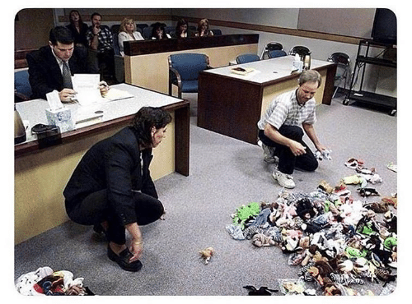
A Non-Traditional Mkt…

Slide 4
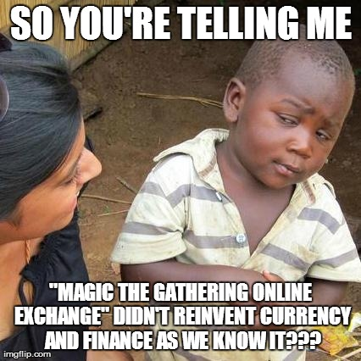
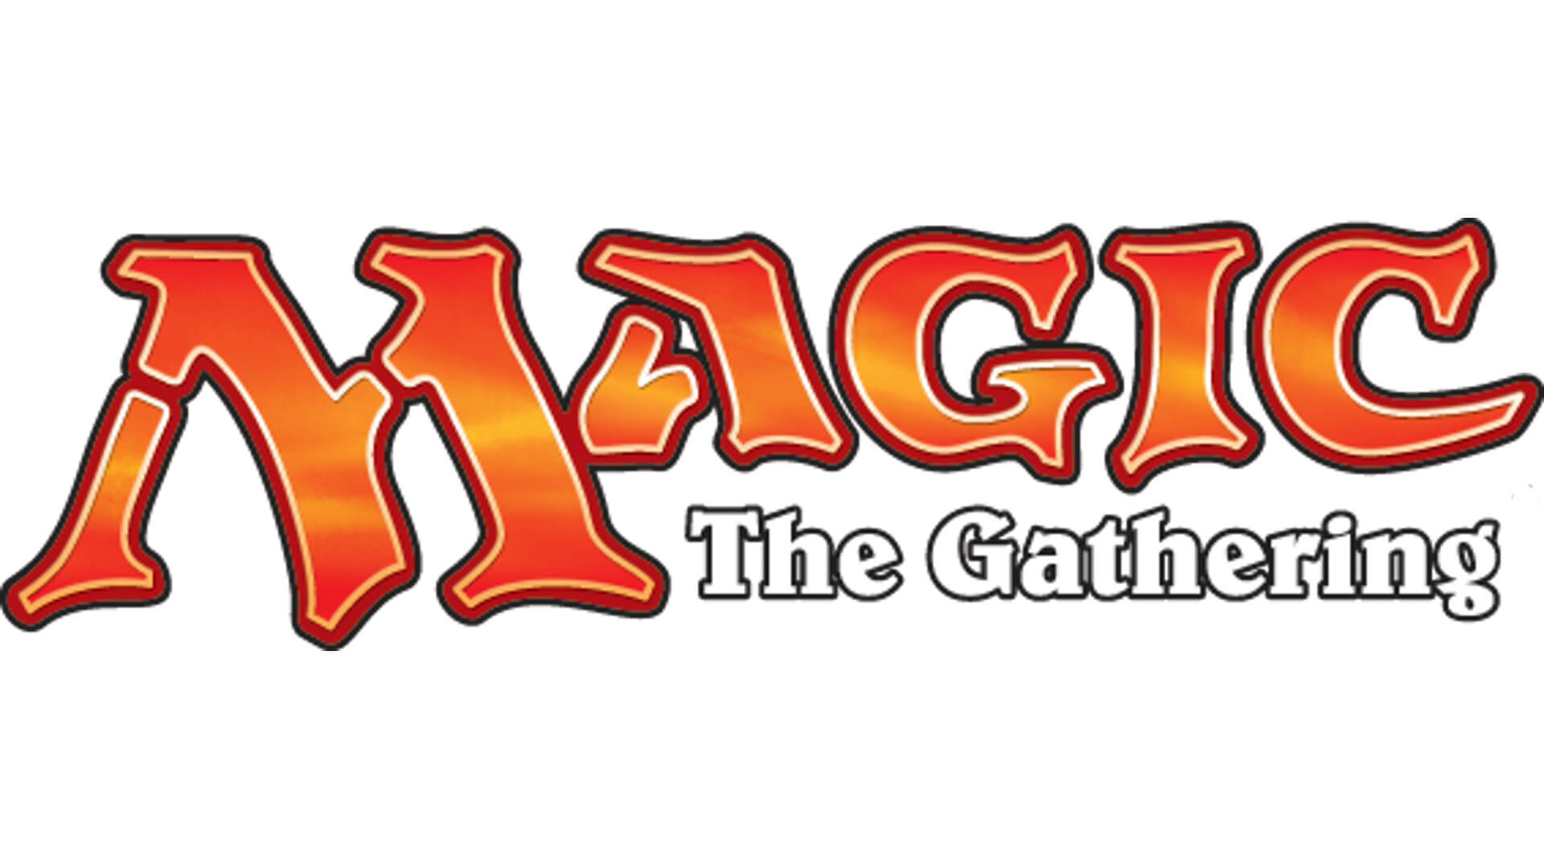
Another non-traditional Market Example
Owned by Hasbro, MTG is a 30 year old collectible trading card game. It is estimated that there are 8-12million players worldwide. Thus is it popular and has demonstrated longevity unlike other non-traditional markets.

Slide 5
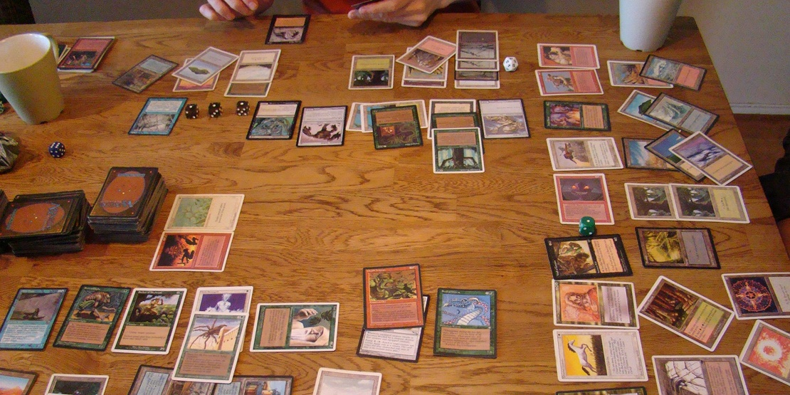
Magic The Gathering
Players create 60 card decks with cards of different abilities for a duel. Cards are fantasy based with creatures, sorceries, and mythical artifacts.

Slide 6
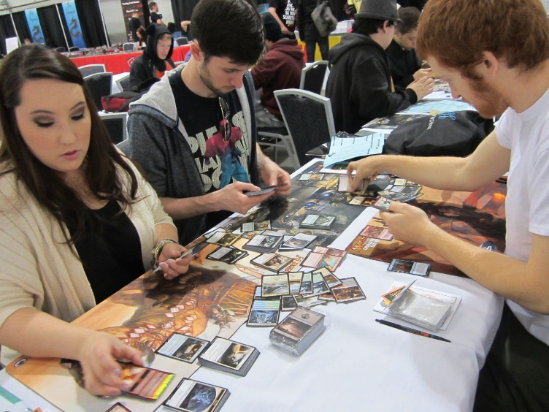
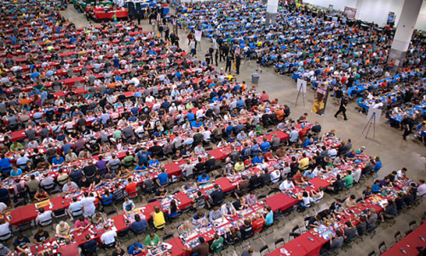
Magic The Gathering
The cards have limited print runs & varying rarities

Slide 7
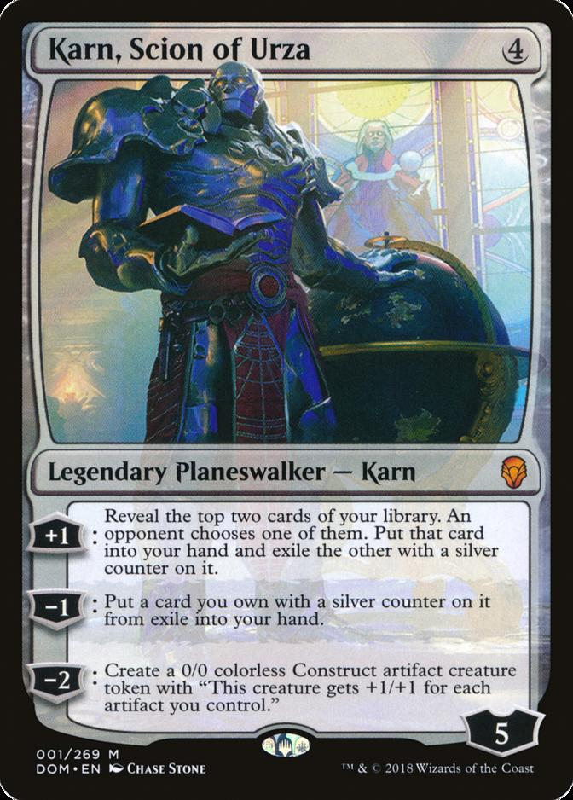
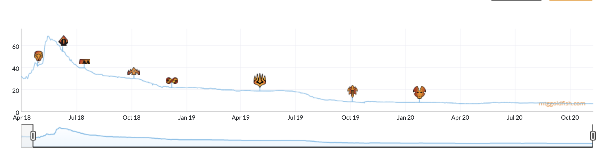
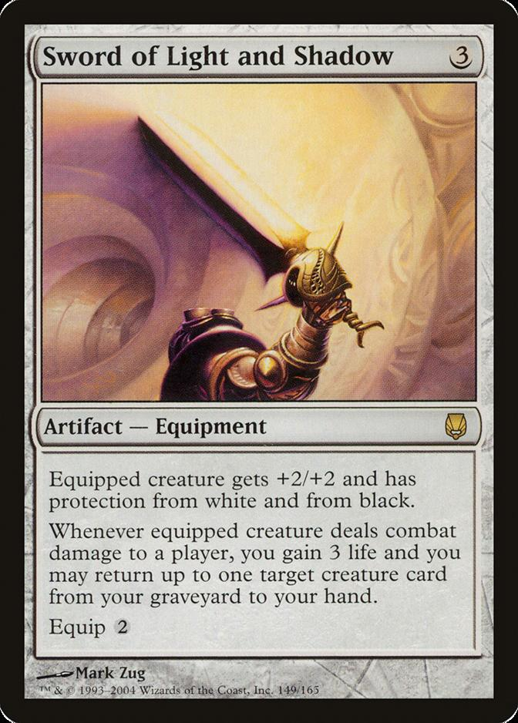
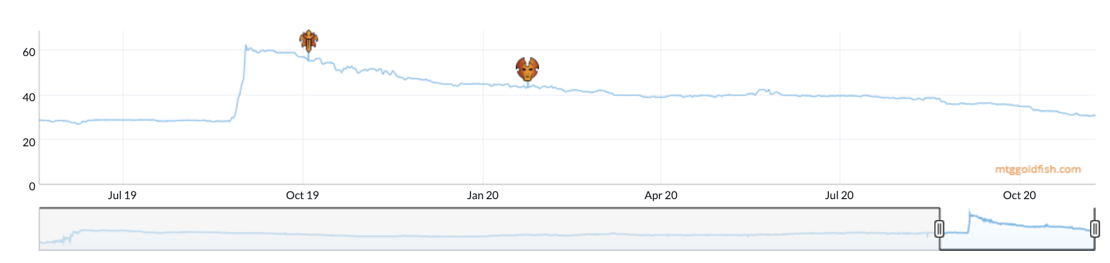
And that’s why it’s a market…
Started out good in the game, but wasn’t!
A new card came out, making this one much more powerful in combination!
Some cards go up and others down at sites like mtggoldfish.com and mtgstocks.com

Slide 8
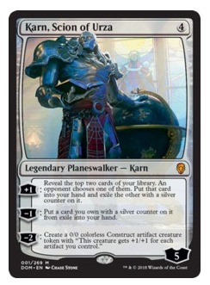
So how do you get cards?
When Karn Scion of Urza came out it was a $40 card. At the time you could get it in a number of ways.
For $19
You could buy Karn from an online marketplace.
For $3
You can open a booster pack from the appropriate expansion set and hope you get it.
For $90
You can buy a booster box of 36 packs from the set and increase your odds of getting it while also getting many other potential valuable cards.
For $540
You can buy 6 of the booster boxes in a case.
Say you are a player that needs to get Karn, Scion of Urza to complete a deck.

Slide 9
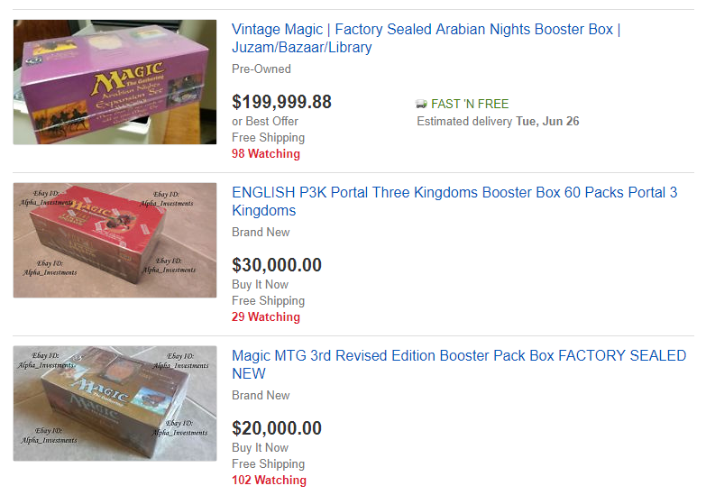
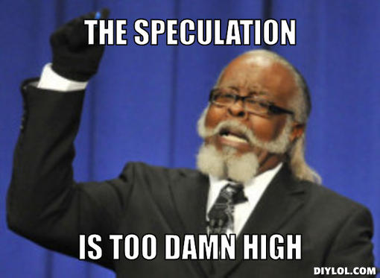
People Speculate as Supply Diminishes

Slide 10
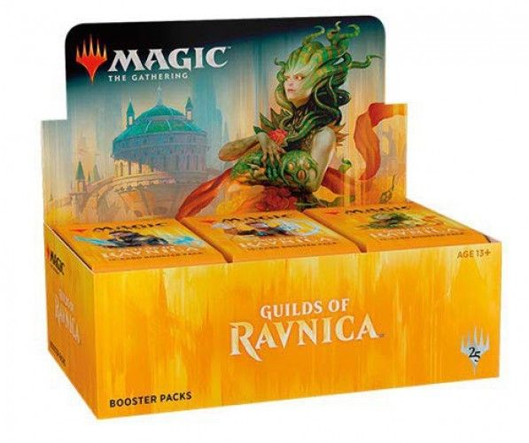
New set characteristics
Usually a pack contains
11 Commons
3 Uncommons
1 Rare
1 in 8 packs will replace the rare with a mythic
1 in 6 packs will have a random premium foil card replacing a common, uncommon, rare or mythic.

Slide 11
Modeling a new set according to risk & reward
When you open a pack:
Risk:
Each expansion set has varying prices. Some cards are worthless while other cards can be expensive.
Reward:
Some packs will contain expensive cards which you can immediately sell for more than the cost of the pack.
Since we know the cards in a set, their prices, and the probabilities of getting specific cards, we can simulate pack openings.
*Keep in mind there are friction costs, shipping a physical good takes time and money.

Slide 12
Sample with a probability
When you don’t want a random sample, then you can declare probability weights.
idx <- 1:10
# Equal Probs
set.seed(123)
sample(idx,3)
# Example Probs
set.seed(123)
sample(idx, 3, replace = T, prob = c(0,0,1,0,0,0,0,0,0,0))
Open D_sample_w_probs.R

Slide 13
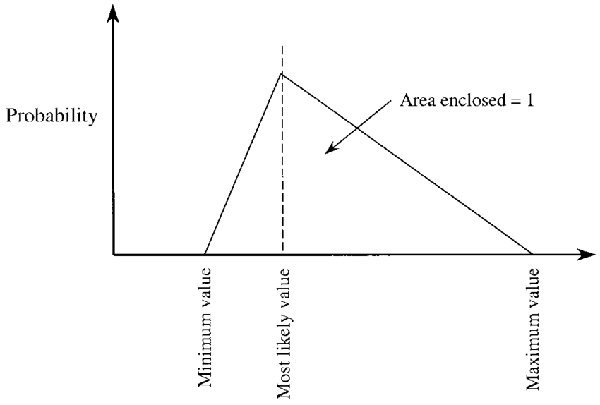
Card prices vary - non-normal & bounded
zz_triangle_example.R
Most likely value [mode] then linear relationships to max & min. This distribution is often used in simulation and modeling to represent uncertain variables when the exact distribution is unknown but assumptions can be made about its shape.

Slide 14
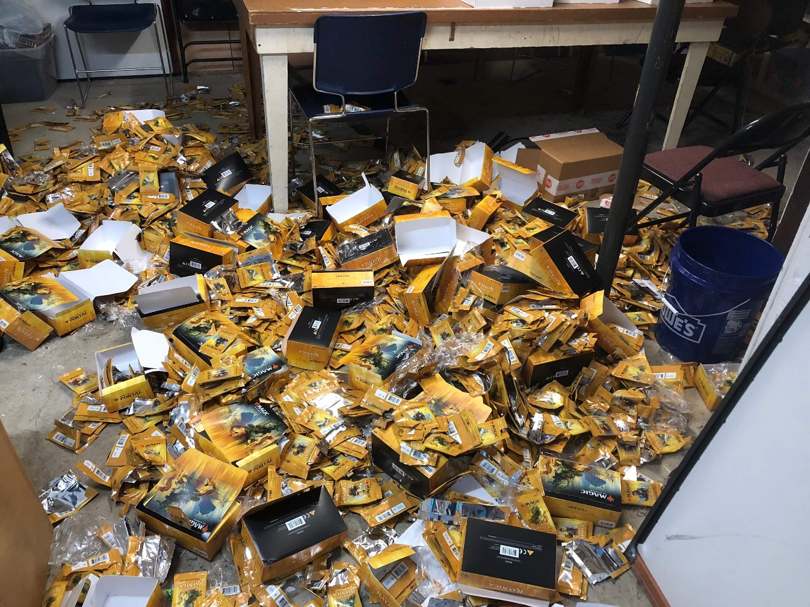
$8500 worth of Magic Cards
Open E_NonTraditionalMkts.R

Slide 15
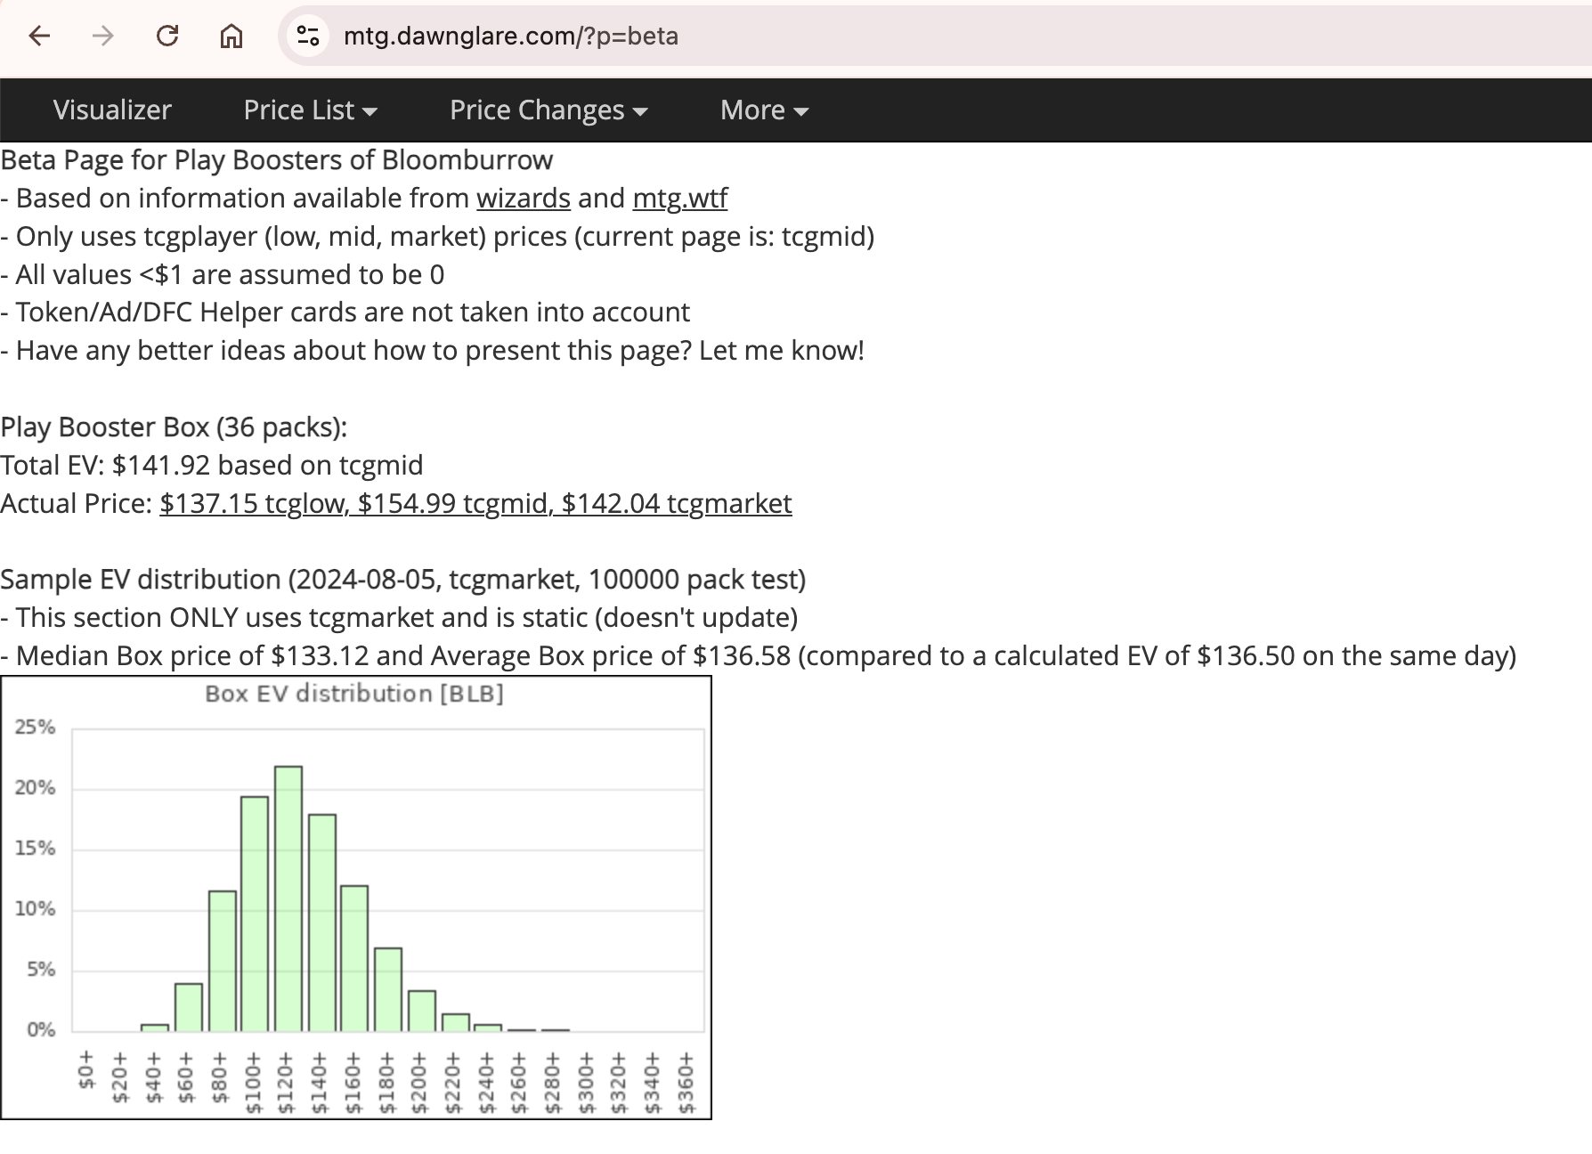
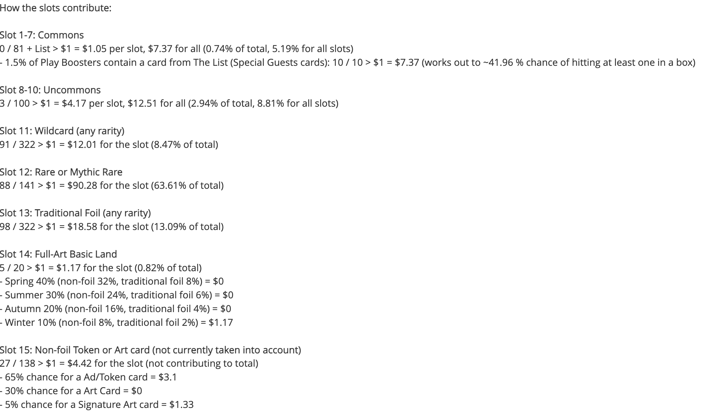
https://mtg.dawnglare.com/?p=sets

