Slide 1
Text Mining & NLP

Slide 2




Shameless Plug #1

Slide 3



Shameless Plug #2

Slide 4
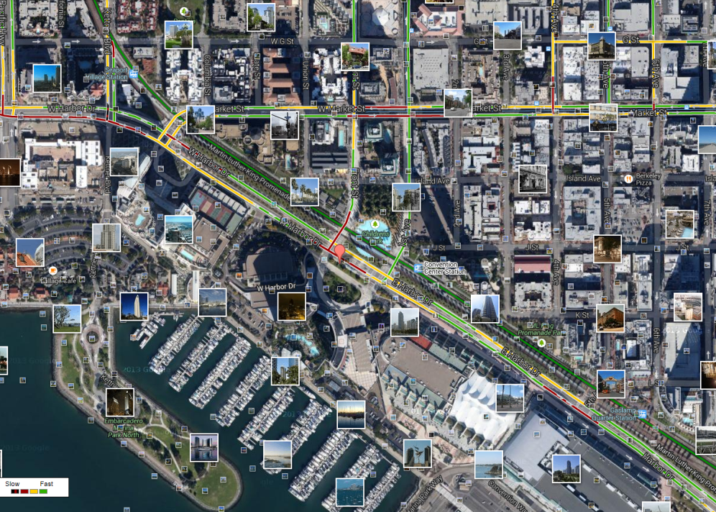
What is Text Mining?
Before Text Mining
Extract new insights from text
Let’s you drink from a fire hose of information
Language is hard; many unsolved problems
Unstructured
Expression is individualistic
Multi-language/cultural implications

Slide 5
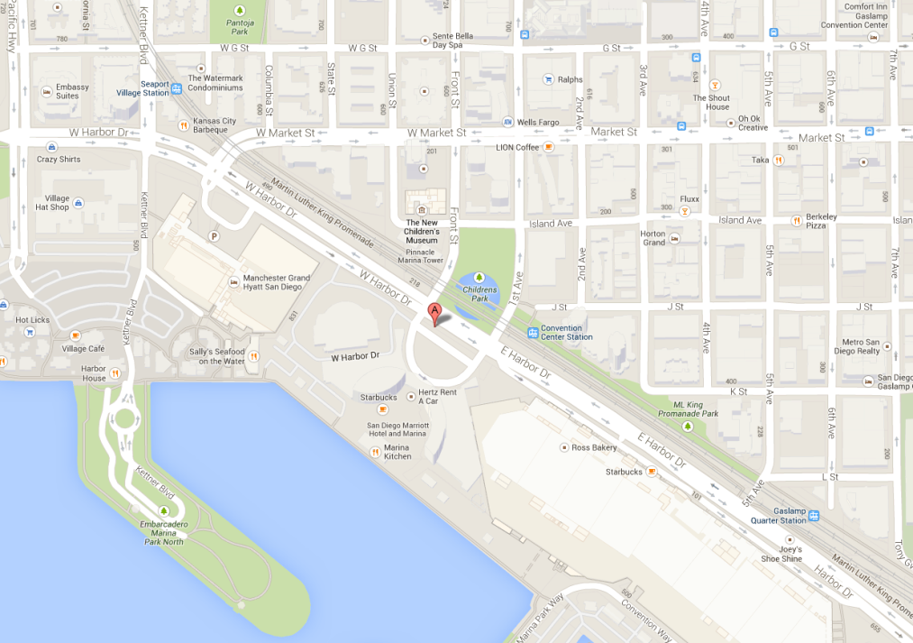
What is Text Mining?
After Text Mining
Extract new insights from text
Let’s you drink from a fire hose of information
Language is hard; many unsolved problems
Unstructured
Expression is individualistic
Multi-language/cultural implications

Slide 6
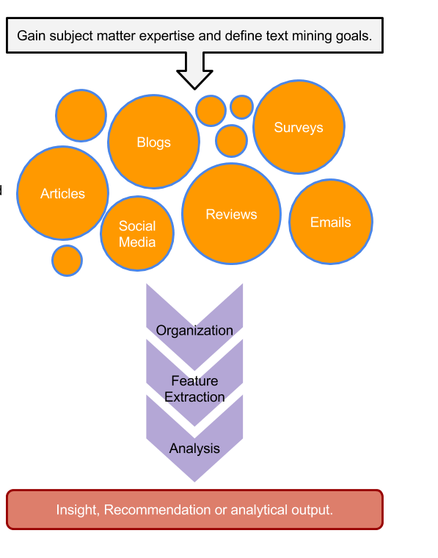
TM Project Workflow
Unorganized State
Natural Language Processing & Analysis
Organized State

Slide 7


R for Cleaning Steps
RT @WatcherGuru: JUST IN: Silicon Valley Bank $SIVB reportedly deactivated its Twitter account. https://t.co/vTkk1QK3zk
Remove Punctuation
Remove extra white space
Remove Numbers
Make Lower Case
Remove “stop” words
blogs
reviews
articles
rt watcherguru just silicon valley bank reportedly deactivated twitter account

Slide 8
Library TM Functions
VCorpus creates a corpus held in memory.
VCorpus(source)
tm_map applies the transformations for the cleaning
tm_map(corpus, function)
getTransformations() will list all standard tm corpus transformations. We can apply string functions from other packages with content_transformer(FUNCTION)
tm_map(corpus, removePunctuation) - removes punctuation from the documents
tm_map(corpus, stripWhitespace) - extra spaces, tabs are removed
tm_map(corpus, removeNumbers) - removes numbers
tm_map(corpus, content_transformer(tolower)) – makes all case lower
tm_map(corpus, removeWords) - removes specific “stopwords”
New Text Mining Concepts
Corpus- A collection of documents that analysis will be based on.
Stopwords – are common words that provide very little insight, often articles like “a”, “the”. Customizing them is sometimes key in order to extract valuable insights.
7/13/24
Kwartler
8

Slide 9
Custom Functions in 2_Cleaning_and_Frequency_Count.R
“tryTolower” is poached to account for errors when making lowercase.
tryTolower <- function(x){
# return NA when there is an error
y = NA
# tryCatch error
try_error = tryCatch(tolower(x), error = function(e) e)
# if not an error
if (!inherits(try_error, 'error'))
y = tolower(x)
return(y)}
“clean.corpus” makes applying all transformations easier.
cleanCorpus<-function(corpus, customStopwords){
corpus <- tm_map(corpus, content_transformer(qdapRegex::rm_url))
corpus <- tm_map(corpus, removePunctuation)
corpus <- tm_map(corpus, stripWhitespace)
corpus <- tm_map(corpus, removeNumbers)
corpus <- tm_map(corpus, content_transformer(tryTolower))
corpus <- tm_map(corpus, removeWords, customStopwords)
return(corpus)
}

Slide 10
Nuances & Inputs for Setting Up a TM Project
“custom.stopwords” combines vectors of words to remove from the corpus
#Create custom stop words
customStopwords <- c(stopwords('english'), 'lol', 'smh')
Add channel specific stop words.
E.g. Twitter abbreviations
Retaining Meta Data Information
# Data
text <- read.csv('https://raw.githubusercontent.com/kwartler/Hult_Visualizing-Analyzing-Data-with-R/main/DD1/G_Mar14/data/coffeeVector.csv')
head(text$x)
# Make a volatile corpus
txtCorpus <- VCorpus(VectorSource(text$x))
# Preprocess the corpus
txtCorpus <- cleanCorpus(txtCorpus, customStopwords)

Slide 11
For Bag of Words, how is data organized?
Document Term Matrix
 | Term1 | Term2 | Term3 | … | Term_n
Tweet1 | 1 | 1 | 1 | 0 | 0
Tweet2 | 0 | 1 | 0 | 0 | 0
Tweet3 | 3 | 0 | 0 | 3 | 0
… | 0 | 0 | 0 | 1 | 1
Tweet_n | 0 | 0 | 0 | 1 | 0
Code to Create the DTM/TDM and change to a matrix
Why are DTM & TDM Sparse? What do they represent?
txtDtm<-DocumentTermMatrix(txtCorpus)
txtDtmM<-as.matrix(txtDtm)
??
The matrices are sparse (many 0’s) so additional steps may be needed to extract information.

