Slide 1
Improving data narratives.
Images
ggplot2
echarts4r
Documents & webpages
markdown
R-Markdown
Layouts of client-side & server-side applications
flexdashboard
Shiny & opencpu

Slide 2
Let’s build up from the visualization
ggplot2
echarts4r
Grammar of graphics, building images layer by layer
Control 3 basic components
Layered grammar: combine multiple layers to create complex visualizations.
Aesthetics: properties of a plot, such as color, size, shape, & position.
Geoms: objects (e.g., points, lines, bars) that make up a plot
R extension of JavaScript library echarts
Control 3 basic components
Data: The data used to create the chart.
Chart type: The type of chart you want to create (e.g., line chart, bar chart, scatter plot).
Options: Various options that control the appearance and behavior of the chart.
STATIC PLOTS
INTERACTIVE PLOTS
More options
Limited options
(unless you know JavaScript)

Slide 3
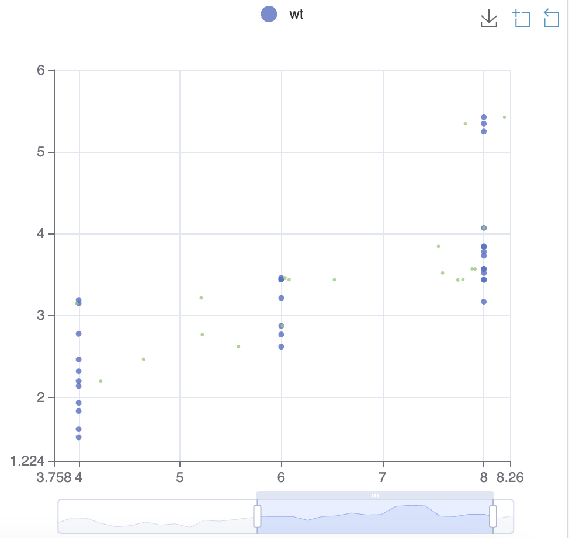
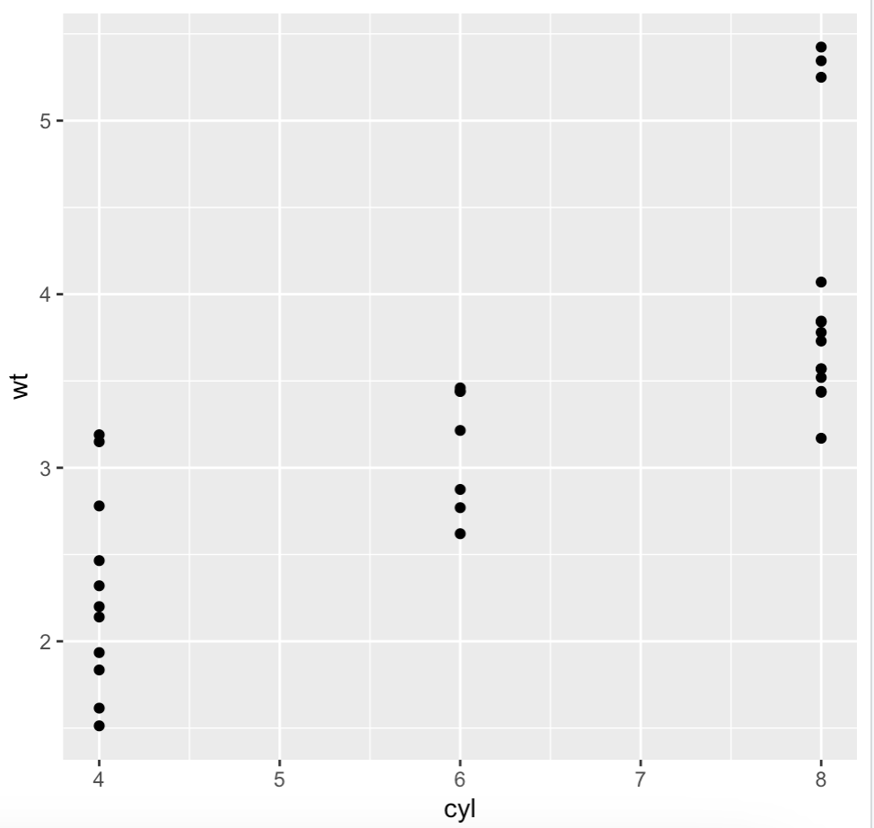
Compare Vizuals –G_ggplot_echarts4r.R
ggplot2
echarts4r
library(ggplot2)
data(mtcars)
ggplot(mtcars, aes(x = cyl, y = wt)) +
geom_point()
library(echarts4r)
mtcars |>
e_charts(cyl) |>
e_scatter(wt, symbol_size = 5) |>
e_scatter(wt, jitter_factor = 2, legend = FALSE) |>
e_toolbox_feature(feature = "saveAsImage") |>
e_datazoom()
Download, zoom & reset
Interactive zoom

Slide 4
What do you do with your visualizations?
markdown
R-Markdown
Easy to read and write
Platform-independent (works across different operating systems and devices)
Fast and lightweight
Supports a wide range of formatting options
Some common Markdown syntax examples:
Headers: # Heading 1, ## Heading 2
Bold text: **Bold text**
Italic text: *Italic text*
Lists: - Item 1, - Item 2
Embed R code snippets & outputs into your document
Create custom layouts and themes for your documents
Easy to create reproducible research reports
Fast and efficient way to write and publish research findings
Supports a wide range of output formats (e.g., HTML, PDF, Word)
Embedding R code: r knitr::kable(head(mtcars))
HTML, PDF, Word & Presentations
Many R packages support Rmd

Slide 5
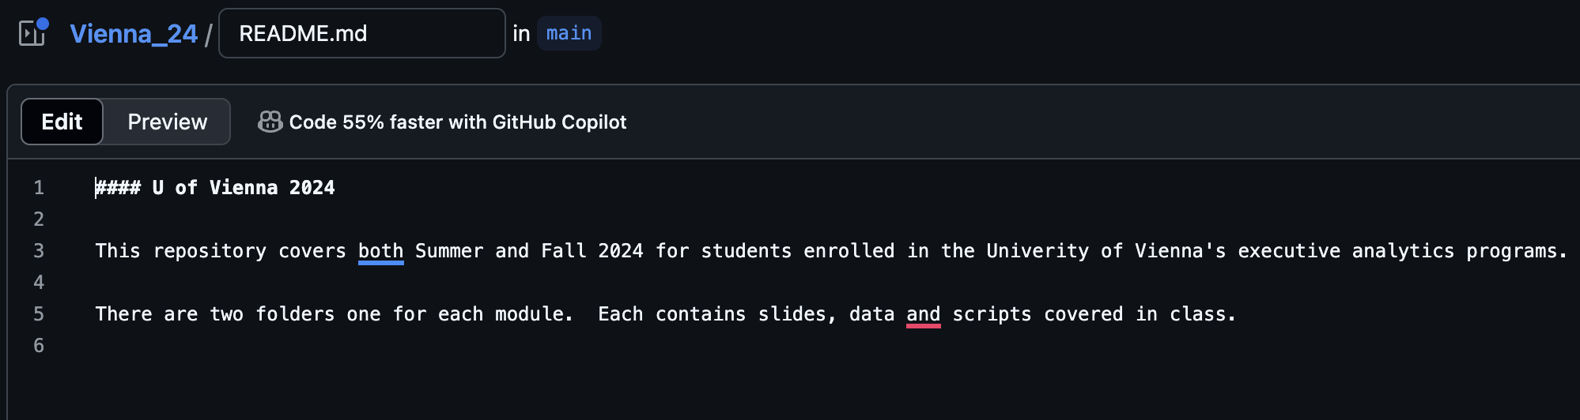
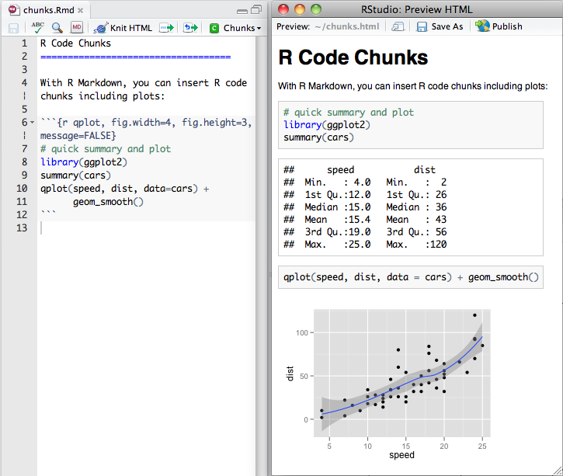
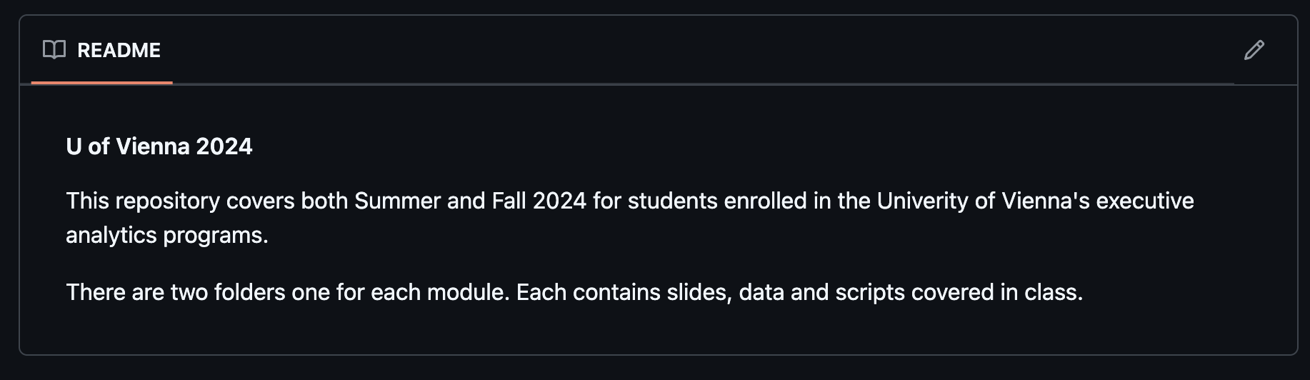
Compare Markdown to R-Markdown
markdown
R-Markdown

Slide 6
What about as a web framework w/back-end?
flexdashboard
Shiny & opencpu
Use R Markdown to publish a group of related data visualizations as a dashboard.
Support for a wide variety of components including htmlwidgets; base, ggplot2
Flexible and easy to specify row and column-based layouts.
R has a web framework for computation called shiny
Not as robust as python’s flask or Django etc.
R’s opencpu package turns any package function into an API. In doing so it turns R into the backend computation engine and any front end framework like javascript can be used with it.
w/echarts4r dashboards have interaction but not calculation. Users can explore data but no server is present to make real-time calculations. Flexdashboard has compelling layouts and themes for customizations.
Shiny- good but hard to scale, limited ownership of front-end layout, css without additional work
You can use r-md and flexdashboard and use gitpages for free hosting of portfolio projects!
OpenCPU – requires knowledge of package & function writing. Still need front end coding knowledge to make a website.

Slide 7
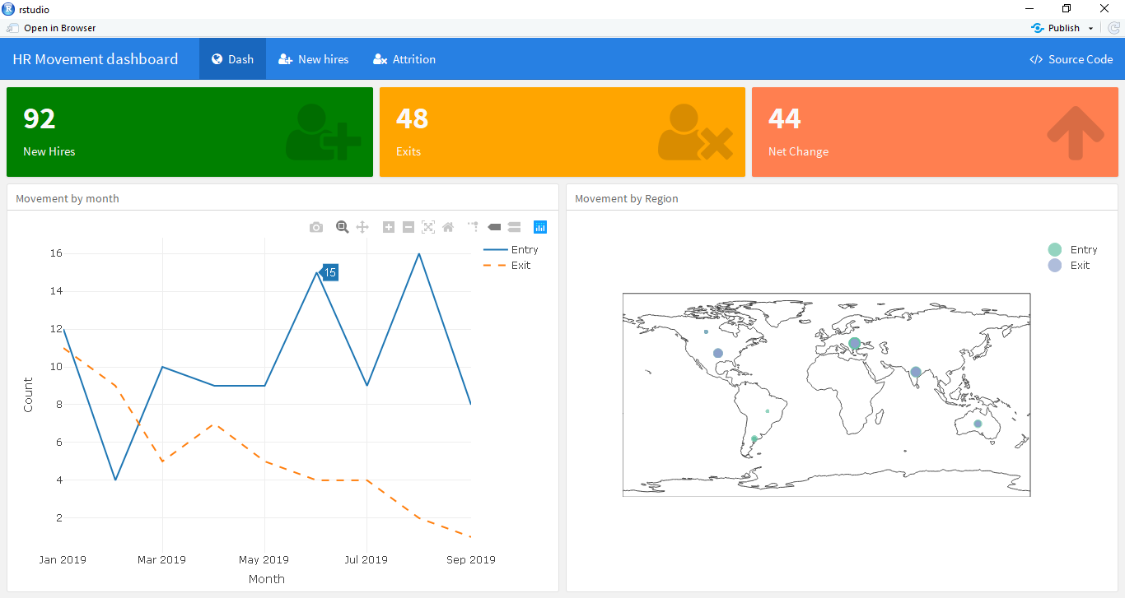
Compare webpages
flexdashboard
Shiny
opencpu
Static and “client side” user interactivity (echarts4r)

Slide 8
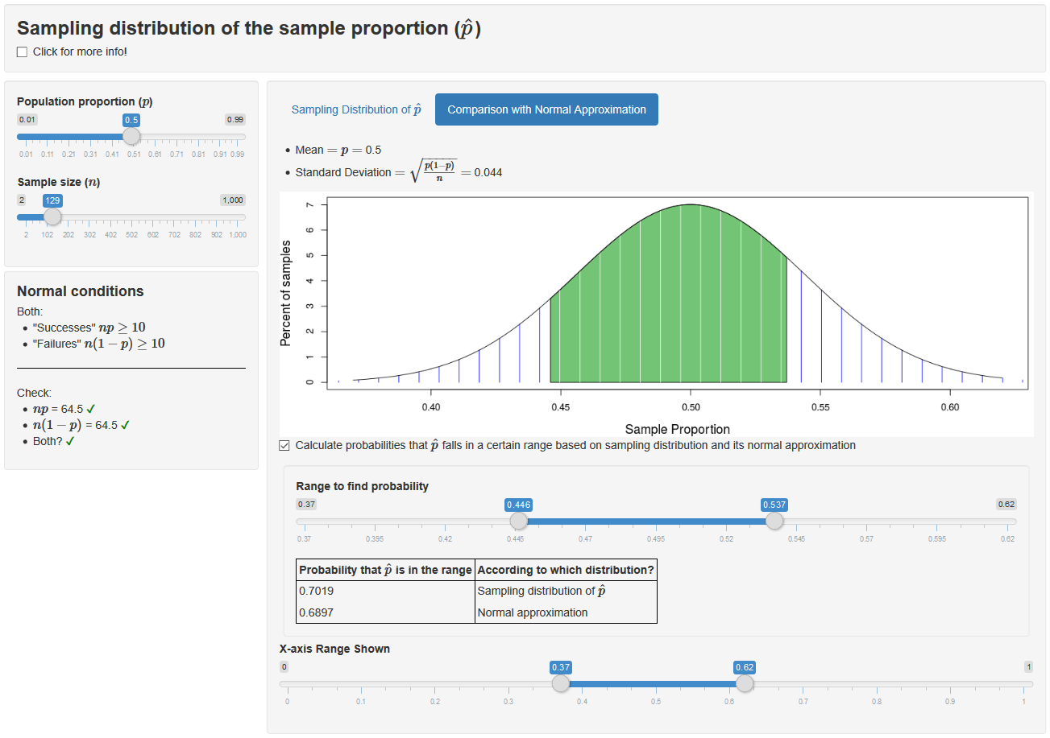
Compare webpages
flexdashboard
Shiny
opencpu
Plots and outputs are redone with R as the calculation engine with user inputs.

Slide 9
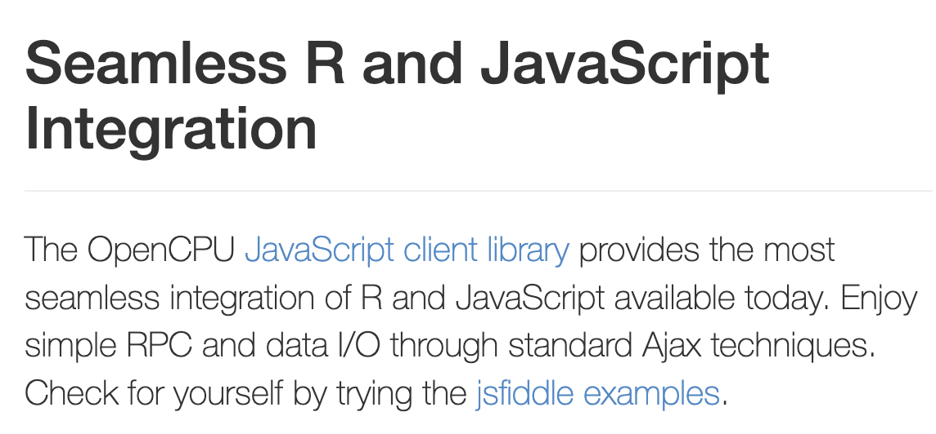
Compare webpages
flexdashboard
Shiny
opencpu
R functions become a json API endpoint that many languages can interact with.

