Slide 1
Agenda
Start | End | Item
 |  | Core Concepts in Data Mining
 |  | Break
 |  | More R learning & EDA

Slide 2
Data Mining in this course
Business Analytics – analyzing historical business data with basic math, SME rules, tallies, tables, summary statistics etc
Business Intelligence – what has happened or is happening that can help current business decisions, often done with visuals, powerpoint, dashboards i.e. tableau
Data Mining – includes machine learning (ML) & data science; applies more sophisticated methods to understand and predict business outcomes.
In this class we explore basic analytics, some business intelligence and ML methods in an effort to bring quantitative judgment to bear on business decisions.

Slide 3


"Where a human-being has to make a judgement call or decision about something, where there is a long history of that type of decision being made, is an opportunity to look at to see if you can apply artificial intelligence.”
Loretta Ibanez, Ph.D. Innovation Senior Director

Slide 4
When can you embark on data-driven decisions?
1
2
3
Intelligent decision to be made (human or automated).
Historical results of the decision & outcome
Available data for exploration, explanation or prediction purposes.
In this course all use cases have these three components implied if not explicitly declared.

Slide 5
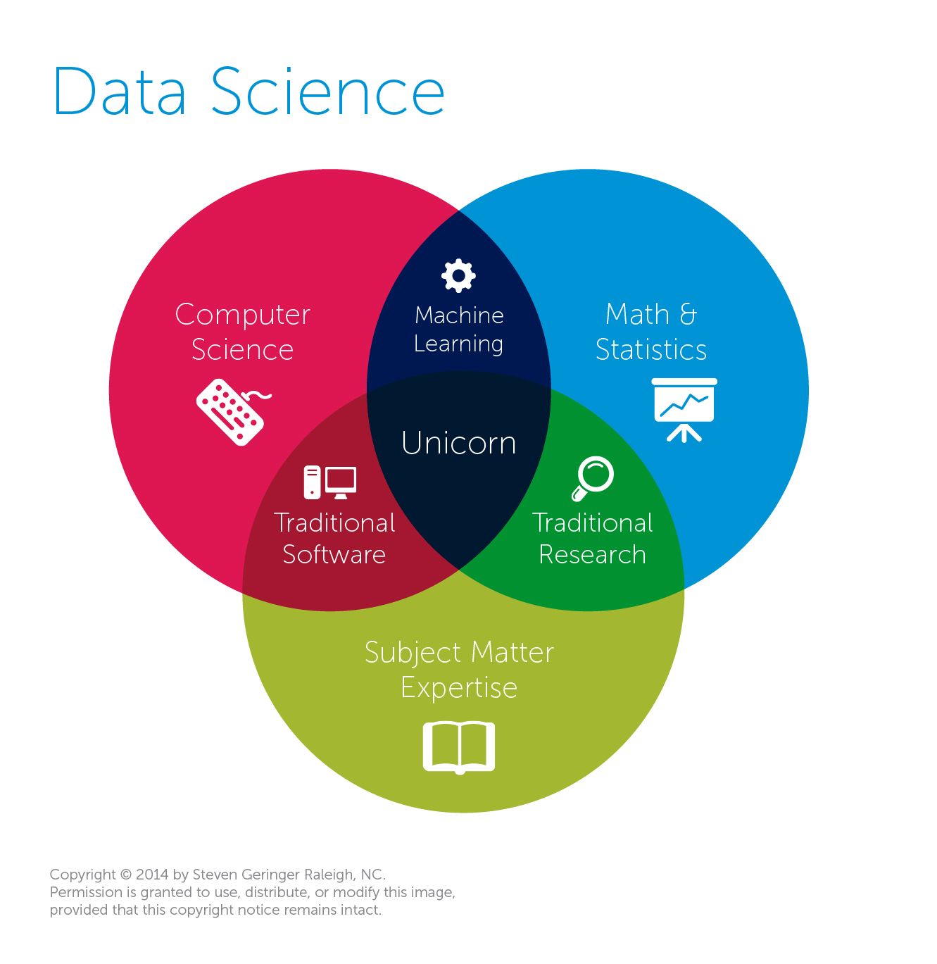
Data Mining & Science is almost always missing business acumen.
Traditional View
Data Science
The study of information with the goal of extracting meaningful insights and creating actionable recommendations.
*often does not require “big data” or extremely exotic approaches to have a business impact
Machine Learning
An outgrowth of artificial intelligence, machine learning is the set of tools, methodologies and techniques allowing a computer to “learn” about a specific situations represented with data.

Slide 6
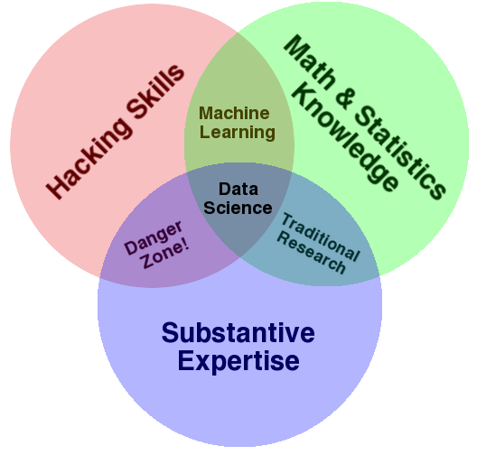
Expertise is not confined to math or CS…but learning business implications.
Another Popular View
Why hacking skills?
Data science takes creativity
Art & Science
A sprinkle of obsessive behavior to explain the data phenomenon
My $0.02
Both diagrams have expertise yet it is often overlooked. Many data scientists are technically sound but lack business acumen or substantive expertise.

Slide 7
Diagnosing & Defining a data mining project
Questions to Ask:
Is this a data mining problem? If so, what data would be helpful?
What is the current state?
What are the possible outcomes of the business scenario?
How will the outcome of the data mining project be used?
What is success for this project?

Slide 8

Pitfalls
Without asking these questions your efforts will:
Have scope-creep or never end!
Be difficult to define success
Be difficult to implement or have a limited impact

Slide 9

Let’s do this for real…
Meet Dale
Runs the analytics group at Busy-ness Corp a large conglomerate that makes, distributes corn dogs.
He looks miserable because senior leaders make his job harder than needed.
Let’s help Dale add some structure to his data mining projects.

Slide 10

Let’s do this for real
Hey Dale, its me…from OfficeSpace.
I read in the WSJ that everyone should be using blockchain. Should we?
Is this a biz analytics, intel or data mining problem?
What is the current state?
What are the possible outcomes of the business scenario?
How will the outcome of the data mining project be used?

Slide 11

Let’s do this for real
Your Daleness, I work in marketing (and apparently hate phones). I want to do a mailing to prospective corndog eaters. Can you identify how many postcards we should send & ROI?
Is this a biz analytics, intel or data mining problem?
What is the current state?
What are the possible outcomes of the business scenario?
How will the outcome of the data mining project be used?

Slide 12

Let’s do this for real
Dale-areno! I think we are getting a lot more calls than usual about defective corn dogs. Can you investigate whether that’s true?
Is this a biz analytics, intel or data mining problem?
What is the current state?
What are the possible outcomes of the business scenario?
How will the outcome of the data mining project be used?

Slide 13

Let’s do this for real
The Notorious DALE, let’s forecast how many of our current corn dog debtors will be delinquent. Is that getting better or worse over time?
Is this a biz analytics, intel or data mining problem?
What is the current state?
What are the possible outcomes of the business scenario?
How will the outcome of the data mining project be used?

Slide 14

Let’s do this for real
The East coast regional corn dog sales are up! I wonder if my region is worse than them.
Is this a biz analytics, intel or data mining problem?
What is the current state?
What are the possible outcomes of the business scenario?
How will the outcome of the data mining project be used?

Slide 15

Let’s do this for real
Despite that idiot in marketing selling defective dogs, we need a new warehouse in the East region. Which zip code should we build it in to support a strong workforce?
Is this a biz analytics, intel or data mining problem?
What is the current state?
What are the possible outcomes of the business scenario?
How will the outcome of the data mining project be used?

Slide 16


Let’s call Dale to tell him what we learned.
https://www.motionelements.com/stock-video-3902092-successful-black-businessman

Slide 17
My framework, learned from 15yrs in the space, but not exhaustive Examples below.
Risk
Reward
Cost
Benefit
Explore
Do we have variances?
What are core components to a system?
What are the strongest SKUs?
What is our cost allocation?
Among options what is our best XYZ choice?
Explain
What is causing variances?
Why are some SKUs strong (price, seasonality etc)?
What drove the cost changes (inflation, input material etc)?
Why is X yielding this impact on Y?
Predict
Predict variances & anomalies.
Predict the revenue from a marketing campaign.
Can we optimize costs?
Predict individual customer propensities.
Generate
Generative AI is an emerging space with novel and yet to be determined questions, answers and business impact.

Slide 18
Tools and methods for the action
Risk
Reward
Cost
Benefit
Explore
Exploratory Data Analysis…descriptive statistics, basic visualizations
Retrospective views
Explain
Data narratives, advanced visualization, correlation linear regression beta and residual exploration linear programming
Descriptive views;
Predict
Machine Learning – supervised, unsupervised, time-series forecasting, Natural Language Processing (NLP), NN
Generate
Generative AI- DNN, ChatGPT, Image Diffusion and TBD?

Slide 19
Types of Problems
Retrospective
Descriptive
Data Science
Predictive
Supervised Learning
Classification
Binary
Multi-Class
Continuous
Forecasting
Unsupervised Learning
Associative System

Slide 20
Types of Problems
Retrospective
Descriptive
Data Science
Predictive
Supervised Learning
Classification
Binary
Multi-Class
Continuous
Forecasting
Unsupervised Learning
Associative System
How did we do last quarter?
Usually point in time and standalone information not summary.

Slide 21
Types of Problems
Retrospective
Descriptive
Data Science
Predictive
Supervised Learning
Classification
Binary
Multi-Class
Continuous
Forecasting
Unsupervised Learning
Associative System
What is the average number of donuts served each morning?
Retrospective but can be summary and/or in comparison to other data.

Slide 22
Types of Problems
Retrospective
Descriptive
Data Science
Predictive
Supervised Learning
Classification
Binary
Multi-Class
Continuous
Forecasting
Unsupervised Learning
Associative System
Ask yourself is there an outcome variable that we want to predict.
Will the next person that calls accept the credit card offer?
The outcome is 1 = yes, 0=no

Slide 23
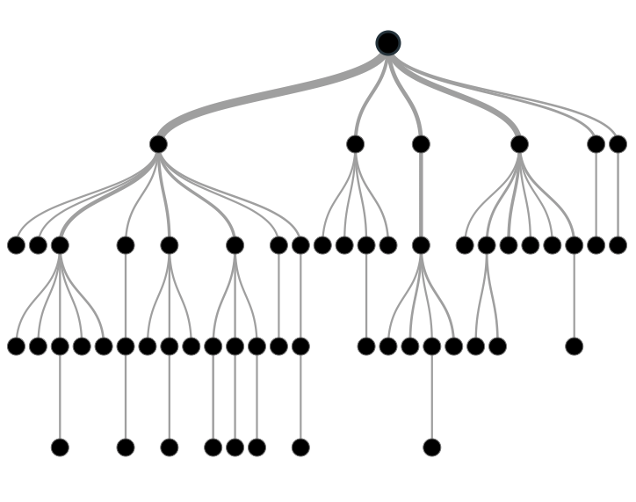

Supervised Learning: Classification & Prediction
Inferring a function from labeled data.
“Learn from telling”, “Look at my data and I will tell you what to predict”
Data Setup
Method
Business Examples
Application
Marketing-Will a customer buy yes or no? How much will a customer spend?
Operations- Will an applicant default? When will a machine break?
Flat “Excel” file. Each row is a record or observation. Each column is an attribute of the record.
One column is the outcome, y or target attribute.
Modeling e.g. K-NN, linear regression, decision tree, random forest etc.
Use the model to make predictions for the target label on the new data.

Slide 24
Types of Problems
Retrospective
Descriptive
Data Science
Predictive
Supervised Learning
Classification
Binary
Multi-Class
Continuous
Forecasting
Unsupervised Learning
Associative System
Ask yourself is there an outcome variable that we want to predict.
Will the next person that calls accept the credit card offer?
The outcome is 1 = yes, 0=no, they will accept.

Slide 25
Types of Problems
Retrospective
Descriptive
Data Science
Predictive
Supervised Learning
Classification
Binary
Multi-Class
Continuous
Forecasting
Unsupervised Learning
Associative System
Ask yourself is there an outcome variable that we want to predict.
Will the next patron purchase ProductA, ProductB or ProductC?
The outcome is one of three classes, A, B, C.

Slide 26
Types of Problems
Retrospective
Descriptive
Data Science
Predictive
Supervised Learning
Classification
Binary
Multi-Class
Continuous
Forecasting
Unsupervised Learning
Associative System
Ask yourself is there an outcome variable that we want to predict.
How many ice cream cones will we sell on an 85 degree, Saturday?
(the outcome is a continuous 0 to some number of cones)

Slide 27
Types of Problems
Retrospective
Descriptive
Data Science
Predictive
Supervised Learning
Classification
Binary
Multi-Class
Continuous
Forecasting
Unsupervised Learning
Associative System
Ask yourself is there an outcome variable that we want to predict.
How much corn meal will we need for our corn dogs this month?
(there is an outcome, and the data is time related)

Slide 28
Types of Problems
Retrospective
Descriptive
Data Science
Predictive
Supervised Learning
Classification
Binary
Multi-Class
Continuous
Forecasting
Unsupervised Learning
Associative System
Ask yourself is there an outcome variable that we want to predict.
Can our customer database be grouped in some meaningful way?
(there is no clear outcome to predict, we can observe and explore the clusters within the customer db)

Slide 29
Unsupervised Learning: Find meaningful groups
Trying to find hidden structure in unlabelled data.
“Learn from observing”, “Look at my data and tell me about it”
Data Setup
Method
Business Examples
Application
Marketing-Find customer segments for specific marketing campaigns.
Operations-Identify locations for cell towers based on population density and area characteristics.
Text Analysis- Topic modeling of articles
Flat “Excel” file. Each row is a record or observation. Each column is an attribute of the record.
Clustering e.g. K-Means, Hierarchical Clustering etc
In new data find the customers/observations that most likely are part of a particular cluster.

Slide 30
Types of Problems
Retrospective
Descriptive
Data Science
Predictive
Supervised Learning
Classification
Binary
Multi-Class
Continuous
Forecasting
Unsupervised Learning
Associative System
Ask yourself is there an outcome variable that we want to predict.
What should we offer customers that bought the corn dog?
(There is not really a distinct outcome, only observed data similar to the unsupervised example. Should we offer additional dogs, condiments, orange soda, red wine, steak etc. Among all choices, how are items associated based on purchase history?)

Slide 31

Your turn…
Methods
Scenarios
Retrospective
Descriptive
Data Science
Predictive
Supervised Learning
Classification
Binary
Multi-Class
Continuous
Forecasting
Unsupervised Learning
Associative System
Will the Mystics (pro basketball team) win the game?
Binary Classification

Slide 32
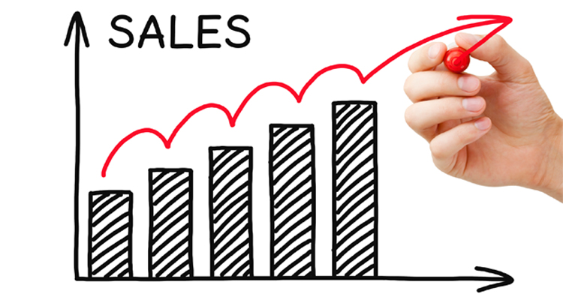
Your turn…
Methods
Scenarios
Retrospective
Descriptive
Data Science
Predictive
Supervised Learning
Classification
Binary
Multi-Class
Continuous
Forecasting
Unsupervised Learning
Associative System
How did same stores sales change year over year?
Descriptive or Retrospective

Slide 33

Your turn…
Methods
Scenarios
Retrospective
Descriptive
Data Science
Predictive
Supervised Learning
Classification
Binary
Multi-Class
Continuous
Forecasting
Unsupervised Learning
Associative System
What should we place next to the cheese in the grocery cooler?
Association

Slide 34

Your turn…
Methods
Scenarios
Retrospective
Descriptive
Data Science
Predictive
Supervised Learning
Classification
Binary
Multi-Class
Continuous
Forecasting
Unsupervised Learning
Associative System
How many patients should we expect in the urgent care tomorrow?
Predictive | Continuous or Forecasting

Slide 35

Your turn…
Methods
Scenarios
Retrospective
Descriptive
Data Science
Predictive
Supervised Learning
Classification
Binary
Multi-Class
Continuous
Forecasting
Unsupervised Learning
Associative System
How many runs will the Chennai SuperKings make?
Continuous

Slide 36
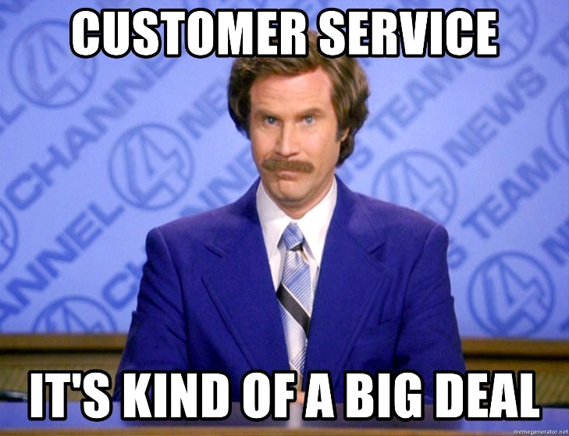
Your turn…
Methods
Scenarios
Retrospective
Descriptive
Data Science
Predictive
Supervised Learning
Classification
Binary
Multi-Class
Continuous
Forecasting
Unsupervised Learning
Associative System
What are our customer personas and how are they similar by account attribute?
Unsupervised

Slide 37
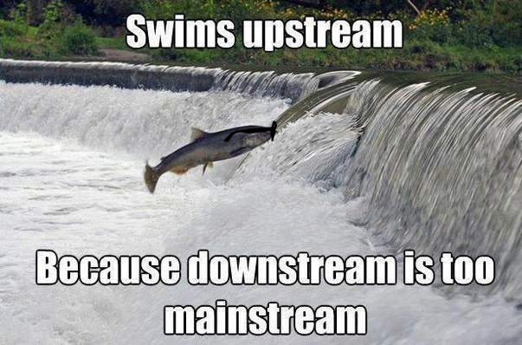
Your turn…
Methods
Scenarios
Retrospective
Descriptive
Data Science
Predictive
Supervised Learning
Classification
Binary
Multi-Class
Continuous
Forecasting
Unsupervised Learning
Associative System
How many fish did each vessel catch yesterday?
Retrospective/Descriptive

Slide 38
Quiz!
Is there a target variable in unsupervised learning?
True or False? Data Science is defined as the study of information with the goal of extracting meaningful insights and creating actionable recommendations.
Data scientists need what type of skills?
What is an example of a supervised learning business question?
Name three data attributes would you need for that example.

Slide 39
Agenda
Start | End | Item
 |  | Core Concepts in Data Mining
 |  | Break
 |  | More R learning & EDA

Slide 40
Let’s Practice!
Open:
C_Functions_basicEDA_Viz.R
read.csv
dim()
table()
indexing
subset()
sample()
as.matrix()
barplot()
ggplot()
Open the script, get familiar with libraries, reading data, functions applied to objects & making visuals.

Slide 41

What is ggplot?
The first layer is to define a ggplot, with screenTime as the data. The aesthetics (aes) define that information should be colored by each character. However, there is no other information at this point.
ggplot(screenTime, aes(colour=screenTime$character))
ggplot is a “grammar of graphics” package. It works by adding layers with an “+” to construct a visual.

Slide 42
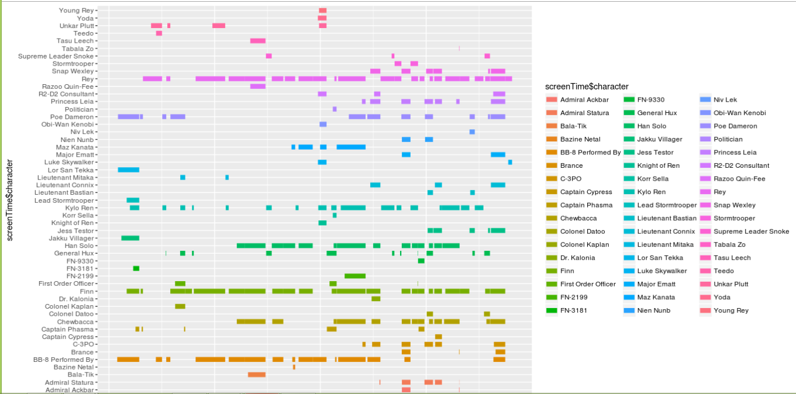
Understanding ggplot…
The second layer adds a line segment for each character and defines the size of each.
ggplot(screenTime, aes(colour=character)) +
geom_segment(aes(x=start, xend=end,y=character, yend=character),linewidth=3)

Slide 43
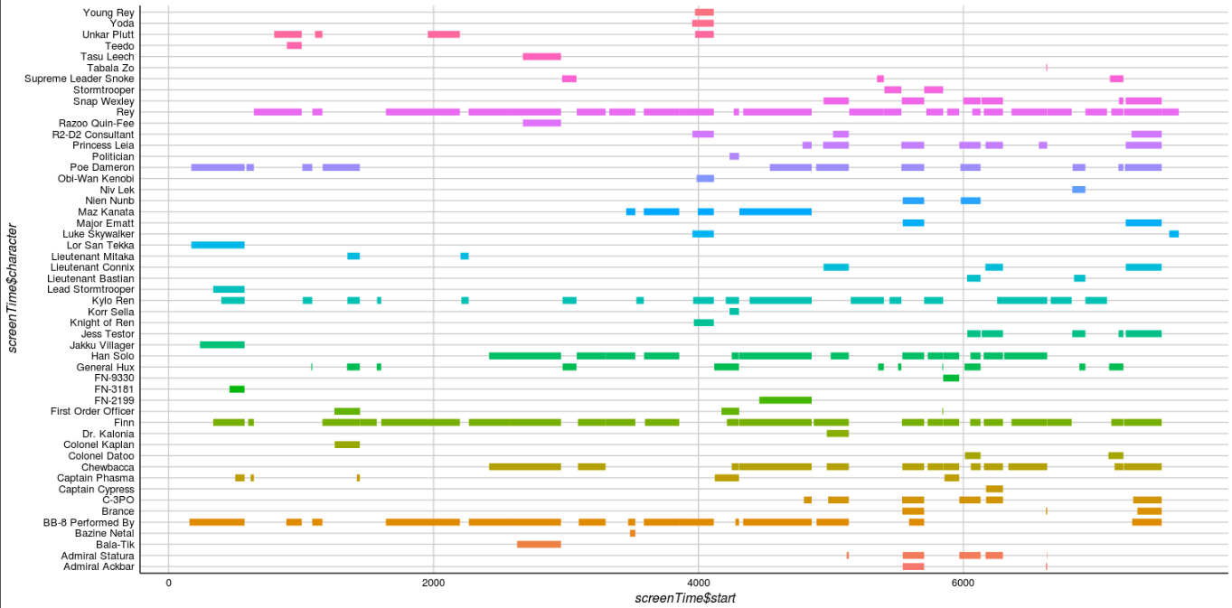
Understanding ggplot…
The third layer changes the background, axis & colors. The fourth layer removes the legend which is redundant in this context.
ggplot(screenTime, aes(colour=character)) +
geom_segment(aes(x=start, xend=end,y=character, yend=character),linewidth=3) + theme_gdocs() + theme(legend.position="none")

