Slide 1
API Sources
Ted Kwartler

Slide 2

What is an API?
“Application Program Interface”
Clearly defined methods of communication between various software components.

Slide 3
Two formats
XML – Extensible Markup Language
Ever wonder why Excel files went from xls to xlsx? The data is stored as XML.
JSON- Javascript Object Notation
Similar to R but used to make interactive objects in web browsers.
Respond in XML or JSON
Ask a question

Slide 4


Your phone doesn’t have every map in the world.
“Your phone requests information from the maps API services to render the information.

Slide 5
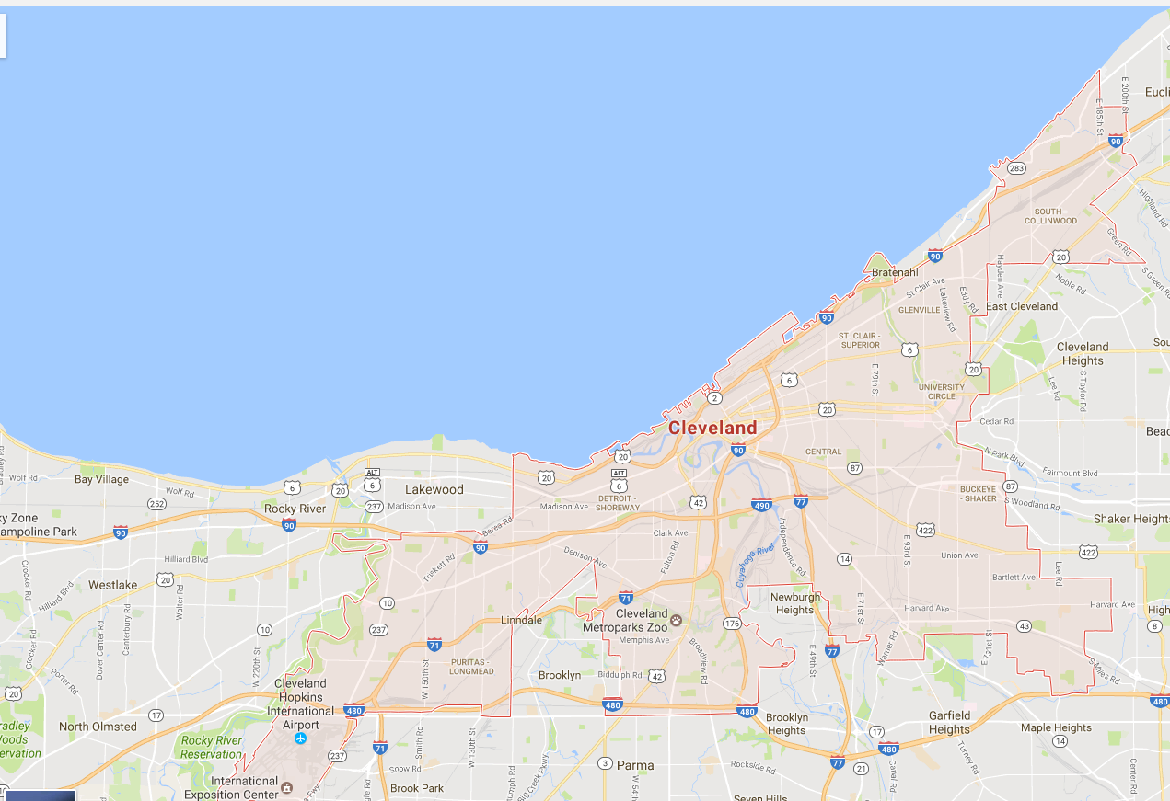
Your phone doesn’t have every map in the world.
www.google.com/maps/place/Cleveland,+OH/@41.4951143,-81.8462865,11z
Google Maps API Services include
Geocoding
Base map “tiles”
Basic Geographic Info

Slide 6
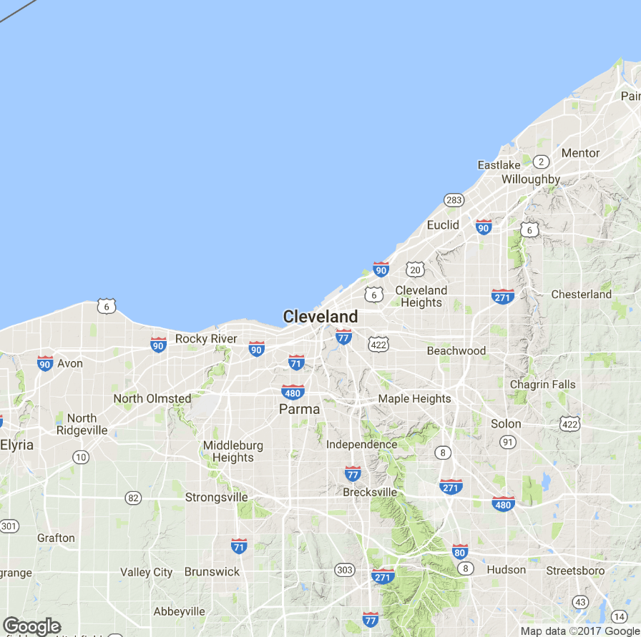
APIs are behind many of the sites you use everyday.
Static Map API
Static images are loaded as tiles underneath allowing you to scroll and navigate in your browser.

Slide 7
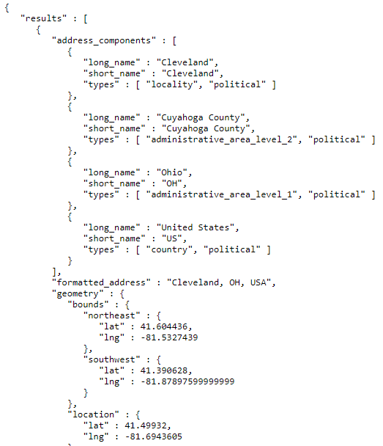
APIs are behind many of the sites you use everyday.
JSON Information API
On top of the tiles, more information is needed including the geo-political information and coordinates for the “bounding box”

Slide 8

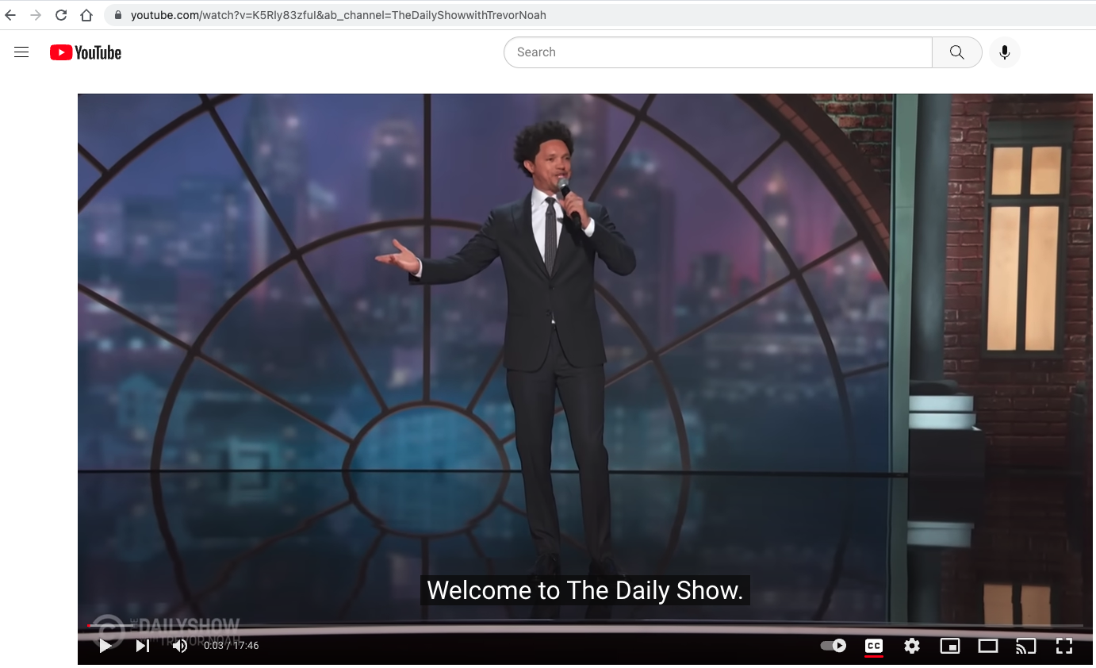
If you know where to look, you can access APIs for data!
If the video has closed captioning, let’s grab the text by clicking “cc”
https://www.youtube.com/watch?v=K5Rly83zfuI&ab_channel=TheDailyShowwithTrevorNoah

Slide 9

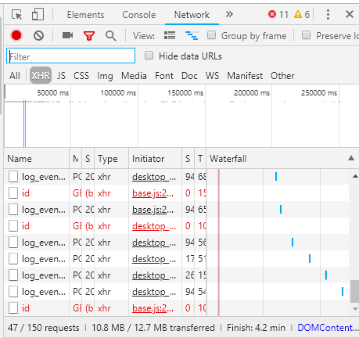
In chrome access the developer console.
While the video is playing, press F12 & reload the page.

Slide 10
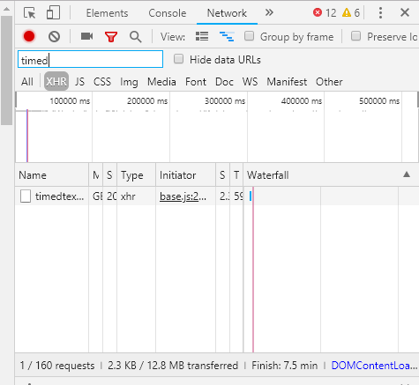
Click XHR and search for “timed” as in timedtext.
Right click on the request name and select “open in new tab”

Slide 11
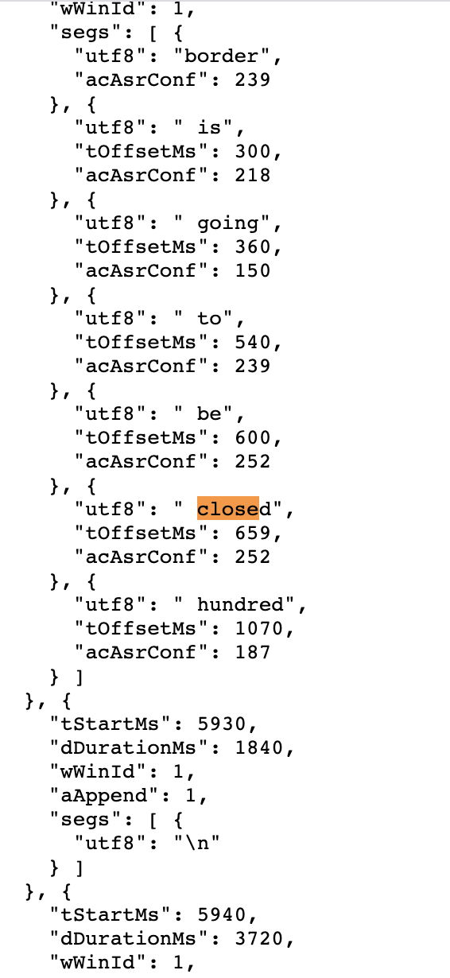
Closed Caption Data is in JSON

Slide 12
Let’s Practice…
C_youtubeAPI_example.R
D_youtubeAPI_curlconverter_example.R

Slide 13
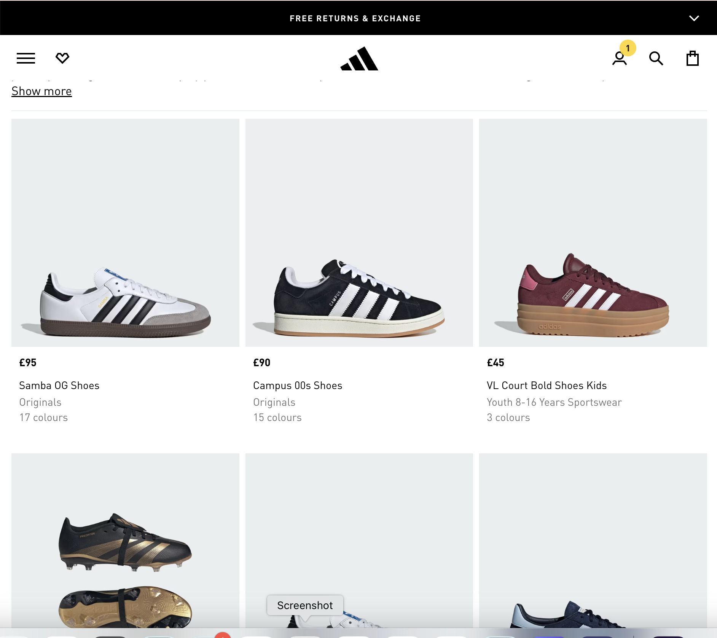
Next generation approaches to web-scraping
https://www.adidas.co.uk/shoes
Api’s exist but have checks for automated crawling.
Python’s curl-cffi has an impersonate parameter
R doesn’t have a similar function so curlconvertor will get a “403” forbidden

Slide 14
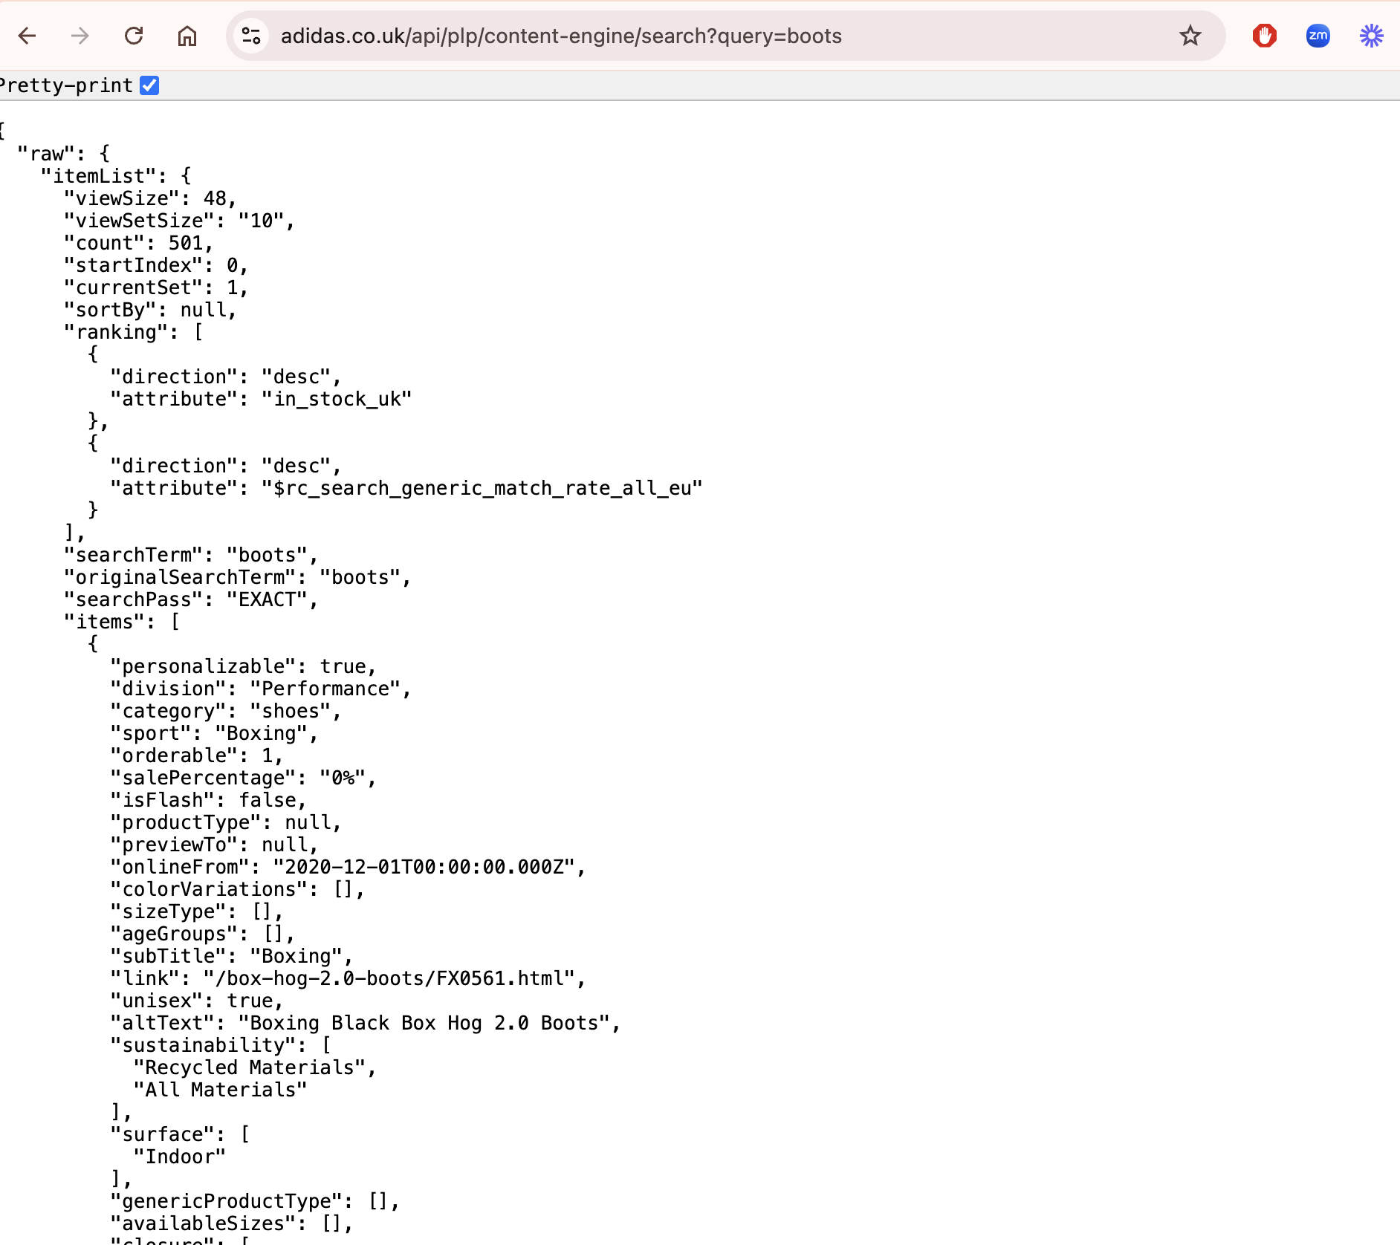
Adidas search API
https://www.adidas.co.uk/api/plp/content-engine/search?query=boots
Works in your browser, 403 “forbidden” in many curl requests

Slide 15
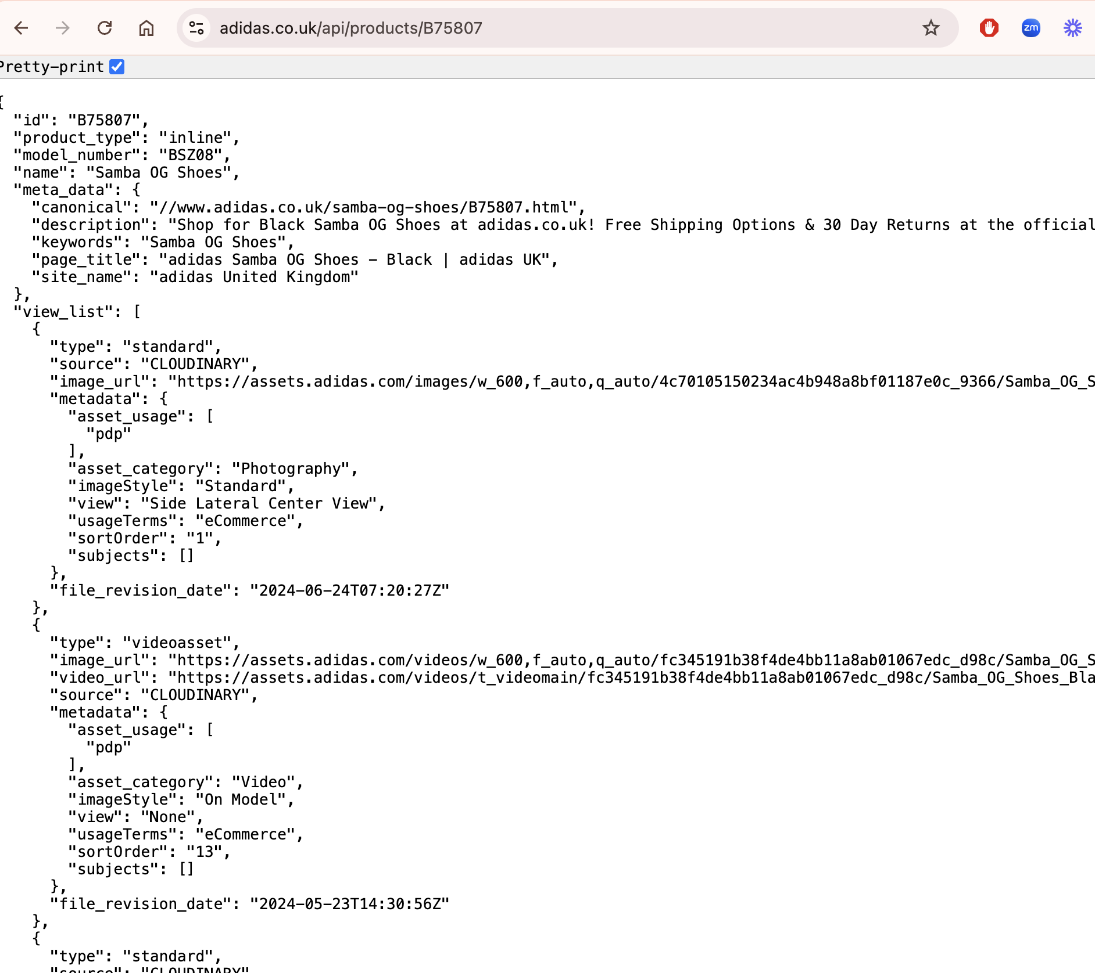
Adidas product API
https://www.adidas.co.uk/api/products/B75807
Works in your browser, 403 “forbidden” in many curl requests

Slide 16
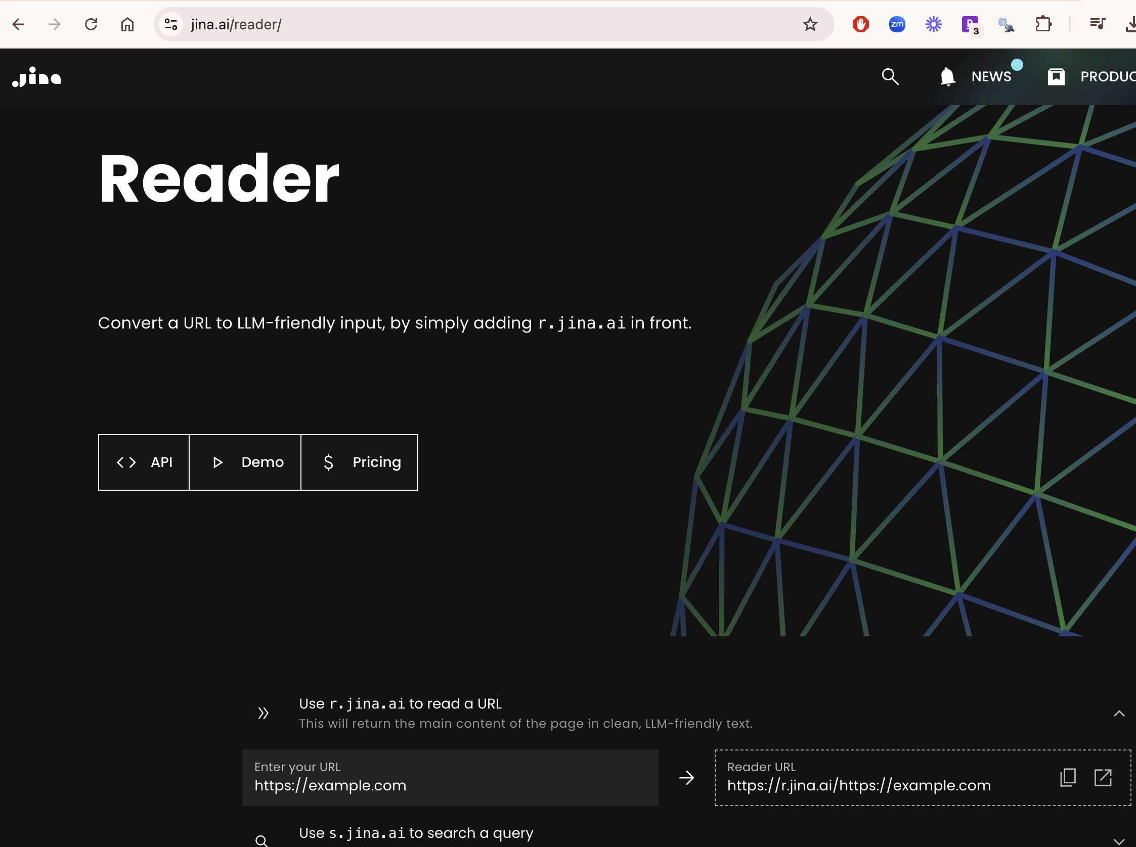
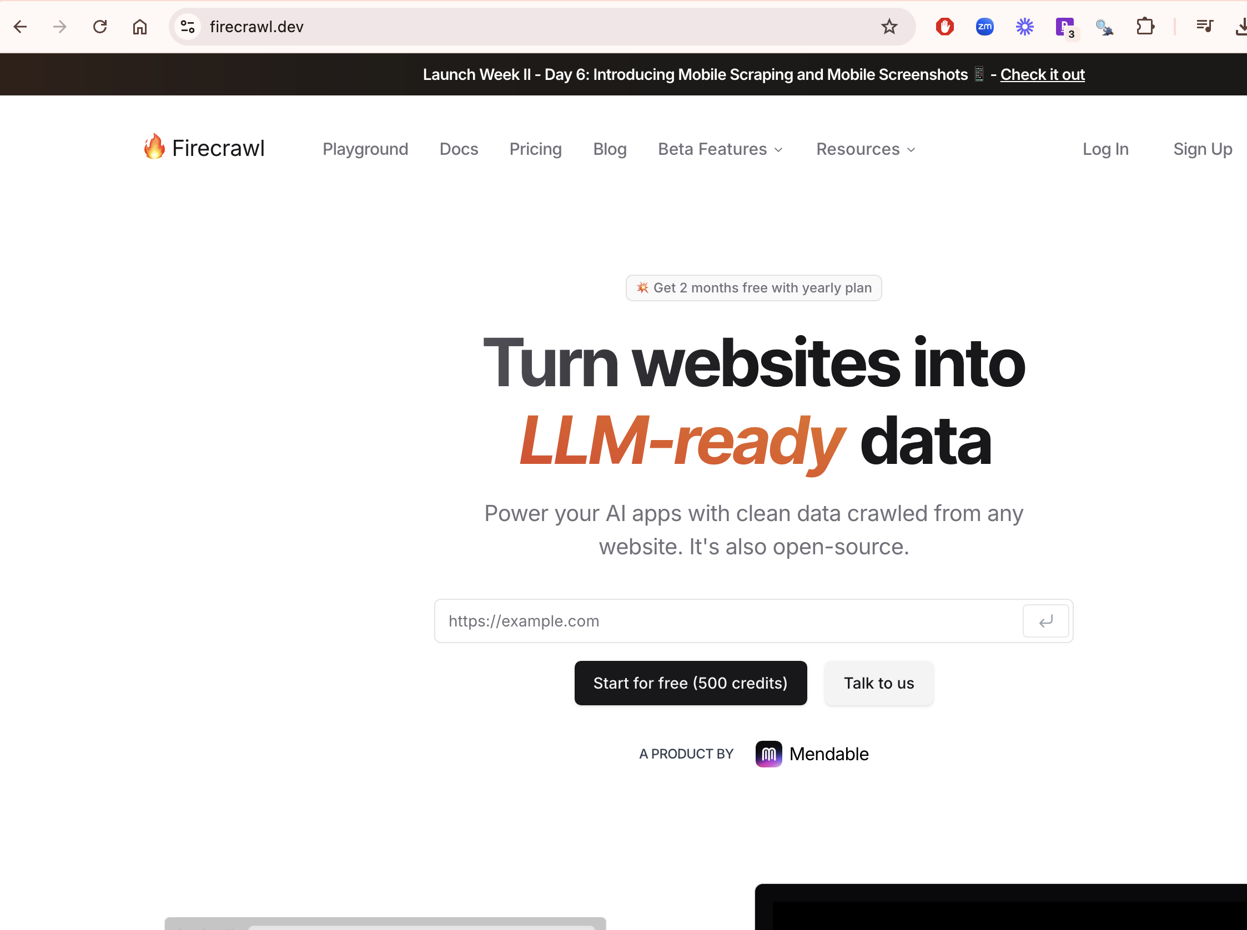
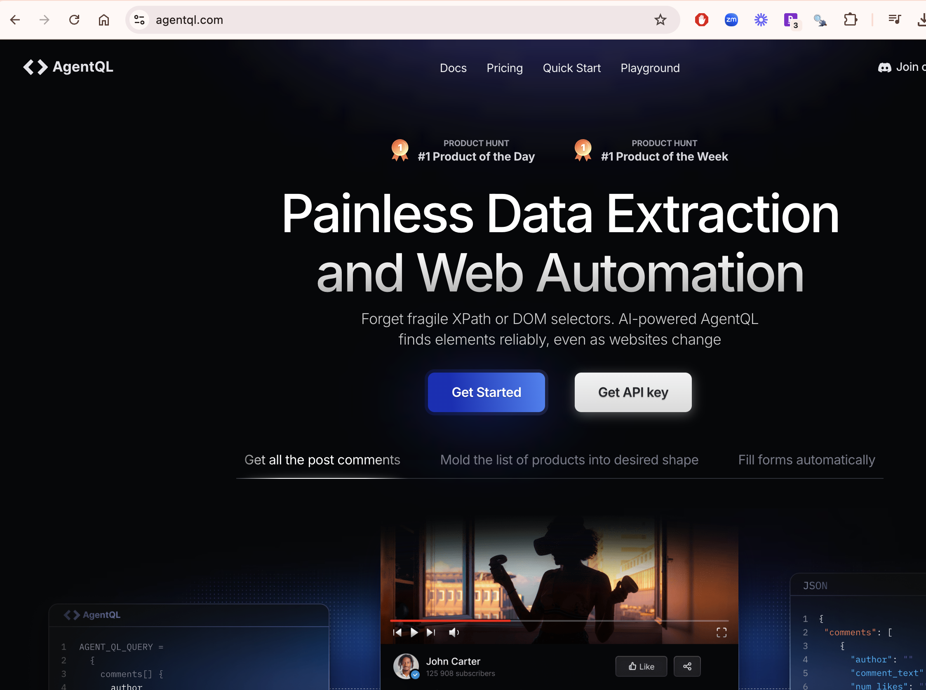
We can use LLM agents to crawl, and also LLMs to extract information.
LLMs have trouble parsing HTML because its cluttered, so services exist to change HTML to markdown.
Jina AI - easy
Firecrawl AI- medium
AgentQL AI- more advanced

Slide 17
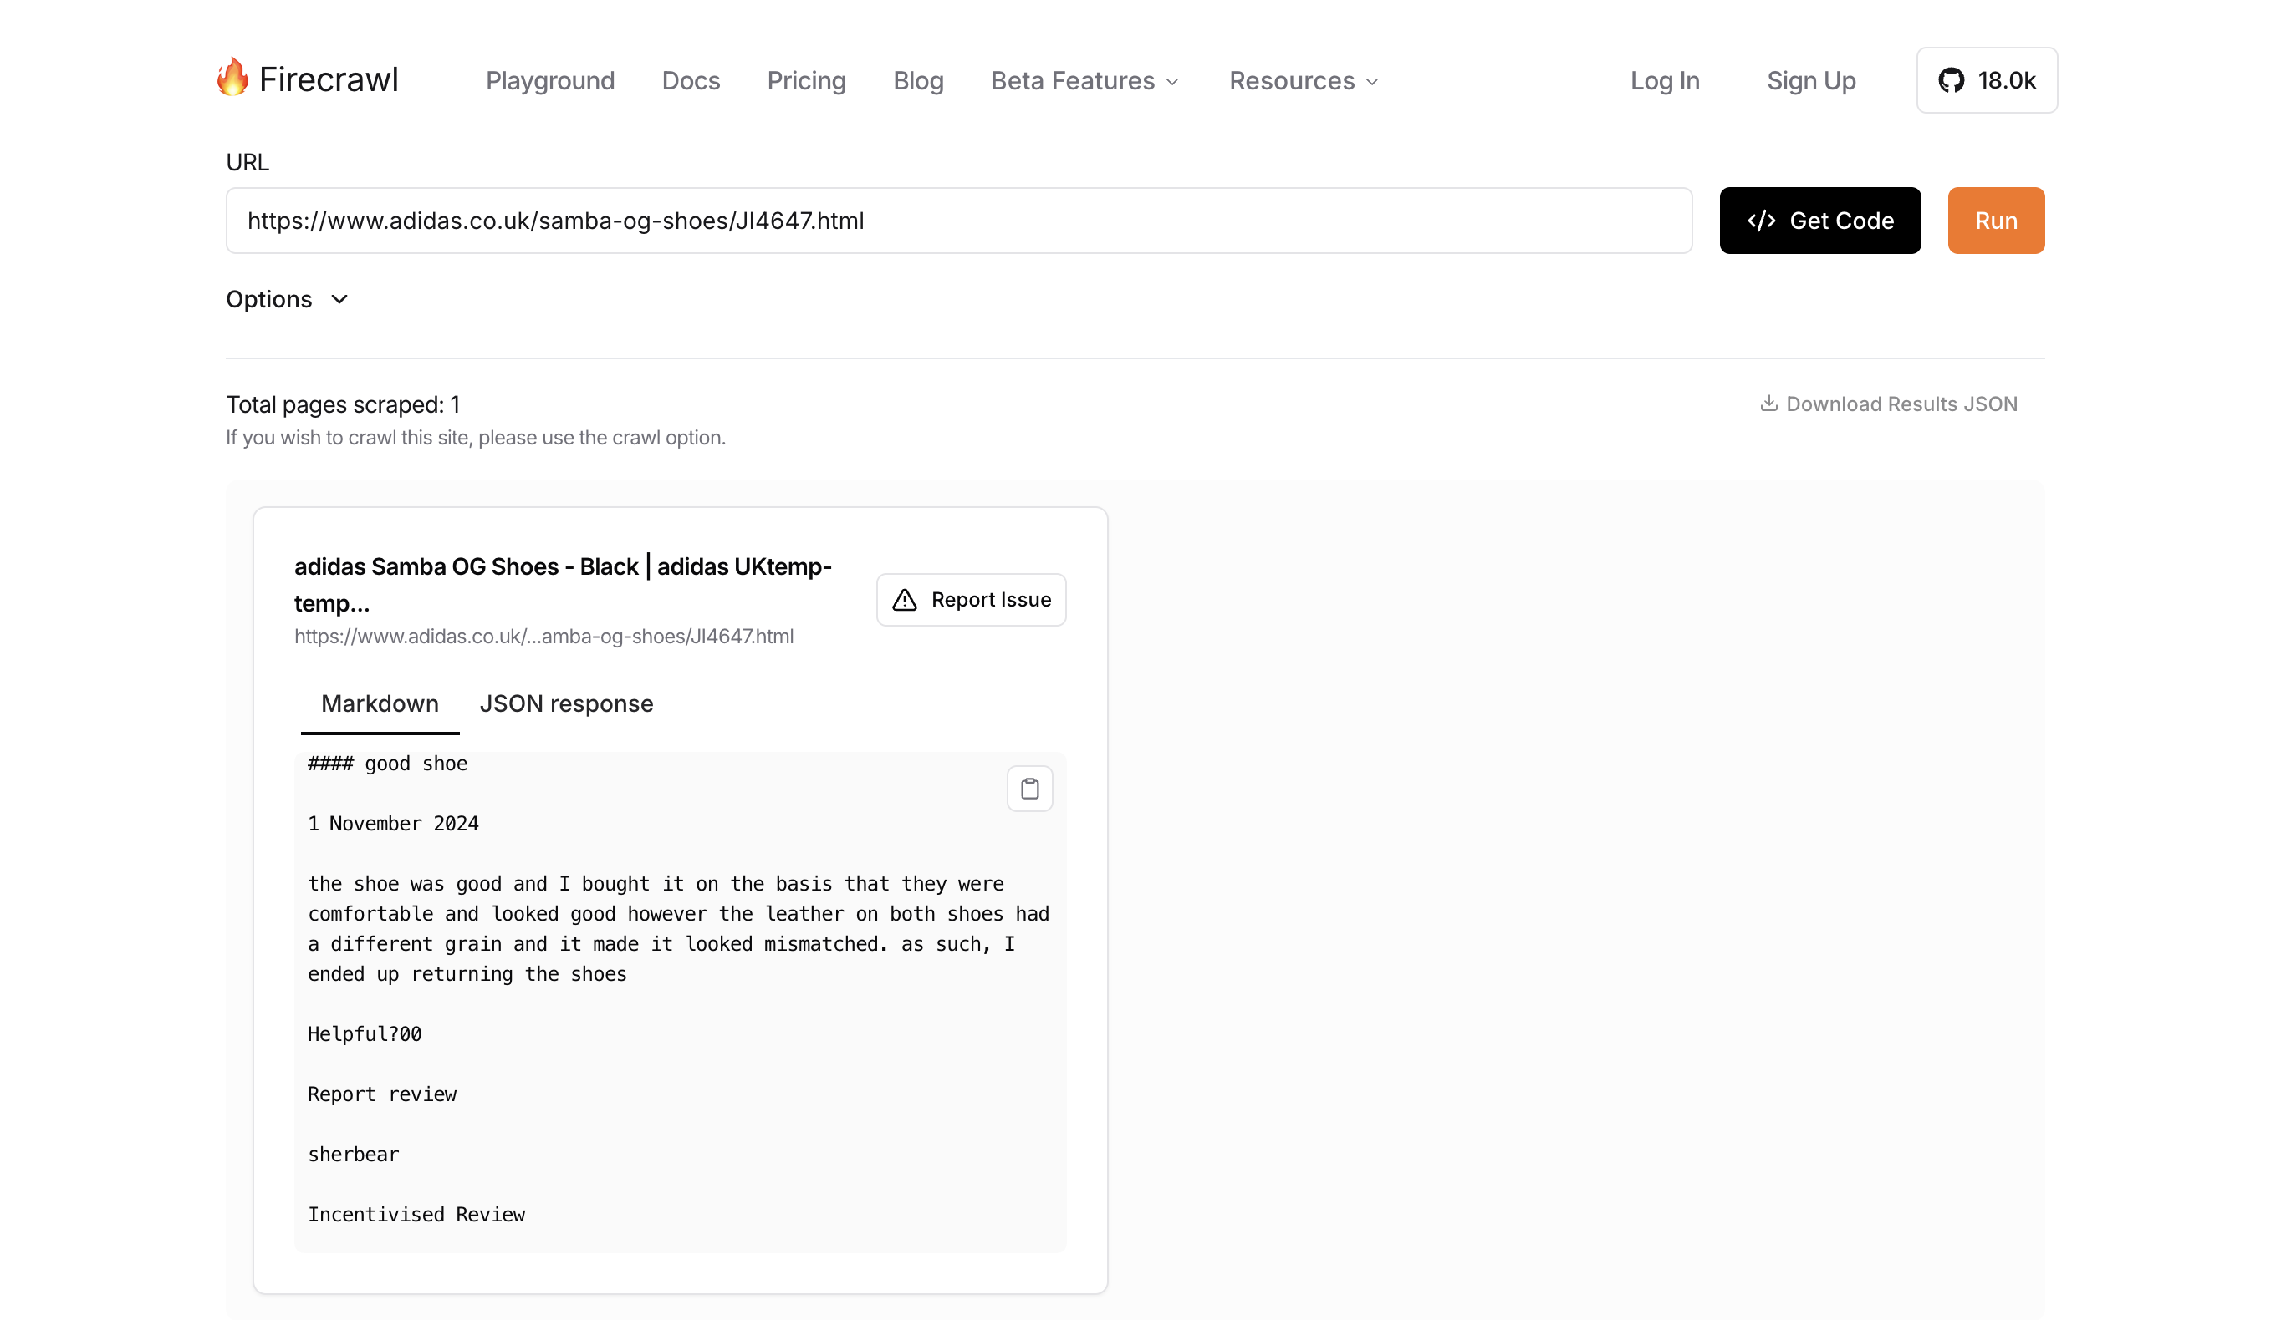
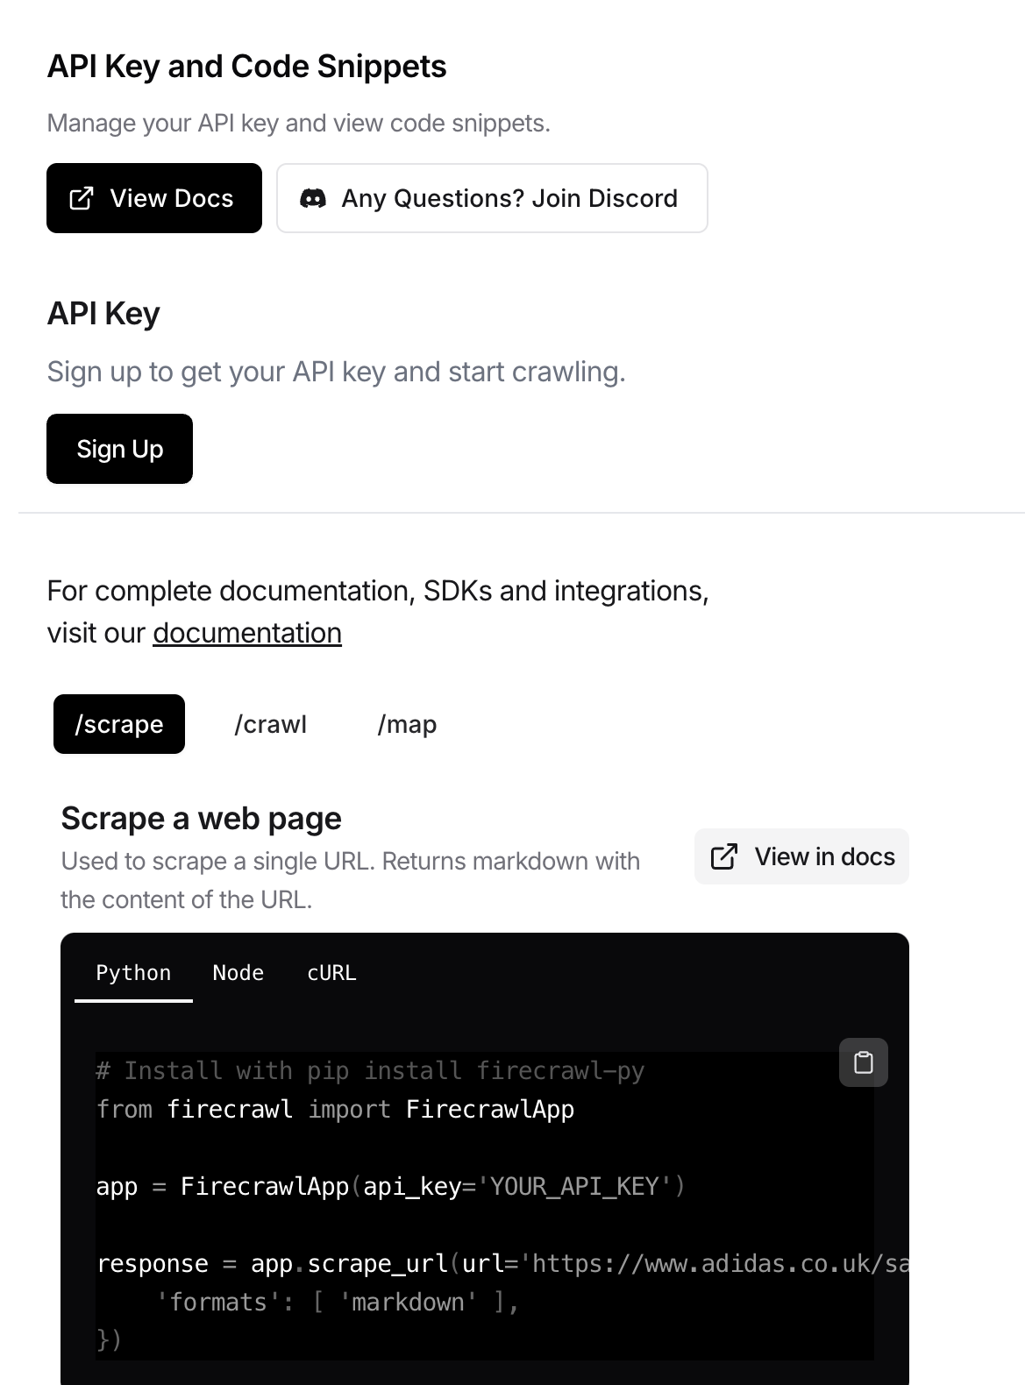
Firecrawl – has a cost, turns website into markdown or json
Seems to get more information into the output than Jina & can scrape more complicated sites

Slide 18
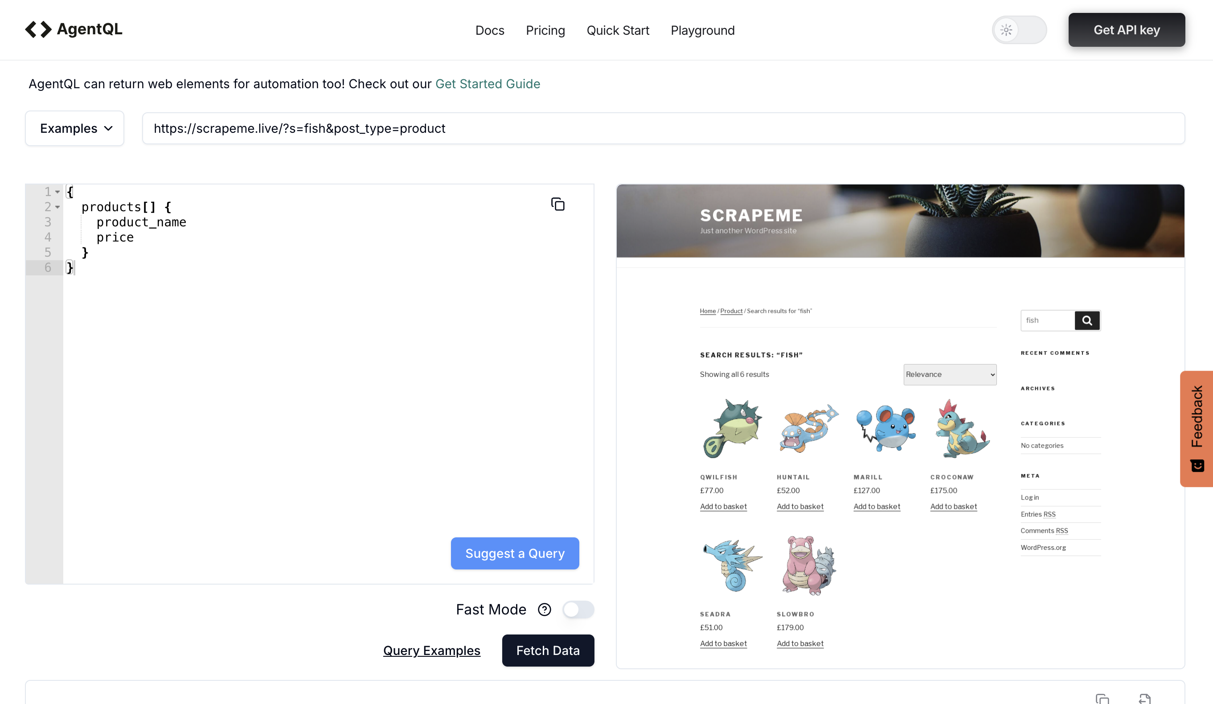
Requires api key, has a cost & requires knowledge of the query language (pretty easy)
Can handle logins, captcha and other complicated tasks.
Has a Chrome add-in which helps you identify sections of a page in the query language.
Seems to take a long time.

Slide 19
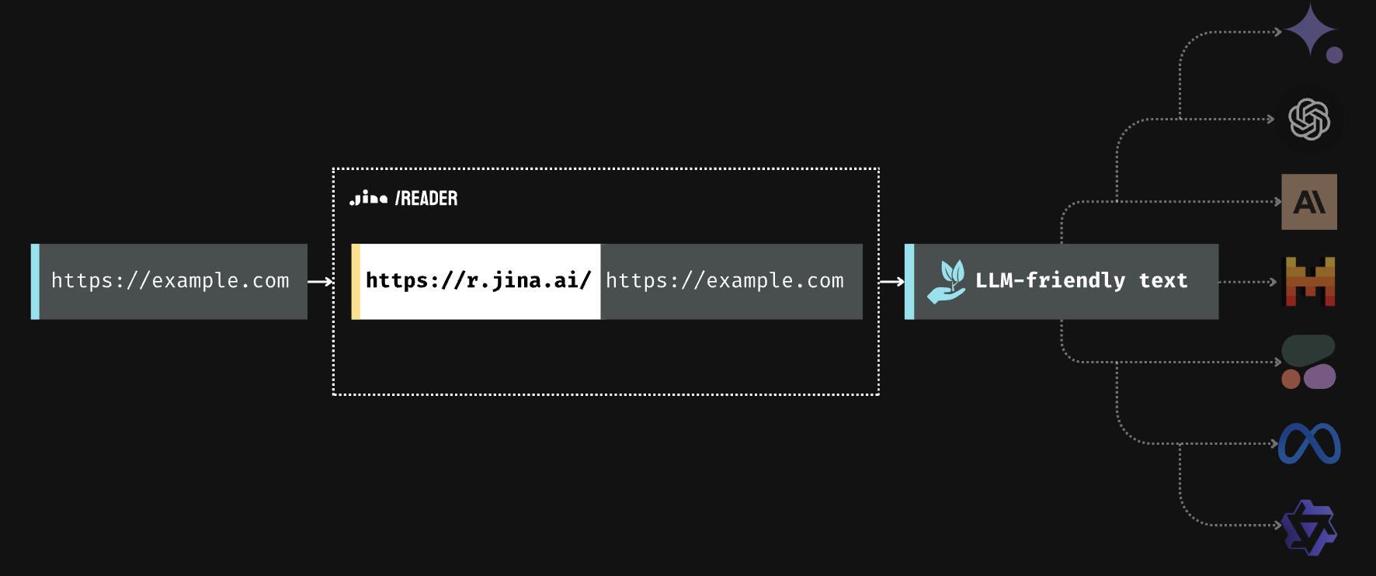
Jina AI – has a free tier & easy html to MD
https://r.jina.ai/https://example.com
We can build this pipeline in R. Can also describe images & pdfs.

Slide 20
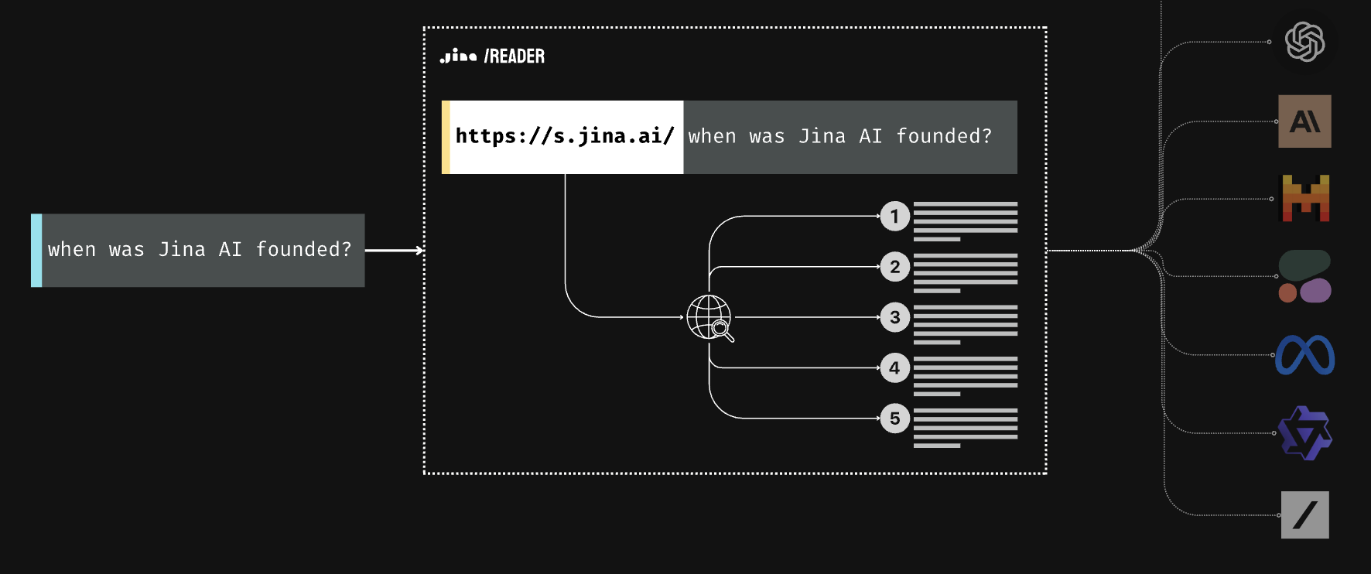
Jina AI – has a free tier & direct query to markdown
https://s.jina.ai/when%20was%20the%20university%20of%20Vienna%20founded?
Requires authentication

Slide 21
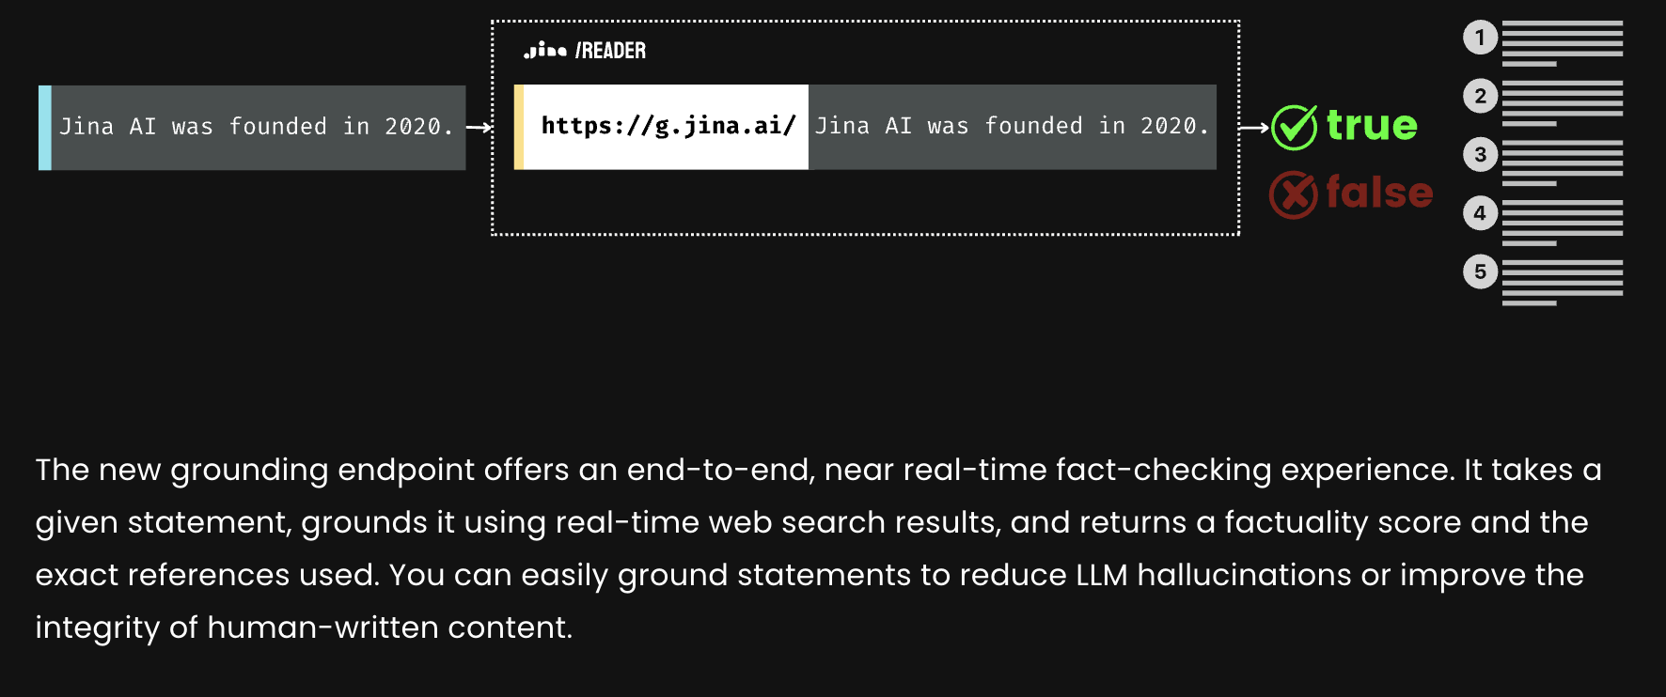
Jina AI – Fact checking based on web results
https://g.jina.ai/when%20was%20the%20university%20of%20Vienna%20founded?
Requires authentication

Slide 22
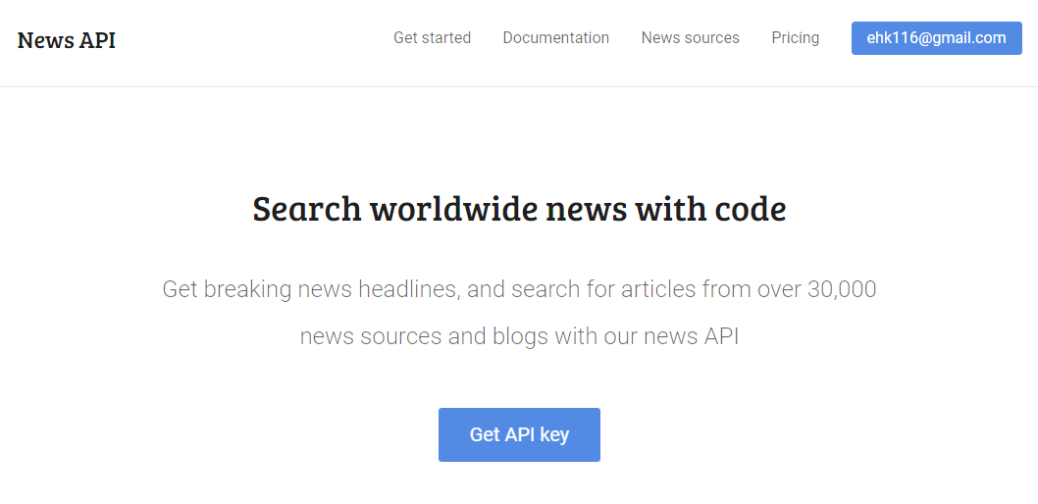
A Simple JSON API with authentication
Sign up at https://newsapi.org/

