Slide 1

APIs: Large Language Models as a Data Source
One key, one request format, hundreds of models. Every answer is a row of data you can analyze.
Notes:
About 15 minutes, then straight into the NLP block. Goal: everyone leaves with a working askLLM() function. Old scraping, YouTube and newsAPI material is retired to the not covered folder.

Slide 2

An API is an agreed way for one program to ask another for data
Every API call is the same three steps
Request: your program sends a question in the agreed format
Process: their server does the work you cannot do locally
Data: the answer comes back, almost always as JSON
Application Programming Interface
You never see their code or their database. You only see the menu of what you may ask for, and the format the answer comes back in.
XML and JSON are the two answer formats you will meet; today everything is JSON.
Notes:
Two minutes. The menu analogy: a restaurant does not let you into the kitchen; you order from the menu in a set way and food comes out.

Slide 3

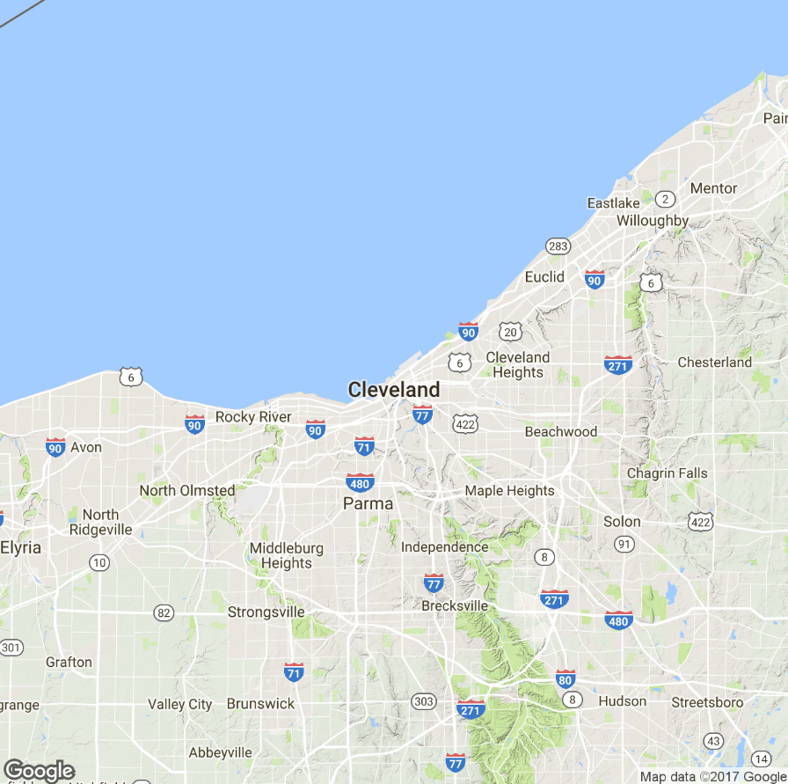
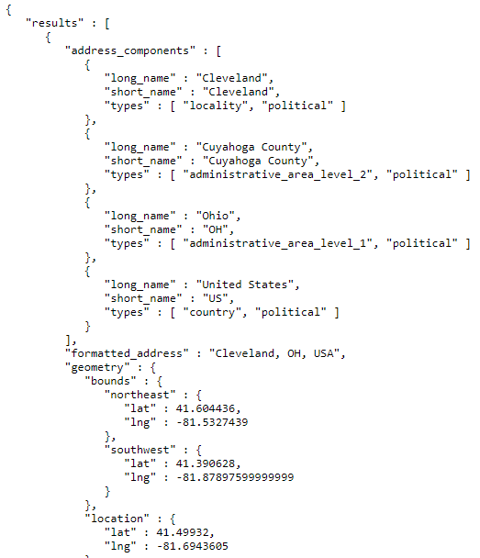
Your phone doesn't have every map in the world
Every scroll is a new request.
The maps app asks the API for two kinds of data and draws them on screen: images for the map itself, and JSON for everything on top of it.
1. Map tiles
Images loaded underneath so you can scroll
2. JSON
Names, borders and the coordinates of the box you see
Most apps are thin clients calling APIs. ChatGPT is too, and so is our R script.
Notes:
Two minutes. Open Google Maps on the projector and scroll if time allows.

Slide 4
OpenRouter: one key and one format for hundreds of models
OpenAI
Your R
script
OpenRouter
checks your key, routes the request, bills your credit
Google
Anthropic
Mistral
Meta
Switching companies means changing one word in the request: the model name.
and many more
Cheap switching is what makes comparing models, and the GEO activity, possible.
Notes:
Two minutes. Without a router you would need a separate account, key, bill and request format for each company.

Slide 5
Every request answers three questions: where, who and what
POST('https://openrouter.ai/api/v1/chat/completions',
add_headers(Authorization =
paste('Bearer', apiKey)),
body = toJSON(list(
model = 'openai/gpt-4o-mini',
messages = list(list(
role = 'user',
content = 'What is Vienna known for?')),
temperature = 0.7,
max_tokens = 200),
auto_unbox = TRUE))
Where: the URL
The address of the chat endpoint. The same for every model.
Who: the header
Your key, so OpenRouter knows whose credit to bill.
What: the body
model picks the company. messages hold the prompt. temperature sets how much answers vary. max_tokens caps length, and so cost.
The prompt is just one field in the body. Change the body, not the code.
Notes:
Three minutes. Colors on the code match the three cards. Point out that the code is identical whichever model you call.

Slide 6
The answer comes back as JSON; R turns it into a list
{
"model": "openai/gpt-4o-mini",
"choices": [{
"message": {
"role": "assistant",
"content": "Vienna is known for..."
}
}],
"usage": {
"prompt_tokens": 14,
"completion_tokens": 31
}
}
out <- content(resp)
out$choices[[1]]$message$content
out$usage
status_code() | What it means
200 | It worked; read the content
401 | Key missing or wrong; check .Renviron and restart R
402 | Out of credit
429 | Too many requests at once; slow down
Check status_code() before you trust the content.
Notes:
Two minutes. The nesting is why we index with [[1]]: choices is a list because some APIs return several candidate answers.

Slide 7
A key is a password, and every token costs money
Keys
Store it in .Renviron; read it with Sys.getenv()
Never paste it into a script, a slide or a chat
Never commit it; bots scan GitHub for keys within minutes
Class key: on Moodle, with a spending cap. Your own key: fund a few dollars
About 2 cents
for 100 short answers from a small model
You pay per token, in and out
Prices are per million tokens and vary 100 times between models
max_tokens is your cost cap
Save every response with saveRDS() so you never pay twice
Estimate: 100 calls x about 300 output tokens at about $0.60 per million. Check prices before class.
Notes:
Two minutes. Recalculate the estimate with the live price list from section 1 of the script before class. A frontier model can cost 50 to 100 times more for the same calls.

Slide 8
Let's practice: E_openrouter_basics.R
1
2
3
4
5
List the models
One request
Change the request
askLLM()
Many models
Ask the server what it has and what it costs. No key needed.
Send a prompt, read the JSON, find the answer and the tokens.
Add a system role, raise the temperature, swap the model.
Wrap it all in a function with explicit return().
Same question to three models, saved as a data frame.
askLLM() is the engine for the GEO brand activity after the break.
Notes:
Two to three minutes of live code, the rest happens in the GEO block. Step 5 already checks whether each answer mentions a brand: that is the GEO question in miniature.

