Slide 1

Non-Traditional Market Making
Simulate a booster box with your own functions before you buy 100 of them
Data Analytics in R | Day 1 | Ted Kwartler
Notes:
This lab follows the writing functions block. Roughly 25 minutes of setup and function walkthrough, 45 minutes of coding, then we open the real Reality Fracture box.

Slide 2
Non-traditional markets
Traditional
Non-traditional
Stock markets
Bond markets
Housing and mortgages
Commodities: gold, silver
Crop futures
Consumer credit
Crypto-currencies
Beanie Babies
Derivatives (originally)
Web domains and blogs
Sneakers (stockx.com)
Collectible trading cards
Compared with traditional markets, emerging markets lack transparency and regulation, and are easier to manipulate.
Notes:
Ask the room for other examples. Concert tickets, watches, NFTs, Pokemon cards. What do they have in common?

Slide 3
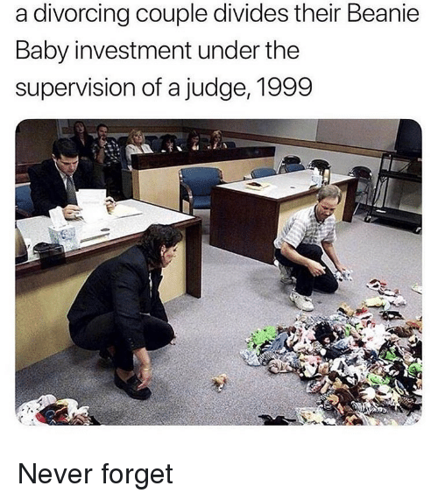
A non-traditional market: worth what the next buyer pays
Never forget
In 1999 a divorcing couple split their Beanie Baby collection, one toy at a time, in front of a judge.
Notes:
The punchline: an asset is only worth what the next buyer will pay. When the market collapsed, so did the value of the collection.

Slide 4

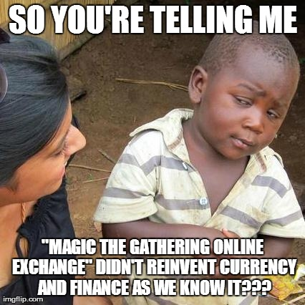
Another non-traditional market
Magic: The Gathering is a collectible trading card game first sold in 1993 and owned by Hasbro through Wizards of the Coast. An estimated 8 to 12 million people play worldwide, so unlike most collectibles it is popular and has demonstrated longevity.
Notes:
More than 30 years old. Popularity and longevity are what make it a market rather than a fad.

Slide 5
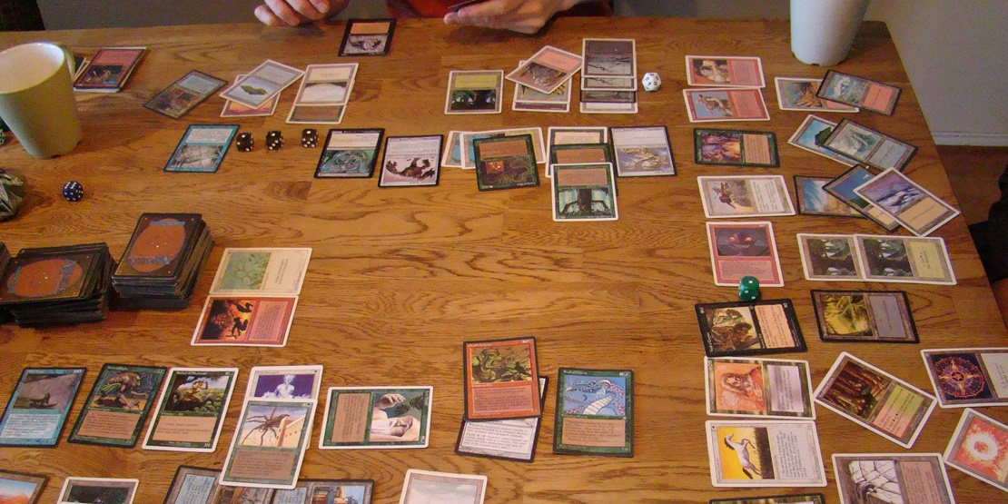
Magic: The Gathering
Players build 60 card decks and duel. Cards are fantasy creatures, spells and mythical artifacts.
Notes:
Cards have game value. That demand from players is what gives individual cards a price.

Slide 6
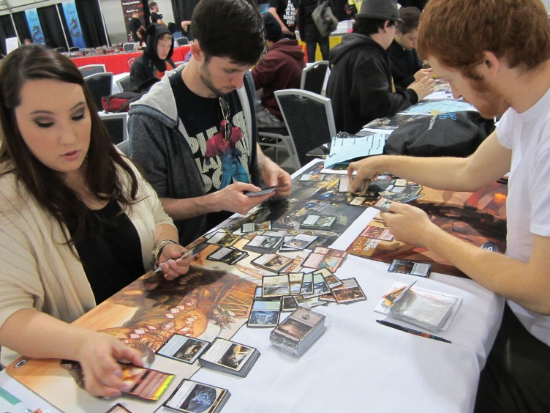
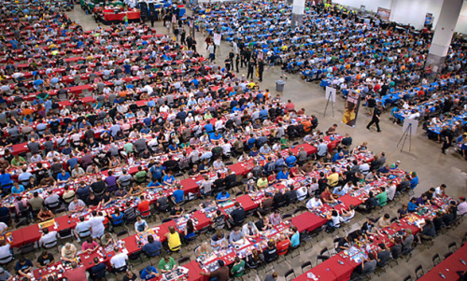
Organized play keeps demand alive
Cards have limited print runs and varying rarities.
Notes:
Limited supply plus steady demand from tournaments: the ingredients for a price.

Slide 7
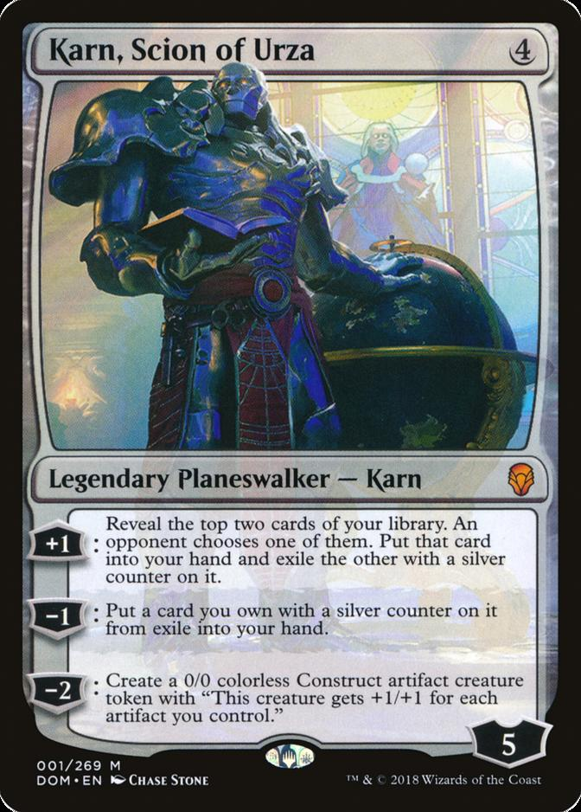
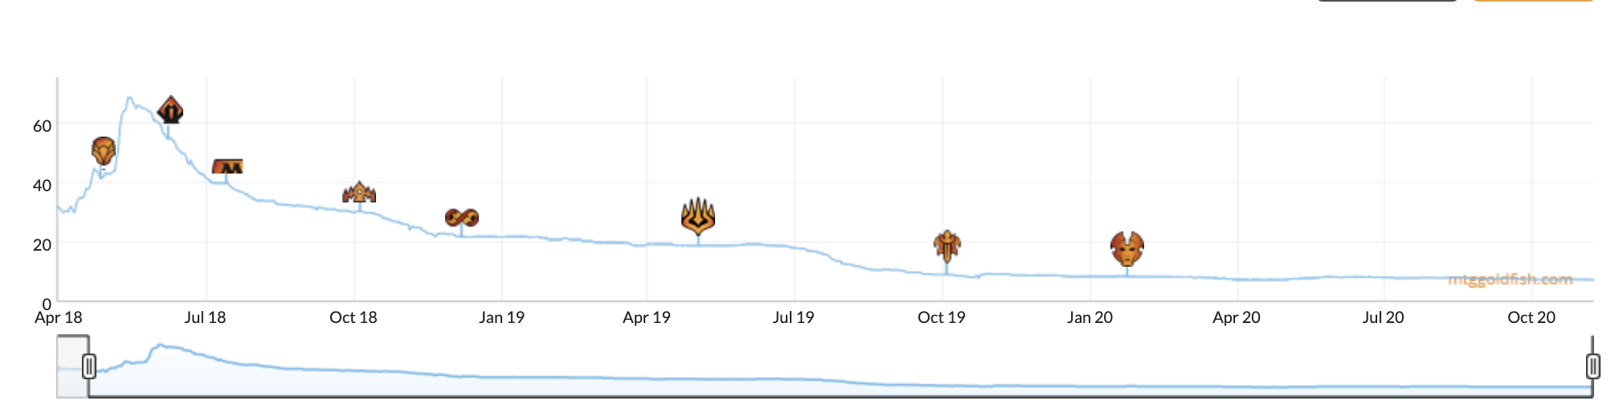
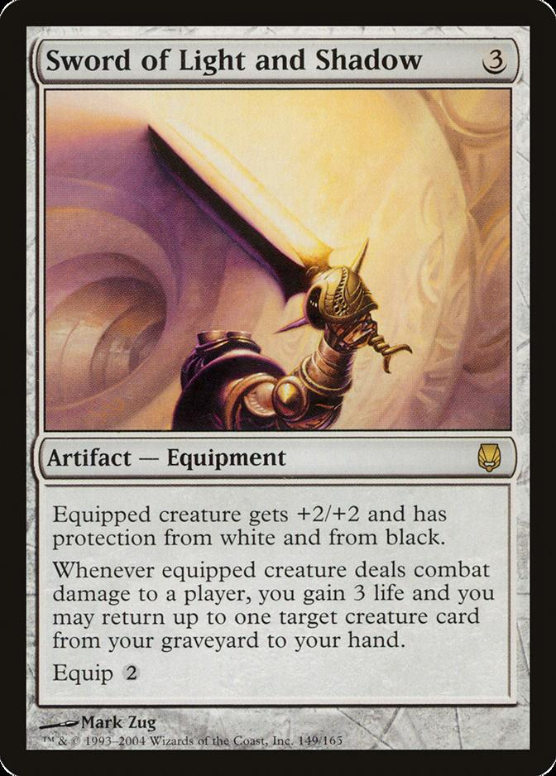
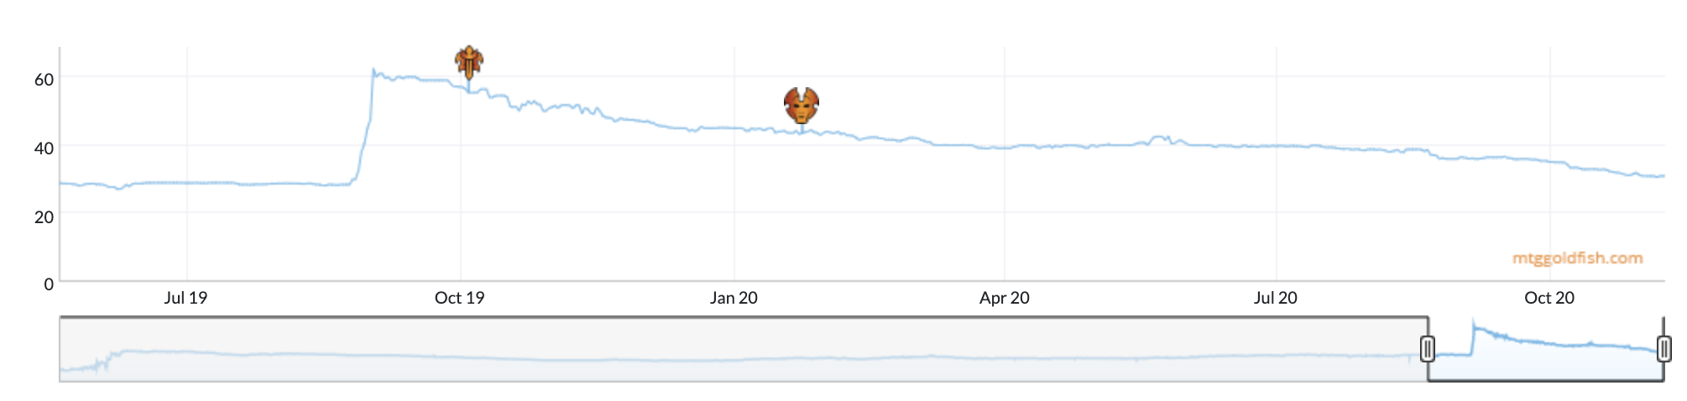
And that is why it is a market
Started out good in the game, but was not
Price drifted down as players found better options.
A new card made this one stronger
A combination appeared and the price jumped overnight.
Card prices move daily on sites like mtggoldfish.com, mtgstocks.com and tcgplayer.com
Notes:
Two directions: Karn fell as the game evolved, Sword rose when a new card created a combo. Prices respond to information, like any market.

Slide 8
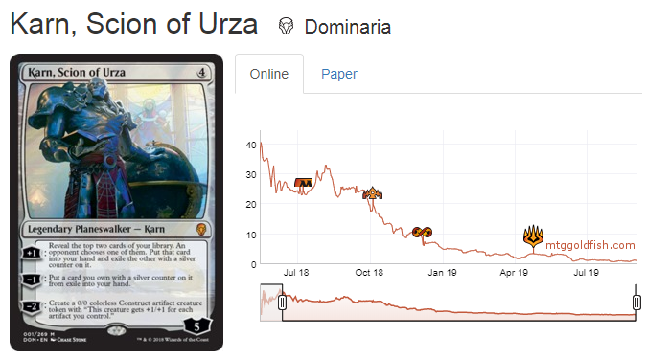
So how do you get cards?
Price | What you get
$19 | Karn himself, from an online marketplace
$3 | One booster pack from the set, and a hope
$90 | A booster box of 36 packs: better odds of Karn plus many other cards that may be valuable
$540 | A case of six booster boxes
Say you need Karn, Scion of Urza to finish a deck. When it came out it was a $40 card.
Notes:
The box is the interesting choice: it is a portfolio of lottery tickets. That is the investment question for the rest of the lab.

Slide 9
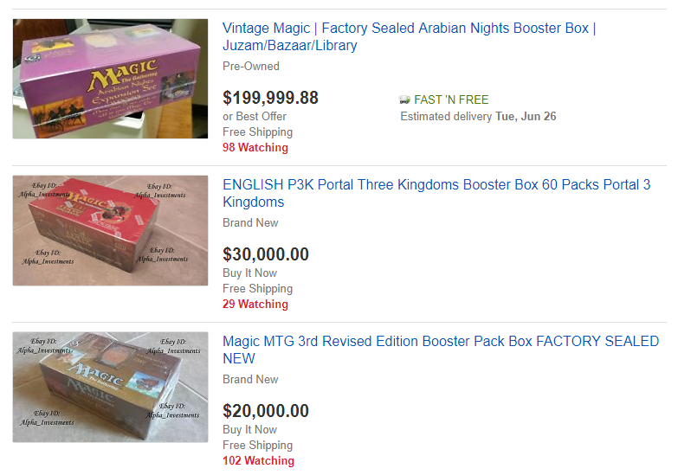
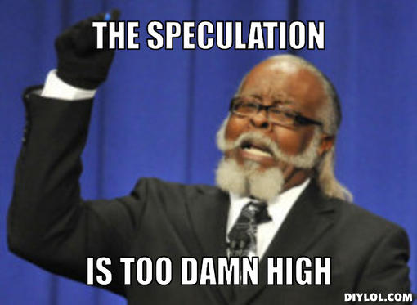
People speculate as supply diminishes
Notes:
Sealed product from the 1990s lists for tens of thousands of dollars. Every new set is someone hoping for that.

Slide 10
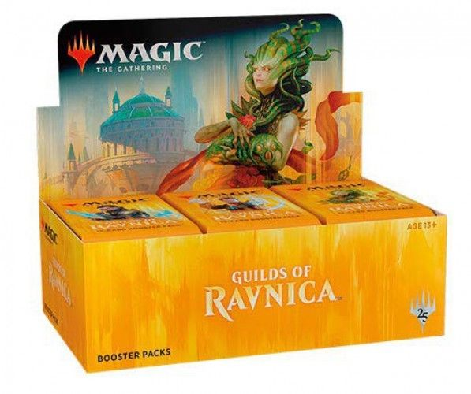
2018: what was in a Guilds of Ravnica pack
36 packs per box
11 commons
3 uncommons
1 rare
  1 in 8 packs a mythic replaces the rare
1 in 6 packs a premium foil of any rarity replaces a common
Ted bought 100 of these boxes at $79.50 each.
Notes:
This is the original trade we replay in Part 1 of the script with the October 2018 price list.

Slide 11
2026: a Reality Fracture Play Booster is built slot by slot
6
Commons
1
Uncommon
1
Wildcard
3
Echoed pair
1
Rare or mythic
1
Foil
1
Land
1
Token
always
3.8% braintwister
23% C, 74% U, 3% braintwister
88.9% U, 6.7% R, 1.4% M
14.8% mythic, special treatments
49.5% C, 40.5% U, 6% R, 1.2% M
basics and duals, some foil
always
 | Guilds of Ravnica, 2018 | Reality Fracture, 2026
Packs per box | 36 | 30
Cost per box | $79.50 paid | about $100 wholesale, $119.75 market
Cost per pack | $2.21 | $3.33 wholesale
Odds: Wizards of the Coast, "Collecting Reality Fracture". Each slot is its own sample() with probabilities. data/play_booster_collation.csv
Notes:
Same idea as 2018 but more slots and more treatments. Each slot is its own weighted draw, which is exactly what openSlot() does. The wholesale price is an estimate for a 100 box order.

Slide 12
Model a new set according to risk and reward
Risk
Each set has varying prices. Most cards are nearly worthless; a few are expensive.
Reward
Some packs hold a card you can sell right away for more than the pack cost.
We know the cards, their prices and the odds of each one, so we can simulate opening packs.
Keep friction in mind: fees, shipping and your time cost money.
Notes:
Friction is the part people forget. It turns out to decide the 2026 answer.

Slide 13

Sample with a probability
idx <- 1:10
# Equal probabilities
set.seed(123)
sample(idx, 3)
# Declare probability weights
set.seed(123)
sample(idx, 3, replace = T, prob = c(0,0,1,0,0,0,0,0,0,0))
# The rare slot: a mythic about 1 pack in 8
sample(c('rare', 'mythic'), 8, replace = T,
prob = c(7/8, 1/8))
Open
scripts/A_sample_w_probs.R
When you do not want a purely random sample, give sample() a prob vector. The weights do not even have to add to 1; R rescales them.
Notes:
Run the file. Change the seed and the weights. The last line is the mythic check inside crackPack().

Slide 14
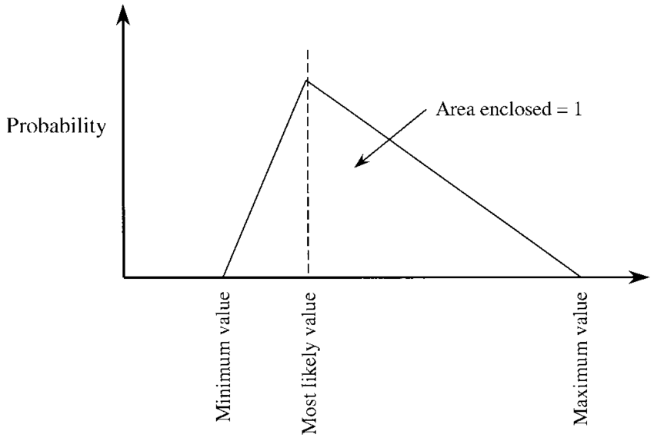
Card prices vary: bounded and not normal
The most likely value (the mode) sits between a minimum and a maximum, with straight lines down to each. Use it when the true distribution is unknown but you can say something about its shape.
# A card: low $3.00, market $4.99
rtriangle(1, a = 3, b = 4.99, c = 4.99)
Open scripts/B_triangle_example.R
Notes:
Our assumption: a card sells somewhere between its lowest listing and market price, most often near market. That is cardPrice().

Slide 15
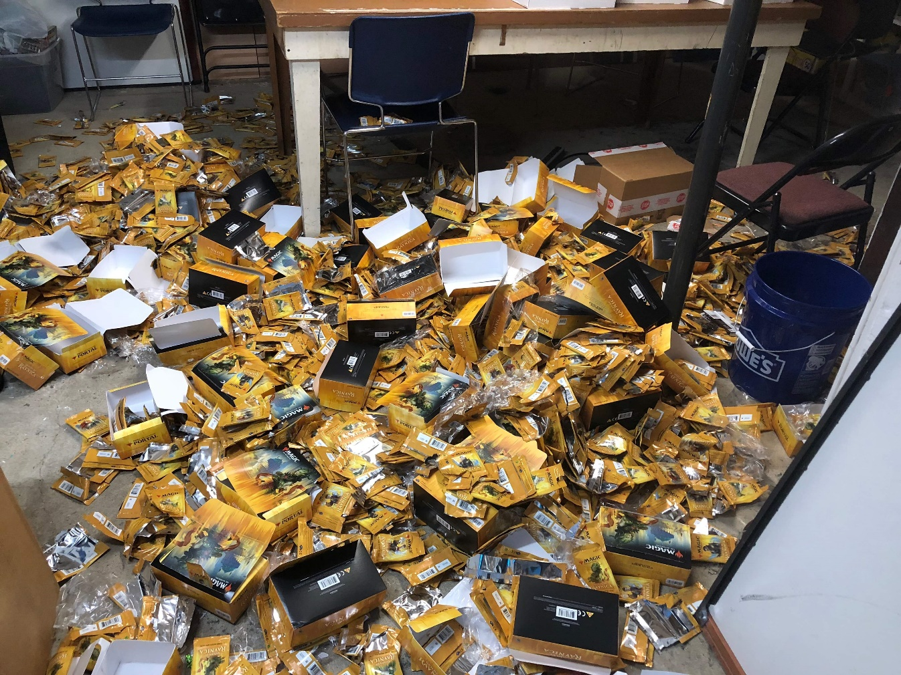
What $8,500 of Magic cards looks like
100 boxes
Guilds of Ravnica, 2018
3,600 packs
about 54,000 cards
Was it worth it? Simulate before you open.
Notes:
The real trade. Then ask: if you had $10,000 today, would you do it again with Reality Fracture? We will answer with five functions.

Slide 16
The lab in five small functions
cardPrice()
one sale price for one card
crackPack()
open one pack using rarity odds
packValue()
what the pack sells for after frictions
openBox()
open every pack in a box
simulateBoxes()
repeat for many boxes
Then decide: maxBid() the most to pay per box, and compareStrategies() open the box, or sell it sealed, or sell the packs.
Each function does one job, so each can be tested alone: crack one pack and look at it before you simulate 3,600.
Notes:
Same habits as the INN Hotels refactor: one job each, clear names, defaults, explicit return.

Slide 17
crackPack(): split the price list by rarity, then sample
crackPack <- function(cardDF, packsPerMythic = 8, packsPerFoil = 6) {
onlyCommon <- subset(cardDF, cardDF$rarity == 'C')
onlyUncommon <- subset(cardDF, cardDF$rarity == 'U')
onlyRare <- subset(cardDF, cardDF$rarity == 'R')
onlyMythic <- subset(cardDF, cardDF$rarity == 'M')
commons <- onlyCommon[sample(1:nrow(onlyCommon), 10), ]
uncommons <- onlyUncommon[sample(1:nrow(onlyUncommon), 3), ]
...
BASIC script
______ <- subset(cardDF,
cardDF$rarity == 'C')
onlyUncommon <- _____(_____,
cardDF$rarity == ___)
Fill in the blanks in C_mtg_investment_BASIC_STUDENT.R, or write the bodies from comments in C_mtg_investment_STUDENT.R.
subset() keeps the rows that match; sample() picks row numbers; the brackets pull those rows out.
Notes:
The pattern subset, sample row numbers, index rows repeats for every rarity. Ask: why sample row numbers instead of sampling the data frame?

Slide 18
A weighted coin decides the mythic and the foil
mythicCheck <- sample(c(TRUE, FALSE), 1,
prob = c(1 / packsPerMythic, 1 - 1 / packsPerMythic))
if (mythicCheck == TRUE) {
premium <- onlyMythic[sample(1:nrow(onlyMythic), 1), ]
} else {
premium <- onlyRare[sample(1:nrow(onlyRare), 1), ]
}
...
pack <- rbind(commons, uncommons, premium, lastCard)
pack$foil <- c(rep(FALSE, 14), foilCheck)
return(pack)
}
Argument | Default | Meaning
packsPerMythic | 8 | mythic in 1 of 8 packs
packsPerFoil | 6 | foil in 1 of 6 packs
Odds are arguments with defaults, so a different set is one changed number, not a rewritten function.
Notes:
This is sample() with probabilities from the warm up, plus if/else from the functions block.

Slide 19
packValue(): market value is not what you collect
packValue <- function(pack, sellFee = 0.15, bulkCutoff = 1,
bulkPrice = 0.005) {
values <- numeric(nrow(pack))
for (i in 1:nrow(pack)) {
values[i] <- cardPrice(pack$low[i], pack$market[i])
}
netValues <- ifelse(values >= bulkCutoff,
values * (1 - sellFee), bulkPrice)
return(sum(netValues))
}
Sell below market
cardPrice() draws between the low price and market
Bulk
cards under $1 sell to a dealer for about $5 per 1,000
Fees
the marketplace keeps about 15% of each sale
packValue(pack, sellFee = 0, bulkCutoff = 0) gives the frictionless market value.
Notes:
Every friction is an argument. The decision depends on them, so we want managers to be able to change them.

Slide 20
Pass a function into a function: one openBox() for any set
openBox <- function(cardDF, packFun, nPacks = 36, ...) {
packValues <- numeric(nPacks)
for (i in 1:nPacks) {
onePack <- packFun(cardDF, ...)
packValues[i] <- packValue(onePack)
}
return(packValues)
}
openBox(guilds, crackPack, nPacks = 36)
openBox(rf, openPlayBooster, nPacks = 30, odds = odds)
packFun
is whichever pack opener you hand it: the 2018 crackPack() or the 2026 openPlayBooster().
...
passes any extra arguments, like the odds table, straight through to packFun.
Notes:
This is the payoff of small functions. simulateBoxes() calls openBox() the same way, so the 2026 analysis reuses all of the 2018 code.

Slide 21
openPlayBooster(): one weighted draw per slot
openSlot <- function(cardDF, slotOdds) {
pick <- sample(1:nrow(slotOdds), 1, prob = slotOdds$probability)
outcome <- slotOdds[pick, ]
pool <- subset(cardDF, cardDF$rarity == outcome$rarity &
cardDF$treatment == outcome$treatment & ...)
cards <- pool[sample(1:nrow(pool), outcome$cards_in_slot), ]
return(cards)
}
openPlayBooster <- function(cardDF, odds) {
slots <- unique(odds$slot)
pack <- list()
for (i in 1:length(slots)) {
pack[[i]] <- openSlot(cardDF, subset(odds, odds$slot == slots[i]))
}
return(do.call(rbind, pack))
}
Data drives the function
The odds live in play_booster_collation.csv, not in the code. When Wizards changes the pack, change the file.
Both scripts give you these complete. Explain each line to a partner.
Notes:
Shortened on the slide; the scripts include the echoed pair rule and the foil flag. Missing odds published as under 1% are set to half a percent.

Slide 22
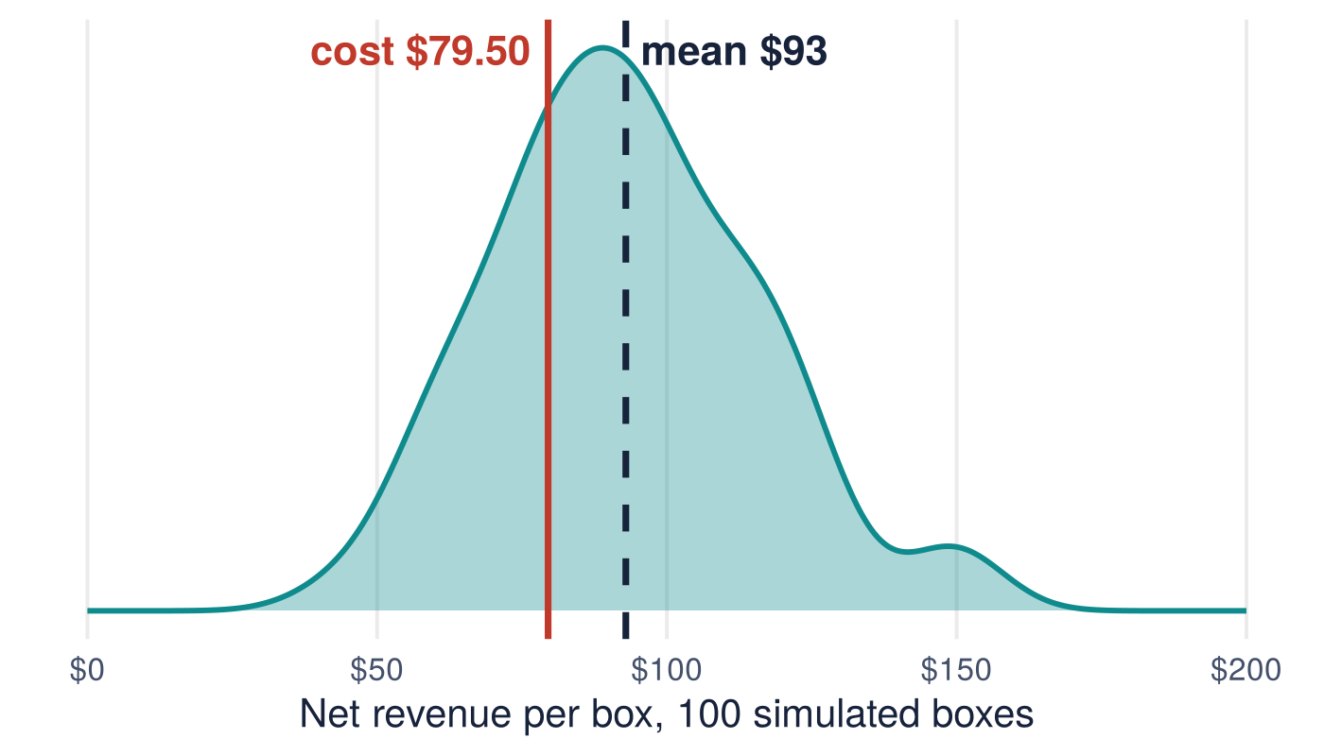
2018: the Guilds of Ravnica trade made money
$93
mean net revenue per box, cost $79.50
30%
of simulated boxes lost money
$74
max bid for an 80% chance of profit
100 simulated boxes, October 2018 prices, seed 2018. Net of below-market sales, bulk and 15% fees.
Notes:
Expected profit about $13 a box, so roughly $1,300 on 100 boxes, with real risk on any single box.

Slide 23
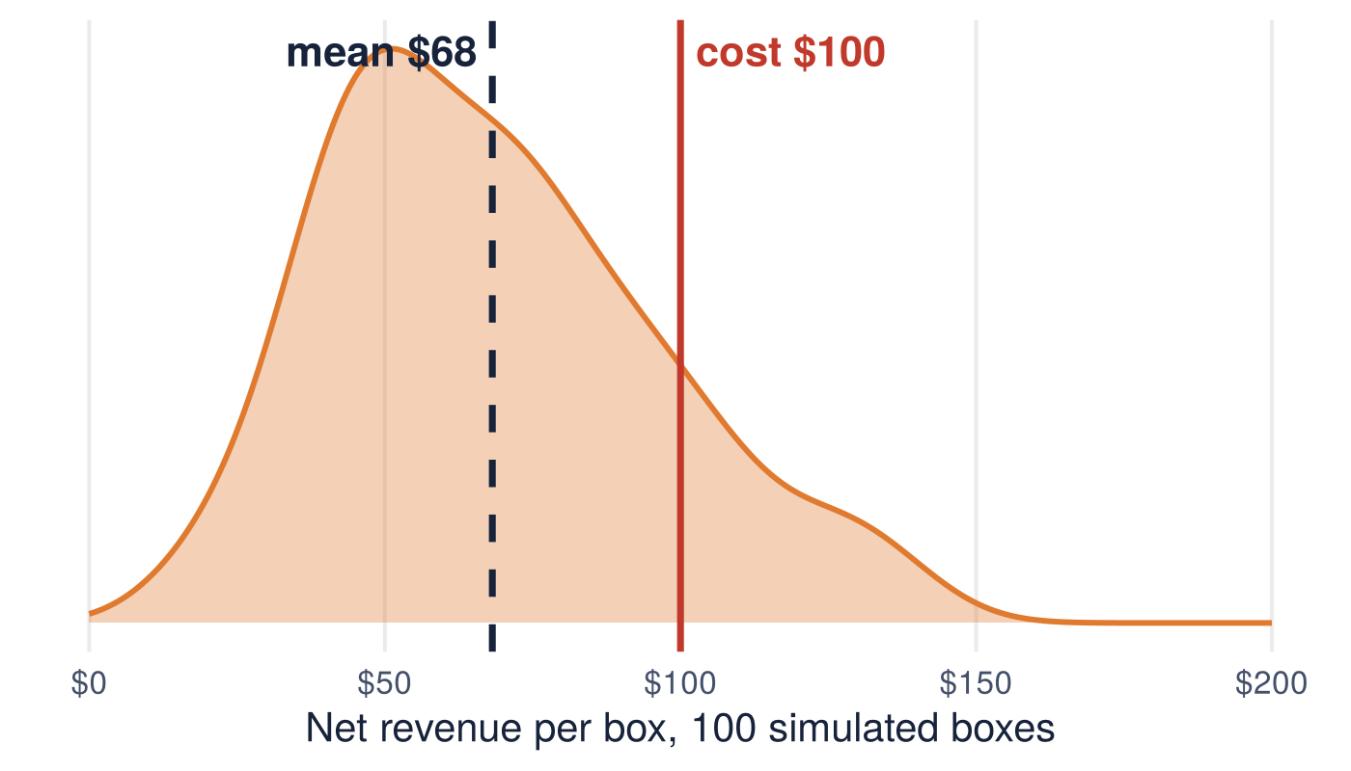
2026: Reality Fracture loses money if you open it
$68
mean net revenue per box, cost about $100
86%
of simulated boxes lost money
$43
max bid for an 80% chance of profit
100 simulated boxes, TCGplayer prices November 1, 2026, seed 2026. Same frictions as 2018.
Notes:
Same functions, new price list and pack structure. 100 boxes opened would lose about $3,200.

Slide 24
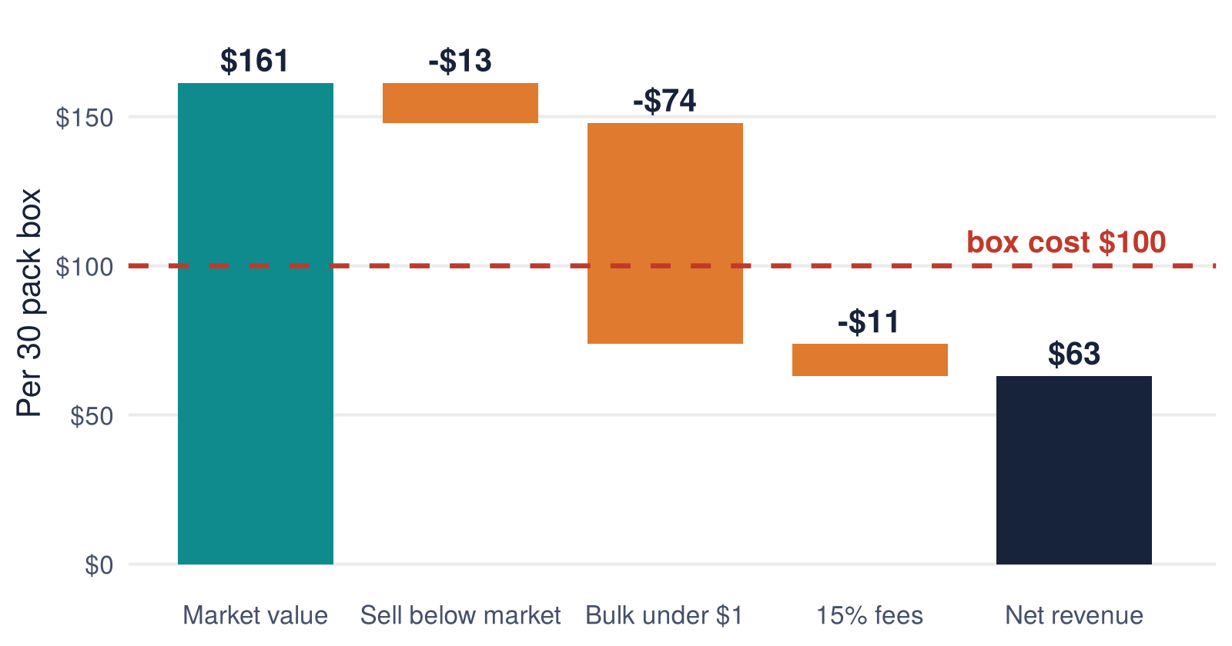
Where the money goes in one box
The box is worth $161 at market
Most of that value sits in cards under $1. Sold as bulk, they collect a few cents.
Bulk is the friction that kills the trade.
Average over 1,000 simulated boxes (30,000 packs).
Notes:
Ask: which friction would you attack first? Selling bulk smarter (playsets, lots) is a real business; that is the extend question in the script.

Slide 25
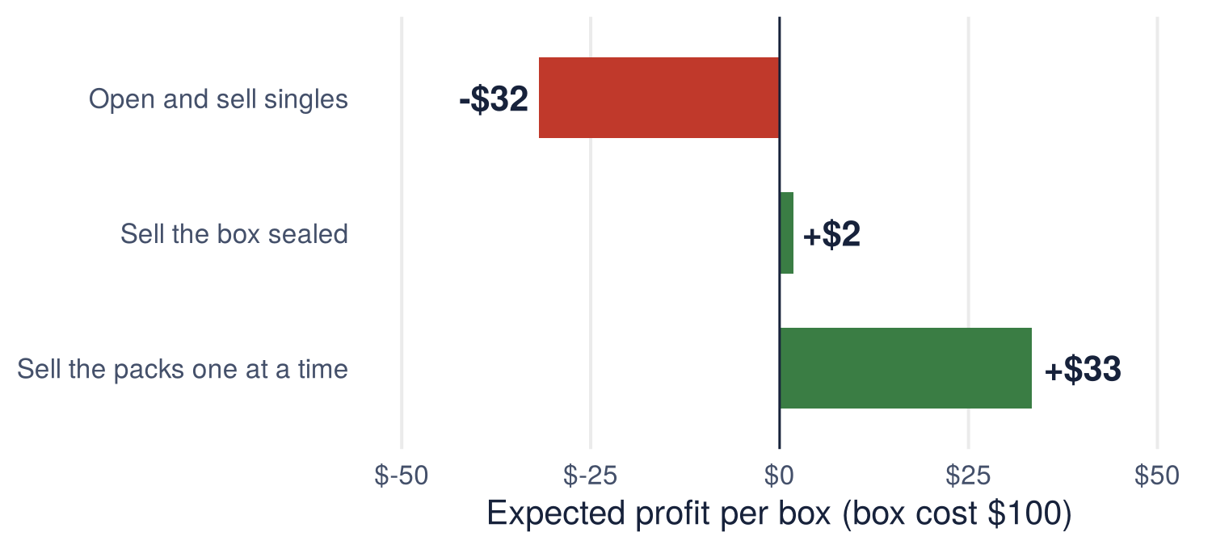
The decision: do not open it, sell it
 | 2018 | 2026
Cost per pack | $2.21 | $3.33
Open: profit per box | +$13 | -$32
Open: 100 boxes | +$1,341 | -$3,182
At about $100 wholesale, selling the 30 packs one at a time at $5.23 earns about $33 a box before your time.
Notes:
compareStrategies() output. Loose packs need foot traffic or a storefront; sealed resale barely breaks even. Sensitivity: change the wholesale price and the bulk price and see when opening wins again.

Slide 26




Your turn: build the functions
Pick your file
scripts/C_mtg_investment_BASIC_STUDENT.R fills blanks; C_mtg_investment_STUDENT.R writes the bodies from comments
Challenge
Which assumption moves the answer most: the 15% fee, the bulk price, or the low price discount? Loop over three values of one and record mean revenue per box. At what wholesale price would you buy 100 boxes?
Part 1, then Part 2
Replay the 2018 Guilds trade, then reuse the same functions on Reality Fracture
Work in pairs
One person types, one checks each function on a single pack before simulating
45 minutes
Stuck for five minutes? source() Z_mtg_functions.R and keep going
Notes:
Common misses: forgetting return(), passing crackPack() with parentheses into openBox(), and forgetting odds = odds for the Play Booster.

Slide 27




Then we open the real box
Predict
Write down what your pack is worth at market before you open it
$5.10
simulated market value of the average pack
Open and record
Enter each card’s collector number (bottom left) in the class sheet; tokens are T
$3.59
Compare
D_class_pack_opening.R prices our pulls and plots them against 1,000 simulated packs
the median pack: most packs are below average
1 in 4
Prizes
Best pack in the room, and the closest prediction
packs are worth more than the $5.23 a pack costs
Notes:
Ask before opening: should your guess be the mean or the median? The skew means most people will be disappointed and one or two will be thrilled. That is the whole lesson in one pack.

Slide 28

One box is one draw
Functions made 3,000 simulated packs cheap. The simulation, not the lucky pack, is what you invest on.
Day 1 | Non-traditional market making
Notes:
Tie back to the post-module assignment: master track students must write at least two custom functions.

Slide 29
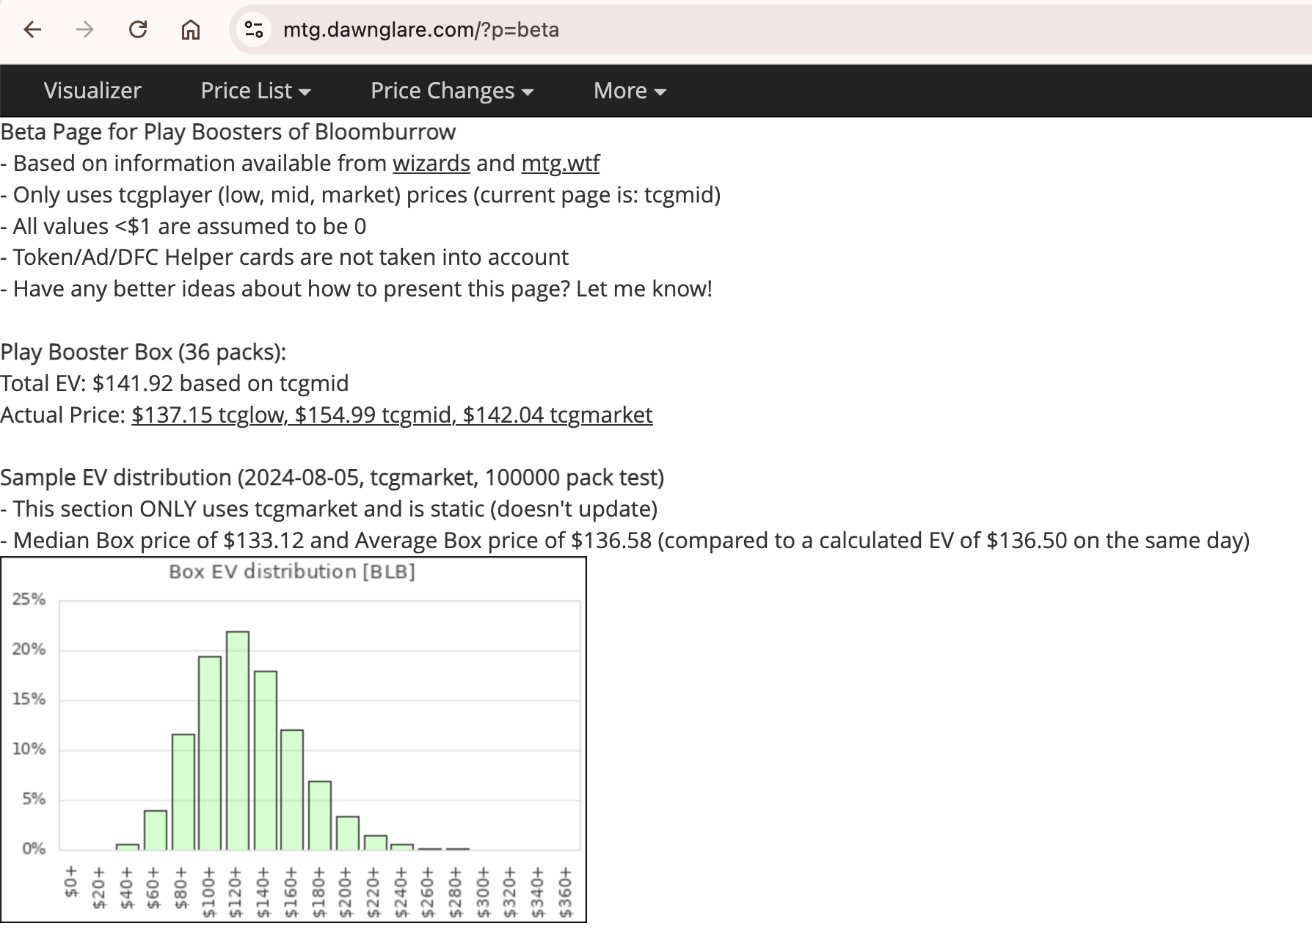
Appendix: price and odds sources
Prices: TCGplayer price guide, Near Mint market prices, retrieved November 1, 2026
Pack odds: Wizards of the Coast, "Collecting Reality Fracture"
2018 prices: Guilds of Ravnica list, October 16, 2018
Expected value calculators for other sets: mtg.dawnglare.com/?p=sets
Prices move daily; rerun the scripts with a fresh list before you buy
Notes:
Dawnglare publishes expected value per set; a good check on our simulation for older sets.

