Slide 1

Cultivating an Adaptive Mindset for the Data Driven Era
The tools change every few months. How you and your organization change is the durable skill.
Data Analytics in R | Day 2 | Ted Kwartler
Notes:
About 30 to 40 minutes, then straight into the PDCA exercise. Four parts: how fast AI moves, why value lags adoption, what classic change management teaches, and where each of us sits on the adoption spectrum.

Slide 2
Three years of AI video: same prompt, different world
Drop the 2023 video here
Insert > Video, then delete this box
Drop the 2026 video here
Insert > Video, then delete this box
2023
Will Smith eating spaghetti, ModelScope text to video
2026
The same test, Kling 3.0
The 2023 clip became a meme because it was so bad. The 2026 clip is hard to tell from real footage.
Notes:
Play both. Ask: if video went from this to this in three years, what happened to the tools in your own job over the same period? The 2023 clip was made with ModelScope in early 2023 and posted to Reddit; the 2026 version with Kling 3.0 circulated in February 2026.

Slide 3
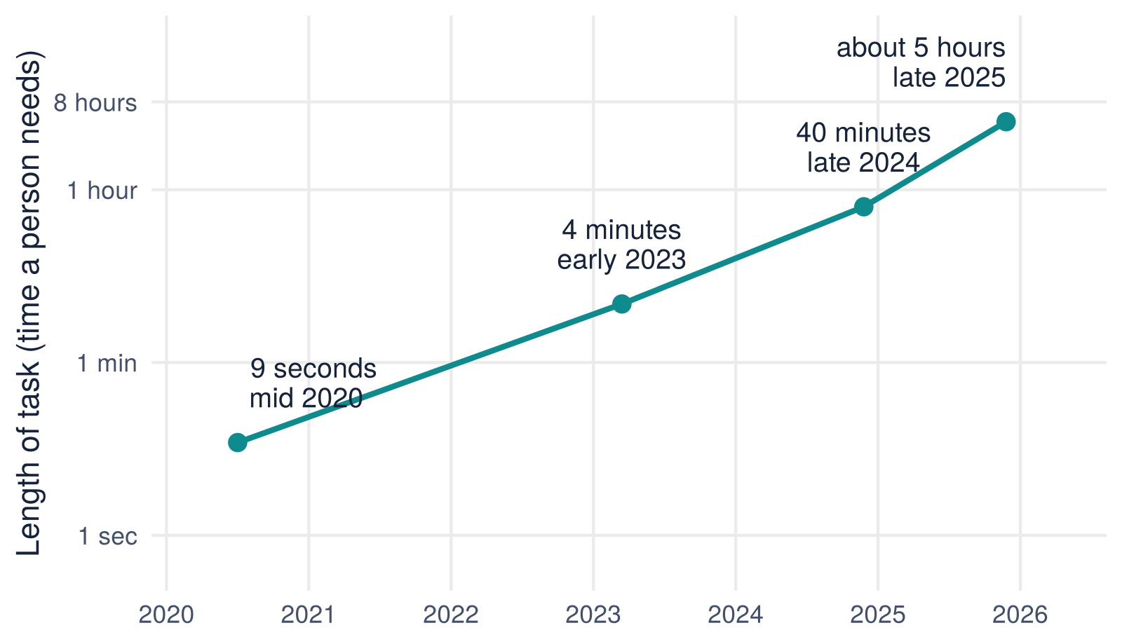
The length of task AI can finish keeps doubling
About 7 months
for the task length AI completes half the time to double (METR)
8.8% to 50%+
top score on Humanity’s Last Exam, early 2025 to April 2026
280x cheaper
cost of GPT-3.5 level answers, Nov 2022 to Oct 2024
Sources: METR via MIT Technology Review (Feb 2026), mostly software tasks, wide error bars; Stanford AI Index 2025 and 2026.
Notes:
Read the chart carefully: the y axis is how long a person would need for the task, not how long the model runs. Tasks are mostly coding, and models do worse on messy work. The point is the slope, not any single number.

Slide 4
What changed between the two spaghetti videos
 | 2023 | 2026
How you use it | Chat with a model; copy and paste the answer | Agents that use tools, browse, write and run code, and finish multi-step work
Longest task (METR) | About 4 minutes of human work | About 5 hours of human work
What it can read at once | A few thousand words | Whole codebases, contracts and report archives
Media | Text, early images, glitchy video | Photoreal video with sound, voice, images
Investment | $253 billion in AI (2024) | $581 billion in AI (2025)
Whatever you concluded about AI the last time you tried it is probably out of date.
Notes:
Investment figures from the Stanford AI Index 2026. Ask who last tried an AI tool on real work more than six months ago.

Slide 5
Adoption is easy; value is hard
88%
About 1 in 3
39%
6%
of organizations use AI in at least one function
have started scaling AI beyond pilots
report any EBIT impact; most say under 5%
are "high performers" with 5%+ of EBIT from AI
What the 6% do differently
They are nearly three times as likely to have fundamentally redesigned workflows, and more than three times as likely to aim for transformative change rather than incremental efficiency.
Source: McKinsey, The state of AI in 2025, survey published November 5, 2025.
Notes:
Same story as the Bramble+ exercise: having the dashboard is not the same as making the decision. Tools are cheap; redesigning how work gets done is the hard part.

Slide 6
We have seen this before: electricity took 40 years to pay off
1880s
Power stations open in New York and London
1900
Factories swap the steam engine for one big electric motor. Little changes.
1910s
Firms rebuild: single floor plants, a small motor at each machine, work laid out around the flow of materials, workers retrained
1920s
Manufacturing productivity grows more than 5% a year
The gain came from redesigning the factory, not from installing the motor. AI is the motor.
Paul A. David, "The Dynamo and the Computer," American Economic Review Papers and Proceedings, 1990.
Notes:
Bolting AI onto today’s process is the 1900 factory. Ask: what is the single floor plant version of your department?

Slide 7
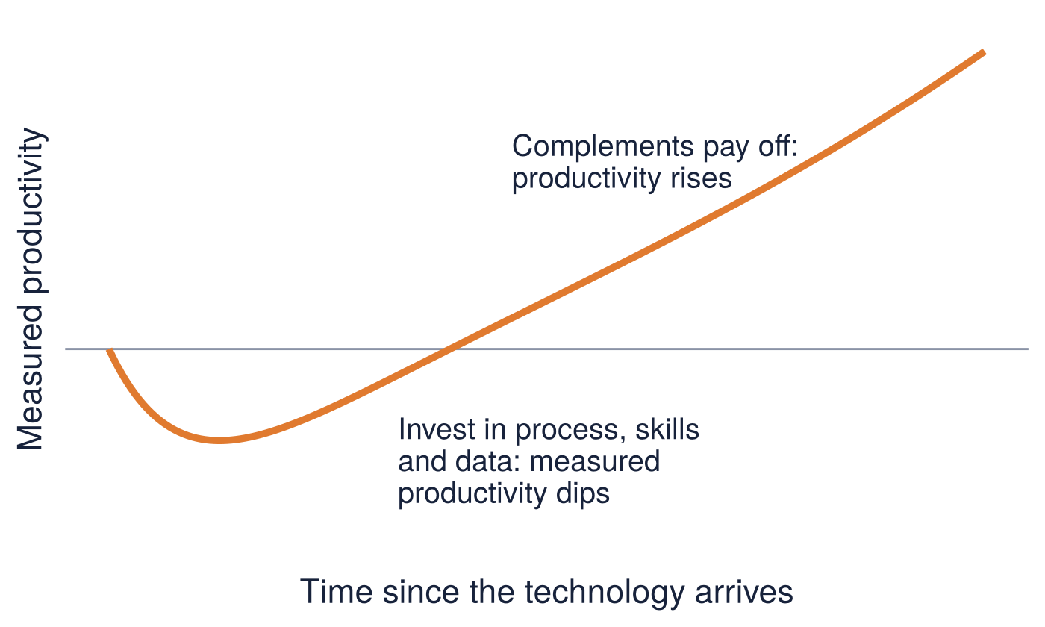
Expect a dip before the payoff: the productivity J-curve
Why the dip?
General purpose technologies need large hidden investments: new processes, skills, data and business models. Those cost time and money now and show up in the numbers later.
For managers
Judging an AI program in its first quarters measures the dip. Decide up front what leading indicators show the complements are being built.
Brynjolfsson, Rock and Syverson, "The Productivity J-Curve," American Economic Journal: Macroeconomics, 2021. Curve is illustrative.
Notes:
Connect to the skeptic persona later: early disappointment is expected, not proof the technology fails.

Slide 8
Everyone has a role with AI: creators, operators, consumers, innovators
AI creators
AI operators
AI consumers
AI innovators
Who
Data scientists, data engineers, software developers
Does
Build and validate models and AI products
Mindset it needs
Rigor: is it right, and how do we know?
Who
DevOps, IT, risk and compliance
Does
Deploy, monitor, secure and govern
Mindset it needs
Reliability: what happens when it fails?
Who
Business users, customers
Does
Use AI outputs in daily work
Mindset it needs
Judgment: when do I trust it, and when do I check?
Who
Senior executives, business strategy, analysts
Does
Decide where AI creates value and redesign work
Mindset it needs
Value: what should change, not just what can?
Most of this room are consumers today and innovators tomorrow. Which are you in your job right now?
Notes:
Same four roles as the AI workflow slide in the bias deck. The point: adaptive mindset is not only for technologists. Consumers need judgment, innovators need to redesign work.

Slide 9
Where does AI capability live? Three operating models
 | Centralized | Hub and spoke | Decentralized
How it works | One AI center of excellence builds and runs everything | A central hub sets standards, platforms and governance; embedded spokes build in the business | Each business unit hires and builds on its own
Strengths | Control, consistent standards, scarce talent pooled | Shared guardrails with local speed and business knowledge | Speed and closeness to the problem
Risks | Bottleneck; far from the business; "throw it over the fence" | Unclear decision rights between hub and spokes | Duplicated tools, uneven risk control, shadow AI
Fits when | Early and highly regulated | Scaling across many units | Mature, autonomous units
Many organizations move from centralized to hub and spoke as they scale. The model is a choice, not a default.
Notes:
Ask: which one does your organization run today, on purpose or by accident? Shadow AI is what decentralized looks like when nobody chose it.

Slide 10
AI literacy is now a requirement, not a perk
Understand
AI is probabilistic: 2 + 2 is "99.99% likely 4". Know what it is good at and where it fails.
EU AI Act, Article 4
Since February 2, 2025, organizations that provide or deploy AI in the EU must take measures to ensure sufficient AI literacy among the staff who operate and use it.
Use
Prompt, give context, and check the output before it reaches a customer.
Apply
Spot work worth redesigning and measure whether it got better.
Govern
Own the risk: data, accountability, bias and escalation.
Every role needs Understand and Use. Innovators also need Apply; operators need Govern.
Notes:
Vienna angle: this is already a legal obligation for students’ employers. Ask who has had any AI literacy training at work.

Slide 11
Classic change management: four models worth knowing
Model | Core idea | The AI era question
Lewin (1947) | Unfreeze, change, refreeze | What if it never refreezes because the tools change every quarter?
Kotter (1995) | Eight steps: urgency, coalition, vision, communicate, empower, short-term wins, consolidate, anchor in culture | Who is your guiding coalition, and what is the first visible win?
ADKAR (Hiatt, Prosci) | Each person moves through Awareness, Desire, Knowledge, Ability, Reinforcement | Which step is your team stuck on: desire or ability?
Bridges (1991) | Change is external; transition is psychological: an ending, a neutral zone, a new beginning | What are people losing, such as expertise or identity, and is it named?
Classic models assume a destination. With AI the destination keeps moving.
Notes:
Kotter first published the eight steps in Harvard Business Review in 1995 ("Leading Change: Why Transformation Efforts Fail") and expanded them in the 1996 book. ADKAR came from Prosci founder Jeff Hiatt in the 1990s. The right column is the discussion.

Slide 12
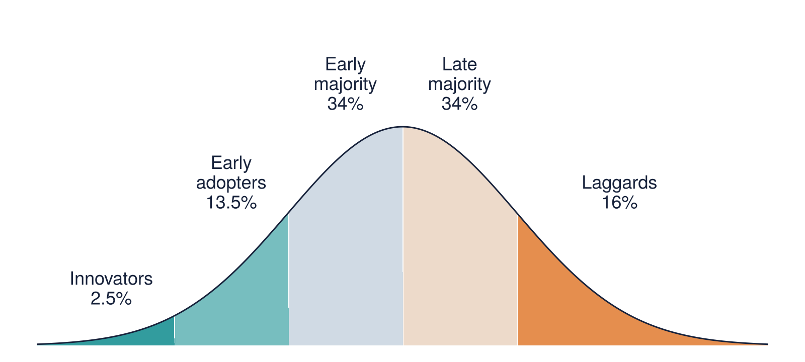
Technology adoption: people adopt at different speeds and for different reasons
Technology Acceptance Model
People adopt what they believe is useful and easy to use (Davis, 1989). Training fixes ease; only real use cases fix usefulness.
People, process, technology
Change one corner and the others must move too (Leavitt, 1965). Tools without process and skills change rarely sticks.
Rogers, Diffusion of Innovations (1962).
Your organization has all five groups. A rollout plan that works for innovators fails the late majority.
Notes:
Moore’s "chasm" sits between early adopters and the early majority: the pilots work, the rollout stalls. Ask where most of their colleagues sit on this curve.

Slide 13
Why AI strains the classic playbook
The target moves
Capabilities change every few months, so a plan written for this year’s tools is stale before rollout ends.
The frontier is jagged
AI is strong at some tasks and weak at others that look just as hard. Inside its abilities, knowledge workers performed up to 40% better; just outside, they were 19 points less likely to be right.
Adoption starts bottom up
Employees often use AI before policy exists. Leaders manage behavior that is already happening, much of it invisible.
Adaptive mindset: run small loops (Plan, Do, Check, Adjust) instead of one big change.
MIT Sloan, "What is the jagged AI frontier?"; Dell’Acqua, Kellogg, Lakhani, Mollick et al., "Navigating the Jagged Technological Frontier," 2023.
Notes:
This is the bridge to the exercise. Classic models still matter for people (ADKAR, Bridges), but the plan itself has to be iterative.

Slide 14
Mona Lisa: the jagged frontier
Mona Lisa slide
Placeholder for Ted’s example of the jagged nature of AI
Notes:
Mona Lisa slide: placeholder for Ted’s jagged frontier example. Delete the dashed box once the content is in.

Slide 15
Four mindsets you will meet, and may be
Resists
Embraces
The Skeptic
"It makes things up. It is a fad. It will come for my job."
The Tepid Tester
"I tried it for an email once. It was fine, I guess."
The Pragmatic Adopter
"I use it every week for three tasks, and I check the output."
The All In
"Automate everything. Agents first, people later."
Each one gets something right. Each one has a blind spot.
Notes:
Ask students to note silently which one they are, which one their boss is, and which one their team is. They will use this on the next slides.

Slide 16

Persona 1 of 4: The Skeptic
“It makes things up. It is a fad. It will come for my job.”
Reflect
What evidence would change your mind, and have you looked for it in the last six months?
Which of your objections were true in 2023 and are still true today?
If your team is already using AI without telling you, what is that costing you?
Gets right
Checks outputs, takes risk and accountability seriously.
Blind spot
Judges 2026 tools by 2023 experience, and the team adopts without them, often in secret.
Moves forward when someone shows evidence on their own work, not a demo.
Notes:
Give students a minute to write answers privately. Do not ask anyone to say which persona they are unless they volunteer.

Slide 17
Persona 2 of 4: The Tepid Tester
“I tried it for an email once. It was fine, I guess.”
Reflect
When did you last give AI a task you assumed it could not do?
Which recurring task would you hand over if the first draft were 80% right?
What would you need to learn to use it on real work this month?
Gets right
Experiments at low risk and stays open.
Blind spot
Never gets past toy tasks, so never sees real value; mistakes "I tried it" for "I learned it".
Moves forward with one real task and a little coaching.
Notes:
Give students a minute to write answers privately. Do not ask anyone to say which persona they are unless they volunteer.

Slide 18
Persona 3 of 4: The Pragmatic Adopter
“I use it every week for three tasks, and I check the output.”
Reflect
Which of your AI gains could a colleague reuse tomorrow, and have you shown them?
How do you know the output is right, and would that check work for 100 people?
What would change if you redesigned the whole process instead of one task?
Gets right
Ties use to real workflows and verifies results.
Blind spot
Personal gains that never spread; optimizes tasks instead of redesigning the workflow.
Moves forward by sharing and by redesigning the workflow, not just the task.
Notes:
Give students a minute to write answers privately. Do not ask anyone to say which persona they are unless they volunteer.

Slide 19
Persona 4 of 4: The All In
“Automate everything. Agents first, people later.”
Reflect
Where would an AI error hurt most, and who reviews it before it does?
What decision are you letting AI make that a person still needs to own?
Who on your team are you leaving behind, and what would bring them along?
Gets right
Brings urgency and ambition, and sees the transformation.
Blind spot
Over-trusts outside the jagged frontier, skips governance, and leaves people behind.
Moves forward by adding review, ownership and people to the speed.
Notes:
Give students a minute to write answers privately. Do not ask anyone to say which persona they are unless they volunteer.

Slide 20
Reflect: where are you, your team and your boss?
1
3 minutes alone
Place yourself, your team and your manager on the spectrum. Answer the questions for your own persona.
2
5 minutes in pairs
Share one answer. Your partner asks: what would move you one step to the right, or one step back toward caution?
3
2 minutes as a room
Show of hands: where is most of the room? Where do you think your employer is?
There is no right persona. The adaptive mindset is the willingness to move when the evidence moves.
Notes:
Ten minutes. If time is tight, skip the pairs and go straight to the show of hands.

Slide 21

Next: practice small loops
Plan, Do, Check, Adjust on a real business problem, with a disruption you will not see coming
PDCA group exercise, about 60 minutes
Notes:
Hand out scenario cards and sealed envelopes. Each group can take on the personas from their scenario card.

Slide 22
Sources
Brynjolfsson, Rock and Syverson (2021). The Productivity J-Curve. American Economic Journal: Macroeconomics 13(1).
Bridges, W. (1991). Managing Transitions.
David, P. A. (1990). The Dynamo and the Computer. American Economic Review 80(2).
Davis, F. D. (1989). Perceived usefulness, perceived ease of use, and user acceptance of information technology. MIS Quarterly.
Dell’Acqua, F., McFowland, E., Mollick, E., Lifshitz-Assaf, H., Kellogg, K., Rajendran, S., Krayer, L., Candelon, F. and Lakhani, K. (2023). Navigating the Jagged Technological Frontier. HBS Working Paper 24-013.
MIT Sloan. Working definitions: What is the jagged AI frontier?
European Union (2024). AI Act, Article 4: AI literacy, applicable from February 2, 2025.
Hiatt, J. (2006). ADKAR: A Model for Change. Prosci.
Kotter, J. (1995). Leading Change: Why Transformation Efforts Fail. Harvard Business Review; Leading Change (1996).
Leavitt, H. (1965). Applied organizational change in industry. Handbook of Organizations.
Lewin, K. (1947). Frontiers in Group Dynamics. Human Relations.
McKinsey (2025). The state of AI in 2025: Agents, innovation, and transformation.
MIT Technology Review (2026). This is the most misunderstood graph in AI (on METR time horizons).
Rogers, E. (1962). Diffusion of Innovations.
Stanford HAI (2025, 2026). AI Index Report.
TechRadar (2026). Will Smith eating spaghetti was peak AI chaos in 2023.

