Slide 1
Regression

Slide 2
Agenda
Start | End | Item
 |  | Regression in Action
 |  | Partitioning Data
 |  | Understanding Regression (simple univariate)
 |  | Build & Evaluate a Multiple Linear Regression
 |  | Housekeeping

Slide 3
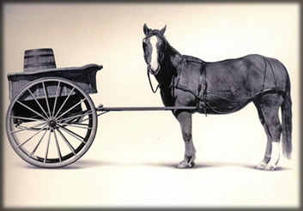
Let’s Practice
Open A_Regression.R
Predict Diamond Prices with linear regression.

Slide 4


Slide 5
Agenda
Start | End | Item
 |  | Regression in Action
 |  | Partitioning Data
 |  | Understanding Regression (simple univariate)
 |  | Build & Evaluate a Multiple Linear Regression
 |  | Housekeeping

Slide 6
The Problem of Overfitting
Statistical models can produce highly complex explanations of relationships between variables
The “fit” may be excellent
When used with new data, models of great complexity may do not do so well.
Notes:
6

Slide 7
100% fit – not useful for new data
Notes:
7

Slide 8
Another view of overfitting to a problem…

Slide 9
Overfitting, continued.
Causes:
Too many predictors start to inject noise not signal
Not adhering to a priori partitioning – up next
Lack of data knowledge & problem understanding
Consequence: Deployed model will not work as well as expected with completely new data.

Slide 10
Minimize Overfitting - Partitioning
Divide data into training portion and validation portion
Test model on the test portion
Training Data
All Data
Test Data
Notes:
How do you want to “spend” data

Slide 11
Minimize Overfitting - Partitioning
Divide data into training portion , validation & test portions
Tune a model and/or compare models with the validation portion
The “true” way a model will behave when launched on new data.
Training Data
All Data
Validation
Data
Test Data
Notes:
How do you want to “spend” data

Slide 12
Best Practice
If you have enough data and the model impact is large, this is a good partitioning schema
However, this much effort is seldom undertaken.
Feature Engineering
Data
Training Data
All Data
Validation Data
Test Data
Notes:
How do you want to “spend” data
For large data – production, 10% improvement = $500M; 10% overfitting = $-500m
Additional layer of partitionoing CV discussed later

Slide 13
Review
Data Mining:
Supervised - Classification & Prediction
Unsupervised- Association Rules, Data Reduction, Data Exploration & Visualization
Before algorithms can be applied, data must be explored then pre-processed (treated)
To evaluate performance and to avoid overfitting, data partitioning is used
Models are fit to the training partition and assessed on the validation and test partitions
Today’s lesson explores partitioning and simple prediction.

Slide 14
Supervised Learning
Goal: Predict a single “target” or “outcome” variable
Training data, where target value is known
Score to data where value is not known
Methods: Classification and Prediction

Slide 15
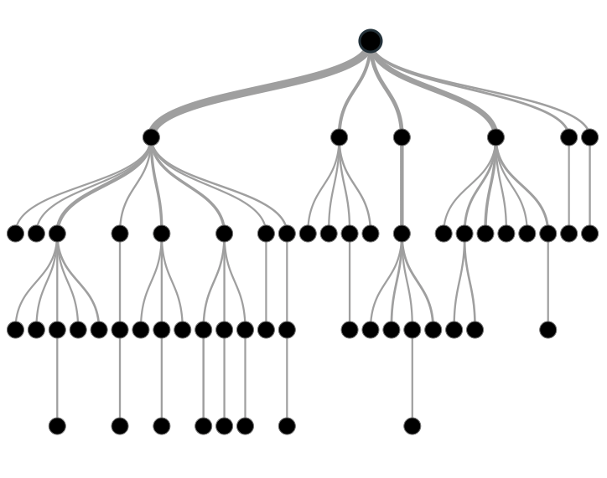

Supervised Learning
Inferring a function from labeled data.
“Learn from telling”, “Look at my data and I will tell you what to predict”
Data Setup
Algorithm
Business Context
Application
Marketing-Will a customer buy yes or no? How much will a customer spend?
Operations- Will an applicant default? When will a machine break?
Sports Analytics- How many points will the Bears’ QB score? What is the Bears’ probability of winning?
Requires expertise and stakeholder buy in
Flat “Excel” file. Each row is a record or observation. Each column is an attribute of the record.
One column is the outcome, y or target attribute.
Modeling e.g. K-NN, linear regression, decision tree, random forest etc.
Use the model to make predictions for the target label on the new data.

Slide 16
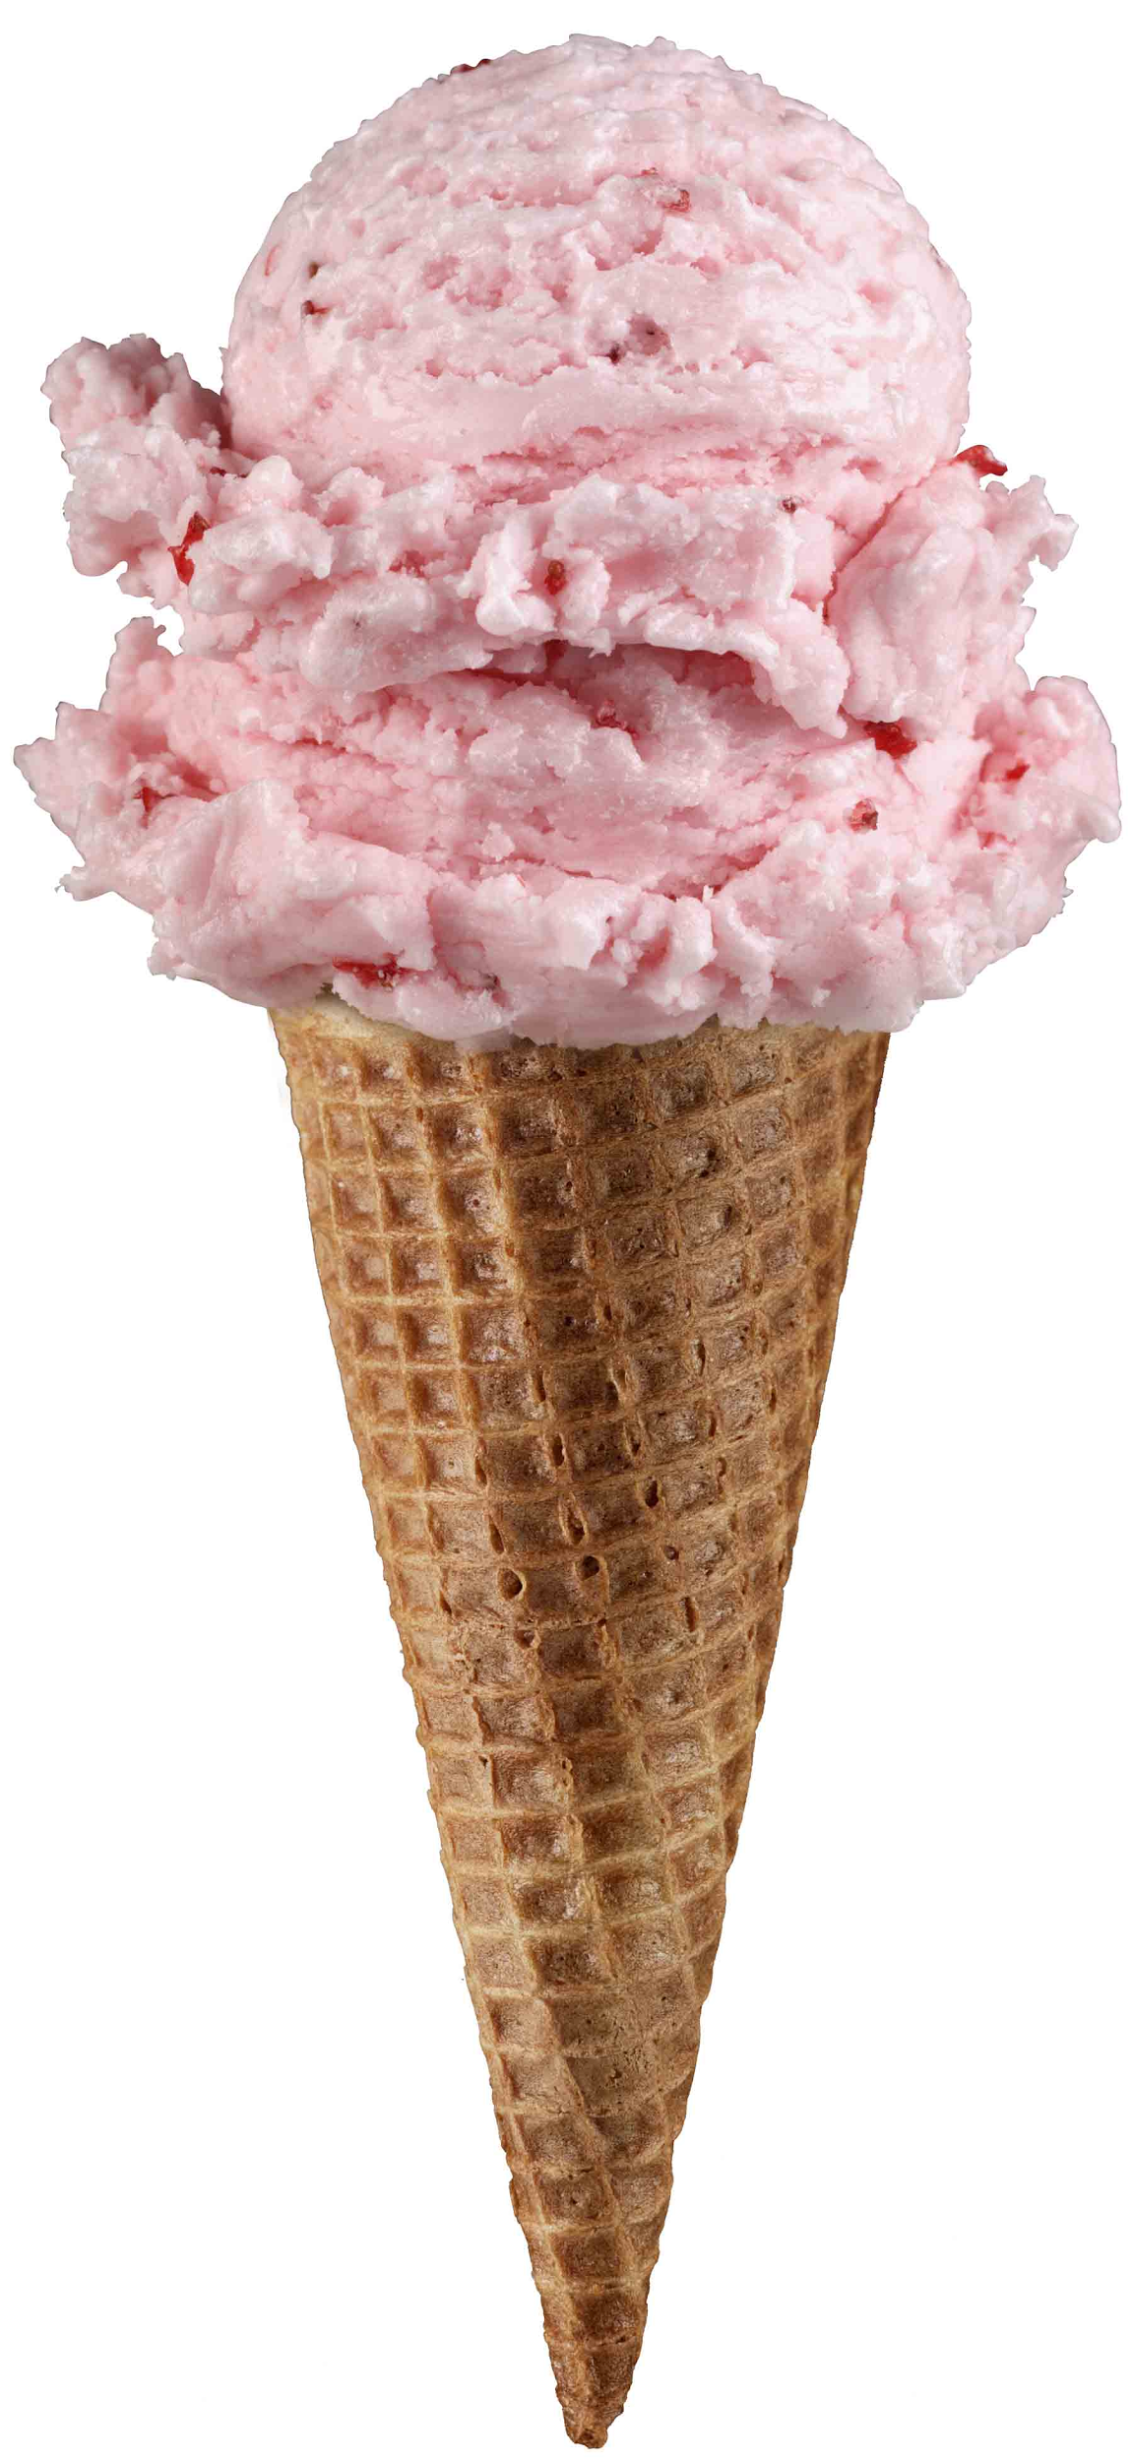
Supervised Learning Example
Inferring a function from labeled data.
“Learn from telling”, “Look at my data and I will tell you what to predict”
What impacts ice cream sales?
#
=ƒ(…)
Notes:
Just did carat to diamond prices
Now let’s add more than 1 input

Slide 17
Linear Regression for continuous outcomes
#
= $β$ + ($β$*temperature) + ($β$*day) + ($β$*price) + error
Some linear combination of temperature values, day of the week dummy variables and price estimate the number of cones that will sell.
Notes:
What should we expect the beta signs to be? Whats the relationship the information has with ice cream sales?
Temp goes up? Sales go up. Temp goes down? Sales go down. Positive relationship
Price goes up? Sales go down. Price goes down? Sales go up. Negative relationship

Slide 18

The linear combination equation captures information
outcome
coefficients
constant
error (noise)
predictors

Slide 19
The linear combination equation captures information
Outcome:
The “dependent”, “y” or “target”.
Number of Ice Cream Cones

Slide 20
The linear combination equation captures information
Constant:
The “intercept” or “beta-naught” has no predictor associated with it.
Avg. Number of Ice Cream Cones expected to sell if predictors were all 0.

Slide 21
The linear combination equation captures information
Predictors:
The “informative features”, “x” or “independent” variables.
Variables affecting sales in the data, temp, day, & price.

Slide 22
The linear combination equation captures information
Coefficients:
The “weight”, “betas” or “coefficients” multiplied with the specific “x” variable value.

Slide 23
The linear combination equation captures information
Error:
The “error” or “noise” represents the value the equation is wrong compared to the actual Y.

Slide 24
The linear combination equation captures information
outcome
coefficients
constant
error (noise)
predictors
The combinations of beta coefficients seeks to minimize the squared errors between the actual Y values and the equation. This combination manifests as the “best fit line”

Slide 25
#
= $6$ + 0.$25$*temperature + $3$*satudray_dummy + -0.5*price
Beta-Naught | Temperature | Saturday_dummy | Price
6 | 0.25 * 80 degrees | 3 * 1 | -0.5 * 5
5 | 0.25 * 88 | 3 * 0 | -0.5 * 2

Slide 26
#
= $6$ + 0.$25$*temperature + $3$*satudray_dummy + -0.5*price
Beta-Naught | Temperature | Satuday_dummy | Price | Best Fit Prediction
6 | 0.25 * 80 degrees | 3 * 1 | -0.5 * 5 | 26.5
6 | 0.25 * 88 | 3 * 0 | -0.5 * 2 | 27

Slide 27
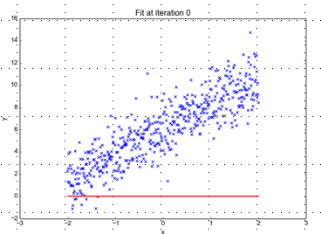
Minimizing the Sum of Ordinary Least Squared Errors
Equation:
Y= 0 +(0*x)
Beta “Naught” = 0
Intercept is 0
X beta coefficient = 0
No slope
Blue points Y Values represent actual outcome.
MINUS
Red line is the predicted outcome
Equals the Error

Slide 28
Big Errors
Equation:
Y= 0 +(0*x)
Beta “Naught” = 0
Intercept is 0
X beta coefficient = 0
No slope
Blue points Y Values represent actual outcome.
MINUS
Red line is the predicted outcome
Equals the Error

Slide 29
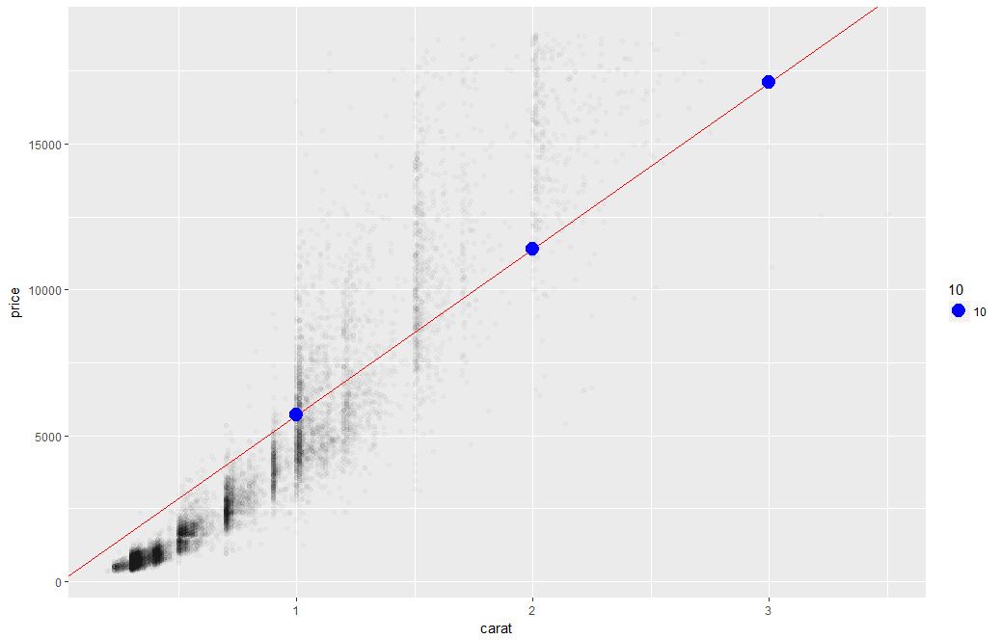
What’s really going on?
Errors between a prediction and actual.
Notice some are negative and some are positive

Slide 30
Why Squared Error?
Blue points Y Values represent actual outcome.
MINUS
Red line is the predicted outcome
Equals the Error
Cones
85
48
45
27
32
30
69
80
15
61
Prediction
67
42
54
95
1
48
51
95
20
22
Error
18
6
-9
-68
31
-18
18
-15
-5
39
-3
(18 + 6 + -9 + -68 + 31 + -18 + 18 + -15 + -5 + 39)
Notes:
Is this a good model?
18 + -18 cancel each other out

Slide 31
Why Squared Error?
Without squaring the errors positive & negative prediction errors cancel each other out.
(18² + 6² + -9² + -68² + 31² + -18² + 18² + -15² + -5² + 39²)
8445
324 + 36 + 81+ 4624 + 961 + 324 + 324 + 225 + 25 + 1521
Squaring the error means all errors have the same impact on the optimization function.
Notes:
Is this a good model?
18 + -18 cancel each other out

Slide 32
So what is really going on?
The algorithm is optimizing the inputs and weights (beta’s) to minimize the sum of squared errors.
This is called “ordinary least squares (OLS).

Slide 33
Let’s Practice
Open C_Regression_v1.R

