Slide 1
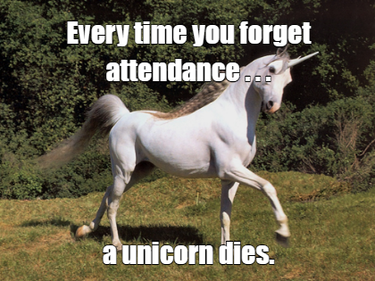

Slide 2
Text Mining & NLP ElasticNet Regression
Ted Kwartler

Slide 3
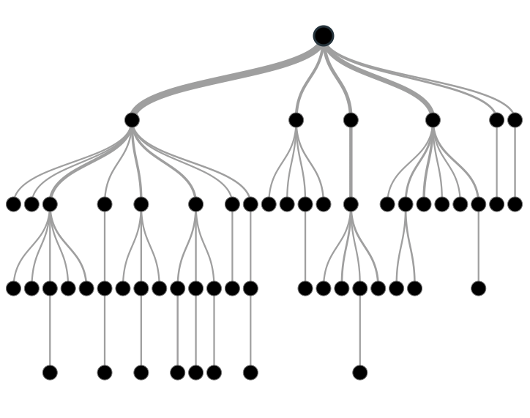

Supervised Learning
Inferring a function from labeled data.
“Learn from telling”, “Look at my data and I will tell you what to predict”
Data Setup
Method
Business Examples
Application
Marketing-Will a customer buy yes or no? How much will a customer spend?
Operations- Will an applicant default? When will a machine break?
Flat “Excel” file. Each row is a record or observation. Each column is an attribute of the record.
One column is the outcome, y or target attribute.
Modeling e.g. K-NN, linear regression, decision tree, random forest etc.
Make predictions for the target on the new data.

Slide 4
Modeling Process
SEMMA
In this course…
1. Sample
For elasticNet we will do random sampling
2. Explore
Very basic EDA to get familiar w/data but more needs to be done in reality
3. Modify
Bag of Words organization as a modeling matrix
4. Model
Other methods exist but we only use LASSO
5. Assess
Measure Accuracy but there are others

Slide 5
Sampling Step: Basic Partitioning Schema
Divide data into training portion and validation portion
Test model on the validation portion
Training Data
All Data
Test Data
Notes:
How do you want to “spend” data

Slide 6
Good for prod deployments
Divide data into training portion , validation & test portions
Tune a model and/or compare models with the a validation portion
The “true” way a model will behave when launched on new data.
Training Data
All Data
Validation
Data
Test Data
Notes:
How do you want to “spend” data

Slide 7
Best Practice when doing very robust analysis
If you have enough data and the model impact is large, this is a good partitioning schema
However, this much effort is seldom undertaken.
Feature Engineering
Data
Training Data
All Data
Validation Data
Test Data
Notes:
How do you want to “spend” data
For large data – production, 10% improvement = $500M; 10% overfitting = $-500m
Additional layer of partitionoing CV discussed later

Slide 8
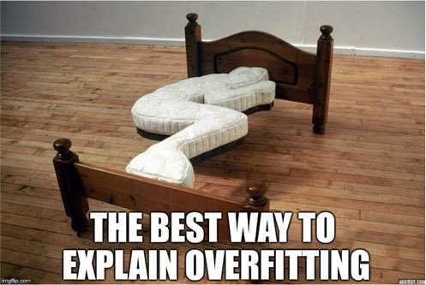
Why perform sampling?

Slide 9
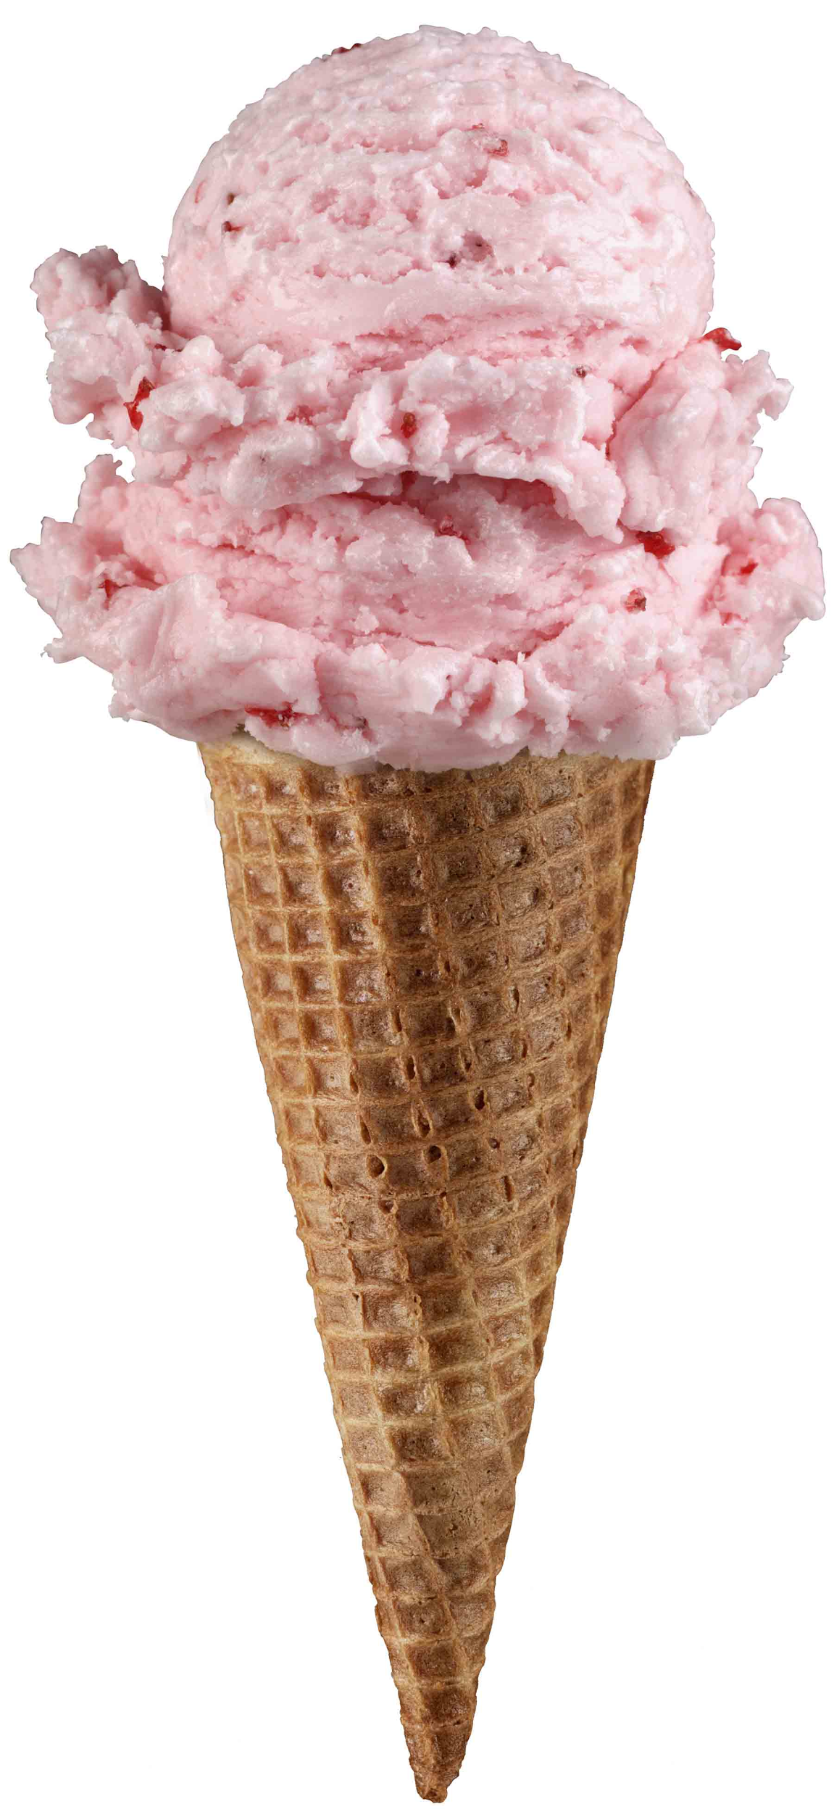
Supervised Learning Example
Inferring a function from labeled data.
“Learn from telling”, “Look at my data and I will tell you what to predict”
What impacts ice cream sales?
#
=ƒ(…)

Slide 10
Linear Regression for continuous outcomes
Some linear combination of temperature values, day of the week dummy variables and price estimate the number of cones that will sell.
#
= $β$ + ($β$*temperature) + ($β$*day) + ($β$*price) + error
Notes:
What should we expect the beta signs to be? Whats the relationship the information has with ice cream sales?
Temp goes up? Sales go up. Temp goes down? Sales go down. Positive relationship
Price goes up? Sales go down. Price goes down? Sales go up. Negative relationship

Slide 11

The linear combination equation captures information
outcome
coefficients
constant
error (noise)
predictors

Slide 12
Regression Equation Review
Regression
How Many Cones?
#
= $β$ + $β$*temperature + $β$*day + $β$*price + error

Slide 13
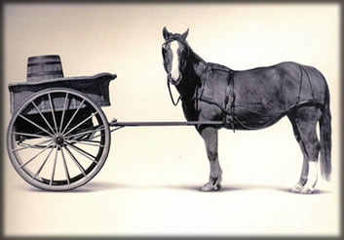
Let’s Practice
Open A_Regression_Cart_before_Horse.R
Predict Diamond Prices with linear regression.

