Slide 1

Open C_lm_for classes.R

Slide 2

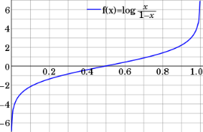
Step 1: Logistic Response Function
Regression
How Many Cones?
#
= $β$ + $β$*temperature + $β$*day + $β$*price + error
Logistic Regression
Will they buy a cone Y/N?
Logit of
= $β$ + $β$*temperature + $β$*day + $β$*price + error
We will let R handle calculating the equation output logOdds to the more understandable probability of an event.
Notes:
Logit = log odds = logarithm of the odds p/(1 − p)
Ln(p/(1-p) = b0 + b1 + b2 …e
P is defined as the probability that Y=1 then we take the log odds

Slide 3
Logistic Regression
Extends idea of linear regression to situation where outcome variable is categorical
Instead of ordinary least squares, β are derived through an iterative process called maximum likelihood estimation
We focus on binary classification
i.e. Y=0 or Y=1

Slide 4
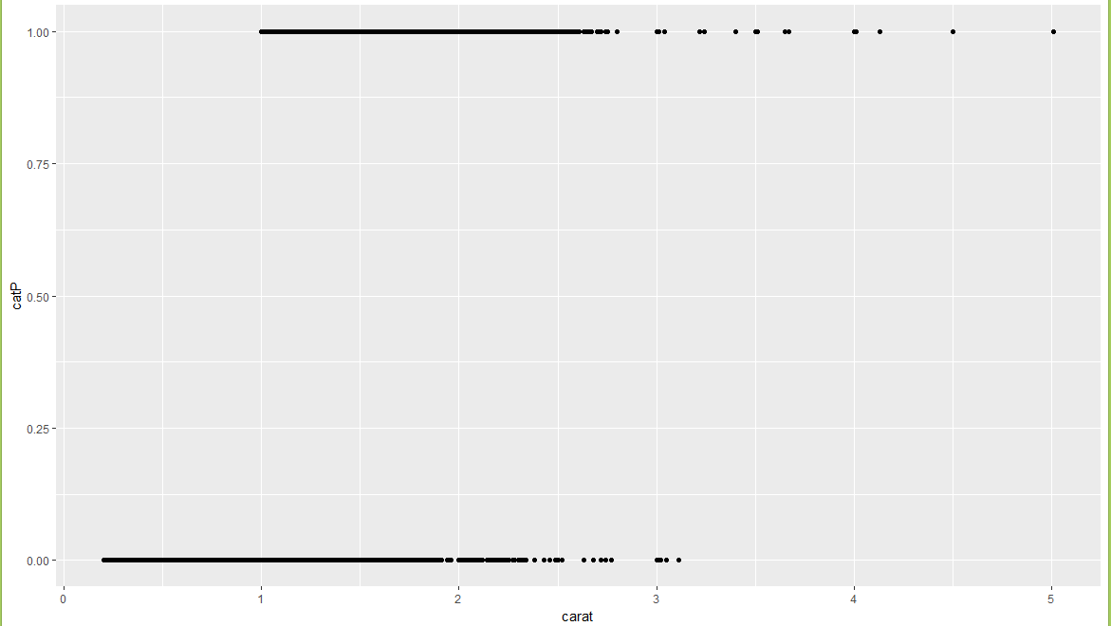
A binary relationship between carat and price
Diamonds above or below $11K

Slide 5
A binary relationship between carat and price
Diamonds above or below $11K
“is this diamond worth more than $11K or not.” Predicting 2 means 2 yes’es?

Slide 6
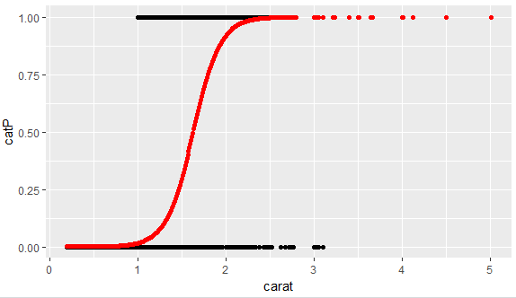
1.
What is the log-odds of the price above $11K? = Beta + Beta*Carat
2. Convert to probability with logistic response function (e^l / (1+e^l)
3. The probabilities are more intuitive than the log-odds from the equation.

Slide 7

NCAA Classification Madness
Objective: Identify the probability of a team winning in Round 1.
College Basketball
Annual 64 team tournament
Business Impact:
$1B wagered
$2B in lost productivity
Bragging Rights

Slide 8

My friend Mandy is next level.
https://fivethirtyeight.com/features/how-a-data-scientist-whod-never-heard-of-basketball-mastered-march-madness/

Slide 9

D_fullyMarchMadnessREVISED.R

