Slide 1
ID 3 Clusters
Select US State Fuel Cost (x) vs Sales (y)

Slide 2
Intuition for 3 clusters…
Select US State Fuel Cost (x) vs Sales (y)
low cost &
high sales
Mid cost &
Mid sales
High cost &
high sales

Slide 3

K-Means Unsupervised
Previous slide clustering was done by “eye”
“K” clusters are defined by practitioner
Need a defined distance measure between record
Euclidean Distance (common but not great for text)
Scale each vector to so one unit of measure doesn’t dominate ie # of rooms in a house vs sq-Meter of house

Slide 4
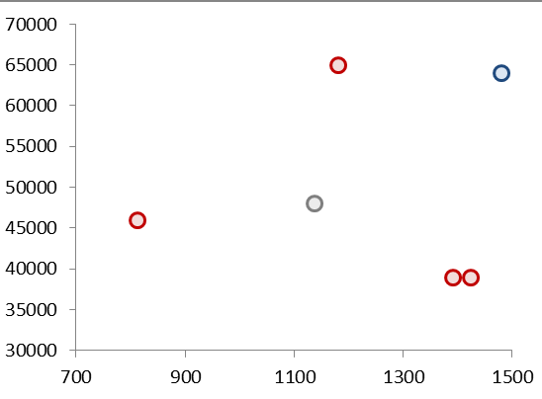
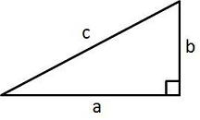
Quick Refresher
Remember Pythagorean Theorem?
Example Data
A²+B²=C²
b
c
a

Slide 5
K Means
Select US State Fuel Cost (x) vs Sales (y)
2
1
3
Random centroid placement

Slide 6
K Means
Select US State Fuel Cost (x) vs Sales (y)
2
1
3
Calculate the distance from each point to each centroid

Slide 7
K Means
Select US State Fuel Cost (x) vs Sales (y)
2
1
Cluster “3”
3
Cluster “1”
Pts assigned to closest centroid.

Slide 8
K Means
Select US State Fuel Cost (x) vs Sales (y)
2
1
Cluster “2”
Cluster “2”
Cluster “2”
Cluster “3”
3
Calculate the MEAN AVERAGE distance among assigned pts to centroid

Slide 9
K Means
Select US State Fuel Cost (x) vs Sales (y)
2
2
1
3
3
1
Move the centroid to the average distance among all assigned points

Slide 10
K Means
Select US State Fuel Cost (x) vs Sales (y)
2
Since “3” moved, this pt is assigned to “2”
3
1
Pt reassignment affects the avg distances so the process repeats…

Slide 11
K Means
Select US State Fuel Cost (x) vs Sales (y)
2
2
1
2
3
3
1
1
The new pt assignments again moves the centroid. The process repeats until no reassignments occur after moving the centroids (convergence).

Slide 12
K Means
Select US State Fuel Cost (x) vs Sales (y)
2
3
1
The new pt assignments again moves the centroid. The process repeats until no reassignments occur after moving the centroids (convergence).

Slide 13
K-Means Unsupervised
Previous slide clustering was done by “eye”
“K” clusters are defined by practitioner
Need a defined distance measure between record
Euclidean Distance (common but not great for text)
Scale each vector to so one unit of measure doesn’t dominate ie # of rooms in a house vs sq-Meter of house
Because it is the mean average all data attributes must be numeric (non factor ie what is the average of “blue eyes” or “medium” or “first”. Luckily w/text this is not an issue!

Slide 14

Try it out!
Open C_kmeans.R

Slide 15
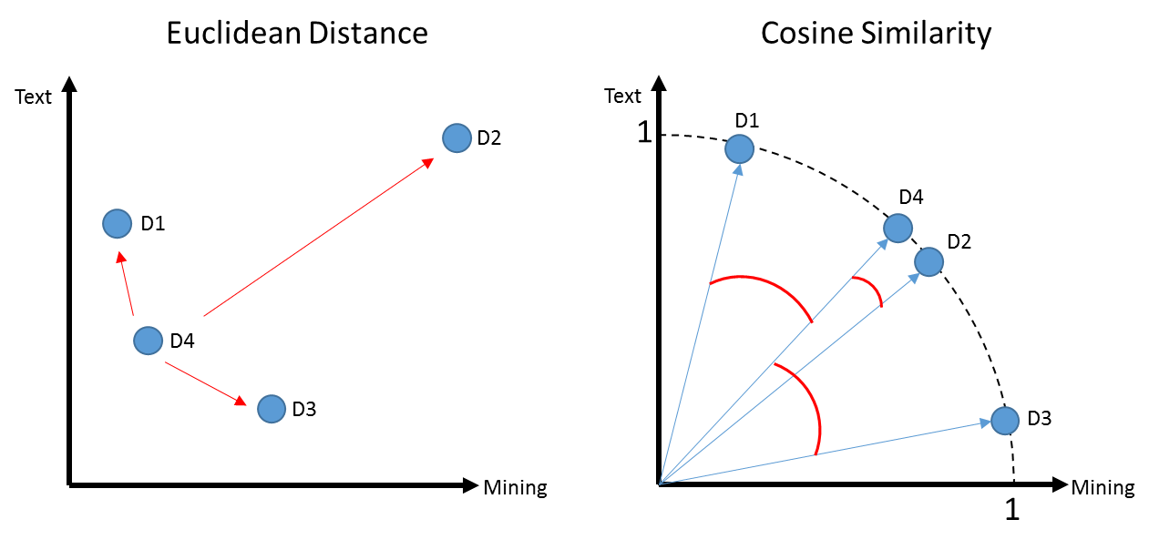
K-Means Problems
Computationally intensive (non-parametric)
Centroid will be greatly affected by an outlier
In this example a centroid would be “pulled” away from the actual cluster D1,D4 & D3

Slide 16

K- Mediod Clustering
Same steps as K-Means but instead of mean averages, uses the median distance to move centroids
Less impacted by outliers
Mean of 1,2,3,4,5,60 = 12.5
Median of 1,2,3,4,5,60 = 3.5 (closer to more points in vector space)
Open D_kmediods.R

Slide 17
K Means Vs Spherical K-Means
D1 a book for aspiring authors referring to “text” a lot
D2 & D4 refer to “text” and “mining” in equal proportions like the course book
D3 refers to “mining” ie minerals
D1, D4, D3 probably appear as 1 cluster w/D2 standing alone

Slide 18
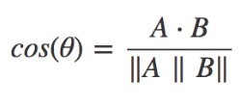
Another way to measure distance
Euclidean: How dissimilar are documents?
Cosine: How similar are documents?
 | Doc1 | Doc2
Term1 | 1 | 0
… | 0 | 1
… | 3 | 2
… | 6 | 6
… | 7 | 1
… | 0 | 0
Starting with a numeric Vector Representation from tokens
1. Calculate the “dot product” of the vectors:
(1*0) + (0*1) + (3*2) + (6*6) + (7*1) + (0*0)
0 + 0 + 6+ 36+ 7+ 0 = 49

Slide 19
Another way to measure distance
Euclidean: How dissimilar are documents?
Cosine: How similar are documents?
 | Doc1 | Doc2
Term1 | 1 | 0
… | 0 | 1
… | 3 | 2
… | 6 | 6
… | 7 | 1
… | 0 | 0
Starting with a numeric Vector Representation from tokens
Doc1: 1,0,3,6,7,0
Doc2: 0,1,2,6,1,0
Rearranged to follow more easily.
1. Calculate the “dot product” of the vectors:
(1*0) + (0*1) + (3*2) + (6*6) + (7*1) + (0*0)
0 + 0 + 6+ 36+ 7+ 0 = 49

Slide 20
Another way to measure distance
Euclidean: How dissimilar are documents?
Cosine: How similar are documents?
Starting with a numeric Vector Representation from tokens
Doc1: 1,0,3,6,7,0
Doc2: 0,1,2,6,1,0
Multiply each corresponding value
1. Calculate the “dot product” of the vectors:
(doc1: 1 * doc2: 0) + (doc1: 0 * doc2: 1) + (doc1: 3 * doc2: 2) +
(doc1: 6 * doc2: 6) + (doc1: 7 * doc2: 1) + (doc1: 0 * doc2: 0)
0 + 0 + 6+ 36+ 7+ 0 = 49

Slide 21
Cosine
1. Calculate the “dot product” of the vectors:
(1*0) + (0*1) + (3*2) + (6*6) + (7*1) + (0*0)
0 + 0 + 6+ 36+ 7+ 0 = 49
2. Calculate the magnitude for a documents
Doc1: 1,0,3,6,7,0
Doc2: 0,1,2,6,1,0
Multiply each value to itself; sum up each doc; get sqrt
Multiply each value to itself; sum up each doc; get sqrt
Multiply single vector value

Slide 22
Cosine
1. Calculate the “dot product” of the vectors:
(1*0) + (0*1) + (3*2) + (6*6) + (7*1) + (0*0)
0 + 0 + 6+ 36+ 7+ 0 = 49
2. Calculate the magnitude for a documents
Doc1: 1,0,3,6,7,0
Doc2: 0,1,2,6,1,0
Multiply each value to itself; sum up each doc; get sqrt
Multiply each value to itself; sum up each doc; get sqrt
Multiply single vector value
Doc1: (1*1) + (0*0 )+ (3*3) + (6*6) + (7*7 )+ (0*0)
1 + 0 + 9 + 36 + 49 + 0 = 95
Sqrt(95) = 9.7
Doc2: (0*0)+(1*1)+(2*2)+(6*6)+(1*1) + (0*0)
0 + 1 + 4 + 36 + 1 + 0 = 42
Sqrt(42) = 6.4
9.7 * 6.4 = 63.1

Slide 23
Cosine
1. Calculate the “dot product” of the vectors:
(1*0) + (0*1) + (3*2) + (6*6) + (7*1) + (0*0)
0 + 0 + 6+ 36+ 7+ 0 = 49
2. Calculate the magnitude for a documents
Doc1: (1*1) + (0*0 )+ (3*3) + (6*6) + (7*7 )+ (0*0)
1 + 0 + 9 + 36 + 49 + 0 = 95
Sqrt(95) = 9.7
Doc2: (0*0)+(1*1)+(2*2)+(6*6)+(1*1) + (0*0)
0 + 1 + 4 + 36 + 1 + 0 = 42
Sqrt(42) = 6.4
9.7 * 6.4 = 63.1
3. Distance Measure: 49 / 63.1 = 0.77
Value will always be between 0,1.

Slide 24
Spherical K-Means
Euclidean: How dissimilar are documents?
Cosine: How similar are documents?
Uses cosine similarity to calculate distance
Values are normalized to 0,1
Cosine is measuring similarity…so a value of 0 means orthogonal (independent)
These are similar docs i.e cosine similarity is closer to 1
Using cosines now D4, D2 represent a cluster as expected and you may have to declare add another K

Slide 25
Side by Side
Big distance D4 to D2 means they are dissimilar
Distance is between 0 to inf.
Higher value means bigger distance.
D4 to D2 Small angle distance means they are similar.
Distance is between 0 to 1.
Higher value means smaller distance.
i.e. 1 to 1 for division is a duplicate document!

Slide 26
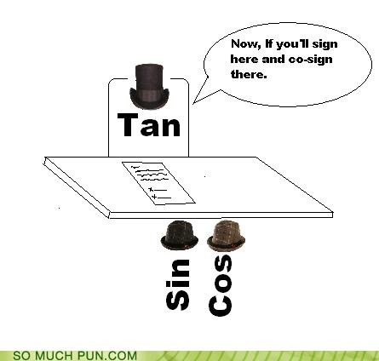
Open E_spherical_kmeans.R

Slide 27

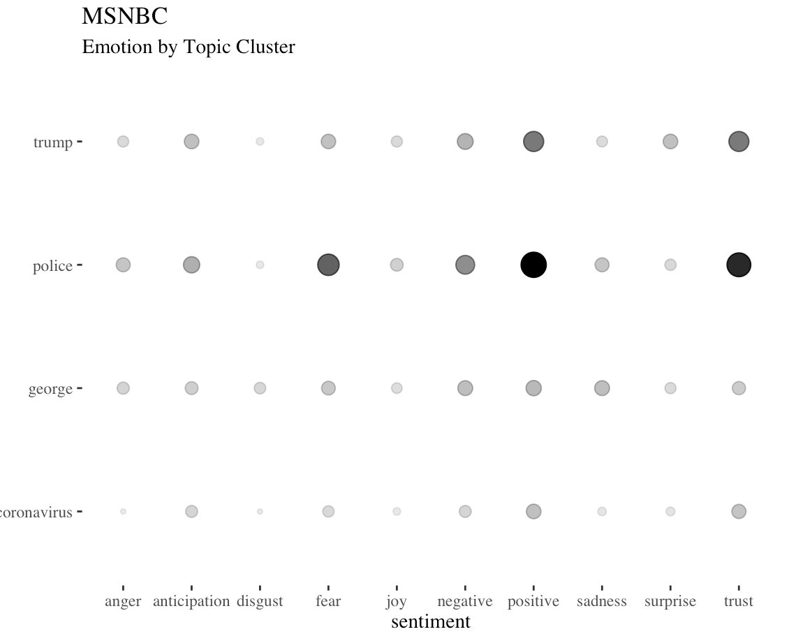
Now let’s mix sentiment and clustering
Text Segmented by Sentiment
Text Segmented by Cluster then Sentiment
Class4
C_sentimentAnalysis_II.R – Use Sentiment to Divide and Explore terms; when sentiment matters.
Class5
F_clustering_sentiment.R – Use cluster to Divide documents, then apply sentiment and explore terms; when topic matters

