Slide 1
DAY 1 · 8:00 TO 9:00
Environment Setup
and Orientation
Two toolchains, one course. Let's confirm everything works before the real content starts.
Generative AI in Finance | Executive MBA | Finance Masters + Data Science Masters
© 2026 Ted Kwartler

Slide 2
















Instructors
Ted Kwartler
Scott Lindeman
Jared Bowns
© 2026 Ted Kwartler
2

Slide 3
What we cover this hour
1
A quick word on how this course runs
2
Two toolchains: R and RStudio, then Node and GitHub
3
What R and RStudio actually are, for anyone new to them
4
Verify every account and tool from the pre module checklist
5
Fork the starter repository and get oriented in OpenRouter
6
Troubleshoot anything that is not working yet
© 2026 Ted Kwartler
3

Slide 4
Community Learning Expectations
I expect:
Kindness > Cleverness
Active learning & participation
To make adjustments along the way so learning will be engaging & fun
Academic rigor
The use of AI (ChatGPT etc) to be used
My goal for your learning experience is that the topics are:
Interesting to cover a lot of topics
Applicable as a professional or future business person
Perspective building as a consumer affected by these methods
What this course does not expect
Heavy math skills, software engineering or prior coding experience. This is not a math course, and you do not need to be a developer to finish it. Both R and your AI assistant do the heavy lifting. You are also not going to become a day trader with this course.
© 2026 Ted Kwartler
4

Slide 5

Two toolchains, one course
Different tools solve different problems.
R & RStudio
Node & GitHub
Statistical computing, used to calculate & chart moving averages, MACD, & RSI directly against real price data.
Builds an actual single page application you will demo, using Vite, vibe coding, and OpenRouter for the AI calls.
Runs entirely on your machine. No deployment, no public URL, just analysis.
Runs locally today. Tomorrow's GitHub Actions session publishes it to a public URL.
© 2026 Ted Kwartler
5

Slide 6
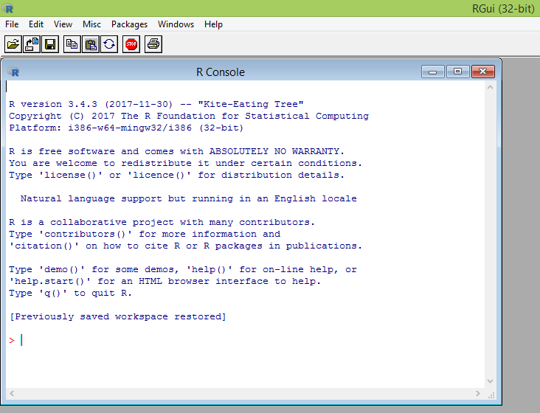
What is R?
A language & environment built for statistical computing & graphics.
Free and open source, extensible with more than 20,000 packages.
Built by statisticians, for statistical and financial analysis.
Excellent graphing capabilities, which is why we use it for this morning's charts.
Widely used throughout academia and within industry.
If you get stuck…ask & use your chatbot!
Most AI assistants, including Claude, already know R well. Describe what you are trying to do in plain language and ask for the R code, the same habit from this course's vibe coding sessions.
© 2026 Ted Kwartler
6

Slide 7
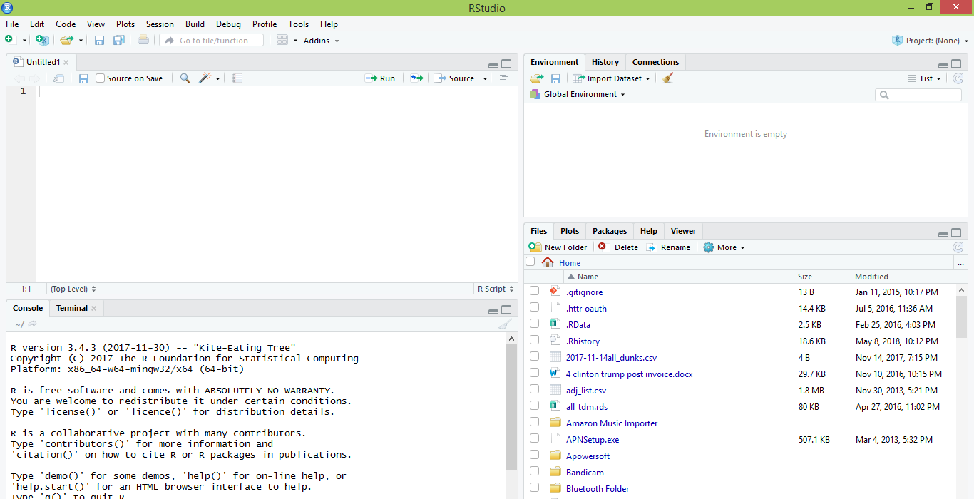
What is R?
RStudio is an IDE, an integrated development environment, built specifically for R
IDE – Integrated Development Environment
Adds additional functionality e.g. git, shiny projects, markdown templates
Not the only IDE for R
R studio is the most popular IDE for R although there are others & you don’t actually need it to execute R code.
© 2026 Ted Kwartler
7

Slide 8


What is RStudio?
R Studio sits atop of the installed R version. Without base R, R studio cannot function. By programmatically accessing base R, R Studio improves the interface and functionality.
Nice interface & additional functionality for faster programming, analysis & production.
Statistical & graphing software
Without base R installed, RStudio cannot run anything. You need both, and both should already be on your machine from the pre module checklist.
© 2026 Ted Kwartler
8

Slide 9
Clone the class repository
Connect to git repository.
R Studio sits on top of base R & adds functionality.
Class Files hosted on github.com
Makes the programmatic connection.
© 2026 Ted Kwartler
9

Slide 10
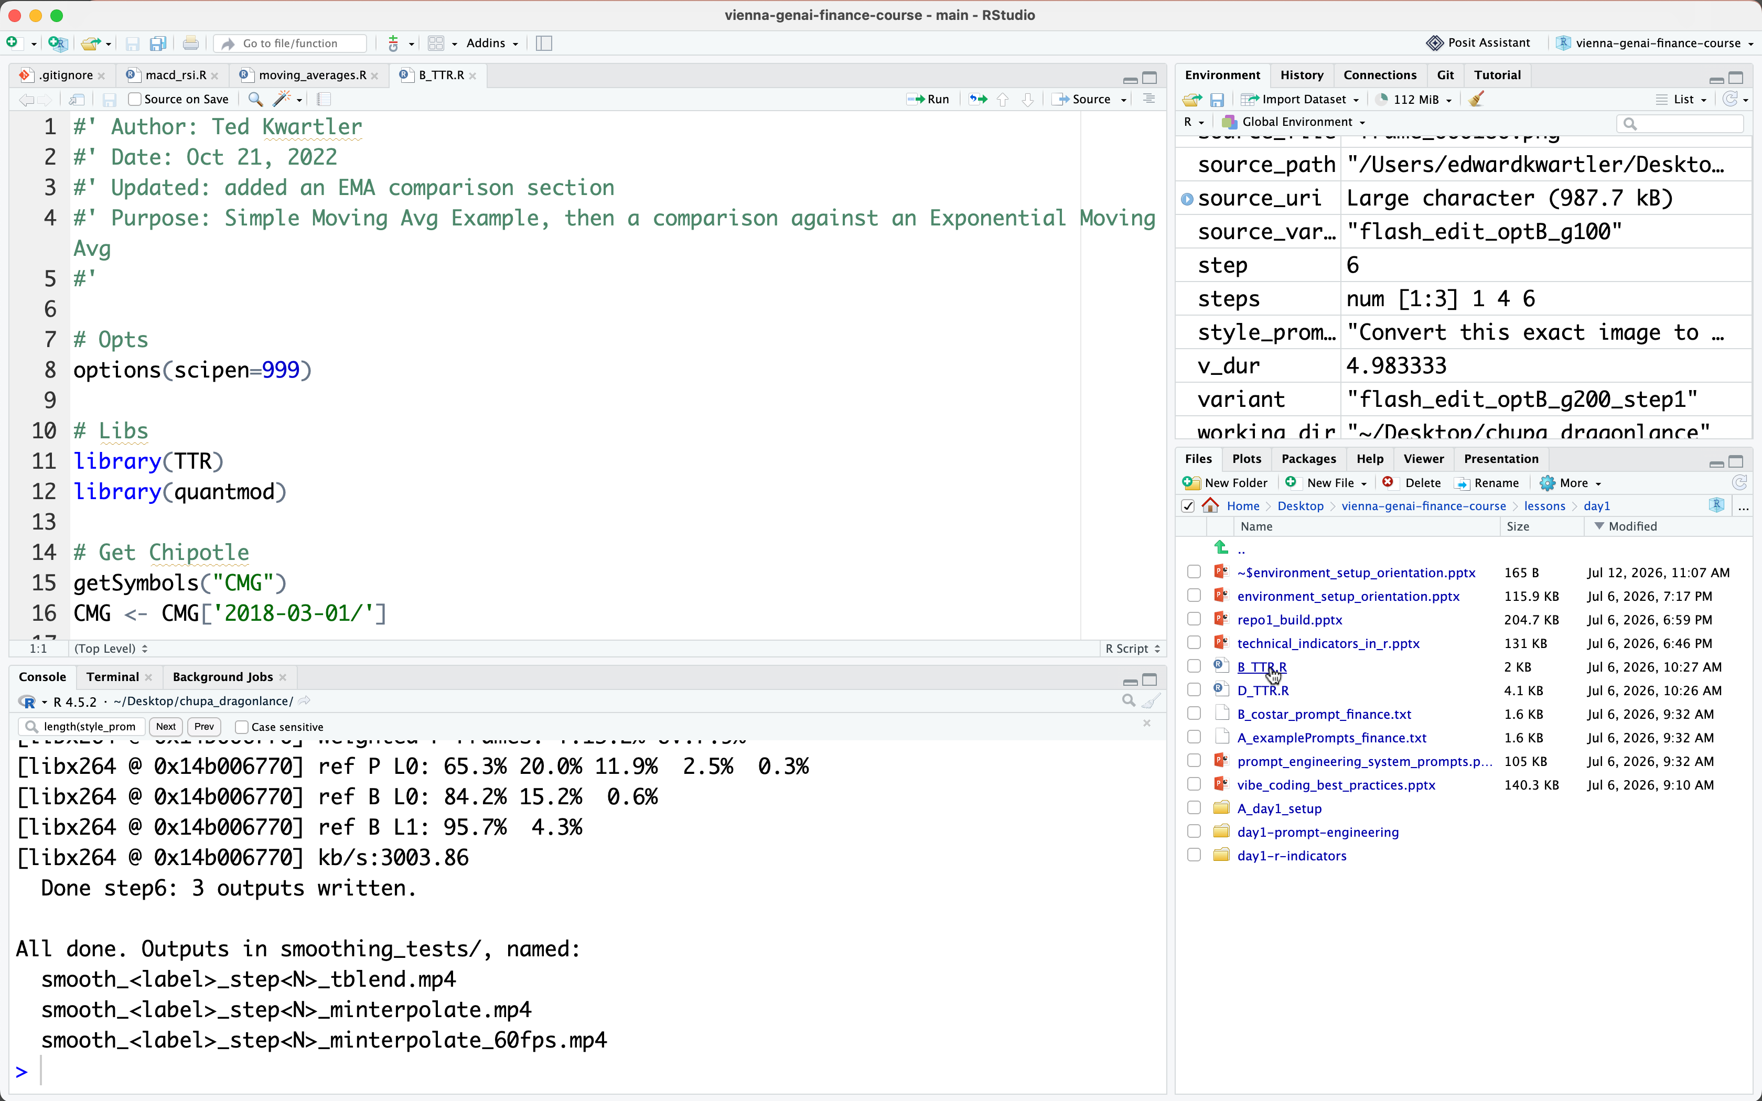
RStudio's four panes
Works the same way on Windows, Mac, and Linux.
Scripting
Environment
Write & edit code, then send it to the console to execute.
Running list of every object currently loaded, such as fetched price data & stored vars.
Console
Files, plots, packages, help
Code execution & where results & errors print.
Browse files, load packages, view charts, & search documentation
© 2026 Ted Kwartler
10

Slide 11
Where is R used?
Media
Services
Finance
Technology
Government
SAS
Oracle
IBM
Teradata
Coursera
SAP
DataCamp
Alteryx
TIBCO
OneTick
Amazon
Google
Microsoft
Google
Facebook
Twitter
Foursquare
Kickstarter
New York Times
Economist
Warner Bros.
Lloyd’s Bank
Credit Suisse
American Century
Australia and New Zealand Banking Group
Food & Drug
Administration
National Weather
Service
National Institute
of Standards
in Techn
Zillow
Trulia
eHarmony
PredictWise
Nationwide
R is ubiquitous in various industries used for analysis, prototyping and visualization. However, more often python is used in production environments.
© 2026 Ted Kwartler
11

Slide 12
R +/-
Strengths
Limitations
Extensible, with over 20,000 packages
Struggles with truly large data without extra effort
Built by statisticians, for statistics and finance
Official documentation can be terse
Free & open source
Slower than lower level languages
Outstanding graphing capability
Production grade apps take real effort to build
Large, active community for help
For the scope of what we build this week, moving averages, MACD, RSI, R's limitations do not get in the way.
© 2026 Ted Kwartler
12

Slide 13
The basic R workflow
The same five step pattern behind every script you run this morning.
1
Set your path
Point R at a local file, or a URL, so it knows where to look.
2
Load libraries
library(quantmod), library(TTR), the specialized tools for this task.
3
Read the data in
read.csv() or similar brings the data into memory as an object.
4
Apply a function
A library function transforms that object: SMA(), MACD(), RSI().
5
Consume the result
Plot it, print it, or save it. This is the point of the whole script.
© 2026 Ted Kwartler
13

Slide 14
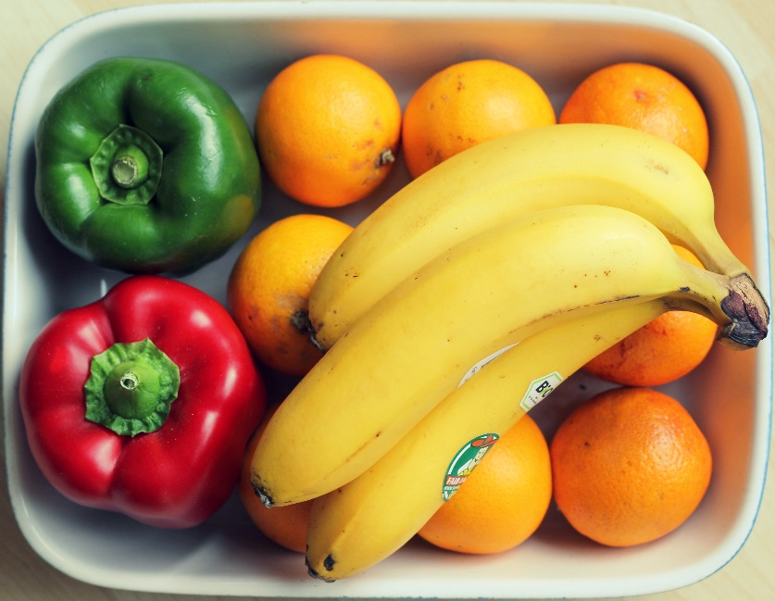
Breakfast R!
Let’s eat a banana for breakfast. Where is the fruit?
2
Load Libraries
Point R at a local folder, file, or a URL, so it knows where to look.
# If a "local" file, define the path to the file.
# Modern R: skip setwd() - it's fragile (breaks if anyone else runs the
# script, or you move the file) and RStudio/Posit no longer recommends it.
# Use an RStudio Project + the here package instead, so the path is always
# relative to the project root regardless of whose machine runs it.
scenesDF <- here::here("ted", "fruit", "basket", "some_file.csv")
# OR WINDOWS
# Forward slashes work fine on Windows in R - no escaping needed.
scenesDF <- "C:/Documents/ted/fruit/basket/some_file.csv"
# Or, since R 4.0, a raw string lets you paste a Windows path literally:
scenesDF <- r"(C:\Documents\ted\fruit\basket\some_file.csv)"
# OR MAC
scenesDF <- "~/Desktop/ted/fruit/basket/some_file.csv"
# OR
# From a URL
scenesDF <- 'https://raw.githubusercontent.com/kwartler/some_repository/main/ted/fruit/basket/some_file.csv'
© 2026 Ted Kwartler
14

Slide 15


Breakfast R!
Found the fruit basket, what tools do I need? This specialized R to be a “breakfast preparing machine”.
1
Load libraries
library(quantmod), library(TTR), the specialized tools for this task.
# Load Libraries
library(knife)
library(peel)
library(readr)
© 2026 Ted Kwartler
15

Slide 16

Before loading a library use install.packages(“name_of_package”).
You only need to do this once per environment
But you will need to repeat it w/each new installation!
© 2026 Ted Kwartler
16

Slide 17

Breakfast R!
Since R can cut & peel, now let’s pick our fruit!
3
Read the data in
Many packages have read functions depending on file type i.e. pdf, excel, csv, and even database connections
banana <- read.csv("Banana.csv")
OR
banana <- read.csv("www.csvFile.csv")
Must
Be In the working directory or full path declared
Be inside quotes
Have correct capitalization, spacing & spelling matter.
Must
Refer to the URL
R now has the object called banana in memory ie “opening a spreadsheet”
© 2026 Ted Kwartler
17

Slide 18

What if my file isn’t a CSV?
R can open many files types with different functions
CSV
Excel
SaS
SPSS
Rds, rda, fst etc
Connections
Databases (SQL, mongoDB)
S3 Buckets
APIs
Recommendation: to get started stick with CSV.
Most software can export CSV & the class files are CSV.
© 2026 Ted Kwartler
18

Slide 19
R often uses functions for calculation, & to accomplish tasks.
Function
Input
Output
Packages load specific functions to accomplish specific tasks. You can also write your own functions & packages.
© 2026 Ted Kwartler
19

Slide 20
R often uses functions for calculation, & to accomplish tasks.
Our Function accepts any number and is a “plus 2 and multiply by 3” Machine.
© 2026 Ted Kwartler
20

Slide 21
R often uses functions for calculation, & to accomplish tasks.
plusTwoTimesThree
Input
X = 2
© 2026 Ted Kwartler
21

Slide 22
R often uses functions for calculation, & to accomplish tasks.
plusTwoTimesThree
X = 2
2+X = 4
4 * 3 = 12
Return (12)
Input
X = 2
© 2026 Ted Kwartler
22

Slide 23
R often uses functions for calculation, & to accomplish tasks.
plusTwoTimesThree
X = 2
2+X = 4
4 * 3 = 12
Return (12)
Input
X = 2
Output
12
© 2026 Ted Kwartler
23

Slide 24
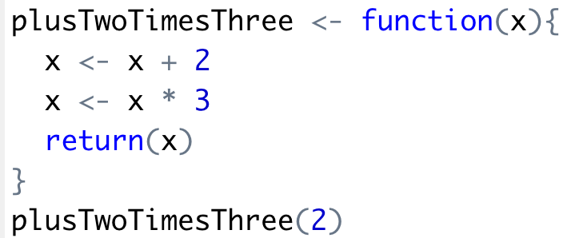
R often uses functions for calculation, & to accomplish tasks.
Input
X = 2
Output
12
© 2026 Ted Kwartler
24

Slide 25

R often uses functions for calculation, & to accomplish tasks.
Input
X = 2
© 2026 Ted Kwartler
25

Slide 26

Breakfast R!
Within the knife & peel packages there are functions like dice, slice, pound, peel etc. & we need to select the right functions for our analysis.
4
Apply a function
A library function transforms that object: SMA(), MACD(), RSI().
halfBanana <- cutinhalf(banana )
Output
Function
(
Input
)
"<-" is the assignment operator, assigning a variable name to the function output.
© 2026 Ted Kwartler
26

Slide 27


Breakfast R!
Within the knife & peel packages there are functions like dice, slice, pound, peel etc. & we need to select the right functions for our analysis.
4
Apply a function
A library function transforms that object: SMA(), MACD(), RSI().
library(knife)
library(peel)
banana <- read.csv("Banana.csv")
halfBanana <- cutinhalf(banana )
halfBanana <- peel ( halfBanana)
Output
Function
(
Input
)
Line by line we execute code, sometimes creating new object variables & other times overwriting them.
© 2026 Ted Kwartler
27

Slide 28
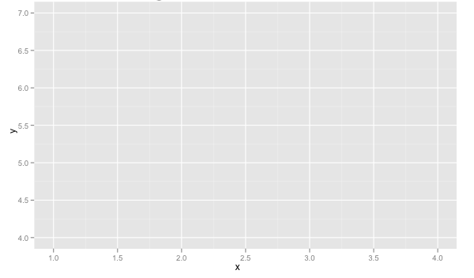
Breakfast R!
Now our output is ready for consumption, breakfast is ready!
1
Consume the result
Plot it, print it, or save it. This is the point of the whole script.
library(knife)
banana <- read.csv(“Banana.csv”)
halfBanana <- cutinhalf(banana)
halfBanana <- peel(halfBanana)
plot(halfBanana)
Function
(
Input
)
Sometimes we do not create new objects in the environment but just objects (ML models, or plots).
© 2026 Ted Kwartler
28

Slide 29






The basic R workflow
The same five step pattern behind every script you run this morning.
1
Set your path
Point R at a local file, or a URL, so it knows where to look.
2
Load libraries
library(quantmod), library(TTR), the specialized tools for this task.
3
Read the data in
read.csv() or similar brings the data into memory as an object.
4
Apply a function
A library function transforms that object: SMA(), MACD(), RSI().
5
Consume the result
Plot it, print it, or save it. This is the point of the whole script.
© 2026 Ted Kwartler
29

Slide 30
DAY 1 · 8:00 TO 9:00
Setup Review
Let’s confirm our toolchains are set up. Ask for help if you’re not prepared.
Generative AI in Finance | Executive MBA | Finance Masters + Data Science Masters
© 2026 Ted Kwartler

Slide 31
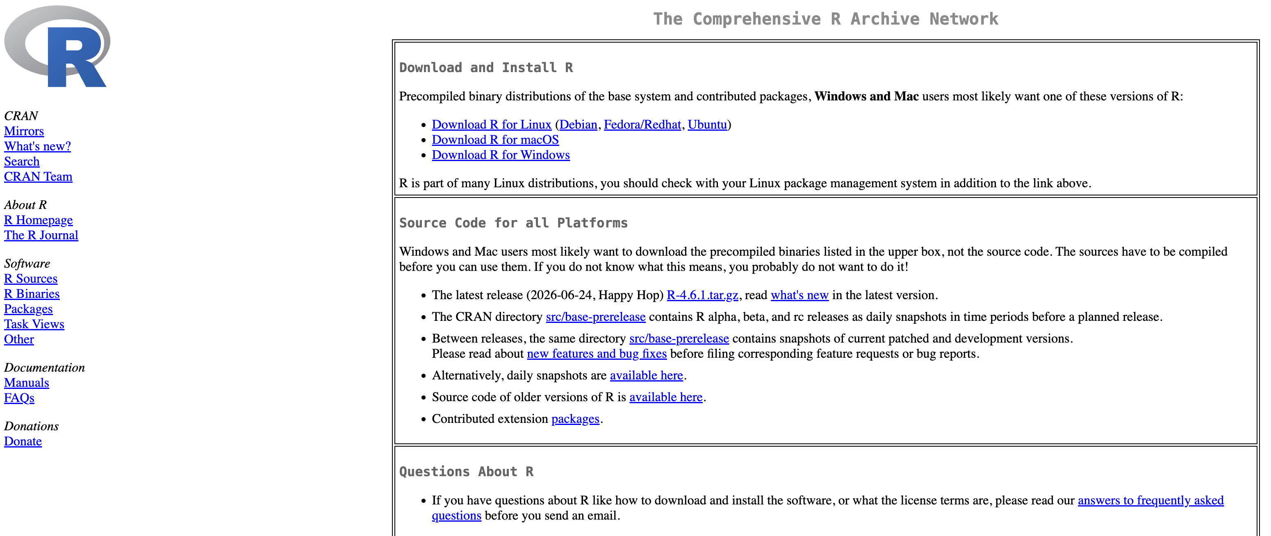
Install R
Install the statistical engine for our technical trading rules.
https://cran.r-project.org/
© 2026 Ted Kwartler
31

Slide 32
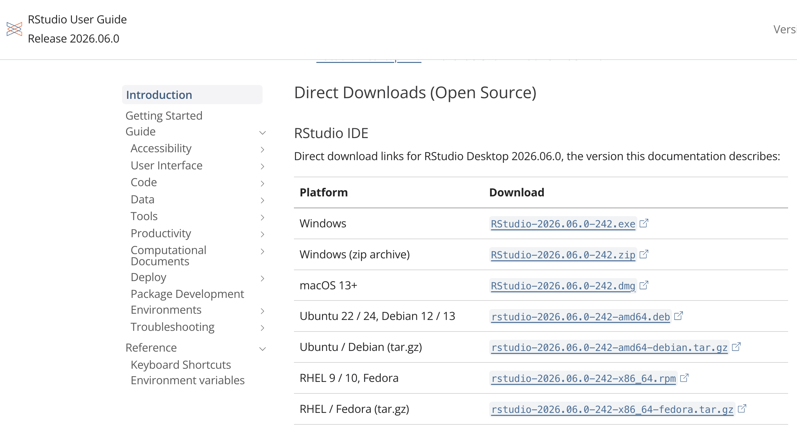
Install R-Studio
Install the IDE adding functionality to our software.
https://docs.posit.co/ide/user/#rstudio-ide-oss-downloads
© 2026 Ted Kwartler
32

Slide 33
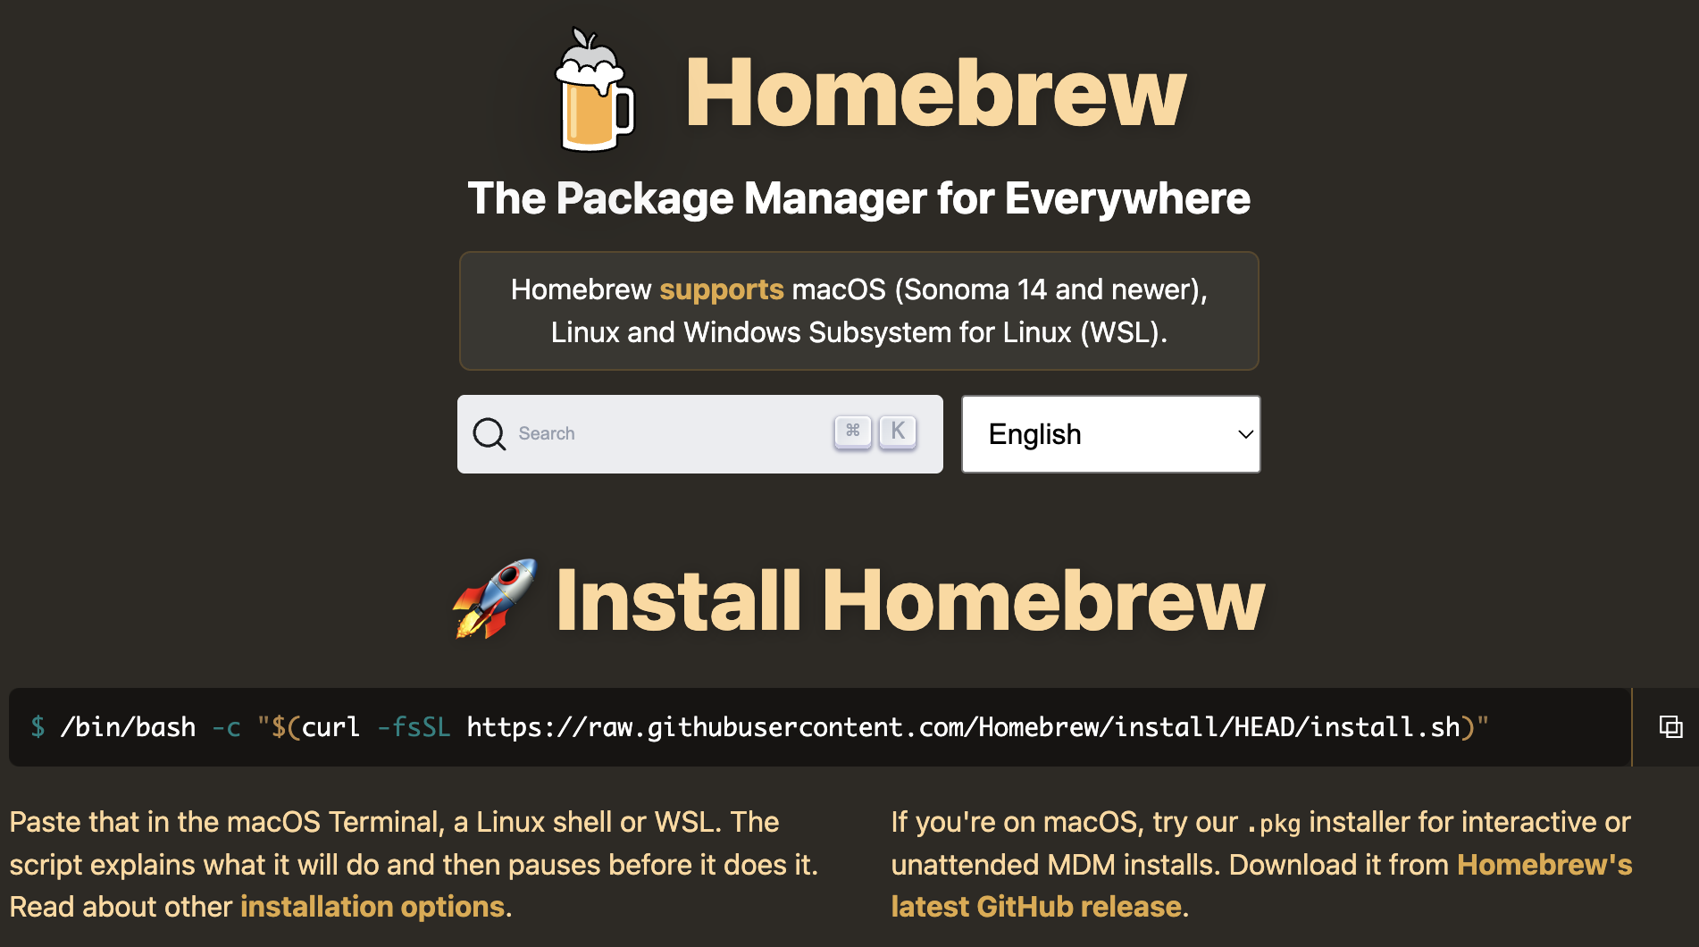
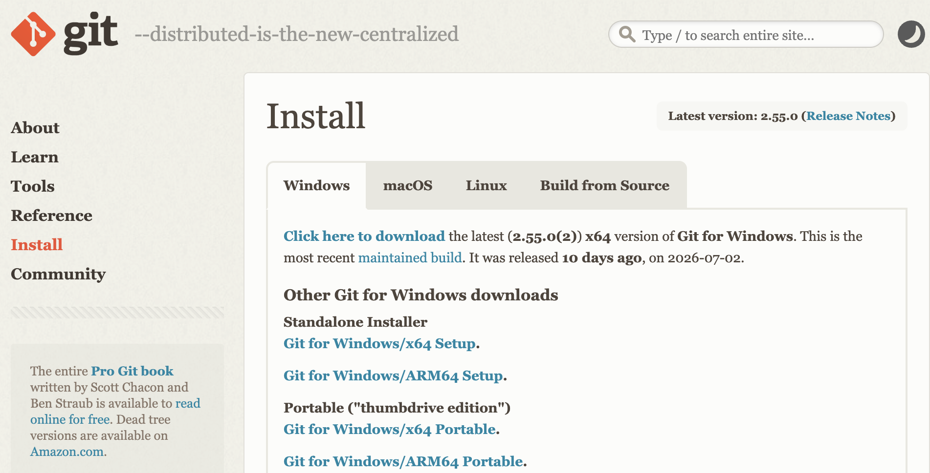
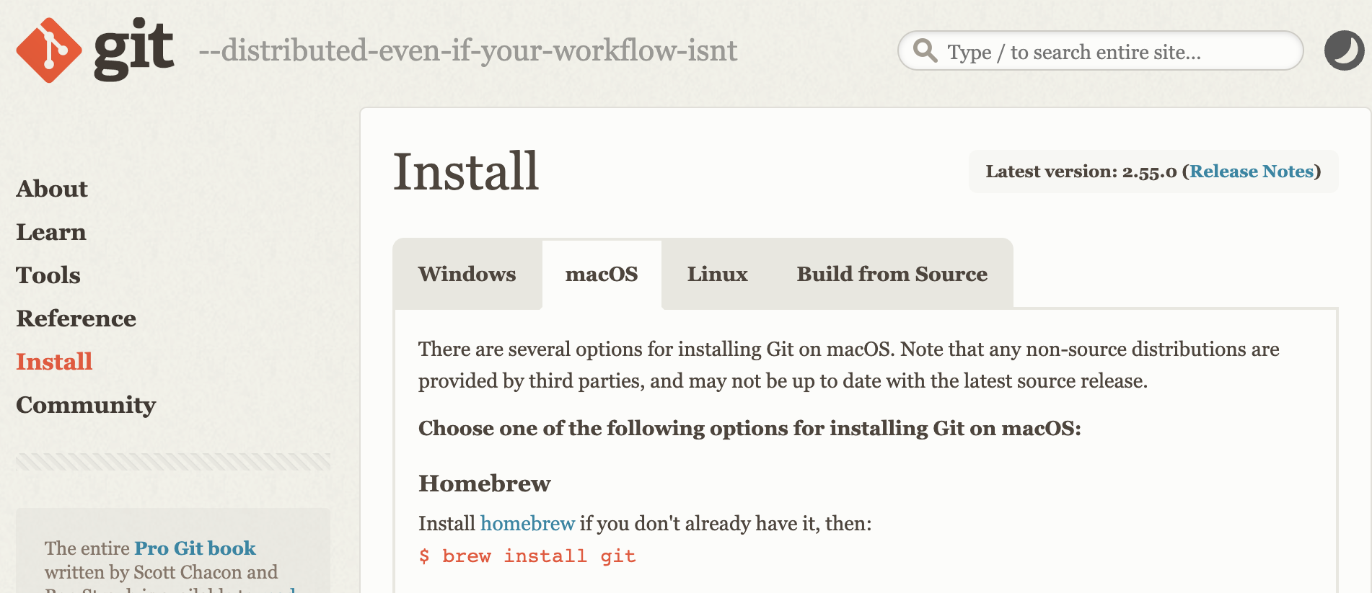
Install Git for your operating system
Git let’s you connect to the class repositories.
Windows
MAC
https://brew.sh/
https://git-scm.com/install/windows
https://git-scm.com/install/mac
© 2026 Ted Kwartler
33

Slide 34
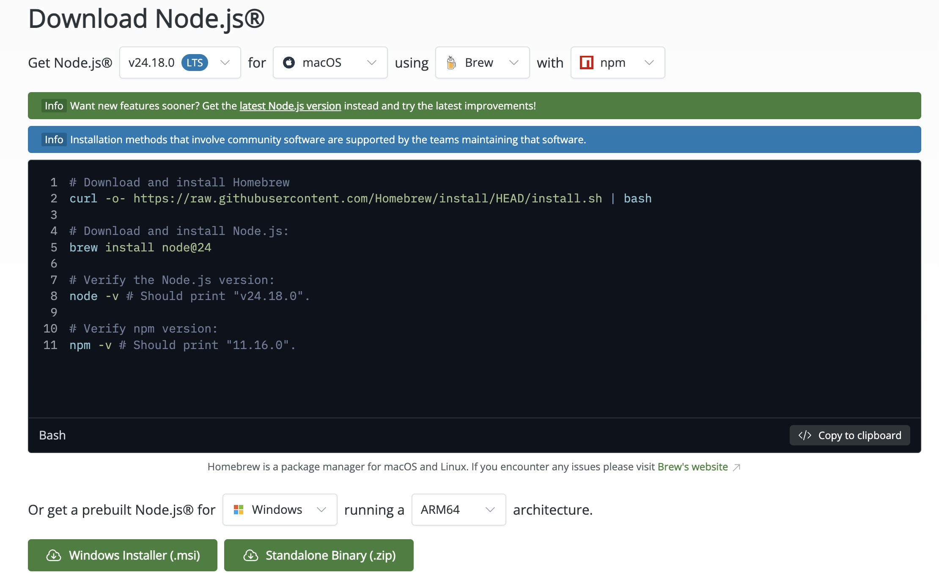
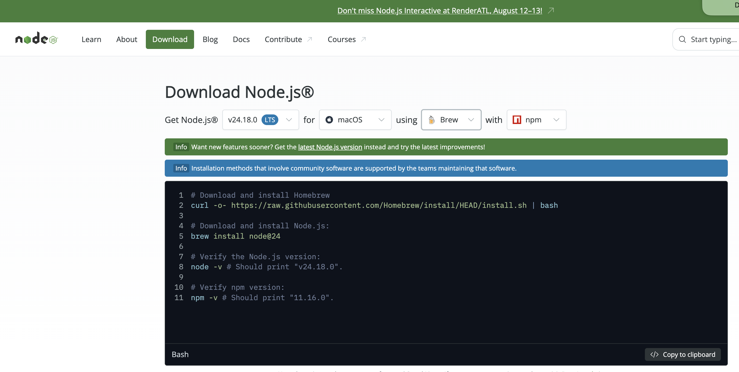
Install nodeJS [which includes NPM]
https://nodejs.org/en/download
Windows
MAC
1. Check: Settings → System → About → "System type”. If it says "ARM-based processor," grab the ARM64 .msi instead of x64.
2. Download and run the appropriate Windows Installer (.msi), specifically node-v24.18.0-x64.msi
1. Select node “LTS” [long-term-support], mac, & brew. 2. Get the brew command & install it.
© 2026 Ted Kwartler
34

Slide 35
With software installed, now we use git to get our class material
1
Use the Template
Create your own copy of the course repo on GitHub
2
Clone into RStudio
Open it as a Version Control project
3
Verify Your Setup
Confirm git, node, and npm all work
4
Sign-Up & Add Your API Keys
Store keys safely, never commit them
© 2026 Ted Kwartler
35

Slide 36
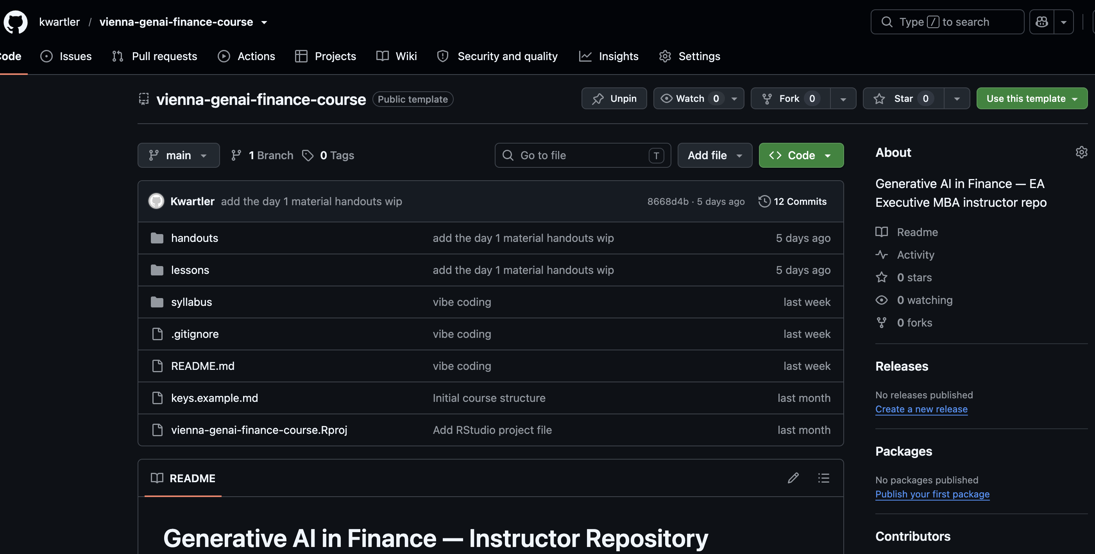
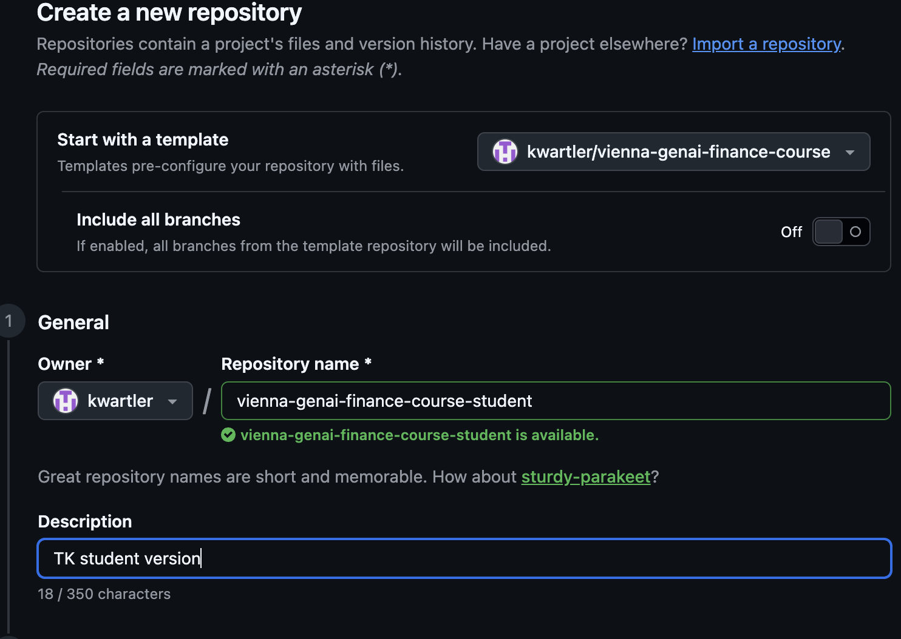
1
Use the Template
Go to www.github.com/kwartler/vienna-genai-finance-course
Click the green “Use this template” button
Choose “Create a new repository”
Name it genai-finance-[yourname] and click Create repository
Add a description
© 2026 Ted Kwartler
36

Slide 37
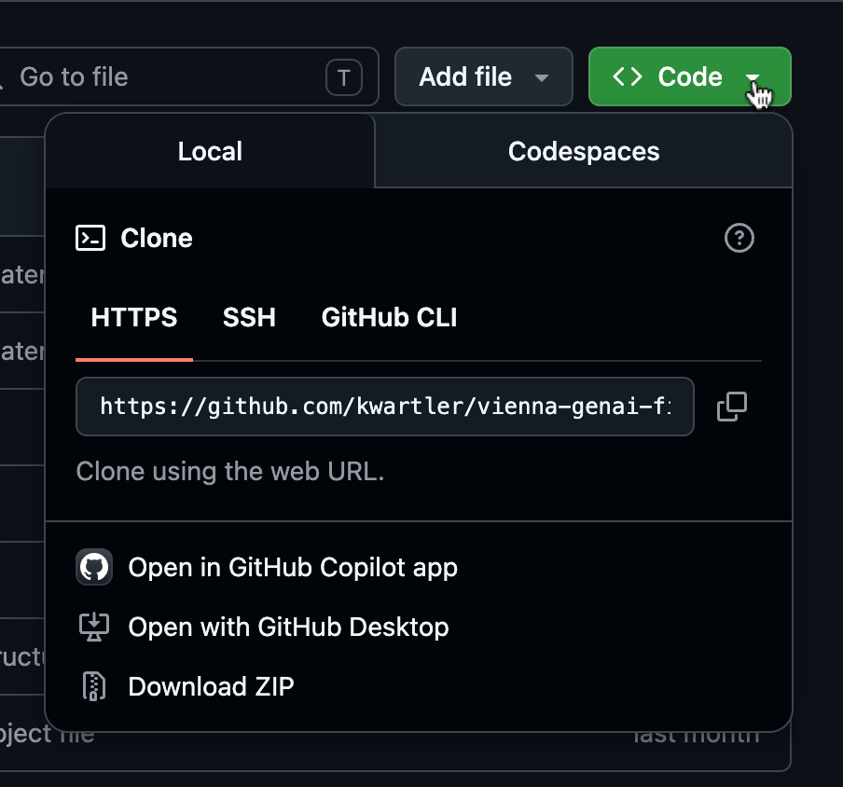
2
Clone your template repo with RStudio
Click the green Code button on your new repo, copy the HTTPS URL
In RStudio: File → New Project → Version Control → Git
Paste your repo URL, choose a folder, click Create Project
RStudio clones the repo and sets your working directory automatically
© 2026 Ted Kwartler
37

Slide 38
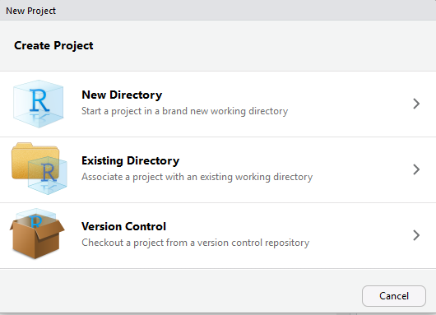
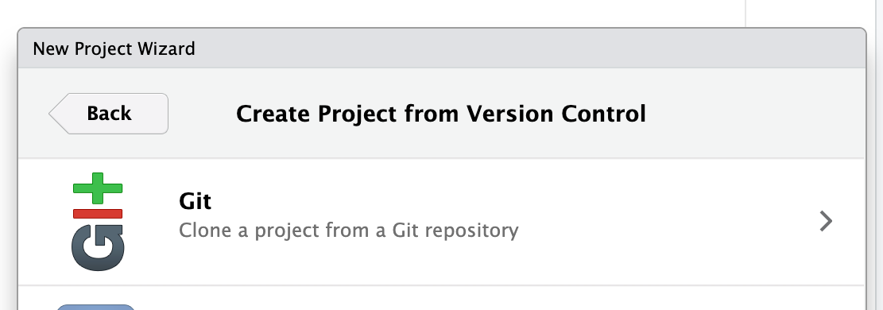
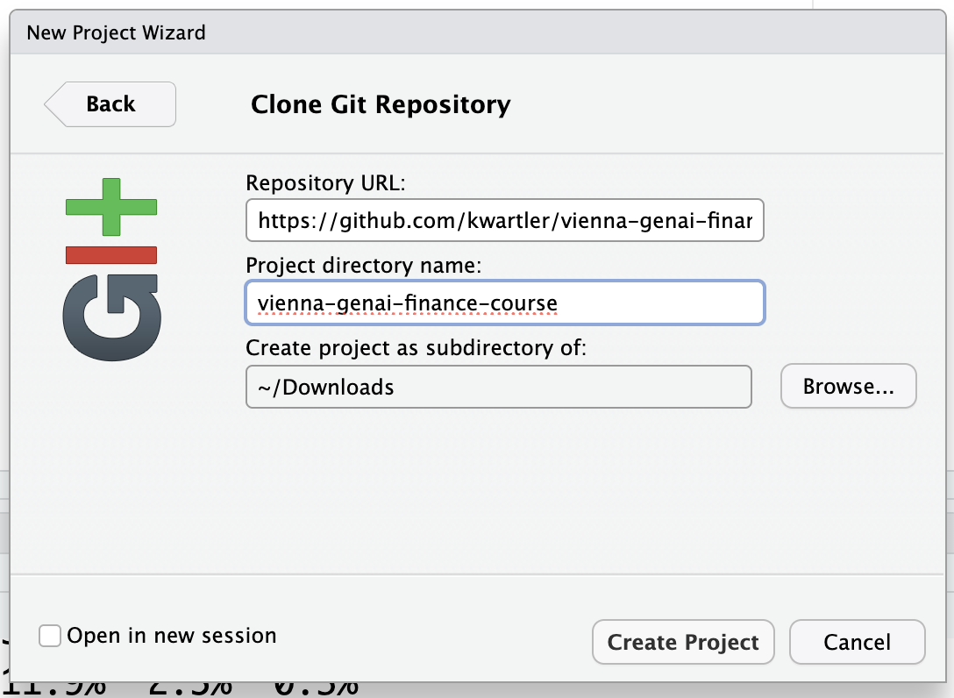
2
Clone your template repo with RStudio
Click the green Code button on your new repo, copy the HTTPS URL
In RStudio: File → New Project → Version Control → Git
Paste your repo URL, choose a folder, click Create Project
RStudio clones the repo and sets your working directory automatically
© 2026 Ted Kwartler
38

Slide 39
3
Verify Your Setup
Open the Terminal tab (not Console) in RStudio and run:
git --version
node --version
npm --version
All three should return version numbers. If any fail, flag an instructor!
© 2026 Ted Kwartler
39

Slide 40
If something is not working yet
Completely normal. This is what the rest of this hour is for.
1
Read the actual error message before asking for help. It usually says exactly what is wrong.
2
Ask your AI assistant to explain the error in plain language, the same habit you will use all week.
3
Raise your hand. An instructor will come to you.
4
If a tool truly will not install in time, pair with a neighbor until the next break. We can try to help at the break. We will not let a setup issue stop your learning. However, we cannot overcome your administrative rights on your computer i.e. if your work computer does not let you install anything. This is why the effort was assigned prior to the module.
© 2026 Ted Kwartler
40

Slide 41
4
Sign-Up & Add Your API Keys
Sign up at
www.newsapi.org
https://site.financialmodelingprep.com/
https://aistudio.google.com/prompts/new_chat
Obtain API Keys for each site
https://newsapi.org/account
https://site.financialmodelingprep.com/developer/docs/dashboard?tab=apiDetails
https://aistudio.google.com/app/api-keys
Open keys.example.md in the repo
Follow its instructions for where to store each key
Never paste real API keys into R scripts
Never commit real keys to GitHub
© 2026 Ted Kwartler
41

Slide 42

Checklist: confirm your tools
From the pre module setup. Work through this now, before we move on.
RStudio Desktop and R 4.x installed and opening without error
Node.js (LTS) installed: check by running node -v in a terminal
Git installed, a GitHub account created, templated version of class repo
A saved API key from newsapi.org
A saved API key from financialmodelingprep.com
A saved Gemini API key from Google AI Studio
Missing something? Raise your hand now. This is exactly what this hour is for.
© 2026 Ted Kwartler
42

Slide 43

A quick orientation to OpenRouter
OpenRouter is a single API that can reach many different AI models. Instead of separate accounts for every model provider, one key and one endpoint reaches whichever model you name in the request.
A shared class key, for today only
Your instructor will share a temporary OpenRouter key for in class use this week. Use it with claude-sonnet-4-6 or gemini-2.0-flash as the model. For pre module and independent work outside class, use your own personal Gemini key instead.
This afternoon's Repo 1 Build is the first time you will actually call this API from your own application.
© 2026 Ted Kwartler
43

