Slide 1













Ted Kwartler
MBA
Work
Teaching
Advisory Roles

Slide 2
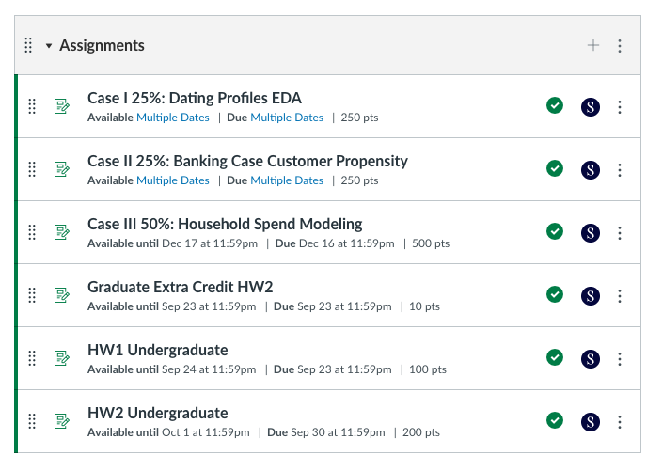
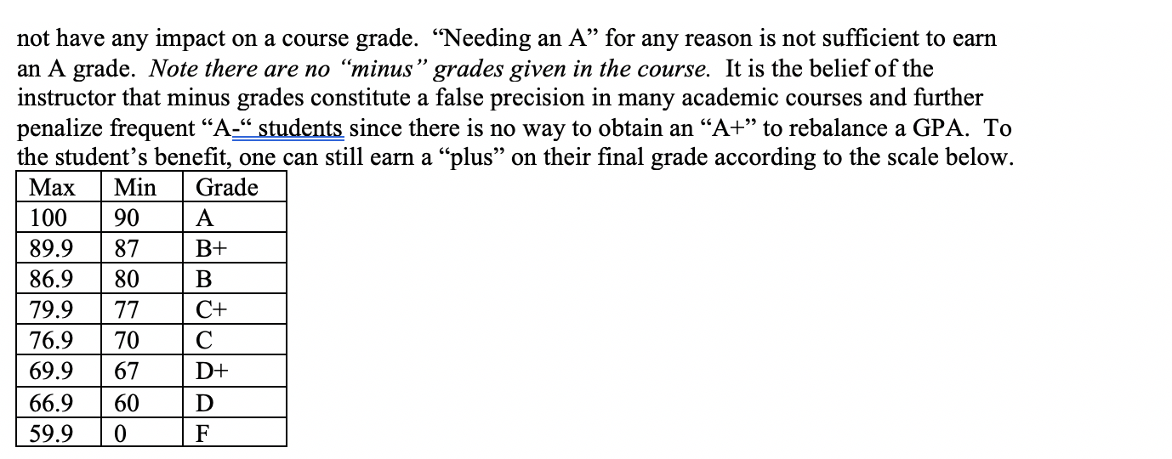
Syllabus Review
https://github.com/kwartler/Harvard_DataMining_Business_Student

Slide 3
Community Learning Expectations
I expect:
Kindness > Cleverness
Active learning & participation
To make adjustments along the way so learning will be engaging & fun
Academic rigor
The use of AI (ChatGPT etc) to be used
I do not expect:
Significant math skills – not a heavy math course; we let R do the work
My goal for your learning experience is that the topics are:
Interesting to cover a lot of topics
Applicable as a professional or future business person
Perspective building as a consumer affected by these methods
Notes:
Always new approaches and applications for DS so adjustments and active learning is paramount

Slide 4
Intro to R
Learning Objectives
What is R?
What is R Studio?
Scripting Structure in this course
Why? This ensures a basic fluency before the course really starts.

Slide 5
The course uses three software components for learning.
Integrated Development Environment
Version Control & file sharing
Statistical Software

Slide 6

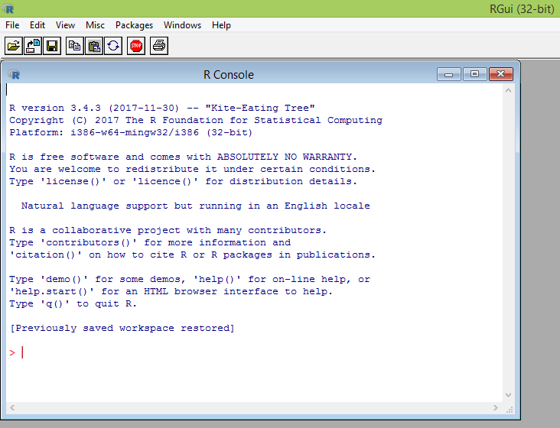
What is R?
Flexible
Open source
Academic & growing in industry
Language agnostic, SQL, Weka, C, Fortran, Java etc
R is a language & environment for statistical computing and graphics. It is the most popular statistical software in circulation today and is used by more than 2 million data scientists & statisticians worldwide.
How Companies Use R to Compete in a Data-Driven World, Data-informed.com

Slide 7

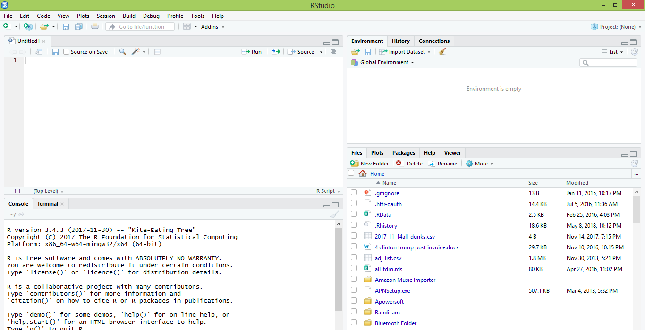
What is R Studio?
IDE – Integrated Development Environment
Adds additional functionality e.g. git, shiny projects, markdown templates
R studio is the most popular IDE for R although there are others & you don’t actually need it to execute R code.

Slide 8
What is the relationship between R & R studio?
Nice interface & additional functionality for faster programming, analysis & production.
Statistical & graphing software
R Studio sits atop of the installed R version. Without base R, R studio cannot function. By programmatically accessing base R, R Studio improves the interface and functionality.

Slide 9
Now that you have R, R-Studio & Git, time to connect to our class repository.
Connect to git repository.
R Studio sits on top of base R & adds functionality.
Class Files hosted on github.com
Makes the programmatic connection.

Slide 10
R Studio has four main panes
Scripting
Environment
Commands are written & adjusted here then executed in the console. Then saved for future quick execution.
List of objects & values
e.g. loaded “excel” files
Files, Plots, Packages, Help
Console
Find files, load packages, see visualizations and quickly find help
Execution of scripts and commands, data exploration and code results
R Studio works on Linux, Windows and iOS.

Slide 11
R: Where is it being used?
Media
Google
Facebook
Twitter
Foursquare
Kickstarter
New York Times
Economist
Warner Bros.
Services
Zillow
Trulia
eHarmony
DataSong
PredictWise
Nationwide
Finance
Lloyd’s Bank
Credit Suisse
American Century
Australia and New Zealand Banking Group
Technology
SAS
Oracle
IBM
Teradata
Coursera
SAP
DataCamp
Alteryx
TIBCO
OneTick
Amazon
Google
Microsoft
U.S Government
Food & Drug
Administration
National Weather
Service
National Institute
of Standards
in Technology
R is ubiquitous in various industries used for analysis, prototyping and visualization. However, more often python is used in production environments.

Slide 12
Ok, it’s awesome but…
Pros
Cons
VERY extensible
20K+ packages
Built by stats, made for stats
Free, open source
Cutting edge
Diverse applications
Outstanding graphical capabilities
Large community-based help
Tough to do “big data”
In memory data constraints w/o extra effort
Official documentation is terse
Not as polished as a commercial application
Slow compared to lower level languages
Production worthy apps can be difficult to create
Large community-based help
Most Large Language Models (LLMs) like ChatGPT know R code! You can just ask to get help.

Slide 13

A basic R workflow
Let’s eat a banana for breakfast. Where is the fruit?
If a “local” file define the path to the file
setwd(‘ted/fruit/basket’)
scenesDF <- "forceAwakens_definedScenes.csv"
OR WINDOWS
scenesDF <- "C:\\Documents\\hult\\ forceAwakens_definedScenes.csv"
OR MAC
scenesDF <- "~/Desktop/Hult/forceAwakens_definedScenes.csv"
OR
From a URL
scenesDF <- 'https://raw.githubusercontent.com/kwartler/Hult_Visualizing_Analyzing_Data_with_R/main/Lessons/A_Intro_Admin/data/forceAwakens_definedScenes.csv'
The item of interest needs to be in the “working directory” or a defined path

Slide 14


R uses functions, libraries & objects
Found the fruit basket! What tools do I need?
#setwd(“ted/fruit/basket”)
# Load Libraries
library(knife)
library(peel)
library(readr)
Change R into a breakfast preparing machine with specialized libraries.

Slide 15

Another trap!
Before loading a library use
install.packages(“name of package”).
You only need to do this once per environment
But you will need to repeat it w/each new environment!

Slide 16
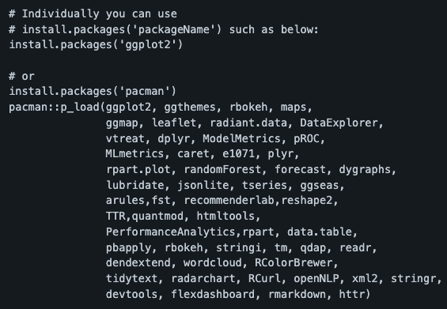
The course readme has the packages to install.
Don’t install them now, it takes awhile.

Slide 17

R uses functions, libraries & objects
Now R is a cutting & peeling machine, let’s pick our fruit.
library(knife)
library(peel)
banana <- read.csv(“Banana.csv”)
OR
banana <- read.csv(“www.csvFile.csv”)
Must
Be In the working directory or full path declared
Be inside quotes
Have correct capitalization, spacing & spelling matter.
Must
Refer to the URL
Or be the URL in quotes
R now has the object called banana in memory ie “opening a spreadsheet”

Slide 18

What if my file is Excel or ???
R can open many files types with different functions
CSV
Excel
SaS
SPSS
Rds, rda, fst etc
Connections
Databases (SQL, mongoDB)
S3 Buckets
APIs
Recommendation: to get started stick with CSV. Most software can export CSV. Most class files are CSV.

Slide 19
R uses functions, libraries & objects
Function
Input
Output
R uses predefined functions to accomplish things.

Slide 20
R uses functions, libraries & objects
Our Function accepts any number and is a “plus 2 and multiply by 3” Machine.

Slide 21
R uses functions, libraries & objects
plusTwoTimesThree
Input
X = 2

Slide 22
R uses functions, libraries & objects
plusTwoTimesThree
X = 2
2+X = 4
4 * 3 = 12
Return (12)
Input
X = 2

Slide 23
R uses functions, libraries & objects
plusTwoTimesThree
X = 2
2+X = 4
4 * 3 = 12
Return (12)
Input
X = 2
Output
12

Slide 24
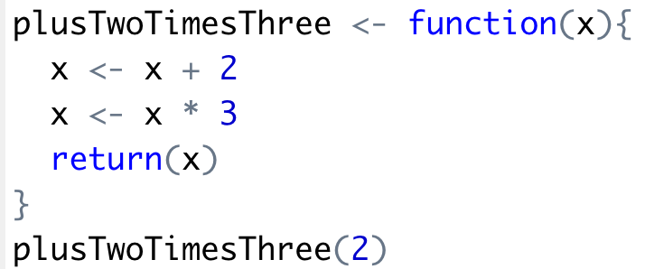
R uses functions, libraries & objects
Input
X = 2
Output
12

Slide 25

R uses functions, libraries & objects
Input
X = 2

Slide 26

R uses functions, libraries & objects
halfBanana <- cutinhalf(banana )
Output
Function
(
Input
)
“ <- ” is the assignment operator

Slide 27


R uses functions, libraries & objects
library(knife)
library(peel)
banana <- read.csv(“Banana.csv”)
halfBanana <- cutinhalf(banana )
halfBanana <- peel ( halfBanana)
Output
Function
(
Input
)
Results of an object can be used in the next function.

Slide 28
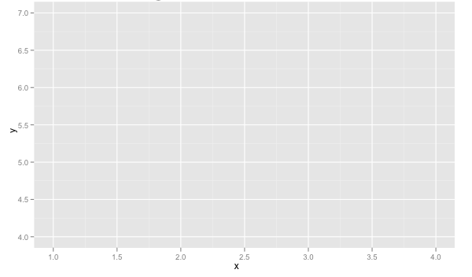
R uses functions, libraries & objects
setwd(“ted/fruit/basket”)
library(knife)
banana <- read.csv(“Banana.csv”)
halfBanana <- cutinhalf(banana)
halfBanana <- peel(halfBanana)
plot(halfBanana)
Function
(
Input
)
You don’t always have to declare an output object & you can also save items to disk.

Slide 29






Workflow review
1
Optional use file paths to point to your files & where to save outputs.
2
Load some customized libraries with library() for your specific analysis and methodology. Sometimes we will also create customized functions not in a library to aid our analysis.
3
Read in the file so the object is “in-memory” with read.csv() or similar.
4
Apply a function(s) from a library to adjust or create new objects in memory. The pseudo code for this is:
object<-function(applied to object)
5
Consume the results by saving, plotting etc.

Slide 30

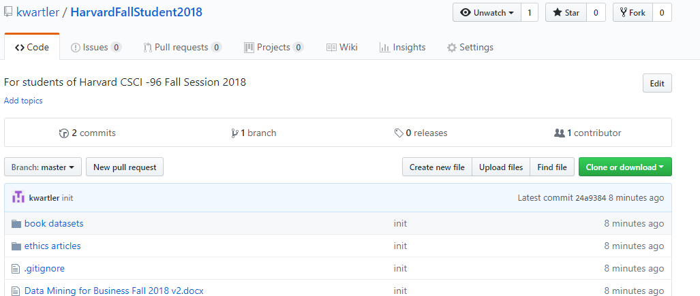
To get scripts, pptxs & data use the class repo
https://github.com/kwartler/Harvard_DataMining_Business_Student
If you have git software, when do a “git pull” in Rstudio.
Alternatively you can download a zip of the repo on github.com but this can be cumbersome with file updates.

Slide 31
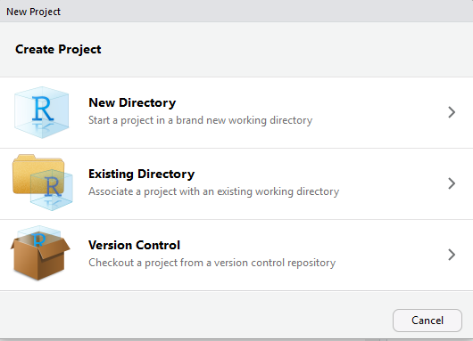
Now let’s get class files by setting up a new project & do a “git clone”
For you to look at in browser: https://github.com/kwartler
Open R Studio
File
New Project
Version Control

Slide 32
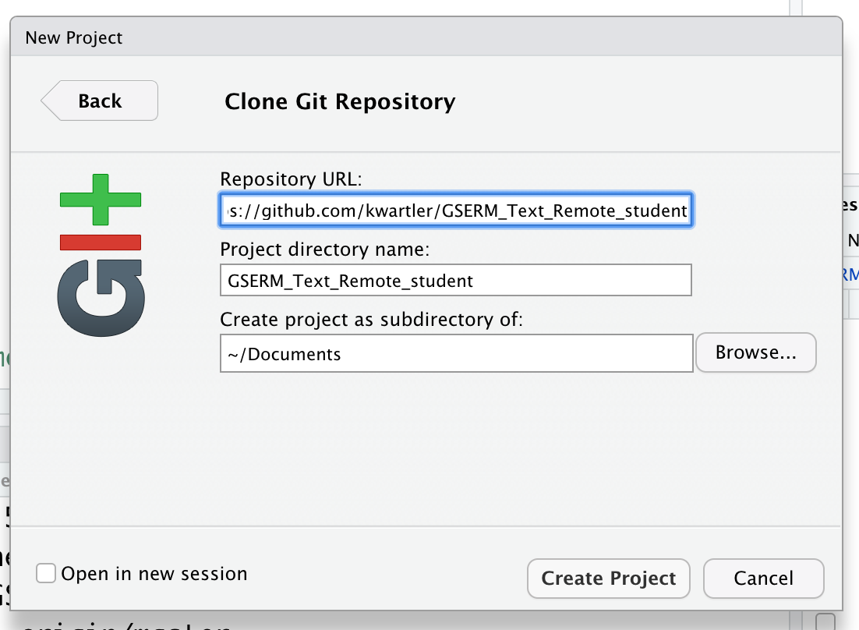
Setup a new project & do a “git pull”
In R Studio
File
New Project…
Version Control
Select Git
Add URL from github repository, create a folder name & destination to save files to

Slide 33
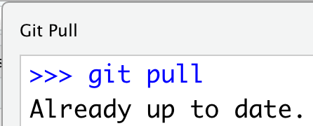
Each class we will perform a git pull in case there are updates to curriculum to aid learning.
In R Studio
File
New Project…
Version Control
Select Git
Add URL, folder name & destination for files
EACH Class session perform a Git Pull to update files

Slide 34
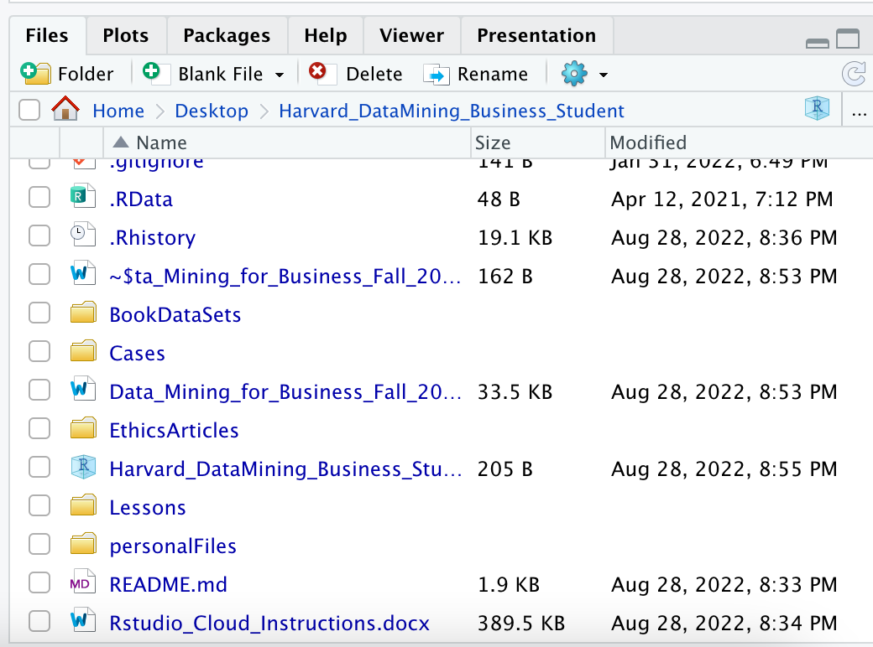
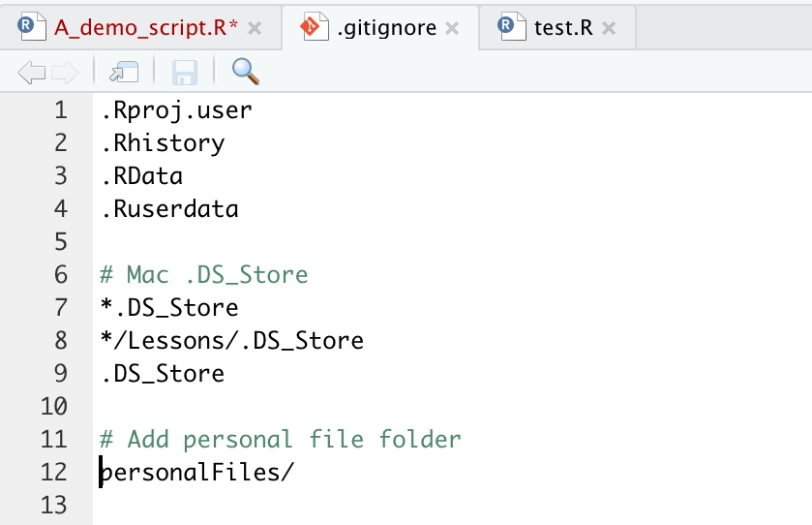
Saving YOUR copy of files.
To avoid conflicts with the class files create a “personal” folder that is ignored.
1 Create the Personal Folder
2 Add to the “gitignore” file
SAVE All your work there, copies of class files, homework, cases.

Slide 35
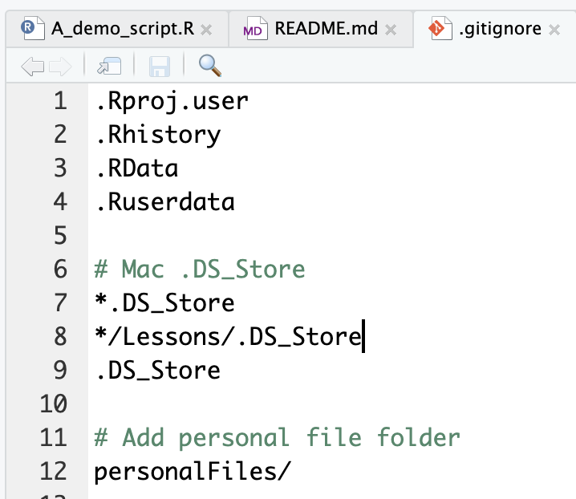
Second to last item. Create a personal folder.
Open the “gitignore” file. Add slash personal
Name of folder to be ignored “personalFiles”
When you work and make changes to scripts, SAVE AS to a personal folder that is ignored by git.

Slide 36
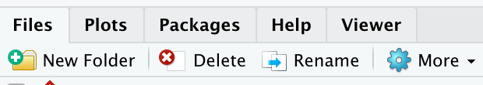
Second to last item. Create a personal folder.
In the lower right file section click “New Folder”. Name it “personal” exactly as in the gitignore (capitalization)
Click New Folder

Slide 37
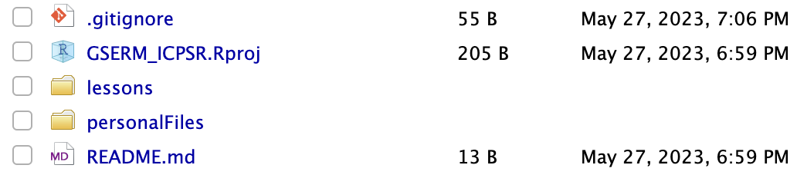
Save yourself a headache! Create a personal folder.
In the lower right file section click “New Folder”. Name it “personal” exactly as in the gitignore (capitalization)
Any file you change should be in this folder as “Save As”

Slide 38
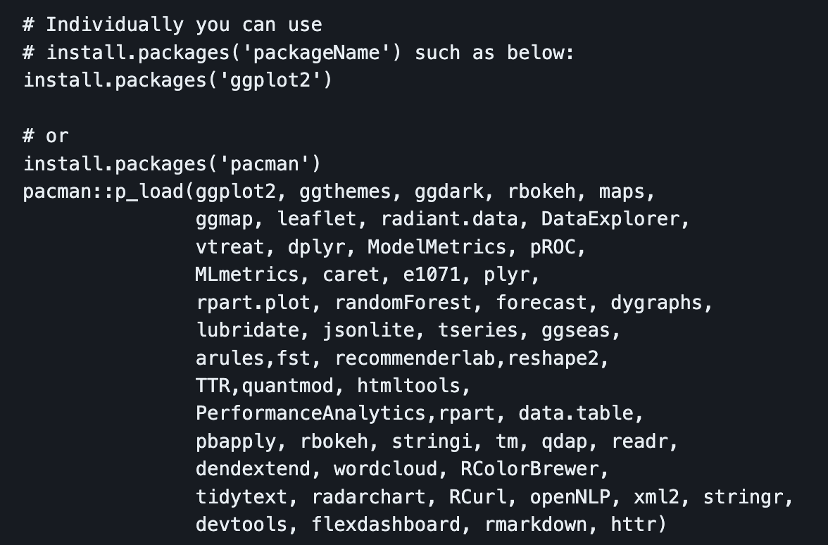
Libraries to install…we cover a lot in this course!
Please review the readme file of the Student repo!!

Slide 39
Don’t worry if you need help!

Slide 40
Agenda
Start | End | Item
 |  | Introductions
 |  | Syllabus Review
 |  | Break
 |  | Intro to R
 |  | R Installation, environment & git
 |  | Simple R Scripting

Slide 41
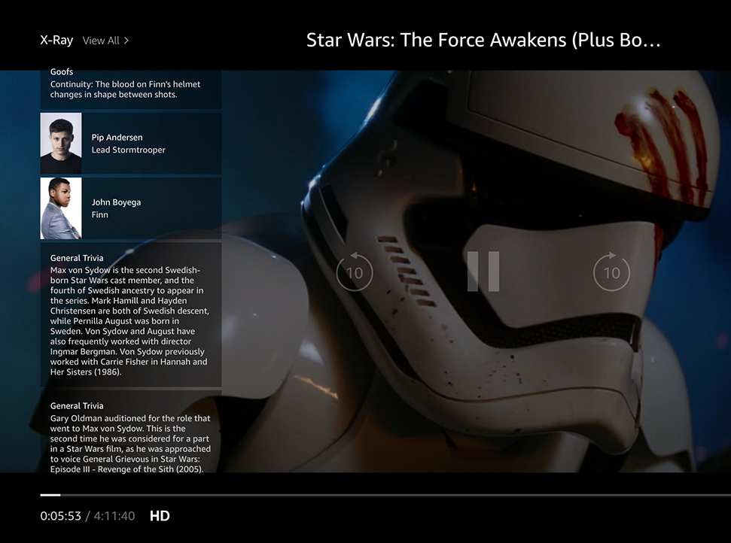
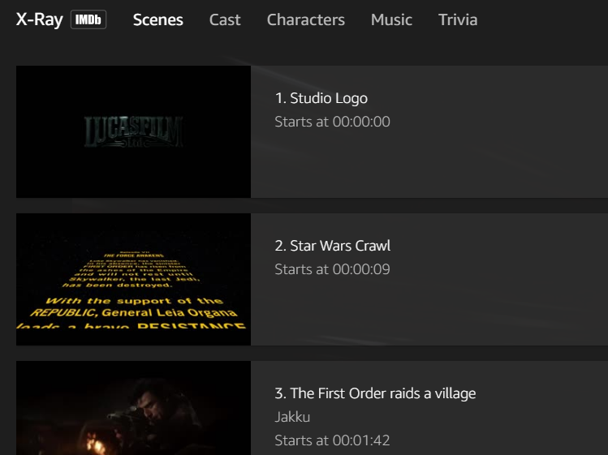
Amazon X-Ray: A basic R-Script
Left Hand Screen:
Actor Information & Trivia
Center “Pop-over” Screen:
Scenes, Cast, Characters, Music & Trivia

Slide 42

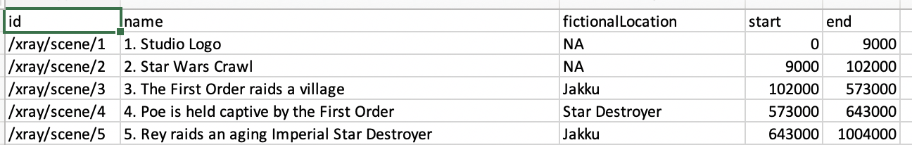
Let’s practice!
Open A_demo_script.R
Learning Outcome: Following a consistent workflow, load, clean, & analyze real data with multiple data types to establish basic familiarity.

