Slide 1


Environmental Impact of Food Production Analysis
Prepared by: Paa Kwasi Amoah Apau-Danso
Date: September 2025

Slide 2


Business Questions
Which food products contribute the most to total GHG emissions?
Which food products contribute the least to total GHG emissions?
What is the breakdown of emissions by supply chain stage?
Animal-based vs Plant-based total emissions
Which foods use the most land?
Which foods consume the most freshwater?
Which foods cause the highest eutrophying emissions?

Slide 3
Methodology
Data Loading & Cleaning
Data Visualization
Extraction of Insights

Slide 4
Data Loading & Cleaning
Standardized column names (lowercase, underscores)
Fixed encoding errors (e.g., gPOâ‚„eq → gPO4eq)
Corrected typo: 'Packging' → 'Packaging'
Created new column: Total_GHG_Emissions (sum of stage-level emissions)
Exported clean CSV for Power BI analysis

Slide 5
TOOLS USED
Python (Pandas): Data cleaning and preprocessing
Power BI: Visualization and analysis
GitHub: Version control and documentation

Slide 6
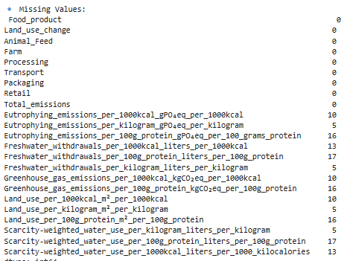
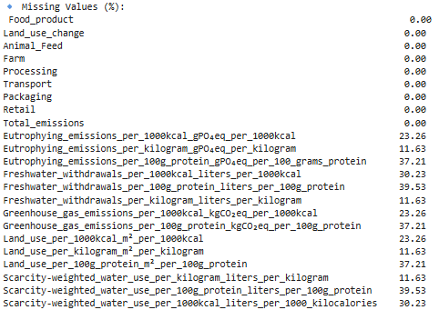
EDA

Slide 7
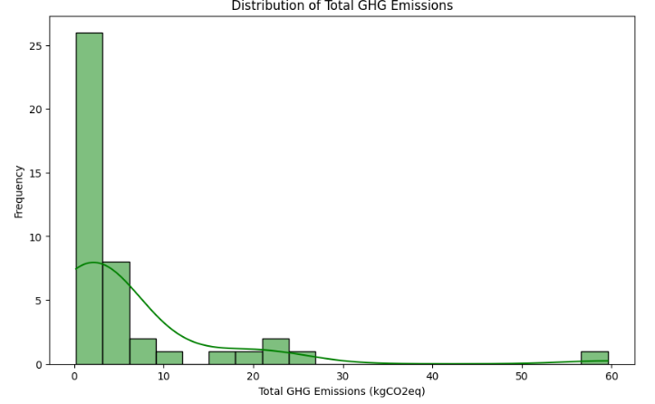
EDA

Slide 8
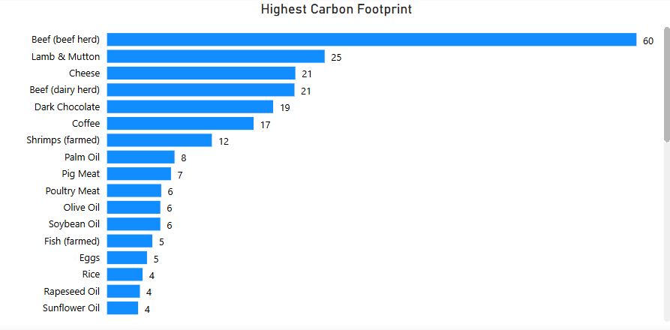
Which food products contribute the most to total GHG emissions?

Slide 9
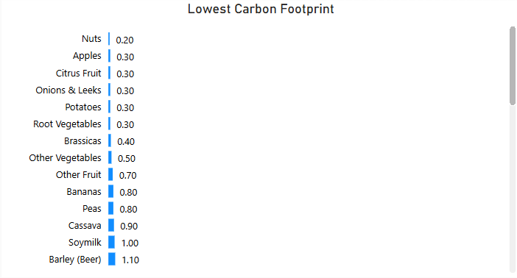
Which food products contribute the least to total GHG emissions?

Slide 10
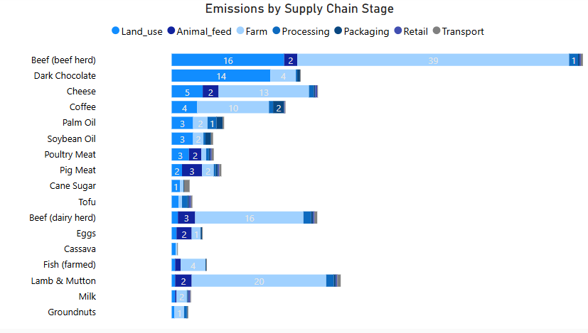
What is the breakdown of emissions by supply chain stage?
2865

Slide 11
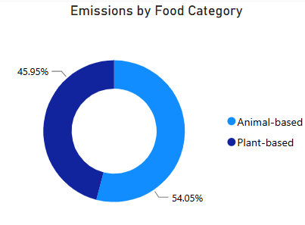
Animal-based vs Plant-based total emissions

Slide 12
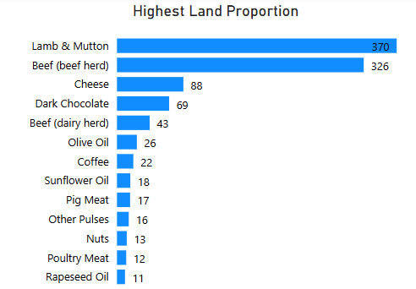
Which foods use the most land?

Slide 13
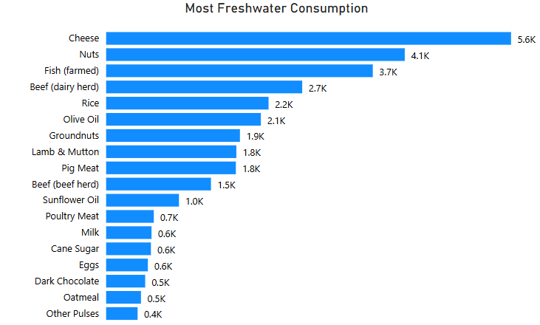
Which foods consume the most freshwater?

Slide 14
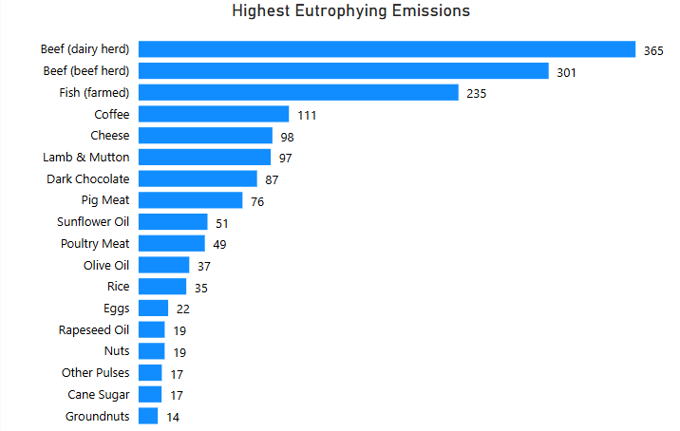
Which foods cause the highest eutrophying emissions?

