Slide 1
TRACKFIT
Kwasi Edwards
Shanea Lewis

Slide 2
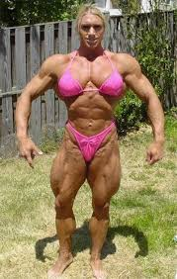
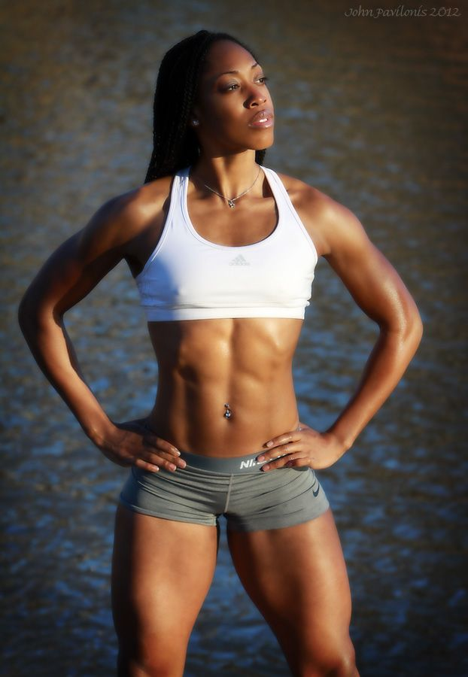

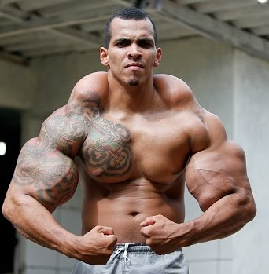
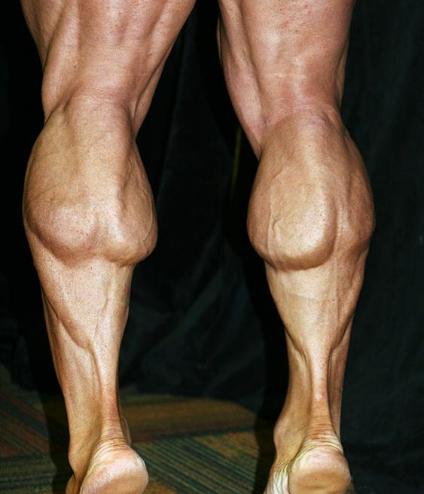

Slide 3
TRACKFIT
MOTIVATIONAL MOBILE FITNESS MANAGER

Slide 4
