Slide 1
Navigating the Complexities of Platform Trials: Design and Simulation
J. Kyle Wathen
Vice President of Scientific Strategy and Product Innovation
Cytel
Bayes 2024, Rockville, MD October 23-25, 2024

Slide 2
Outline
How to install OCTOPUS and get course content
Introduction to platform trials
ASA – DahShu IDSWG Workgroup – Useful Aids and “Tools”
Introduction to OCTOPUS R package
Comparing accrual approaches using shiny app
Hands on examples with OCTOPUS

Slide 3
Course Preliminaries
OCTOPUS GitHub Repository https://github.com/kwathen/OCTOPUS
OCTOPUS Package Website: https://kwathen.github.io/OCTOPUS/
Install OCTOPUS n R
library(remotes)
remotes::install_github( "kwathen/OCTOPUS")
Check to make sure you have V1.3.1 as updates were added today!
Short Course Material
https://github.com/kwathen/BayesPharma2024-OCTOPUS
Step 1: Once on the repository at the link above, click the green box labeled “Code”, see below in the red box.
Step 2: In the menu that expands, click Download ZIP, shown in the 2nd red box below.
Step 3: Unzip the zip file that was downloaded. This can be done by right clicking on the zip file, then extract all

Slide 4

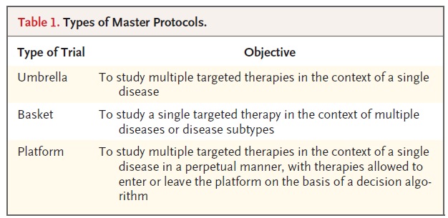
Reference
Woodcock J, LaVange LM. Master Protocols to Study Multiple Therapies, Multiple Diseases, or Both. N Engl J Med. 2017 Jul 6;377(1):62-70. doi: 10.1056/NEJMra1510062. PMID: 28679092.

Slide 5
What is a Platform Trial?
An experimental infrastructure to evaluate multiple treatments and/or combinations of treatments in heterogeneous patient populations
Not all interventions are included, or even known, at the start of the platform
Pre-existing infrastructure for clinical operations and trial implementation
Patient data can be shared to improve analysis

Slide 6



Protocol Organization
Master Protocol
ISA 1
ISA 2
ISA 3
ISA = Intervention Specific Appendix
Contains experimental treatment(s) & matched control
6

Slide 7
Example Platform – Adding New Treatments
ISAi – Intervention Specific Appendix i, which contains Control vs Experimental i
ISA 2
ISA 1
2022Q3 2023Q1 2023Q3 2024Q1 2024Q3
7
7

Slide 8
Example Platform – Adding New Treatments
ISAi – Intervention Specific Appendix i, which contains Control vs Experimental i
ISA 3
ISA 2
ISA 1
2022Q3 2023Q1 2023Q3 2024Q1 2024Q3
8
8

Slide 9
Example Platform – Adding New Treatments
ISAi – Intervention Specific Appendix i, which contains Control vs Experimental i
ISA 4
ISA 3
ISA 2
ISA 1
2022Q3 2023Q1 2023Q3 2024Q1 2024Q3
9
9

Slide 10
Sharing Information Between ISAs?
ISAi – Intervention Specific Appendix i, which contains Control vs Experimental i
ISA 5
ISA 4
ISA 3
ISA 2
ISA 1
2022Q3 2023Q1 2023Q3 2024Q1 2024Q3
10
10

Slide 11
Platform Trial In Practice
Development of a master protocol should be done in a very pragmatic fashion
Learning curve may be steep for a team or group when organizing a master protocol for the first time
Similar experiences and approaches taken in various organizations and groups
Utilize experience and wealth of knowledge available
Avoid the assumption that master protocol is always the “best” approach, consider in stages using “Tools and Aids”
Master Protocols are NOT ALWAYS THE BEST APPROACH

Slide 12
“Tools” and Aids
To help determine if a master protocol is a good option, consider the following stages for Master Protocols (MP) planning
Considering a MP - MP Score Card – A set of questions that can be scored in a preliminary fashion to help determine if a master protocol is a good fit (little time investment)
Assessing a MP - Master Protocol Quick Start Worksheet – A list of more detailed questions that may require more input and knowledge about the trial under consideration (more time-consuming exercise)
Implementing a MP - Simulation Plan and Report: A formal write up of the details for simulating the trial and the desired output that will be obtained. Often good to outline the required improvement and/or performance that would is required to justify a master protocol (can be very time consuming)

Slide 13
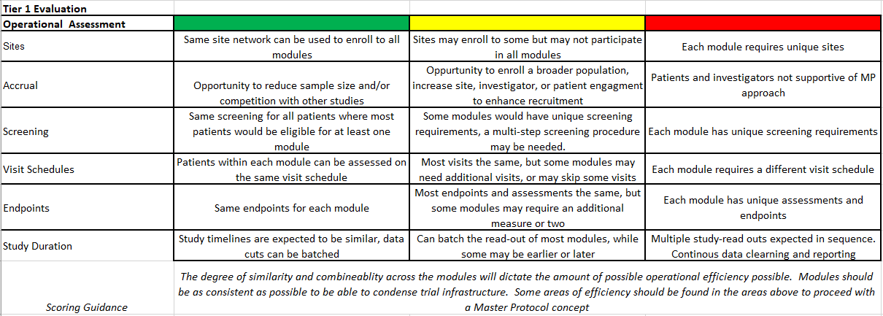
Score Card – Considerations for MP

Slide 14
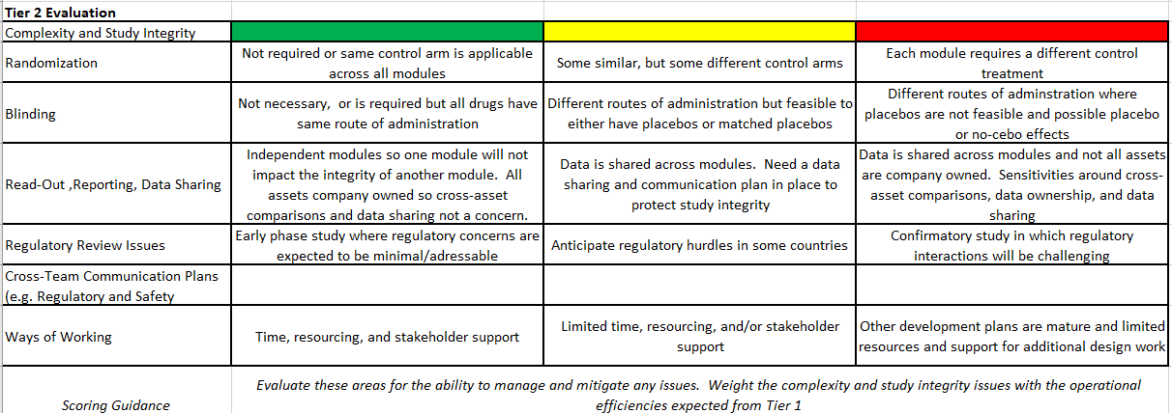
Score Card – Considerations for MP

Slide 15
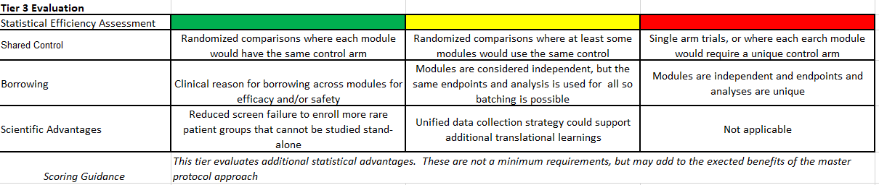
Score Card – Considerations for MP

Slide 16
Transition from Considering to Assessing a MP

Slide 17
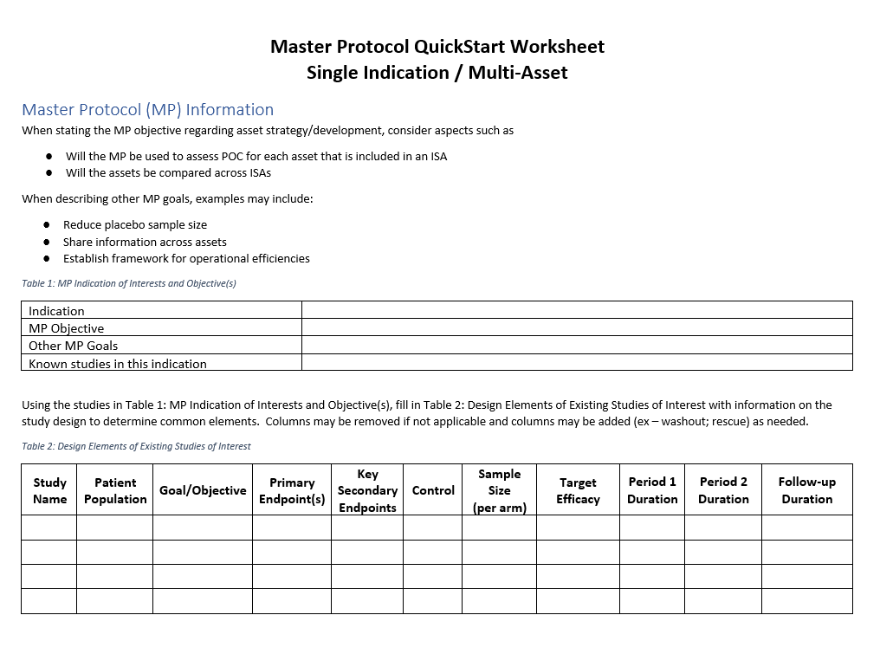

Slide 18
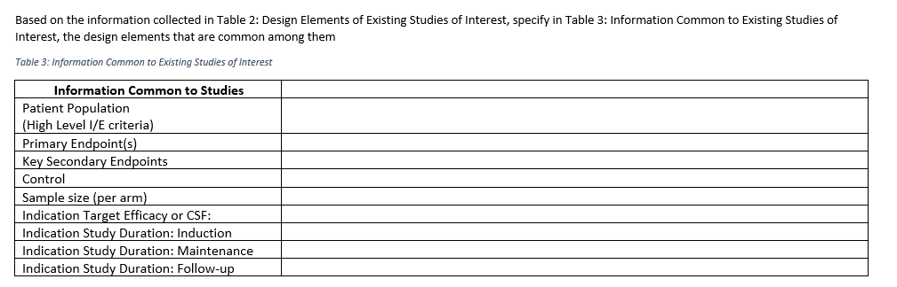

Slide 19
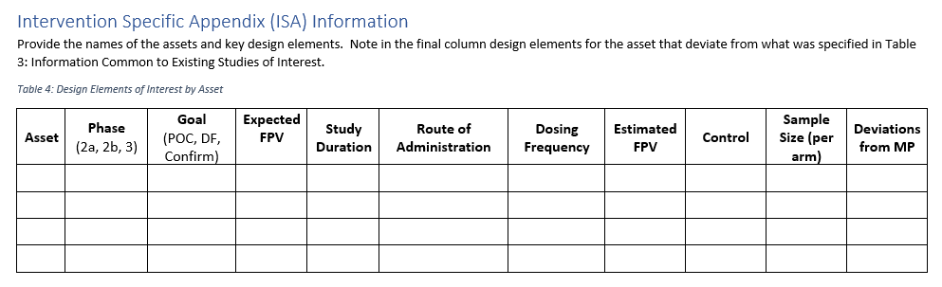

Slide 20
Transition from Assessing a MP to Implementing a MP

Slide 21
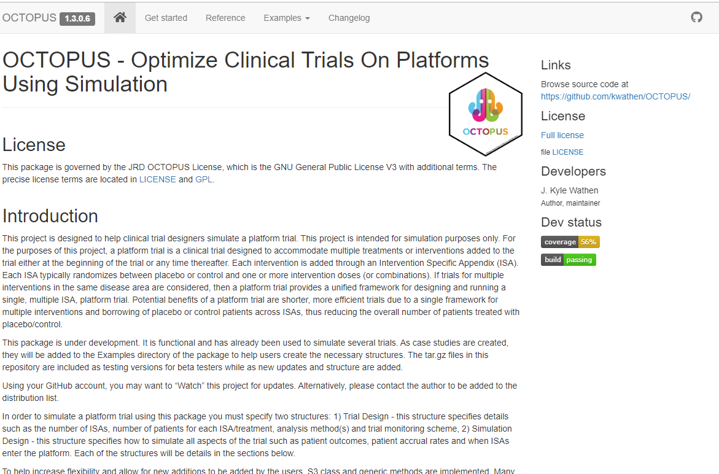
Open Source Software - GitHub Page
https://github.com/kwathen/OCTOPUS

Slide 22
R Package + Project Specific Files
OCTOPUS Package
Project Specific
Core components
Built on generic functions
Tested
Generalized functions from projects
Community driven development in future versions
Define trial design element
Define simulation design element
Define any project specific functions
Key Advantages – Tested code, reuse general parts, speed up development, learn across projects, project details remain in the project specific files, extendable, generic concepts can be moved from projects to package
Allowed for easy exploration of designs including client provided Winbugs model for analysis and customization to fine the need of client

Slide 23
Implementing a MP – Comparing Recruitment
Compare a standard approach of 2 consecutive POC studies to a platform with 2 ISAs
Assumptions:
Each POC and ISA have N = 90 (no borrowing of data in platform)
Platform may enroll at more sites because it will run longer and have more than 1 experimental treatment (Number of Sites in Platform = 1.5 * POC)
Each site takes about 4 months to get to anticipated enrollment rate of 0.15 patients per month per site
Start the 1st POC faster than the platform

Slide 24
Comparing Recruitment - Assumptions
2 POCs
Delay to start the 1st POC – 3 months
Delay between 1st and 2nd POC - 6 months
7 months to open 60 sites
Platform - 2 ISAs
Delay to start the 1st ISA – 6 months
Delay between 1st and 2nd ISA – 1 month
90 sites will be opened at a rate of 80% of a POC for the first ISA
2nd ISA will open at 130% of the POC
Number of Sites Open
Month | 1 | 2 | 3 | 4 | 5 | 6 | 7 | 8 | 9 | 10+
2 POCs | 2 | 4 | 8 | 10 | 20 | 40 | 60 | 60 | 60 | 60
Platform 1st ISA | 1.6 | 3.2 | 6.4 | 8 | 16 | 32 | 48 | 54 | 72 | 91
Platform 2nd ISA | 2.6 | 5.2 | 10.4 | 13 | 26 | 52 | 78 | 90 | 90 | 90

Slide 25

Question: In terms of recruitment, which approach is better?
Hands on using OCTOPUS
Shiny application so no R coding for this example
In R Studio
library( OCTOPUS )
OCTOPUS::RunExample( "CompareRecruitment" )

Slide 26
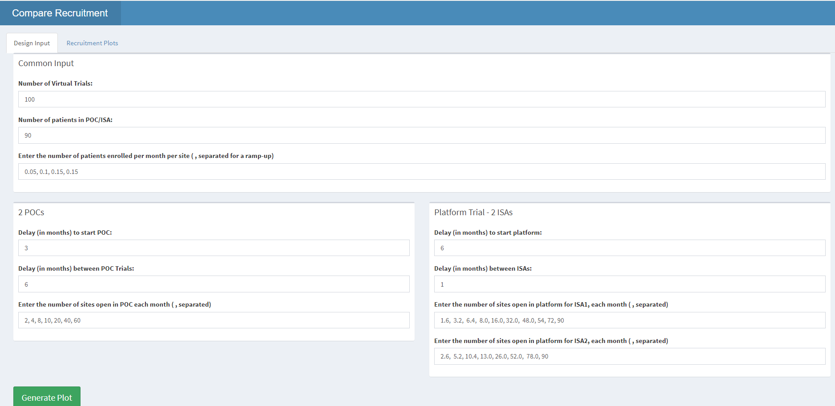

Slide 27
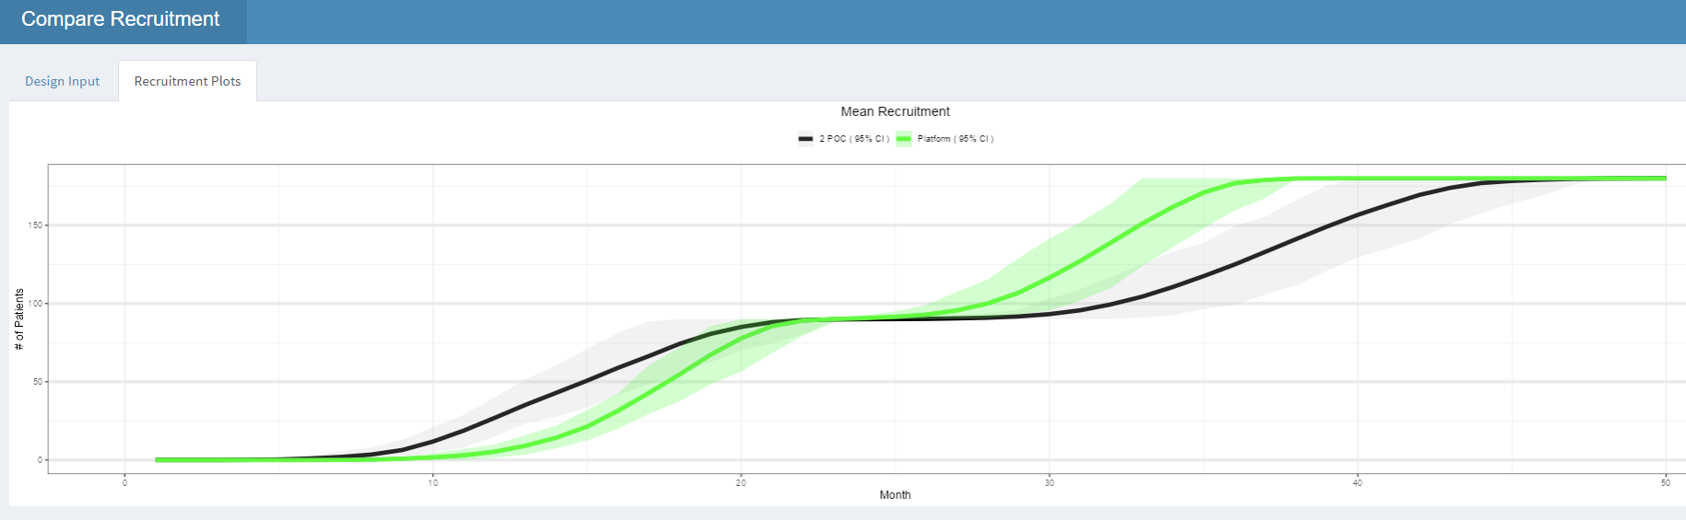

Slide 28
Platform Trial Simulation
Simulating an adaptive trial can be difficult
Simulating a 2-arm adaptive trial and using the results for a platform trial for all ISAs does NOT give an adequate understanding of how a platform trial will function in practice
Simulating patient data using the same model as analysis is a good starting point, but does NOT give an adequate understanding of how a platform trial will function in practice
Simplifying assumptions are often needed, but try to limit how much simplification is done or the simulations will NOT give an adequate understanding of how a platform trial will function in practice
Teams are often new to platform trials, good to start showing simulations as soon as possible as many issues can be avoided.
Good to start with simple simulations that may be familiar to at some of the team, and expand in various directions

Slide 29
Example Simulation Outline
Where to Find Code
1.Example1Start – Code generated with OCTOPUS
2.Example1 – Modified code for simulation
3.Example1Borrow
4.Example2
5.Example3
Example 1 – Start Simple
2 ISAs (2 experimental treatments), ISA 2 starts at month 6.
Ramp up in recruitment – 5, 10, 15 patients per month for month 1, 2, 3 and after
Normal endpoint
Bayesian regression model β₀ + β₁*I( Treatment= Experimental) via JAGS
Assume all control patients are borrowed
Design 1) Fixed sample size, ISA 1: 85:85, ISA2: 100:100
Alternative Designs: 2) double sample size, 3) add interim analysis
Example 2 – Expand focus on borrowing, tradeoffs
Bayesian regression model β₀ + β₁*I( Treatment= Experimental) + β₂*I( External Control)
Add option with no borrowing of control
Borrow control with external control model (in this example external means enrolled in another ISA)
Simulate patient drift (included for statistical audience, normally include this later on an as needed basis)
Example 3 – Adding IA – Focus on timeline tradeoff
Example 4 – Impact of timing of ISA addition (who goes first?)

Slide 30
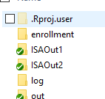
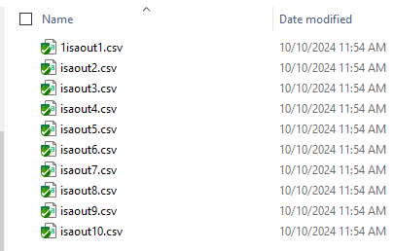
General Workflow for Using OCTOPUS
Setup a file to allow you to call OCTOPUS::CreateProject
Modify files as needed (most common BuildMe.R, analysis, and patient simulation)
BuildMe.R
Create the simulation objects
Run simulation
Post Process
Combine results
Process simulation results
Create graphs or simulation report

Slide 31
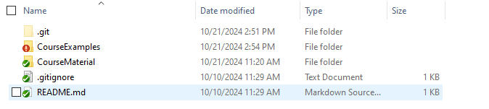
Example 1 - Start
Start in the CourseExamples folder
Open Step1-CreateProject.R file
After executing the CreateProject
Example 1 – Start Simple
2 ISAs (2 experimental treatments), ISA 2 starts at month 6.
Ramp up in recruitment – 5, 10, 15 patients per month for month 1, 2, 3 and after
Normal endpoint
Bayesian regression model β₀ + β₁*I( Treatment= Experimental) via JAGS
Assume all control patients are borrowed
β₀ ~ Normal( m₀, s₀ ) β₁ ~ Normal( m₁, s₁ )
Design 1) Fixed sample size, ISA 1: 85:85, ISA2: 100:100
Alternative Designs: 2) double sample size, 3) add interim analysis
What scenarios do we want to run?
Specify mean on control and experimental as well as standard deviation for each scenario and ISA

Slide 32
Changes to OCTOPUS Generated Code - Analysis
Copy the BayesianNormalRegressionFunctions.R file
R/RunAnalysis.BayesNormalRegression.R – Read off the priors for beta0 and beta1, setup data list for the JAGS mode, call SamplePosterior
dBeta0PriorMean <- cAnalysis$dBeta0PriorMean
dBeta0PriorSD <- cAnalysis$dBeta0PriorSD
dBeta1PriorMean <- cAnalysis$dBeta1PriorMean
dBeta1PriorSD <- cAnalysis$dBeta1PriorSD
# Need vTrt to be an indicator of the Experimental treatment
vTrt <- ifelse( vTrt ==1, 0, 1 )
# Setup the list that is sent to sample the posterior, including data and prior info from the cAnalysis
lData <- list( nQtyPats = length( vTrt ),
vY = vOut,
vTreatment = vTrt,
dBeta0PriorMean = dBeta0PriorMean,
dBeta0PriorSD = dBeta0PriorSD,
dBeta1PriorMean = dBeta1PriorMean,
dBeta1PriorSD = dBeta1PriorSD )
# Note: These values could be added to the input if you are trying to determine them
nQtySamplesPerChain <- 2500
dDelta <- cAnalysis$dMAV
lPost <- SamplePosterior( lData, cAnalysis, nQtySamplesPerChain , dDelta )
dPrGrtMAV <- lPost$dPrGrtMAV
3. BuildMe.R – load the R2jags library, Update prior code, source additional file
lCommonPrior <- list( dBeta0PriorMean = 0, dBeta0PriorSD = 100, dBeta1PriorMean = 0, dBeta1PriorSD = 100 )
lAnalysis <- replicate( 2, lCommonPrior, simplify = FALSE)
…
source( "R/BayesianNormalRegressionFunctions.R")

Slide 33
Changes to OCTOPUS Generated Code – Patient Simulation
R/SimPatientOutcomes.Normal.R – Read off the priors for beta0 and beta1, setup data list for the JAGS mode, call SamplePosterior
vMean <- c( cSimOutcomes$MeanCtrl, cSimOutcomes$MeanExp )
vStdDev <- c( cSimOutcomes$StdCtrl, cSimOutcomes$StdExp )
# In the for loop change from simulating binary data to normal data
vPatientOutcomes <- rnorm( vQtyPats[ iArm ], mean = vMean[ iArm ], sd = vStdDev[ iArm ])
2. BuildMe.R – Update scenario code to use the variables above
dfScenarios <- data.frame( Scenario = integer(), ISA = integer(),
MeanCtrl = double(), MeanExp = double(),
StdCtrl = double(), StdExp = double() )
dfScenarios <- dfScenarios %>% dplyr::add_row(Scenario= 1, ISA= 1:2, MeanCtrl=0, MeanExp=0, StdCtrl= 10, StdExp= 10) %>% dplyr::add_row( Scenario = 2, ISA = 1:2, MeanCtrl = 0, MeanExp = 5, StdCtrl = 10, StdExp = 10 ) %>% dplyr::add_row( Scenario = 3, ISA = 1, MeanCtrl = 0, MeanExp = 0, StdCtrl = 10, StdExp = 10 ) %>% dplyr::add_row( Scenario = 3, ISA = 2, MeanCtrl = 0, MeanExp = 5, StdCtrl = 10, StdExp = 10 )
Update the source before the RunSimulation command to include the following:
source( "R/BayesianNormalRegressionFunctions.R")
library( R2jags)

Slide 34
Example 1 - Start
Start in the CourseExamples folder
Open Step1-CreateProject.R file
After executing the CreateProject
Example 1 – Start Simple
2 ISAs (2 experimental treatments), ISA 2 starts at month 6.
Ramp up in recruitment – 5, 10, 15 patients per month for month 1, 2, 3 and after
Normal endpoint
Bayesian regression model β₀ + β₁*I( Treatment= Experimental) via JAGS
Assume all control patients are borrowed
β₀ ~ Normal( m₀, s₀ ) β₁ ~ Normal( m₁, s₁ )
Design 1) Fixed sample size, ISA 1: 85:85, ISA2: 100:100
Alternative Designs: 2) double sample size, 3) add interim analysis
What scenarios do we want to run?
Specify mean on control and experimental as well as standard deviation for each scenario and ISA

Slide 35
Utilizing Multiple Cores (Faster Simulations)
Example in BuileMeRunMultiCore.R – Initially same setup as the BuildMe.R
Copy simulation object setup from the BuildMe.R
Add the source and load of libraries to the R/RunParallelSimulations.R file

Slide 36
Example 2 – Focus on borrowing, tradeoffs
Compare no borrowing to platform with borrowing
Bayesian regression model β₀ + β₁*I( Treatment= Experimental)
Bayesian regression model β₀ + β₁*I( Treatment= Experimental) + β₂*I( External Control)
Simulate patient drift (included for statistical audience, normally include this later on an as needed basis)
Found in the 3.Example1Borrow folder

Slide 37
Example 2 (Cont)
Bayesian regression model β₀ + β₁*I( Treatment= Experimental) + β₂*I( External Control)
Update build me files to have 3 design options
Add scenarios with drift
Scenario 1 – Null
Scenario 2 – Mean on Exp = 5 for both ISAs
Scenario 3 – ISA 1: Mean on control = 0, Mean on Exp = 5
ISA 2: Mean on control = 5, Mean on Exp = 5
Scenario 4 – ISA 1: Mean on control = 0, Mean on Exp = 5
ISA 2: Mean on control = 5, Mean on Exp = 10

Slide 38
Changes to the Code
1. Start with RunAnalysis.BayesNormalRegression and save as RunAnalysis.BayesNormalRegressionWithISAEffect
Add:
vExternalControl <- ifelse( vISA != cAnalysis$nISA & vTrt == 1, 1, 0 )
vExternalControl <- vExternalControl[ !is.na( vOut ) ]
# Pull the additional prior
dBeta2PriorMean <- cAnalysis$dBeta2PriorMean
dBeta2PriorSD <- cAnalysis$dBeta2PriorSD
Add vExternalControl = vExternalControl and additional priors to the lData list
Call SamplePosteriorWithISAEffect for sampling posterior
2. Start with BayesianNormalRegressionFunctions.R and save as BayesianNormalRegressionFunctionsWithISAEffect.R
Update the name of function to SamplePosteriorWithISAEffect
Update the mean to vMean[ i ] <- dBeta0 + vTreatment[ i ]*dBeta1 + vExternalControl[ i ]*dBeta2
Add the prior
dBeta2 ~ dnorm( dBeta2PriorMean, 1/( dBeta2PriorSD*dBeta2PriorSD ) )
Track dBeta2 if desired
In the InitsNormalModel update the function name and add
dBeta2 <- rnorm( 1, cAnalysis$dBeta2PriorMean, cAnalysis$dBeta2PriorSD )

Slide 39
Changes to the Code
3. BuildMe Changes
Under the prior add a new prior
lCommonPriorISAEff <- list( dBeta0PriorMean = 0, dBeta0PriorSD = 100,
dBeta1PriorMean = 0, dBeta1PriorSD = 100,
dBeta2PriorMean = 0, dBeta2PriorSD = 100 )
lAnalysisISAEff <- replicate( 2, lCommonPriorISAEff, simplify = FALSE)
Update design 1 to no borrow control patients
cTrialDesign <- SetupTrialDesign( strAnalysisModel = "BayesNormalRegression",
strBorrowing = "NoBorrowing",
Replace design 3 with a copy of design 2 updating analysis model
cTrialDesignTmp <- SetupTrialDesign( strAnalysisModel = "BayesNormalRegressionWithISAEffect",
strBorrowing = "AllControls",
...
lAnalysis = lAnalysisISAEff
Source the new files – Make sure to add this also to the RunParallelSimulations function
source( "R/BayesianNormalRegressionFunctionsWithISAEffect.R")
source( 'R/RunAnalysis.BayesNormalRegressionWithISAEffect.R' )

Slide 40
Interim Analysis Options
No interim analysis
Any number of IAs specified, each specified by a number of patients enrolled with a set amount of follow-up
Example: IA 1 when 25% enrolled with 8 weeks follow-up,
IA 2 when 50% enrolled with 12 weeks follow-up
FA when 100% enrolled with 24 week follow-up
Specify when to start IA and how frequently to preform additional analysis
Example: Start 2 months after 30 patient enrolls then perform analysis every 3 months
https://kwathen.github.io/OCTOPUS/reference/CheckTrialMonitor.html
Updates for the example
For the designs that “borrow” add IA at 50% of patients enrolled with 1 month of follow-up
Using higher decision boundaries at the IA to avoid making the wrong decision to with insufficient data

Slide 41
Adding Interim Analysis – Code Changes
Update to BuildMe.R
Copy designs 2 and 3 and paste them below design 3
This will create designs 4 and 5 that we add IA to
Design 2 & 4 are the same, but 4 has IA. Design 3 & 5 are the same but 5 has an IA
Add the following code at the start of design 4
mMinQtyPats <- cbind( floor(apply( mQtyPatientsPerArm , 1, sum )/2), apply( mQtyPatientsPerArm , 1, sum ) )
vMinFUTime <- rep( dQtyMonthsFU, ncol( mMinQtyPats) )
dQtyMonthsBtwIA <- 0
vPUpper <- c( 0.99, 0.99 )
vPLower <- c( 0.05, 0.05 )
dFinalPUpper <- 0.975
dFinalPLower <- 0.05
Update the call to SetupTrialDesign
cTrialDesignTmp <- SetupTrialDesign( strAnalysisModel = "BayesNormalRegression",
strBorrowing = "AllControls",
mPatientsPerArm = mQtyPatientsPerArm,
mMinQtyPat = mMinQtyPats,
vMinFUTime = vMinFUTime,
dQtyMonthsBtwIA = dQtyMonthsBtwIA,

Slide 42
Example 4 – Impact of timing of ISA
Who goes first?
Results and code are in 5.Example3 folder
Updates for this example:
Make both ISAs have a sample size of 100 per arm
Add scenarios with drift
Scenario 1 – Null
Scenario 2 – Mean on Exp = 5 for both ISAs
Scenario 3 – ISA 1: Mean on control = 0, Mean on Exp = 5
ISA 2: Mean on control = 0, Mean on Exp = 2
Scenario 4 – ISA 1: Mean on control = 0, Mean on Exp = 2
ISA 2: Mean on control = 0, Mean on Exp = 5

Slide 43
Summary
OCTOPUS provides a flexible framework for simulating platform trials
It is not currently push button or UI driven
Requires R programming knowledge
Reduces the time to first simulation results significantly
Simulations have been run in the cloud with 6000+ cores
Personally utilized for design and simulation of more than 20 trials in various disease areas
Open source, if you are interested reach out
Future direction: maybe add directly to the package or build companion packages (eg analysis, various patient simulator) or build pipelines for other R packages or commercial software integration
Platform trials
High quality simulations are critical to understanding how the trial will preform in practice
Many unknowns, try to limit simplifying assumptions where possible
Simulate the trial you plan to run
Explaining simulation results to non-statisticians be very difficult
Platform trials may NOT be the best options, always consider the trade-off between complexity and results.

Slide 44
Thank You! Kyle.Wathen@Cytel.com

Slide 45
Previous Slides

Slide 46
Initial Design
Fixed design
Value of a control arm vs using historical data
Binary outcome at 6 months
Also had two other outcomes under consideration with longer outcome window
Understand borrowing of control patient data from earlier ISAs or historical data, and risks associated with it
Understand the impact of having treatments start at different times
Understand timelines of when things would occur

Slide 47
Statistical Model
For simplicity, ignore ISA
X ~ Binary( π_{i} ) for i = C (Control) or E (Experimental)
Priors
π_{c} ~ Beta( a, b ); Vary amount of prior data utilized
Non-informative π_{c} ~ Beta( 0.15, 0.85 );
Reflect prior response rate of 15%
π_{E} ~ Beta(0.15, 0.85 ); Assume prior response rate is same C/E
Decision Criteria
Assuming a Minimal Acceptable Value (MAV) decisions are based on
p = Pr(π_{E} - π_{c} > MAV | data ) > P_{U} → E is better than C
Use MAV = 0 for decision making but may also be interested in MAV = 0.2

Slide 48
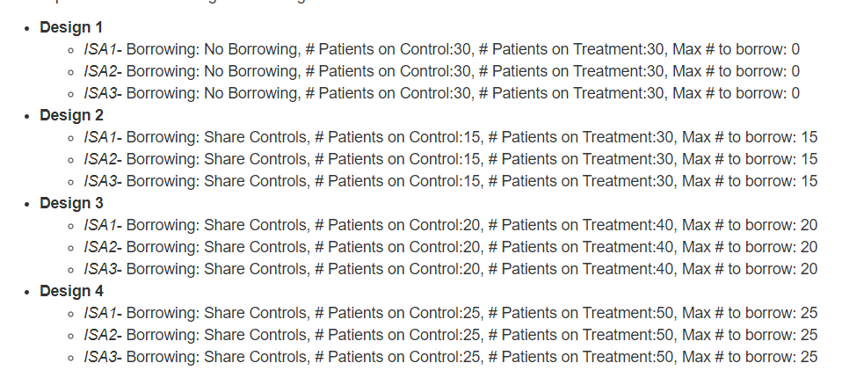
Trial Design – An Iterative Process Starting with a Fixed Design
Explanation of Borrowing:
First two ISAs would begin the at the start of platform and borrowing patients is done first from concurrent ISAs then most recent as needed. Done to prioritize use of concurrent patients

Slide 49
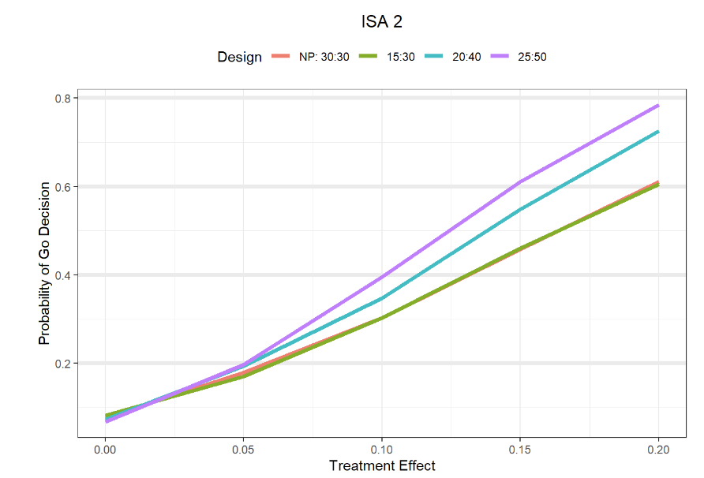
Probability of Making a Go Decision

Slide 50
Probability of Making a Go Decision

Slide 51
Probability of Making a Go Decision
Platform - Smaller Sample Size, Same Probability of Go

Slide 52
Probability of Making a Go Decision
Platform – Same Sample Size, Higher Probability of Go

Slide 53
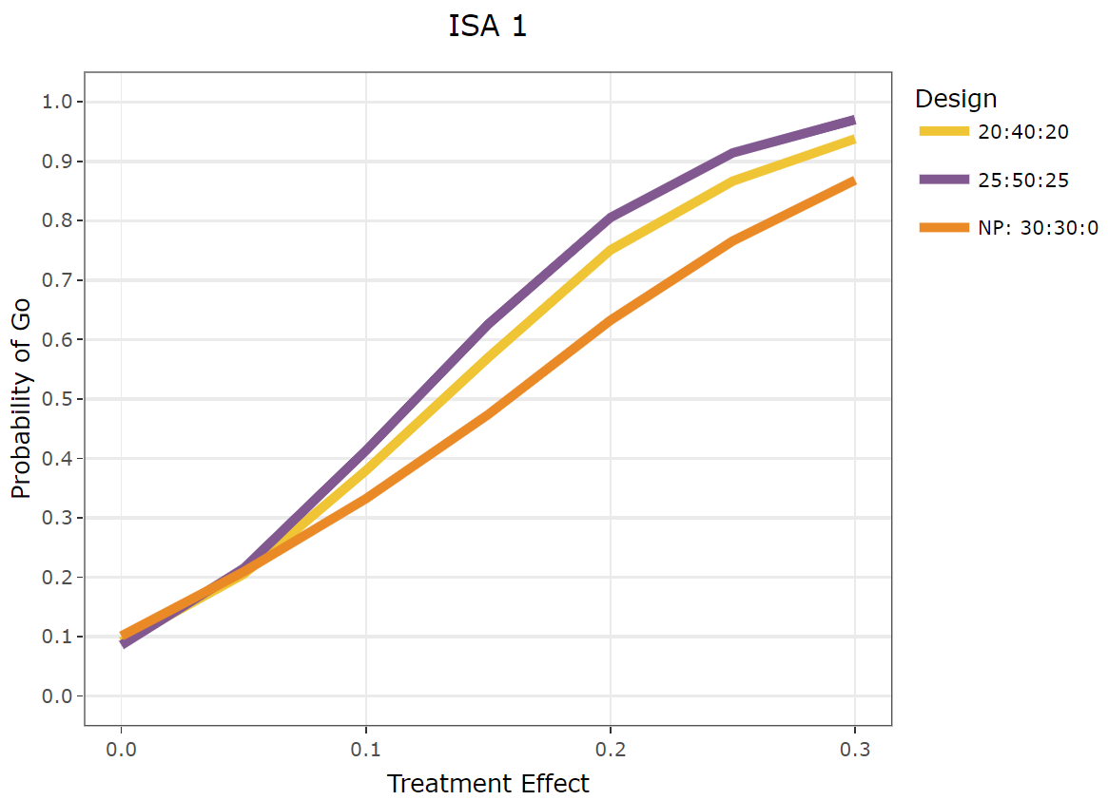
Sample Size Comparison
Adding the number of “borrowed” patients
Futility?
Expanded treatment effect

Slide 54
Interim Analysis for Futility
For simplicity, ignore ISA
X ~ Binary( π_{i} ) for i = C (Control) or E (Experimental)
Priors
π_{c} ~ Beta( 0.15, 0.85); Vary amount of prior data utilized
Reflect prior response rate of 15%
π_{E} ~ Beta(0.15, 0.85 ); Assume prior response rate is same C/E
At Interim Analysis – Futility Decision
p = Pr(π_{E} - π_{c} > MAV | data ) < P_{L} → E is UNLIKELY better than C → Stop for futility
At Final Analysis Decision Criteria
p = Pr(π_{E} - π_{c} > MAV | data ) > P_{U} → E is better than C

Slide 55
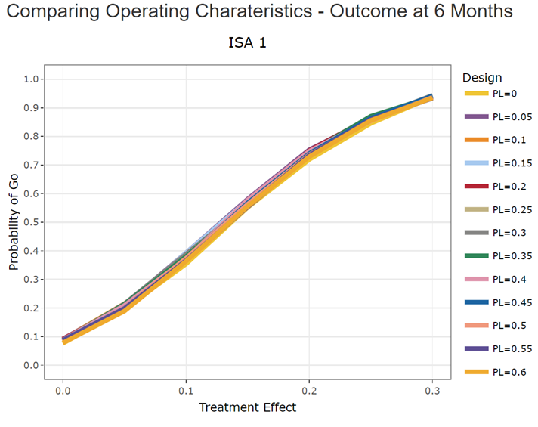
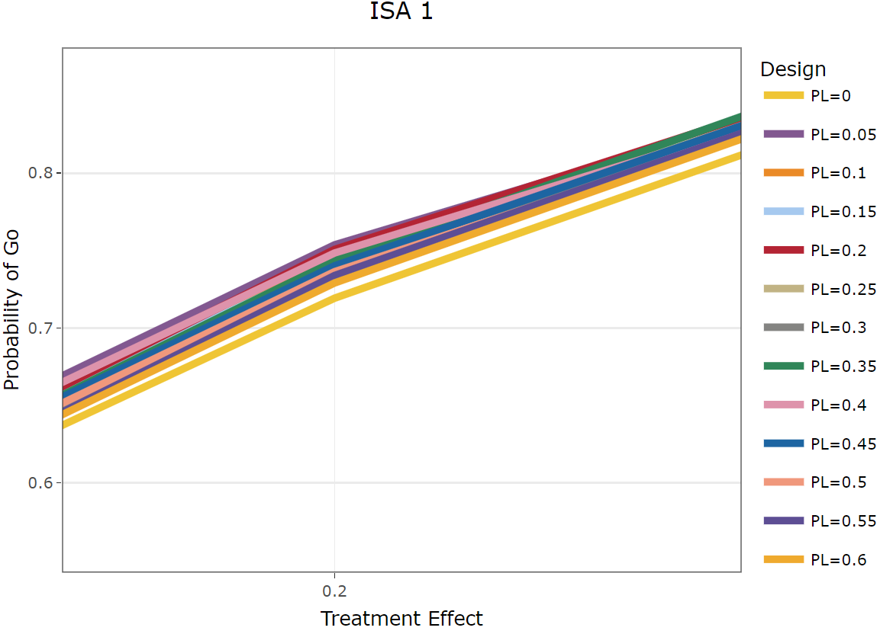
Interim Analysis for Futility – Probability of Go

Slide 56
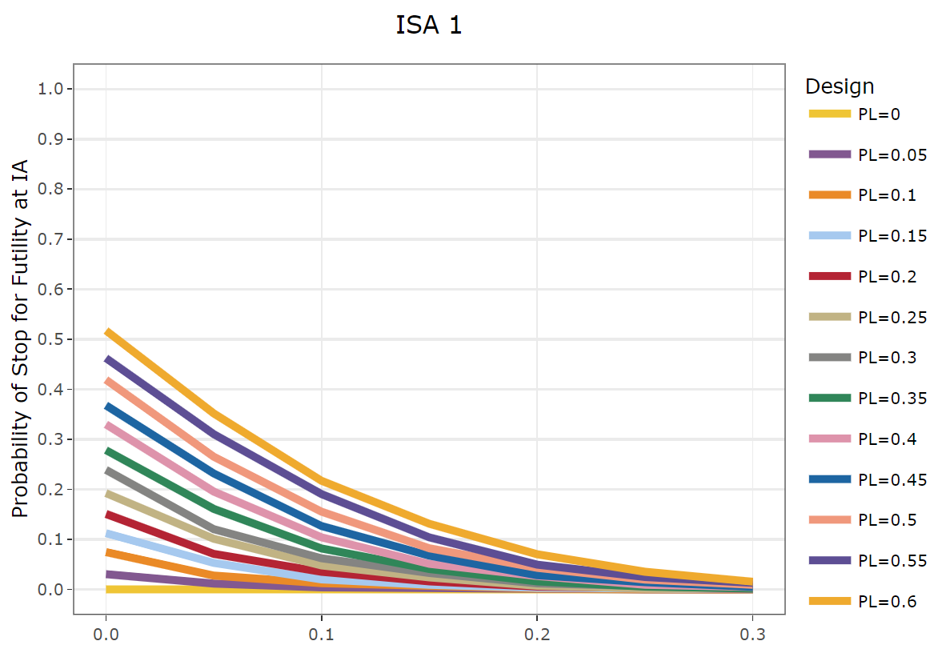
Probability of Futility at IA

Slide 57
Visuals Can Make it Difficult to Convey Trade-off

Slide 58
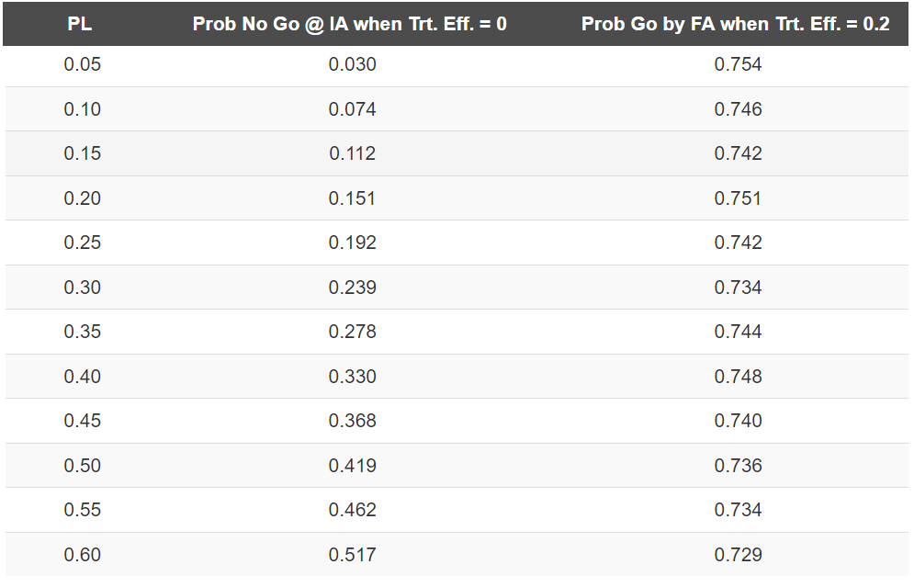
Trade-off Futility vs Go Probability

Slide 59
What does this mean to individual trials?

Slide 60

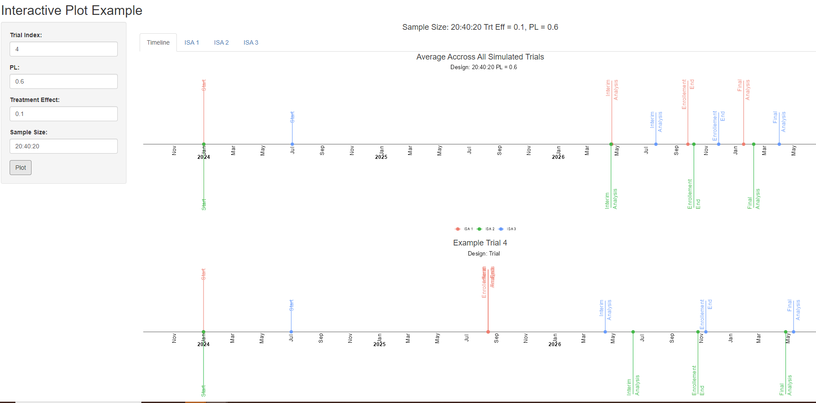

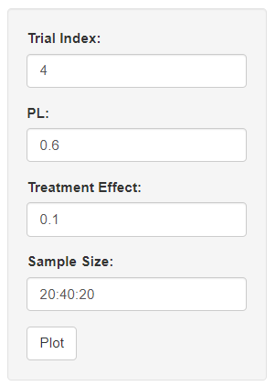




Slide 61
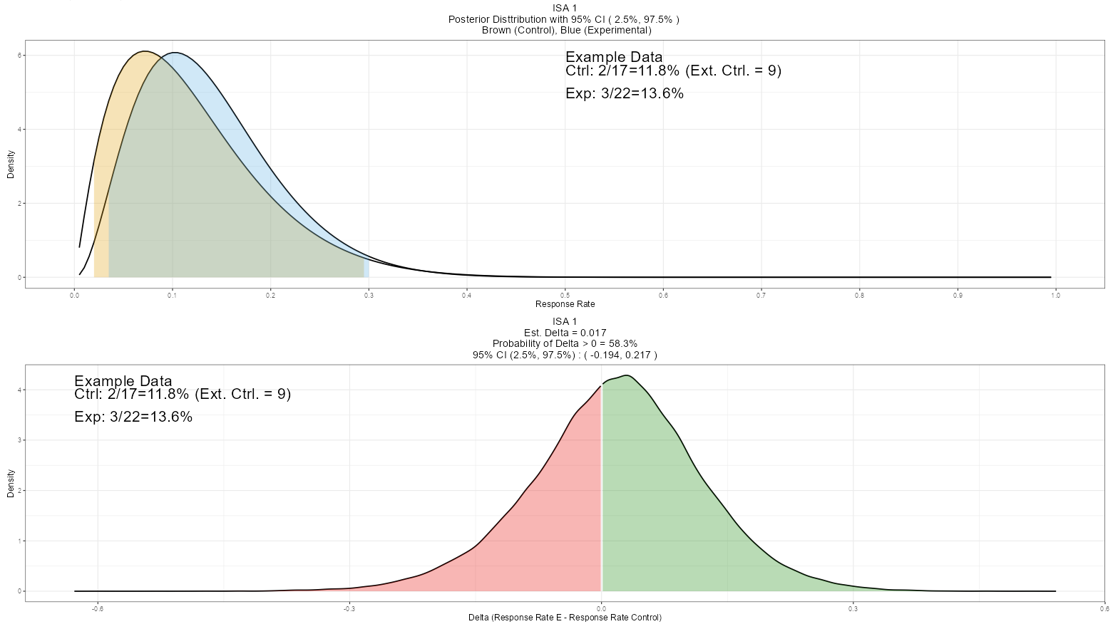

Slide 66
How likely is it that E will be selected as superior at the end?

Slide 67
Bayesian Predictive Probabilities
Current Data: Control (2/17) – N = 13 remaining
Experimental (3/22) – N = 8 remaining
 |  | Experimental
 |  | 0/8 | 1/8 | … | 8/8
Control | 0/13 | C: 2/30; E: 3/30 | C: 2/30; E: 4/30 | … | C: 2/30; E: 11/30
 | 1/13 | C: 3/30; E: 3/30 | C: 3/30; E: 4/30 | … | C: 3/30; E: 11/30
 | … | … | … | … | …
 | 13/13 | C: 16/30; E: 3/30 | C: 16/30; E: 4/30 | … | C: 16/30; E 11/30
Each Cell Compute: p_{i,j} = Pr(π_{E} - π_{c} > MAV | data ), i = # responses on C, j = # responses on E
If p_{i,j} > P_{U} → Compute likelihood using Beta-Binomial distribution as p’_{i,j}
Otherwise p’_{i,j} = 0
→ Predictive probability of success is the sum of p’_{i,j}

Slide 68
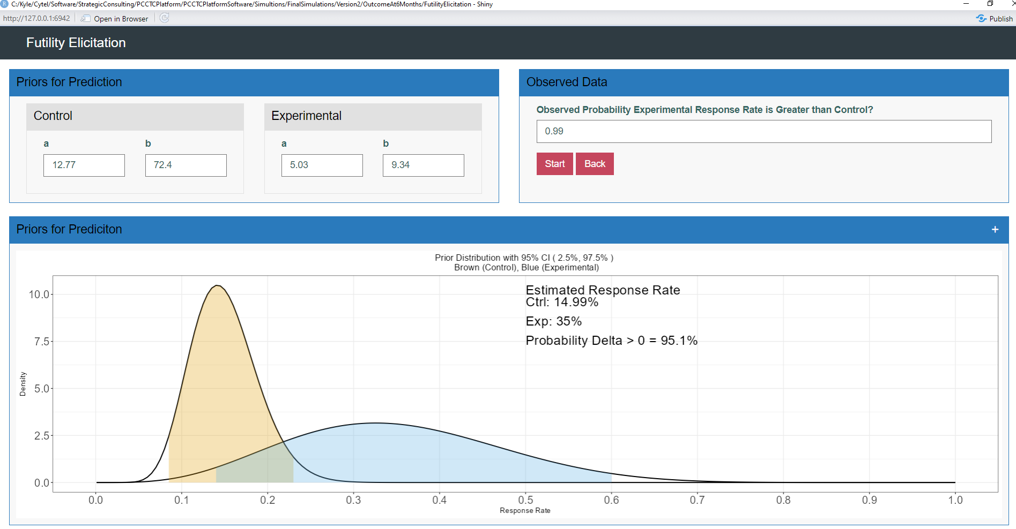

Slide 69
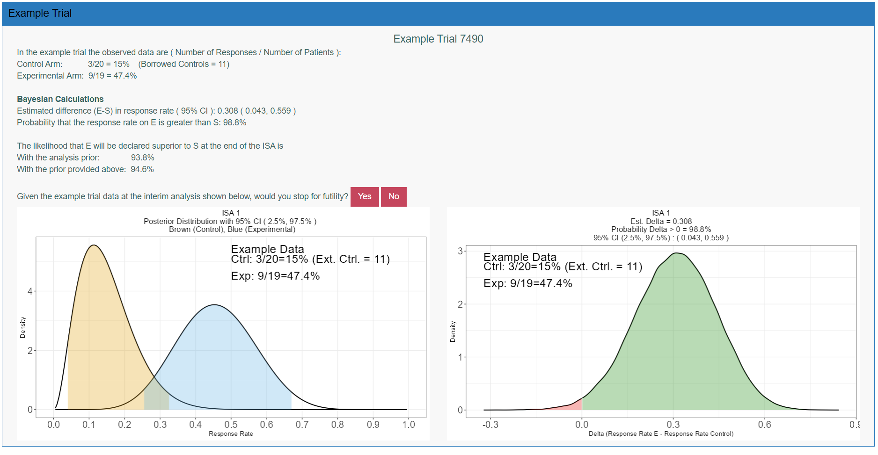

Slide 70
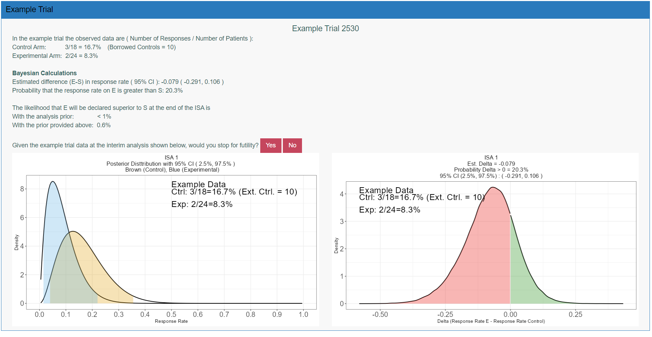

Slide 71
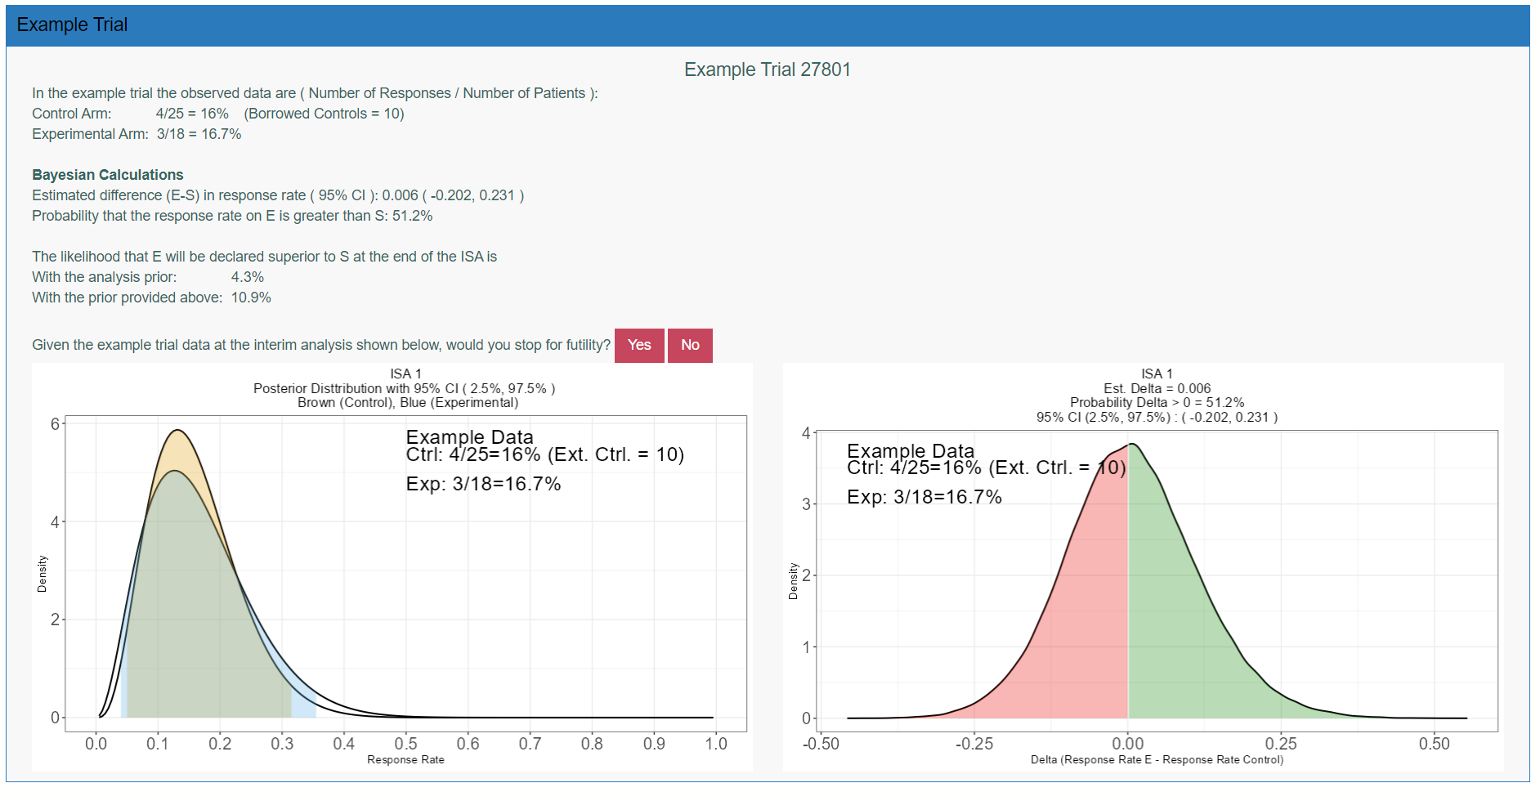
`

Slide 72
Summary
Platform studies can be difficult to design
Beginning with score card and quick start worksheet can help identify potential issues and provide input to simulation plan
OCTOPUS – simulations running quickly by leveraging exiting R code
Walking through trade-offs can lead to additional calculations that are useful – Predictive Probabilities
Walking through example trials can demonstrate potential data sets that the team may encounter at an interim analysis allowing for checking for agreement between design recommendations based on analysis and the team decision
Variety of visuals, tables, example trial walk through, and shiny app helped to improve communication and team understanding

