Slide 1
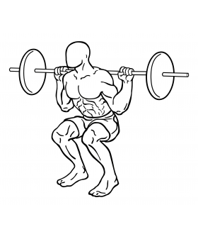
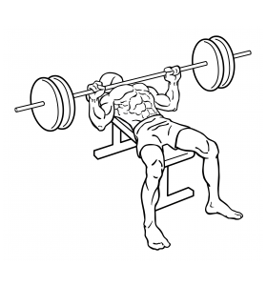
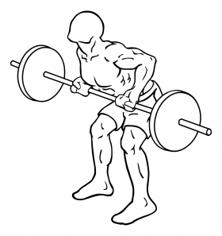
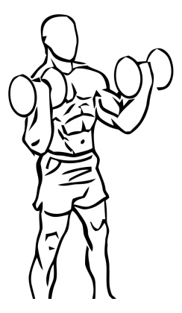
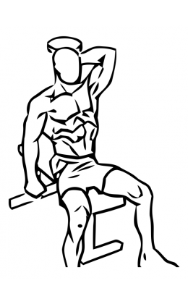
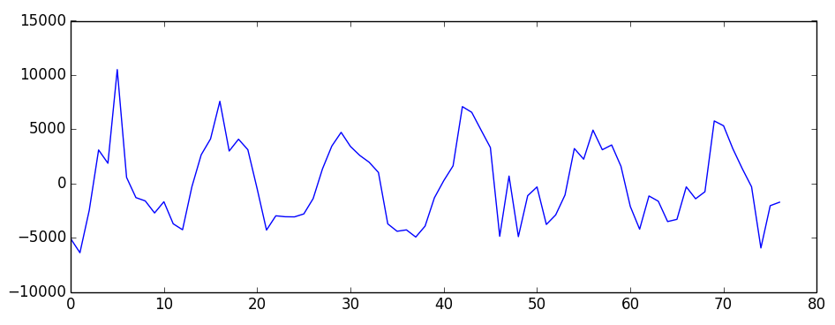
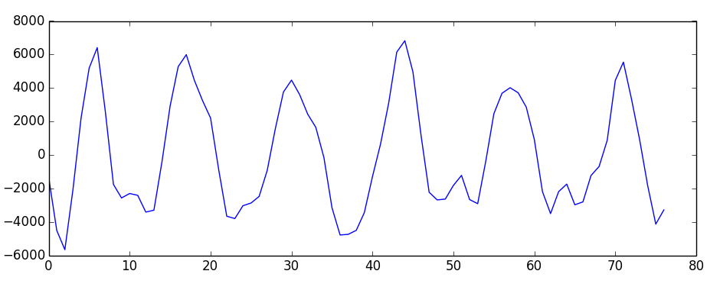
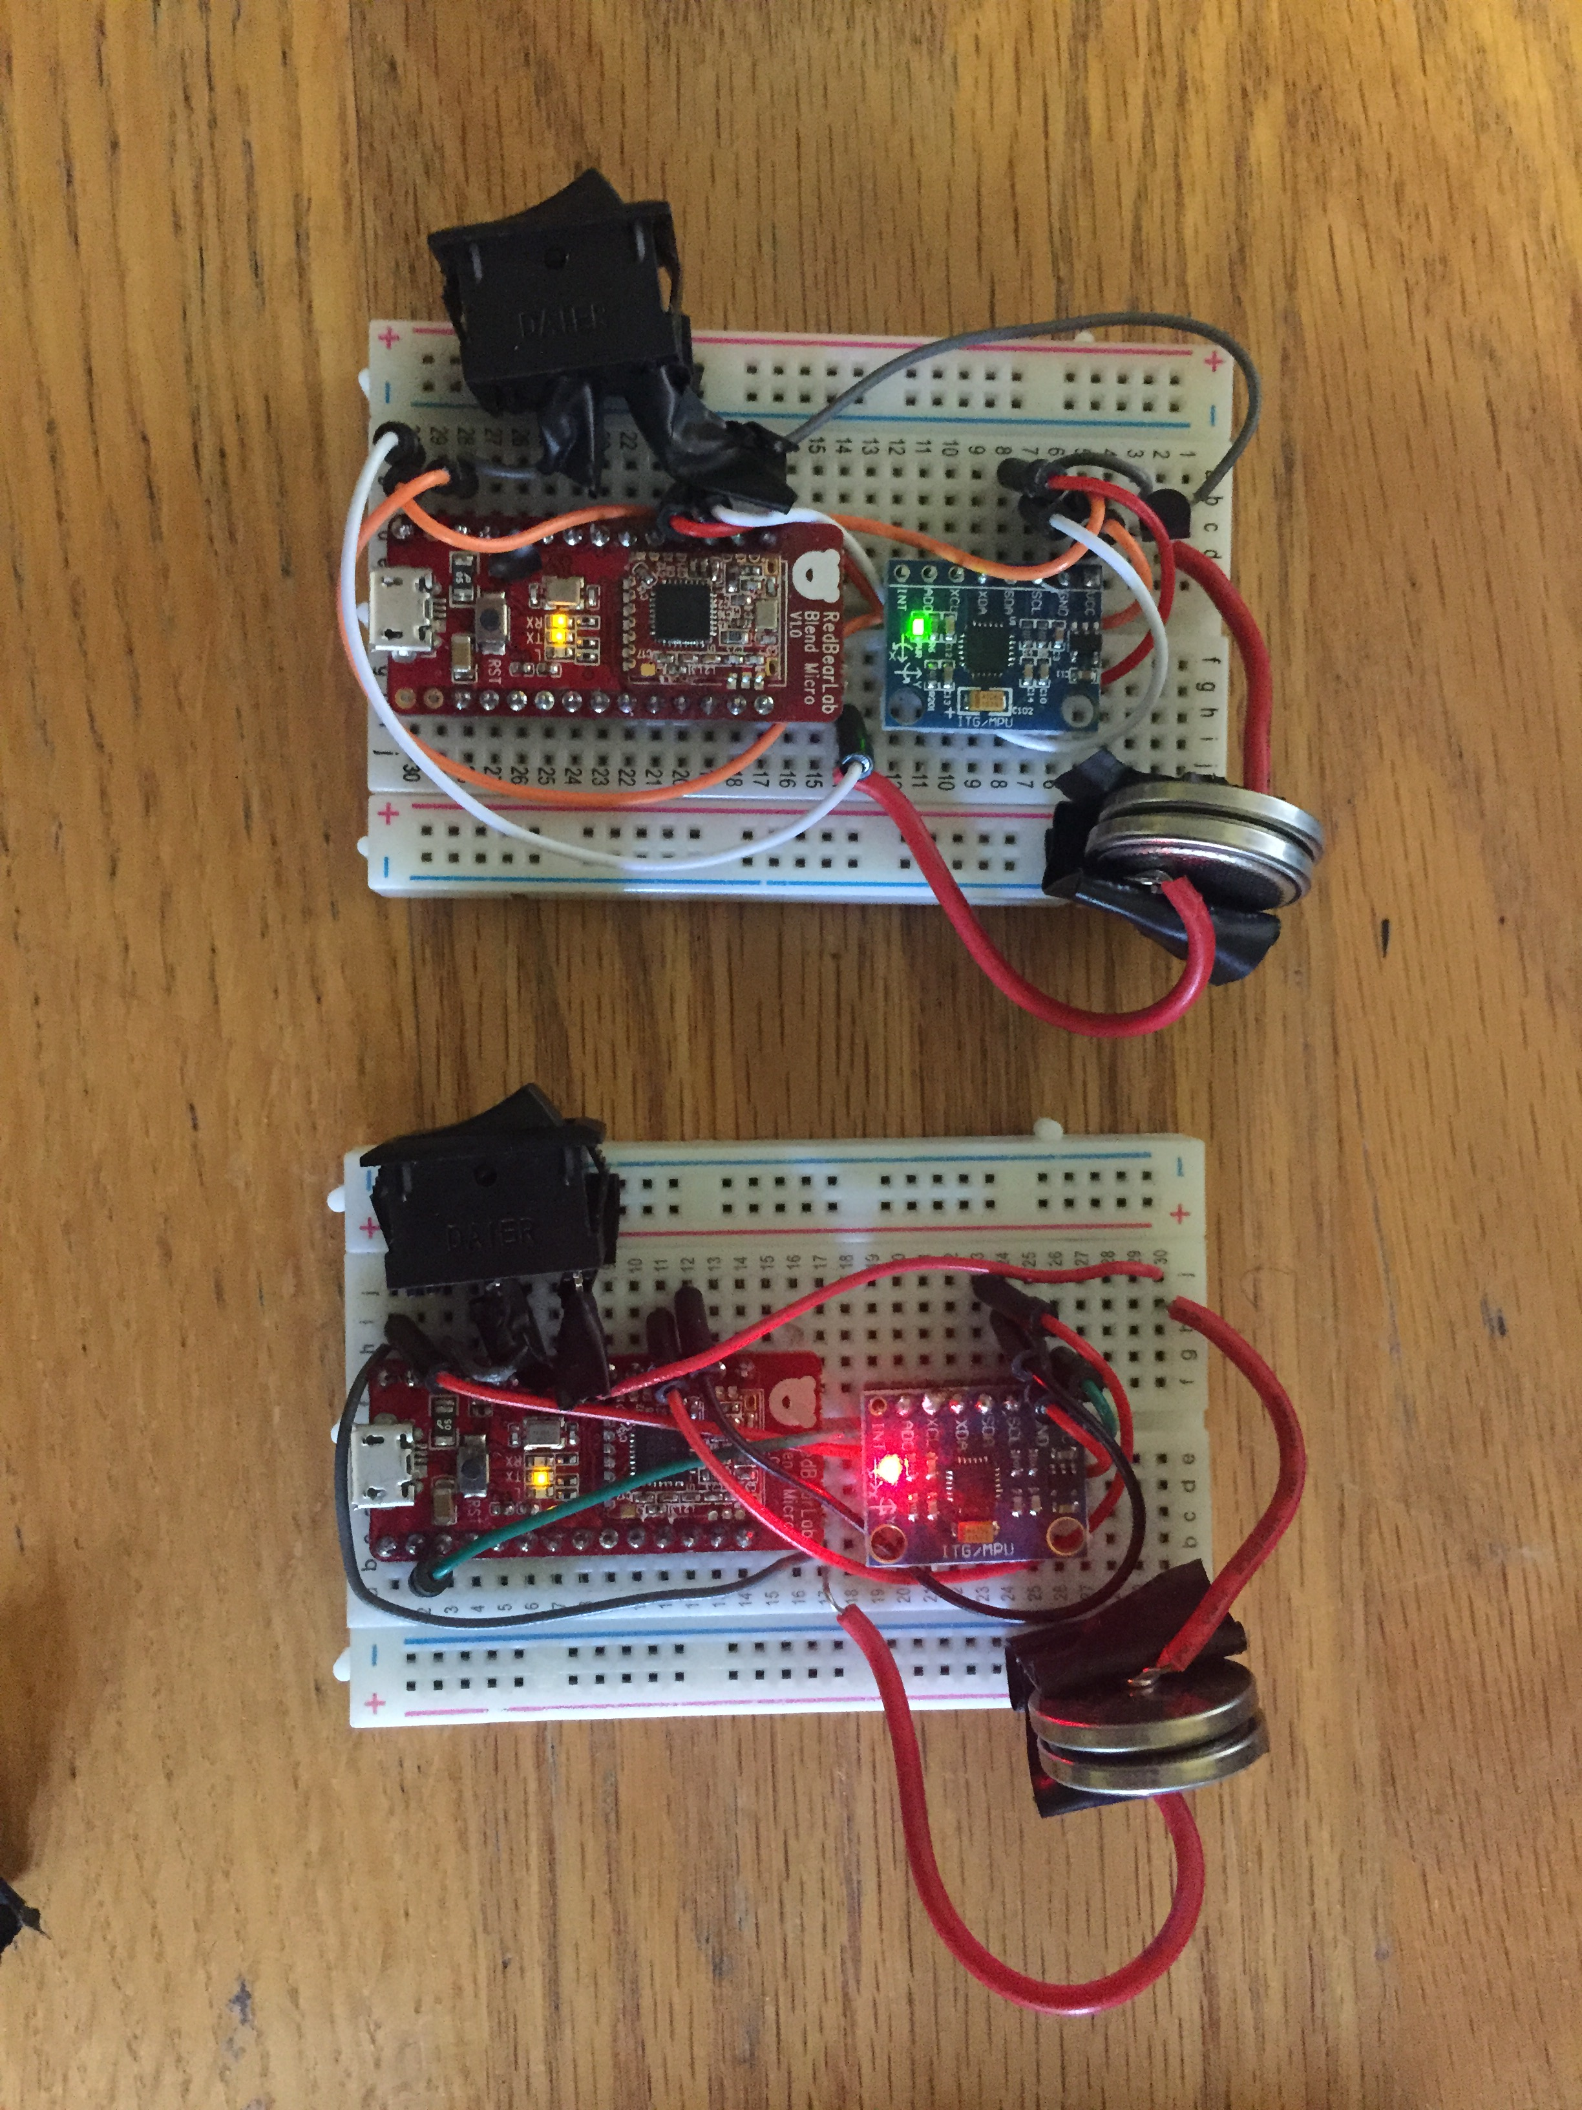
Activity Recognition for Weight Lifting
a b c d e
Determines what exercise is being performed with 95% accuracy
Counts repetitions with 100% accuracy
Data Collection
Activity Recognition
Rep Counting
Collected inertial sensing data from 11 individuals.
Each subject performed the same lifting regiment: 3 sets of 5 repetitions of each exercise: squats (a), bench press (b), rows (c), bicep curls (d), tricep extensions (e)
AccelY <= -0.5g
True
False
Bent Over Rows
AccelZ <= -0.25g
Bicep Curls
AccelZ <= 0.30g
AccelX <= 0.46g
Squats
Bench Press
Tricep Extensions
Biquadratic IIR filter removes noise; then count zero crossings
Fc = 3.5 Hz, Q = 0.7, Gain = 6 dB (chosen experimentally)
Trained CLF Tree uses mean values of accelerometer X, Y, Z axes to recognize activity

