Slide 1



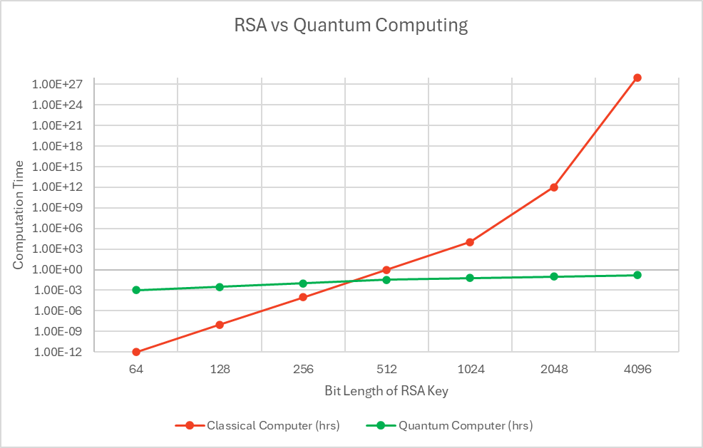
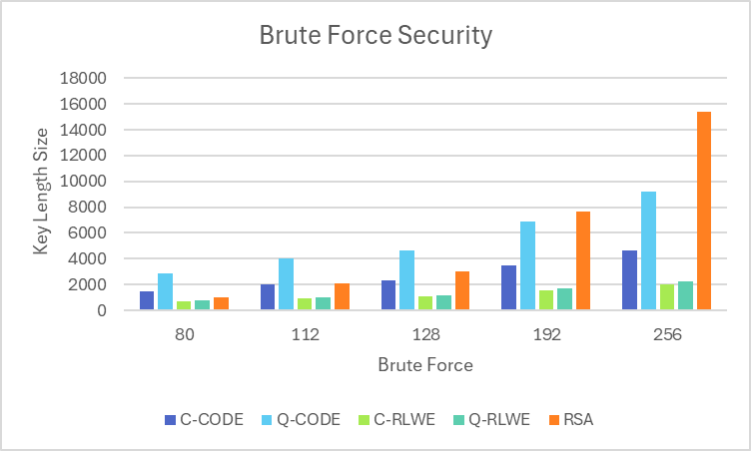
Quantum-Secure Cryptology Implementation in Cryptocurrency
1/c Cowen Bland, 1/c Kyle Boe, 1/c Torin Kearney, 1/c Felix Hernandez-Kossick
Advisor: LT William Maxam Sponsor: LCDR Ryan Quarry
Problem Statement:
The absence of quantum-secure cryptologic technique in modern digital applications poses a significant risk as quantum computing advances.
Project Overview:
Objective: Develop a proof-of-concept demonstrating that quantum-resistant cryptology is practical using classical resources, by creating a quantum-secure cryptocurrency. It will be able to support the simultaneous implementation of quantum-secure signing, hashing, and secure communication (key exchange) algorithms.
Capstone Github Repository
Why Care about Quantum Security?
The graph on the left depicts the length of time it will take a classical computer vs. a quantum computer to break RSA keys. The graph on the right depicts the minimum key size necessary to resist brute force attacks. Comparing RSA, non-quantum secure, and quantum secure algorithms. These graphs demonstrate that when quantum computers become available, current algorithms we rely on can be broken relatively quickly, highlighting the need for a proactive defense.
Source: https://www.sidnlabs.nl/downloads/4oxVA1OT3RL4KUtZz3DuJv/cf8eda7b3a0c3dd34a9e4be2d1f0f5ee/centr-workshop-pqc.pdf, Source: F. Borges, P. R. Reis and D. Pereira, "A Comparison of Security and its Performance forKey Agreements in Post-Quantum Cryptography," in IEEE Access, vol. 8, Source: NIST SP 800-57 Part 1
Consensus Mechanisms
Criteria | Proof of Work | Proof of Authority | Proof of Stake + Proof of Help
Energy Efficiency | High energy use | Moderate | Low
Latency & Throughput | Variable latency | Mixed | Predictable, low latency
Security Against Attacks | 51% attacks possible | Centralized trust | Stake-based trust & verifiable timeline
Why a Cryptocoin?
Provides value with creation of immutable ledger in the form of a blockchain
Research value (new field)
Testbed that can support the simultaneous implementation of all our algorithms
Recommendations
Replace RSA with Dilithium2
Replace SHA-2 with SHA-3 (Keccak)
Implement NewHope into all comms
Our Chosen Algorithms vs the Field
 | Non-Repudiation |  | Data Integrity |  | Confidentiality
Criteria | RSA (Classical Signature) | Dilithium-2 (Quantum Signature) | SHA256 (Classical Hash) | SHA-3 (Keccak) (Quantum Hash) | ECDH (Classical Key Exchange) | NewHope (Quantum Key Exchange)
Quantum Security | Already broken with quantum tech available today | Resistant against quantum | Vulnerable to quantum | Designed for quantum era | Vulnerable to quantum | Resistant against quantum
Standardization | Long standing | NIST standard | Common | NIST standard | Widely used | NIST finalist
Performance | Very fast | Average ~ 5 millisecond Slower | Very Fast | Average ~ 70% of Sha 256 | Very Fast | Fast ~ 2 millisecond slower
Notes:
24 font
More Specific Recommendations

