Slide 1
Network Security
CS 6823 - Lecture 0
Introduction, Expectations, and Policies
Phillip Mak
pmak@nyu.edu

Slide 2
Who am I?
Phillip Mak
Information Assurance Engineer at the U.S. Army (since 2006)
Prior experience at N.Y.S.E (formally SIAC)
MS CS (concentration in Information Security) at Polytechnic University
Provide systems and security engineering services to Army programs during the development phase
Provide Cyber Security monitoring during live operational testing of networked system
Information Assurance for Smart Munitions

Slide 3
Course Organization

Slide 4
WARNING You will be learning potentially dangerous techniques in this course. By continuing the beyond this point you agree that all of the knowledge gained will be used in an ethical manner. The point of this course is to learn about network security not to harm people or systems. If you do, you will end up in jail and I won’t be able to (or will) save you.

Slide 5
Contact Information
The best way to reach me us by email:
pmak@nyu.edu
Office hours: By appointment.
Please do email me any suggestions, questions, topics, or interesting tidbits or articles you may have, which I will try go over them at the next class. This allows me to talk about topics that you have an interest with.

Slide 6
Course Website:
Main Website: https://newclasses.nyu.edu/
VLAB: https://vital.poly.edu/interim/
Syllabus - subject to change so check the NYU Classes “Syllabus”
Lecture Slides - will be posted one-week prior to class. Students must review the slides before the corresponding lecture
Assigned Readings are typically news and research articles related to current events in Cybersecurity

Slide 7
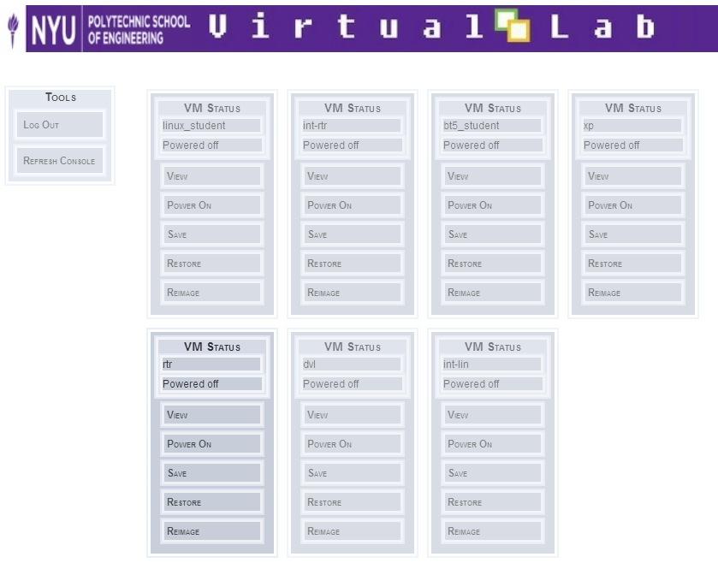
Virtual Lab (VLAB)
Allows usage and practice of security tools in a controlled environment. Lab 0 details how to get setup
https://vital.poly.edu/interim/
Register at https://vital.poly.edu/interim/registration.php
Registration Code:
__________
(To be given)

Slide 8
Course Goals
Understand the problems of securing a network
Understand the underlying protocols and technologies
Crypto, IPsec, SSL
Examine the methods and tools for attacking and defending a network
network reconnaissance, enumeration, exploits, tools.
defense tools (firewalls, ids, router, switches, wireless)
Explore some advanced topics
E.g., Wireless, IPv6
Notes:
Purpose: Security concepts, not specific technologies
Next several classes: All the steps that a hacker needs to break into a system:
Gathering information – what IP addresses are owned, topology
Identifying hosts and services
Finding vulnerabilities
Exploitation: gaining access, elevating access
Post-Exploitation: maintaining access, removing traces
Cryptography: how encryption works, how SSL works
Network Defense Tools
IPv6

Slide 9
Prerequisites
Good Foundation in Networking and TCP/IP. CS 684 or equivalent course in computer networking.
Reference: Internetworking with TCP/IP, Vol 1, 5th Edition, Doug Comer
Basic understanding of operating systems with a working knowledge of Linux.
Notes:
TCP/IP: understanding the OSI model
ARP vs. IP
Ethernet, IP, TCP packet
Linux – Lab 1
Course difficulty – Computer Security
- make clear what the prerequisits
- don't have it, they should drop the class
- NYU only has one week to add/drop. next monday
- 3.4 is the average grade

Slide 10
Textbook
No textbook assigned.
Rather than a textbook, reading materials (such as URLs, papers, news articles) will be regularly assigned and posted on NYU Classes.
Material from these sources are fair game for exams even if the material is not covered in class
Notes:
Stack Exchange

Slide 11
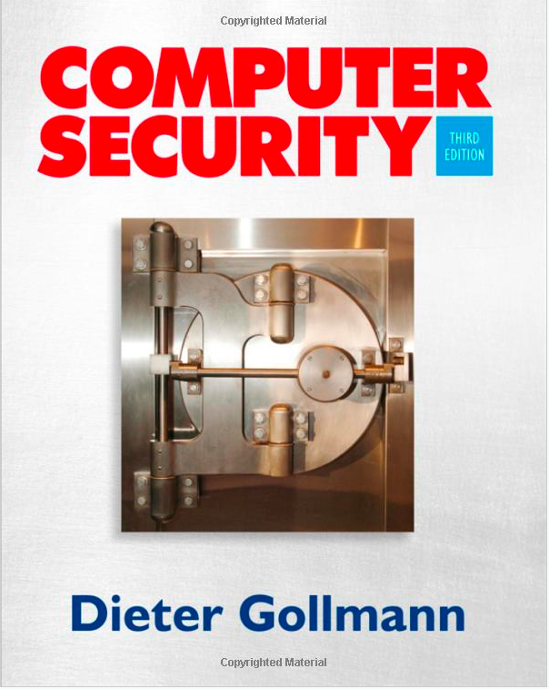
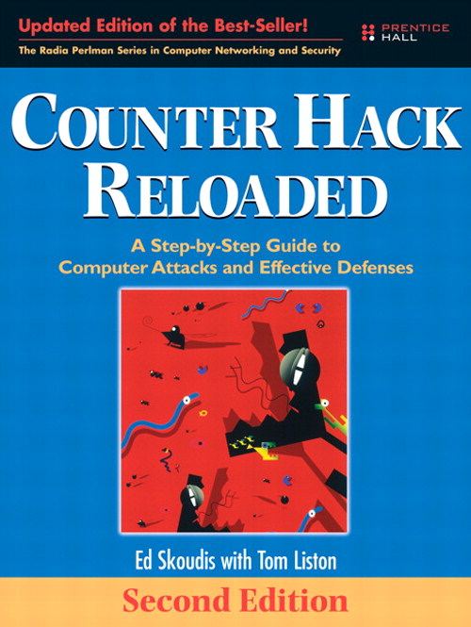
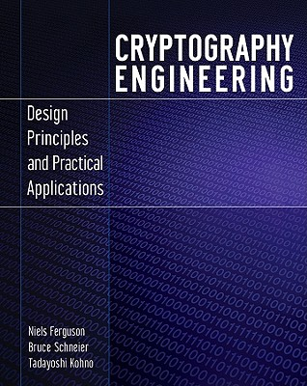
Optional Textbooks (none required)
Computer Security Second Edition (Optional)
Dieter Gollmann
ISBN: 0470741155
Published: 2011
Counter Hack Reloaded (Optional)
Ed Skoudis
ISBN: 0131481045
Published: 2006
Cryptography Engineering (Optional)
Neils Ferguson, Bruce Schneier
ISBN: 978-0-470-47424-2
Published: 2010
Notes:
Books not required, but it helps a lot to get you into the mindset of fundamentals

Slide 12
Course Policies
10% Homework & Quizzes
30% Labs
30% Midterm
30% Final
Syllabus on NYU Classes
No late assignments accepted. No Dropped Labs
Plagiarism policy – Don’t do it
https://engineering.nyu.edu/academics/code-of-conduct/academic-dishonesty
Notes:
How to get an A
change of grades are not allowed
Plagiarism in academics vs. legal
No tolerance

Slide 13
Course Expectations
Expected workload is approximately 13 hours a week
Student should be prepared for each lecture
Review Lecture Slides
View reading materials
View lecture, either live or recording
Labs and homeworks
Ample time will be given to complete each assignment
Online class:
Weekly Webinars will be used to review the materials and go over confusing or difficult portions.
If you’re not able to attend live, then please ensure you view the recording
Recordings will also be available to in-person students

Slide 14
Prepping for Class
Set up calendar feed
https://newclasses.nyu.edu/access/calendar/ical/netsec_fall2015.ics
This is the same calendar as shown in NYU Classes “Calendar”
Setup VLAB (details in lab 0)
https://vital.poly.edu/interim/registration.php
Registration Code: _____________ (to be given)

Slide 15
Things That I Won’t Do at the End of the Course
Give you extra work so that you can try and improve your grade
Bump your grade up because you feel that you deserve it, need it for a scholarship, etc.
Review earlier assignments in an effort to try and “find’ points.
Unless there is a true grading error, do not come asking for extra points.

