Slide 1
Network Security
CS 6823 - Lecture 1
Security Basics
Phillip Mak
pmak@nyu.edu

Slide 2
Network Security
Most topics in Computer Science are focused on achieving a desired behavior
Computer and Network Security is focused on preventing undesired behavior
Need to think differently
Paranoia is actually a good thing!
Enemy is going to try and find a input or state in your system which allows for a circumvention of protection measures.
Notes:
e.g., a web server is meant to serve pages, not for hosting malicious content
Understand concepts to make Database perform the desired operations
“create DB for a web app” vs. “ensuring company data doesn’t leak to unauthorized personnel”
It may take only one bufferoverflow for a webserver to be taken over
Example: malicious email, or infecting VPN computer

Slide 3
Think Differently
Security Mindset
What is the system designed to do? What is the proper operation?
The system is typically larger than just the computer or network. However for the purposes of this course we will focus on these parts. (Others, physical, human behavior)
What are the vulnerabilities in the system? How can this system be attacked?
How can the system be defended?
Is the cost of the defense worth it? -Important concept!
Notes:
Systems also need to not do what they’re not supposed to do
Systems tends to have multiple components controlled by different parties
Thinking differently: vulnerabilities in the system of systems
Time/cost analysis of attacking or defending a system

Slide 4


Simplistic View on Password Authentication
Password

Slide 5


Reality – Larger System in Play
Password Recovery:
Prompt for High School
Password
Social Networks
Social Engineering
Attacker

Slide 6
Attack on Wired Magazine Writer 2012 (1 of 3)
Attacker’s goal was to take the targets twitter handle @mat
Could directly attacker Twitter’s authentication but…
Attacker found from the Twitter page the personal home page of the account holder
There he found his gmail address
Went to Google’s account recovery page
The recovery page showed that he had an alternate email ending in @me.com
Attacker new he could recover a @me.com email with just the billing address and last four digits of the associated credit card
Full details from the author

Slide 7
Attack on Wired Magazine Writer 2012 (2 of 3)
Attacker could get credit card info from a “loophole” in Amazon
Call Amazon and tell them you are the account holder and want to add a credit card. To do this the attacker just needs the email and billing address of the account holder.
Got billing address since the victim registered a domain name for his website.
Call back Amazon and indicate you lost access to your email account. Provide name, address and the new cc#
Amazon sends account info to new email address held by attacker

Slide 8
Attack on Wired Magazine Writer 2012 (3 of 3)
Attacker then could login and see last four digits of original cc#.
Went back to Apple and took over @me and iCloud account (which are linked)
Since @me was recovery email from Google and Twitter the attacker now took over those accounts as well.
Wiped victims computer remotely using iCloud “feature”
What are the bounds of this security system?
Notes:
Lessons:
Weakness in one system can affect another independent one

Slide 9
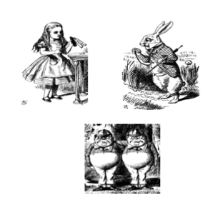
The Cast of Characters
The Cast of Characters
Alice and Bob are the good guys
Trudy is the bad guy (gal)

Slide 10
Alice’s Online Bank
Alice opens Alice’s Online Bank (AOB)
What are Alice’s security concerns?
If Bob is a customer of AOB, what are his security concerns?
How are Alice and Bob concerns similar? How are they different?
How does Trudy view the situation?
Notes:
Qs we’ll going to discuss

Slide 11

CIA - You will see this in many textbooks
Confidentiality - keeping information secret from unauthorized users
Integrity - insuring that the information is genuine and hasn’t been tampered with.
Availability - ensuring that the system is always available.
Also add:
Authenticity – determining the origin of data – Type of Integrity
Non-Repudiation – proving the integrity and origin – Type of Integrity
Good way to frame the problem.
But security is far more complex.
Confidentiality
Availability
Security
Objectives
Integrity

Slide 12
CIA - Confidentiality
Alice’s Online Bank (AOB) must prevent Trudy from learning Bob’s account balance
Bob doesn’t want the wrong people knowing his account details
Confidentiality: prevent unauthorized reading of information

Slide 13
CIA - Integrity
AOB must know what the account information is, and must prevent or detect tampering
Bob must not be able to improperly change his own account balance
Trust must not be able to change Bob’s account balance
Integrity: prevent unauthorized writing of information

Slide 14
CIA - Availability
AOB’s information must be available when needed
Bob must be able to make transaction
If not, he’ll take his business elsewhere
Availability: Data is available in a timely manner when needed

Slide 15
Beyond CIA
How does Bob’s computer know that “Bob” is really Bob and not Trudy?
Bob’s password must be verified
This requires some clever cryptography
What are security concerns of pwds?
Are there alternatives to passwords?
Notes:
Stringent password requirements
Something You Know/Have/Are

Slide 16
When some says “Their Network is Secure”
What does this mean?
Definition of Security – “Freedom from Risk or Danger” Random House Unabridged Dictionary
Is it 100% protected against every conceivable threat?
No
Is it impossible to attack and compromise
No
Most of the time it means:
The network has been designed so as to maintain an acceptable level of risk.

Slide 17
Security is an engineering trade-off
The objective is typically not to make the system secure against every threat.
Instead the goal is to optimize the security of the system given certain constraints (cost, end user usability, information sensitivity)
Notes:
Complexity of attack / layers of protection

Slide 18
Security is an ongoing process - not a product
If a vendor comes to you and says that their “box” will secure your network - run!
Security requires not only technical countermeasures and tools but processes and procedures.
Once a tool, process or procedure is put in place it must be continuously revisited.
SECURITY IS PRIMARILY ABOUT RISK MANAGEMENT
Notes:
IDS box, FW box, some monitoring tool

Slide 19
General Concept of Risk Analysis and Management
A risk consists of something of value (an “asset” at risk) which may lose value if a negative event occurs.
A threat to a system is any potential occurrence, malicious or otherwise, that can have an adverse effect on the assets and resources associated with the system.
A vulnerability of a system is some characteristic that makes it possible for a threat to occur.
An attack (exploit) on a system is some action that involves exploitation of some vulnerability in order to cause an existing threat to occur.
Risk analysis is the process of:
Identifying the assets at risk
Putting quantitative or qualitative measures on the potential loss (impact)
Putting quantitative or qualitative measures on the likelihood of the event happening
Risk Management is a process for planning on how to control those risks
Notes:
quantitative – with numbers/objective
qualitative – subjective
e.g. AOB

Slide 20
Non-IT Example 1: Driving risk
Assets at risk: people’s lives and health, the automobile, other property
Negative event: auto accident
Risk Management:
Risk reduction: Following DWI laws, defensive driving techniques, ABS, driving slow or just not driving on snowy days
Risk mitigation: Seat belts, air bags, “crumple zones” in auto design
Risk transfer: insurance
Risk acceptance: residual risk of injury, deductible on insurance
Notes:
Asset: mental health, stress
Reduction / mitigation (if it still happens…) / transfer (not my problem) / acceptance: low enough anyway

Slide 21
Information Security Risk Concept
Vulnerability
Information Asset
At Risk
Threat (attacker)
Risk analysis starts with understanding what assets are potentially at risk, what the threats are. This forms the basis for finding the “sweet spot” of putting in enough security for to protect the value of the assets.

Slide 22
Information Security Risk Analysis
Example: in a system that uses personal information such as name, SSN, etc., “Identity theft” is a risk. The related IT asset at risk is the confidentiality of that information. The impact of a compromise is the potential for identity theft.
Example: in a battlefield communications system, human lives are at risk if the system cannot be used to call in support. The related IT asset is the availability of the system, and the impact of a failure is potential for loss of life
The risk management strategies that we consider are for the IT assets, but the impact is based on the real assets
Notes:
Fantasy football site: availability

Slide 23
Asset Owner vs. IT Asset at Risk Owner
The owner of the asset may not be the owner of the related IT asset at risk:
Example: an “identity” that may be stolen is an asset of that person, but the related IT asset (SSN, etc.) is under the control of many other entities.
Example: a civilian undercover agent (spy) transmits information to which only he has access back to a military organization. If that military organization’s system is compromised, the agent’s life may be at risk
If the owner of the IT system does not suffer the impact of a compromise, what is the motivation to pay for the needed controls for proper risk management?
Example: Target was breached by hackers between Nov 27 – mid-Dec and personal information for 70-110 million people were stolen. The potential impact of each compromise was on the credit card holders (fraud, identity theft), Target, and the credit/debit card companies (which cover all fraudulent transactions above $50 per account by law).
Laws and policies are required so owners of IT assets include it in their risk analysis and risk management
Notes:
BREAK
The owner of the asset is not the owner of the IT asset
Rules, laws, and policies need to be accounted for
IT assets include people, processes, functions, and the actual system

Slide 24
Risk Management: So how does one Analyze Risk?
Notes:
BREAK

Slide 25
Threat Modeling
Threats and assets are key – vulnerabilities and attacks are only concerns if there is a threat to an asset to be concerned about.
How do we identify and evaluate threats?
Arbitrary Threat Lists – For example by brainstorming process done with experts
Random and unstructured, dubious completeness
Threat Trees or Attack Trees
More structured, currently favored approach
Easier way to account for one-to-many relationships
Notes:
Don’t care of we don’t lose an asset – alice runs a blog
e.g. available for a short time
- RSA detected hack
Each system and environment is different
Takes time and is labor intensive, takes a large structured process

Slide 26
Threat Modeling
Start with questions like the following:
Who are my potential adversaries?
What is their motivation, and what are their goals?
How much inside information do they have?
How much funding do they have?
How averse are they to risk?
Enumerate threats by stepping through each asset and reviewing a list of attack goals for each asset.
Assets and threats are closely correlated.
Notes:
ADVERSARIAL
Individual
Outsider
Insider
Trusted Insider
Privileged Insider
Group
Ad hoc
Established
Organization
Competitor
Supplier
Partner
Customer
Nation-State
ACCIDENTAL
User
Privileged User/Administrator
STRUCTURAL
Information Technology (IT) Equipment
Storage
Processing
Communications
Display
Sensor
Controller
Environmental Controls
Temperature/Humidity Controls
Power Supply
Software
Operating System
Networking
General-Purpose Application
Mission-Specific Application
ENVIRONMENTAL
Natural or man-made disaster
Fire
Flood/Tsunami
Windstorm/Tornado
Hurricane
Earthquake
Bombing
Overrun
Unusual Natural Event (e.g., sunspots)
Infrastructure Failure/Outage
Telecommunications
Electrical Power

Slide 27
Threat Trees
Start with each abstract threat and then iteratively refine description carefully and gradually
Collection of threat trees gives you threat forest
Threat
Sub-threat
Notes:
Threat – something that can have an adverse effect

Slide 28
Example
Hospital Computer System Threats
Patient Medical Information
Non-Patient Medical Information
Life Threatening
Non Life
Threatening
Billing
Non-Billing
Disclosure
Integrity
DOS
D
I
DOS
Malicious
Developer
Non-Malicious
Developer
MD
NMD

Slide 29
Using Threat Trees For Risk Calculation
Relationship between threats can be conjunctive (AND) or Disjunctive (OR).
Nodes can be labeled with level of effort, risk, criticality etc.
Labels can be propagated from leaves to root in obvious manner.
Effort = Moderate
OR
Effort = Moderate
Effort = High
Notes:
Effort: L/M/H

Slide 30
RISK ASSESSMENT

Slide 31
Risk Assessment
Assessment: measures the impact of an event, and the probability of an event (threat agent exploiting a vulnerability)
Quantitative (objective) and Qualitative (subjective) approaches both used.
Quantitative approach:
Compute expected monetary value (impact) of loss for all “events”
Compute the probability of each type of expected loss
Qualitative approach: use Low, Medium, High; ratings; other categorical scales
Notes:
This entire course can be thought as risk analysis and management
Risk management approach – ground vehicles

Slide 32
Risk Management
Accept the risk – Risk is low but costly to mitigate - worth accepting. Monitor.
Transfer the risk – Transfer to somebody else via insurance, warnings etc.
Remove the risk - Remove the system component or feature associated with the risk if the feature is not worth the risk.
Mitigate the risk - Reduce the risk with countermeasures.
The understanding of risks leads to policies, specifications and requirements.
Appropriate security mechanisms are then developed and implemented.
Notes:
Give examples of each

Slide 33
Quantitative - Security Cost Risk Assessment
Exposure Factor (EF) = Percentage of asset loss caused by identified threat
Single Loss Expectancy (SLE) = Asset Value X Exposure Factor
Annualized Rate of Occurrence (ARO) = Estimated frequency a threat will occur within a year
Annualized Loss Expectancy (ALE) = SLE x ARO
Notes:
With numbers
ALE = how much you’ll lose per year, so how much should be used to safeguard it?
EPA- $9.1 Million; FDA- $7.9 Million

Slide 34
Example:
Fire Damage to a building:
Asset Value: value of the building - $750,000
Single Loss Expectancy (SLE: Asset Value x Exposure Factor) - $250,000 (damage caused by the fire)
Annualized Rate of Occurrence (ARO) - .05 (5% chance every year that there will be a fire)
Annualized Loss Expectancy (ALE: $250,000 x .05) = $12,500
So does a fire alarm system which costs $5000 to install and maintain yearly worth it?
YES - Fire Alarm Cost < ALE

Slide 35
Network Security Example:
Credit Card database stolen from online retailer via SQL injection:
Asset Value: Here the asset value is a bit nebulous so it sometimes is better to focus on the SLE
Single Loss Expectancy (SLE): If the database is stolen and/or damaged how much is it going to cost the company in PCI fines, lost business, consulting fees for security, etc. $1M is not unreasonable for a medium sized retailer.
Annualized Rate of Occurrence (ARO) - Can get this information from network consulting organizations or your insurance company. 5%
Annualized Loss Expectancy (ALE)= $1Mx.05=$50,000
So does a web firewall which costs $24K make sense? Most likely, YES

Slide 36
Quantitative: Useful or Not?
Pros:
Objective, independent process
Credibility for audit, management (especially corporate management)
Solid basis for evaluating cost/benefit of countermeasures
Quantitative risk assessment is the basis for insurance, risk managed portfolios, etc.
Cons:
In most cases, it is difficult to enumerate all types of events and get meaningful data on probability and impact
Very time consuming, costly to do right
Many unknowns may give a false sense of control
Not reliable for “rare” events or “unthinkable” impacts

Slide 37
Qualitative Approach – Establish Impact
Rather than have specific numbers, Establish classes of loss values (“impact”), such as:
Low, medium, high
Under $10K, between $10K and $1M, over $1M (used by at least one company)
Type of loss (e. g. compromise of credit card #, compromise of SSN, compromise of highly personal data)
Minor injury, significant injuries, loss of life, large scale loss of life (used by emergency response organizations to categorize non-IT events)
Rank ordering

Slide 38
Qualitative Approach – Establish Likelihood
Establish classes of likelihood of compromise
Low, medium, high likelihood
Decide on a risk management approach to each combination of (class of loss, likelihood of loss)
Focus effort on medium to high loss and/or medium to high likelihood items

Slide 39
Qualitative Approach
DoD classified information:
CONFIDENTIAL “shall be applied to information, the unauthorized disclosure of which reasonably could be expected to cause damage to the national security”
SECRET “shall be applied to information, the unauthorized disclosure of which reasonably could be expected to cause serious damage to the national security”
TOP SECRET “shall be applied to information, the unauthorized disclosure of which reasonably could be expected to cause exceptionally grave damage to the national security”

Slide 40
THINK LIKE AN ATTACKER

Slide 41
Attack Trees
Another way to visualize the current security posture of a system
Helps to indentify the most vulnerable areas of the system and where to apply resources.
A method of building a database which describes the security state of the system
Attack Trees Section/Slides
Reference: Attack Trees SANS 99 – Bruce Schneier

Slide 42
Attack Trees – How do they Work?
Represents the attacks and countermeasures as part of a tree structure
Root node is the goal of the attack. In a complex system there is probably many root nodes or goals.
Leaf nodes are the attacks

Slide 43
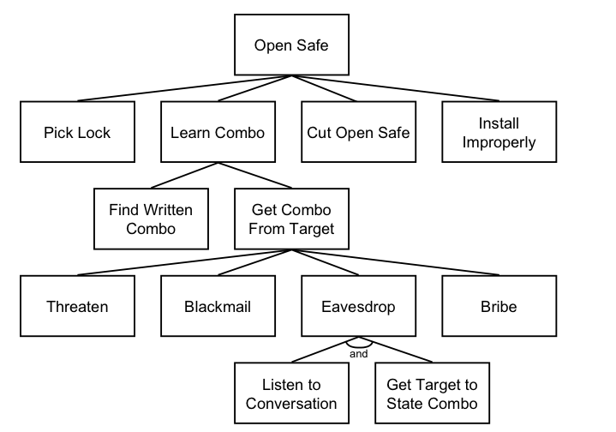
Basic Attack Tree

Slide 44
AND Nodes OR Nodes
“OR” nodes represent different ways of achieving the same goal
To break into a house you can pick the lock or break the window
“AND” nodes represent different steps in achieving a single outcome.
To enter a window you need to break the windows AND climb through the opening.

Slide 45
Boolean Node Values
Once the tree is created Boolean values can be assigned to each node.
Example: probable vs. improbable

Slide 46
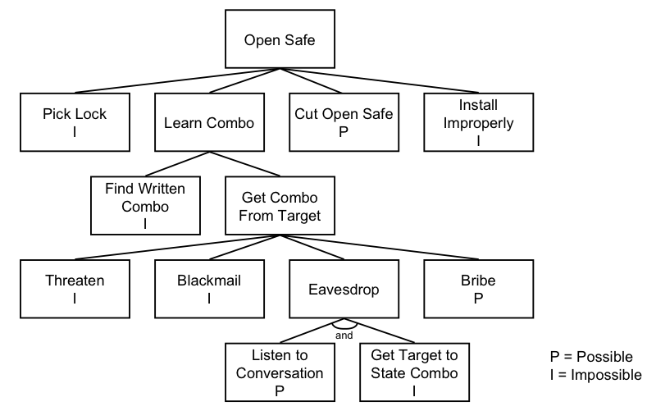
Possible vs. Impossible Node Values

Slide 47
Other Possible Boolean Node Values
Easy vs. Not Easy
Expensive vs. Not Expensive
Intrusive vs. Non-Intrusive
Legal vs. Illegal

Slide 48
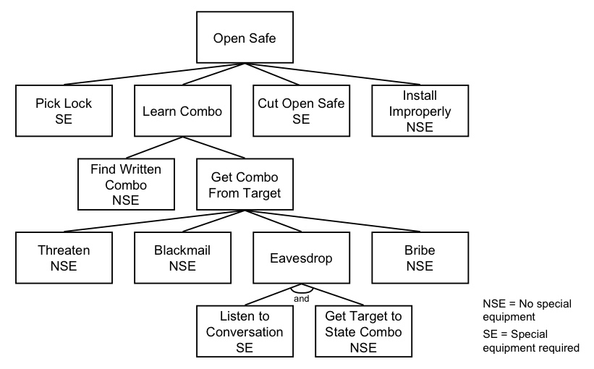
Special Equipment Needed

Slide 49
Continuous Node Values
Cost in $ to attack or defend
Time to achieve goal
Cost in resources to attack or defend

Slide 50
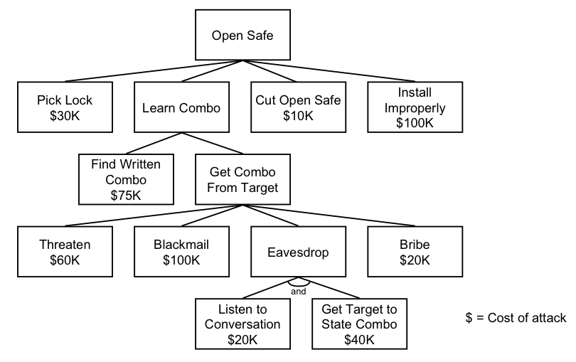
Cost of an Attack

Slide 51
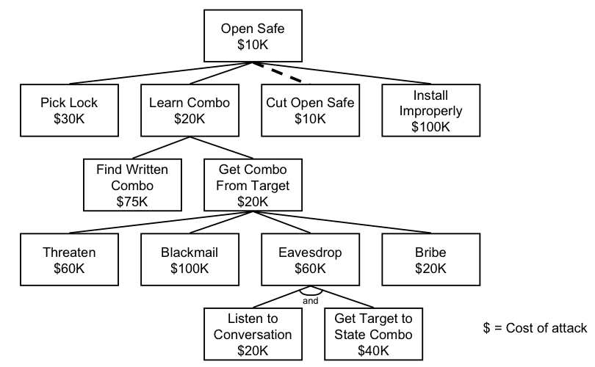
Cheapest Attack
Notes:
Test Note

Slide 52
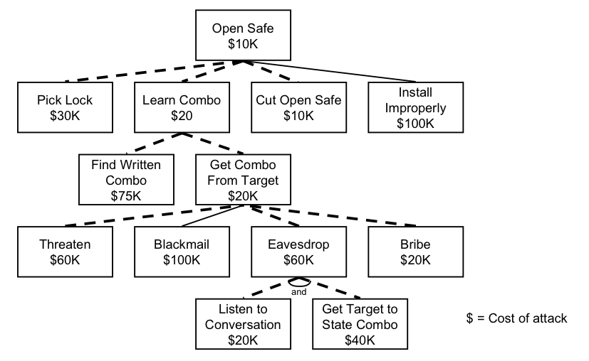
Attacks Less than $100K

Slide 53
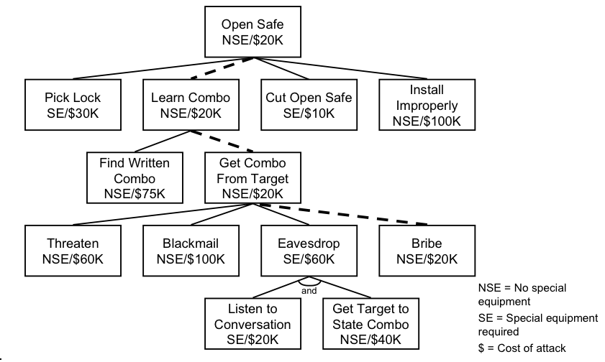
Cheapest Attack Requiring No Special Equipment

Slide 54
Applying a Countermeasure – Cheapest NSE now $60K

Slide 55
Tree Construction
1) Identify Attack Goals. Each Goal is a separate Attack Tree
2) Identify attacks against these goals
3) A database of attack trees can be developed and resused (plugged in)
Notes:
Go through with the class an attack tree based on current events. Bomb on plane/airport security.

Slide 56
Example – ACME Enterprises
Notes:
Goal: get proprietary secrets
- dumpster diving, or steal garbage
- emanation: scout, get equiptment, monitor
- get insider: plant or recruit
- get physical access
- attack via network
- get access to web server
- domain name/FW/OS details/scan for vulberabilities
- telephone

Slide 57
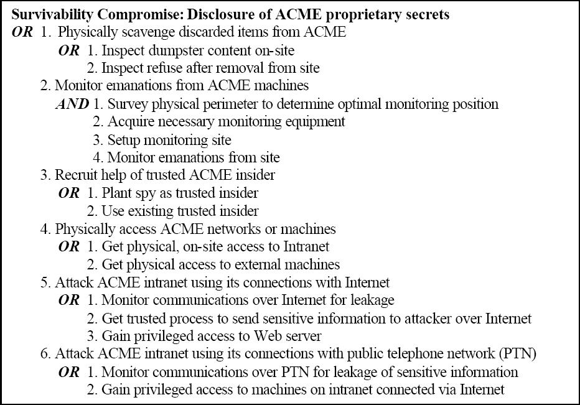
ACME High Level Attack Tree

Slide 58
ACME – Expansion of Node

Slide 59
Need to Stay Current!
Infragard
http://www.nym-infragard.us
High Technology Crime Investigation Association
http://www.htcia.org/
NY/NJ Electronic Crimes Task Force
http://www.secretservice.gov/ectf_newyork.shtml
IEEE – Security and Privacy Magazine

Slide 60
Next Class
Attack Methods Part 1

