Slide 1
Network Security
CS 6823 – Lecture 5
Cryptography
Phillip Mak
pmak@nyu.edu

Slide 2
Cryptography
Overview
Symmetric Key Cryptography
Public Key Cryptography
Message integrity and digital signatures

Slide 3
Cryptography basics
Cryptography is the process of converting plaintext into ciphertext.
Plaintext – Readable text
Ciphertext – Unreadable or encrypted text
Cryptography is used to hide information from unauthorized users
Decryption is the process of converting ciphertext back to plaintext
Cryptography requires at least two pieces of information
Encryption algorithm
Encryption key

Slide 4
History of Cryptography
Substitution Cipher
Replaces one letter with another letter based on some key
Example: Julius Caesar’s Cipher
Key value of right shift 3
ABCDEFGHIJKLMNOPQRSTUVWXYZ
DEFGHIJKLMNOPQRSTUVWXYZABC
Notes:
Alphabet Shifts Left

Slide 5
History of Cryptography (cont)
Cryptanalysis studies the process of breaking encryption algorithms
When a new encryption algorithm is developed; cryptanalysts study it and try to break it.
This is an important part of the development cycle of a new encryption algorithm
Notes:
AES was scrutinized for three years, and still is today

Slide 6
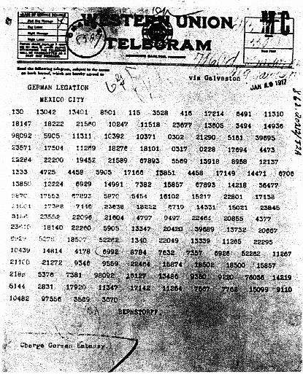
World War I
Zimmerman Telegram
Encrypted telegram from foreign secretary of the German empire to German ambassador in Mexico
Intercepted and decrypted by the British
Indicated that unrestricted sub warfare would commence. Proposed an alliance with Mexico to reclaim lost land to US.
Pivotal in US entering WWI
Courtesy: Wikipedia

Slide 7
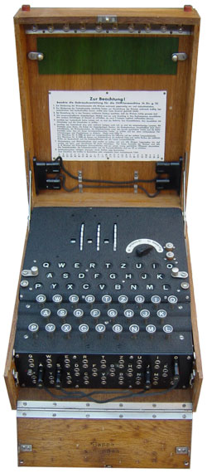
World War II
Enigma
Used by the Germans
Replaced letters as they were typed
Substitutions were computed using a key and a set of switches and rotors.

Slide 8
Cryptography Issues
Confidentiality: only sender, intended receiver should “understand” message contents:
sender encrypts message
receiver decrypts message
Message Integrity: sender, receiver want to ensure message not altered (in transit, or afterwards) without detection.
End-Point Authentication: send, receiver want to confirm identity of each other.
Non-Repudiation: ensuring that the sender actually sent the message

Slide 9
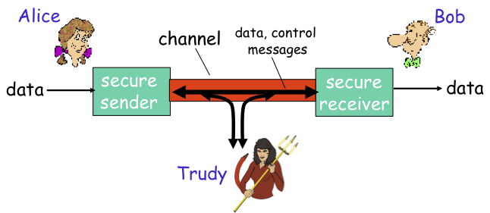
Friends and enemies: Alice, Bob, Eve
Well known in network security world
Bob, Alice want to communicate securely
Trudy (intruder) may intercept, delete, add to message

Slide 10
Who might Bob, Alice be?
...well, real-life Bobs and Alices!
Web browsers/server for electronic transactions
online banking client/server
DNS servers
routers exchanging routing table updates

Slide 11
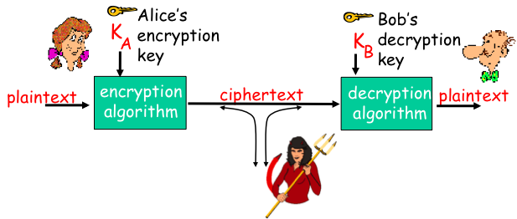
The Language of Cryptography
m plaintext message
K_{A}(m) is ciphertext, encrypted with key K_{A}
m = K_{B}(K_{A}(m))
Notes:
Last line is recovering plaintext. Take ciphertext Ka(m) and apply decryption key Kb

Slide 12
Simple Encryption Scheme
Substitution Cipher: substituting one thing for another
Mono-alphabetic cipher: substitute one letter for another
Plaintext: abcdefghijklmnopqrstuvwxyz
Ciphertext: mnbvcxzasdfghjklpoiuytrewq
Example:
Plaintext: bob. i love you. alice
ciphertext: nkn. s gktc wky. mgsbc
Key: The mapping from the set of 26 letters to the set of 26 letters
Notes:
Frequency Analysis; how to decrypt? What’s the key? How to transfer the key

Slide 13
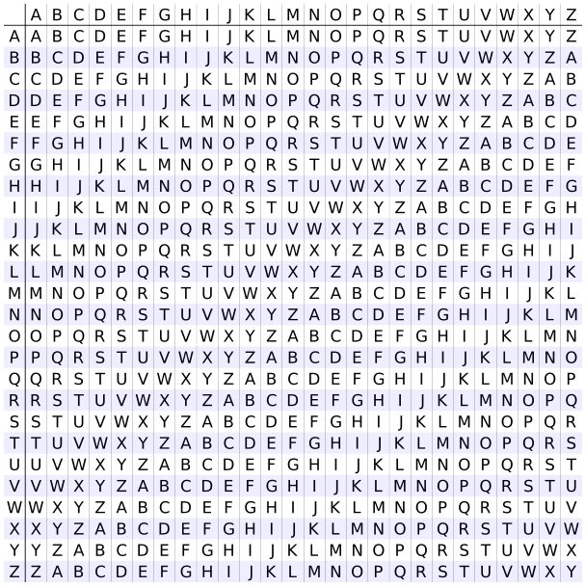
Poly-alphabetic Encryption: Vigenère
M1 M2 M3, M4
n monoalphabetic ciphers M1, M2, ...., Mn
Cycling pattern:
e.g. n=4, M1, M3, M4, M3, M1, M3, M4, M3, …
For each new plaintext symbol, use subsequent monoalphabetic pattern in a cyclic pattern.
dog: d from M1, o from M3, g from M4
Key: the n ciphers and the cyclic pattern
Algorithm: Vigenère
Example:
Plaintext: NYU Row N/Column C -> P
Key: COMSEC Row Y/Column O -> M
Ciphertext: PMG Row U/Column M -> G
Figure: All possible shift ciphers

Slide 14
Vernam – Perfect Substitution Cipher
If we use Vignere with keylength as long as the plaintext then cryptanalysis will become very difficult.
If we change key every time we encrypt then cryptanalyst’s job becomes even more difficult. One-time pad or Vernam Cipher.
How do we get such long keys?
A large book shared by transmitter and receiver.
Initial key followed by previous messages themselves!!
Random number sequence based on common shared and secret seed.
Such a cipher is difficult to break but not very practical.
Also called a “one time pad”

Slide 15
Breaking an Encryption Scheme
Cipher-text only attack: Eve has ciphertext that she can analyze.
Two approaches:
Search through all keys: must be able to differentiate resulting plaintext from gibbersh
Statistical analysis
Known-plaintext attack: Eve has some plaintext corresponding to some ciphertext.
E.g., in monoalphabetic cipher, trudy determines pairings for a,l,i,c,e,b,o
Chosen-plaintext attack:
Eve can get the ciphertext from some chosen plaintext

Slide 16
Computational Effort Required
Time – Number of primitive operations required. Computational time required for the attack. Some attacks become more feasible as computing power becomes cheaper and faster.
Memory – Amount of storage required to complete the attack. This can be either hard disk or memory.
Data – Amount of captured data required to complete the attack.

Slide 17
Rainbow Tables
Rainbow Table
Pre-computes commonly used passwords
Time/Memory Tradeoff
Used to recover the plaintext from a given HASH value.
Commonly used to attack HASHed password
Each user with the password “password” will have the same hash 5f4dcc3b5aa765d61d8327deb882cf99
Defense
Adding a SALT to each password
SALT – random number concatenated to the PASSWORD to prevent Rainbow table attacks
Since SALT is a random number the attacker would have to compute a Rainbow table for each SALT value. Large SALT value is critical
Password & hash (MD5)
password | 5f4dc…
password | 5f4dc…
password | 5f4dc…
password123 | 482c8…
p@ssword123 | 95463…
p@$$word123 | 270db…
Password | SALT | Hash (MD5)
password | 3OjH1 | e740b…
Password | gIW9E | 9921a…
Password | 1Hhw9 | a4a16…
password | pLRt8 | C6d82…
p@ssword123 | lCwLI | ec33b…
p@$$word123 | EFxXk | 952ba…

Slide 18
Types of Cryptography
Crypto often uses keys:
Algorithm is typically known to everyone
Only “keys” are secret – Kerckhoff’s Principle – Can be extended to security systems design in general
Public Key Cryptography
Involves the use of two keys
Symmetric key cryptography
Involves the use of one key
Hash functions
Involves the use of no keys
Nothing secret: How can this be useful?

Slide 19
Shannon Characteristics of Good Ciphers
The amount of secrecy needed should determine the amount of labor appropriate for encryption and decryption.
The set of keys and enciphering algorithms should be free from complexity.
The implementation of the process should be as simple as possible.
Errors in ciphering should not propagate and cause corruption of future information in the message.
The size of enciphered text should be no longer than the text of the original message.

Slide 20
Confusion and Diffusion
Confusion: Changes in the key should affect many parts in the ciphertext.
Diffusion: Changing one character in the plaintext will result in multiple changes throughout the ciphertext.

Slide 21
Symmetric Key Cryptography

Slide 22
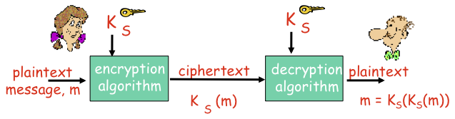
Symmetric Key Cryptography
Symmetric Key crypto: Bob and Alice share same symmetric key: K_{s}

Slide 23
Two Types of Symmetric Ciphers
Stream Ciphers
Encrypt one bit at a time
Block Ciphers
Break plaintext message into equal-size blocks
Encrypt each block as a unit

Slide 24
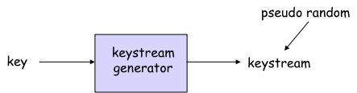
Stream Ciphers:
Combine each bit of keystream with bit of plaintext to get bit of ciphertext
m(i) = i_{th} bit of message
k_{s}(i) = i_{th} bit of keystream
c(i) = i_{th} bit of ciphertext
c(i) = k_{s}(i) ⊕ m(i) (⊕ = exclusive or)
m(i) = k_{s}(i) ⊕ c(i)

Slide 25
Problems With Stream Ciphers
Known plain-text attack
There’s often predictable and repetitive data in communication messages
attacker receives some cipher text c and correctly guesses corresponding plaintext m
k_{s} = m ⊕ c
Attacker now observes c’, obtained with same sequence ks
m’ = k_{s} ⊕ c’
Even easier
Attacker obtains two ciphertexts, c and c’, generating with same key sequence
c ⊕ c’ = m ⊕ m’
There are well known methods for decrypting two plaintexts given their XOR
Integrity problem too
suppose attacker knows c and m (eg, plaintext attack);
wants to change m to m’
calculates c’ = c ⊕ (m ⊕ m’)
sends c’ to destination

Slide 26
RC4 Stream Cipher
RC4 is a popular stream cipher
Extensively analyzed and considered good
Key can be from 1 to 256 bytes
Used in WEP for 802.11
Can be used in SSL

Slide 27
Block Ciphers
Message to be encrypted is processed in blocks of k bits (e.g., 64-bit blocks).
1-to-1 mapping is used to map k-bit block of plaintext to k-bit block of ciphertext
Example with k=3
input output
000 110
001 111
010 101
011 100
input output
100 011
101 010
110 000
111 001
What is the ciphertext for 010110001111 ?

Slide 28
Block Ciphers
How many possible mappings are there for k=3?
How many 3-bit inputs?
How many permutations of the 3-bit inputs?
Answer: 2³! = 40,320 ; not very many!
In general, 2^{k}! mappings; huge for k=64
Problem:
Table approach requires table with 2⁶⁴ entries, each entry with 64 bits
Table too big: instead use function that simulates a randomly permuted table

Slide 29
Prototype Function
64-bit input
8bits
8bits
8bits
8bits
8bits
8bits
8bits
8bits
S₁
S₂
S₃
S₄
S₅
S₆
S₇
S₈
Substitution table
8 bits
8 bits
8 bits
8 bits
8 bits
8 bits
8 bits
8 bits
64-bit intermediate
Loop for n rounds
64-bit output
From Kaufman
et al

Slide 30
Why Rounds in Prototype?
If only a single round, then one bit of input affects at most 8 bits of output.
In 2nd round, the 8 affected bits get scattered and inputted into multiple substitution boxes.
How many rounds?
How many times do you need to shuffle cards?
Becomes less efficient as n increases

Slide 31
Encrypting a Large Message
Why not just break message in 64-bit blocks, encrypt each block separately?
If same block of plaintext appears twice, will give same cyphertext.
How about:
Generate random 64-bit number r(i) for each plaintext block m(i)
Calculate c(i) = K_{S}( m(i) ⊕ r(i) )
Transmit c(i), r(i), i=1,2,…
At receiver: m(i) = K_{S}(c(i)) ⊕ r(i)
Problem: inefficient, need to send c(i) and r(i)

Slide 32
Cipher Block Chaining (CBC)
CBC generates its own random numbers
Have encryption of current block depend on result of previous block
c(i) = K_{S}( m(i) ⊕ c(i-1) )
m(i) = K_{S}( c(i)) ⊕ c(i-1)
How do we encrypt first block?
Initialization vector (IV): random block = c(0)
IV does not have to be secret
Change IV for each message (or session)
Guarantees that even if the same message is sent repeatedly, the ciphertext will be completely different each time

Slide 33
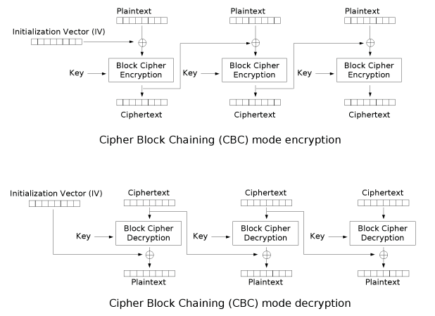
Cipher Block Chaining (CBC)

Slide 34
Symmetric Key Crypto: DES
DES: Data Encryption Standard
US encryption standard [NIST 1993]
56-bit symmetric key, 64-bit plaintext input
Block cipher with cipher block chaining
How secure is DES?
DES Challenge: 56-bit-key-encrypted phrase decrypted (brute force) in less than a day
1998: EFF’s $250k machine- 1,800 custom chips
No known good analytic attack making DES more secure:
3DES: encrypt/decrypt 3 times with 3 different keys
ciphertext = E_{K3}(D_{K2}(E_{K1}(plaintext)))

Slide 35
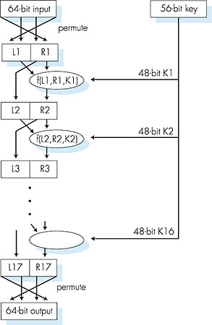
Symmetric Key Crypto: DES
DES Operation:
initial permutation
16 identical “rounds” of function application, each using different 48 bits of key
Final permutation

Slide 36
Advanced Encryption Standard
Newest (Nov. 2001) symmetric-key NIST standard, replacing DES
Processes data in 128 bit blocks
128, 192, or 256 bit keys
Brute force decryption (try each key) takes 10 billion years for AES
Based on the current fastest supercomputer 33.86 petaFLOPS (10¹⁵ FLOPS)
Not adjusted for technological advancements
Notes:
Problem with symmetric encryption

Slide 37
Public Key Cryptography

Slide 38
Public Key Cryptography
Public Key Cryptography (Asymmetric)
radically different approach [Diffie-Hellman76, RSA78]
sender, receiver do not share secret key
public encryption key known to all
private decryption key known only to receiver
Issues Symmetric Key
Cryptography
Requires Sender and Receiver know shared key
Q: How do we agree on the key in the first place?
Secretly sharing keys is extremely difficult problem

Slide 39
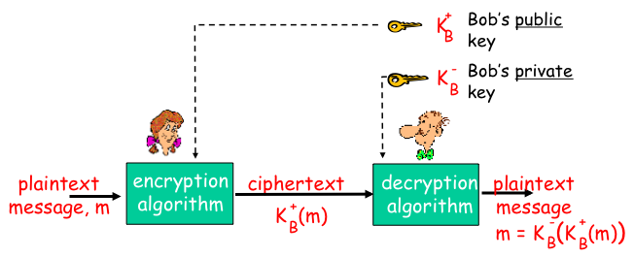
Public Key Cryptography

Slide 40
Public Key Encryption Algorithms:
Requirements:
need KB and KB such that:
-
+
-
+
K (K (m)) = m
B
B
Given public key KB, it should be impossible to compute private key KB
+
-
RSA: Rivest, Shamir, Adelson algorithm

Slide 41
Prereq: Modular Arithmetic
x mod n = remainder of x when divide by n
Facts:
(a+b) mod n = [(a mod n) + (b mod n)] mod n
(a-b) mod n = [(a mod n) - (b mod n)] mod n
(a*b) mod n = [(a mod n) * (b mod n)] mod n
(a*b*c)mod n = [(a mod n)(b mod n)(c mod n)] mod n
Review worked examples:
https://www.khanacademy.org/math/applied-math/cryptography/modarithmetic/a/fast-modular-exponentiation

Slide 42
RSA: Getting Ready
A message is a bit pattern.
A bit pattern can be uniquely represented by an integer number.
Thus encrypting a message is equivalent to encrypting a number.
Example
m= 10010001 . This message is uniquely represented by the decimal number 145.
To encrypt m, we encrypt the corresponding number, which gives a new number (the ciphertext).

Slide 43
RSA: Creating Public/Private Keypair
1. Choose two large prime numbers p, q.
(e.g., 1024 bits each)
2. Compute n = pq, Φ = (p-1)(q-1)
3. Choose e (with e< Φ) that has no common factors
with Φ. (e, Φ are “relatively prime”).
4. Choose d such that ed-1 is exactly divisible by Φ.
(in other words: ed mod Φ = 1 ; or d = e mod Φ)
-1
5. Public key is (n,e). Private key is (n,d).
{
{
K
+
K
-
B
B

Slide 44
RSA: Encryption and Decryption
0. Given (n,e) and (n,d) as computed above
1. To encrypt message m (<n), compute
e
c = m mod n
2. To decrypt received bit pattern, c, compute
d
m = c mod n
e
d
m = (m mod n)
mod n
c

Slide 45
RSA Example
Bob chooses p=5, q=7. Then n=35, Φ=24.
e=5 (so e, Φ relatively prime).
d=29 (so ed-1 exactly divisible by Φ).
Encrypting 8-bit messages.
m
e
e
bit pattern
m
c = m mod n
encrypt:
0000lI00
12
248832
17
d
d
c
c
m = c mod n
decrypt:
17
481968572106750915091411825223071697
12

Slide 46
RSA: Another Important Property
The following property will be very useful later:
-
+
+
-
K (K (m)) = m
=
K (K (m))
B
B
B
B
use public key first, followed by private key
use private key first, followed by public key
Result is the same!

Slide 47
Why is RSA Secure?
Suppose you know Bob’s public key (n,e). How hard is it to determine d?
Essentially need to find factors of n without knowing the two factors p and q.
Fact: factoring a big number is hard.
Φ = (p-1)(q-1)
Hard to find p, q, Φ when given n, e
Generating RSA Keys
Have to find big primes p and q
Approach: make good guess then apply testing rules
Typical key size is 2048-bits

Slide 48
Problems with RSA
Slow to generate keys e, d even by today’s CPU power
Does not have Perfect Forward Security
But it’s free from licensing concerns

Slide 49
Session Keys
Exponentiation is computationally intensive
DES is at least 100 times faster than RSA
Session key, K_{S}
Bob and Alice use RSA to exchange a symmetric key K_{S}
Once both have K_{S}, they use symmetric key cryptography

Slide 50
Diffie-Hellman
Allows two entities to agree on shared key.
But does not provide encryption
n is a large prime; g is a number less than n.
n and g are made public
a, g, n
A=gª mod n
K=Bª mod n
b
B=g^{b} mod n
K=A^{b} mod n
g, n, A
B

Slide 51
Diffie-Hellman (cont)
Alice and Bob agree to use a prime number n=23 and base g=5.
Alice chooses a secret integer a=6, then sends Bob A = gª mod n
A = 5⁶ mod 23 = 8.
Bob chooses a secret integer b=15, then sends Alice B = g^{b} mod n
B = 5¹⁵ mod 23 = 19.
Alice computes s = Bª mod n
19⁶ mod 23 = 2.
Bob computes s = A^{b} mod n
8¹⁵ mod 23 = 2.

Slide 52
Message Integrity and Digital Signatures

Slide 53
Message Integrity
Allows communicating parties to verify that received messages are authentic.
Content of message has not been altered
Source of message is who/what you think it is
Message has not been artificially delayed (playback attack)
Sequence of messages is maintained
Let’s first talk about message digests

Slide 54
Encryption vs. Hashing
PlainText
CipherText
Message
Encryption( )
or
Hash
Decryption( )
Message Digest
Encryption keeps communications private
Encryption and decryption can use same or different keys
Achieved by various algorithms, e.g. DES, CAST
Need key management
Hash transforms message into fixed-size string
One-way hash function
Strongly collision-free hash
Message digest can be viewed as “digital fingerprint”
Used for message integrity check and digital certificates
Hash is generally faster than encryption

Slide 55
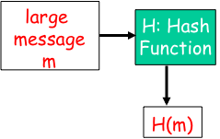
Message Digests
Function H( ) that takes as input an arbitrary length message and outputs a fixed-length string: “message signature”
Note that H( ) is a many-to-1 function
H( ) is often called a “hash function”
Desirable properties:
Easy to calculate
Irreversibility
Collision resistance: Computationally difficult to produce m and m’ such that H(m) = H(m’)
Seemingly random output

Slide 56
Hash Function Algorithms
MD5 hash function widely used (RFC 1321)
computes 128-bit message digest in 4-step process.
SHA-1 is also used.
US standard [NIST, FIPS PUB 180-1]
160-bit message digest
kobrien-laptop:~ kobrien$ echo "test" | md5sum
d8e8fca2dc0f896fd7cb4cb0031ba249 -
kobrien-laptop:~ kobrien$ echo "test" | md5sum
d8e8fca2dc0f896fd7cb4cb0031ba249 -
kobrien-laptop:~ kobrien$ echo "test1" | md5sum
3e7705498e8be60520841409ebc69bc1 -
kobrien-laptop:~ kobrien$ echo "test1" | md5sum
3e7705498e8be60520841409ebc69bc1 -

Slide 57
Commonly Used Hash Functions (MD5 and SHA)
Both MD5 and SHA are derived based on MD4
MD5 provides 128-bit output, SHA provide 160-bit output, (only first 96 bits used in IPSec)
Both of MD5 and SHA are considered one-way strongly collision-free hash functions
SHA is computationally slower than MD5, but more secure
MD5, SHA1 not collision resistant
Relevance to non-repudiation, commitment

Slide 58
So What Does This Mean?
SHA1 is still much safer than MD5
Best known attack has effort > 2^64
HMAC SHA1 (keyed SHA1) believed to be unaffected by current attacks
Industry making a move towards SHA256 and other secure crypto methods
Actual transition will take place within standard groups first
IETF and NIST among others addressing this issue

Slide 59
Birthday Attack
If 23 people are in the room, what is the chance that they all have different birthdays?
365 364 363 362 361 360 343 365 ^{x} 365 ^{x} 365 ^{x} 365 ^{x} 365 ^{x} 365 ^{x . . .} 365
= 49%
So there’s a 51% chance that two of them have the same birthday

Slide 60
Birthday Attack (Cont)
If there are N possible hash values,
You’ll find collisions when you have calculated 1.2 x sqrt(N) values
SHA-1 uses a 160-bit key
Theoretically, it would require 2⁸⁰ computations to break
SHA-1 has already been broken, because of other weaknesses

Slide 61
Security Level of Crypto Algorithms
Security Level | Work Factor | Algorithms
Weak | O(2⁴⁰) | DES, MD5
Legacy | O(2⁶⁴) | RC4, SHA1
Minimum | O(2⁸⁰) | 3DES, SEAL, SKIPJACK
Standard | O(2¹²⁸) | AES-128, SHA-256
High | O(2¹⁹²) | AES-192, SHA-384
Ultra | O(2²⁵⁶) | AES-256, SHA-512

Slide 62
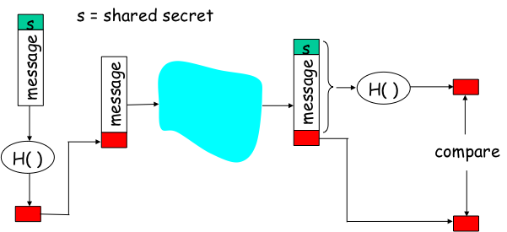
Hash-Based Message Authentication Code (HMAC)
Authenticates sender
Verifies message integrity
No encryption!
Also called “keyed hash”

Slide 63
End Point Authentication
Want to be sure of the originator of the message – end-point authentication.
Assuming Alice and Bob have a shared secret, will MAC provide message authentication.
We do know that Alice created the message.
But did she send it?

Slide 64
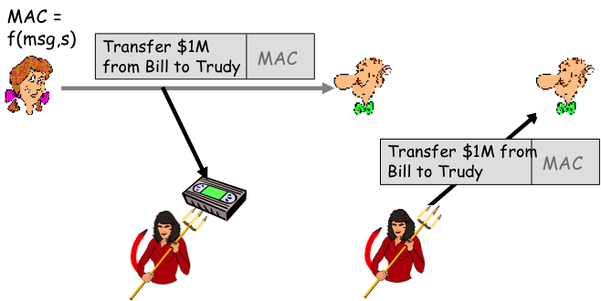
Playback Attack
Bob cannot distinguish between the original communication and the later playback
Problem is that the shared secret is used over and over

Slide 65
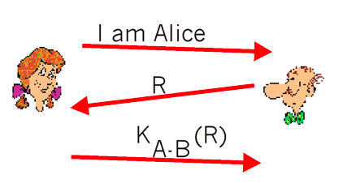
Defending Against Playback Attack: Nonce
1) Alice sends the message, “I am Alice,” to Bob
2) Bob chooses a nonce, R, and sends it to Alice
3) Alice encrypts the nonce using Alice and Bob's symmetric secret key, K_{A-B}, and sends the encrypted nonce, K_{A-B} (R) back to Bob.
A nonce is a number that a protocol will only ever use once-in-a-lifetime

Slide 66
Nonce (con’t)
It is the fact that Alice knows K_{A-B} and uses it to encrypt a value that lets Bob know that the message he receives was generated by Alice.
The nonce is used to ensure that Alice is "live." Bob decrypts the received message. If the decrypted nonce equals the nonce he sent Alice, then Alice is authenticated.

