Slide 1
Benchmarking: Past, Present, and Future (Session 2 Introduction)
Mark Liberman
The University of Pennsylvania

Slide 2
This session is about benchmarking in the PRESENT –
But the core issues are new versions of old problems
and not just for benchmarking but for empirical research in general.

Slide 3
So today’s benchmarking can learn from the past in sometimes unexpected ways
and (perhaps even more surprisingly) from other disciplines.

Slide 4
This session’s participants:
Brian MacWhinney and Saturnino Luz, “Detection of Dementia from Speech Samples”.
Douwe Kiela “Dynabench: Rethinking Benchmarking in AI”.
Anders Søgaard “5 Ways to Make Your Data More Relevant”.
Victor Petrén Bach Hansen and Anders Søgaard, “Guideline Bias in Wizard-of-Oz Dialogues”.

Slide 5
Brian MacWhinney on data for DementiaBank:
More training data needed. Despite involvement of 180 labs and a similar number of published papers, other projects have not been contributing data
The data problem has many aspects –
Total number of subjects is small (Pitt DementiaBank collection is the best – but only 181 subjects)
Amount of data per subject+task is small (“Cookie Theft” picture-description averages 90-100 words per session)
There are no test batteries normed for longitudinal tracking (Describing the same picture once a month , or re-telling the same story?)
The standard neuropsychological tasks are culturally biased
None of these issues are new, or limited to clinical HLT applications. As Brian knows well, this is part of a much broader discussion.

Slide 6
Douwe Kiela on problems with benchmarking:
● Saturation: We achieve “human-level” performance on benchmarks without having solved
the problem. Whenever saturation happens, we lose valuable time as a field.
● Bias: Inadvertent annotator artifacts and other biases make benchmarks too easy.
● Alignment: Benchmarks don’t measure the right thing - test set performance is not always a
good proxy for “how well would this system work in the real world”.
● Leaderboard culture: The community is overly focused on leaderboard rank but should think
more about how creative solutions to the problem.
● Reproducibility: Self-reported results cannot be trusted.
● Accessibility: Models that do well on benchmarks are often not easily accessible to the
community to probe, let alone to laypeople.
● Backward compatibility: When a new benchmark or dataset comes out, we cannot easily
re-evaluate old models on the new data.
● Utility: Not everyone cares about the same thing. E.g. efficiency traded off against accuracy.
Each of these problems can be a feature as well as a bug . . . (because “not everyone cares about the same thing”)

Slide 7
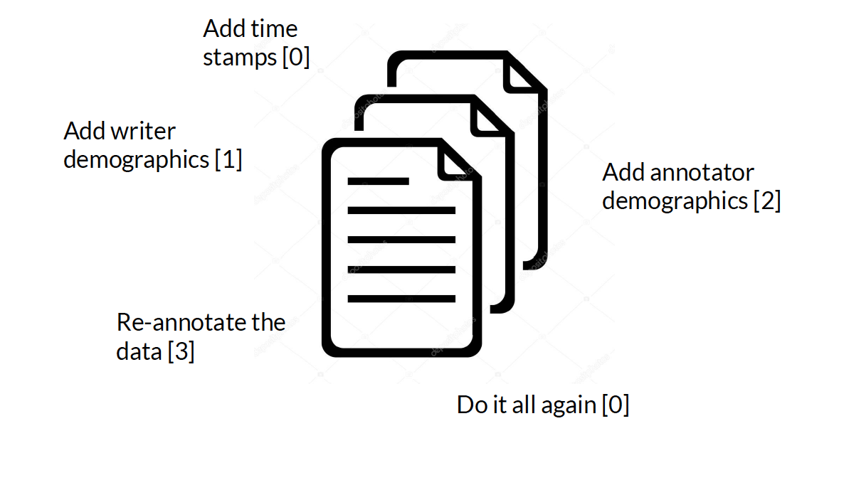
Anders Søgaard on better benchmarking data:
. . .compare the role of uncontrolled covariates in lab-animal drug testing. . .

Slide 8
Hansen & Søgaard on “Guidelines Bias”:
Priming effects: “We ask different turkers what movies they like/love/prefer.”
Order effects: “Order of goals of conversations in guidelines can also bias the conversation.”
Pollsters and social-science survey designers have been wrestling with such problems for nearly a century. . .

