Slide 1
Introduction to Zoom Session 4 (on the Future)
Ken Church
https://github.com/kwchurch/Benchmarking_past_present_future#S4

Slide 2
Zoom Session 4: Future https://github.com/kwchurch/Benchmarking_past_present_future#S4
Moderator: Ken Church
Greg Diamos, Peter Mattson and David Kanter
Dave Ferrucci
Ido Dagan
Samuel Bowman
Eunsol Choi
Alëna Aksënova, Daan van Esch, James Flynn and Pavel Golik

Slide 3
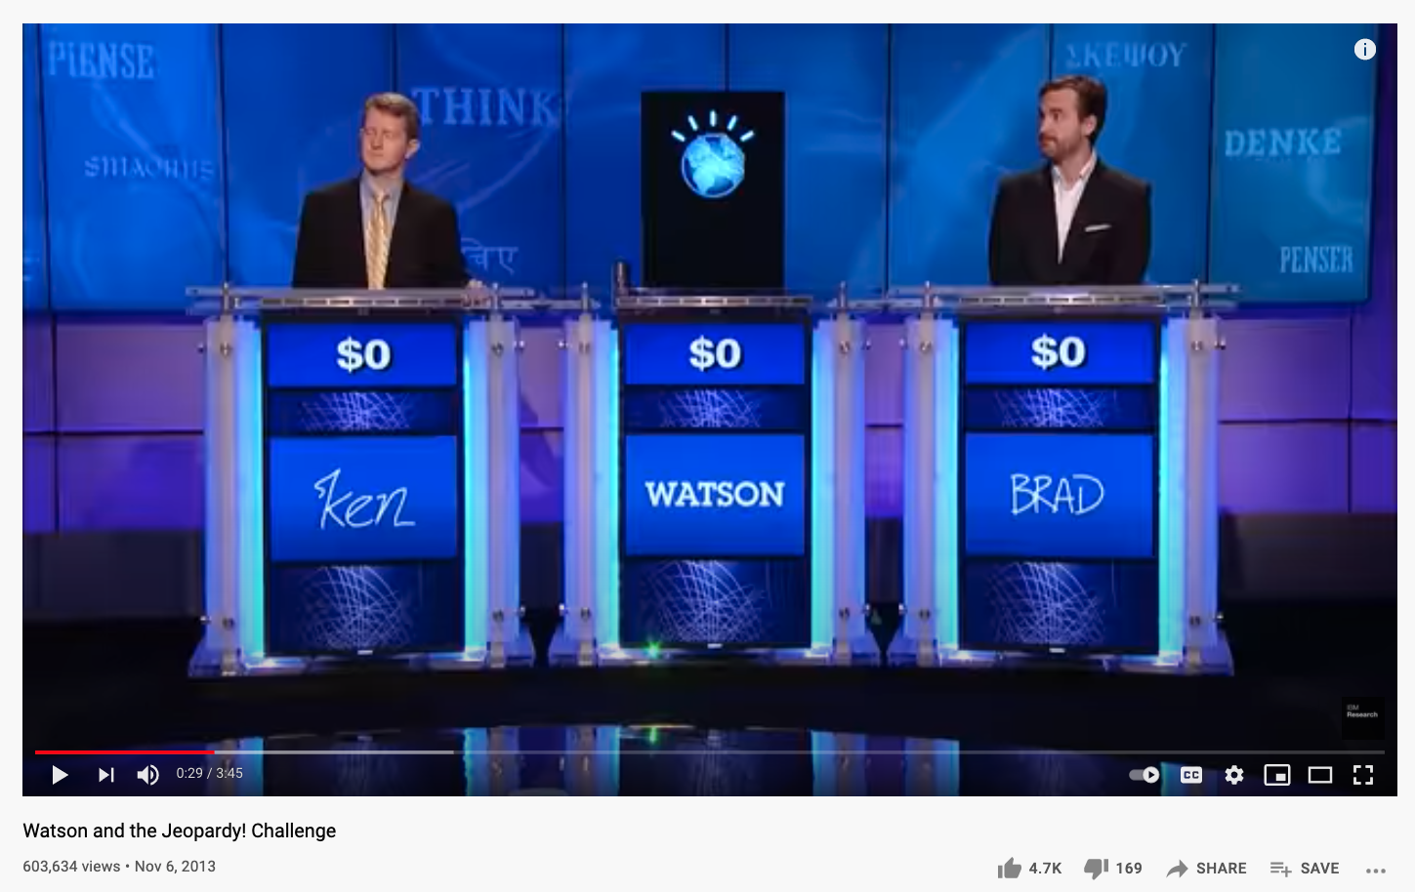
Dave Ferrucci Machine Understanding in Context
Past
Future
Today’s latest Deep Learning ``marvels’’ do not ``understand’’
we are not ambitious enough
or rigorous enough
in defining comprehension
QA (SQuAD)
Answers = Spans???
BERT/ERNIE???

Slide 4
Ido Dagan Moving out of the comfort zones: desired shifts in NLP benchmarking
While deep-learning has transformed our field,
Benchmarking practices haven’t changed that much,
Often addressing the same old tasks/apps.
While performance has rocketed,
Mostly within deep learning comfort zones,
We aren’t doing as well as we think we are,
The old goals (profound language technology) are far from solved
In this talk, Ido will argue for three desired interrelated shifts
Realistic use cases
Realistic expectations (humility)
System test → Unit test (End-to-end→ Modularity/Representation);

Slide 5
Alëna Aksënova, Daan van Esch, James Flynn and Pavel Golik How Might We Create Better Benchmarks for Speech Recognition?
Realistic Settings
Use Cases Matter
Dictation ≠ IVR (call centers) ≠ Movies
Latency (please applaud)
Throughput
(need to delete to maintain real time)
Cost: inference >> training
Terminology
Speaking rate
Recording conditions
(background noise)
Codecs
crappy compression/packet loss
Metrics:
Use Cases Matter
WER treats all words equally (not good for subtitles)
Some errors are worse than others (misleading/offensive vs. hard to detect)
Diagnostic: how am I doing? vs.prioritization (what needs to be fixed first)
Forced alignment (useful for prosodic research)
Diarization (who spoke when)
Demographics: age, gender, dialect

Slide 6
Eunsol Choi Context for Interpreting Benchmark Performances
Context: Resources
Compare models using similar amounts of resources
Context: Time
Answers to questions depend on time
And more: audience (personalization), location, etc.
Opportunities for interdisciplinary collaboration
Systems research
Web search

Slide 7
Greg Diamos, Peter Mattson and David Kanter ML Commons (and ML Perf)
Two topics:
What is MLPerf?
Advice for groups wanting to create new sets of benchmarks

Slide 8
Sam Bowman What Will it Take to Fix Benchmarking in Natural Language Understanding?
Evaluation is broken
Unrealizable; biased scores
Little room for researchers to demonstrate improvements
Paths forward
Adversarial constructions → obscures abilities we want to measure
Goals/Concerns:
Validity, Reliability, Statistical Power, Social Bias
Restoring a healthy evaluation ecosystem requires progress
reliability of annotations
size
social bias

Slide 9
Questions for Discussion?
Dave
What’s wrong with BERT?
Ido, Alëna, …
You make an excellent case for realistic settings and expectations
I often hear students talk about benchmarks as if
benchmarks ≈ the real world
How do we help such students?
Eunsol, Greg,
You both bring up some great opportunities for interdisciplinary collaboration
Can you say more about collaborations that you are involved in
and would like to be involved in?
Sam,
Your discussion of validity and reliability remind me of experimental psychology
Should our field know more about topics from other fields and other times: psychology in 1950s?

