Slide 1
Lessons from SPEC
John R. Mashey (mash) AT techviser dot com
ACL-2021 Workshop on Benchmarking:
Past, Present and Future (BPPF)
August 5-6, 2021

Slide 2
Speaker – John R. Mashey
PhD Computer Science, Penn State, 1974
Early UNIX software, Bell Labs 1973-1983, MTS → Supervisor
Programmer’s Workbench, shell programming, text processing, environment variables, workload measurement/tuning in first UNIX computer center, UNIX per-process accounting UNIX+mainframe data mining apps, capacity planning/tuning, benchmarking => 3B20
Convergent Technologies 1983-1984, MTS → Director Software
Compiler & OS tuning, uniprocessor/multiprocessor servers
MIPS Computer Systems 1985-1992, Mgr. OS → VP Systems Technology
System coprocessor, TLB, interrupt-handling; byte addressing(!), halfword instructions; ISA evolution, multiprocessor features, multi-page-size TLB, 64-bit
MIPS Performance Brief editor; a SPEC benchmarking group founder 1988
Hot Chips committee through 2015; ex-frequent poster on comp.arch
Silicon Graphics 1992-2000, Director Systems Technology → Chief Scientist & VP
R10000 & later architecture, including performance counters & software, Big Data
ccNUMA system architecture (NUMAflex in Origin3000, Altix)
Benchmarking issues in High Performance Computing, DBMS; technology forecasting
Mostly-retired ☺ Occasional consulting for VCs / advisory committees for high-tech co’s; Computer History Museum (www.computerhistory.org) Trustee since 2001 2011-13 – consulting for Nvidia, Unified Memory, performance, ~17 patents
Investigative reporting on climate denialism/disinformation, articles & talks since 2008 Advisor UCSF Center for Tobacco Control Research & Education since 2013
❤ ☹1995

Slide 3
Overview
3+1 benchmarking organizations – TPC, SPEC, EEMBC, MLCommons
SPEC in 2021
Historical context for SPEC
Origin of SPEC in Campbell bar and early days
SPEC - Correct math, but missed statistical implications
Lessons, including on brief thoughts on NLP benchmarking
“When you can measure what you are speaking of and express it in numbers, you know that on which you are discussing. But when you cannot measure it and express it in numbers, your knowledge is of a very meagre and unsatisfactory kind.” -Lord Kelvin
“…benchmarks shape a field, for better or worse. Good benchmarks are in alignment with real applications, but bad benchmarks are not, forcing engineers to choose between making changes that help end users or making changes that only help with marketing.” -David A. Patterson,
“Creating good benchmarks is harder than most imagine.” – John R. Mashey
Forewords to Systems Benchmarking (2020), by Kounev, Lange, Kistowski (SPEC) No matter how much people want performance to be a single number, even the right mean with no distribution can be misleading, and the wrong mean certainly is no better.

Slide 4
3 Long-established benchmarking groups, 1 New
Old ones
1988 TPC – Transaction Processing Performance Council http://www.tpc.org/ Market researcher Omri Serlin convinced 8 companies to form TPC, 08/10/88.
1988 SPEC – Standard Performance Evaluation Corporation www.spec.org EE Times’ reply to email was impetus for 4 companies to start, incorporated 11/14/88.
1997 EEMBC Embedded Microprocessor Benchmark Consortium www.eembc.org Originally started by EDN (Electrical Design News)’ Markus Levy, as EDN EMBC, 12 members.
Long history may offer insights, but next, new group likely overlaps more with NLP:
MLCommons https://mlcommons.org for Machine Learning, academe+industry
As per https://rise.cs.berkeley.edu/blog/mlperf-spec-for-ml/ “The RISE Lab at UC Berkeley today joins Baidu, Google, Harvard University, and Stanford University…” “Historical Inspiration. We are motivated in part by the … (SPEC) benchmark for general-purpose computing that drove rapid, measurable performance improvements for decades starting in the 1980s.”
2018 MLPerf first results https://mlcommons.org/en/history/
All are driven, (mostly) funded by corporate members SPEC, EEMBC and MLCommons have significant participation by academics/labs. Groups sometimes overlap/cooperate, power metrics by SPEC and MLCommons: https://www.hpcwire.com/2021/04/21/mlperf-issues-new-inferencing-results-adds-power-metrics-nvidia-wins-again/ Also EEMBC-MLCommons interactions

Slide 5
SPEC - 2021
SPEC - www.spec.org, https://en.wikipedia.org/wiki/Standard_Performance_Evaluation_Corporation
“The Standard Performance Evaluation Corporation (SPEC) is a non-profit corporation formed to establish, maintain and endorse standardized benchmarks and tools to evaluate performance and energy efficiency for the newest generation of computing systems. SPEC develops benchmark suites and also reviews and publishes submitted results from our member organizations and other benchmark licensees.”
2018 30 Years – meeting https://www.spec.org/30th Timeline https://www.spec.org/30th/timeline.html - 125 members in 22 countries
Most work done by members/associates, plus 4 staff
SPEC started with 1 small group, now 5, often with multiple subgroups
1988 OSG - Open Systems Group – “benchmarks for desktop systems, workstations & servers running open operating system environments” www.spec.org/osg/
1996 GWPG - Graphics & Workstation Performance Group, was GPC→ www.spec.org/gwpg
1996 HPG - High Performance Group (parallel supercomputing) www.spec.org/hpg PERFECT Club →https://www.spec.org/30th/hpg.html
2011 RG - Research Group – “collaborative research efforts in the area of quantitative system evaluation and analysis, fostering the interaction between industry and academia. It also researches and then suggests new groups/subgroups for developing areas.”
https://research.spec.org/news/single-view/article/new-textbook-on-systems-benchmarking.html Kounev, Lange, Kistowski, Systems Benchmarking (2020)
>2018 ISG - International Standards Group - work with governments www.spec.org/isg/

Slide 6
SPEC – Members and Associates
https://www.spec.org/consortium/
Each group (OSG, GWPG, HPG, ISG, RG) has
Own benchmark suites, rules and dues structure
Members – mostly companies, bulk of the money
Associates – mostly universities, sometimes National Laboratories, standards groups.
Some overlap, depending on interests
OSG, for example.
Membership $2,500 initiation, $7,500 Annual Dues, get licenses for all benchmarks
Associate $1,000 initiation $ 500 Annual Dues (Nonprofits, educational)
Companies typically devote 1 or more people to SPEC work, salaries far outweigh
Benchmarks typically cost $1500-$2500 commercial license, noncommercial free.

Slide 7
SPEC – OSG Members and Associates
Example – OSG - https://www.spec.org/consortium/
“Members: Advanced Micro Devices (AMD) * Altos Computing Inc. * Amazon Web Services, Inc. * Apple Inc. * ARM * ASUSTek Computer Inc. * Auristor Inc * Bull Atos Technology * Chengdu Haiguang IC Design Co., Ltd. * Cisco Systems * Dell Inc. * Epsylon Sp. z.o.o. Sp. Komandytowa * Format sp. z o.o. * Fujitsu, Ltd. * Gartner, Inc. * Giga-Byte Technology Co., Ltd. * Google, Inc. * Hewlett Packard Enterprise (HPE) * Hitachi Vantara LLC * Hitachi, Ltd * IBM * Inspur * Intel Corporation * iXsystems Inc. * Lenovo * Microsoft Corporation * NEC Corporation * NetApp, Inc. * Nettrix * Netweb Pte Ltd * New H3C Technologies Co., Ltd. * NVIDIA Corporation * Oracle Corporation * Principled Technologies, Inc. * Pure Storage * Qualcomm Technologies Inc. * Quanta Computer Inc * Red Hat, Inc * Supermicro Computer, Inc. * Taobao (China) Software Co. Ltd. * VIA Technologies, Inc. * VMware, Inc. * WekaIO * ZTE Corporation *”
“Associates: Charles University * China Academy of Information and Communications Technology * China Electronics Standardization Institute * ForTISS -- An-Institut der Technischen Universitaet Muenchen * Indiana University * Institute of Information Science, Academia Sinica * Japan Advanced Institute of Science and Technology (JAIST) * Karlsruhe Institute of Technology (KIT) * Leibniz-Rechenzentrum, Bavarian Academy of Science * Linaro Limited * National University of Singapore * Peng Cheng Laboratory * Purdue University * RWTH Aachen University * South China University of Technology * Technische Universitat Darmstadt * Technische Universitat Dresden, ZIH * Telecommunications Technology Association * Tsinghua University * University of Aizu * University of California at Berkeley * University of L'Aquila - Dept of Computer Science and Engineering (DISIM) * University of Maryland * University of Miami * University of Texas at Austin * University of Tsukuba * University of Wuerzburg * UT-Battelle Oak Ridge National Labs (ORNL) * Virginia Polytechnic Institute and State University *”

Slide 8
Benchmark categories
Benchmarks are usually called SPEC <label> year, like SPECint92, SPECfp92, SPECviewperf 2020, etc.
Benchmark sets - https://www.spec.org/benchmarks.html – multiple programs/set
(1) Cloud – OSG
(1) CPU - OSG (1989, 1992, 1995, 2000, 2006, 2017)- how it started
(12) Graphics/Workstations – GWPG
(3) ACCEL/MPI/OMP – HPG – (3)
(4) Java Client/Server - OSG
(2) Storage - OSG
(2) Power - OSG
(1) Virtualization – OSG
(30) Retired – benchmarks become obsolete, although some components persist
Pervasive issue, not just for SPEC
People want to see individual benchmark results, select those most relevant
But also demand overall summary numbers, many historical arguments over math
Designers of hardware and software want to use summaries for optimization

Slide 9
Historical context for SPEC
1970- Computer industry mainframes & minicomputers
Proprietary operating systems
Fortran and COBOL more-or-less portable, if careful
System implementation languages proprietary to vendors, rarely released or supported outside
Bell Labs’ Unix, C language propagated widely around universities, starting ~1974 on Digital Equipment Corporation PDP-11. UC Berkeley active with Berkeley System Distribution (BSD)
Unix Edition VII (1979) relatively portable, included retargetable Portable C Compiler (PCC)
DEC VAX 11/780 (1978) most successful superminicomputer family, widely used, became canonical “1” in performance, ran both DEC VAX/VMS and Unix, esp. BSD
Motorola 68000 (1979) & 68010 (1982) adequate for running {Unix, C}➔ workstations, servers
1980- Rapid rise of microprocessors, especially Reduced Instruction Set Computers
Early 1980s – RISC research: UC Berkeley (David Patterson) and Stanford (John Hennessy), strong emphasis on quantitative design methods based on benchmarks, not intuition
~1986- First “golden age of computer architecture”, Hennessy & Patterson Turing lecture, paper https://cacm.acm.org/magazines/2019/2/234352-a-new-golden-age-for-computer-architecture/fulltext
“Cambrian explosion” of new microprocessor architectures Almost all had C compilers → for first time, common system implementation language
Rapid increases in performance, far beyond rates of superminis & mainframes
MIPS, Hewlett-Packard, IBM, others shipped global optimizing compilers → sometimes caused trouble for simplistic benchmarks
Ferocious competition, ever-changing industry coalitions, claims, arguments, technologies

Slide 10
Benchmarking and Benchmarketing - 1988
CPU performance seems most basic metric, one might think it easy, BUT…
https://en.wikipedia.org/wiki/Benchmark_(computing) reasonable overview Many date from the 1980s.
Plethora of benchmarks, typically in C or Fortran, not very consistent
Academics produced many
Unix Review, Digital Review, Byte, etc published own sets of benchmarks
High-performance computing had (decent) floating point LINPACK, Livermore Loops, for (usually vector) codes, but small synthetic, unrealistic Whetstone widely quoted
Some of the most popular benchmarks were awful, especially Dhrystone, infamously unrealistic, small integer C program, susceptible to unrealistic optimizations, outright cheating
Customers wanted (often large) realistic benchmarks to which they could relate
Customers/third-party developers brought programs to “porting centers” → reality check
Most computer companies regularly published “Performance Briefs”
People who wrote these often knew each other, traded documents (we knew competitors would manage to get them anyway), asked for updated numbers, sometimes even traded code
Small, well-known benchmarks like Whetstone, Dhrystone, etc … because we had to
More realistic larger codes, sometimes proprietary, sometimes open-sourced, but with different versions or inputs

Slide 11
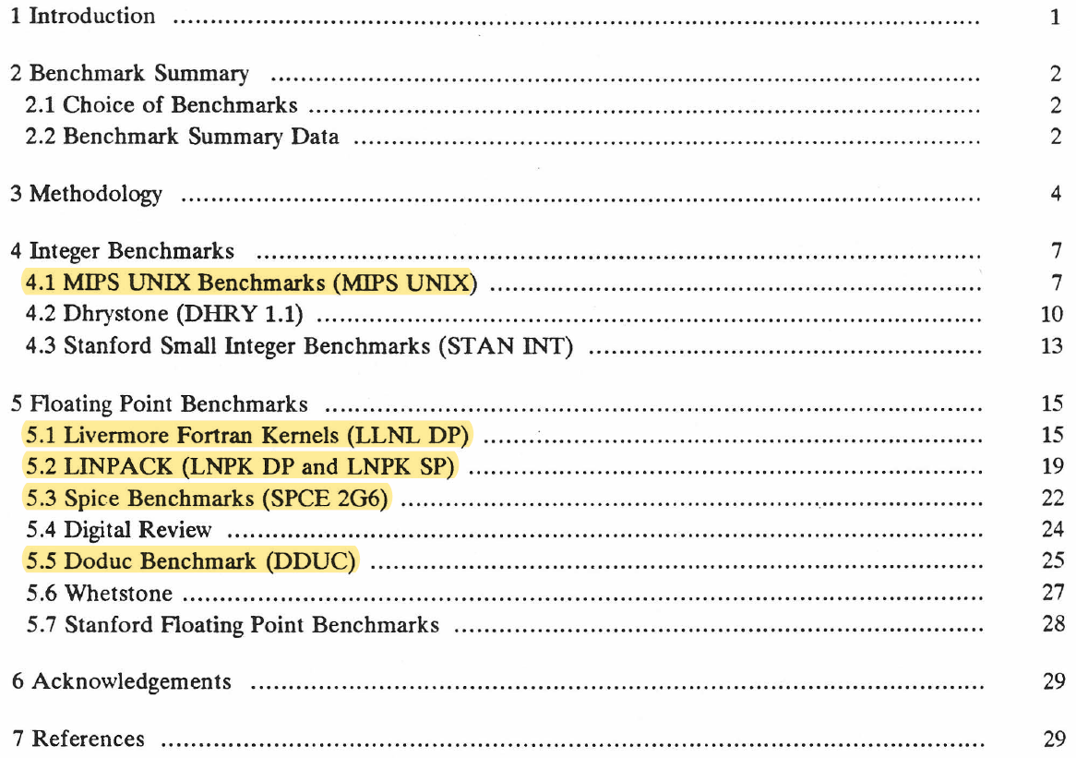
Example – MIPS Performance Brief 3.5, October 1988
Most realistic benchmarks highlighted

Slide 12
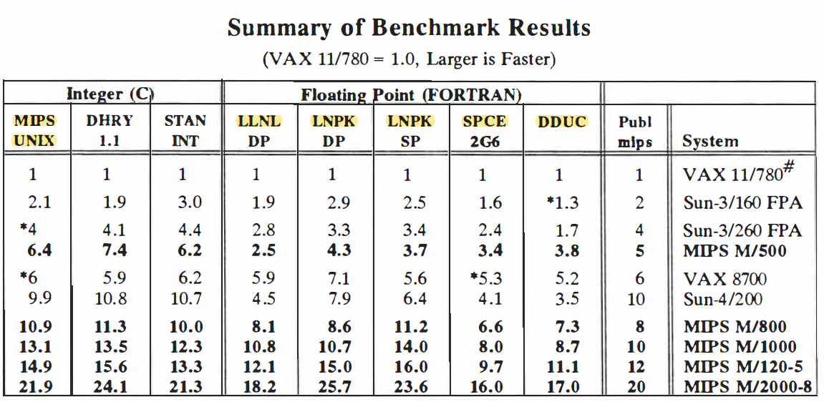
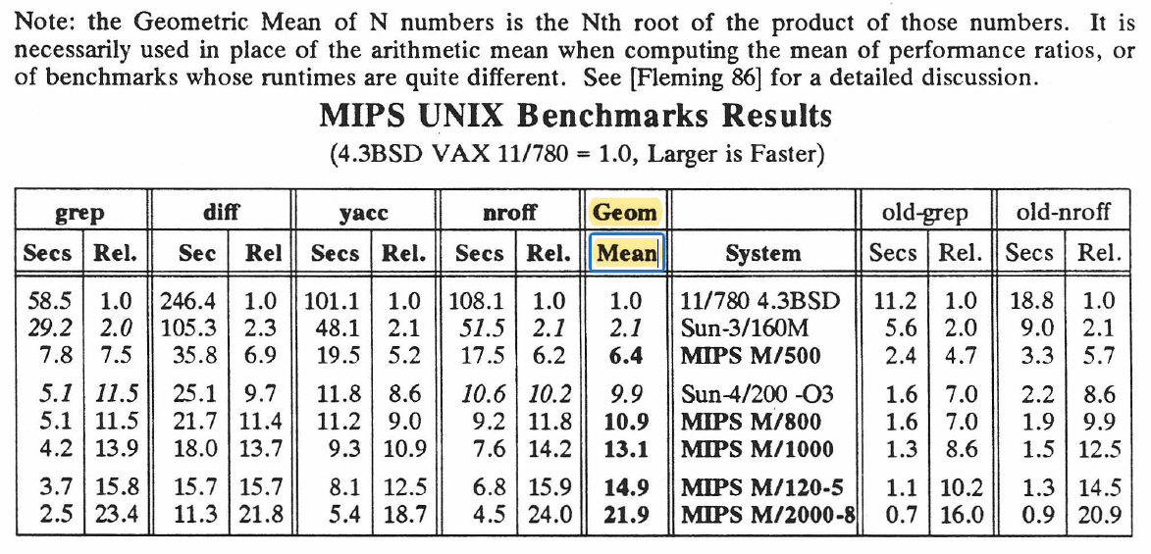
MIPS Performance Brief Summary, Geometric Mean
Ugh
4 real Unix programs were used to publish aggregate integer performance
Many quoted Dhrystone (VAX)-mips, ugh, but usually gave higher numbers than more realistic benchmarks
Small benchmarks from Stanford
Vendor-published mips ~consistent in own product line, but incommensurate
Easier to find good floating point benchmarks than integer

Slide 13
Origin of SPEC ~ October 1988 in Campbell, CA Bar
Stan Baker prolific writer for widely-read EE Times magazine, wrote article with common “Dhrystone-MIPS”, i.e., performance relative to VAX-11/780
I emailed him to complain about how awful that was (and I think another did)
He responded: “If it’s so bad, why don’t you industry folks create something better?” He offered his bar in Campbell, CA as a neutral meeting place, plus beer
I contacted folks from Hewlett-Packard, Sun Microsystems and Apollo Computer. All:
wanted to compete on realistic benchmarks than on poor ones like Dhrystone.
hated being asked by marketing to add features to speed Dhrystone, etc
disliked the amount of redundant effort, hard-to-compare results
encountered (legitimate) skepticism of customers confused by benchmark mess
We wanted to codify best practices, often found in good performance briefs
Compile and run reasonably-portable source code for realistic C and Fortran programs. Real customer program were just not ike popular, small, widely-quoted benchmarks
Clearly document system configurations, compiler flags
Every program needed verification test to assure correct execution
Clear reporting to the public
Customers liked consistent relative-performance ratios
Many of our documents included performance relative to VAX-11/780
We knew we needed to get more vendors involved, sometimes over skepticism.

Slide 14
A Year of Work to First Release
Incorporated 11/14/88, with EE Times’ Stan Baker as (neutral) President
Year of hard work
Evaluate suggestions for good benchmarks
“Fuzzy compares” needed for some floating point codes, given differences
“Bench-a-thon” workshops, found surprising nonportabilities, difficulties
Many discussions over rules for running codes, validating results and reporting
Need to distribute source code ruled out proprietary programs University software eventually had turned into products, like spice→Hspice
SPEC Release 1 announced Fall 1989 press conference, help from EE Times
4 integer benchmarks, surprisingly hard to find good ones
6 floating point benchmarks, many choices
10 SPECratios, given as performance / VAX-11/780
SPECmark = SPEC89 = Geometric Mean (GM) of all 10
Wanted 2 separate summary numbers, but got strong pushback from press, reluctantly used one … but vendors quickly published both
SPEC fixed 1992, deleted some, added more: (6) SPECint92, (10) SPECfp92
A member of press asked fair question:
“These are done by computer companies. Isn’t that letting foxes guard the henhouse?”
Our answer: “Nobody is better than a fox at keeping other foxes from eating the hens.”
Coopetition of fierce competitors can actually work well, once culture of trust and honesty built, and people find benefits from avoiding duplicative efforts.

Slide 15
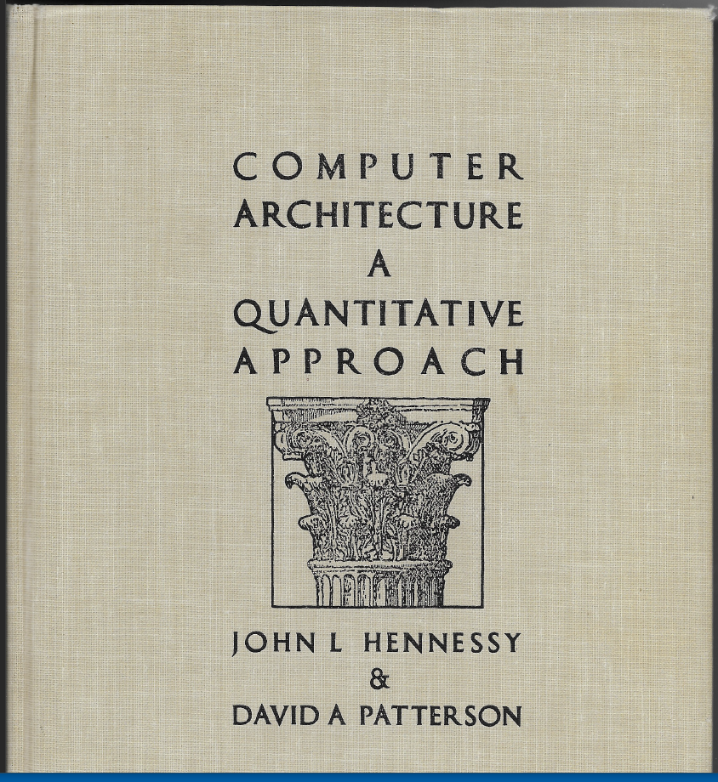
Incorporation In Famed Book Series
John L. Hennessy and David A. Patterson Computer Architecture – A Quantitative Approach, Morgan Kaufmann, 1990. Rapidly became the standard high-level textbook.
Later editions with serious revisions: 1996, 2003, 2007, 2011, 2017.
Essentially guaranteed SPEC visibility, analysis, discussion in universities ➔ associate memberships

Slide 16
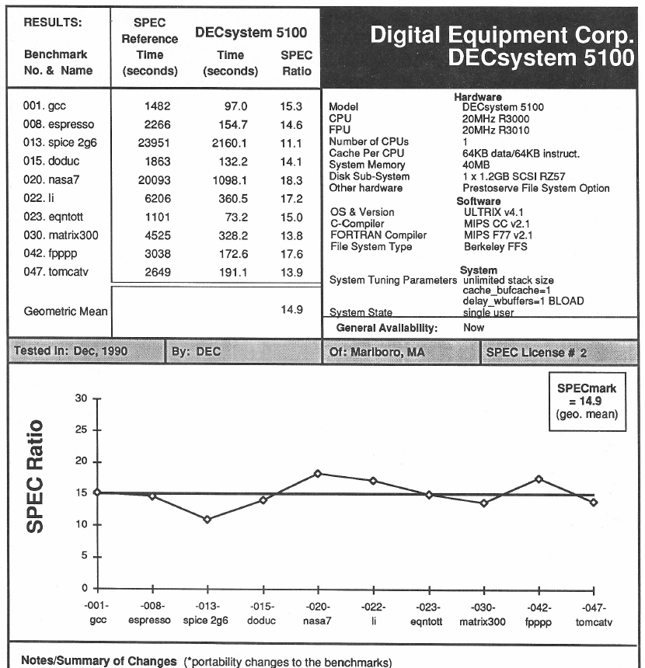
Sample Report
Standard reporting format, example from SPEC Newsletter Volume 3, Issue 1, Winter 1991.
In Campbell bar, all liked Spice circuit simulator as big floating point benchmark, but we accidentally picked a poor choice of input. Warning: no assumptions!
All liked Gnu c (gcc) benchmark only one still in SPEC CPU2017 (C, C++, Fortran) 10 integer 13 floating point
https://www.spec.org/cpu2017/Docs/overview.html#benchmarks

Slide 17
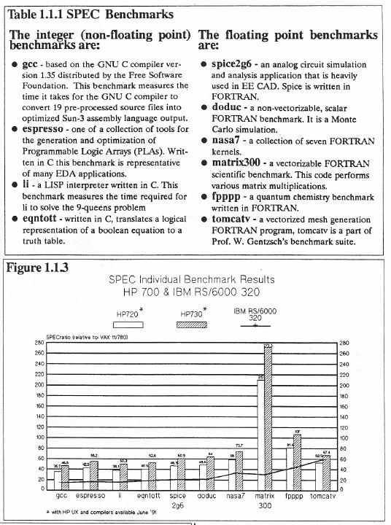
March 1991 HP Performance Brief
During 1990-1991, vendors were including SPEC, for example: HP Apollo 9000 Series 700 Performance Brief March 1991
matrix300 leap? In 1991, several vendors started to enhance their Fortran compilers to use method called “cache-blocking” to improve vector/matrix codes.
Valuable, legitimate optimization, but too small and simple, was sped up far more than seen on more realistic codes. It was dropped in 1992
matrix300

Slide 18
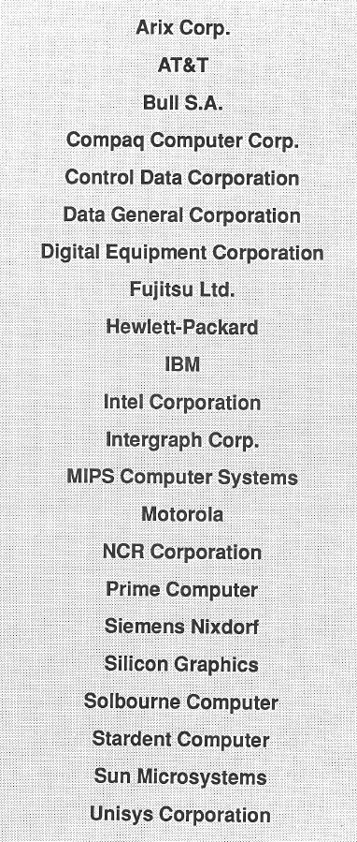
SPEC Membership, Winter 1991
SPEC Newsletter, Volume 3, Issue 1, Winter 1991 Most major vendors had signed up…
Individual vendors had often been reporting summaries separately for integer and floating point subsets.
By SPEC 1992, they were officially split.
All this was pre-Internet. Results were printed in Newsletters. Benchmark codes were shipped on tapes.

Slide 19
Explanations – VAX as (first) Reference Machine
SPEC Newsletter, Volume 2, Issue 1, Winter 1990, by Kaivalya Dixit (Sun) and Robert Novak (MIPS)
“VAX As Reference Machine
Since SPEC first began publishing results, questions about the use of the VAX-11/780 as the reference machine have arisen. The VAX was chosen because it is generally recognized as a 1 mip (millions of instructions per second) machine. With its large installed base, the VAX provides a better
understanding of the relative performance of machines in regards to the Benchmark Suite. The reference machine issue can be likened to a barometer that reports numbers that are worthless unless the mean barometric pressure is known. However, there is no guarantee that SPEC will use the VAX
as the reference platform for future releases. As the benchmarks become more complex, SPEC may switch to a more appropriate reference machine.”
Indeed, newer systems got so much faster it took far too long to run the programs on old VAX-11/780s, and by 1992 the industry was accustomed to the methodology.
It computed consistent relevant performance summaries regardless of choice of reference machine by:
Converting run-times to relative performance= SPECratios
Computing Geometric Means from SPECratios
That was important: there could be no advantage/disadvantage from being chosen as reference.
However, in the 1980s and even later, the choice of summary computation was very contentious among Arithmetic Mean, Harmonic Mean and Geometric Mean. (Livermore Loops reported all 3.) Many papers were written.

Slide 20
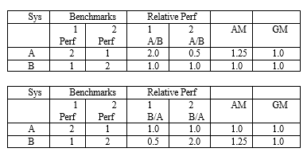
Geometric Mean and Statistics
If well-characterized workload, one can just run the exact programs and measure results, sometimes true for embedded systems and occasionally in high-performance computing
Otherwise, a benchmark set (like SPEC) should be treated as a sample of population: If chosen by experts, it may be representative sample
Statistical methods should be applied. For many data sets:
Compute (arithmetic) mean (AM), standard deviation, skew, kurtosis (1st 4 moments)
Hope for normality (Gaussian) for its properties, but test, as never guaranteed
But for sets of SPECratios, AM gives contradictory results. Extreme example: system A is no better than machine B on combination of benchmarks 1 and 2, but A can seem 1.25X faster if B is chosen as reference, but arbitrary choice. 1980s “ratio games” GM gives consistent results, although our charts should have been logarithmic

Slide 21
Geometric Mean, Statistics, Lognormal Distribution
Many areas of science: people use logarithmic transforms, often hoping to find a lognormal distribution (generated by combinations of multiplicative effects)
In 1989 we missed a basic mathematical identity. Usual way to compute GM was just shorthand for exponentiating average of logarithms of data
Then, one can do standard statistics: Compute mean, standard deviation, skew, kurtosis of logs Perform normality tests, if logs are normal or close, distribution is ~lognormal.
GM (data) = exp(mean of logs)
Standard deviation = exp (log standard deviation) = multiplicative standard deviation sigma, i.e., if lognormal and sigma = 1.2, ~2/3 of data should lie within [GM/1.2 … GM*1.2]
GM(y:x) = 1/GM(x:y) better be
Sigma (y:x) = sigma (x:y) invariant to choice of base.
Skew (y:x) = - skew(x:y) reverses left-to-right
Kurtosis(y:x) = Kurtosis(x:y) has same shape
J. R. Mashey, “War of the benchmark means: time for a truce,” ACM SIGARCH Computer Architecture News vol 32, issue 4, pp.1-14, September 2004. Doi: 10.1145/1040136.1040137 J. R. Mashey, “Summarizing performance is no mean feat,” October 30, 2008, talk given 2005-2008 at various places. https://techviser.com/docs/Mashey.nomeanfeat.2008.pdf Many examples, 77p. https://en.wikipedia.org/wiki/Log-normal_distribution
Standard statistical methods can be used to analyze distributions, not just averages.

Slide 22
Lessons - NLP(?)
Knowing ~nothing of NLP benchmarking, I looked around
Metrics? Accuracy, Precision, Recall or F1? https://towardsdatascience.com/accuracy-precision-recall-or-f1-331fb37c5cb9
Dynabench: Rethinking Benchmarking in NLP https://arxiv.org/abs/2104.14337
https://paperswithcode.com/
Natural Language Processing Performance Metrics (Benchmarks) https://dev.to/amananandrai/natural-language-processing-performance-metrics-benchmarks-4jel GLUE, SuperGLUE, SQuAD, BLEU, MS MACROS, XTREME
This is obviously a huge space, some applications seem to overlap with MLCommons, but there may be generic lessons from experience with SPEC and others.
GLUE/SuperGLUE looks like promising start. There may be more.

Slide 23
GLUE, SuperGLUE?
GLUE: A MULTI-TASK BENCHMARK AND ANALYSIS PLATFORM FOR NATURAL LANGUAGE UNDERSTANDING https://arxiv.org/pdf/1804.07461.pdf
SuperGLUE: A Stickier Benchmark for General-Purpose Language Understanding Systems https://super.gluebenchmark.com/ https://w4ngatang.github.io/static/papers/superglue.pdf
“GLUE is a collection of nine language understanding tasks built on existing public datasets, together with
private test data, an evaluation server, a single-number target metric, and an accompanying expert constructed
diagnostic set. …The progress of the last twelve months has eroded headroom on the GLUE benchmark dramatically.
While some tasks (Figure 1) and some linguistic phenomena (Figure 2 in Appendix B) measured
in GLUE remain difficult, the current state of the art GLUE Score as of early July 2019 (88.4 from
Yang et al., 2019) surpasses human performance (87.1 from Nangia and Bowman, 2019) … Consequently, while there remains substantial scope for improvement towards GLUE’s high-level goals, the original version of
the benchmark is no longer a suitable metric for quantifying such progress. … In response, we introduce SuperGLUE, a new benchmark designed to pose a more rigorous test of language understanding. SuperGLUE has the same high-level motivation as GLUE: to provide a simple, hard-to-game measure of progress toward general-purpose language understanding technologies for English.”
8 benchmark test sets, average for single figure of merit
Reminiscent of SPEC in early days!

Slide 24
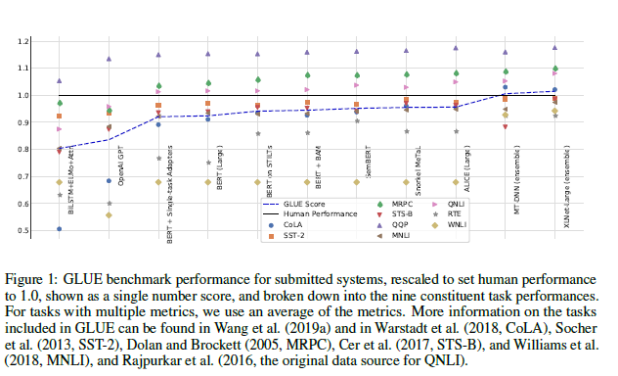
GLUE, SuperGLUE
SuperGLUE paper uses numbers rescaled to human performance = 1 (VAX-11/780 in SPECmark89!)
Blue = GLUE overall score … but is that (correct) GM of rescaled numbers or (wrong) AM?
“average of multiple metrics” seems OK if commensurate, otherwise may skew distribution or have a stronger effect than expected on overall result. If numbers close, may not matter.

Slide 25
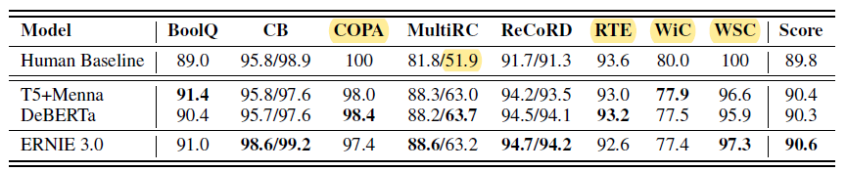
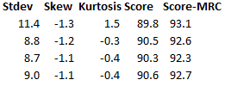
SuperGLUE, Leaderboard
https://super.gluebenchmark.com/leaderboard
ERNIE 3.0: Large-scale Knowledge Enhanced Pre-training for Language Understanding and Generation https://arxiv.org/abs/2107.02137 Many benchmarks, reminiscent of 1980s Performance Briefs
P.14 top 4 from leaderboard, plus a few extra statistics Note NLU software advantage over Human is primarily due to poor results on MultiRC. Human is actually best on 4 of 8 benchmarks. Care needed to avoid over-interpretation. If MRC dropped, Human is ahead.

Slide 26
Lessons: 1989 (CPU) : 2021 (NLP)
In fast-moving field, plethora of benchmarks very likely … and likely confusing
Successful benchmark efforts possible, but take work & persistence
Coopetition works, if people are reasonable and trust develops
Start small and focused, develop extendable processes
Later, expand to adjacent areas
Sometimes act as umbrellas, other groups may join, as GPC and PERFECT → SPEC
But no one group can do it all, depends on structure of the domain
Industry / academe (and often government) cooperation important
Individual benchmarks vs summaries
People must relate to the individual benchmarks or sets of benchmarks, maybe ignore rest
But many also want summary figures
Hope: more analysis of distributions, not just averages, avoid over-interpretation
Good statistical methods should be applied widely to calibrate depth of knowledge
Sometimes multi-modal distributions hint that several populations are mixed
Outliers can be instructive, may strongly affect summaries
From outside, SuperGLUE seems a credible effort to collect and organize results, obviously more benchmarks desirable for better statistics, coverage

