Slide 1
CIKM tutorial
Work in progress

Slide 2
HEMU Dimensions
Computing resources
laptop < cloud access < cluster (1K machines is a typical industry cluster)
Data
Small, medium, big
Algorithmic complexity
Hashing/indexing, PageRank, Deep Learning
Skills
Some things require the worlds' expert, and other things can be done by a software engineer
Things can be done by a non-programmer

Slide 3
HEMU Dimensions - II
Size of team
You
Pizza team
The number of authors per paper has been growing suggesting that you need more and more people to do certain things
Cost
Includes all of the above
As well as externalities such as power
Value
Some things are super expensive and not worth doing
Think about time scales... some things are good for years/decades, and other things age quickly.
How easy is it for the competition to do a fast follow?
Organization
Is your team/company ready for this?

Slide 4
Hard
Large scale inverted index
Crawling
LLMs
Instrumentation

Slide 5
Relevance
Many factors affect whether a document satisfies a particular user’s information need
Topicality, novelty, freshness, authority, formatting, prior knowledge, expertise
Topical relevance: the document is on the same topic as the query
User relevance: everything else
Topical relevance
Focusing on topical relevance does not mean we’re ignoring everything else
It only means we’re focusing on one criteria by which users judge relevance

Slide 6
Large scale experimentation
Principles for designing, running and analyzing experiments
Imagine an e-commerce website where the user:
Visit the homepage -> browse/search for items -> add item to cart -> start purchase process -> complete purchase
Product team wants to add coupon feature to UX
We need to evaluate the impact of the change
Hypothesis: adding new feature will increase revenue
Two user interfaces:
Control (no changes)
Treatment (with coupon feature)

Slide 7

Designing experiments (A/B testing)
Randomization unit
Population
How large does our experiment need to be
How long do we run the experiment
Does the experiment scale well? (1%, 2%, 5%, 10%, … )
https://experimentguide.com/

Slide 8
Recap
Offline evaluation
Online evaluation
Benchmarks consist of
Document collection
Query set
Assessment methodology
Assessment methodology can use raters, user clicks, or a combination
These get quantized into a goodness measure – Precision/NDCG etc.
Different engines/algorithms compared on a benchmark together with a goodness measure

Slide 9
Easy
Inverted index solutions
Elastic Search, Solr, Lucene
SQL-contains
Basic multilingual support
Simple ranking
Tf-idf
BM25
NLP tools
POS, NER, etc.

Slide 10
Medium – Knowledge graphs

Slide 11
Introduction
Knowledge graph (KG) describes objects of interest and connections
Organizing data as nodes and edges
Examples
Microsoft Satori, Google Knowledge Graph, Amazon Product Graph
Knowledge bases (KBs): Yago, Freebase
Knowledge graph and knowledge base terms are used interchangeably

Slide 12
Introduction - II
How to identify nodes and derives edges
So far, most research on KGs/KBs use Wikipedia as source
Benefits: easy to read, easy to parse, Wikipedians
Drawbacks: coverage, outdated content, bias
What do we do when there is no Wikipedia?
… and there are plenty of examples in the real world

Slide 13
Introduction - III
KG is a repository of entities, types and relationships
KG defines entities, types, attributes, relations, provenance
KG is data
KG evolves and needs maintenance

Slide 14
KG vs DB
What’s the difference?
DB
Store data for a specific application purpose
Semantics understood by those who built it and use it
Tables, columns, attributes
KG
All we know about a slice of the world
Semantics understood and agreed by all stakeholders
Application independent
Things, not strings

Slide 15
Why we care?
Machine readable facts about a domain
Data can be used for different use cases
Separation of concerns

Slide 16
KGs in action
Semantic search
Going beyond 10-blue links
Understanding queries and documents
Document retrieval
Expansion
Language modeling
Entity retrieval
Recommendations
Question-answering
Data cleaning

Slide 17
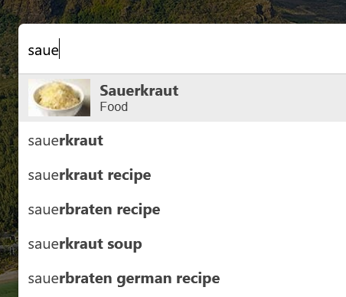
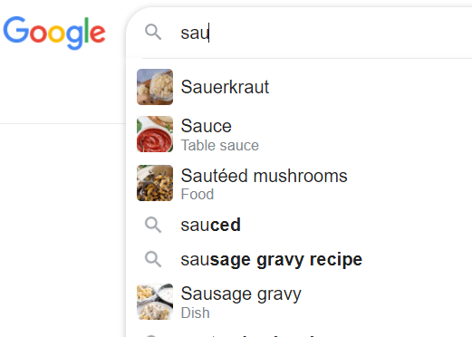
Example - Autocomplete

Slide 18
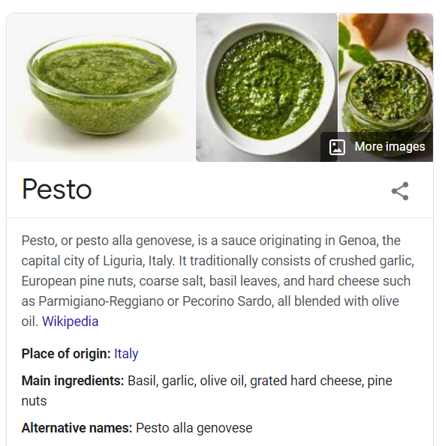
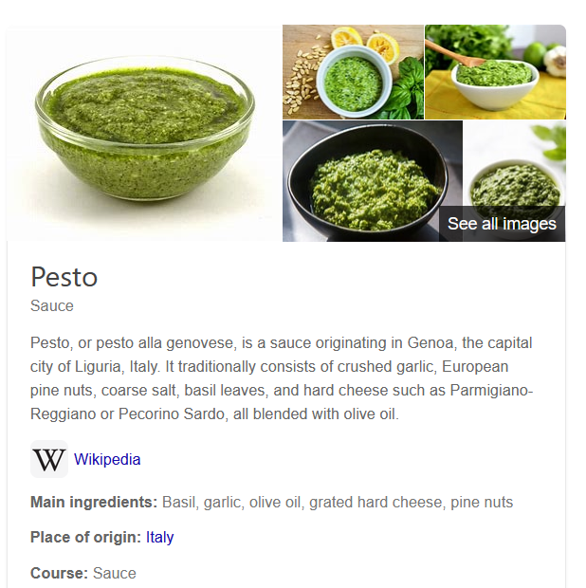
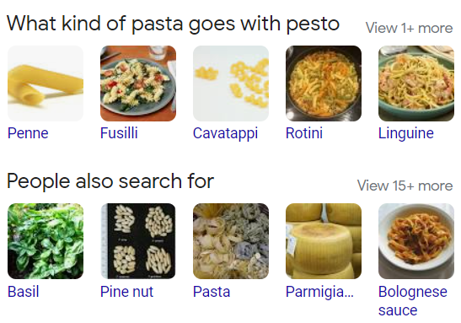
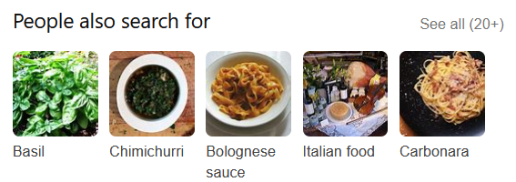
Example - Entity cards

Slide 19
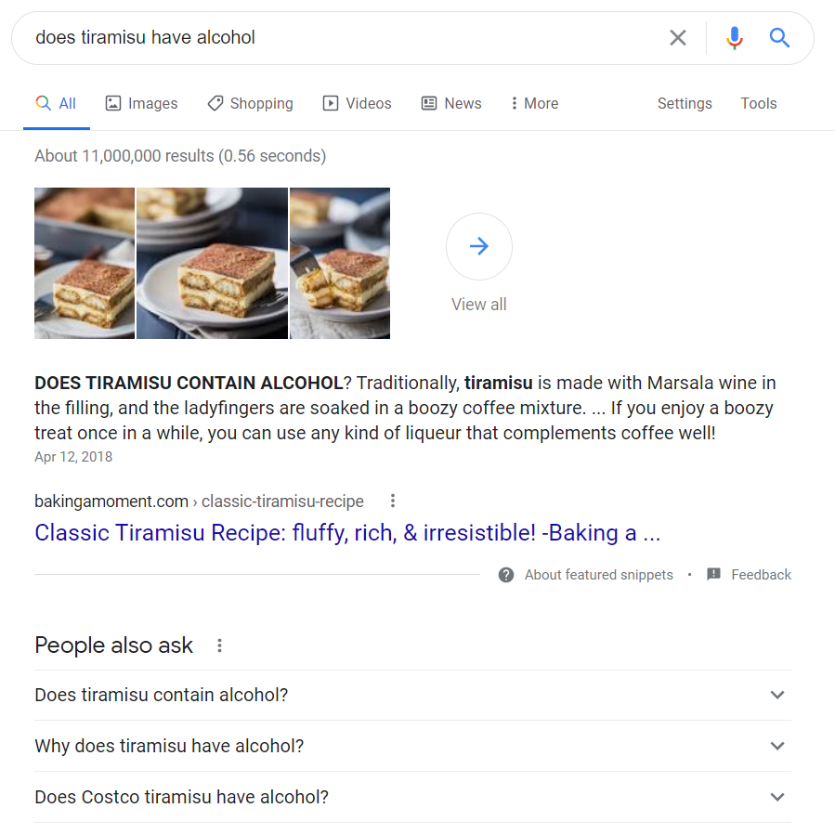
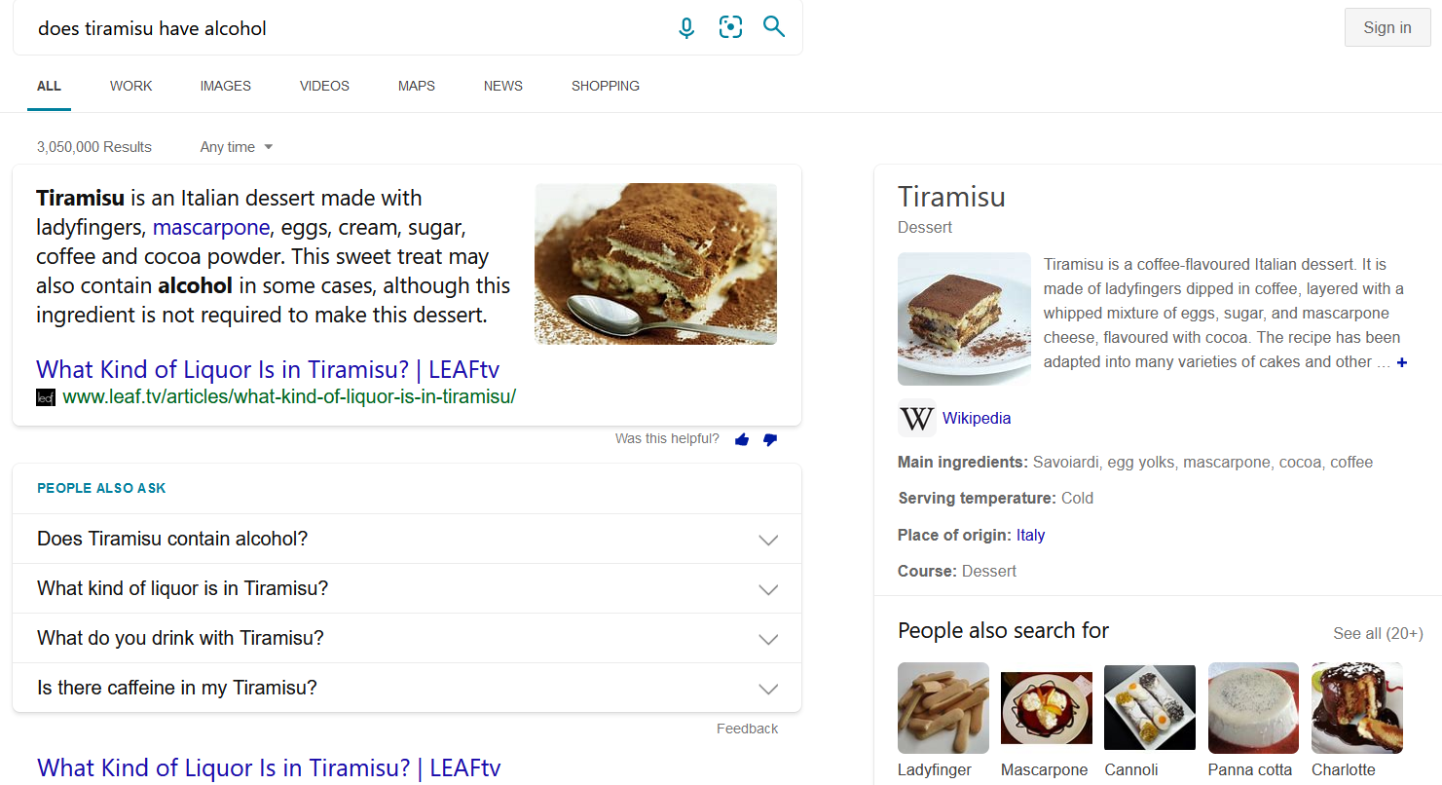
Example - answers

Slide 20
Main concepts
Entity
Object or concept in the real world that can be identified
Uniquely characterized by its name(s), type(s), attributes, and relationships to other entities
Named-entity
Specific entity for which one or many designators or proper names can be used to refer to it
Examples: Red Cross (Organization), California (Location), February (Date)
Unique identifier
An identifier for an entity is a string of chars that uniquely denotes this entity
one-to-one correspondence between each entity identifier (ID) and the object it represents

Slide 21
Main concepts - II
Types
Entities may be categorized into multiple entity types
Types can also be thought of as containers that group together entities with similar properties
Ontology
The process of describing the kinds, properties of and relationships on things in the world
Use the tools of logic to formalize this description
Taxonomies
Taxonomy is a directed acyclic graph, where the nodes are classes and there is an edge from class X to class Y

Slide 22
Main concepts - III
Names
Multiple entities may share the same name
These alternative names are called surface forms or aliases
Attributes
Different types of entities are typically characterized by different sets of attributes
Relationships
Relationships describe how two entities are associated to each other

Slide 23
Relationships and attributes
SPO
Subject-Predicate-Object
Example
<Tom Brady, place of birth, San Mateo>
<Tom Brady, member of sports team, Tampa Bay>
<Tom Brady, occupation, American football player>
<fettuccine, subclass of, pasta>
<fusilli, subclass of, pasta>
<linguine, subclass of, pasta>
<paella, country of origin, Spain>
<paella, has ingredient, chicken>
<paella, has ingredient, rice>

Slide 24
Data models
Direct edge-labeled graphs
RDF is an example
Graph dataset
Set of named graphs. Each named graph is a pair (graph id, graph)
Property graphs
Allows a set of (property, value) pairs and a label to be associated with nodes/edges
Common in graph databases

Slide 25
Data access
Querying
SPARQL
SQL
Raw data
Materialization
Publish high quality data
Search & Browse UI

Slide 26
Information needs
Keyword queries
Free text queries
Structured queries
SQL, SPARQL
Keyword++
Queries with filters or facets
Natural language
Natural language queries, questions
Zero queries
You are the query

Slide 27
How do we build one
Manually
Experts, crowdsourcing
Automation
Generated from input sources
Information extraction
Representation
Entity extraction
Unstructured text
Structured KG
Relation and attribute extraction

Slide 28
Many choices
Semantic Web-like
RDF, OWL, SPARQL
Key-values
Text files, JSON
RDBMS
Tables, columns, SQL
Hybrid
Your favorite combination

Slide 29
Input sources
Data
Wikipedia, catalogs, web pages, query logs, etc.
Importance of top-tier sources
Authoritative content, high coverage, clean representation
Domain specific
Pre-existing categorization
Potentially useful
Alignment

Slide 30
Entity discovery
NER detects mentions of entities and assigns types
Part of your typical NLP toolkit (e.g., NLTK, Stanza, GATE)
Popular types: People, places, organizations, date, etc.
Dictionaries
Abbreviations (Apple, Apple Inc.)
Acronyms (MS, Microsoft)
Stage name (Lady Gaga, Stefani Joanne Angelina Germanotta)
Pattern-based methods
Hearst patterns; co-occurrence
“such as”, “X like Y”, “X and other Y”, “X including Y”

Slide 31
Entity discovery - II
ML
CRF
LSTM models
Embeddings
Word embeddings are computed from co-occurrences and neighborhoods of words in large corpora
Words are highly related if they are used in similar context
Taxonomies from catalogs, networks and user behavior
Wikipedia categories
Tagging systems
Query logs and clicks

Slide 32
Entity linking
Recognizing entity mentions in text and linking them to the corresponding entries in a KG
Assume a KG with existing entities
What’s the difference between NER and EL?
NER recognizes entities and assigns an entity type
EL recognizes entities and assigns an entity id
Importance of having an identifier management system

Slide 33

Entity linking - example
Tom Brady (player)
Tom Brady (director)
Super Bowl 2021
Super Bowl 2020
…
Tampa Bay (Location)
Tampa Bay (Buccaneers - NFL)
Tampa Bay (Lightning - NHL)
Tampa Bay (Ray - MLB)
Tampa (Florida)
Tampa (Kansas)
Tampa Bay Buccaneers (NFL team)

Slide 34
Entity linking – components
Mention detection
Identification of text snippets that can potentially be linked to entities
Using dictionary of entity names and variations
Candidate selection
Ranked list of candidate entities is generated for each mention
Disambiguation
The best entity (or none) is selected for each mention using context (if available)
Ranking problem
Entity annotations

Slide 35
Entity matching
Compute equivalence class
Also known as duplicate detection or record linkage
Name similarity
String similarity
Context similarity
Importance of proximity
Mention-entity popularity
Popularity of an entity
NEMO (Named Entities Made Obvious)
The best evidence for entity disambiguation is provided by the set of co-occurring entities

Slide 36
Attributes and relationships
Pattern-based
Regex
Rule-base extraction
Extraction from semi-structured content
DOM trees
Web tables
Information extraction
Extract (entity-type, alpha, entity-type)
Infoboxes are great if you have them

Slide 37
KG Curation
Quality
Precision, recall
Crowdsourcing
Human in the loop
KG life cycle
Provenance metadata (source, timestamp, extraction method)
Versioning
Twitter CEO (Jack -> Parag -> Elon)
Maintenance

Slide 38
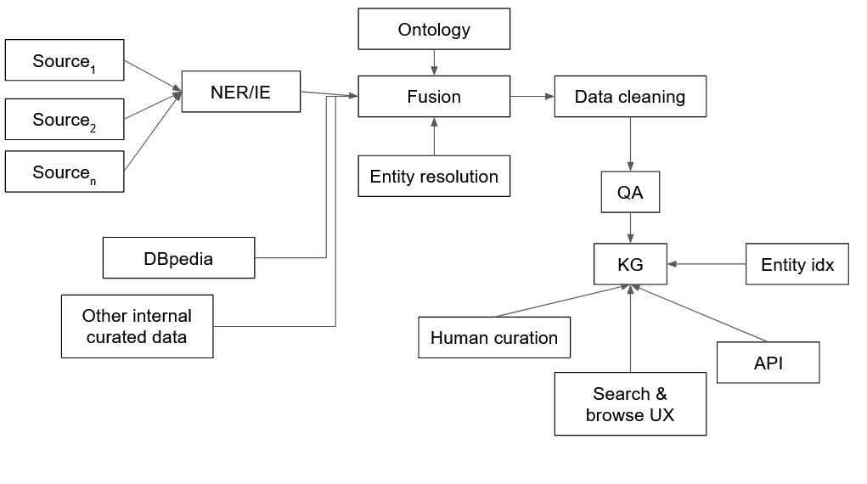
Architecture for KG construction

Slide 39
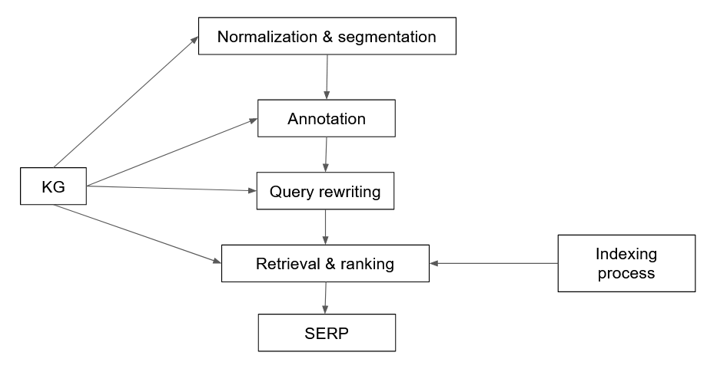
Where is the KG?

Slide 40
Some scenarios
Search
Augment search, query understanding, user intent
Ads
Keyword bidding on nodes and relationships
Example: competitors for pasta brand (Barilla, Colavita)
Recommendations
Recommend products and recipes to users

Slide 41
Some scenarios - II
Recipe recommendation given a shopping list
user = {spaghetti, parmesan cheese, olive oil, ...}
spaghetti carbonara = {spaghetti, pancetta, parmesan cheese, ...}
spaghetti vongole = {spaghetti, anchovy, olive oil, ...}
Question-answering
Resolve natural language questions by providing a direct answer of a list
<cheesecake, has_ingredient, egg>
This triplet can be used to answer queries like “does cheesecake have eggs”

Slide 42
KGs for IR - summary
Document retrieval
Rank documents given a query
Entity retrieval
Rank entities in text or KG according to their relevance to q
Entity recommendation
Given a query q rank each entity e ∈ KG based on their relatedness to the query
Relationship explanation
Given a pair of entities provide an explanation of how the pair is related

Slide 43
Representation
Unique problem
Entities in KG have no textual representation, apart from their names
We can run SPARQL queries but how do we add the IR part?
Predicate folding
Build a textual representation for each entity by considering all triples
Grouping predicates together into a small set of predefined categories
From SPOs triples to a structured document

Slide 44
Predicate folding - example
<spaghetti carbonara, instance_of, recipe>
<spaghetti carbonara, has_ingredient, spaghetti>
<spaghetti carbonara, has_ingredient, pancetta>
<spaghetti carbonara, has_ingredient, eggs>
<spaghetti carbonara, has_ingredient, parmesan>
<spaghetti carbonara, recipe_cuisine, italian cuisine>
<spaghetti carbonara, serving_size, 4>
<spaghetti carbonara, calories, 510>
<spaghetti carbonara, cook_time, 25min>
Name | spaghetti carbonara
Ingredients | Spaghetti, pancetta, eggs, parmesan
Attributes | italian cuisine, serves 4, calories 510, cook time 25min
Related entities | spaghetti aglio e olio, fettuccine alfredo

Slide 45
Entity retrieval
Field search retrieval
Linear combination of matching functions
Can use LTR to learn weights

Slide 46
Document retrieval
Preprocessing
Documents are preprocessed with EL + additional information obtained from KG
Query annotation
Query processed with EL
Expansion
KG feedback: query is issued against an index of a KG in order to retrieve related entities
Corpus-based feedback

Slide 47
Semantic search
Understanding information needs
Query classification
Assign a query to one or multiple pre-defined categories
Query intent classification (Broder)
Query annotation
Generate semantic markup for a query
Query segmentation: group terms into phrases
Query tagging (POS, NER)

Slide 48
EL in queries
Problems
Queries are very short
Limited context, or none at all
Online process under time constraints
Components
Mention detection
Candidate ranking
Interpretations: query may have more than 1 interpretation

Slide 49
Using entities for search
Query assistance
Auto-complete
Specific subset of queries that can be decomposed into entity and refiner components
Query recommendations
Entity cards
Summaries and facts
Entity recommendation
Entity based
Query based
Explanations

Slide 50
KGs & LLMs
TBD

Slide 51
Ugly - Labeling

Slide 52
The bad news first
Labeling is hard
Facebook
Snapchat
Points-Of-Interests (Foursquare, etc.)
Labeling is going to get more difficult
Enterprise
Personalization
Healthcare
New data sets
Some context
We assume supervised or semi-supervised learning
Large scale
Continuous

Slide 53
There is hope
Human computation
AI
CS
HCI
Economics
Behavioral sciences
Lots of research and new ideas
This section
Programming perspective, quality framework, data pipelines, future trends

Slide 54

What is a label?
Spam email?
Label: yes, no

Slide 55
Why we need labels?
Information retrieval
Natural language processing
Machine learning
Artificial intelligence

Slide 56
Why we care?
Provenance
Reproducibility & debugging
Explainability & interpretability
How a training set was created
Bias and fairness
Data management
ML/AI models live & die by the quality of input data
Metadata about labels
Maintenance

Slide 57
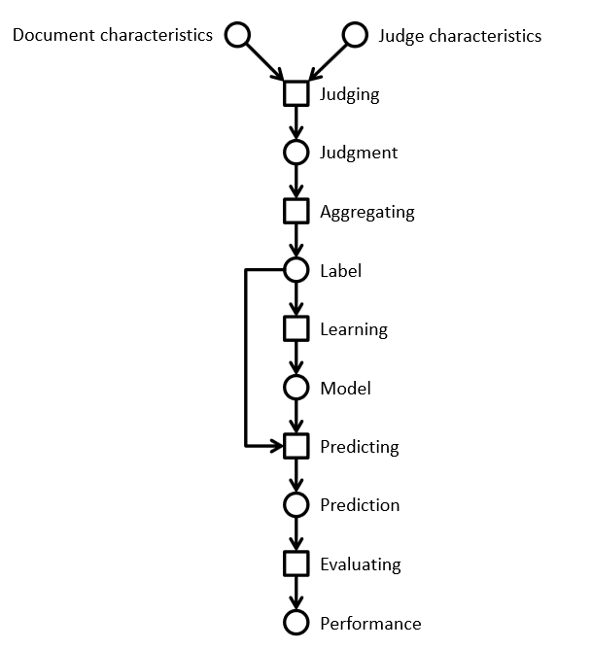
Lifecycle of a label
Information retrieval example
Using a crowd to label a data set
Using ML to process the complete data set

Slide 58
Relevance labels
Indicate whether a search result is valuable to a searcher
Key in evaluation and optimization IR systems
Editors or experts
TREC-style
Crowdsourcing
LLMs

Slide 59
Careful with that axe data, Eugene
In the era of big data and machine learning
labels -> features -> predictive model -> optimization
Labeling perceived as boring
Tendency to rush labeling
Quality is key
Garbage in, garbage out
Own the entire stack
Labeling, modeling, infrastructure, deployment

Slide 60
The state of the field
Human-labeled data is more important than ever
Requirements
Throughput -> ASAP; I need the labels for yesterday
Cost -> cheap; if possible free
Quality -> top
Performed as a one-off by 3rd party (crowd or editors)
Needs development work to get good results
Very limited functionality in current platforms
Mechanical Turk, SageMaker (Amazon)
Figure Eight (Appen)
Toloka (Yandex)
Start-ups
LLMs

Slide 61
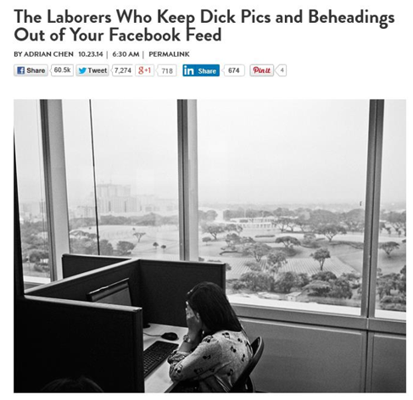
The need for humans

Slide 62
Problems
Monolithic HITs
The structure of a HIT mirrors the structure of the task the developer is working on
Similar to Conway’s law in software engineering
Task complexity
Lengthy instructions
RTFM doesn’t work
We don’t think of HC/crowdsourcing as programming
How to improve
Use established programming practices
Careful, we are dealing with humans and not machines

Slide 63
A spectrum of labeling tasks
Nature of task | Aggregation approach | Evaluation technique
Objective question has a correct answer (objective) | Reliable judge assigns appropriate label for an item | Evaluate workers by comparing individual results with gold set
Judgment question has a best answer (partially objective) | Inter-rater agreement determines label for an item | Evaluate workers by comparing individual results with consensus
Subjective question has consistent answer (subjective) | Repeatable polling determines probability of a label for an item | Evaluate workers by computing the consistency of results between groups

Slide 64
Prepare the environment
Homework before you crowdsource
Assess the lay of the land
Identify your use cases
Understand your product’s data
Design your HITs
Determine your guidelines
Communicate your task
Maintain high quality
Ongoing vs. one-offs HITs
Labels for the machine != labels for humans

Slide 65
HIT design principles
Self-contained, short, and simple
Document presentation
Text alignment & legibility; reading level; multi-cultural and multilingual
Cognitive biases
Implications on the final output: anchor effect, mere exposure, picture superiority
Task complexity
High cognitive load; low usability, specific expertise

Slide 66
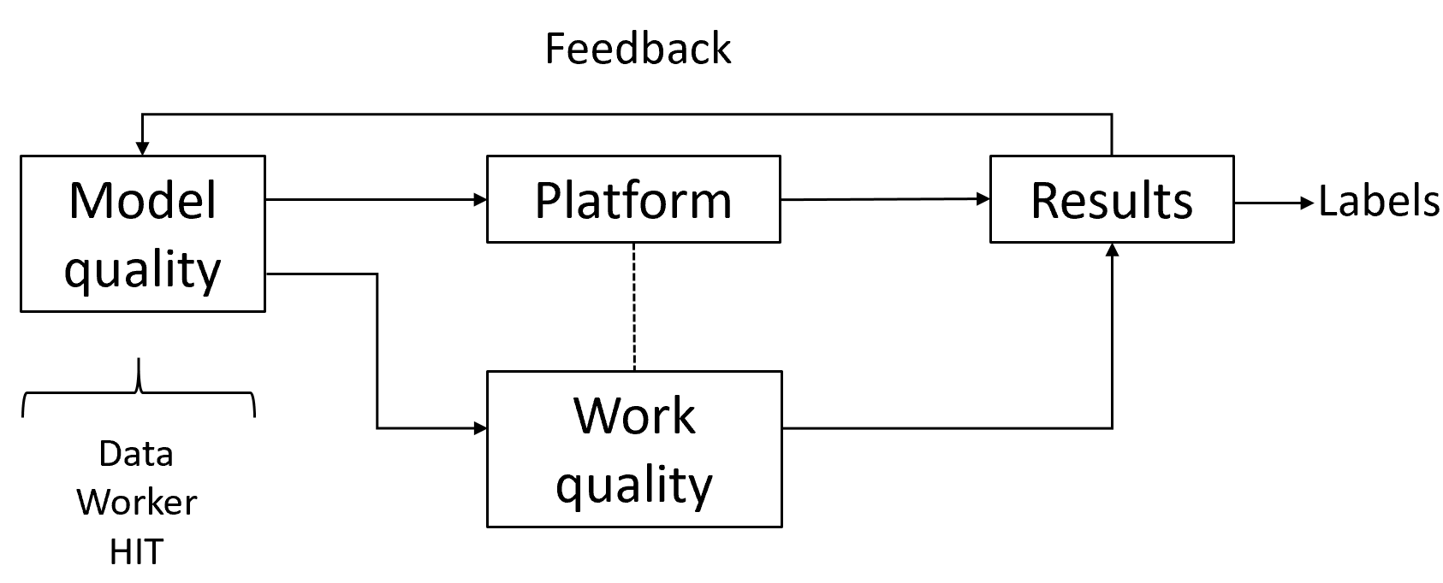
Quality control in general
Extremely important part of the task
Approach as “overall” quality; not just for workers
Bi-directional channel
You may think the worker is doing a bad job.
The same worker may think you are a lousy requester.
Quality framework
Module quality
Work quality

Slide 67
Algorithms used in practice
Voting
Honey pots and programmatic gold
EM
Get another label

Slide 68
LLMs
Human labels are expensive
How about using LLMs to label documents?
Recent research work on this topic

Slide 69
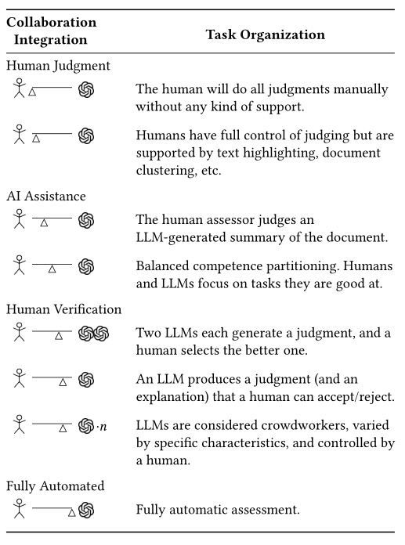
Human-machine collaboration

Slide 70
Prompting
In-context learning
New capabilities can be unlocked in LLMs
LLM is prompted with a few in-context demonstrations
Learns to perform a certain task
Task performance is very sensitive to prompts

Slide 71
Prompt structure
Relevance evaluation task
Task instructions
You are a search quality rater evaluating relevance of web pages
Query-document pair to be labelled
Query {query}
Document {document}
Relevant?
Re-state the task
Output format

Slide 72
Results
Add tables/charts from a couple of papers

Slide 73
Discussion
In favor
LLMs are able to produce an explanation
This could be used to assist humans in relevance judgements
Against
LLMs are not users
IR is about relevance to an information need
No proof that evaluation by LLM has any relationship to reality

Slide 74
The main process is unchanged
Regardless if labeling is done by machines or humans
Three main components
Task design
HIT or prompt engineering
Data
Crowd
Human-based crowd or LLM-based crowd
Quality control
Debugging

