Slide 1
CIKM tutorial
Work in progress

Slide 2
HEMU Dimensions
Computing resources
laptop < cloud access < cluster (1K machines is a typical industry cluster)
Data
Small, medium, big
Algorithmic complexity
Hashing/indexing, PageRank, Deep Learning
Skills
Some things require the worlds' expert, and other things can be done by a software engineer
Things can be done by a non-programmer

Slide 3
HEMU Dimensions - II
Size of team
You
Pizza team
The number of authors per paper has been growing suggesting that you need more and more people to do certain things
Cost
Includes all of the above
As well as externalities such as power
Value
Some things are super expensive and not worth doing
Think about time scales... some things are good for years/decades, and other things age quickly.
How easy is it for the competition to do a fast follow?
Organization
Is your team/company ready for this?

Slide 4
Labeling

Slide 5
The bad news first
Labeling is hard
Facebook
Snapchat
Points-Of-Interests (Foursquare, etc.)
Labeling is going to get more difficult
Enterprise
Personalization
Healthcare
New data sets
Some context
We assume supervised or semi-supervised learning
Large scale
Continuous

Slide 6
There is hope
Human computation
AI
CS
HCI
Economics
Behavioral sciences
Lots of research and new ideas
This section
Programming perspective, quality framework, data pipelines, future trends

Slide 7

What is a label?
Spam email?
Label: yes, no

Slide 8
Why we need labels?
Information retrieval
Natural language processing
Machine learning
Artificial intelligence

Slide 9
Why we care?
Provenance
Reproducibility & debugging
Explainability & interpretability
How a training set was created
Bias and fairness
Data management
ML/AI models live & die by the quality of input data
Metadata about labels
Maintenance

Slide 10
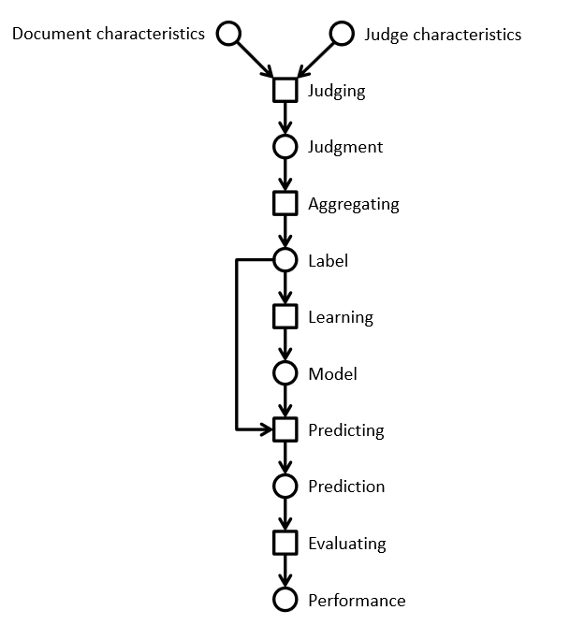
Lifecycle of a label
Information retrieval example
Using a crowd to label a data set
Using ML to process the complete data set

Slide 11
Relevance labels
Indicate whether a search result is valuable to a searcher
Key in evaluation and optimization IR systems
Editors or experts
TREC-style
Crowdsourcing
LLMs

Slide 12
Careful with that axe data, Eugene
In the era of big data and machine learning
labels -> features -> predictive model -> optimization
Labeling perceived as boring
Tendency to rush labeling
Quality is key
Garbage in, garbage out
Own the entire stack
Labeling, modeling, infrastructure, deployment

Slide 13
The state of the field
Human-labeled data is more important than ever
Requirements
Throughput -> ASAP; I need the labels for yesterday
Cost -> cheap; if possible free
Quality -> top
Performed as a one-off by 3rd party (crowd or editors)
Needs development work to get good results
Very limited functionality in current platforms
Mechanical Turk, SageMaker (Amazon)
Figure Eight (Appen)
Toloka (Yandex)
Start-ups
LLMs

Slide 14
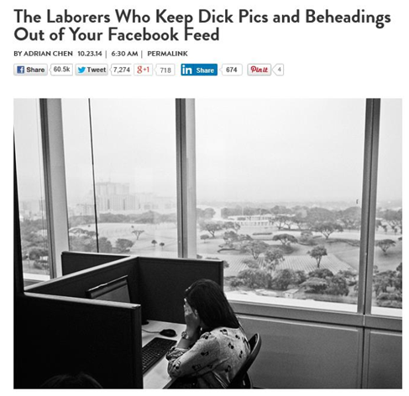
The need for humans

Slide 15
Problems
Monolithic HITs
The structure of a HIT mirrors the structure of the task the developer is working on
Similar to Conway’s law in software engineering
Task complexity
Lengthy instructions
RTFM doesn’t work
We don’t think of HC/crowdsourcing as programming
How to improve
Use established programming practices
Careful, we are dealing with humans and not machines

Slide 16
A spectrum of labeling tasks
Nature of task | Aggregation approach | Evaluation technique
Objective question has a correct answer (objective) | Reliable judge assigns appropriate label for an item | Evaluate workers by comparing individual results with gold set
Judgment question has a best answer (partially objective) | Inter-rater agreement determines label for an item | Evaluate workers by comparing individual results with consensus
Subjective question has consistent answer (subjective) | Repeatable polling determines probability of a label for an item | Evaluate workers by computing the consistency of results between groups

Slide 17
Prepare the environment
Homework before you crowdsource
Assess the lay of the land
Identify your use cases
Understand your product’s data
Design your HITs
Determine your guidelines
Communicate your task
Maintain high quality
Ongoing vs. one-offs HITs
Labels for the machine != labels for humans

Slide 18
HIT design principles
Self-contained, short, and simple
Document presentation
Text alignment & legibility; reading level; multi-cultural and multilingual
Cognitive biases
Implications on the final output: anchor effect, mere exposure, picture superiority
Task complexity
High cognitive load; low usability, specific expertise

Slide 19
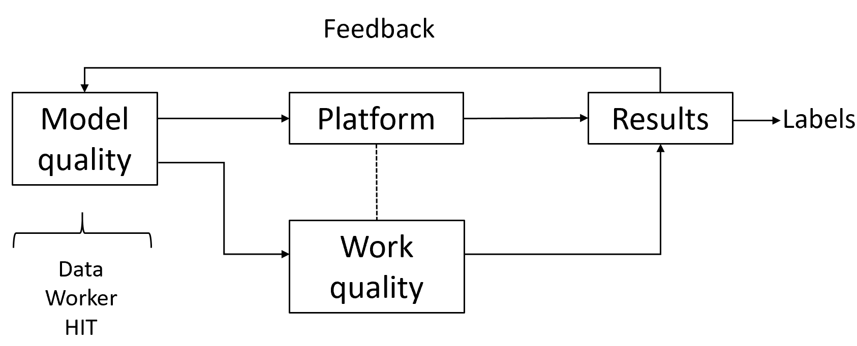
Quality control in general
Extremely important part of the task
Approach as “overall” quality; not just for workers
Bi-directional channel
You may think the worker is doing a bad job.
The same worker may think you are a lousy requester.
Quality framework
Module quality
Work quality

Slide 20
Algorithms used in practice
Voting
Honey pots and programmatic gold
EM
Get another label

Slide 21
LLMs
Human labels are expensive
How about using LLMs to label documents?
Recent research work on this topic

Slide 22
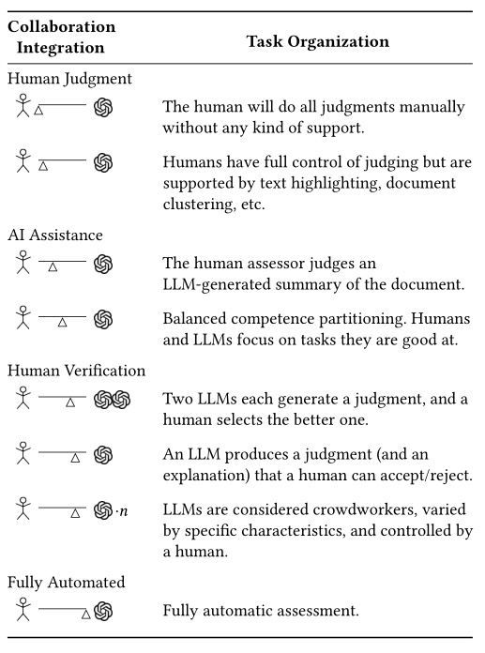
Human-machine collaboration

Slide 23
Prompting
In-context learning
New capabilities can be unlocked in LLMs
LLM is prompted with a few in-context demonstrations
Learns to perform a certain task
Task performance is very sensitive to prompts

Slide 24
Prompt structure
Relevance evaluation task
Task instructions
You are a search quality rater evaluating relevance of web pages
Query-document pair to be labelled
Query {query}
Document {document}
Relevant?
Re-state the task
Output format

Slide 25
Results
Add tables/charts from a couple of papers

Slide 26
Discussion
In favor
LLMs are able to produce an explanation
This could be used to assist humans in relevance judgements
Against
LLMs are not users
IR is about relevance to an information need
No proof that evaluation by LLM has any relationship to reality

Slide 27
The main process is unchanged
Regardless if labeling is done by machines or humans
Three main components
Task design
HIT or prompt engineering
Data
Crowd
Human-based crowd or LLM-based crowd
Quality control
Debugging

