Slide 1
Better Together: Text+Context
Resources Team
Rodolfo Zevallos, Ben Irving, John E. Ortega,
Sandeep Polisetty, and Hui Guan
Notes:
JOHN INTRODUCE

Slide 2
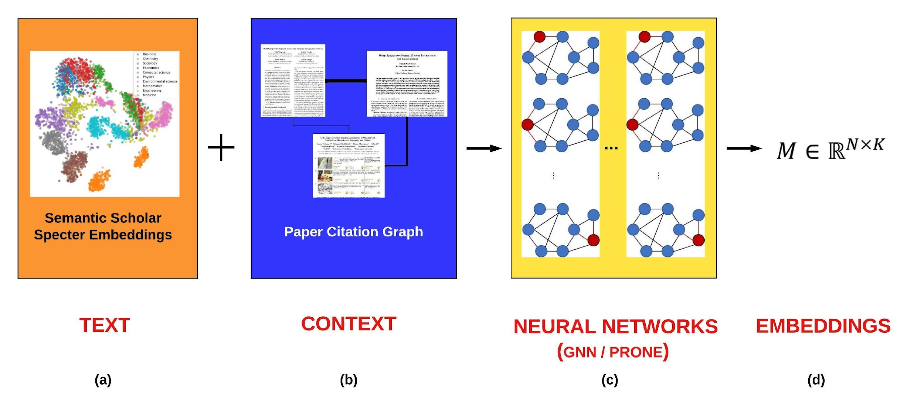
Reminder: What are We Doing?
Text (Titles, Abstracts, Body); Context (Citations)
Notes:
JOHN TALK

Slide 3
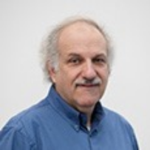



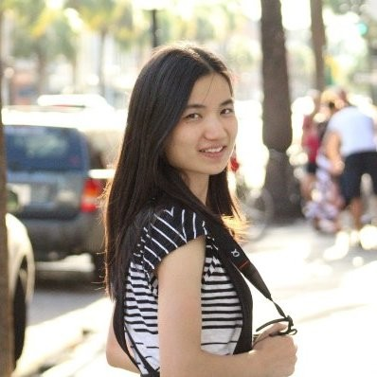

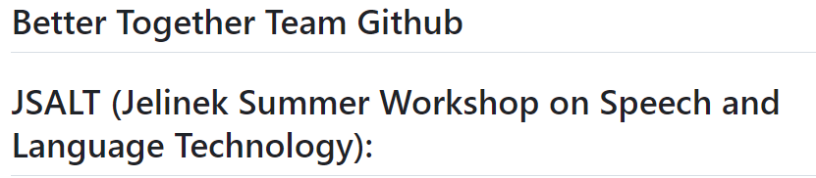
Reminder: These slides are on GitHub.
https://github.com/kwchurch/JSALT_Better_Together
Notes:
JOHN TALK

Slide 4
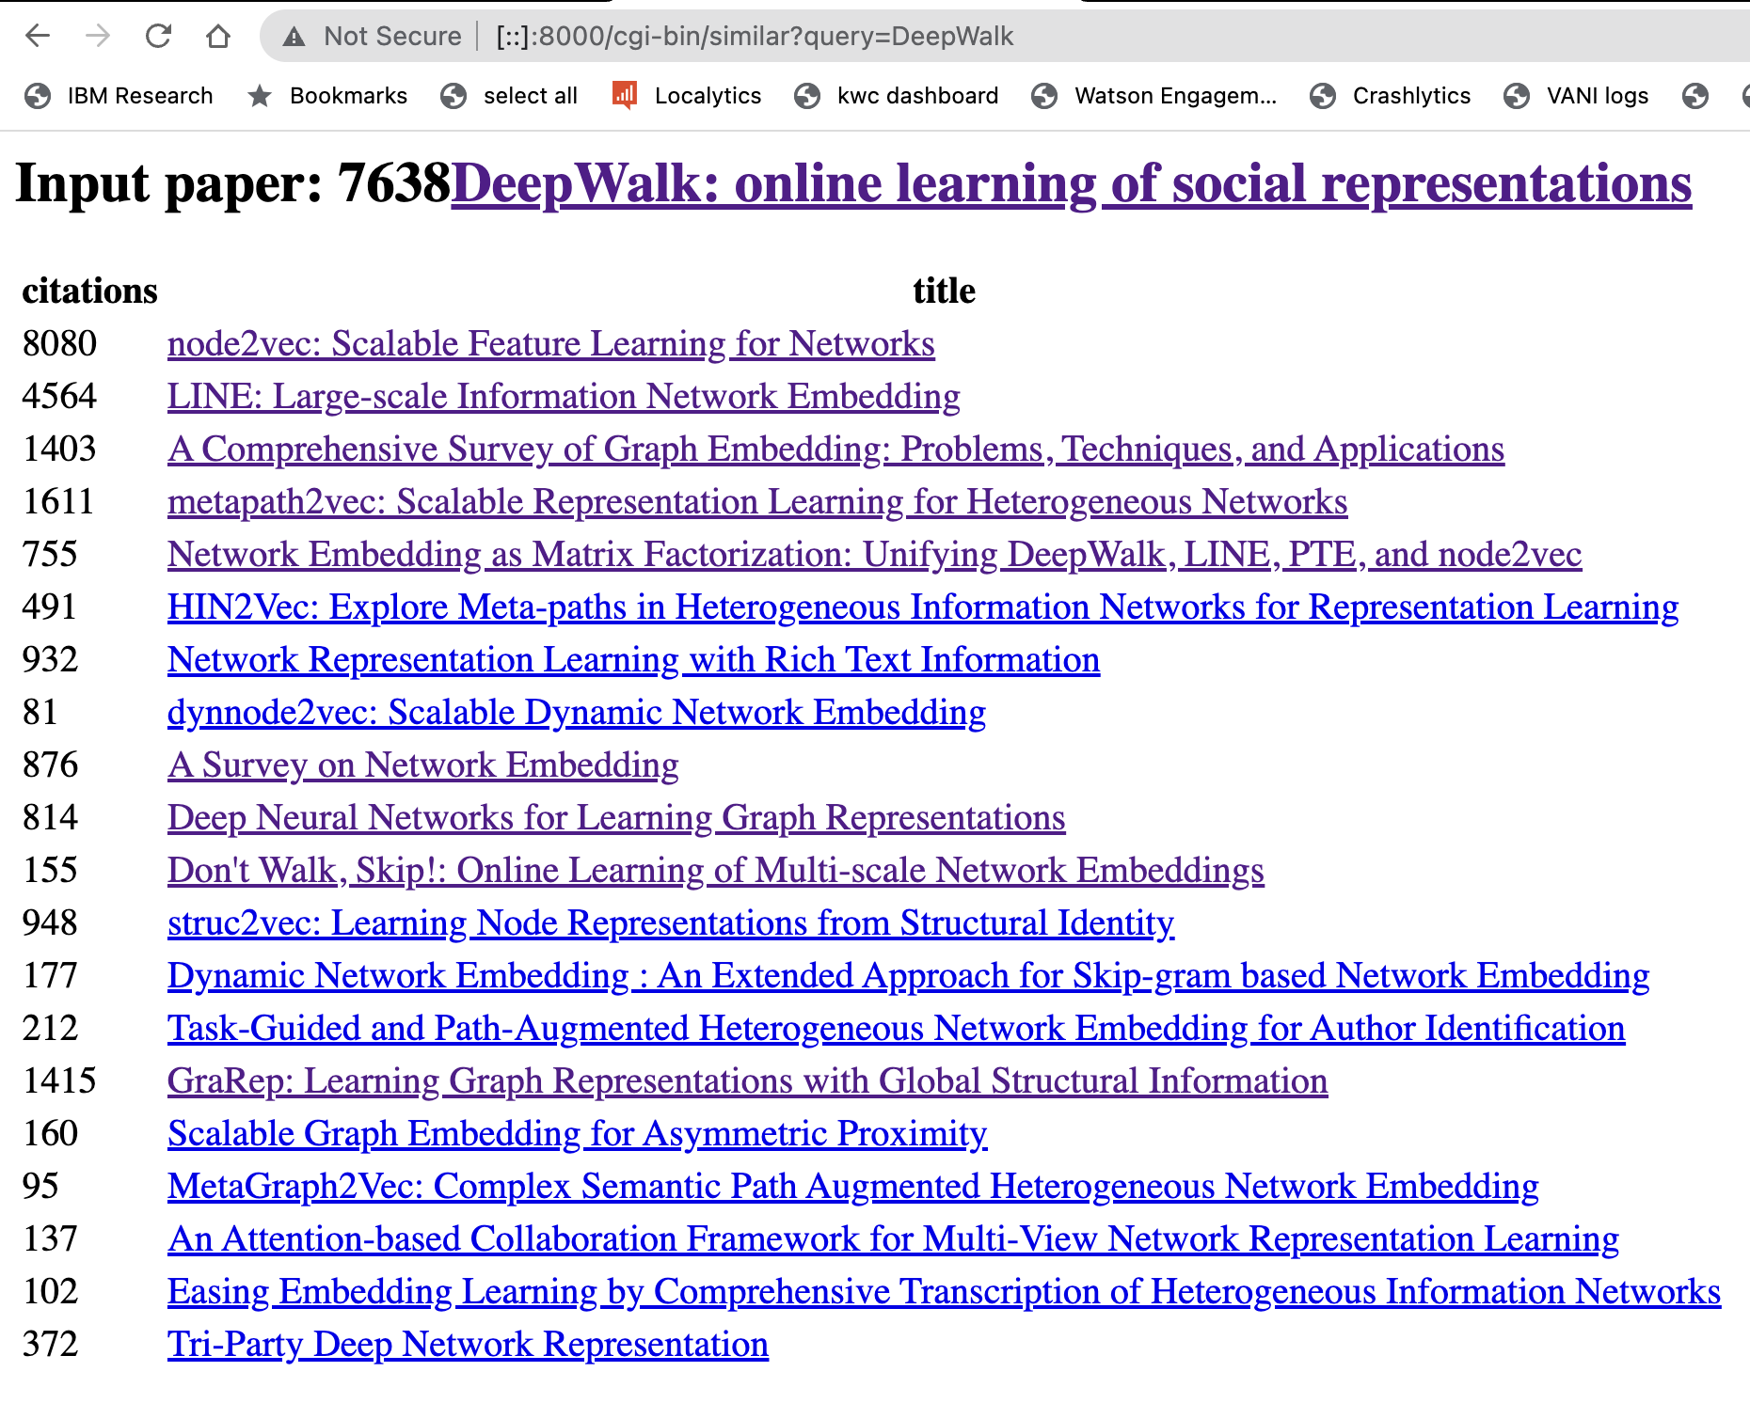

Slide 5
Agenda
Related Work Hypothesis
Prone Optimization
GNN (graphical neural net)
Notes:
RODOLFO TALK

Slide 6
Two Approaches: Text vs Context
Text is based on abstracts and/or titles only (no citations)
Specter 1
Specter 2
Context is based on citations using a citation graph
Prone graph embeddings (node = paper, edge = citation)
Notes:
RODOLFO TALK

Slide 7
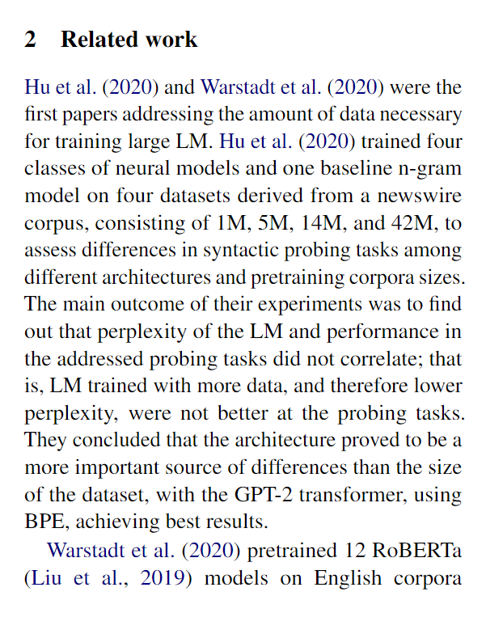
Related Work Hypothesis
Related work references seem to represent entire papers.

Slide 8
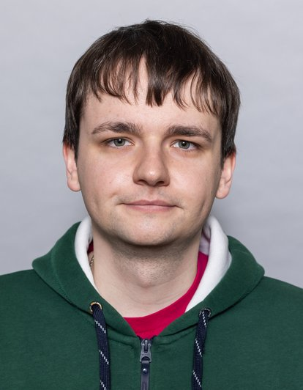
Related Work Experiments
400k papers
Organized by Martin Dočekal (PhD student, BRNO UNIVERSITY OF TECHNOLOGY, Czech Republic)
Related Work annotated dataset
Corpus ids mapped to Semantic Scholar ids
"paper_id":54955648,
"rw_citations":[3045997,2770517,5569544,36379,1665288,74632109,2223771],
"Other_citations":[16395612,14432142]

Slide 9
Related Work Experiments
Vector representations of referenced papers
Specter 1 and 2
Prone
Centroids
related work references
non-related work references
ALL references
Hypothesis: a is better than c.

Slide 10
Related Work Experiments
ALL References Vector = 9 References
Introduction Ref1, Ref2, Ref3
Related Work Ref4, Ref5, Ref6
Conclusion Ref7, Ref8, Ref9
9 References
3 Introduction
3 Rel Work
3 Conclusion
Intro References Vector = 3 References
Rel Work References Vector = 3 References
Conclusion References Vector = 3 References
Sample Paper

Slide 11
Related Work Experiments
get_paper_embedding(sample_paper)
model
Paper
Introduction Ref1, Ref2, Ref3
Related Work Ref4, Ref5, Ref6
Conclusion Ref7, Ref8, Ref9
Intro References Vector = 3 References
Compare and Predict
Rel Work References Vector = 3 References
Conclusion References Vector = 3 References

Slide 12
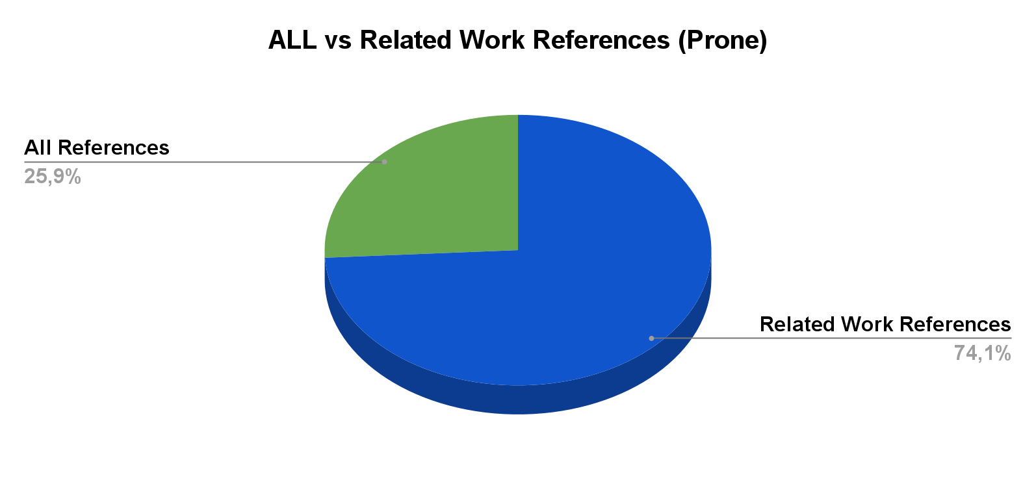
Related Work Experiments
Prone
Notes:
If you just compute the vector from rw, it is usually better than using all of the references. Isn’t clear what the two conditions are.

Slide 13
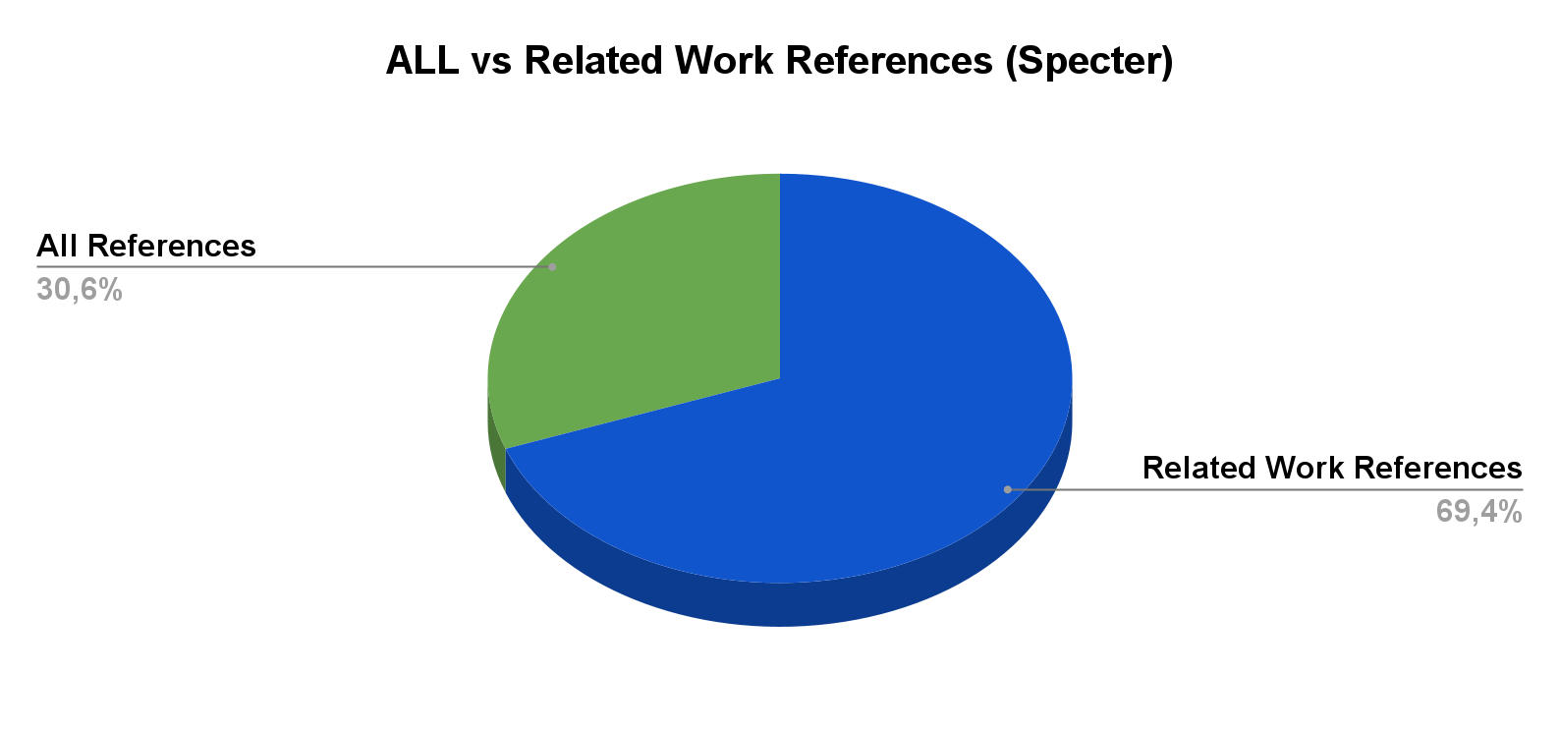
Related Work Experiments
Specter

Slide 14
Related Work Experiments
σVector_Rel_Work + μVector_Other = Vector_All
σ and μ are constants of the equation
We experiment with predicting the entire vector given only related work sections.

Slide 15
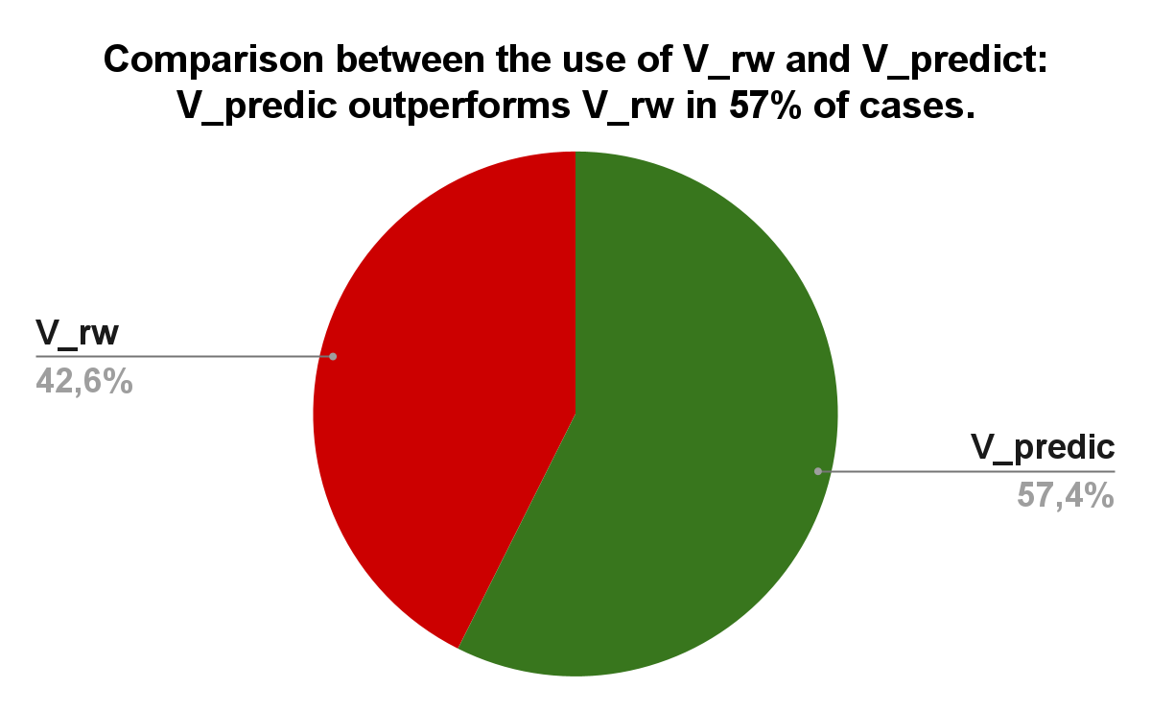
Related Work Experiments

Slide 16
Conclusion and Next Steps
Predictions are better than chance with the first iteration (similar to LogReg).
Related Work references represent the papers in our experiments.
Only one model, will try with more this week.
Approximation only at this point.

Slide 17
Model and limitations
Limited space (<= 2 TB per job)
Limited time (<= 1 day per job)
Without dividing code: 2 TB of memory, 3.8 days
Prefactor
Prone.py
Chebyshev
Finish step
Notes:
Ben

Slide 18
Optimizations
Cython
float32 → float16
Yet to test:
Dask + cupy (why it’s cool. Shouldn’t we just use pytorch?)
Notes:
Ben

Slide 19
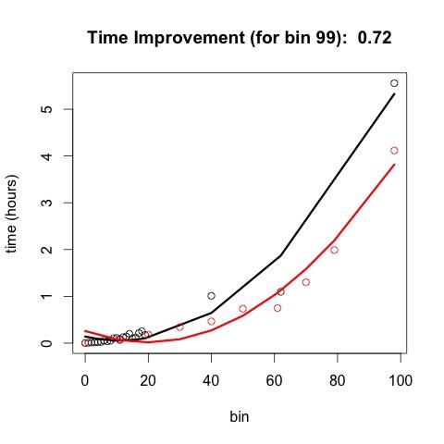
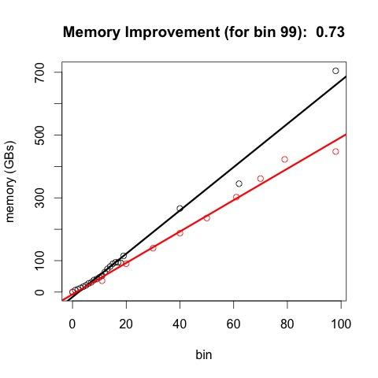
Cheby Results
Notes:
Ben
(generally speaking, memory utilized is some simple multiplication of the input mem ← plot this out)

Slide 20
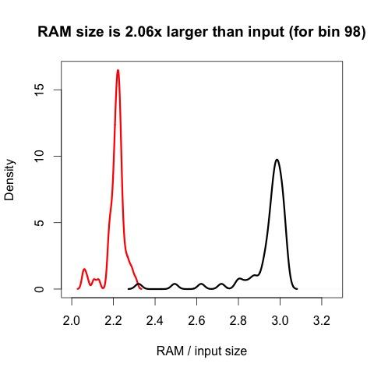
RAM comparison (density)

Slide 21
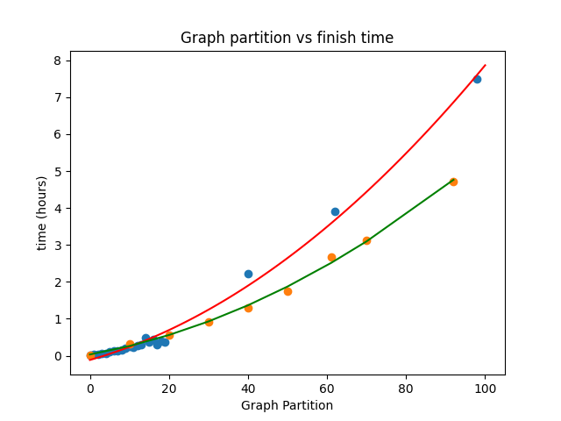
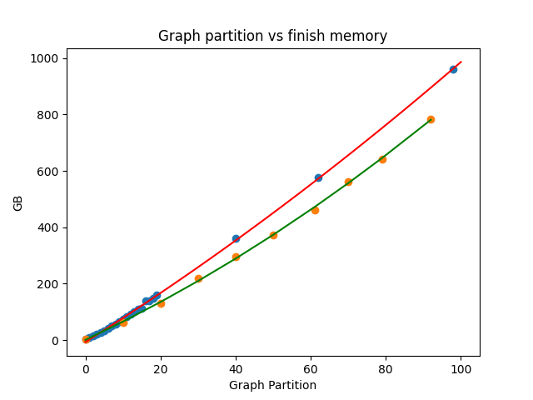
Finish Results
Notes:
Ben

Slide 22
Cython
Superset of Python (use more C in Python)
Still runs in Python runtime, but not compiled to Python bytecode. Instead compiled to native machine code (whatever your microprocessor interprets)
Original code
PVM
Machine code
Notes:
Ben
For instance, . Cython compiler doesn’t call python torch library when releasing the global clock is released.

Slide 23
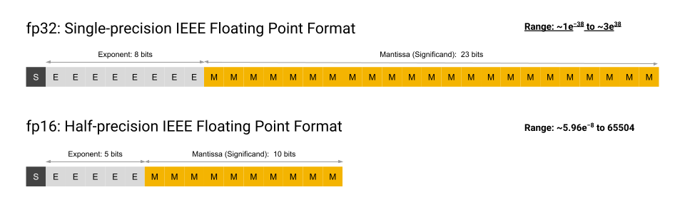
Float32 → Float16
4 decimal places (for float16) vs 8 (for float32)
Problem: (A lot of cpus don’t support it, particularly x86 architectures)
Courtesy of Google
Notes:
Ben

Slide 24
Recap: research question
What is the best approach to combine text and context?
Graph Representation Learning + MLP
ProNE || Node Features
Graph Neural Networks

Slide 25
Recap: research question
What is the best approach to combine text and context?
Accuracy: predict missing links
Scalability: Ability to scale to larger graphs
Inductive learning: Ability to generalize to unseen papers
Graph Representation Learning + MLP
ProNE || Node Features
Graph Neural Networks

Slide 26
Recap: where we are
Have compared ProNE and GNN on a standard benchmark
How about Semantic Scholar?
Noisy?
Not in ML-ready format
200M vs. 3M papers

Slide 27
Recap: where we are
Have compared ProNE and GNN on a standard benchmark
Datset | Model | Training Time | Test Accuracy
Citation-2 | GraphSAGE | 550 sec | 0.74
Citation-2 | Prone + MLP | 800 sec | 0.65

Slide 28
Benchmarking on Semantic Scholar
Noise due to subsampling
Sparsity of sampled graph
Instances of Papers citing Future papers
Time based partitioning of Train and Test data for dense data.
Test and Train and data sampling
Preliminary Results

Slide 29
Data preprocessing
Low Degree nodes add too much noise
4
2
6
1
5
3
2015
2018
2019
Cut off point as we are not recursively expanding nodes before 2015
Training Edge
Test Edge

Slide 30
Prone VS GNN for (2015 - 2018 - 2019)
Method | Time | Accuracy
GNN + MLP | ~ 600 sec | .64
Prone + MLP | NA | OOM

