Slide 1
Document Time Period Prediction

Slide 2
Time Period Prediction – Task Overview
Given a query paper, predict the time period (time bin) it comes from
Input: single scientific paper
Embeddings: Specter, Specter 2, SciNCL, ProNE
References of query paper, along with information such as publication year
Similar documents to query paper
Map of year to time bin
Output: Predicted time bin
Bin 99
………
Bin 0
Time

Slide 3
Time Period Prediction – Motivation
Understand contribution of embedding types and nearest neighbors on predicting information about query paper
Detect missing or incorrect data
Many papers in dataset cannot be found in semantic scholar
Some papers are recorded to cite far into the future
Proxy for other tasks
Venue prediction
Field of study
Reviewer matching
Collaborator search
???

Slide 4
Time Period Prediction – Experiments Overview
Baseline – References
Semantic Scholar API
Similar Papers
Embeddings
ProNE: citations
Specter: text
Specter 2: text
SciNCL: text
Combination
Pairs of embeddings
•Embedding: M ∈ R^(N×K)
•N: ≈200M documents
•K: hidden dimensions
•Similarity of two docs: cos(i,j)⁡
•Similarity of all pairs of docs: MM^T

Slide 5
Time Period Prediction – Data
Bigrams:
Cosine similarity, query paper corpus ID, and list of similar papers to query
(0.9984, 4336316, 121417552)
(0.9970, 4336316, 15371799)
(0.9966, 4336316, 4239637)
(0.9953, 4336316, 117876280)

Slide 6
Time Period Prediction – Data
Bigrams:
Cosine similarity, query paper corpus ID, and list of similar papers to query
(0.9984, 4336316, 121417552)
(0.9970, 4336316, 15371799)
(0.9966, 4336316, 4239637)
(0.9953, 4336316, 117876280)

Slide 7
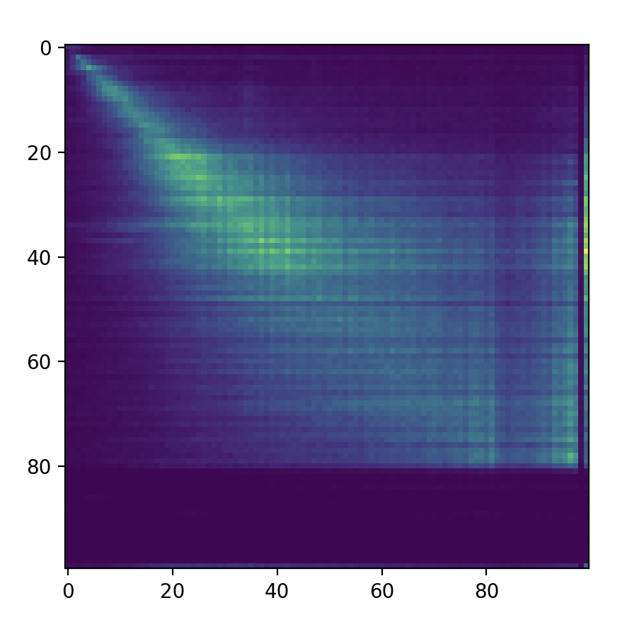
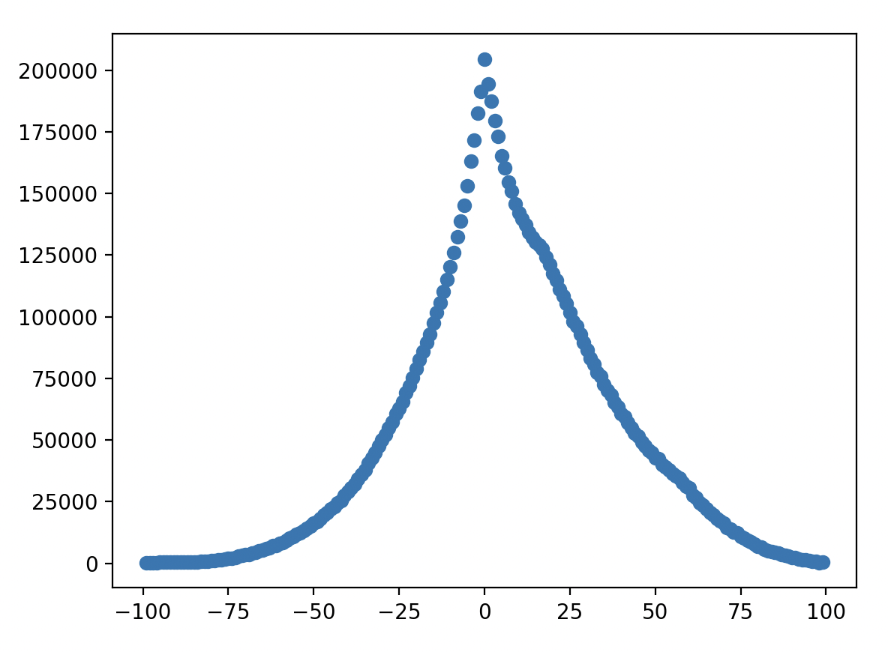
Time Period Prediction – Initial experiments
Count of Citations by Bin Number
Sum of Count of Citations at each Bin Offset
Paper 2 Bin
Count
Paper 1 Bin
Bin Offset

Slide 8
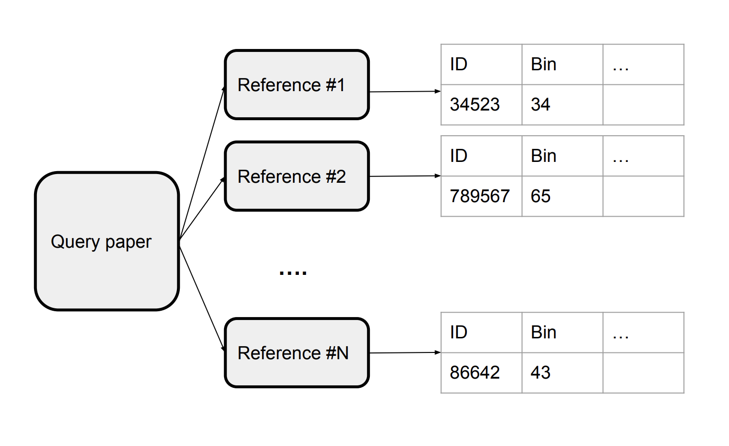
Time Period Prediction – Baseline
Use bin of most recent reference as predicted bin of query paper
Semantic Scholar API
max()

Slide 9
Time Period Prediction – Baseline Results
Method | Cumulative Acc | Accuracy | Precision | Recall | F1
Bin # of most recent reference | 18.80 | 18.80 | 0.21 | 0.19 | 0.19
Bin # of most recent reference + 1 | 39.25 | 20.45 | 0.23 | 0.20 | 0.21
Bin # of most recent reference + 2 | 52.33 | 13.08 | 0.14 | 0.13 | 0.13

Slide 10
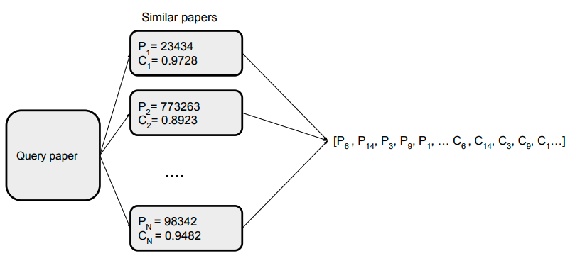
Time Period Prediction – Similar Papers

Slide 11
Time Period Prediction – Similar Papers Results
Method | Accuracy | Precision | Recall | F1
Top 10 by cosine | 7.57 | 0.07 | 0.08 | 0.06
Top 5 by cosine | 7.51 | 0.07 | 0.08 | 0.06
Top 1 by cosine | 6.99 | 0.08 | 0.07 | 0.06

Slide 12
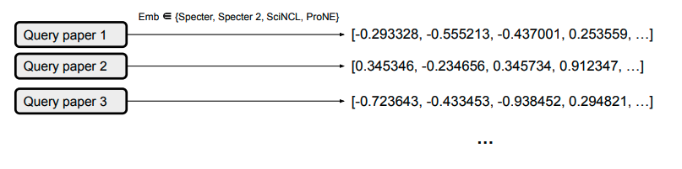
Time Period Prediction – Embeddings

Slide 13
Time Period Prediction – Embeddings Results
Method | Accuracy | Precision | Recall | F1
Specter | 49.87 | 0.48 | 0.50 | 0.48
Specter 2 | 41.23 | 0.39 | 0.41 | 0.39
SciNCL | 24.59 | 0.22 | 0.25 | 0.22
ProNE | 59.45 | 0.58 | 0.59 | 0.58

Slide 14
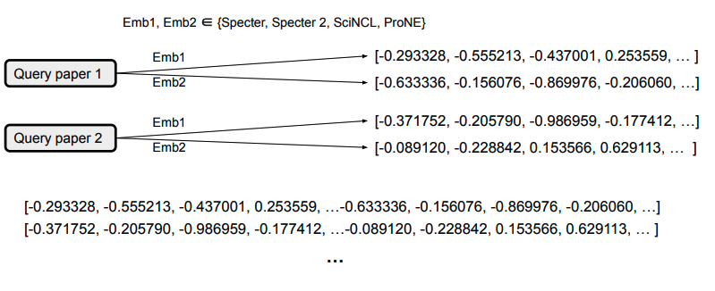
Time Period Prediction – Combinations

Slide 15
Time Period Prediction – Combinations

Slide 16
Time Period Prediction – Combinations Results
Method | Accuracy | Precision | Recall | F1
Specter 2 + Specter | 69.53 | 0.67 | 0.70 | 0.68
SciNCL + Specter 2 | 25.21 | 0.23 | 0.25 | 0.23
SciNCL + Specter | 60.59 | 0.58 | 0.61 | 0.58
ProNE + SciNCL | 67.81 | 0.66 | 0.68 | 0.66
ProNE + Specter 2 | 75.50 | 0.73 | 0.75 | 0.74
ProNE + Specter | 84.20 | 0.82 | 0.84 | 0.82

Slide 17
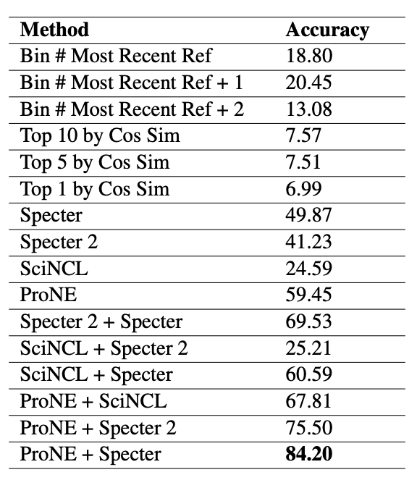
Time Period Prediction – Summary
Baseline
Similar Papers
Embedding
Combinations

Slide 18
Time Period Prediction – Next steps
Consider other features
Min / max / median of time bins of references
Distribution of time bins of references
Improve data preprocessing
Try other model types
Extend to other related tasks
Venue prediction
Field of study identification
Reviewer matching
Collaborator search
AI2 Bridger: https://bridger.apps.allenai.org/?a=2244184

Slide 19
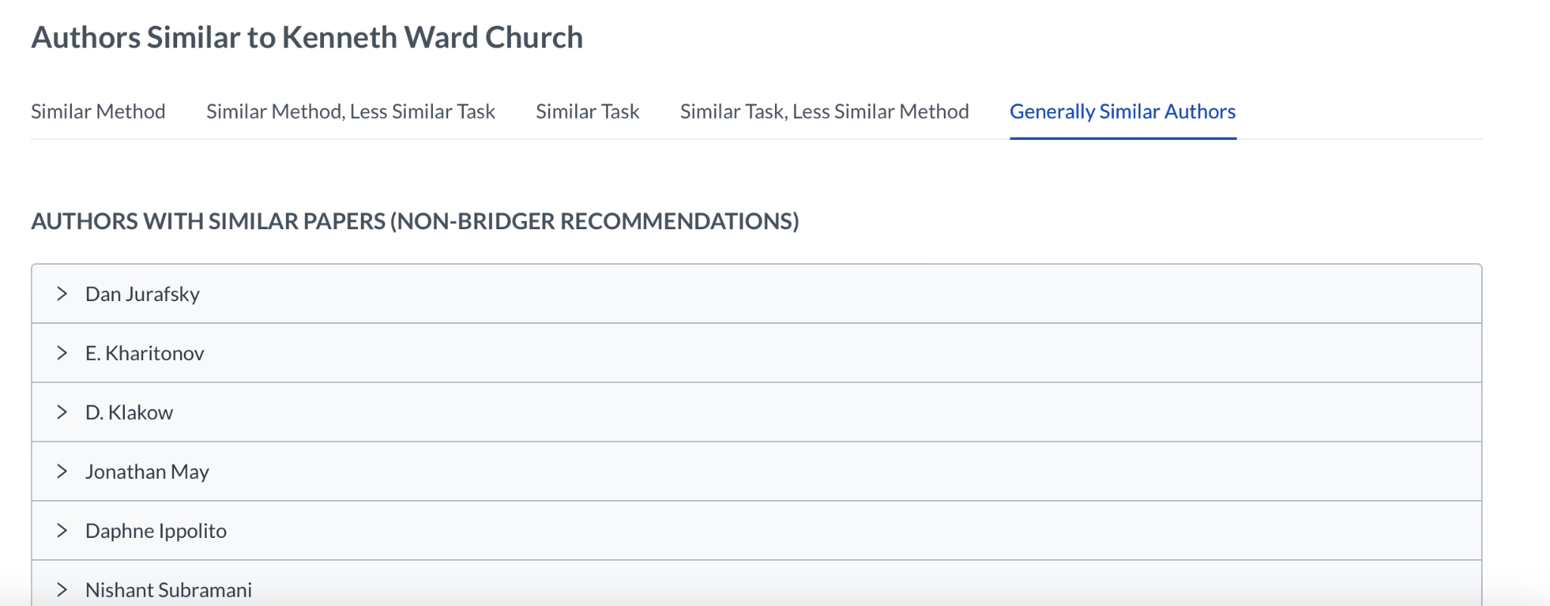
Time Period Prediction – Next steps
AI2 Bridger

Slide 20
Time Period Prediction – Next steps
Venue prediction
Given a paper, predict publication venue
Scenario: Researcher wants to determine which venue to submit to
Field of study
Given a paper, determine field of study or topic of paper
Reviewer matching
Match papers with suitable reviewers; consider reviewer areas of expertise and preferences
Collaborator search
Given an author, recommend potential authors to collaborate with
Consider similarity of papers from different authors

