Slide 1
Checkpoint Better Together: Text + Context
Kenneth Church
Friday, June 30
https://github.com/kwchurch/JSALT_Better_Together

Slide 2
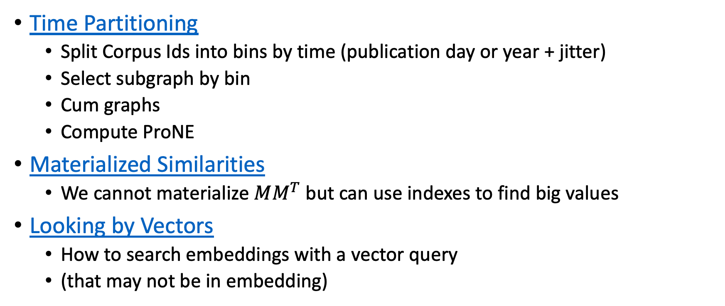
Recent updates
Time Partitioning
Split Corpus Ids into bins by time (publication day or year + jitter)
Select subgraph by bin
Cum graphs
Compute ProNE
Materialized Similarities
We cannot materialize $MM^{T}$ but can use indexes to find big values
Looking by Vectors
How to search embeddings with a vector query
(that may not be in embedding)

Slide 3
Deliverables https://github.com/kwchurch/JSALT_Better_Together/blob/main/doc/deliverables.md
Better access to literature
Resources:
Many embeddings for many papers
Posted models on HuggingFace
Post code on GitHub
Summarization methods to compare and contrast across small (and large) collections of documents
Support incremental updates to embeddings based on citation graphs
Evaluation:
Better numbers,
as well as better benchmarks
Establish that combinations of text and links are better together (than either by itself)
Establish that citing sentences are useful
Improve methods for assigning papers to reviewers
Theory: Unified framework of
Deep nets and
Linear Algebra
Bibliometrics:
Predict citations of a paper over time.
Predict h-index of an author over time.
Find authors that publish too many papers

