Slide 1
Wednesday Update Better Together: Text + Context
Kenneth Church
Wed, July 5
https://github.com/kwchurch/JSALT_Better_Together

Slide 2
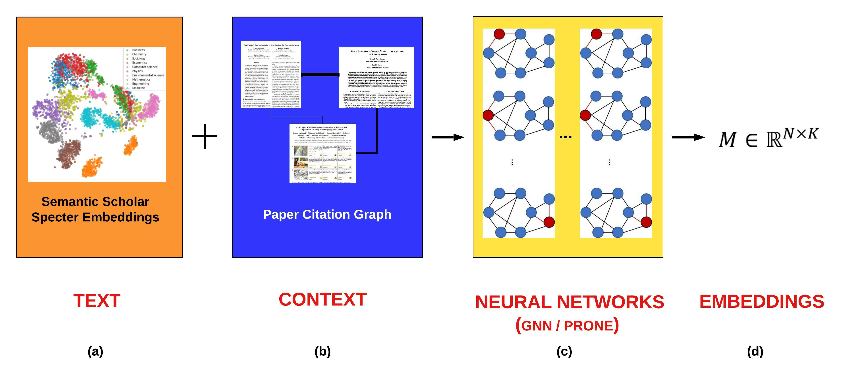
Better Together: Text (Titles, Abstracts, Body); Context (Citations)

Slide 3
Realities
The Real World
Idealizations (Evaluation Benchmarks)
Large
Growing
Dirty
Missing Values
Bad/misleading Values
Small
Static
Clean

Slide 4
Global Scientific Output Doubles Every 9 Years
Timeliness
Web companies keep indexes up to date (web is a moving target)
Ditto for Academic Search

Slide 5
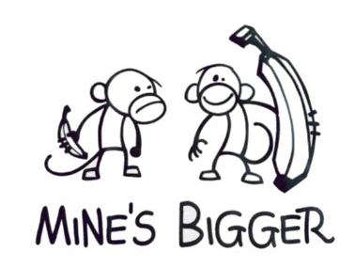
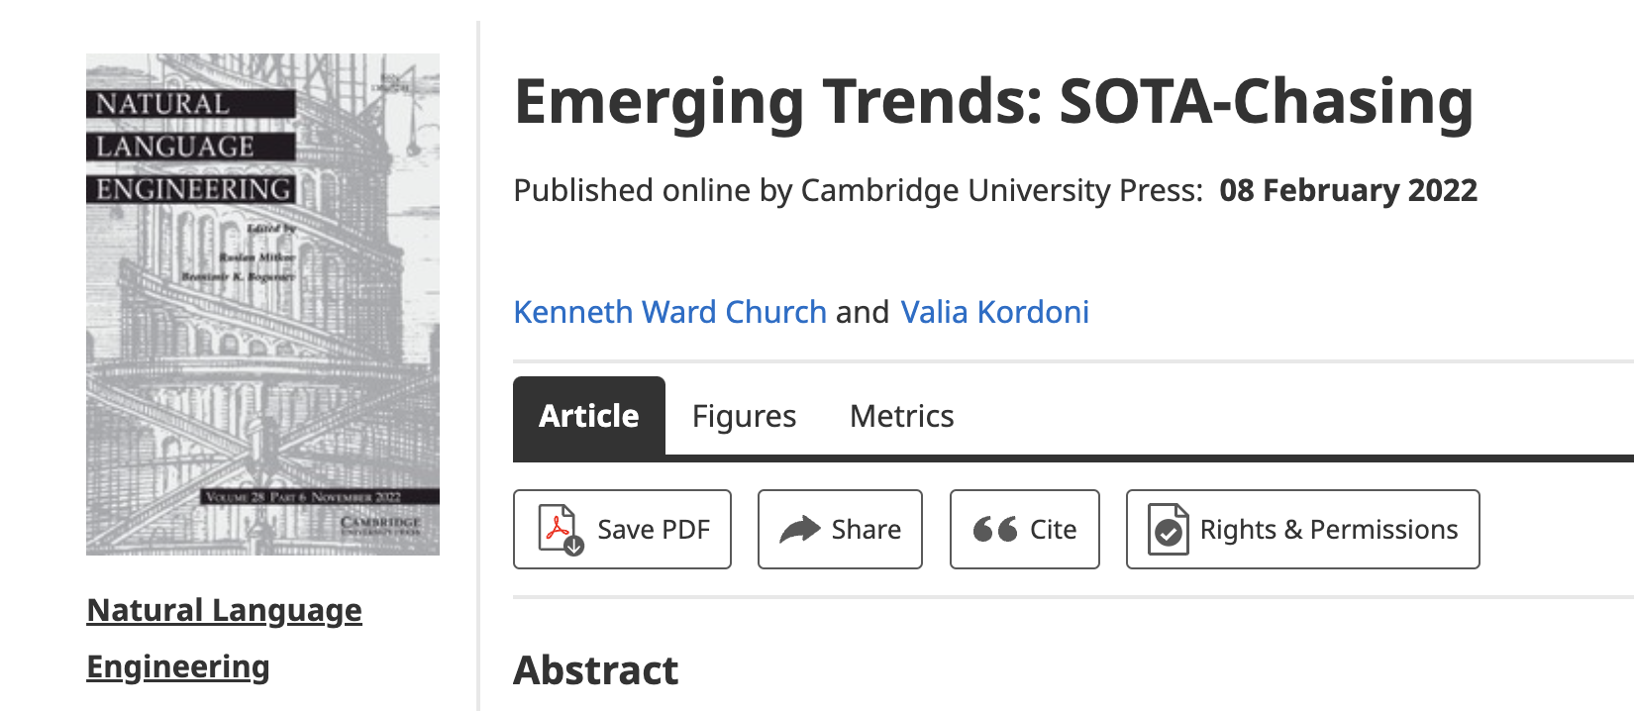
Opportunity for Evaluation: Answer Important Questions
Unimportant Questions (SOTA-Chasing)
Important Questions (Good)
Mine is bigger than yours
What should I read? Cite?
What’s Hot & What’s Not?
Which papers are
tearing up the charts?
Which authors are
rising stars
Timeliness (Update Story)
Post SciBERT on HuggingFace
COVID happens
How long are models good for?
Sell-by dates for models

Slide 6
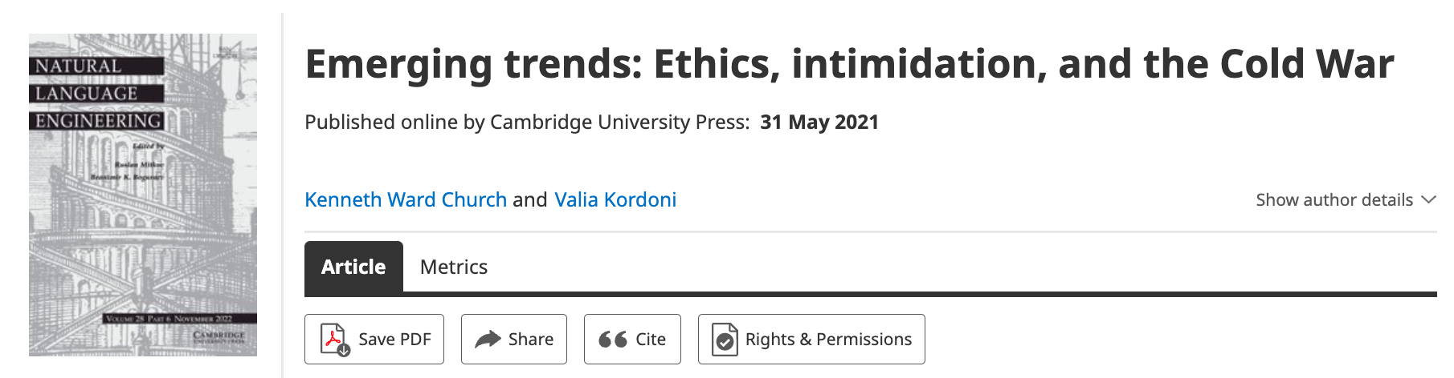
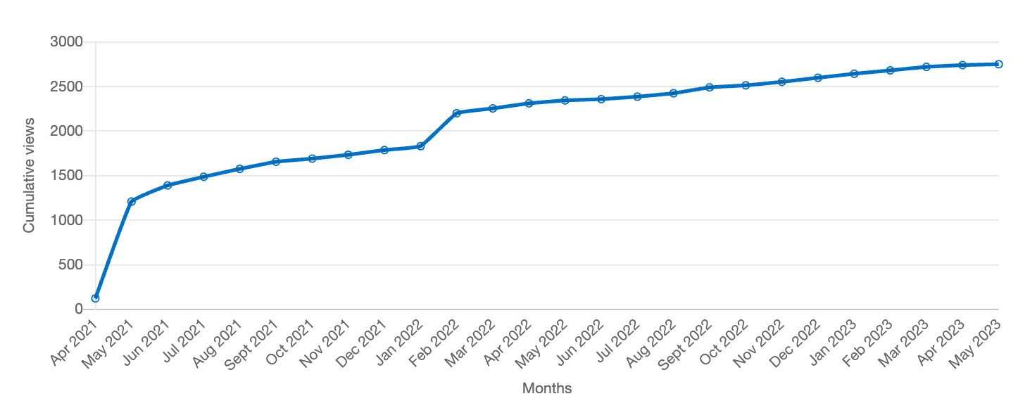
Value: Author Contributions + Audience Appreciation (Literature is a conversation, like social media)
Author Contributions
Time Invariant
Does not change after publication
Audience Appreciation
Evolves over time
Behavioral Signals
Views
Citations
It is difficult to make predictions, especially about the future.
-- Yogi Berra

Slide 7
Where are we? And where are we going?
What do we have already?
Teams
Future Plans

Slide 9
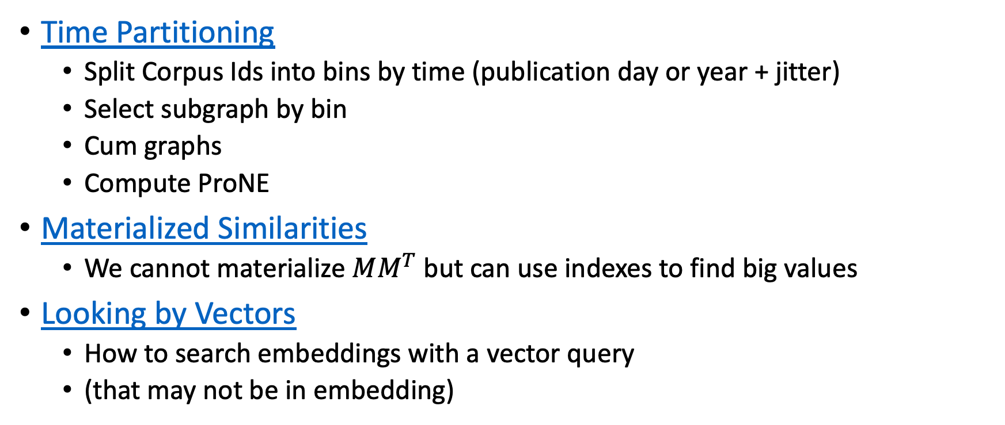
Recent updates
Time Partitioning
Split Corpus Ids into bins by time (publication day or year + jitter)
Select subgraph by bin
Cum graphs
Compute ProNE
Materialized Similarities
We cannot materialize $MM^{T}$ but can use indexes to find big values
Looking by Vectors
How to search embeddings with a vector query
(that may not be in embedding)

Slide 10
Deliverables https://github.com/kwchurch/JSALT_Better_Together/blob/main/doc/deliverables.md
Better access to literature
Resources:
Many embeddings for many papers
Posted models on HuggingFace
Post code on GitHub
Summarization methods to compare and contrast across small (and large) collections of documents
Support incremental updates to embeddings based on citation graphs
Evaluation:
Better numbers,
as well as better benchmarks
Establish that combinations of text and links are better together (than either by itself)
Establish that citing sentences are useful
Improve methods for assigning papers to reviewers
Theory: Unified framework of
Deep nets and
Linear Algebra
Bibliometrics:
Predict citations of a paper over time.
Predict h-index of an author over time.
Find authors that publish too many papers

