Slide 1
Production Runs
Ben Irving

Slide 2
Overview
Overall goal
Optimize Prone, and produce embeddings for general use
Notes:
Ben

Slide 3
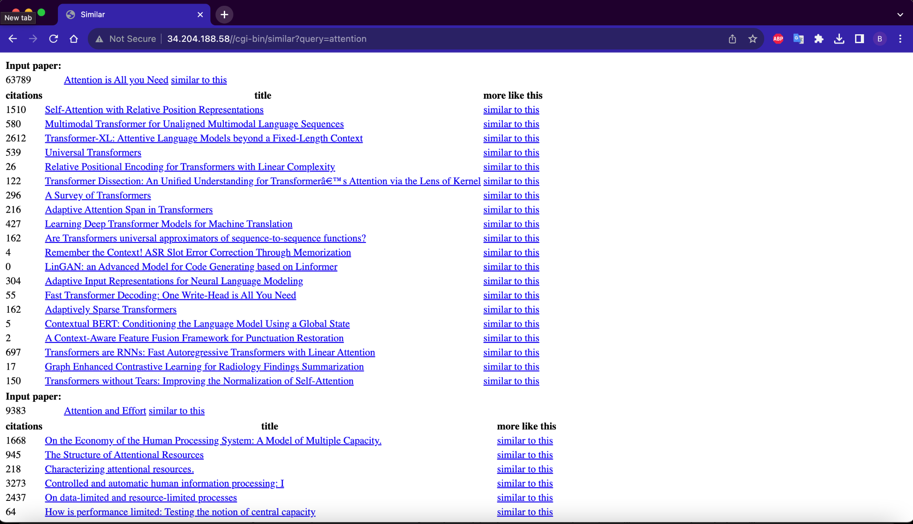

Slide 4
Model and limitations
Limited space (<= 2 TB per job)
Limited time (<= 1 day per job)
Without dividing code: 2 TB of memory, 3.8 days
Prefactor
Prone.py
Chebyshev
Finish step
Notes:
Ben

Slide 5
Optimizations
Cython
float32 → float16
Notes:
Ben

Slide 6
Cython
Superset of Python (use more C in Python)
Still runs in Python runtime, but not compiled to Python bytecode. Instead compiled to native machine code (whatever your microprocessor interprets)
Original code
PVM
Machine code
Notes:
Ben
For instance, . Cython compiler doesn’t call python torch library when releasing the global clock is released.

Slide 7
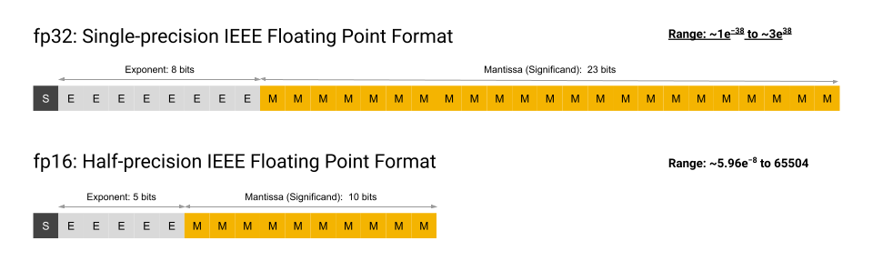
Float32 → Float16
4 decimal places (for float16) vs 8 (for float32)
Problem: (A lot of cpus don’t support it, particularly x86 architectures)
Courtesy of Google
Notes:
Ben

Slide 8
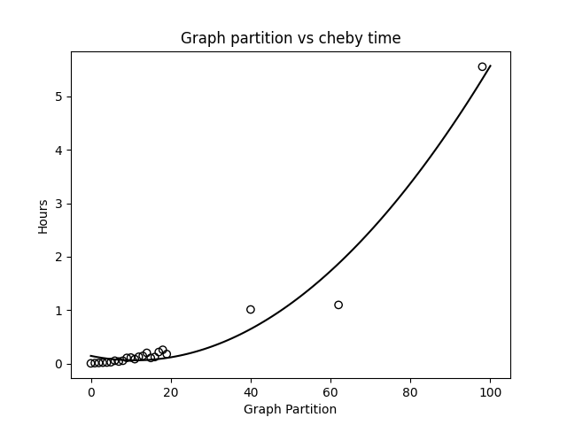
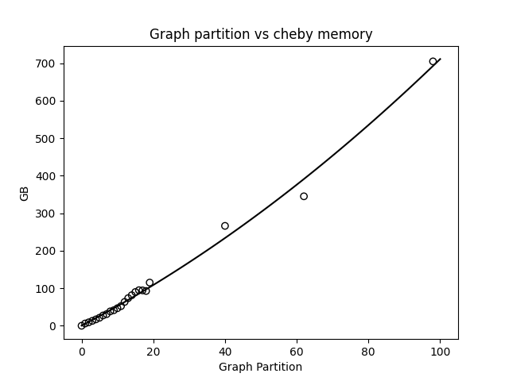
Pre-optimization (chebyshev step)

Slide 9
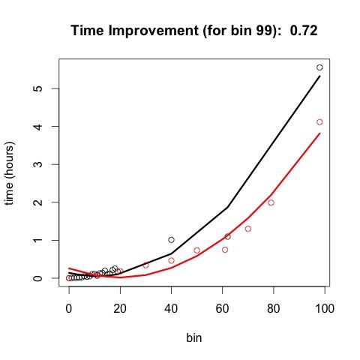
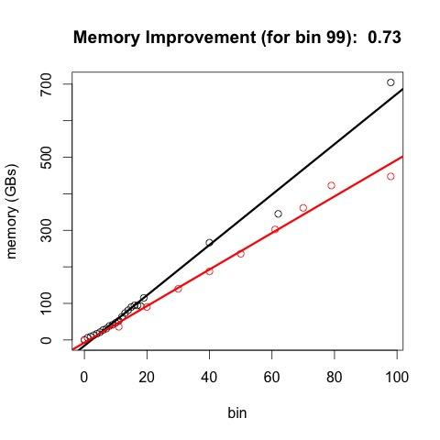
Post optimization (red stuff)
28% time improvement
27% memory improvement
Notes:
Ben
(generally speaking, memory utilized is some simple multiplication of the input mem ← plot this out)

Slide 10
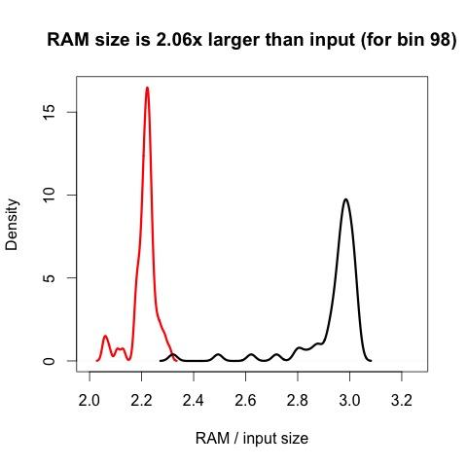
RAM comparison (density)

Slide 11
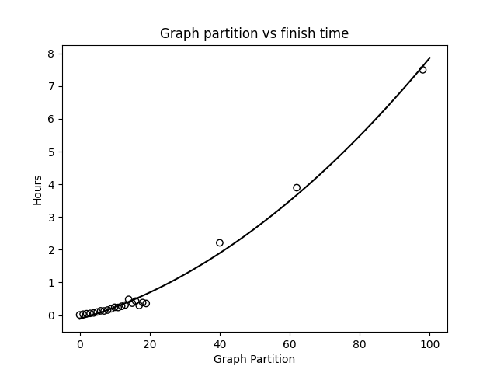
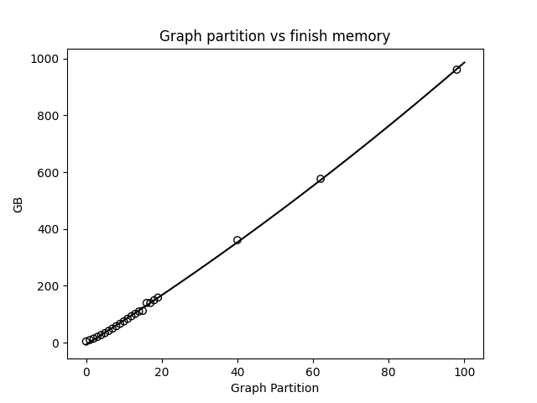
Pre-optimization (finish step)

Slide 12
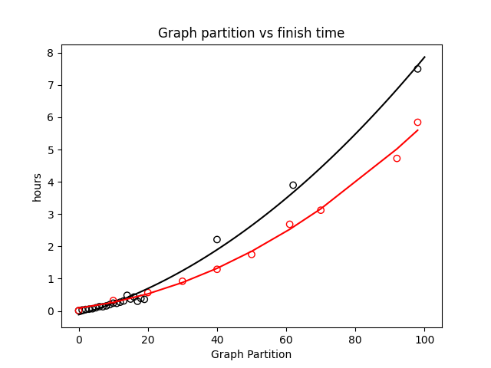
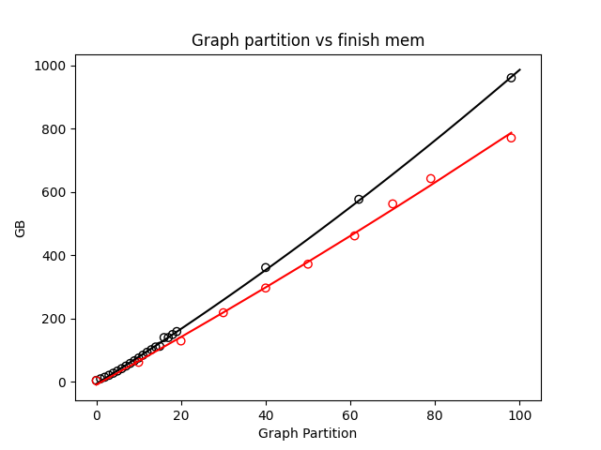
Finish with optimizations (red line)
20% time improvement
23% memory improvement
Notes:
Ben

Slide 13
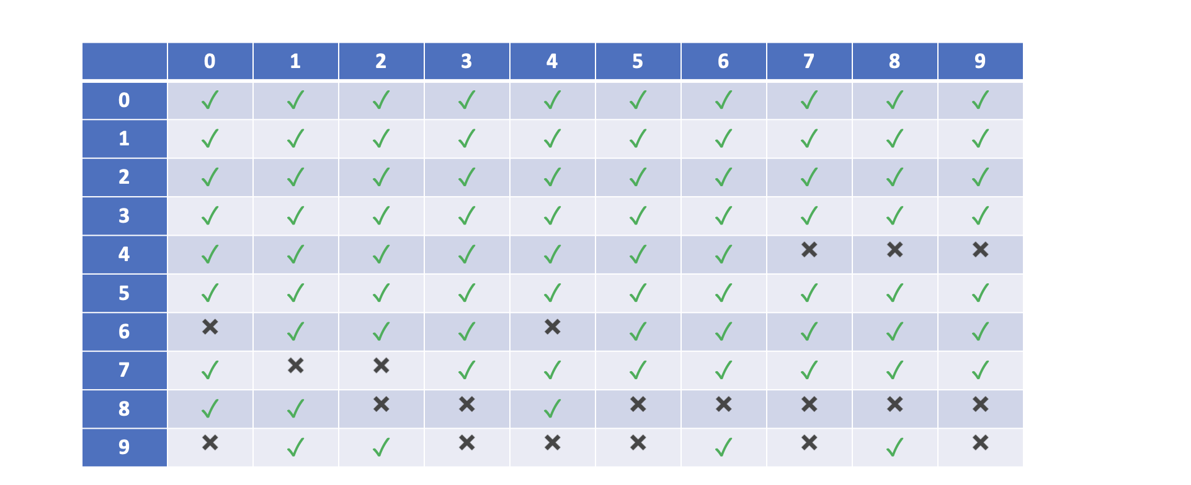
Bins 80% done
Total compute time: 2000 hours (83 days worth)
Total compute memory utilization: 100 TB

