Slide 1
Wednesday Update Better Together: Text + Context
Kenneth Church
Wed, July 5
https://github.com/kwchurch/JSALT_Better_Together

Slide 2
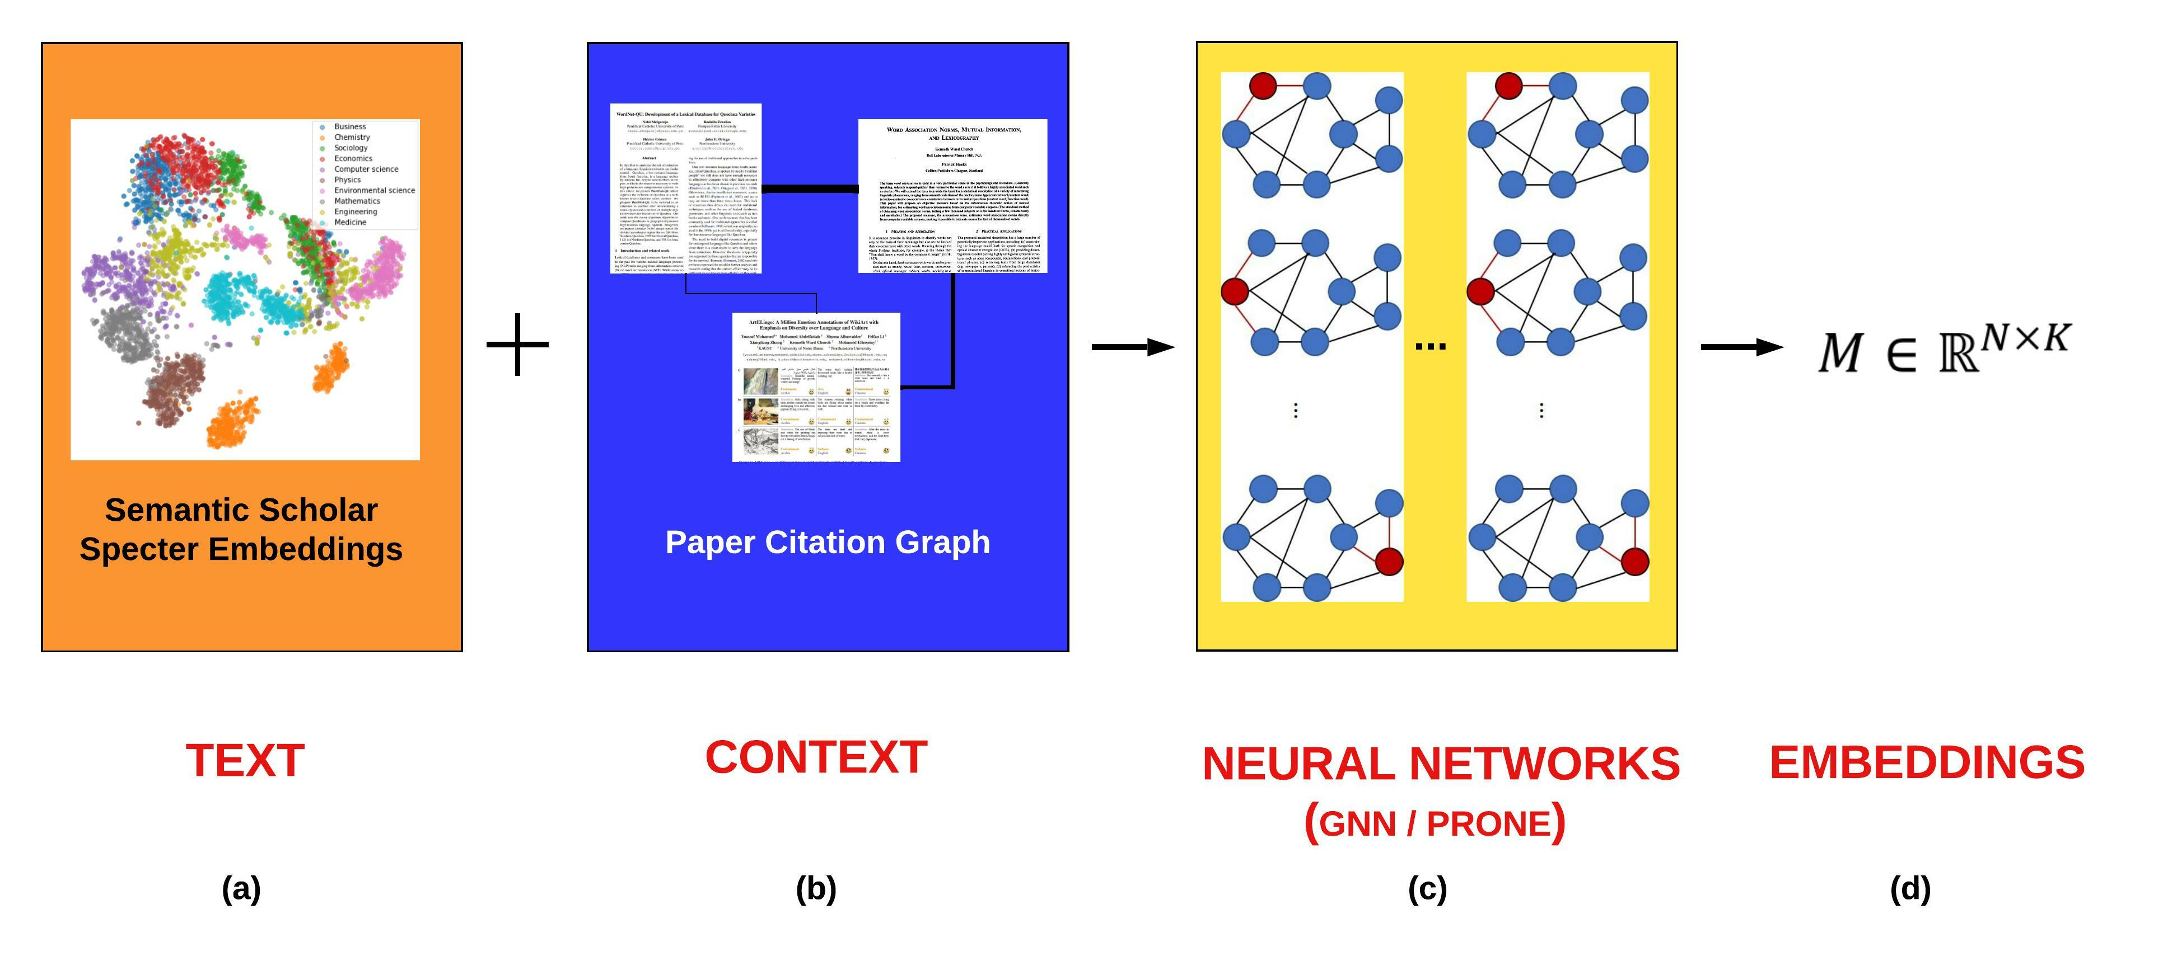
Better Together: Text (Titles, Abstracts, Body); Context (Citations)

Slide 3
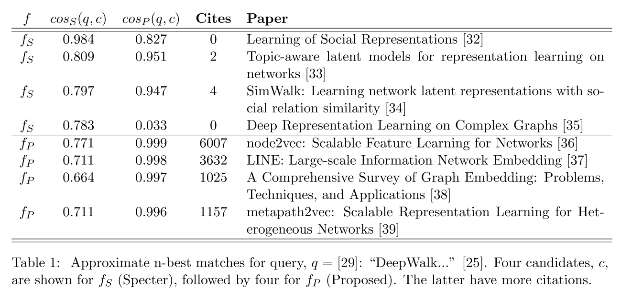
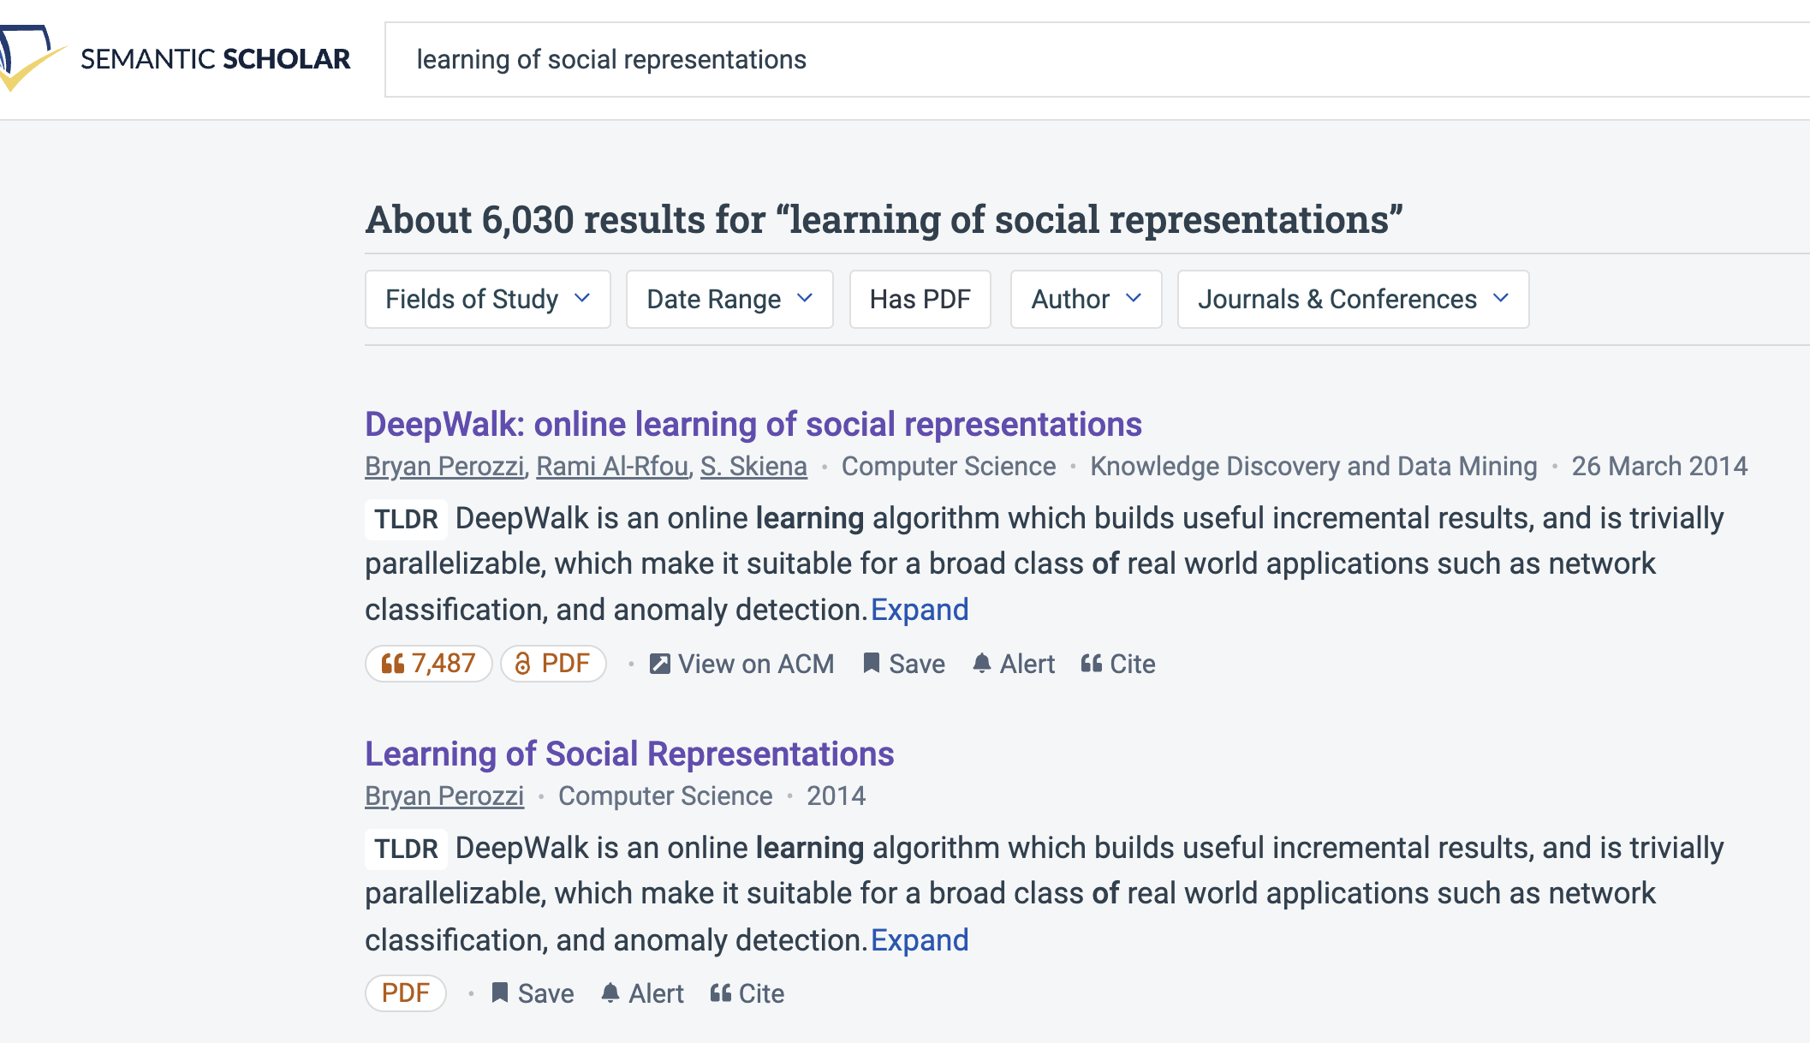
Query: ``DeepWalk: Online Learning of…’’

Slide 4
Document Similarities: Use Cases
Recommendations
What should I read?
What should I cite?
Many systems focus on ``relevance’’ (word overlap)
But don’t recommend dups
Moreover, credibility is super-important
Don’t recommend papers that are buzz-word compliant
But not worth reading
(Most papers are never cited)

Slide 5
Realities
The Real World
Idealizations (Evaluation Benchmarks)
Large
Growing
Dirty
Missing Values
Bad/misleading Values
Small
Static
Clean

Slide 6
Global Scientific Output Doubles Every 9 Years
Timeliness
Web companies keep indexes up to date (web is a moving target)
Ditto for Academic Search

Slide 7
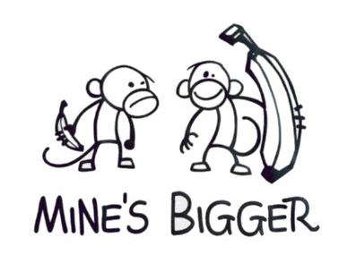
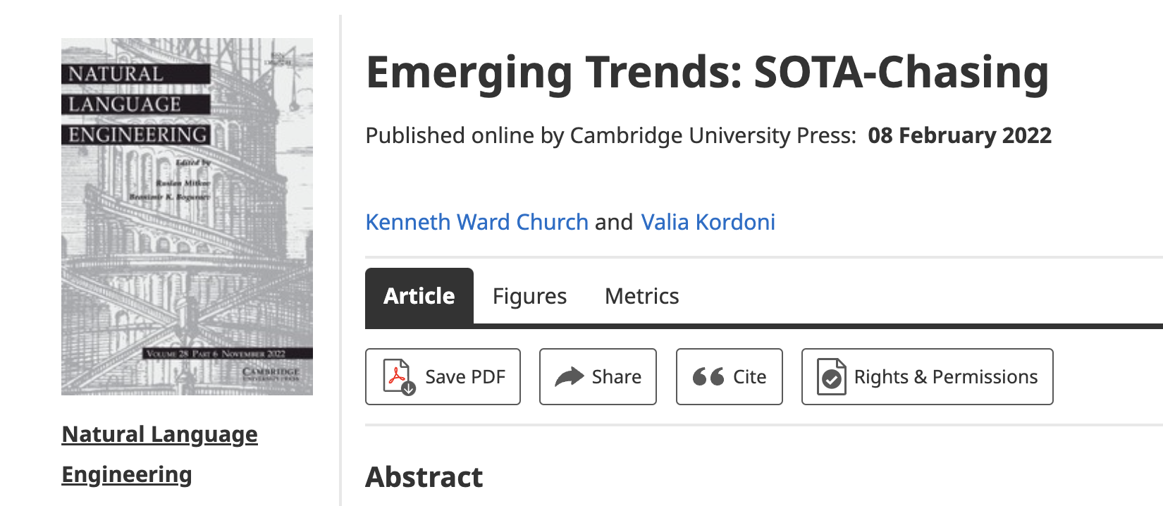
Opportunity for Evaluation: Answer Important Questions
Unimportant Questions (SOTA-Chasing)
Important Questions (Good)
Mine is bigger than yours
What should I read? Cite?
What’s Hot & What’s Not?
Which papers are
tearing up the charts?
Which authors are
rising stars
Timeliness (Update Story)
Post model on HuggingFace
COVID happens
How long are models good for?
Sell-by dates for SciBERT

Slide 8
Standard Test-Train Split Assumes Time is Symmetric
It is difficult to make predictions, especially about the future.
-- Yogi Berra
bin | date
0 | 1684-05
1 | 1936-03
2 | 1951-08
3 | 1958-08
4 | 1963-10
5 | 1967-07
6 | 1970-06
7 | 1973-01
8 | 1975-07
9 | 1977-10
Proposed Split
Sort 200M papers by pub date
Create 100 bins
2M papers per bin
Train on early bins
Test on later bins
Hypo:
Short-term weather forecasting
is easier than long-time forecasting

Slide 9
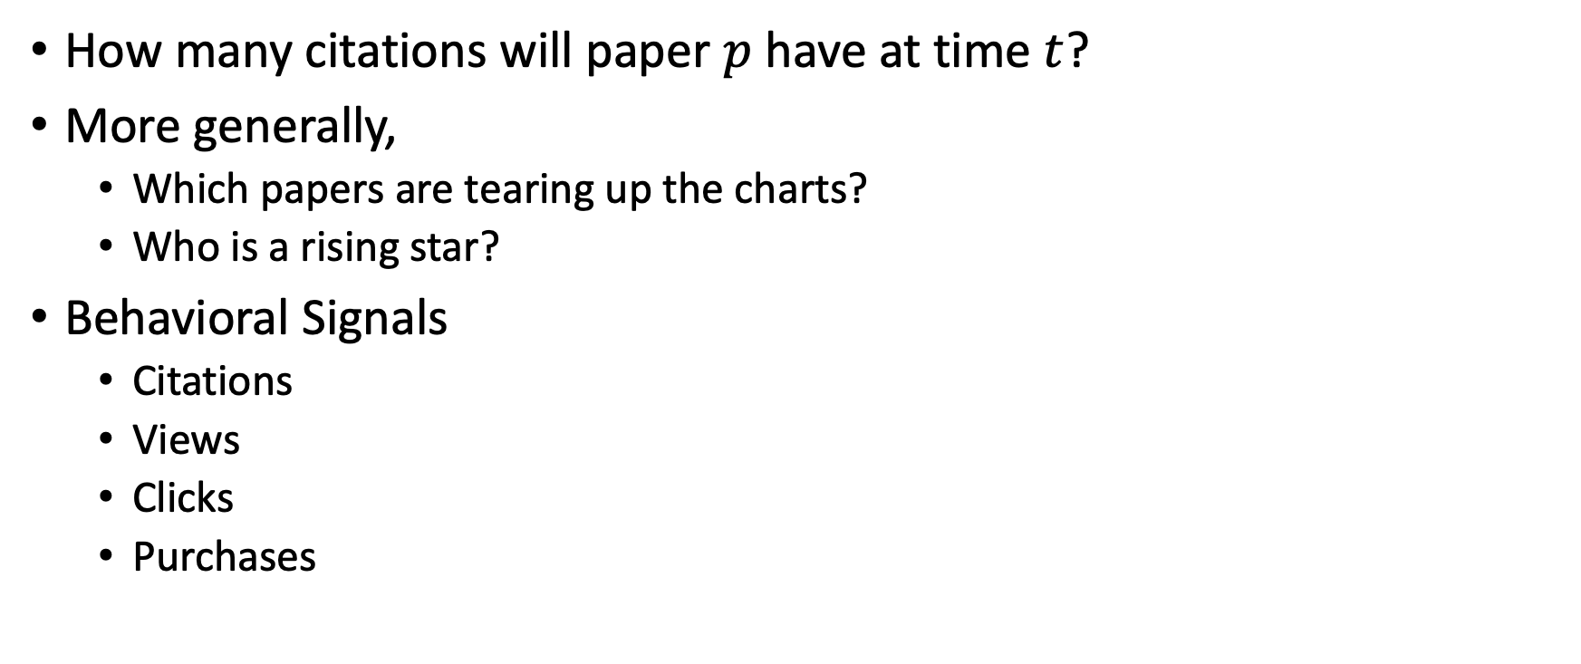
Simple Question: Predicting Audience Appreciation
How many citations will paper $p$ have at time $t$?
More generally,
Which papers are tearing up the charts?
Who is a rising star?
Behavioral Signals
Citations
Views
Clicks
Purchases

Slide 10
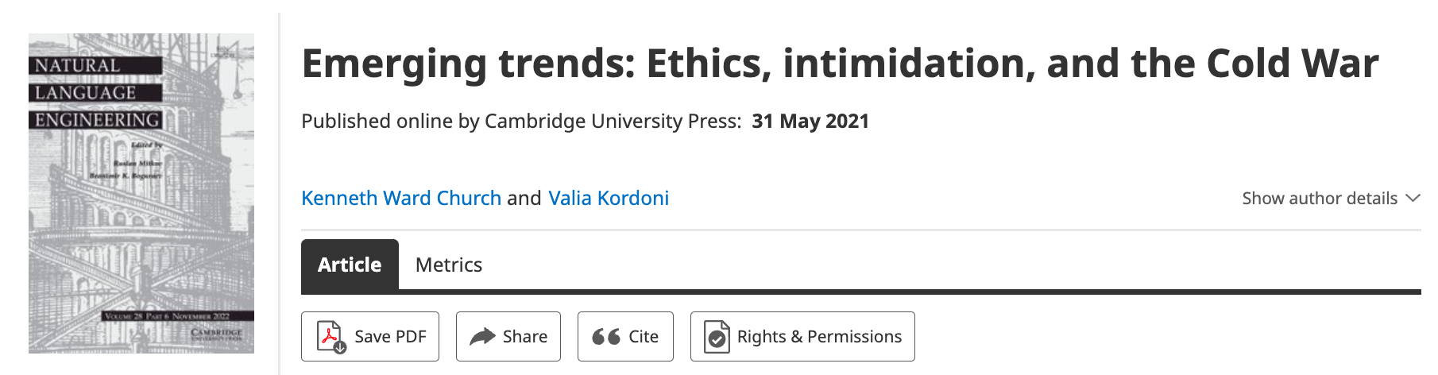
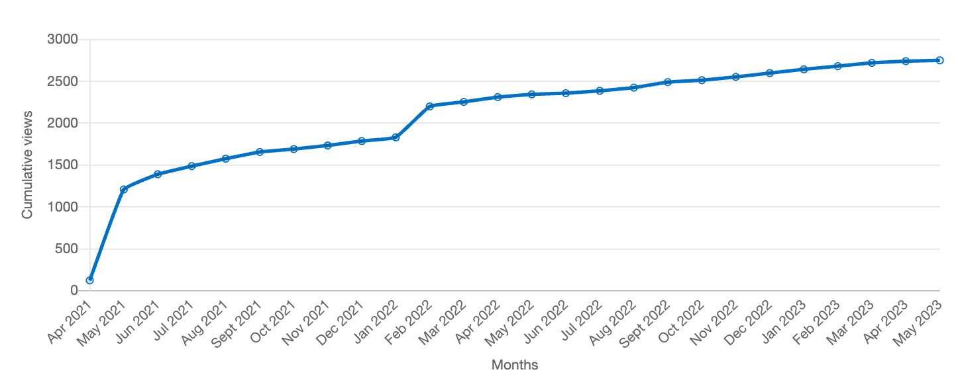
Value: Author Contributions + Audience Appreciation (Literature is a conversation, like social media)
Author Contributions
Time Invariant
Does not change after publication
Audience Appreciation
Evolves over time
Behavioral Signals
Views
Citations
It is difficult to make predictions, especially about the future.
-- Yogi Berra

Slide 11
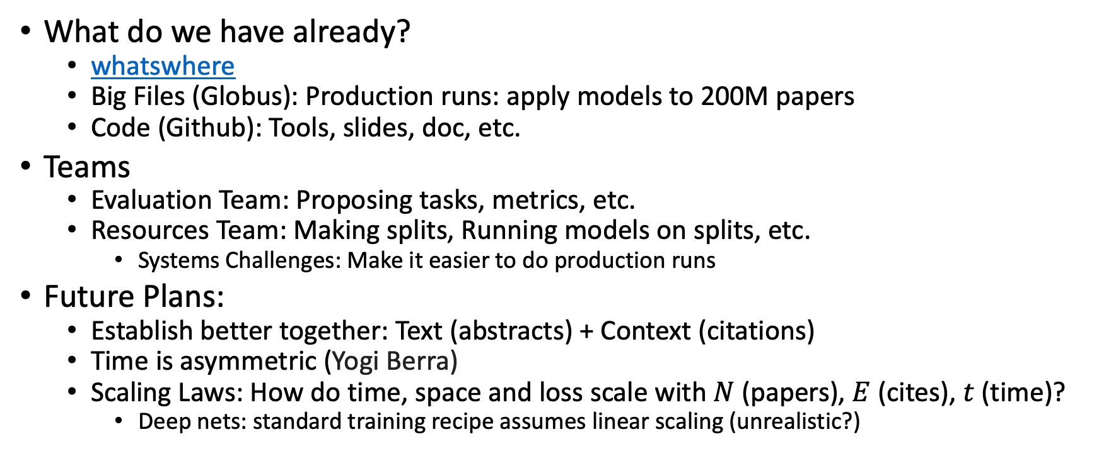
Where are we? And where are we going?
What do we have already?
whatswhere
Big Files (Globus): Production runs: apply models to 200M papers
Code (Github): Tools, slides, doc, etc.
Teams
Evaluation Team: Proposing tasks, metrics, etc.
Resources Team: Making splits, Running models on splits, etc.
Systems Challenges: Make it easier to do production runs
Future Plans:
Establish better together: Text (abstracts) + Context (citations)
Time is asymmetric (Yogi Berra)
Scaling Laws: How do time, space and loss scale with $N$(papers), $E$ (cites), $t$ (time)?
Deep nets: standard training recipe assumes linear scaling (unrealistic?)

Slide 12
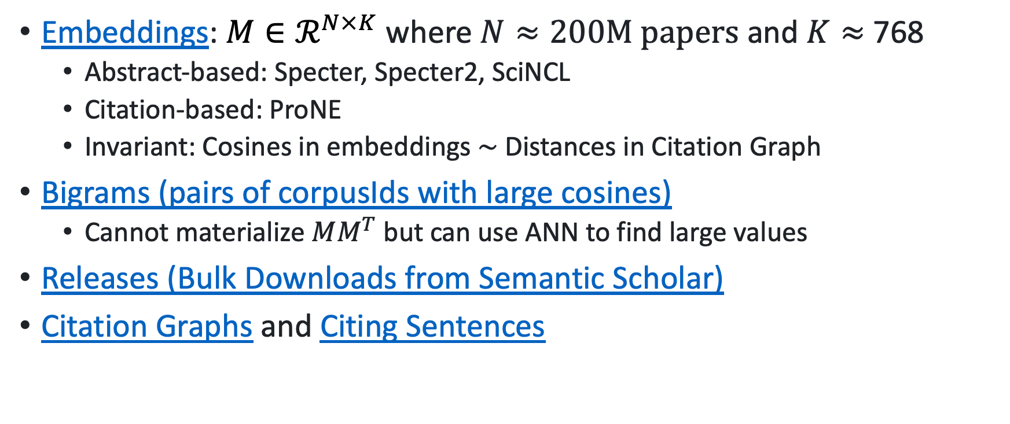
What do we have? Big Files on Globus
Embeddings: $M∈ℛ^{N×K}$ where $N≈200M papers$ and $K≈$ 768
Abstract-based: Specter, Specter2, SciNCL
Citation-based: ProNE
Invariant: Cosines in embeddings $\sim$ Distances in Citation Graph
Bigrams (pairs of corpusIds with large cosines)
Cannot materialize $MM^{T}$ but can use ANN to find large values
Releases (Bulk Downloads from Semantic Scholar)
Citation Graphs and Citing Sentences

Slide 13
Deliverables https://github.com/kwchurch/JSALT_Better_Together/blob/main/doc/deliverables.md
Better access to literature
Resources:
Many embeddings for many papers
Posted models on HuggingFace
Post code on GitHub
Summarization methods to compare and contrast across small (and large) collections of documents
Support incremental updates to embeddings based on citation graphs
Evaluation:
Better numbers,
as well as better benchmarks
Establish that combinations of text and links are better together (than either by itself)
Establish that citing sentences are useful
Improve methods for assigning papers to reviewers
Theory: Unified framework of
Deep nets and
Linear Algebra
Bibliometrics:
Predict citations of a paper over time.
Predict h-index of an author over time.
Find authors that publish too many papers

