Slide 1
Wednesday Update Better Together: Text + Context
Kenneth Church
Wed, July 5
https://github.com/kwchurch/JSALT_Better_Together

Slide 2
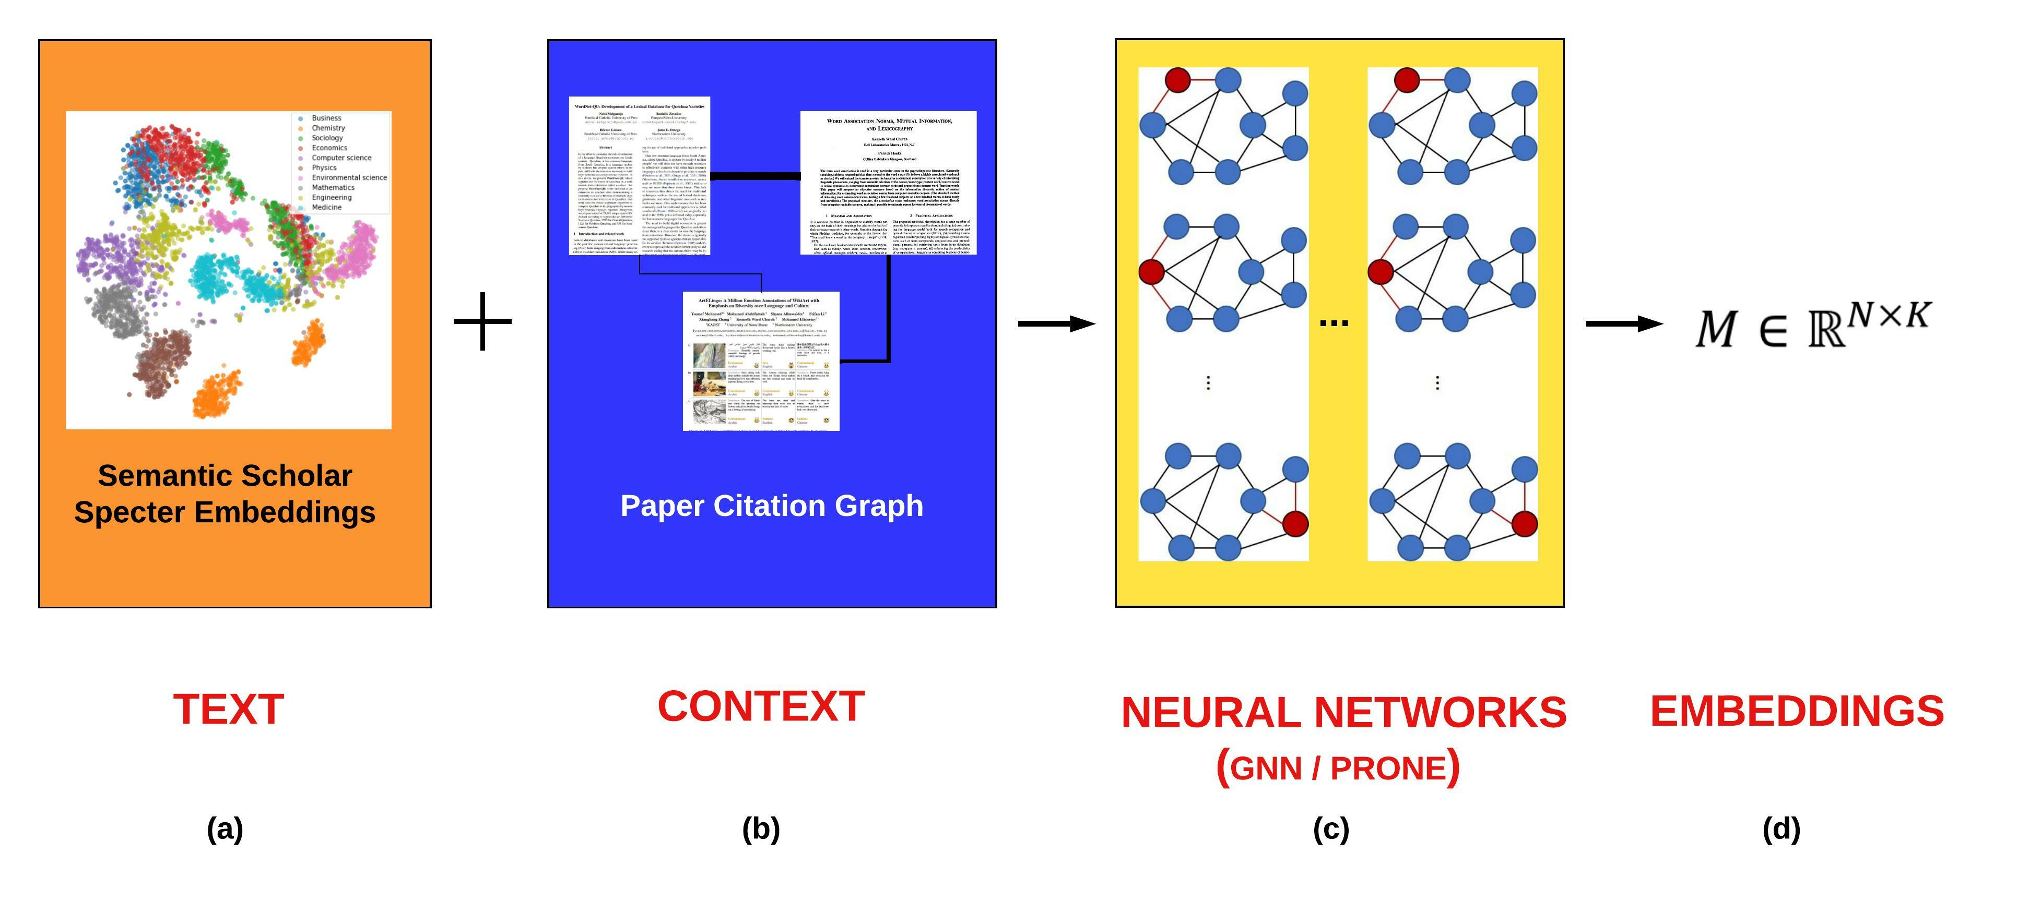
Better Together: Text (Titles, Abstracts, Body); Context (Citations)

Slide 3
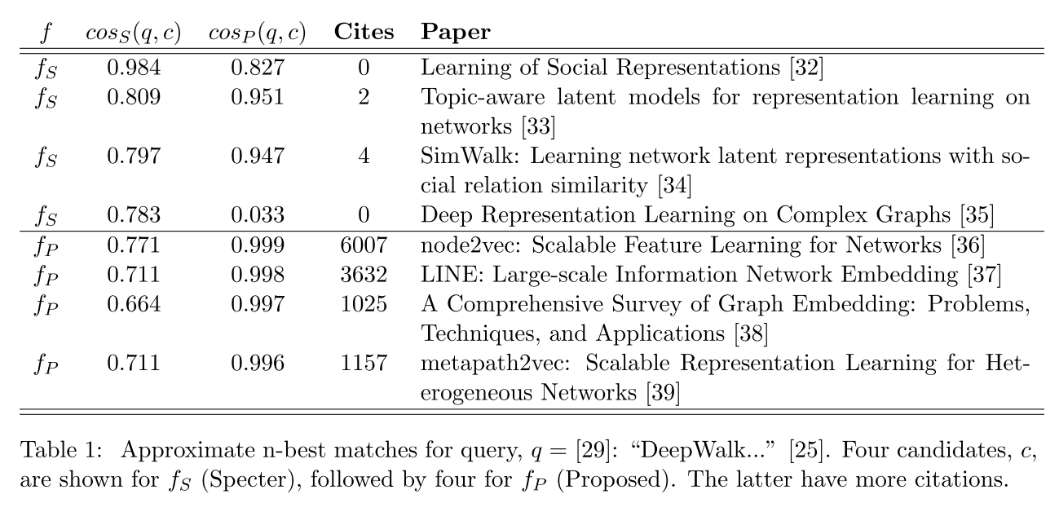
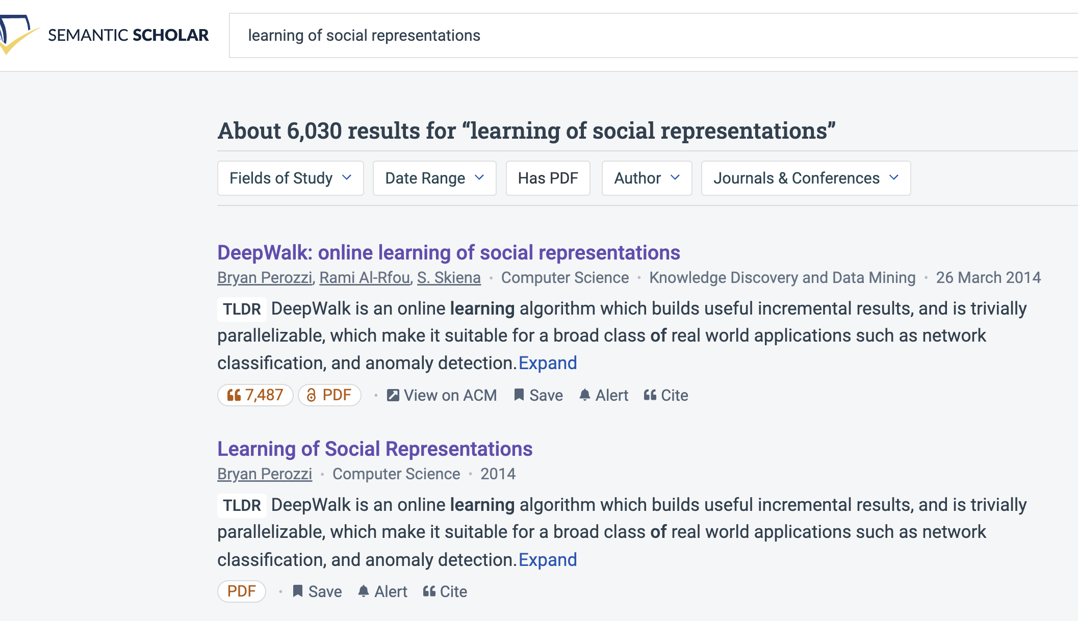
Query: ``DeepWalk: Online Learning of…’’

Slide 4
Document Similarities: Use Cases
Recommendations
What should I read?
What should I cite?
Many systems focus on ``relevance’’ (word overlap)
But don’t recommend dups
Moreover, credibility is super-important
Don’t recommend papers that are buzz-word compliant
But not worth reading
(Most papers are never cited)

Slide 5
Realities
The Real World
Idealizations (Evaluation Benchmarks)
Large
Growing
Dirty
Missing Values
Bad/misleading Values
Small
Static
Clean

Slide 6
Global Scientific Output Doubles Every 9 Years
Timeliness
Web companies keep indexes up to date (web is a moving target)
Ditto for Academic Search

Slide 7
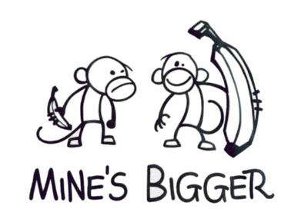
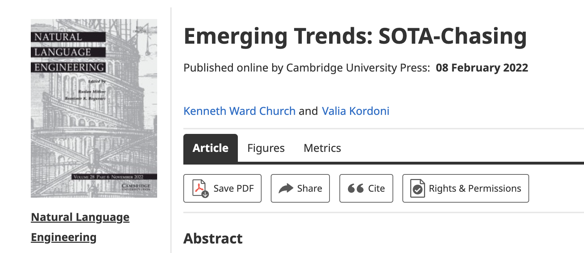
Opportunity for Evaluation: Answer Important Questions
Unimportant Questions (SOTA-Chasing)
Important Questions (Good)
Mine is bigger than yours
What should I read? Cite?
What’s Hot & What’s Not?
Which papers are
tearing up the charts?
Which authors are
rising stars
Timeliness (Update Story)
Post model on HuggingFace
COVID happens
How long are models good for?
Sell-by dates for SciBERT

Slide 8
Standard Test-Train Split Assumes Time is Symmetric
It is difficult to make predictions, especially about the future.
-- Yogi Berra
bin | date
0 | 1684-05
1 | 1936-03
2 | 1951-08
3 | 1958-08
4 | 1963-10
5 | 1967-07
6 | 1970-06
7 | 1973-01
8 | 1975-07
9 | 1977-10
Proposed Split
Sort 200M papers
by pub date
Create 100 bins
2M papers per bin
Train on early bins
Test on later bins
Hypo:
Short-term forecasting
is easier than long-time weather forecasting
90% of literature
(after I started grad school)

Slide 9
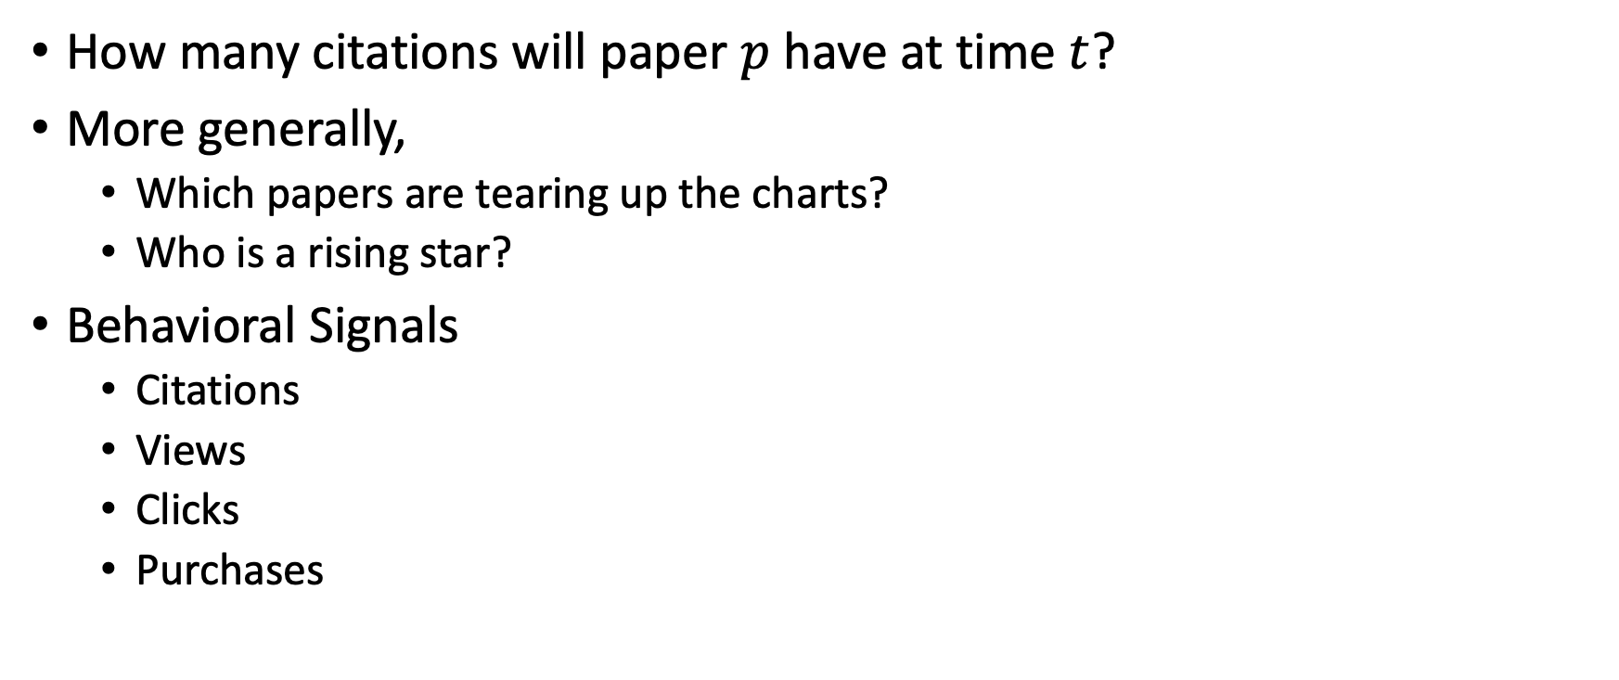
Simple Question: Predicting Audience Appreciation
How many citations will paper $p$ have at time $t$?
More generally,
Which papers are tearing up the charts?
Who is a rising star?
Behavioral Signals
Citations
Views
Clicks
Purchases

Slide 10
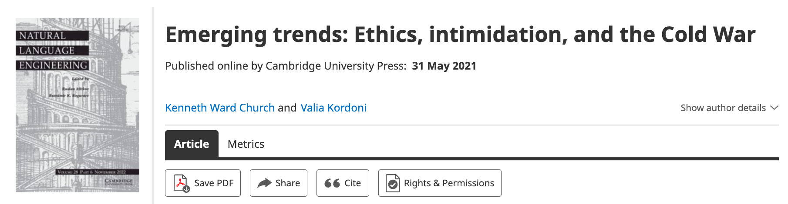
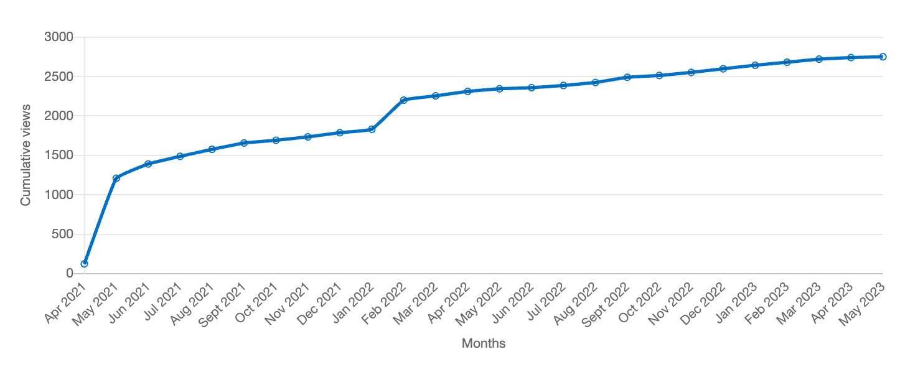
Value: Author Contributions + Audience Appreciation (Literature is a conversation, like social media)
Author Contributions
Time Invariant
Does not change after publication
Audience Appreciation
Evolves over time
Behavioral Signals
Views
Citations
It is difficult to make predictions, especially about the future.
-- Yogi Berra

Slide 11
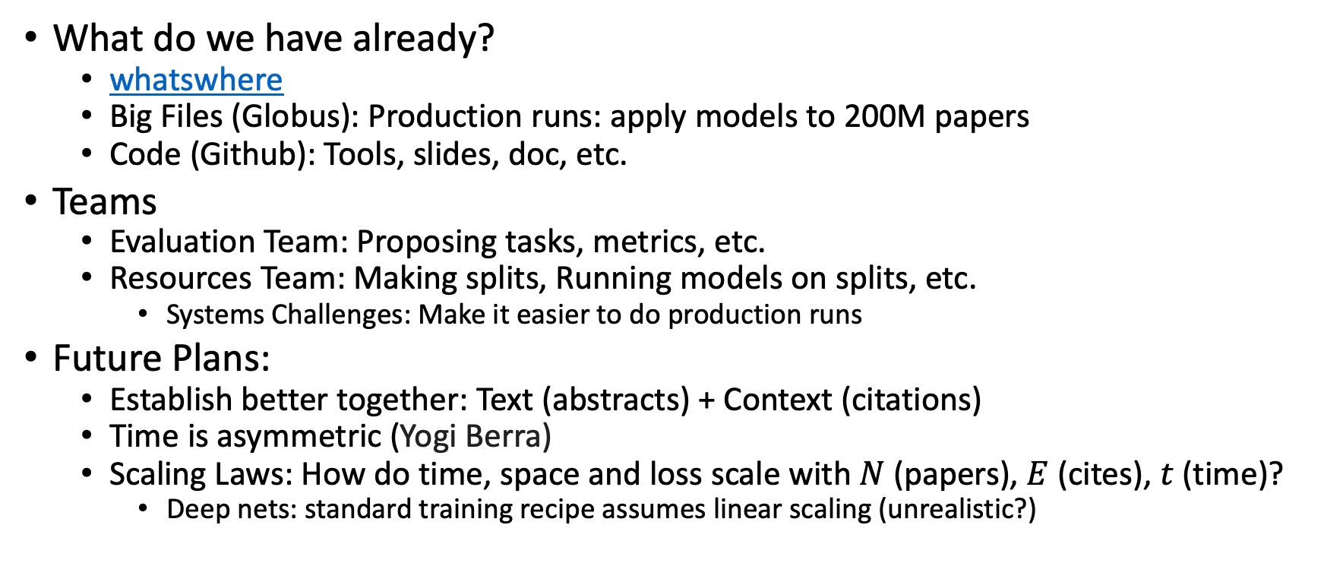
Where are we? And where are we going?
What do we have already?
whatswhere
Big Files (Globus): Production runs: apply models to 200M papers
Code (Github): Tools, slides, doc, etc.
Teams
Evaluation Team: Proposing tasks, metrics, etc.
Resources Team: Making splits, Running models on splits, etc.
Systems Challenges: Make it easier to do production runs
Future Plans:
Establish better together: Text (abstracts) + Context (citations)
Time is asymmetric (Yogi Berra)
Scaling Laws: How do time, space and loss scale with $N$(papers), $E$ (cites), $t$ (time)?
Deep nets: standard training recipe assumes linear scaling (unrealistic?)

Slide 12
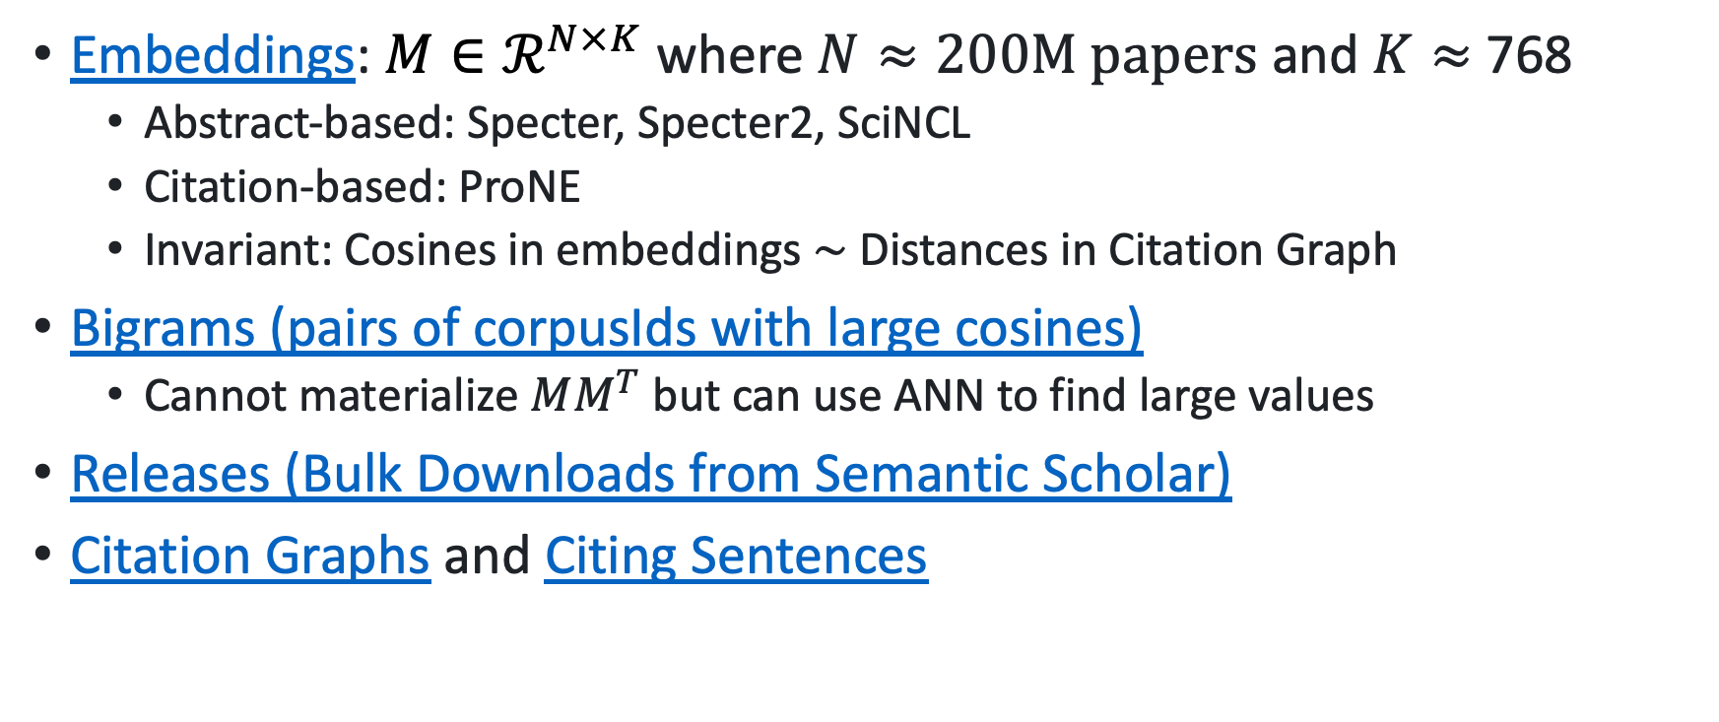
What do we have? Big Files on Globus
Embeddings: $M∈ℛ^{N×K}$ where $N≈200M papers$ and $K≈$ 768
Abstract-based: Specter, Specter2, SciNCL
Citation-based: ProNE
Invariant: Cosines in embeddings $\sim$ Distances in Citation Graph
Bigrams (pairs of corpusIds with large cosines)
Cannot materialize $MM^{T}$ but can use ANN to find large values
Releases (Bulk Downloads from Semantic Scholar)
Citation Graphs and Citing Sentences

Slide 13
Deliverables https://github.com/kwchurch/JSALT_Better_Together/blob/main/doc/deliverables.md
Better access to literature
Resources:
Many embeddings for many papers
Posted models on HuggingFace
Post code on GitHub
Summarization methods to compare and contrast across small (and large) collections of documents
Support incremental updates to embeddings based on citation graphs
Evaluation:
Better numbers,
as well as better benchmarks
Establish that combinations of text and links are better together (than either by itself)
Establish that citing sentences are useful
Improve methods for assigning papers to reviewers
Theory: Unified framework of
Deep nets and
Linear Algebra
Bibliometrics:
Predict citations of a paper over time.
Predict h-index of an author over time.
Find authors that publish too many papers

Slide 14
Better Together Evaluation
05/07/2023

Slide 15
Opportunity for Evaluation: Answer Important Questions
Important Questions (Good)
Requirements
What should I read? Cite?
What’s Hot & What’s Not?
Which papers are
tearing up the charts?
Which authors are
rising stars
Timeliness (Update Story)
Post model on HuggingFace
COVID happens
How long are models good for?
Sell-by dates for SciBERT
Causality
Time is asymmetric
Predict future (not past)
Timeliness
Indexes go stale quickly (months)
Desiderata: incremental updates

Slide 16
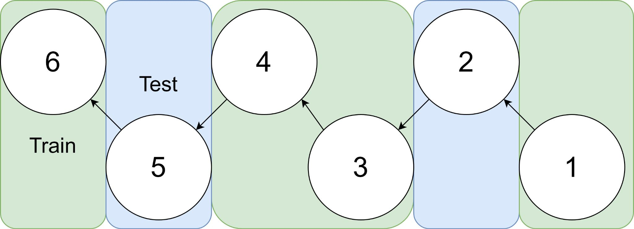
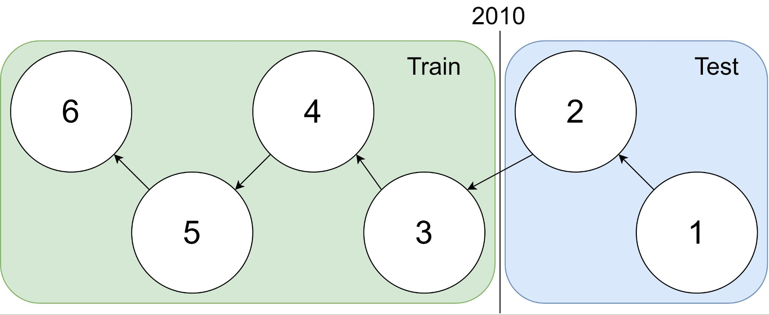
Example: 1 cites 2, 2 cites 3, … 5 cites 6
Traditional Train-Test Split (Non-Causal)
idx | Pub Year | Paper Title
1 | 2018 | [...] Photofragment imaging
2 | 2016 | Convenient probe of S(1D2)[...]
3 | 2005 | Megapixel ion imaging [...]
4 | 2003 | Direct current slice imaging [...]
5 | 1995 | profiles of Cl(2Pj) photofragments [...]
6 | 1988 | Adiabatic dissociation of [...]
Proposed Train-Test Splits (Causal)
Notes:
No asymmetry of time - how to reduce to a soundbite
Audience soundbites
‘Almost all studies in ml do test-train split’ that’s a bad idea when you have time

Slide 17
Pitfalls with Evaluating Paper Systems
Evaluating within the Train set time: artificially easy (when we write papers, we can’t see what will be published in the future), introduces leakage
Tasks artificially simplified: Citation recommendation tasks propose negatives as those papers with a restricted training set (1K-100K). In reality, the number of negatives is closer to 100M.
Small data sets: Some tasks may have as few as 30 samples, which is not enough to differentiate between systems with different capabilities
Notes:
Notes from Ken:
Record myself on zoom call and measure how much time to spend on each slide. >2 slides
Provide some memes and keep things snappy

Slide 18
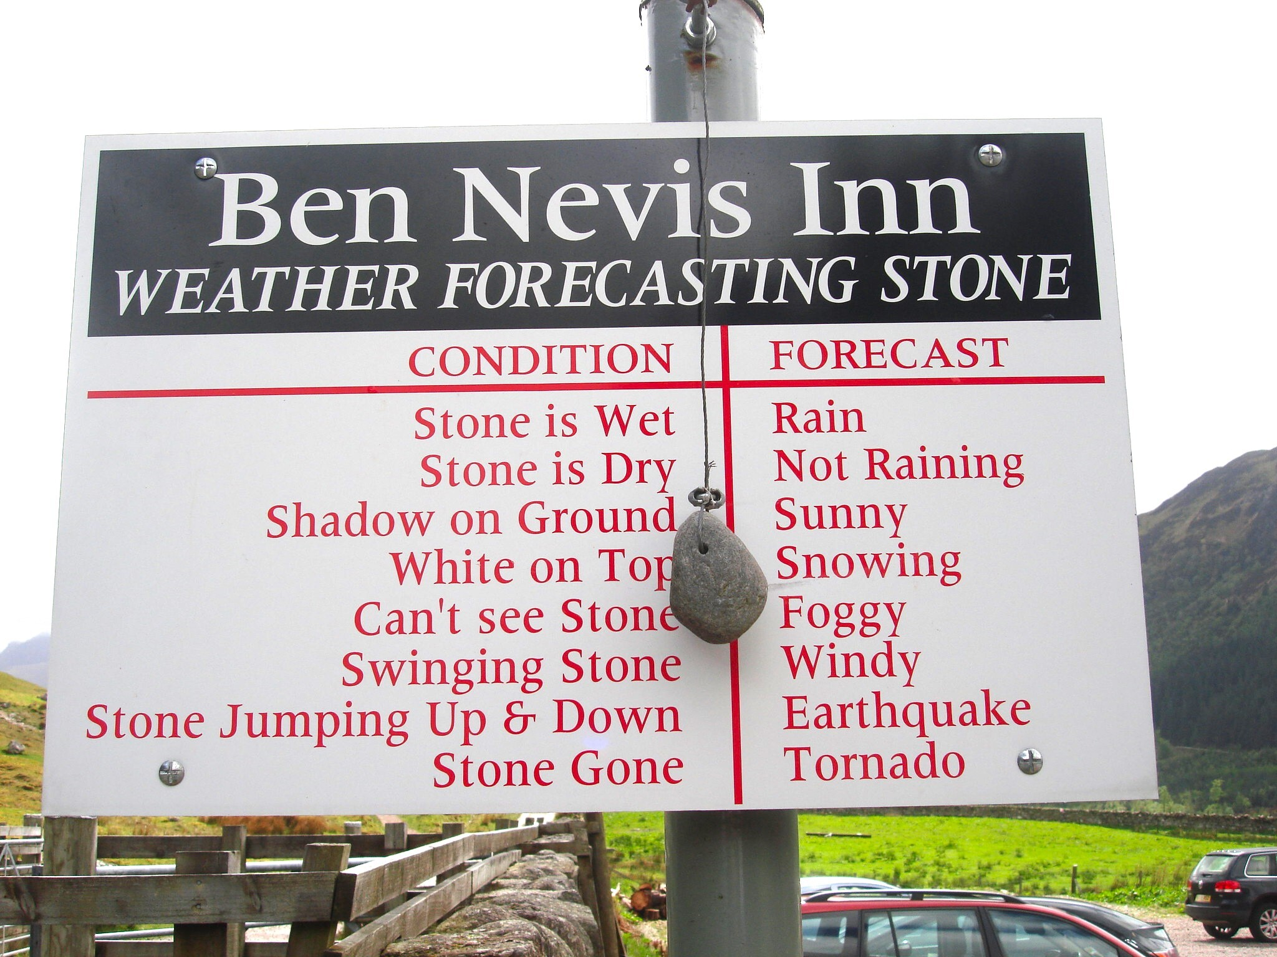
Desiderata: Validity & Capabilities
Validity
Task: reflect a real use case
Not an arbitrary benchmark
Capabilities
Short-term forecasting
is easier than long-term weather forecasting

Slide 19
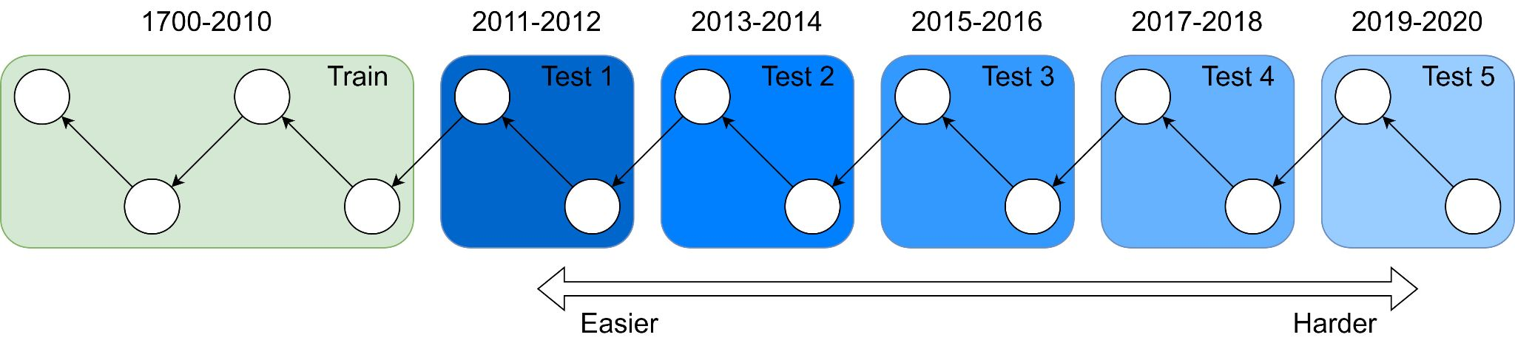
Forecasting
Intuition: as we try these tasks further out, things get muddier. If you’re an expert in 2010 what do you know about COVID, AlphaGo, South Sudan, etc?
Question: How to quantify this?
LLM: Perplexity of SciBERT across different bins, BPE compressibility
Better Together Eval: task performance at y+1, y+2, y+n (up to 2023*)

Slide 20
Evaluation tasks should reflect a real-world use
Citation Recommendation - the paradigmatic Better Together task - What does Paper A reference?
Simple implementation: get Paper A vector representation with model M and retrieve the nearest papers
Can also make Citation Recommendation local: given a sentence in Paper A predict that reference.
Many valencies around features, number of negatives, scoring (classification vs retrieval)
Erroneous Quadruped Walking Depictions, Horváth et al (2009)
“Although humans have observed walking quadrupeds for thousands of years, the exact characterization of the walking of tetrapods had to wait for the advent of photography [?]”
Task: Find a reference to a (History of Science) paper describing the process of photographing tetrapod walking
Notes:
Thesis: it will be harder to do Citation Recommendation as Paper A is chosen further forward in time due to citation graph evolution and academic topic development

Slide 21
Evaluation tasks should reflect a real-world use
Citations after k Years - How many citations did Paper A have after k years?
‘Hit Prediction’, that is, will a paper be successful.
More specifically we ask ‘will the model be ‘a hit’ at a specific time, which is relevant to academic literature as certain topics wax and wane in terms of field attention.
Repeat References - Given A references B, how many times does it reference B?
Agnostic about what multiple references means, but it probably means something
Publication Year - What year is paper A published?
Is a paper timely? Is the model capable of inferring time from the (messy) citation graph
Venue Prediction - Which venue is paper A published in?
Helpful to users: I’ve written a paper in a new area for me, where do I send it?
Peer Reviewer Score - What score was this paper given on OpenReview?
Very hard, potentially aleatory uncertainty in the reviewing process (what did reviewer 2 have for breakfast?) but powerful

Slide 22
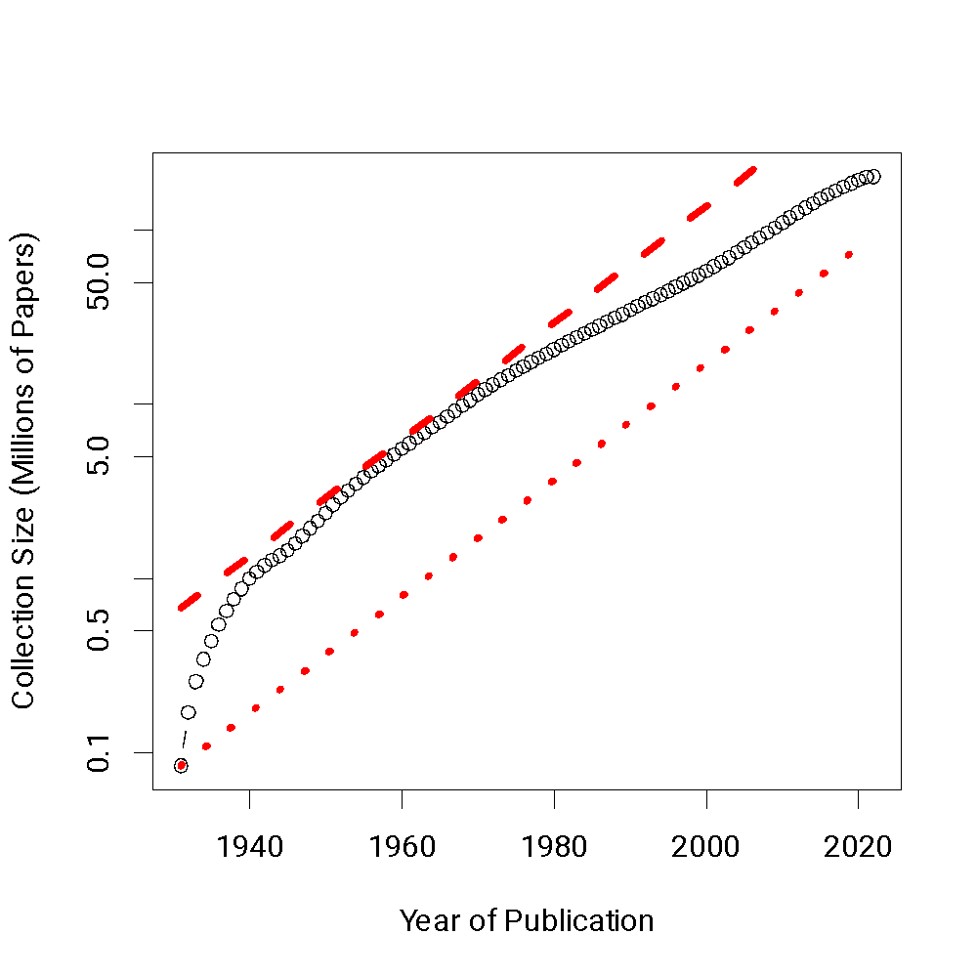
Evaluation data must be updatable
Tasks are derived from core Semantic Scholar data or from APIs which we can join with Semantic Scholar IDs
We define our evaluation set as a function we can run on Semantic Scholar to update at reasonable intervals to reflect shifts over time
These updates will keep model producers honest: is your model from 2016 still good in 2023?

Slide 23
Better Together Evaluation
Evaluation Desiderata
Evaluation data must be causal
Graph is partitioned by date such that models cannot peek forwards in time (where possible)
Evaluation should check capability
With the same tools we use to partition train-test, we make bins which record how far out each prediction is
Evaluation data must be updatable (in two years, literature will have changed)
We create our evaluation as a pipeline against large-scale maintained data-sources to make updates as straightforward as possible
Evaluation tasks should reflect a real-world use, not some arbitrary Benchmark task
We pick a set of evaluation tasks which would be of use to Academic Document authors

