Slide 1
JSALT 2023
From New Paper to Embedding
Rodolfo Zevallos

Slide 2
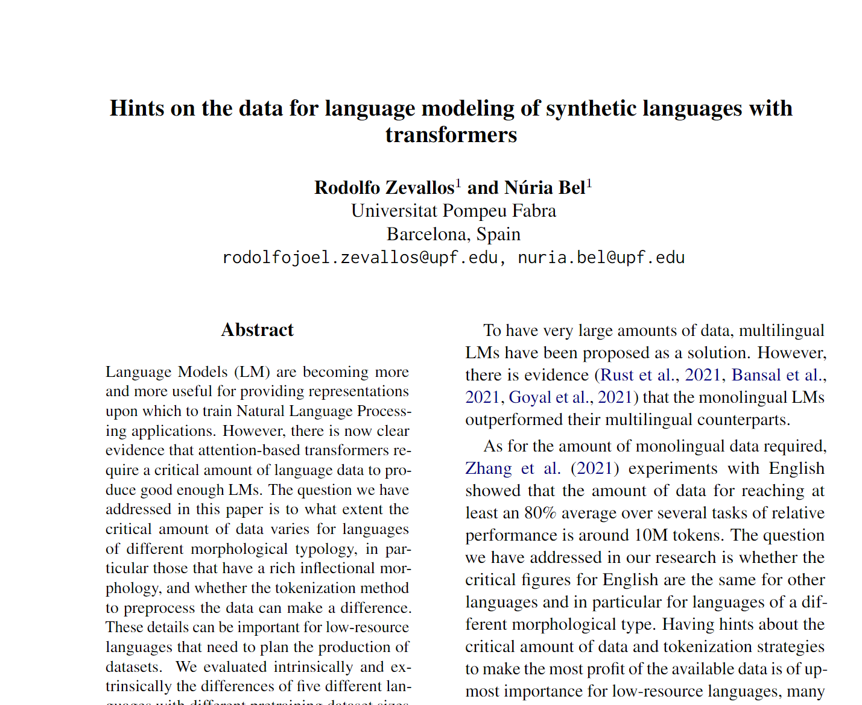
New Paper so New Embedding
How get a new embedding?
Using cites!!

Slide 3
Calculating the new embedding
Embedding
Cites Paper
Models: specter, specter 2, our, etc
Centroid
New
Embedding

Slide 4
Comparing embeddings
New
Embedding
Cosine
Result Report
Papers Dataset
(Embedding)

Slide 5
Results
Specter
Paper | Cos
Revisiting Pre-Trained Models for Chinese Natural Language Processing | 0.9199736
Introduction to the second issue on machine translation for low-resource languages | 0.9106965
ZmBART: An Unsupervised Cross-lingual Transfer Framework for Language Generation | 0.9090991
The REPU CS' Spanish–Quechua Submission to the AmericasNLP 2021 Shared Task on Open Machine Translation | 0.9041589
oLMpics-On What Language Model Pre-training Captures | 0.90228057
Specter 2
Paper | Cos
oLMpics-On What Language Model Pre-training Captures | 0.96565336
JUST-BLUE at SemEval-2021 Task 1: Predicting Lexical Complexity using BERT and RoBERTa Pre-trained Language Models | 0.96111906
Fast, Effective, and Self-Supervised: Transforming Masked Language Models into Universal Lexical and Sentence Encoders | 0.9574798
Discovering Representation Sprachbund For Multilingual Pre-Training | 0.95661914
BART: Denoising Sequence-to-Sequence Pre-training for Natural Language Generation, Translation, and Comprehension | 0.9566013

Slide 6
Results
LinkBERT
Paper | Cos
YNU@Dravidian-CodeMix-FIRE2020: XLM-RoBERTa for Multi-language Sentiment Analysis | 0.31034264
NIST 2022 Language Recognition Evaluation Plan | 0.3075489
Accent Modeling of Low-Resourced Dialect in Pitch Accent Language Using Variational Autoencoder | 0.3015576
Implementation of a ConvolutionalNeural Network (CNN) on a FPGA forSign Language's Alphabet recognition | 0.29048762
YNU_OXZ @ HaSpeeDe 2 and AMI : XLM-RoBERTa with Ordered Neurons LSTM for Classification Task at EVALITA 2020 | 0.28915596
Scincl
Paper | Cos
Discovering Representation Sprachbund For Multilingual Pre-Training | 0.93535507
oLMpics-On What Language Model Pre-training Captures | 0.93225837
Supervised Contrastive Learning for Pre-trained Language Model Fine-tuning | 0.9311466
LowResourceEval­2021: a shared task on speech processing for low­resource languages | 0.9237135
Downstream Datasets Make Surprisingly Good Pretraining Corpora | 0.9222506

Slide 7

Next Steps
Modify text_to_embedding.py to all models no only HF
include my code in github
Get proposed model results
Testing using only cites from “work_related” of the new paper.

