Slide 1
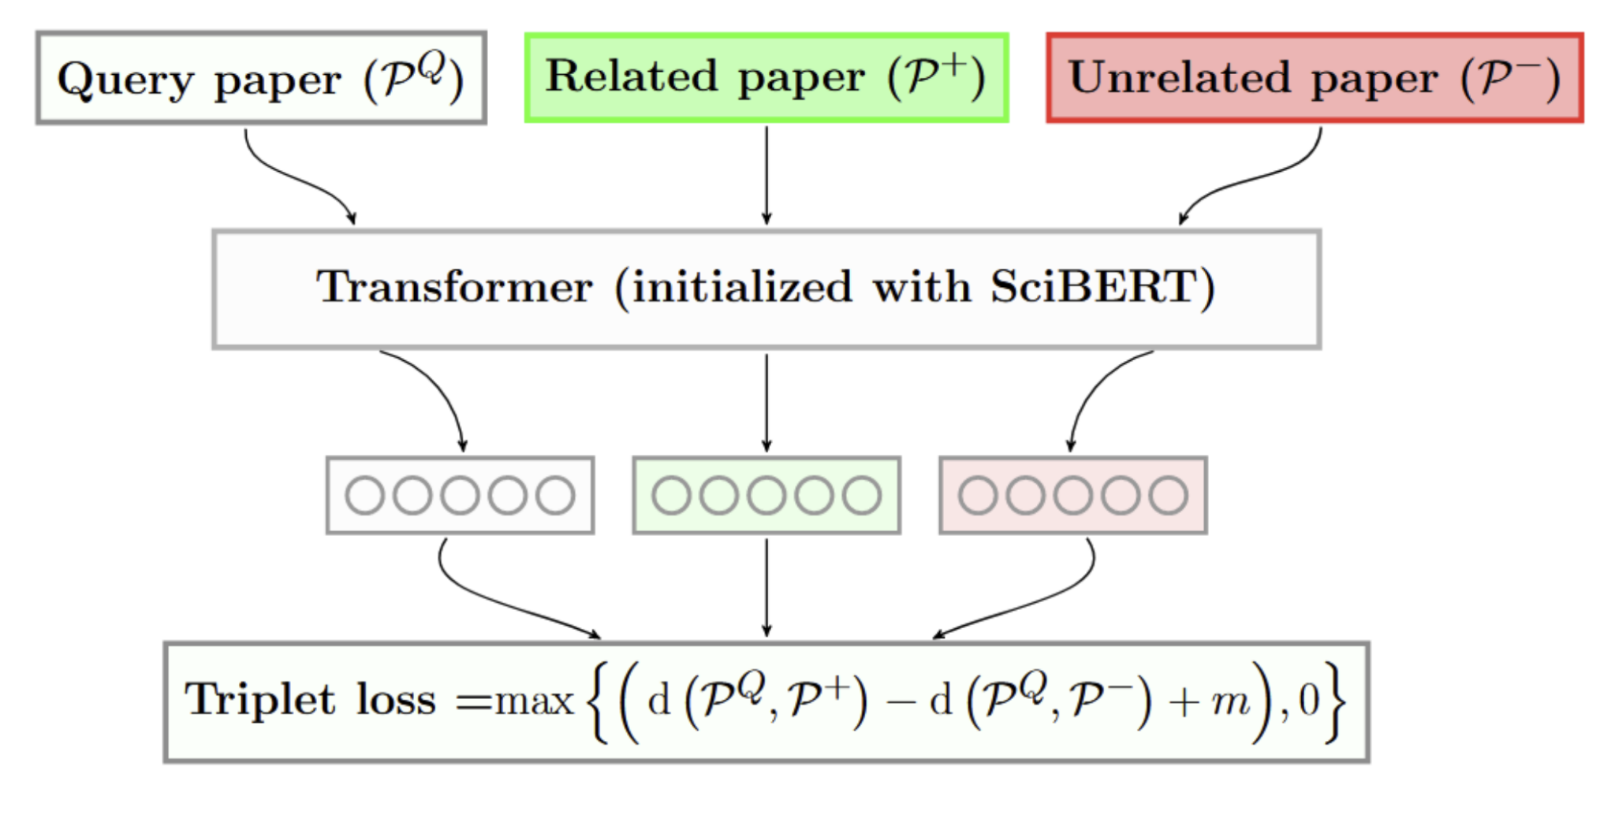
Evaluating text-based models
Text based document representation models rely on an underlying language model (Cohan et al., 2020)
SciBERT is a BERT-like model trained on text from scientific documents (Beltagy et al., 2019)

Slide 2
Perplexity as evaluation
Hypothesis: Perplexity is important. Document representation quality is related to the quality of the underlying language model
Language model perplexity is a measure of how “expected” a piece of text is to the model
So, we can use this measure as a signal of how well we would expect a model to represent a given document

Slide 3
How can we use this?
Evaluate how well the model can represent papers from different times in the past
Evaluate how quickly the model will “rot” past its training date
Find weak areas that the model can improve on

Slide 4
Perplexity for bidirectional models
BERT-style models do not have a well defined perplexity
Instead, use model scoring (Salazar et al., 2021) to calculate a pseudo-perplexity (per-subword)

Slide 5
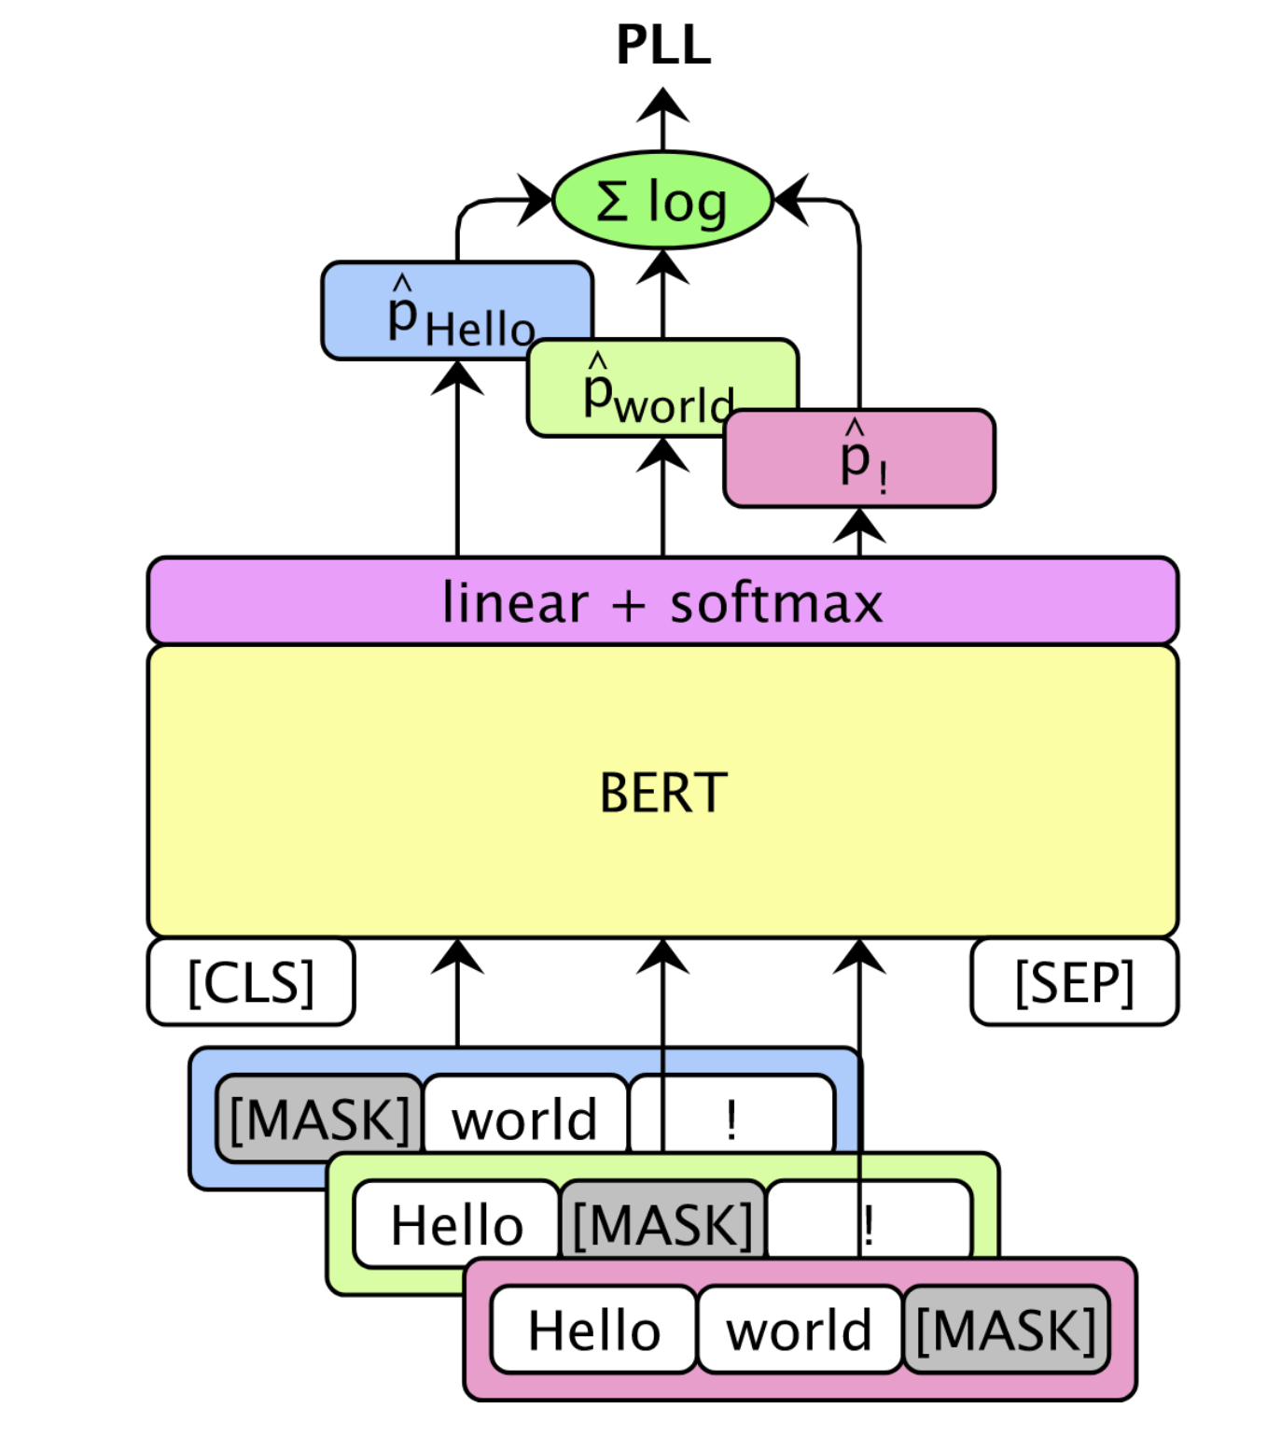
Pseudo Perplexity (PPPL)
BERT-style models do not have a well defined perplexity
Instead, use model scoring (Salazar et al., 2021)

Slide 6
Pseudo Perplexity (PPPL)
“peters pickled peppers”
[CLS]
pet
##ers
pick
##led
pepper
[SEP]
101
11109
1468
3368
2433
18700
102
log(p(pet))
∑ = PLL(w)
|V|
log(p(##ers))
log(...)
log(...)
log(...)
Pseudo log-likelihood
101
[MASK]
1468
3368
2433
18700
102
101
11109
[MASK]
3368
2433
18700
102
101
11109
1468
[MASK]
2433
18700
102
101
11109
1468
3368
[MASK]
18700
102
101
11109
1468
3368
2433
[MASK]
102
Notes:
BERT-style models do not have a well defined perplexity
Instead, use model scoring (Salazar et al., 2021)

Slide 7
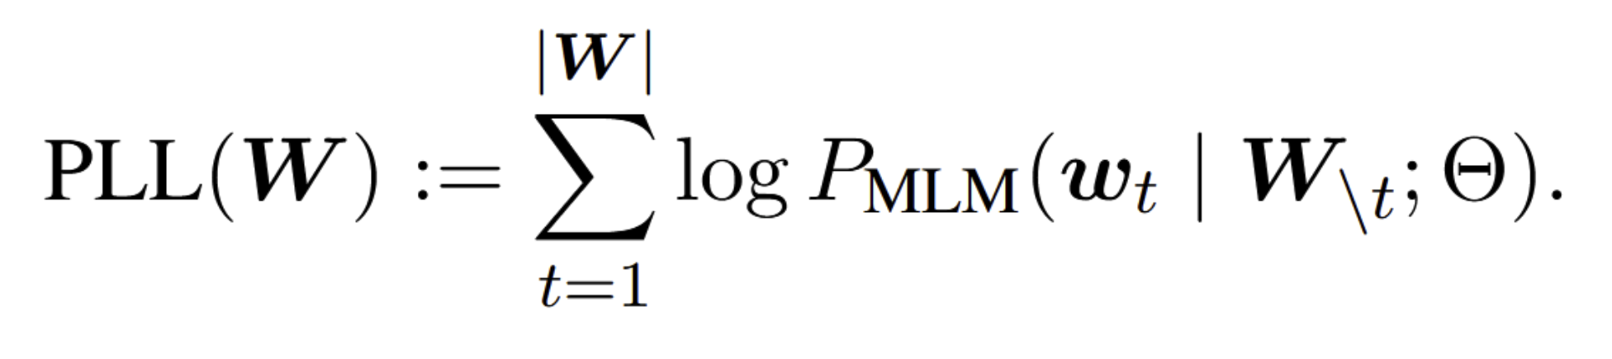
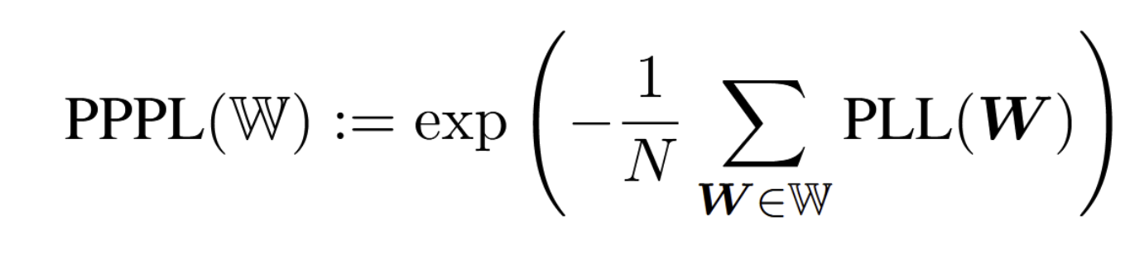
Initial Experiments
Sample 10,000 abstracts from each bin (no filtering)
Score the abstracts using the previous method
Abstract
# Tokens in Bin
Bin

Slide 8
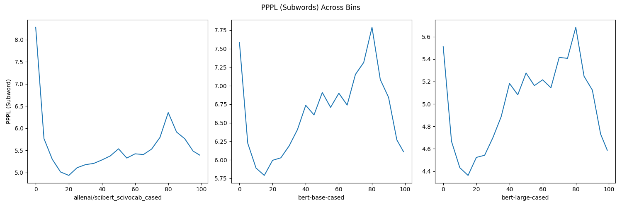
Past Analysis of BERT-like Models

Slide 9
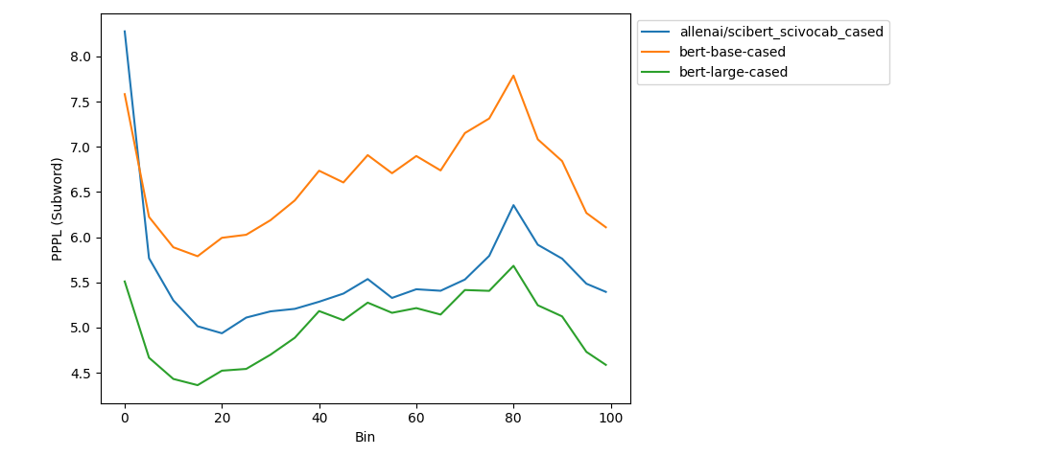
Past Analysis of BERT-like Models

Slide 10
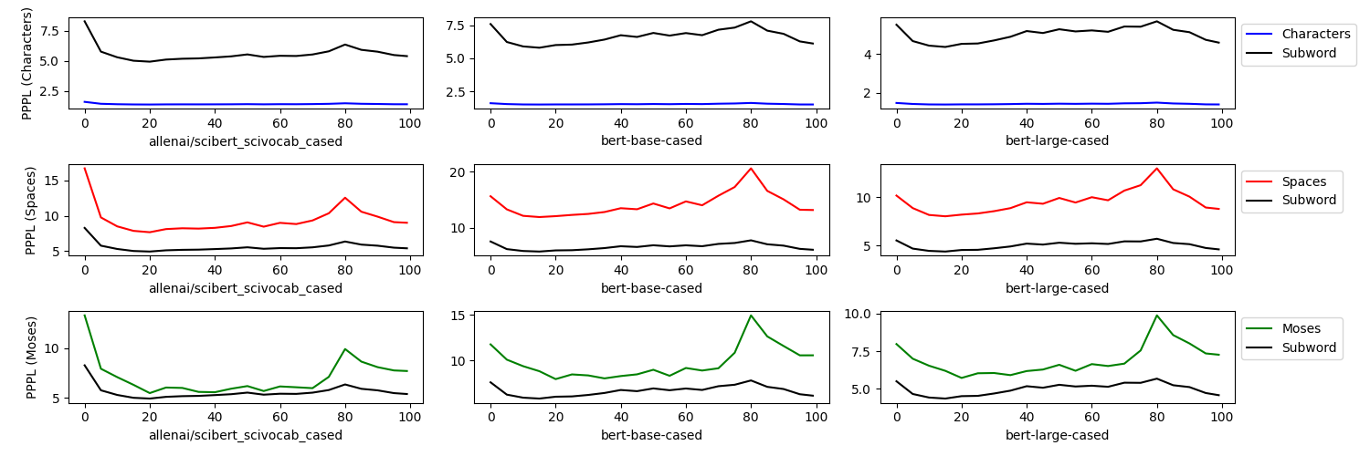
Different Normalization Methods

Slide 11
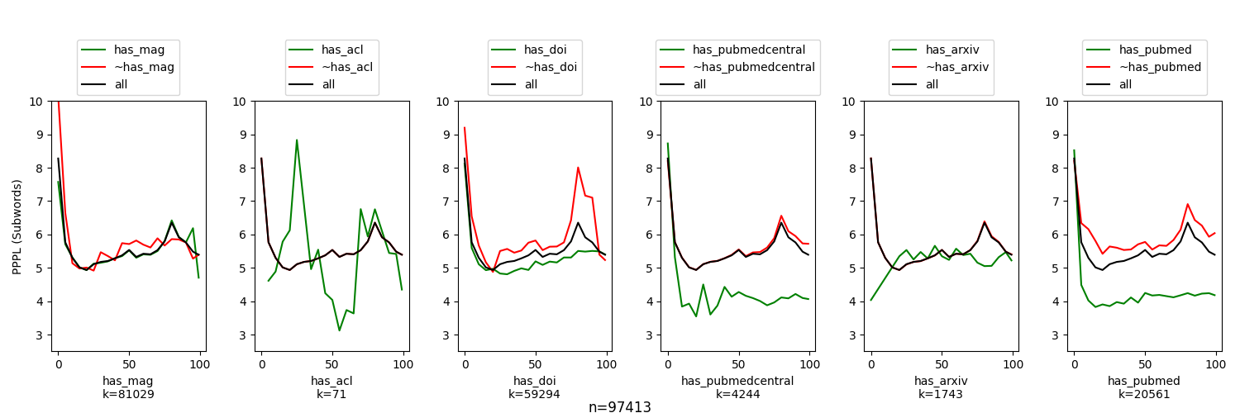
Stratifying By Source Domain

Slide 12
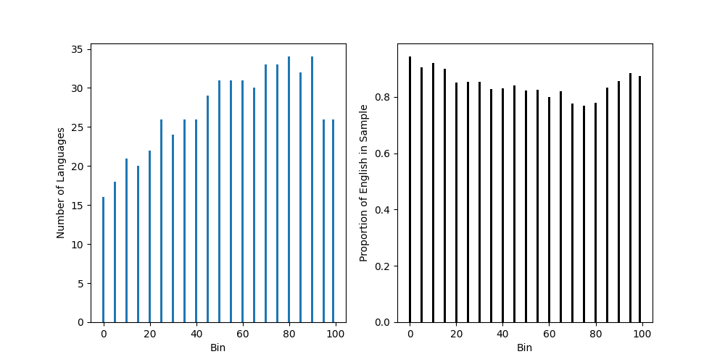
Stratifying by Language

Slide 13
Language Proportions Over Time

Slide 14
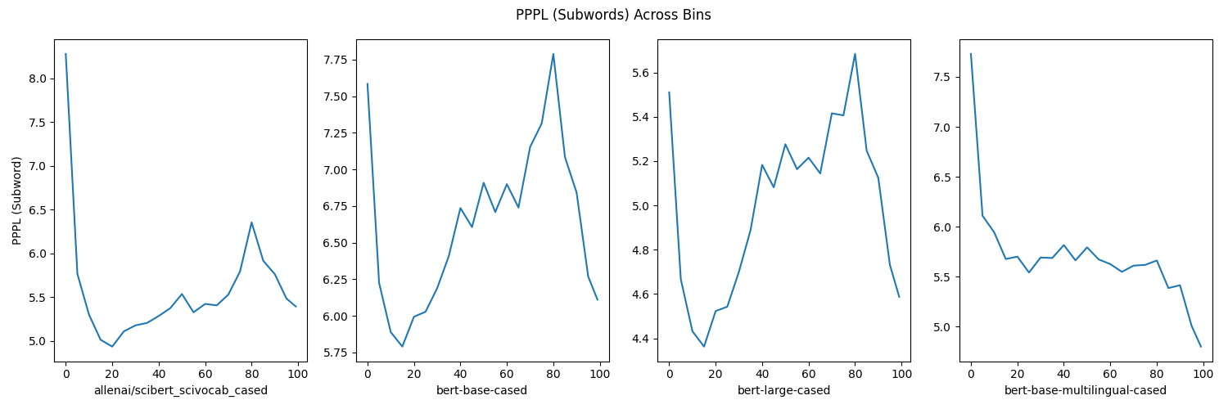
Multilingual Models

Slide 15
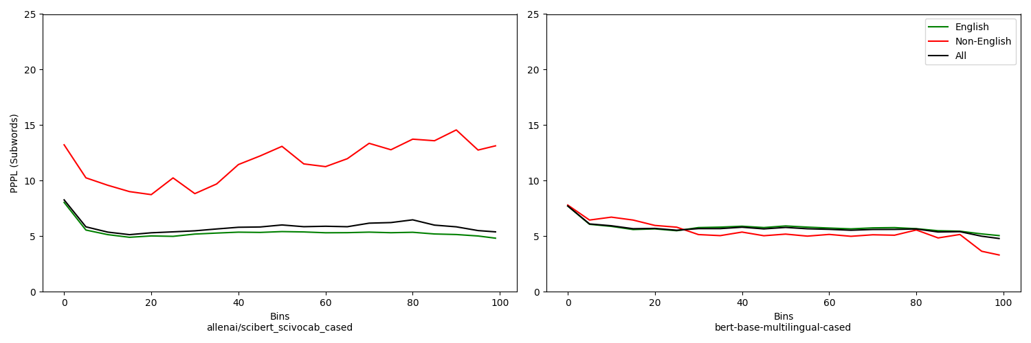
Effect of Non-English Abstracts

Slide 16
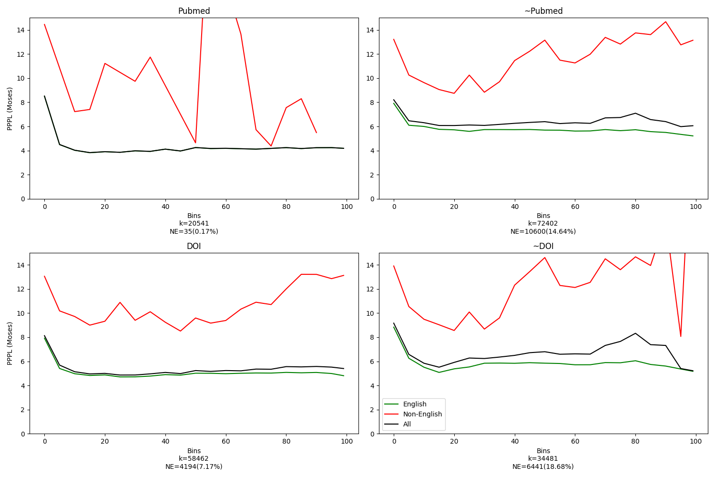
Stratifying by language and domain

Slide 17
Takeaways: Multilinguality

Slide 18
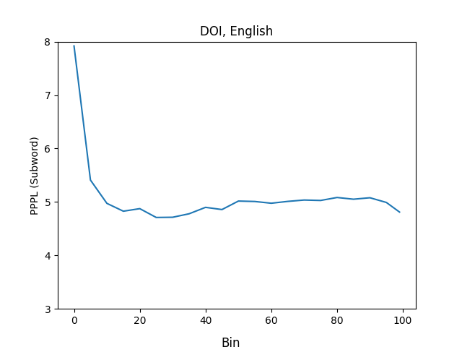
“Clean” Data

Slide 19
Takeaways: Language over Time
From perplexities? Inconclusive
Check other metrics!

Slide 20
Model Architectures
Roberta, XLM-R

Slide 21
Effects of Additional Pretraining

