Slide 1
Stuff to do
Aug 15

Slide 2
Pointers to Overleaf, YouTube, etc.
Papers:
NSF Proposal:
https://github.com/kwchurch/JSALT_Better_Together/blob/main/examples/similar_documents/reading_list/proposal.pdf
Outline for overview paper:
https://www.overleaf.com/7366867588sqxhrgrpcrrv
Talks
Final Presentation: https://www.youtube.com/watch?v=jE49IreXs2U
Benchmarks
Random Walk: https://zenodo.org/deposit/8222854
Websites (need a domain name)
http://34.204.188.58//similar.html

Slide 3
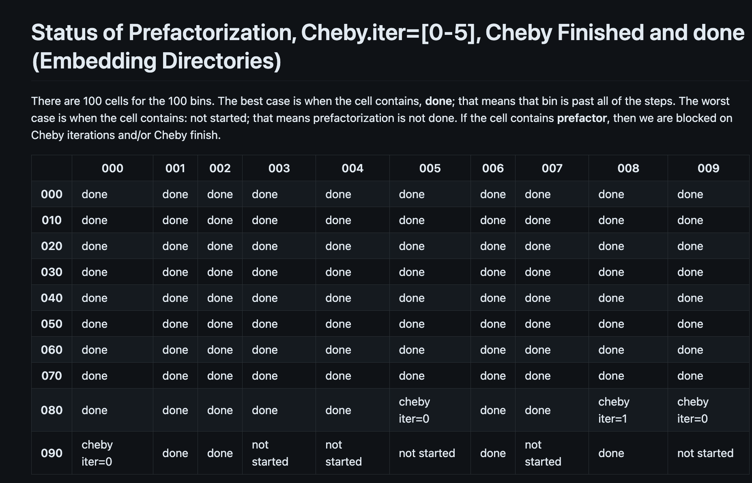
Production Runs https://github.com/kwchurch/JSALT_Better_Together/blob/main/status/combined.md

Slide 4
Papers to Write: https://github.com/kwchurch/JSALT_Better_Together/blob/main/stuff_to_do/papers.md
Overview paper, summarizing the best of the final presentation: Ken (and everyone)
Perplexity Experiments: Abteen
Random Walk Experiments: Peter
Local Citation Recommendation Methods: Peter
Related Work Hypothesis: Rodolfo
Predict Year: Melissa, Shabnam
ProNE Production Runs: Ben, John
GNNs: Sandeep, Hui
Benchmarks
Random Walks: Ken, Peter
Perplexity: Abteen
Local Citation Recommendation Methods: Peter
Related Work: Rodolfo, John
Resources
ProNE Embeddgings: Ken
Embeddgings for Bins: Ken, John, Ben
Embeddings for SciNCL, Specter1, Specter2
GNNs: Sandeep, Hui
Tools: Need to edit GitHub
Website Features
Experiments to Run

Slide 5
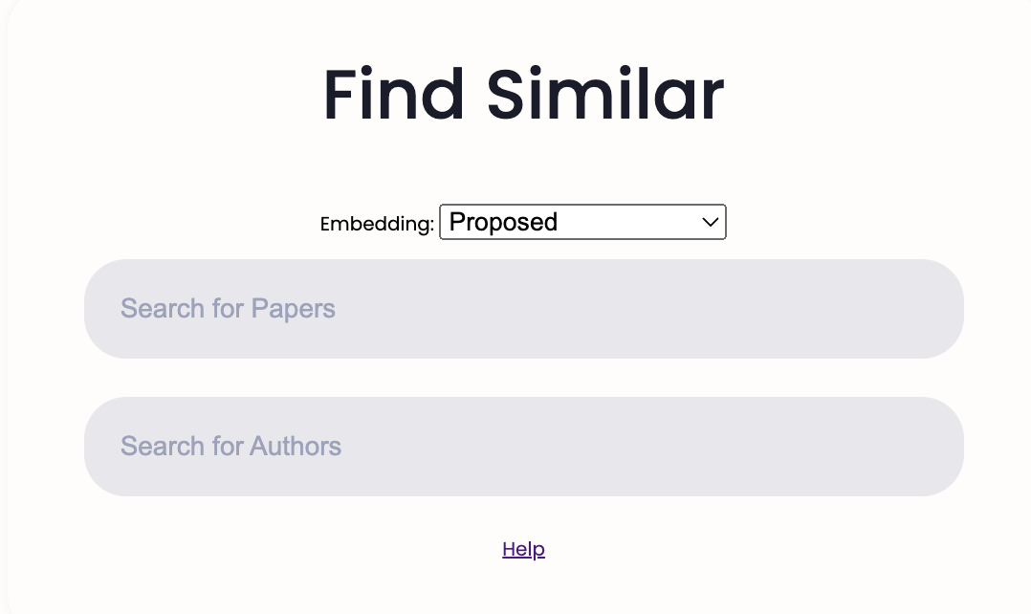
Web Site: http://34.204.188.58/similar.html
Desiderata
Form makes it easy to specify
similar?CorpusId=3051291
similar?search=deepwalk
similar?query=deepwalk
similar?author=Povey&limit=10
embedding=specter
embedding=specter2 embedding=scincl
embedding=proposed

Slide 6
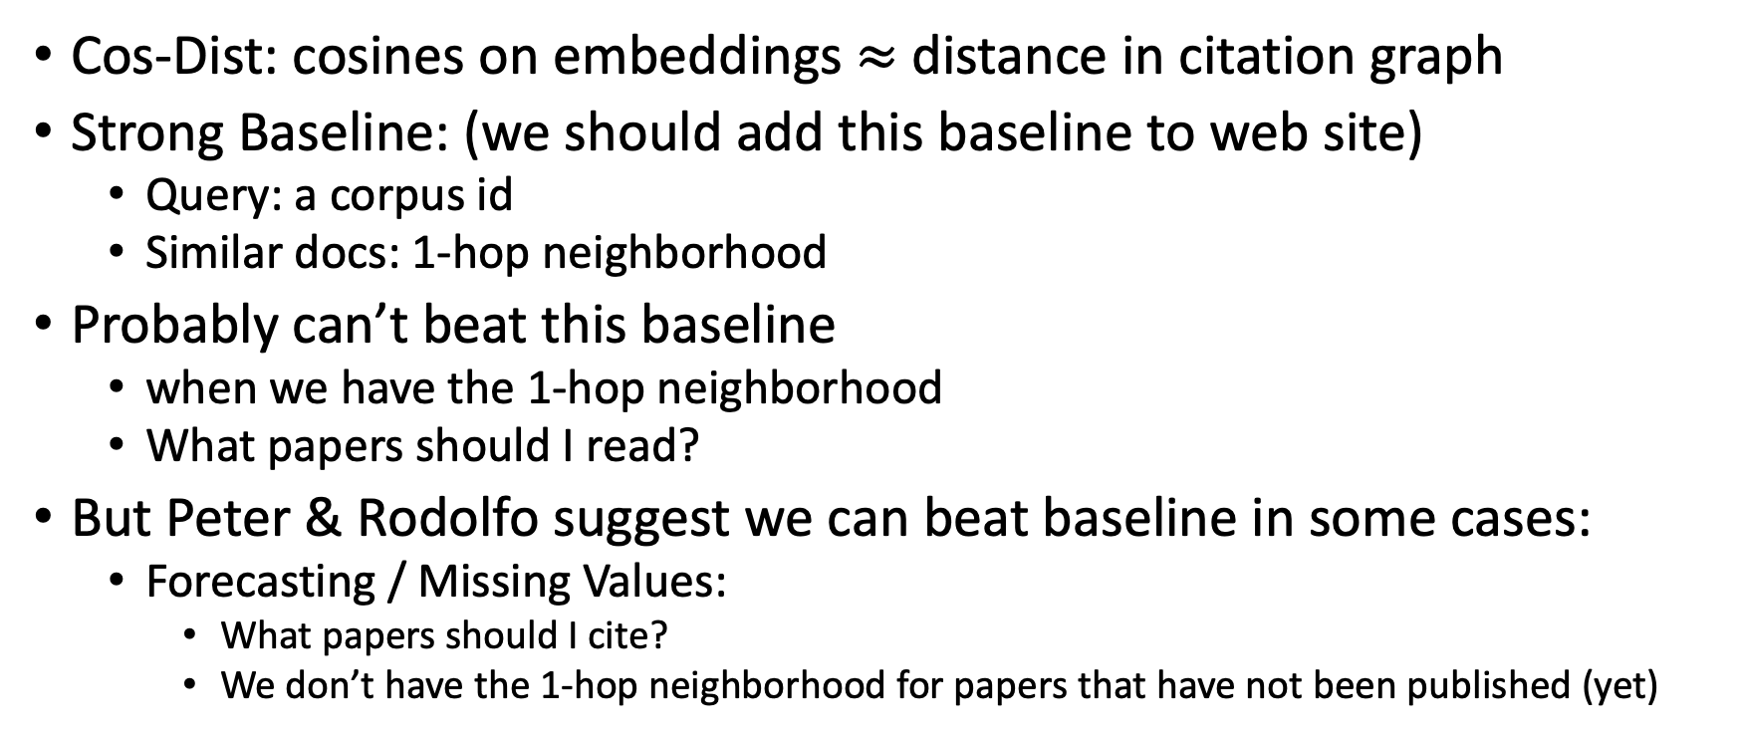
Hypotheses
Cos-Dist: cosines on embeddings $≈$distance in citation graph
Strong Baseline: (we should add this baseline to web site)
Query: a corpus id
Similar docs: 1-hop neighborhood
Probably can’t beat this baseline
when we have the 1-hop neighborhood
What papers should I read?
But Peter & Rodolfo suggest we can beat baseline in some cases:
Forecasting / Missing Values:
What papers should I cite?
We don’t have the 1-hop neighborhood for papers that have not been published (yet)

Slide 7
New Resource: 125M Specter2 Vectors
On Globus
$JSALTdir/semantic_scholar/embeddings/specter2_from_doug
They were unhappy with our website specter2 embeddings
Huggingface:
allenai/specter2 → allenai/specter2_base
allenai/specter2_proximity → allenai/specter2
Hypo: both models are highly correlated with one another; ANN is a bigger deal
Fear:
ANN may need more work
Not enough indexes / offset is too small
There appear to be more good matches than the ones we are reporting
Gold Standard
$JSALTsrc/brute_force_cosines_kwc.py

