Slide 1
Conclusions

Slide 2
Agenda
1.5 hours
1.5 hours
Intro (Ken) – 20 min
Centroids/Related Work
(Rodolfo) – 15 min
Bins
(Shabnam) – 15 min
Forecasting over time
Losses + Time & Space
Production Runs
(Ben) – 10 min
Time & Space
Break – 30 minutes
Experiments
Perplexity (Abteen) – 20 min
Random Walks (Peter) – 10 min
Local Citation Prediction (Peter) – 10 min
Time prediction (Melissa) – 15 min
GNNs (Sandeep, Hui) – 15 min
Deliverables/Conclusions
(Ken) – 5 minutes
Questions – 15 min

Slide 3
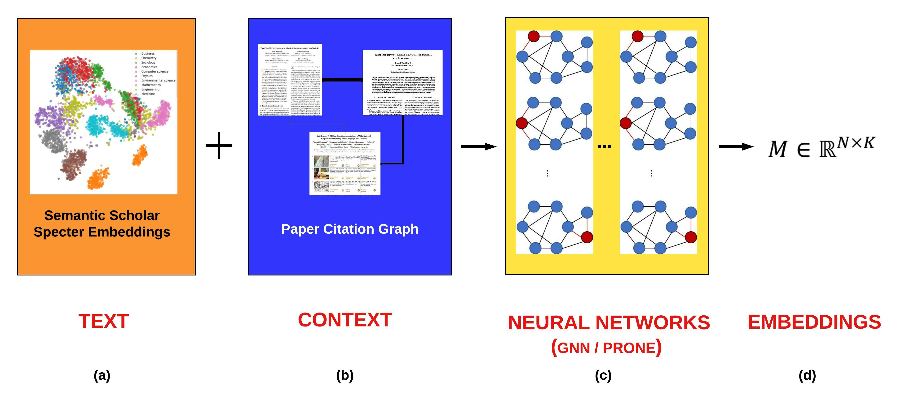
Better Together: Text (Titles, Abstracts, Body); Context (Citations)
Author Perspective
Audience Perspective
Specter, SciNCL
ProNE

Slide 4
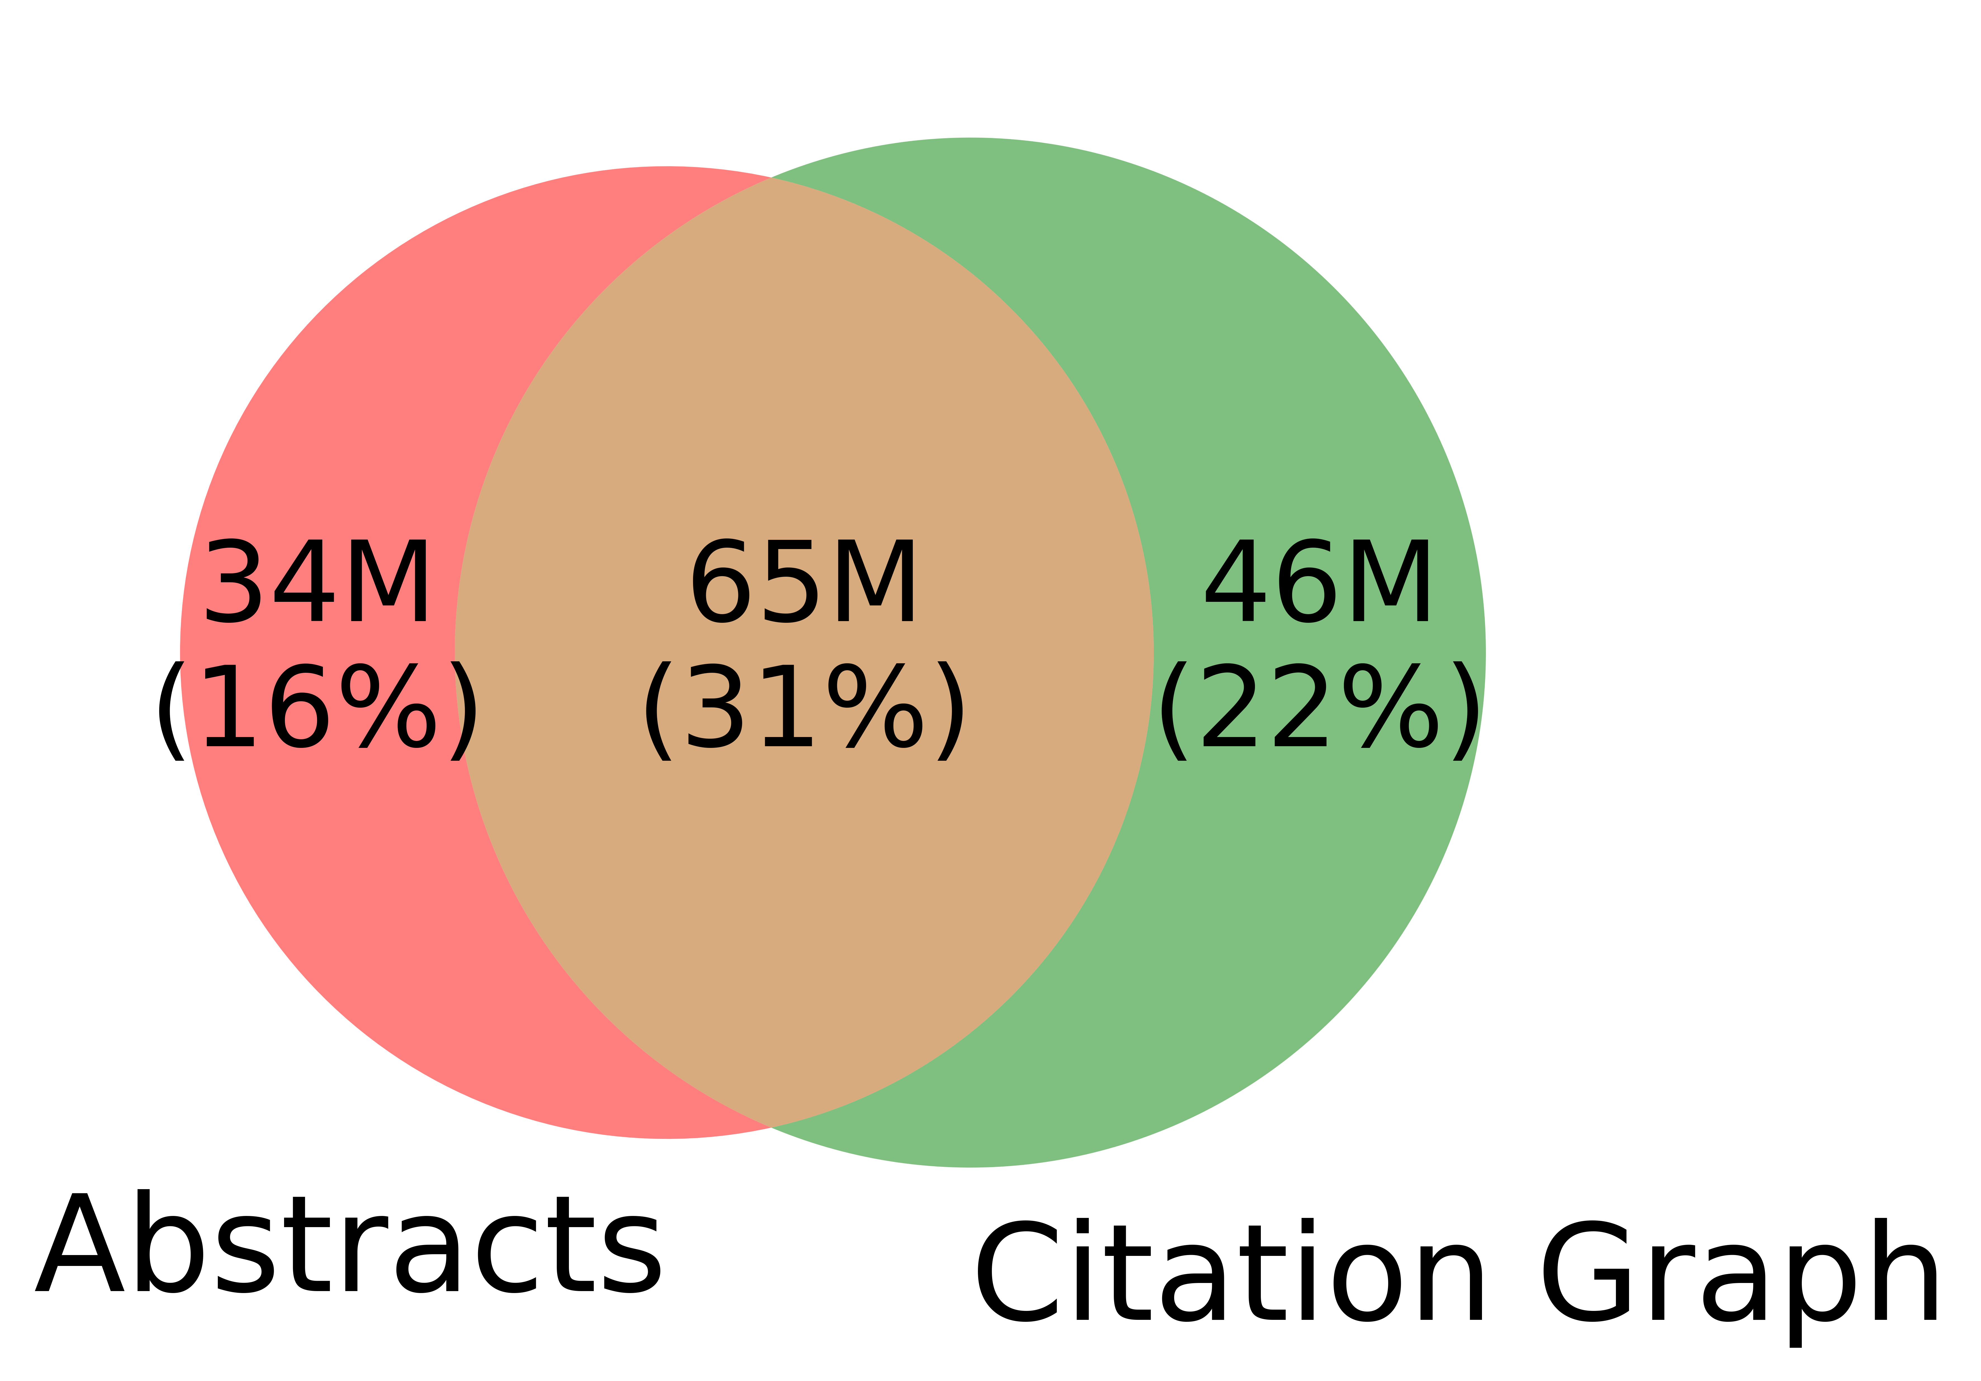
Better-Together Conjectures
Multiple representations are helpful
for missing values (and bad values)
If abstracts are missing, use links
If links are missing, use abstracts
and for graphs of different sizes
When graphs are small:
Text >> Links
when graphs are large:
Links >> Text (Metcalfe’s Law)

Slide 5
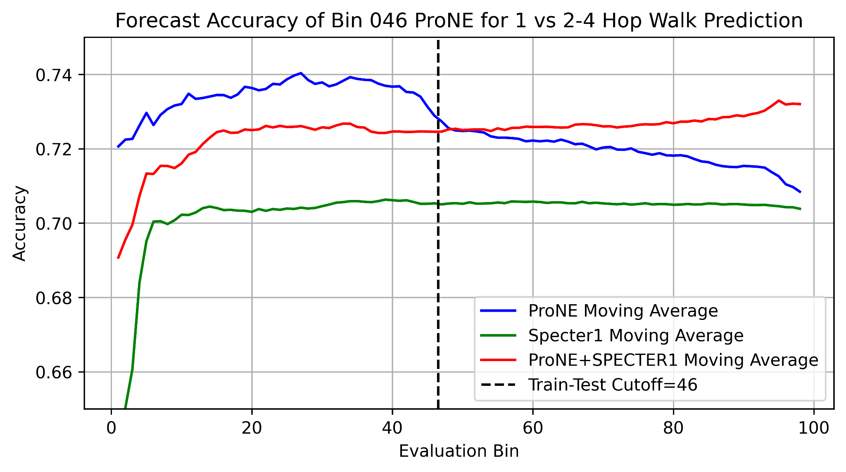
Better Together Observations
ProNE (Context) >> Specter (Text)
Note: ProNE is trained on bins
Unlike Specter (trained on 100%)
Ensembles are better
than either by itself
Text is most helpful
when links are not working well
i.e., long-term forecasting

Slide 6
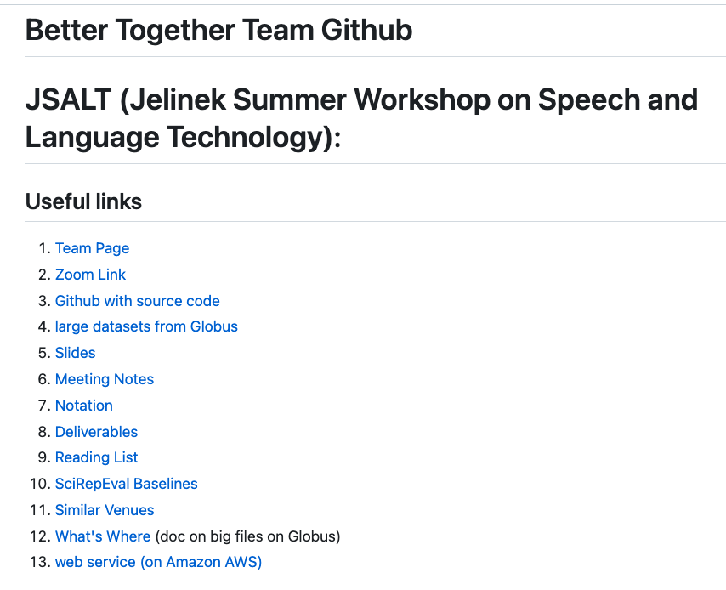

https://github.com/kwchurch/JSALT_Better_Together
including these slides
Web Page

Slide 7
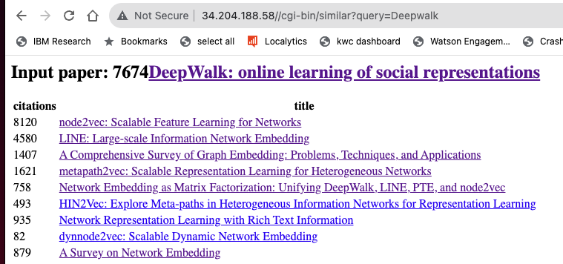

Web Page

Slide 8
Deliverables
GitHub:
massive (but needs editing)
slides, code, reading list
pointers to large files on Globus
Web Server
Recommendations
Input: queries for documents
Output: recommendations (docs)
What Should I read? Cite?
Resources
Data behind web server:
citation graph
embeddings
indexes for approx. nearest neighbors
pairs of corpusIds with large cosines
all of the above for
Specter1, Specter2, SciNCL, ProNE
x100 bins for ProNE
Evaluations & Benchmarks
Intrinsic: Perplexity, Random Walks
Extrinsic: Local Citation Prediction

