Slide 1
Lunch presentation
Ben Irving

Slide 2
Overview
What I’m working on
Optimization stuff
Starting on related work stuff
Notes:
Ben

Slide 3
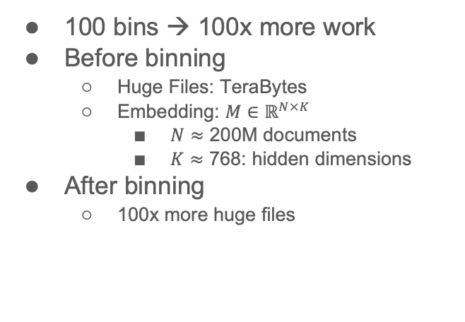
Scale (after binning): Both a Blessing and a Curse
Curse (Ben’s Problem)
Blessing (Abteen & Peter’s Lucky Day)
100 bins → 100x more work
Before binning
Huge Files: TeraBytes
Embedding: $M∈ℝ^{N×K}$
$N$ $≈$ 200M documents
$K≈\text{768}$: hidden dimensions
After binning
100x more huge files
Abteen:
Perplexity varies by bin
in systematic ways
Peter:
Use bins to show
Short-term forecasting is easier
than long-term forecasting
Better together:
Text is more useful
when links are least useful
(small graphs)

Slide 4
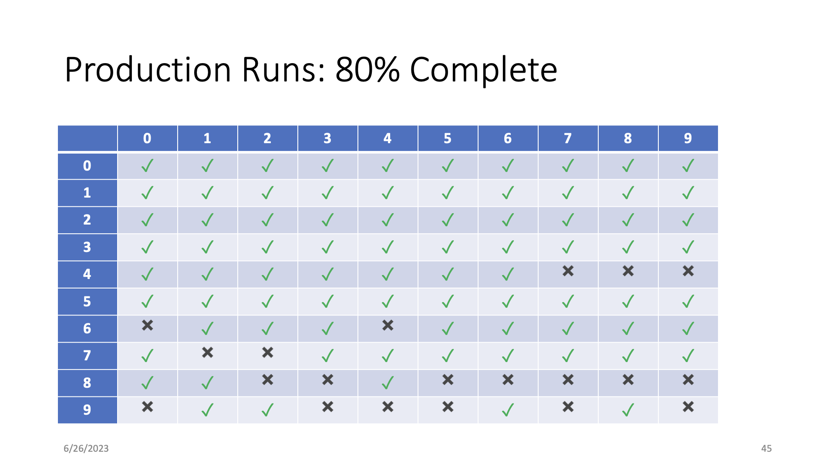

Slide 5
Model and limitations
Limited space (<= 2 TB per job)
Limited time (<= 1 day per job)
Without dividing code: 2 TB of memory, 3.8 days
Prefactor
Prone.py
Chebyshev
Finish step
Notes:
Ben

Slide 6
Optimizations
Cython
float32 → float16
Notes:
Ben

Slide 7
Cython
Superset of Python (use more C in Python)
Still runs in Python runtime, but not compiled to Python bytecode. Instead compiled to native machine code (whatever your microprocessor interprets)
Original code
PVM
Machine code
Notes:
Ben
For instance, . Cython compiler doesn’t call python torch library when releasing the global clock is released.

Slide 8
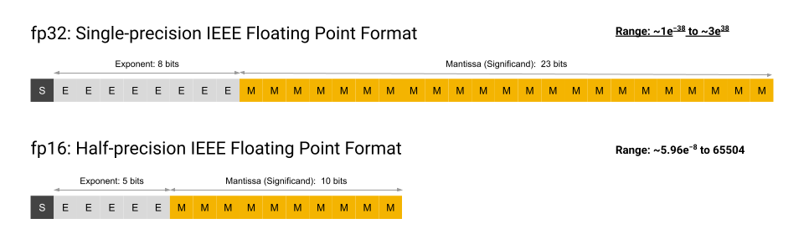
Float32 → Float16
4 decimal places (for float16) vs 8 (for float32)
Problem: (A lot of cpus don’t support it, particularly x86 architectures)
Courtesy of Google
Notes:
Ben

Slide 9
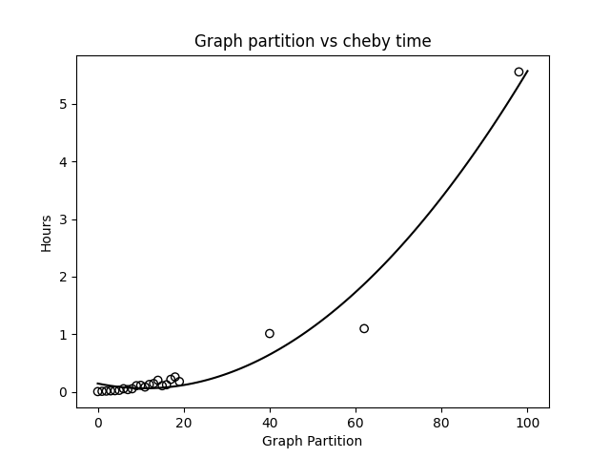
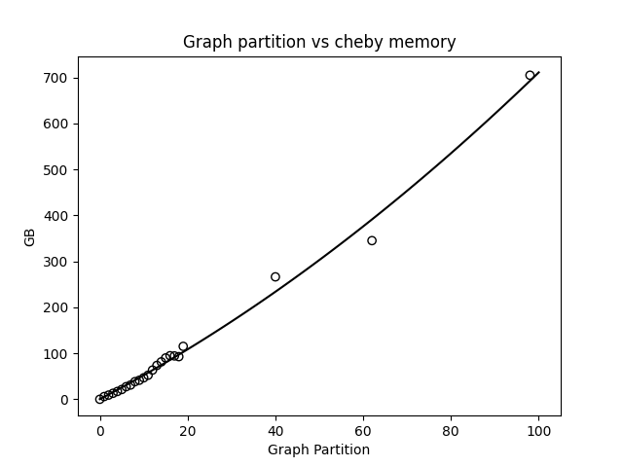
Pre-optimization (cheby step)

Slide 10
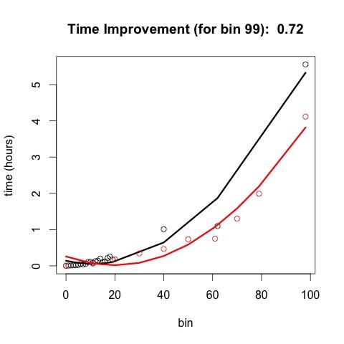
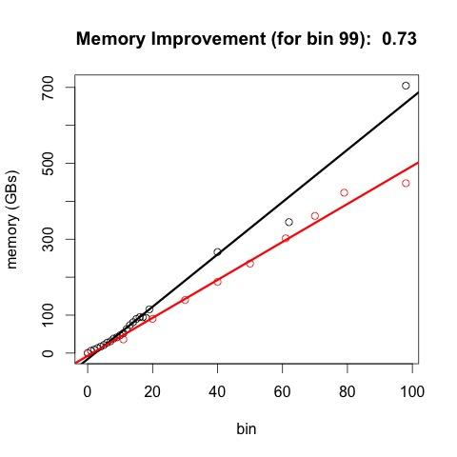
Post optimization (red stuff)
Notes:
Ben
(generally speaking, memory utilized is some simple multiplication of the input mem ← plot this out)

Slide 11
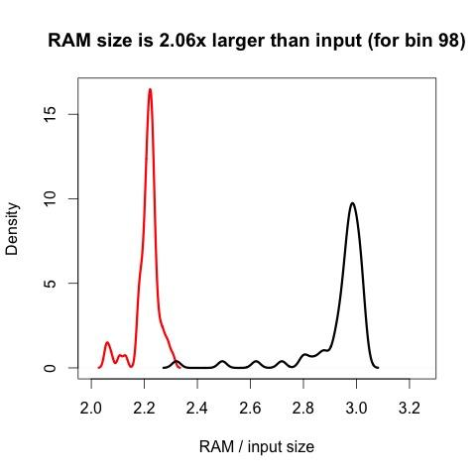
RAM comparison (density)

Slide 12
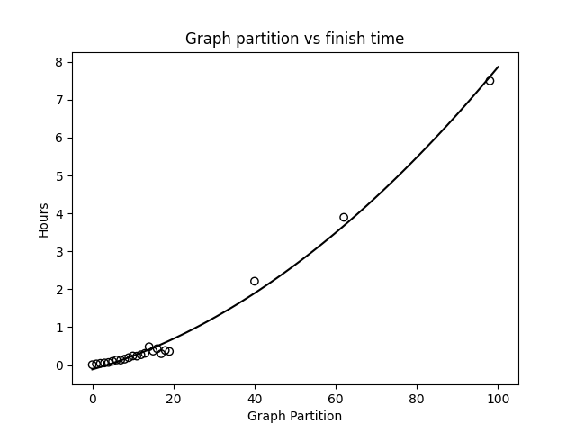
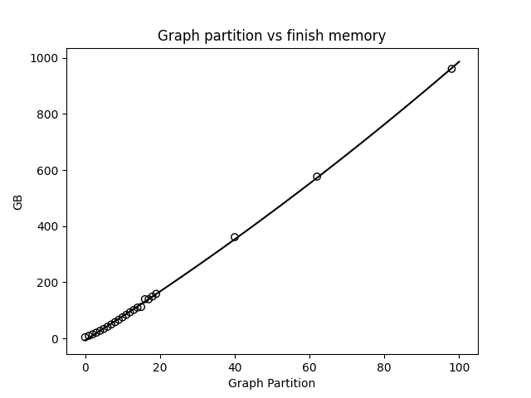
Pre-optimization (finish step)

Slide 13
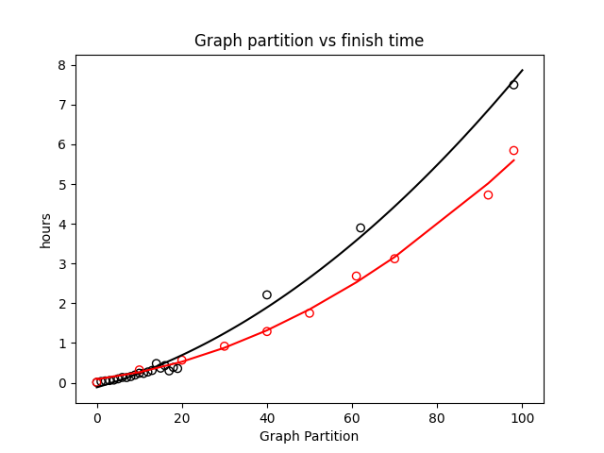
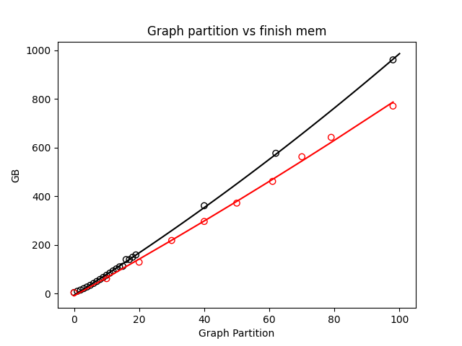
Finish with optimizations (red line)
Notes:
Ben

Slide 14
Related Work Experiments
get_paper_embedding(sample_paper)
model
Paper
Introduction Ref1, Ref2, Ref3
Related Work Ref4, Ref5, Ref6
Conclusion Ref7, Ref8, Ref9
Intro References Vector = 3 References
Compare and Predict
Rel Work References Vector = 3 References
Conclusion References Vector = 3 References

Slide 15
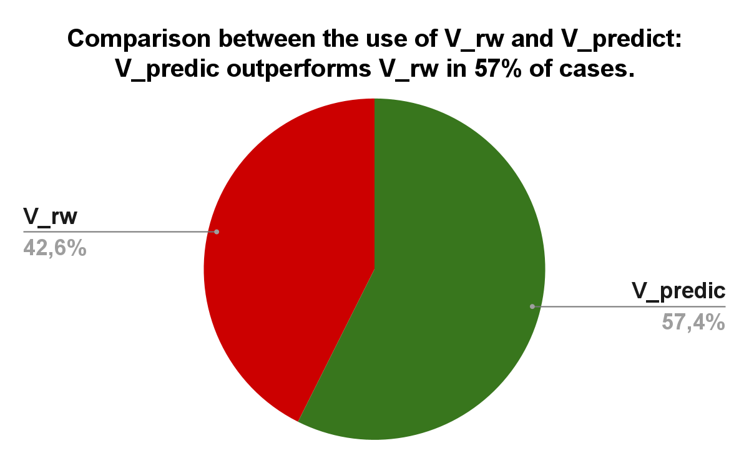
Related Work Experiments (Before)

Slide 16
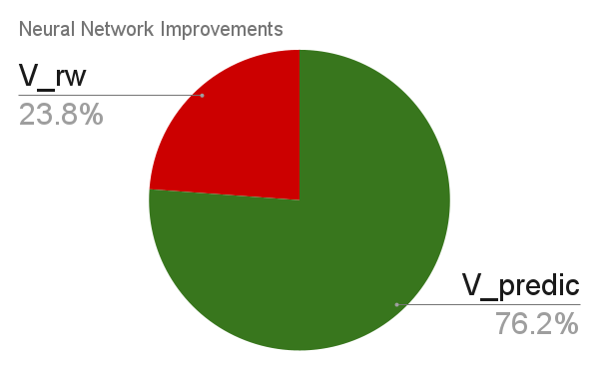
Deeper Networks (with layernorm, and GELU activation)
With improvements, V_predic now outperforms V_rw in 76.2% of cases.

Slide 17
thanks

