Slide 1
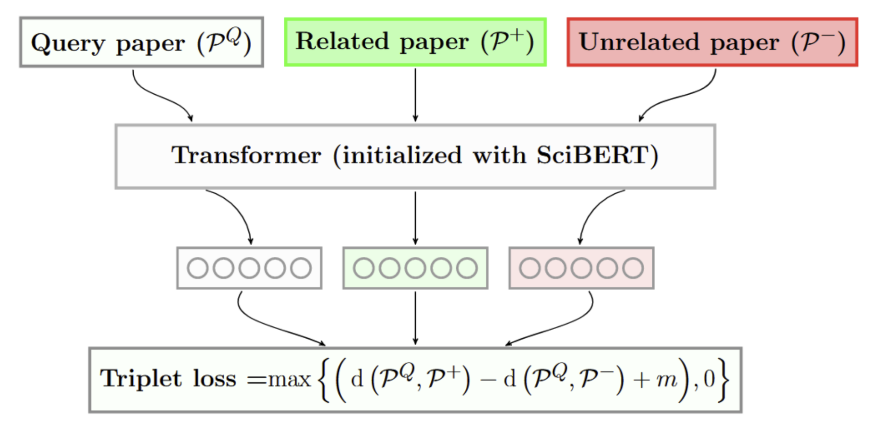
Evaluating text-based models
Text based document representation models rely on an underlying language model (Cohan et al., 2020)
SciBERT is a BERT-like model trained on text from scientific documents (Beltagy et al., 2019)

Slide 2
Perplexity as evaluation
Hypothesis: Perplexity is important. Document representation quality is related to the quality of the underlying language model
Language model perplexity is a measure of how “expected” a piece of text is to the model
So, we can use this measure as a signal of how well we would expect a model to represent a given document

Slide 3
How can we use this?
Evaluate how well the model can represent papers from different times in the past
Evaluate how quickly the model will “rot” past its training date
Find weak areas that the model can improve on

Slide 4
Perplexity for bidirectional models
BERT-style models do not have a well defined perplexity
Instead, use model scoring (Salazar et al., 2021) to calculate a pseudo-perplexity (per-subword)

Slide 5
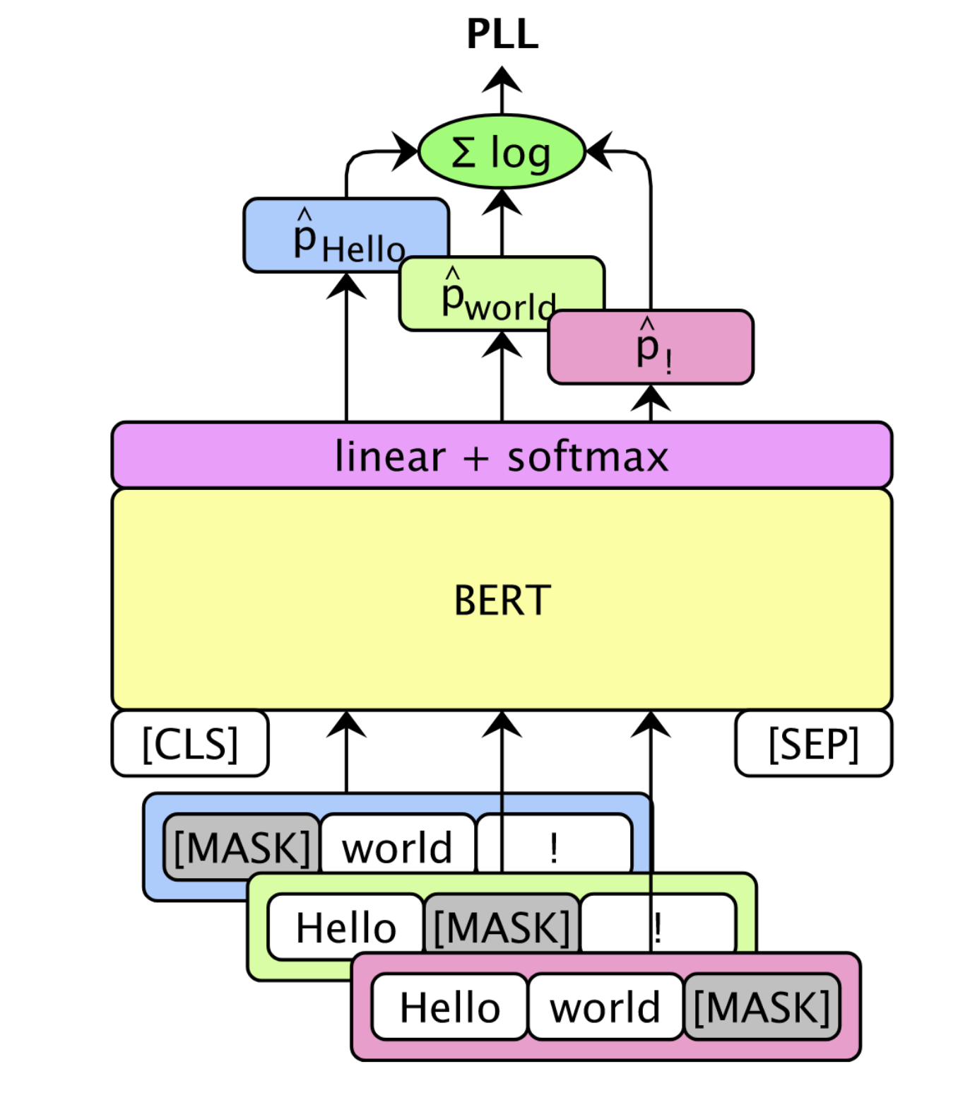
Pseudo Perplexity (PPPL)
BERT-style models do not have a well defined perplexity
Instead, use model scoring (Salazar et al., 2021)

Slide 6
Pseudo Perplexity (PPPL)
“peters pickled peppers”
[CLS]
pet
##ers
pick
##led
pepper
[SEP]
101
11109
1468
3368
2433
18700
102
log(p(pet))
∑ = PLL(w)
|V|
log(p(##ers))
log(...)
log(...)
log(...)
Pseudo log-likelihood
101
[MASK]
1468
3368
2433
18700
102
101
11109
[MASK]
3368
2433
18700
102
101
11109
1468
[MASK]
2433
18700
102
101
11109
1468
3368
[MASK]
18700
102
101
11109
1468
3368
2433
[MASK]
102
Notes:
BERT-style models do not have a well defined perplexity
Instead, use model scoring (Salazar et al., 2021)

Slide 7
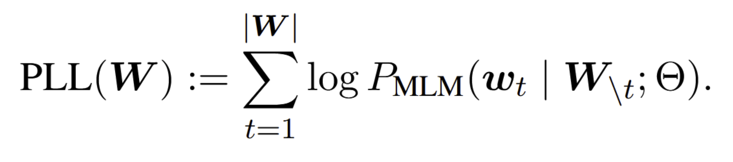
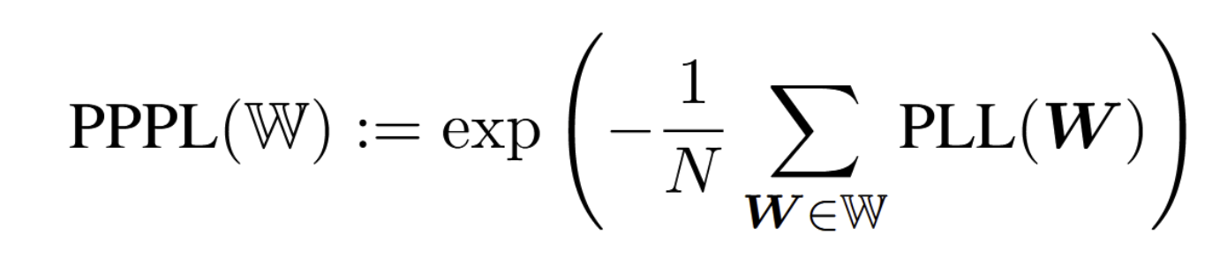
Initial Experiments
Sample 10,000 abstracts from each bin (no filtering)
Score the abstracts using the previous method
Abstract
# Tokens in Bin
Bin

Slide 8
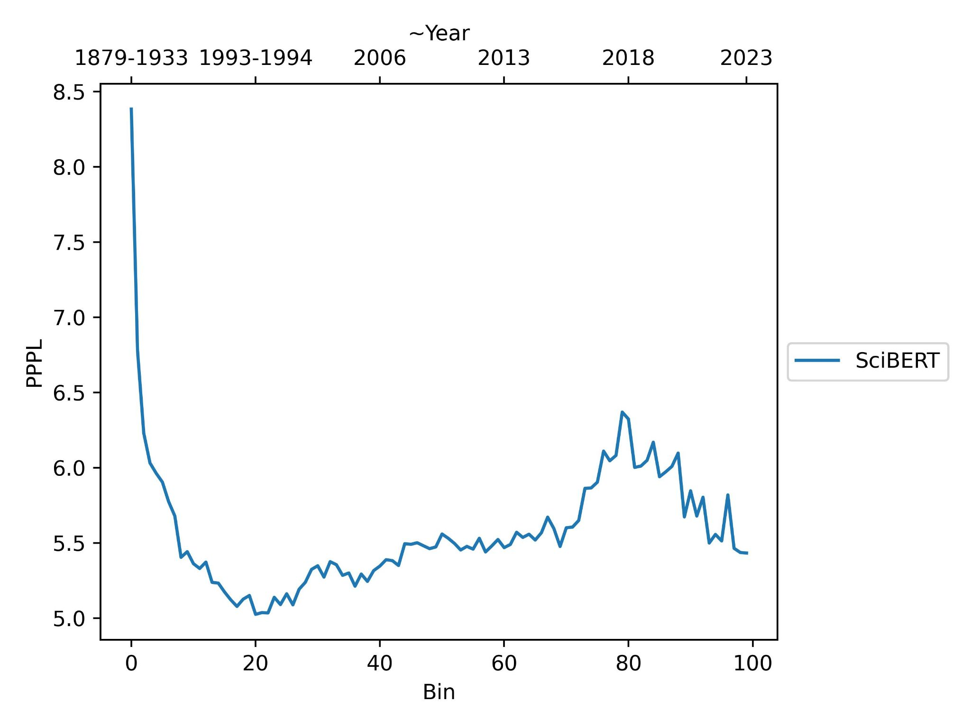
Past Analysis of SciBERT

Slide 9
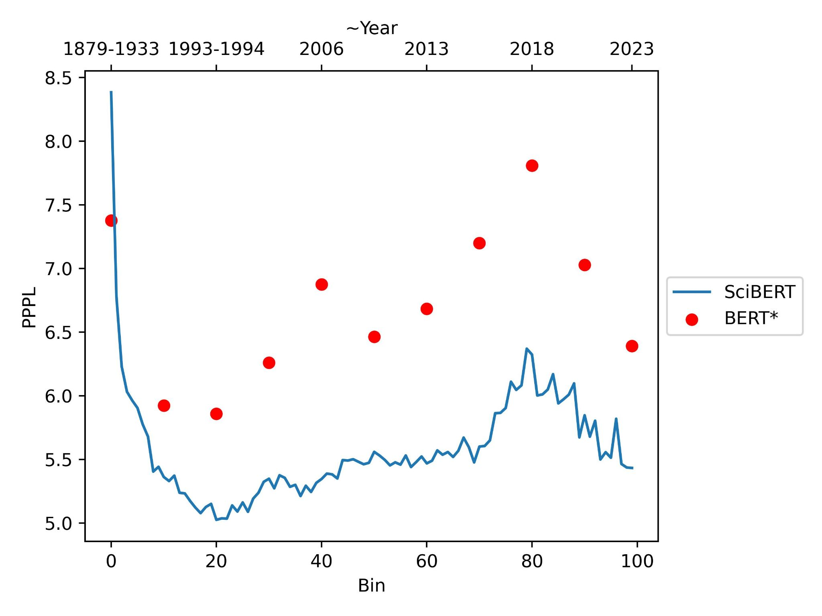
Past Analysis of SciBERT and BERT
500 samples

Slide 10
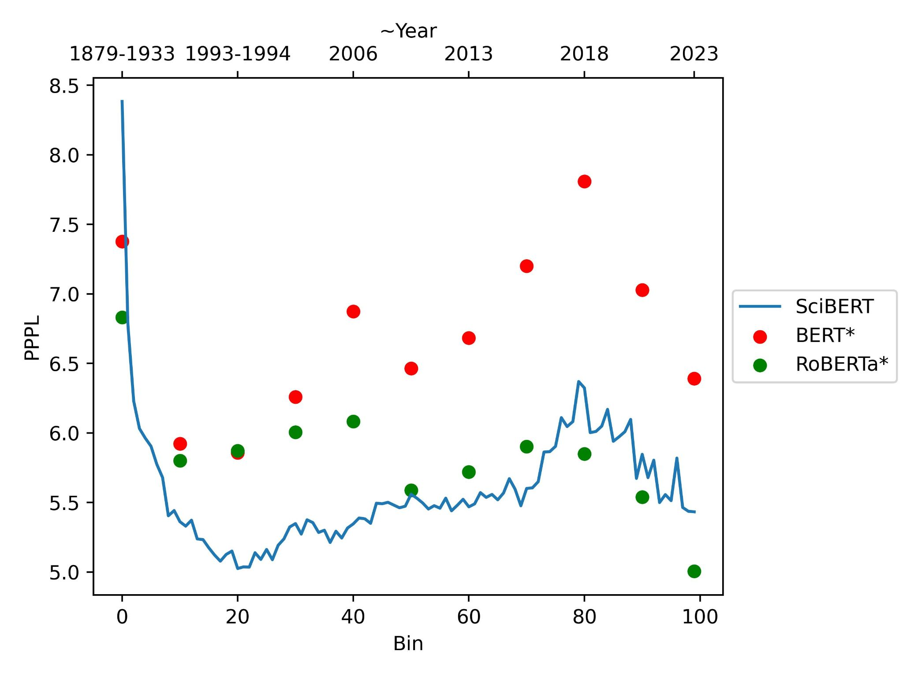
Past Analysis of SciBERT, BERT, and RoBERTa

Slide 11
Observations: Time Structure
Language model perplexity changes across time
These changes are predictable at least in the short term
BERT and SciBERT are more correlated compared to RoBERTa

Slide 12
Preliminary Results
Artifacts from the data or original model training:
Representative sample: earlier data is noisier
Some bins have a larger proportion of shorter abstracts
Sampling method when the model was trained?
Type of documents available for given years?
Artifacts of the field
Popularly used datasets for pretraining

Slide 13
Possible Implications
Our (scientific) language is getting more and more complex as time goes on, meaning language models not only need to be maintained, but maintenance will get harder and harder
One issue: any system which relies on a language model should probably check to see how well-suited it is to both the domain and time of the data being evaluated

Slide 14
Limitations
Re-sample focusing on clean data to evaluate the true language
SciBERT is not SPECTER
Need to take into account other factors which may inflate

Slide 15
Next Steps
Correlations with other measures: type/token ratios, fragmentation ratio, frequency of splitting, compression rates, number of unknown tokens, etc.
Re-sample with more consistent text
Statistical testing across bins
Stratifying by domain, language, etc.
Repeating across different domains and models

Slide 16
Summary
Observed a time structure in the LM perplexity of the data
Holds for multiple models which were trained on different datasets
Notes:
Maybe the performance between bin 80-100 is better because bin 20-40 is getting worse
Roberta has ~15% more parameters than BERT and ~13% more than SciBERT (due to vocabulary) {'scibert': 109971084, 'bert': 108340804, 'roberta': 124697433}

