Slide 1
Proposal: Bins
Research Questions:
How do losses scale
with size of citation graph?
How do losses scale with time?
Weather forecasting:
Short-term is easier than long-term

Slide 2
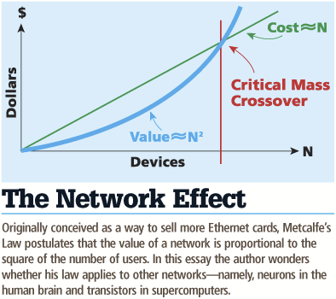
Network Effects: What is the Power of Scale?
Lack of focus on the network nature of papers
SciBERT = Text only
Specter, SciNCL = simple triplet loss
Doesn’t capture the potential power of the full network
Metcalfe's Law: cost scales in N, benefit scales in N^2
How great are the network effects for the citation graph?
Notes:
Graph (our problem) is network. Full effect only if everything is encoded at once, splitting a network is not effective because benefit scales
Literature only focuses on text similarity and few studies consider, going towards positive examples, pushing away from negatives (triplet loss). Consider small portion of citation graph and does not consider power of scaled graph. How can we use whole network in intrinsic evaluation?
Literature does not consider relationships between papers, only pairwise
Not the whole network, small dataset, within dataset, not whole 200m, time not considered

Slide 3
Network Effects: Data and Embeddings
Binning by time:
Split graph into 100 subgraphs by time
Cumulative graphs: each graph includes itself and all previous graphs
Embeddings:
Compute ProNE embeddings on cumulative graphs
Bin 99
………
Bin 0
Time
Notes:
mention equal # papers
consider replacing w/ diagram

Slide 4
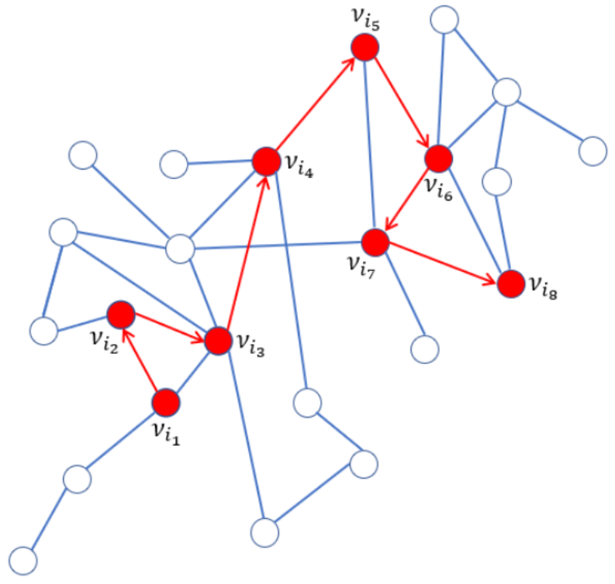
Network Effects: Random Walk
Pick random paper to start, extract all the references, walk to one of those references at random, and so on
There are often multiple paths to a paper – recorded number is the shortest path from starting paper
Limit to 1 to 4 hops away from query paper
Increasing # hops leads to decreasing similarity
Notes:
Evaluation task is predicting references in work, intrinsic eval can be random walk of citations
Use cosine similarity to measure similarity between pairs of papers

