Slide 1
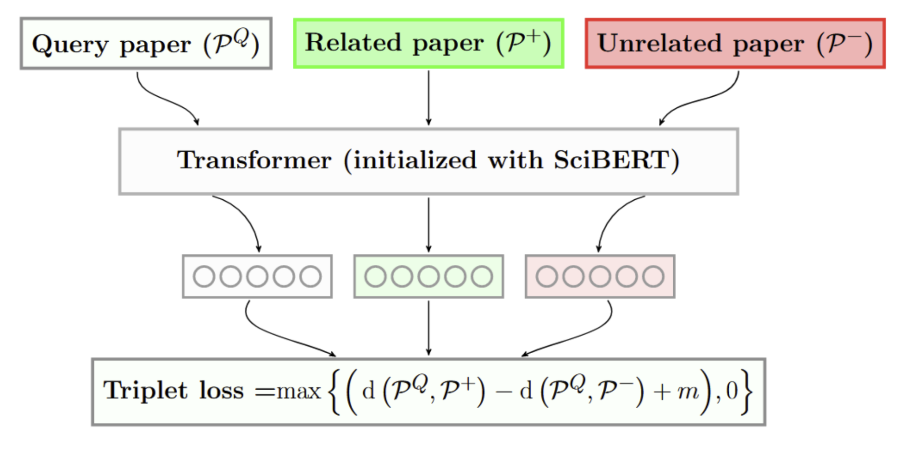
Evaluating text-based models
Text based document representation models rely on an underlying language model (Cohan et al., 2020)
SciBERT is a BERT-like model trained on text from scientific documents (Beltagy et al., 2019)

Slide 2
Perplexity as evaluation
Hypothesis: Perplexity is important. Document representation quality is related to the quality of the underlying language model
Language model perplexity is a measure of how “expected” a piece of text is to the model
So, we can use this measure as a signal of how well we would expect a model to represent a given document

Slide 3
How can we use this?
Evaluate how well the model can represent papers from different times in the past
Evaluate how quickly the model will “rot” past its training date
Find weak areas that the model can improve on

Slide 4
Perplexity for bidirectional models
BERT-style models do not have a well defined perplexity
Instead, use model scoring (Salazar et al., 2021) to calculate a pseudo-perplexity (per-subword)

Slide 5
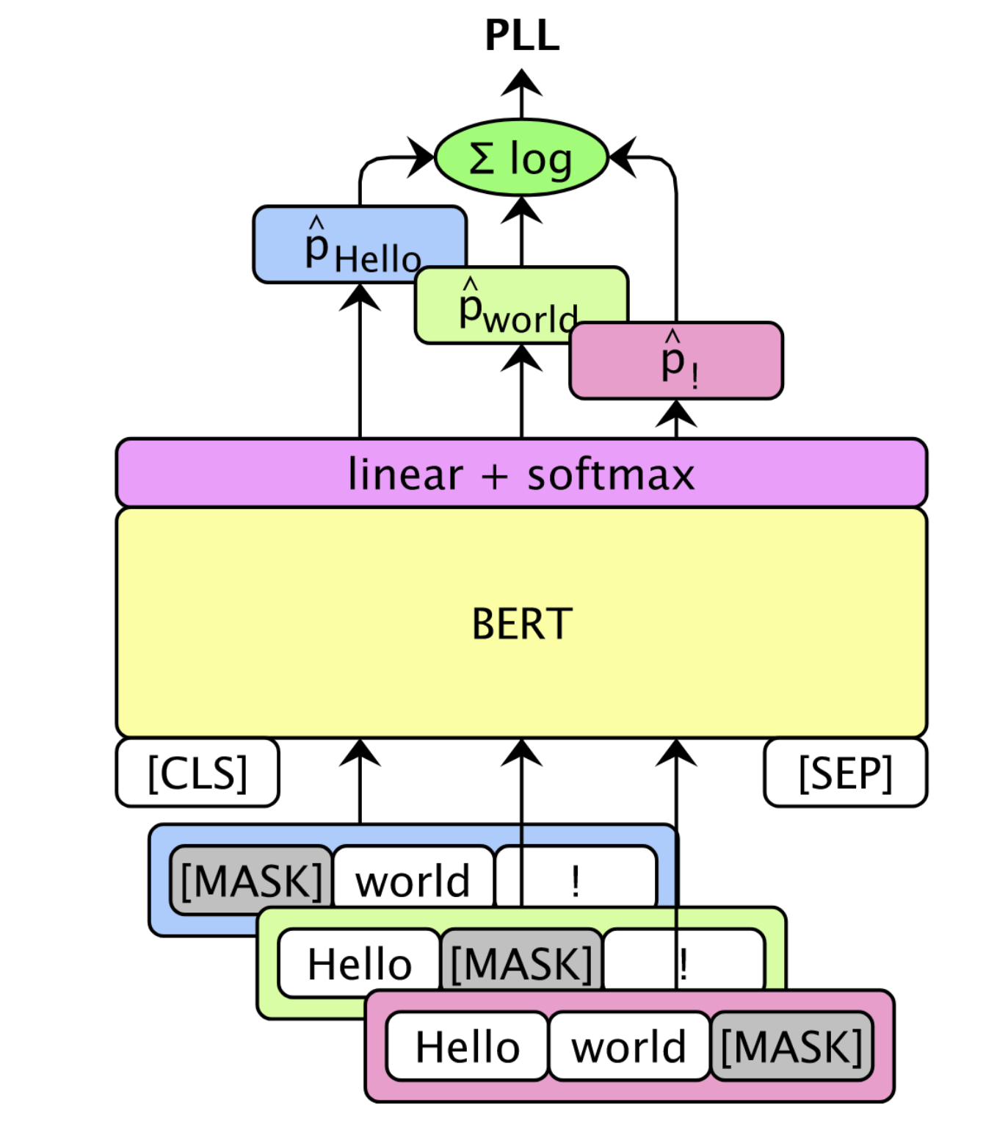
Pseudo Perplexity (PPPL)
BERT-style models do not have a well defined perplexity
Instead, use model scoring (Salazar et al., 2021)

Slide 6
Pseudo Perplexity (PPPL)
“patricks pickled peppers”
[CLS]
pat
##ricks
pick
##led
pepper
[SEP]
101
26227
23587
3368
2433
18700
102
log(p(pat))
∑ = PLL(w)
|V|
log(p(##ricks))
log(...)
log(...)
log(...)
Pseudo log-likelihood
101
[MASK]
23587
3368
2433
18700
102
101
26227
[MASK]
3368
2433
18700
102
101
26227
23587
[MASK]
2433
18700
102
101
26227
23587
3368
[MASK]
18700
102
101
26227
23587
3368
2433
[MASK]
102
Notes:
BERT-style models do not have a well defined perplexity
Instead, use model scoring (Salazar et al., 2021)

Slide 7
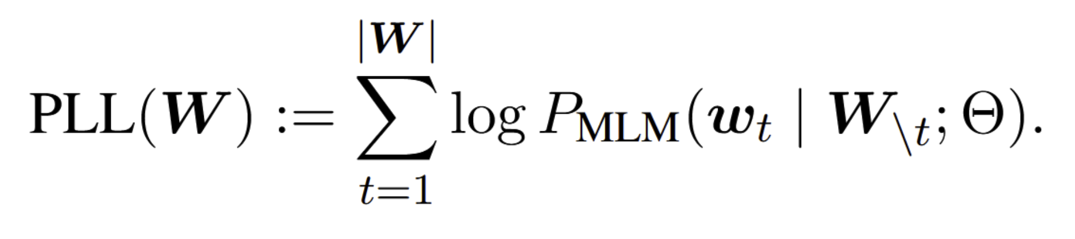
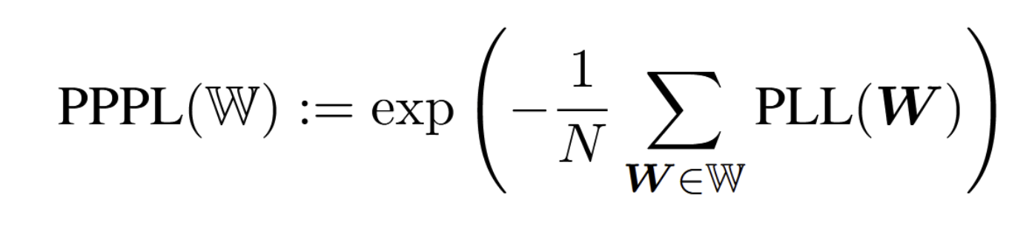
Initial Experiments
Sample 10,000 abstracts from each bin (no filtering)
Score the abstracts using the previous method
Abstract
# Tokens in Bin
Bin

Slide 8
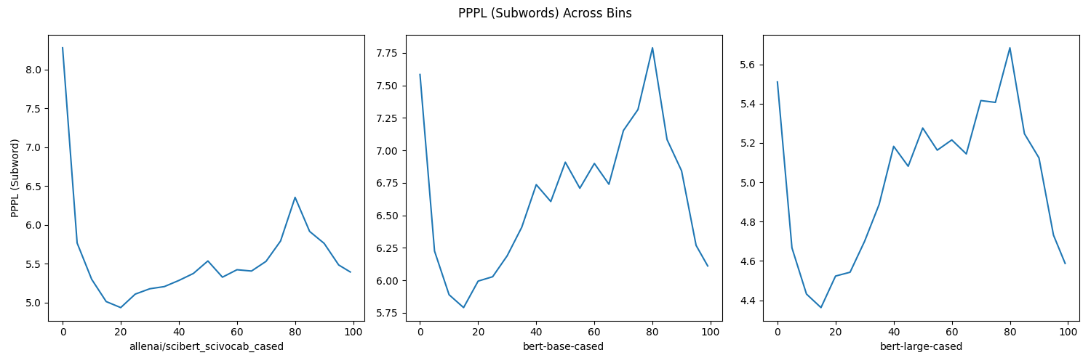
Past Analysis of BERT-like Models

Slide 9
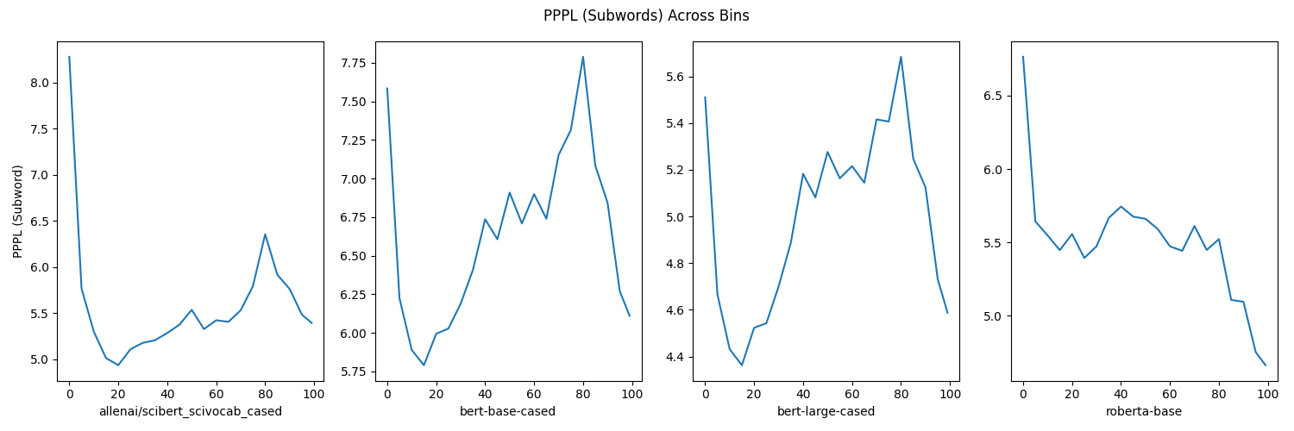
Other Architectures

Slide 10
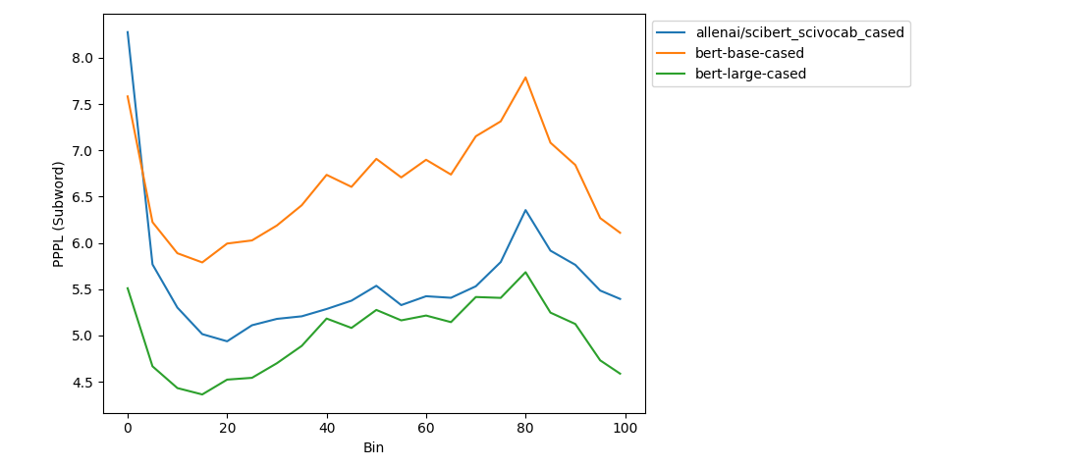
Past Analysis of BERT-like Models

Slide 11
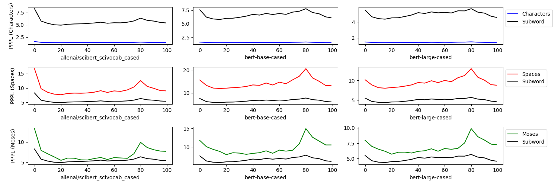
Different Normalization Methods

Slide 12
Stratifying by Source

Slide 13
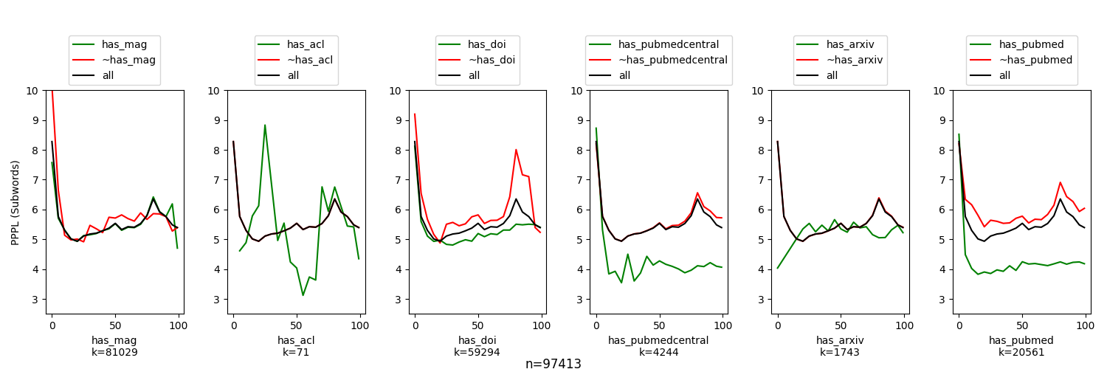
Stratifying By Source Domain

Slide 14
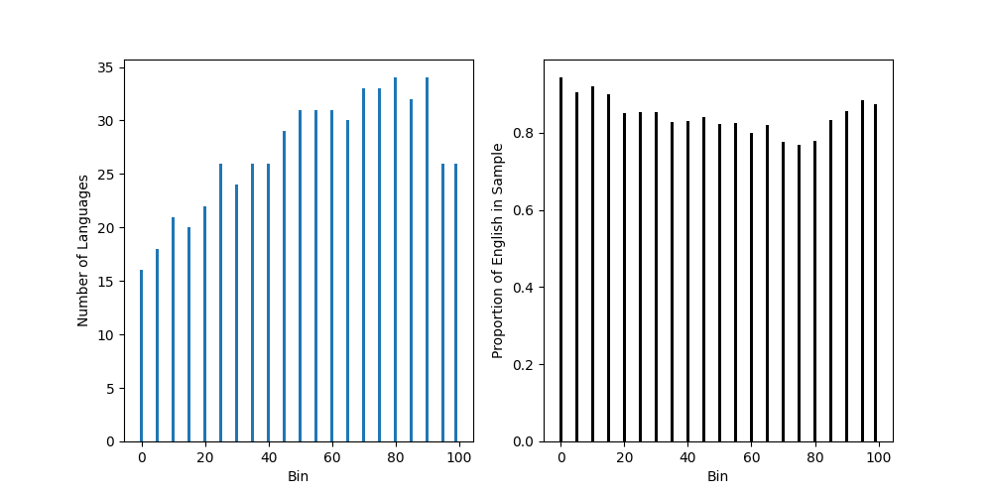
Stratifying by Language

Slide 15
Language Proportions Over Time

Slide 16
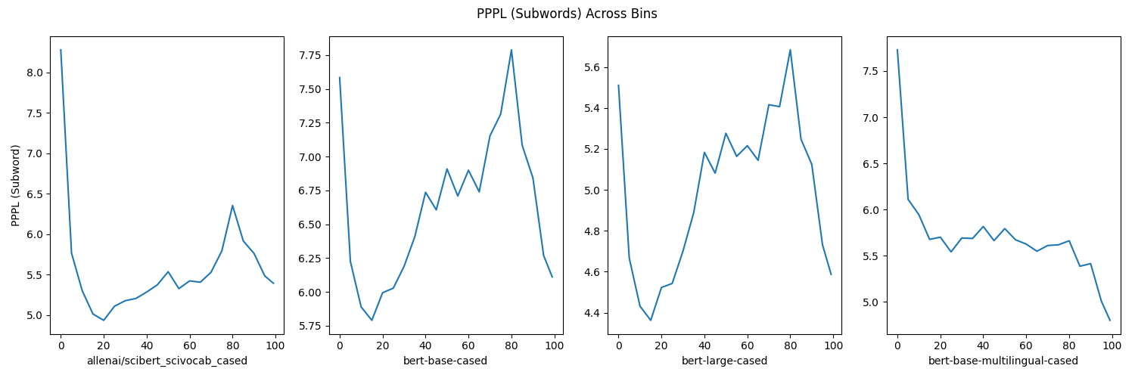
Multilingual Models

Slide 17
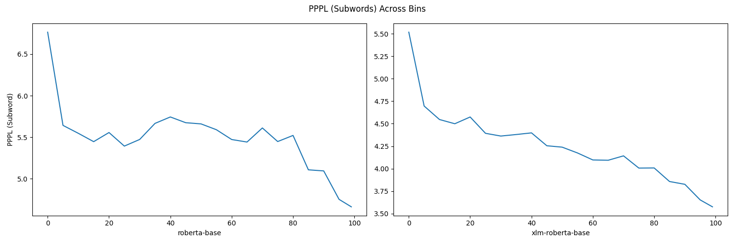
RoBERTa

Slide 18
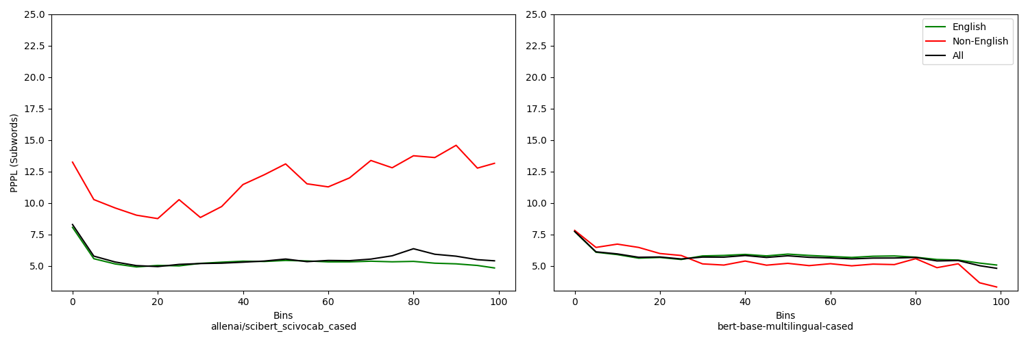
Effect of Non-English Abstracts

Slide 19
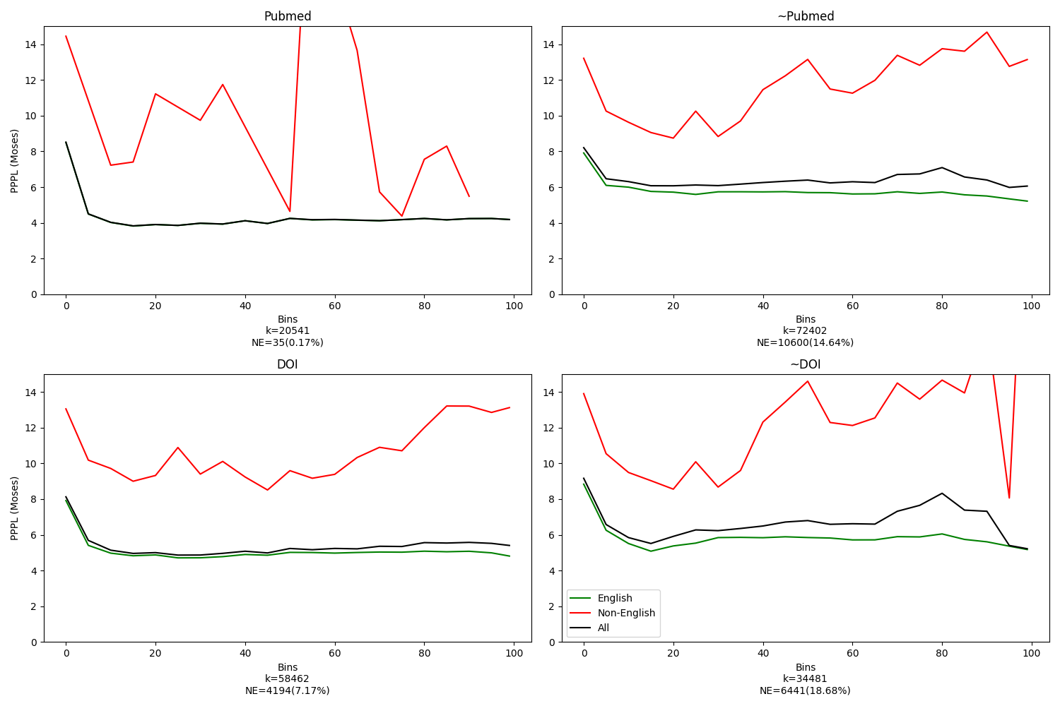
Stratifying by language and domain

Slide 20
Takeaways: Multilinguality

Slide 21
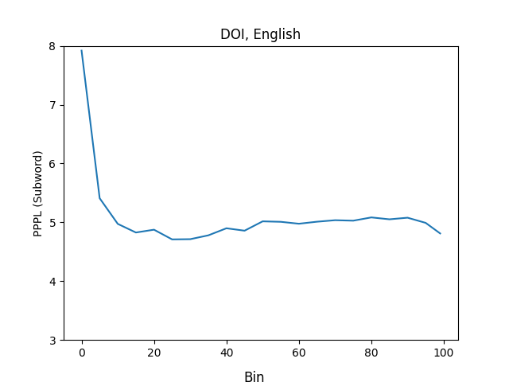
“Clean” Data

Slide 22
Takeaways: Language over Time
From perplexities? Inconclusive
Check other metrics!

Slide 23
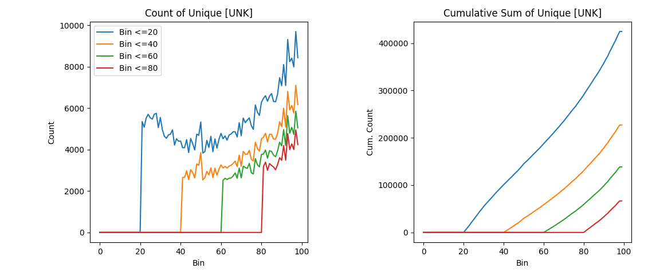
Emergence of New/UNK Tokens

Slide 24
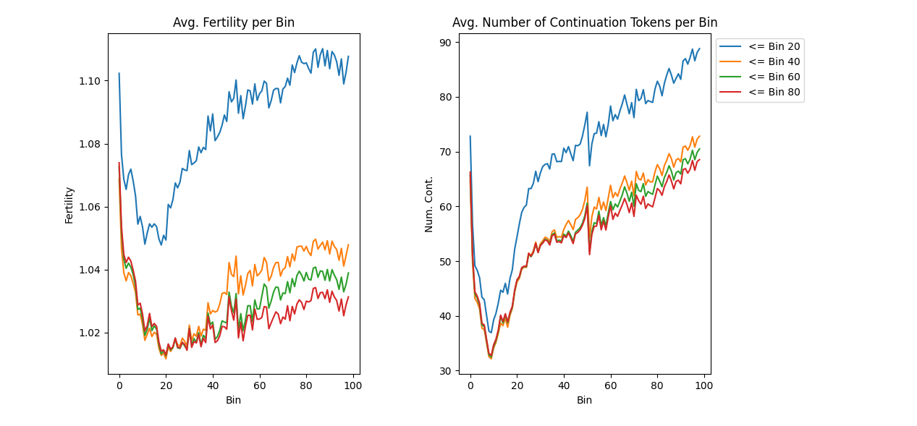
Subword Tokenizer Features

