Slide 1
Lunch presentation
Ben Irving

Slide 2
Overview
What I’m working on
Optimization stuff
Starting on related work stuff
Notes:
Ben

Slide 3
Model and limitations
Limited space (<= 2 TB per job)
Limited time (<= 1 day per job)
Without dividing code: 2 TB of memory, 3.8 days
Prefactor
Prone.py
Chebyshev
Finish step
Notes:
Ben

Slide 4
Optimizations
Cython
float32 → float16
Notes:
Ben

Slide 5
Cython
Superset of Python (use more C in Python)
Still runs in Python runtime, but not compiled to Python bytecode. Instead compiled to native machine code (whatever your microprocessor interprets)
Original code
PVM
Machine code
Notes:
Ben
For instance, . Cython compiler doesn’t call python torch library when releasing the global clock is released.

Slide 6
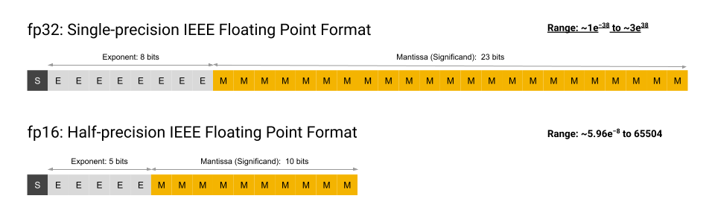
Float32 → Float16
4 decimal places (for float16) vs 8 (for float32)
Problem: (A lot of cpus don’t support it, particularly x86 architectures)
Courtesy of Google
Notes:
Ben

Slide 7
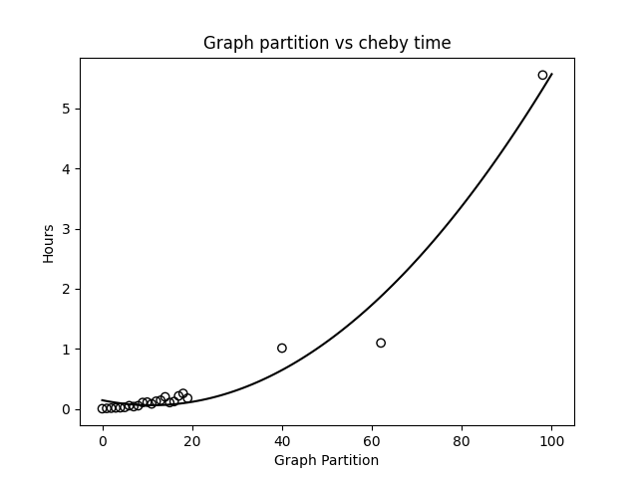
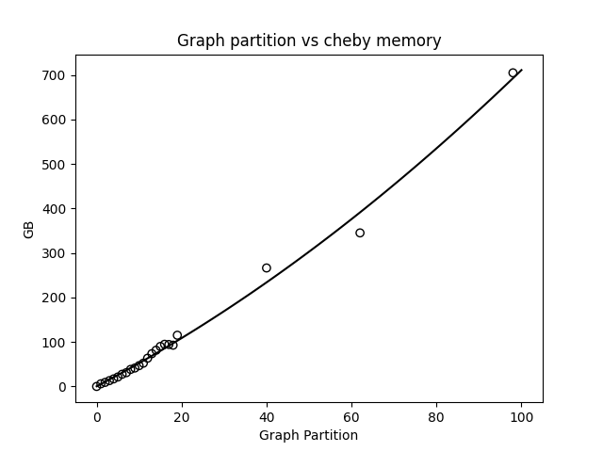
Pre-optimization (cheby step)

Slide 8
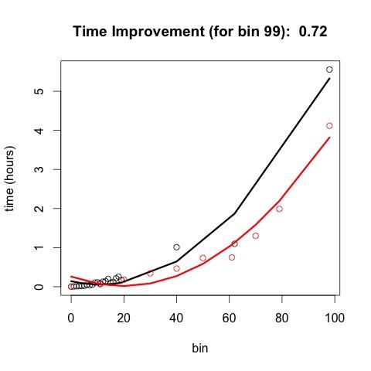
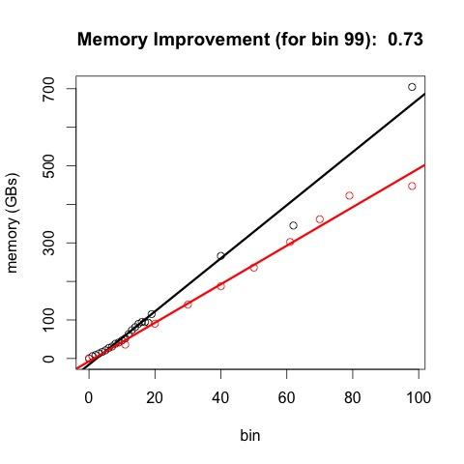
Post optimization (red stuff)
Notes:
Ben
(generally speaking, memory utilized is some simple multiplication of the input mem ← plot this out)

Slide 9
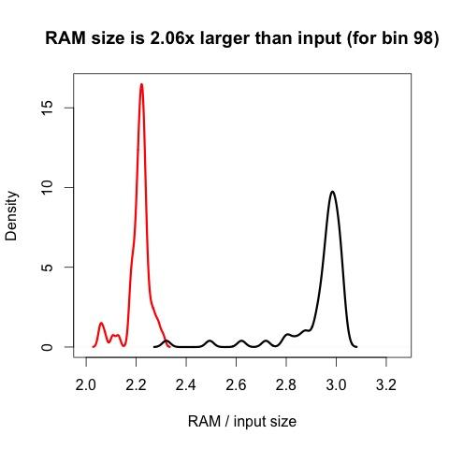
RAM comparison (density)

Slide 10
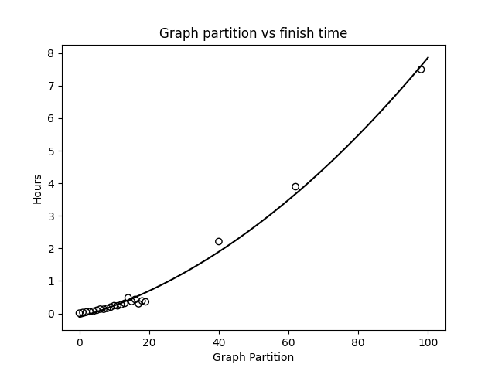
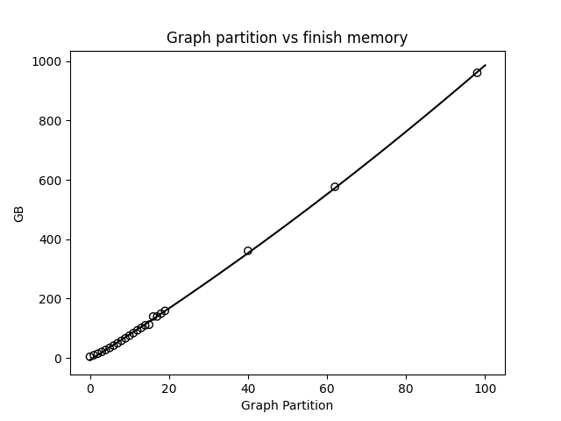
Pre-optimization (finish step)

Slide 11
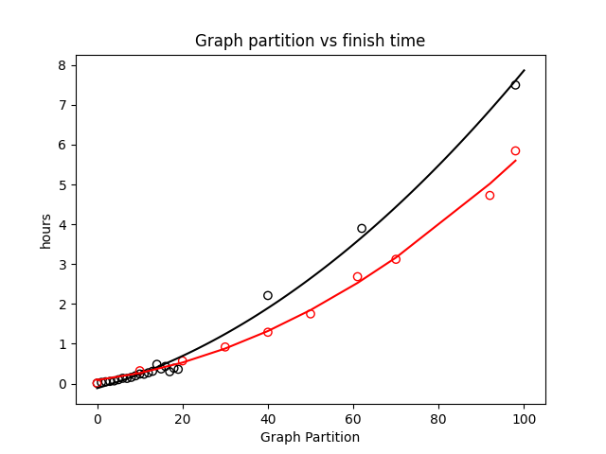
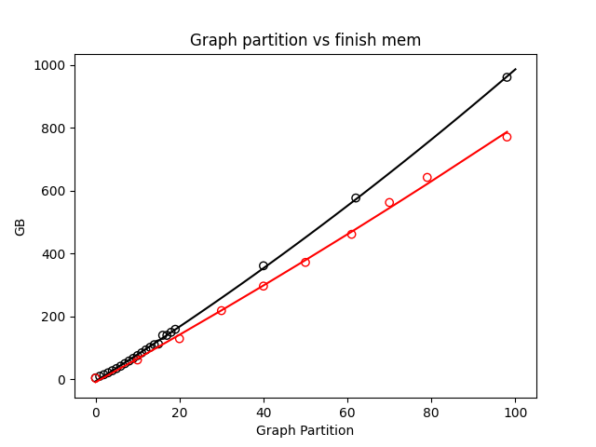
Finish with optimizations (red line)
Notes:
Ben

Slide 12
Related Work Experiments
get_paper_embedding(sample_paper)
model
Paper
Introduction Ref1, Ref2, Ref3
Related Work Ref4, Ref5, Ref6
Conclusion Ref7, Ref8, Ref9
Intro References Vector = 3 References
Compare and Predict
Rel Work References Vector = 3 References
Conclusion References Vector = 3 References

Slide 13
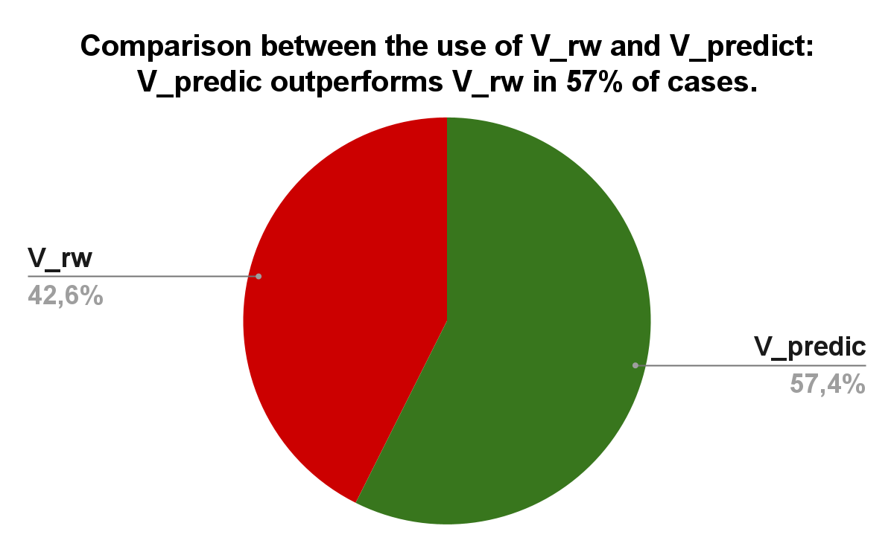
Related Work Experiments (Before)

Slide 14
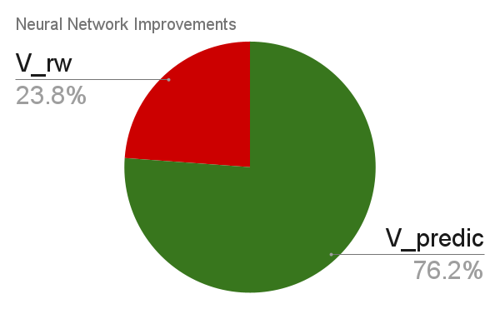
Deeper Networks (with layernorm, and GELU activation)
With improvements, V_predic now outperforms V_rw in 76.2% of cases.

Slide 15
thanks

