Slide 1
Related Work Hypothesis
Rodolfo Zevallos and John Ortega

Slide 2
What to do with a new paper?
Notes:
We test the models by generalizing from new papers, which means obtaining embeddings for papers that have not been used in the training dataset.
To obtain the embedding for a new paper, we used the references of paper. Then, to determine if the new embedding represents the paper effectively, we used cosine similarity to search for similar papers.
In our experiments, we selected a new paper from ACL 2023 (with the following topics...) which has 40 references.
In this figure, you can see the flow of our experiment.
In the first experiment, we used all the references to create the new embedding. In the second experiment, we only used the references from the related works section, and in the third experiment, we utilized the longest cluster obtained from the reference clustering. The embeddings for the references were obtained from Specter 2 and Prone. To obtain the new embedding, we applied the centroid method to the embeddings. Finally, we compared the new embedding obtained from each experiment with a dataset of 500 papers related to the new paper's topics.
Testeamos los modelos mediante la generalización de nuevos papers, es decir: Como obtenemos los embeddings de los papers que no han sido utilizados en los datos de entrenamiento?
Para obtener el embedding del nuevo paper, lo hacemos a partir de las referencias del paper. Luego, para saber si el nuevo embedding representa al paper, usamos similitud de cosenos para buscar papers similares.
Para los experimentos utilizamos un paper nuevo de ACL 2023 (este paper tiene como temas….) el cual tiene 40 referencias.
En el primer experimentos utilizamos todas las referencias para crear el nuevo embedding, para el segundo solo las referencias de la seccion trabajos relacionados y para el tercero el grupo mas largo obtenido de la clusterizacion de las referencias. Los embeddings de las referencias son obtenidas de Specter 2 y Prone, Para obtener el nuevo embedding aplicamos el metodo centroid a las embeddings. Finalmente compararamos el nuevo embedding obtenido de cada experimento con un dataset de de 500 paper en temas relacionados al nuevo paper.

Slide 3
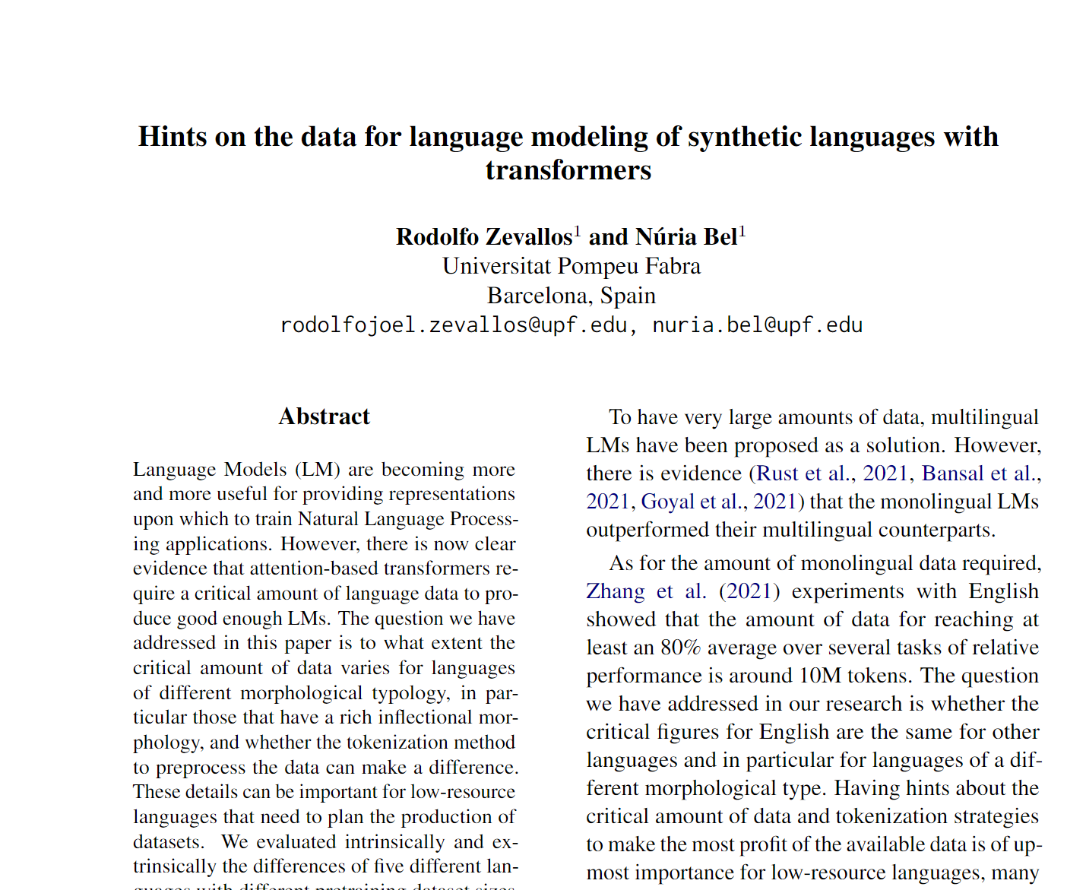
What to do with a new paper?
ACL 2023
Notes:
We test the models by generalizing from new papers, which means obtaining embeddings for papers that have not been used in the training dataset.
To obtain the embedding for a new paper, we used the references of paper. Then, to determine if the new embedding represents the paper effectively, we used cosine similarity to search for similar papers.
In our experiments, we selected a new paper from ACL 2023 (with the following topics...) which has 40 references.
In this figure, you can see the flow of our experiment.
In the first experiment, we used all the references to create the new embedding. In the second experiment, we only used the references from the related works section, and in the third experiment, we utilized the longest cluster obtained from the reference clustering. The embeddings for the references were obtained from Specter 2 and Prone. To obtain the new embedding, we applied the centroid method to the embeddings. Finally, we compared the new embedding obtained from each experiment with a dataset of 500 papers related to the new paper's topics.
Testeamos los modelos mediante la generalización de nuevos papers, es decir: Como obtenemos los embeddings de los papers que no han sido utilizados en los datos de entrenamiento?
Para obtener el embedding del nuevo paper, lo hacemos a partir de las referencias del paper. Luego, para saber si el nuevo embedding representa al paper, usamos similitud de cosenos para buscar papers similares.
Para los experimentos utilizamos un paper nuevo de ACL 2023 (este paper tiene como temas….) el cual tiene 40 referencias.
En el primer experimentos utilizamos todas las referencias para crear el nuevo embedding, para el segundo solo las referencias de la seccion trabajos relacionados y para el tercero el grupo mas largo obtenido de la clusterizacion de las referencias. Los embeddings de las referencias son obtenidas de Specter 2 y Prone, Para obtener el nuevo embedding aplicamos el metodo centroid a las embeddings. Finalmente compararamos el nuevo embedding obtenido de cada experimento con un dataset de de 500 paper en temas relacionados al nuevo paper.

Slide 4
What to do with a new paper?
ACL 2023
Task: find similar papers
Notes:
We test the models by generalizing from new papers, which means obtaining embeddings for papers that have not been used in the training dataset.
To obtain the embedding for a new paper, we used the references of paper. Then, to determine if the new embedding represents the paper effectively, we used cosine similarity to search for similar papers.
In our experiments, we selected a new paper from ACL 2023 (with the following topics...) which has 40 references.
In this figure, you can see the flow of our experiment.
In the first experiment, we used all the references to create the new embedding. In the second experiment, we only used the references from the related works section, and in the third experiment, we utilized the longest cluster obtained from the reference clustering. The embeddings for the references were obtained from Specter 2 and Prone. To obtain the new embedding, we applied the centroid method to the embeddings. Finally, we compared the new embedding obtained from each experiment with a dataset of 500 papers related to the new paper's topics.
Testeamos los modelos mediante la generalización de nuevos papers, es decir: Como obtenemos los embeddings de los papers que no han sido utilizados en los datos de entrenamiento?
Para obtener el embedding del nuevo paper, lo hacemos a partir de las referencias del paper. Luego, para saber si el nuevo embedding representa al paper, usamos similitud de cosenos para buscar papers similares.
Para los experimentos utilizamos un paper nuevo de ACL 2023 (este paper tiene como temas….) el cual tiene 40 referencias.
En el primer experimentos utilizamos todas las referencias para crear el nuevo embedding, para el segundo solo las referencias de la seccion trabajos relacionados y para el tercero el grupo mas largo obtenido de la clusterizacion de las referencias. Los embeddings de las referencias son obtenidas de Specter 2 y Prone, Para obtener el nuevo embedding aplicamos el metodo centroid a las embeddings. Finalmente compararamos el nuevo embedding obtenido de cada experimento con un dataset de de 500 paper en temas relacionados al nuevo paper.

Slide 5
What to do with a new paper?
ACL 2023
Task: find similar papers
Does the new paper have an ID to generate its vector in Specter 2 or Prone model?
Notes:
We test the models by generalizing from new papers, which means obtaining embeddings for papers that have not been used in the training dataset.
To obtain the embedding for a new paper, we used the references of paper. Then, to determine if the new embedding represents the paper effectively, we used cosine similarity to search for similar papers.
In our experiments, we selected a new paper from ACL 2023 (with the following topics...) which has 40 references.
In this figure, you can see the flow of our experiment.
In the first experiment, we used all the references to create the new embedding. In the second experiment, we only used the references from the related works section, and in the third experiment, we utilized the longest cluster obtained from the reference clustering. The embeddings for the references were obtained from Specter 2 and Prone. To obtain the new embedding, we applied the centroid method to the embeddings. Finally, we compared the new embedding obtained from each experiment with a dataset of 500 papers related to the new paper's topics.
Testeamos los modelos mediante la generalización de nuevos papers, es decir: Como obtenemos los embeddings de los papers que no han sido utilizados en los datos de entrenamiento?
Para obtener el embedding del nuevo paper, lo hacemos a partir de las referencias del paper. Luego, para saber si el nuevo embedding representa al paper, usamos similitud de cosenos para buscar papers similares.
Para los experimentos utilizamos un paper nuevo de ACL 2023 (este paper tiene como temas….) el cual tiene 40 referencias.
En el primer experimentos utilizamos todas las referencias para crear el nuevo embedding, para el segundo solo las referencias de la seccion trabajos relacionados y para el tercero el grupo mas largo obtenido de la clusterizacion de las referencias. Los embeddings de las referencias son obtenidas de Specter 2 y Prone, Para obtener el nuevo embedding aplicamos el metodo centroid a las embeddings. Finalmente compararamos el nuevo embedding obtenido de cada experimento con un dataset de de 500 paper en temas relacionados al nuevo paper.

Slide 6
What to do with a new paper?
ACL 2023
Task: find similar papers
Does the new paper have an ID to generate its vector in Specter 2 or Prone model?
NO
Notes:
We test the models by generalizing from new papers, which means obtaining embeddings for papers that have not been used in the training dataset.
To obtain the embedding for a new paper, we used the references of paper. Then, to determine if the new embedding represents the paper effectively, we used cosine similarity to search for similar papers.
In our experiments, we selected a new paper from ACL 2023 (with the following topics...) which has 40 references.
In this figure, you can see the flow of our experiment.
In the first experiment, we used all the references to create the new embedding. In the second experiment, we only used the references from the related works section, and in the third experiment, we utilized the longest cluster obtained from the reference clustering. The embeddings for the references were obtained from Specter 2 and Prone. To obtain the new embedding, we applied the centroid method to the embeddings. Finally, we compared the new embedding obtained from each experiment with a dataset of 500 papers related to the new paper's topics.
Testeamos los modelos mediante la generalización de nuevos papers, es decir: Como obtenemos los embeddings de los papers que no han sido utilizados en los datos de entrenamiento?
Para obtener el embedding del nuevo paper, lo hacemos a partir de las referencias del paper. Luego, para saber si el nuevo embedding representa al paper, usamos similitud de cosenos para buscar papers similares.
Para los experimentos utilizamos un paper nuevo de ACL 2023 (este paper tiene como temas….) el cual tiene 40 referencias.
En el primer experimentos utilizamos todas las referencias para crear el nuevo embedding, para el segundo solo las referencias de la seccion trabajos relacionados y para el tercero el grupo mas largo obtenido de la clusterizacion de las referencias. Los embeddings de las referencias son obtenidas de Specter 2 y Prone, Para obtener el nuevo embedding aplicamos el metodo centroid a las embeddings. Finalmente compararamos el nuevo embedding obtenido de cada experimento con un dataset de de 500 paper en temas relacionados al nuevo paper.

Slide 7
What to do with a new paper?
ACL 2023
Task: find similar papers
Does the new paper have an ID to generate its vector in Specter 2 or Prone model?
NO
How to create the vector of my new paper?
Notes:
We test the models by generalizing from new papers, which means obtaining embeddings for papers that have not been used in the training dataset.
To obtain the embedding for a new paper, we used the references of paper. Then, to determine if the new embedding represents the paper effectively, we used cosine similarity to search for similar papers.
In our experiments, we selected a new paper from ACL 2023 (with the following topics...) which has 40 references.
In this figure, you can see the flow of our experiment.
In the first experiment, we used all the references to create the new embedding. In the second experiment, we only used the references from the related works section, and in the third experiment, we utilized the longest cluster obtained from the reference clustering. The embeddings for the references were obtained from Specter 2 and Prone. To obtain the new embedding, we applied the centroid method to the embeddings. Finally, we compared the new embedding obtained from each experiment with a dataset of 500 papers related to the new paper's topics.
Testeamos los modelos mediante la generalización de nuevos papers, es decir: Como obtenemos los embeddings de los papers que no han sido utilizados en los datos de entrenamiento?
Para obtener el embedding del nuevo paper, lo hacemos a partir de las referencias del paper. Luego, para saber si el nuevo embedding representa al paper, usamos similitud de cosenos para buscar papers similares.
Para los experimentos utilizamos un paper nuevo de ACL 2023 (este paper tiene como temas….) el cual tiene 40 referencias.
En el primer experimentos utilizamos todas las referencias para crear el nuevo embedding, para el segundo solo las referencias de la seccion trabajos relacionados y para el tercero el grupo mas largo obtenido de la clusterizacion de las referencias. Los embeddings de las referencias son obtenidas de Specter 2 y Prone, Para obtener el nuevo embedding aplicamos el metodo centroid a las embeddings. Finalmente compararamos el nuevo embedding obtenido de cada experimento con un dataset de de 500 paper en temas relacionados al nuevo paper.

Slide 8
Our solution: new vector from the paper references.
New Paper
Get Vectors
(Specter 2 or Prone)
Vectors
New
Vector
Centroid Method
Notes:
Get paper references
To obtain the embeddings of each reference using Specter 2 or Prone
Applying centroid method to the references to get a new embedding

Slide 9
Our solution: new vector from the paper references.
Now! We can find similar papers
New Paper
Get Vectors
(Specter 2 or Prone)
Vectors
New
Vector
Centroid Method
Notes:
Get paper references
To obtain the embeddings of each reference using Specter 2 or Prone
Applying centroid method to the references to get a new embedding

Slide 10
Our solution: new vector from the paper references.
Now! We can find similar papers
New
Vector
New Paper
Get Vectors
(Specter 2 or Prone)
INPUT
Vectors
Nearest Neighbors
OUTPUT
New
Vector
Centroid Method
Recommendations
Notes:
Get paper references
To obtain the embeddings of each reference using Specter 2 or Prone
Applying centroid method to the references to get a new embedding

Slide 11
Using all reference citations Cosine
Prone
Impact of Tokenization on Language Models: An Analysis for Turkish
Cross-Lingual Named Entity Recognition Using Parallel Corpus: A New Approach Using XLM-RoBERTa Alignment
Specter 2
oLMpics-On What Language Model Pre-training Captures
Fast, Effective, and Self-Supervised: Transforming Masked Language Models into Universal Lexical and Sentence Encoders
97%
95%
96%
95%
I believe that Prone results are closer to my paper.

Slide 12
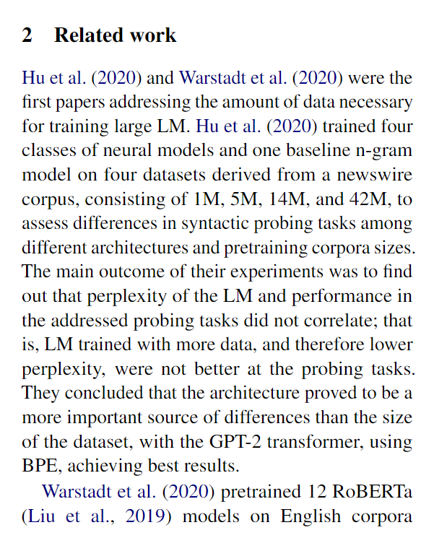


Related Work Hypothesis
Related work references seem to represent entire papers.

Slide 13
Using only related work ref. citations Cosine
Prone
Impact of Tokenization on Language Models: An Analysis for Turkish
RobeCzech: Czech RoBERTa, a monolingual contextualized language representation model
Specter 2
oLMpics-On What Language Model Pre-training Captures
Fast, Effective, and Self-Supervised: Transforming Masked Language Models into Universal Lexical and Sentence Encoders
99%
95%
97%
95%
I believe that Prone results are closer to my paper.

Slide 14
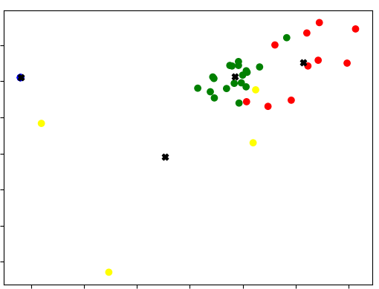
Related Work Neighborhood Experiment
Green dots represent Related Work reference citations
Notes:
We cluster our references, but (question)
Take the green references because we believe they are almost the same as those of the related work.
we take the longest and most compact group
And they are the most closely related to each other and with the paper.

Slide 15
Using all ref citations with clustering Cosine
Prone
Phonologically Informed Edit Distance Algorithms for Word Alignment with Low-Resource Languages
A Basic Language Technology Toolkit for Quechua
Specter 2
On the Stability of Fine-tuning BERT: Misconceptions, Explanations, and Strong Baselines
Probing Across Time: What Does RoBERTa Know and When?
92%
90%
92%
91%
I believe that Prone results are closer to my paper.

Slide 16
Related Work Hypothesis
Cosine_similarity(V_prone, V_rw) > Cosine_similarity(V_prone, V_all)

Slide 17
Related Work Experiments
400k papers
Organized by Martin Dočekal (PhD student, BRNO UNIVERSITY OF TECHNOLOGY, Czech Republic)
Related Work annotated dataset
Corpus ids mapped to Semantic Scholar ids
"paper_id":54955648,
"rw_citations":[3045997,2770517,5569544,36379,1665288,74632109,2223771],
"Other_citations":[16395612,14432142]

Slide 18
Related Work Experiments
Vector representations of referenced papers
Specter 1 and 2
Prone
Centroids
related work references
non-related work references
ALL references

Slide 19
Related Work Experiments
Introduction Ref1, Ref2, Ref3
Related Work Ref4, Ref5, Ref6
Conclusion Ref7, Ref8, Ref9
9 References
3 Introduction
3 Rel Work
3 Conclusion
ALL References Vector = 9 References (V_all)
Rel Work References Vector = 3 References (V_rw)
Sample Paper

Slide 20
Related Work Experiments
get_paper_embedding(sample_paper)
model
V_model
Introduction Ref1, Ref2, Ref3
Related Work Ref4, Ref5, Ref6
Conclusion Ref7, Ref8, Ref9
get_centroid_vector(All References) = V_all
Compare
get_centroid_vector(Related Work References) = V_rw

Slide 21
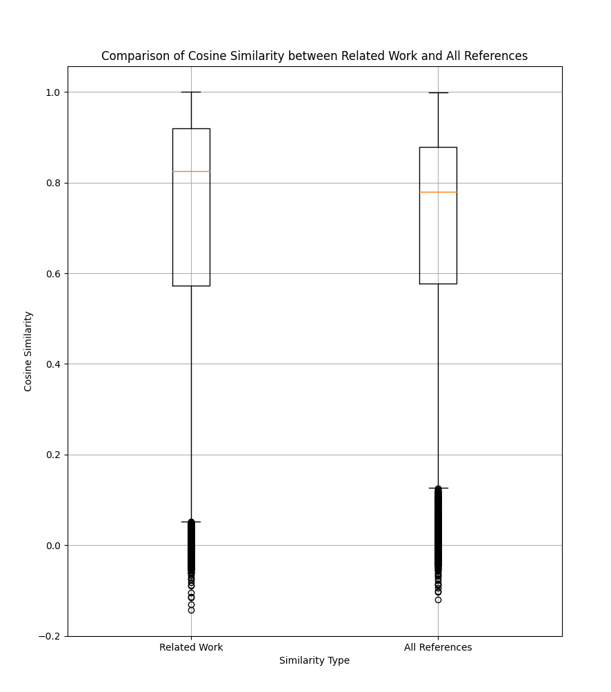
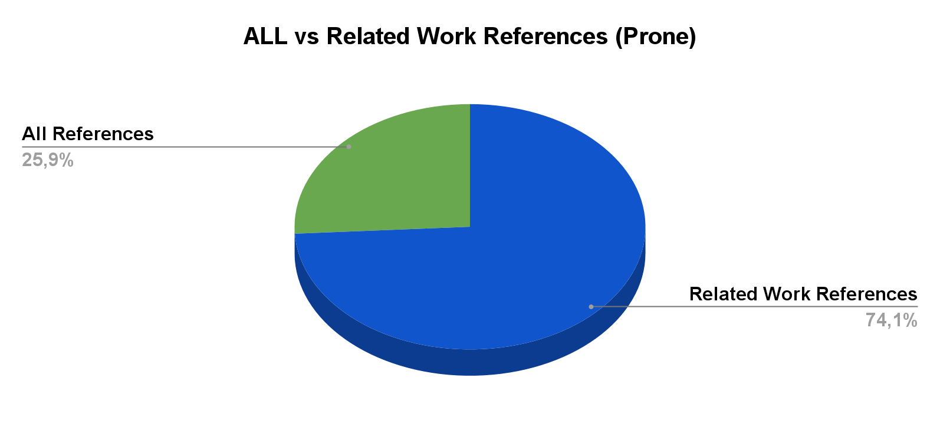
Related Work Experiments
Notes:
If you just compute the vector from rw, it is usually better than using all of the references. Isn’t clear what the two conditions are.

Slide 22
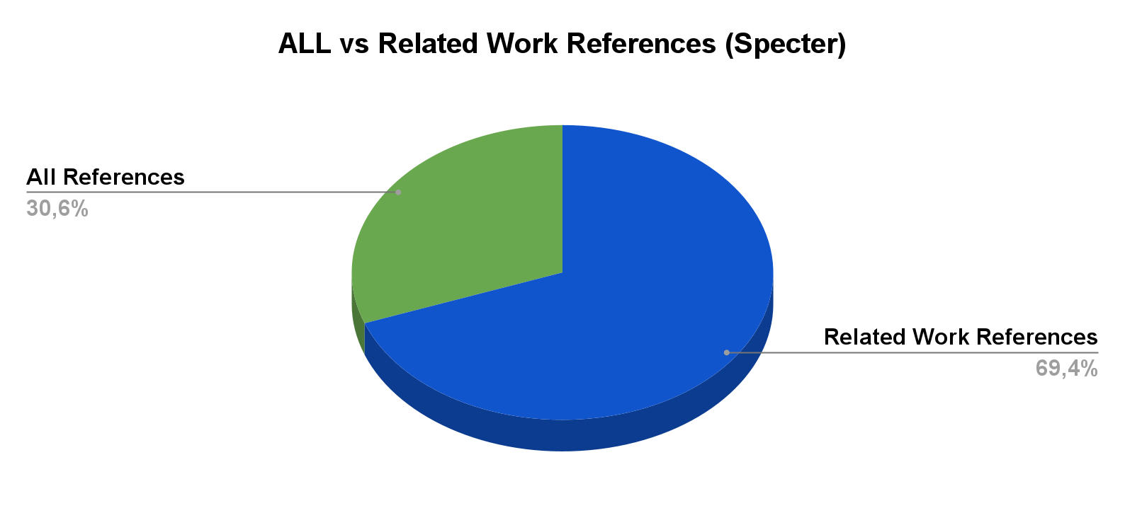
Related Work Experiments

Slide 23
Related Work Experiments
σVector_Rel_Work + μVector_Other = Vector_model
σ and μ are constants of the equation
We experiment with predicting the entire vector given only related work sections.

Slide 24
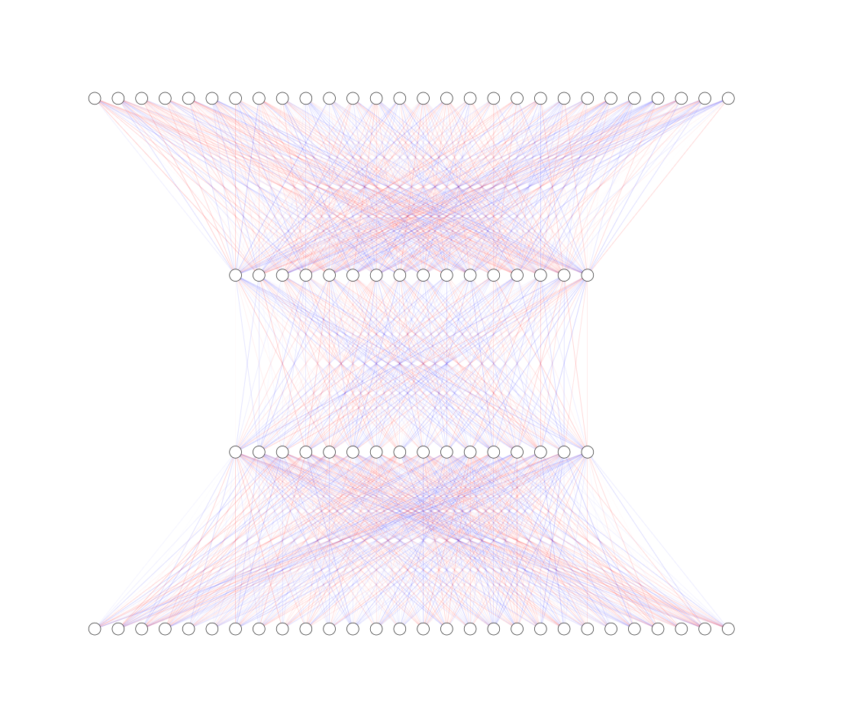
Related Work Experiments
prediction vector = V_predic
We built a neural network to predict the V_model
We used Martin's 400k paper archive
Our NN was trained with a lr of 5e-5, in 3 epochs, using AdamW as an optimizer, in addition, we use a dropout of 0.2 and a batch of 8
Our Neural Network
V_rw + V_nrw

Slide 25
Related Work Experiments

Slide 26
Conclusion
The centroid vector of the references approximates the vector of the model.
The centroid vector of Related Work references is better than use all references.
Using a clustering method helps to get the related work references in case you don't have them.
The vector generated by the neural model is closer to the V_model than the vector of related work references

