Slide 1
Document Time Period Prediction

Slide 2
Time Period Prediction – Task Overview
Given a query paper, predict the time period (time bin) it comes from
Input: single scientific paper
Embeddings: Specter, Specter 2, SciNCL, ProNE
References of query paper, along with information such as publication year
Similar documents to query paper
Map of year to time bin
Output: Predicted time bin
Bin 99
………
Bin 0
Time

Slide 3
Time Period Prediction – Motivation
Understand contribution of embedding types and nearest neighbors on predicting information about query paper
Detect missing or incorrect data
Many papers in dataset cannot be found in semantic scholar
Some papers are recorded to cite far into the future
Proxy for many other related tasks
Venue prediction
Reviewer matching
Collaborator search
???

Slide 4
Time Period Prediction – Experiments Overview
Baseline – References
Similar Papers – Nearest Neighbors
Embeddings
ProNE: citations
Specter: text
Specter 2: text
SciNCL: text
Combination

Slide 5
Time Period Prediction – Data
Bigrams:
Cosine similarity, query paper corpus ID, and list of similar papers to query papers
(0.9984, 4336316, 121417552)
(0.9970, 4336316, 15371799)
(0.9966, 4336316, 4239637)
(0.9953, 4336316, 117876280)

Slide 6
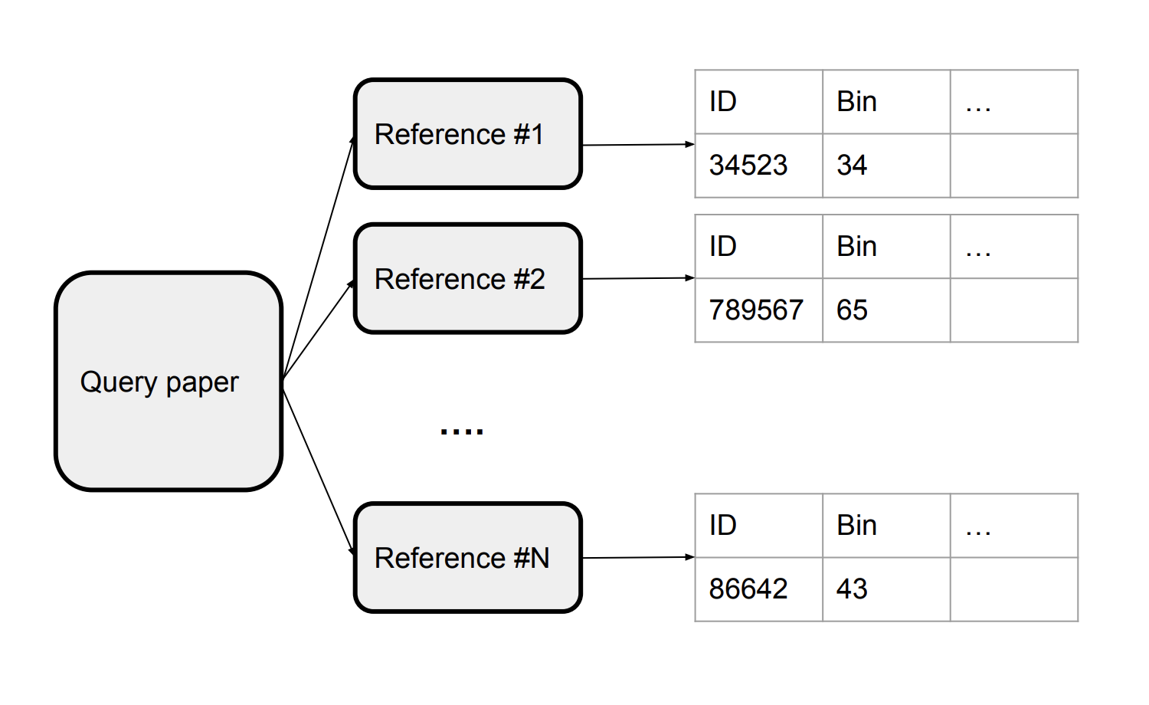
Time Period Prediction – Baseline
Use bin of most recent reference as predicted bin of query paper
Semantic Scholar API
max()

Slide 7
Time Period Prediction – Baseline Results
Method | Accuracy | Cumulative Acc | Precision | Recall | F1
Bin # of most recent reference | 18.80 | 18.80 | 0.21 | 0.19 | 0.19
Bin # of most recent reference + 1 | 20.45 | 39.25 | 0.23 | 0.20 | 0.21
Bin # of most recent reference + 2 | 13.08 | 52.33 | 0.14 | 0.13 | 0.13

Slide 8
Time Period Prediction – Baseline Results
Method | Accuracy | MSE
Bin # of most recent reference | 18.7 | 93.57
Bin # of most recent reference + 1 | 20.5 | 95.25
Bin # of most recent reference + 2 | 13.1 | 98.92

Slide 9
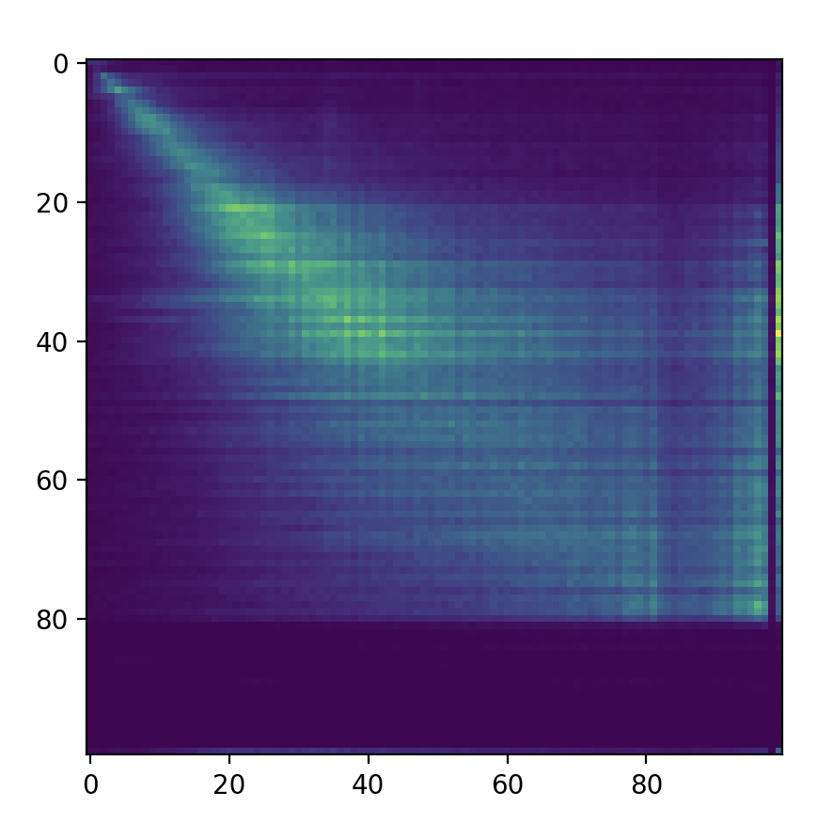
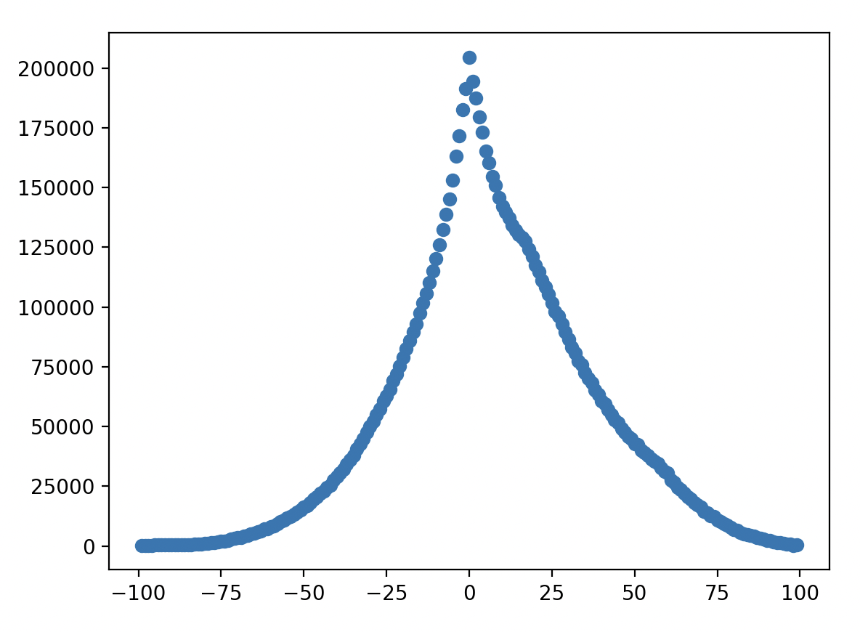
Time Period Prediction – Initial experiments
Count of Citations by Bin Number
Sum of Count of Citations at each Bin Offset
Paper 2 Bin
Count
Paper 1 Bin
Bin Offset
Notes:
Will add labels

Slide 10
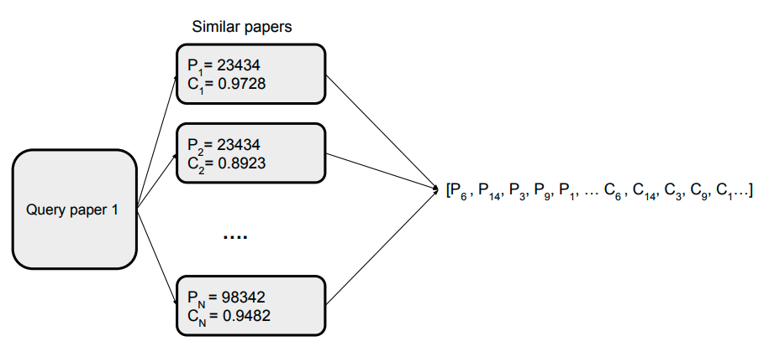
Time Period Prediction – Similar Papers

Slide 11
Time Period Prediction – Similar Papers Results
Method | Accuracy | Precision | Recall | F1 | MSE
Top 10 by cosine | 7.57 | 0.07 | 0.08 | 0.06 | 186.74
Top 5 by cosine | 7.51 | 0.07 | 0.08 | 0.06 | 204.32
Top 1 by cosine | 6.99 | 0.08 | 0.07 | 0.06 | 292.52

Slide 12
Time Period Prediction – Similar Papers Results
Method | Accuracy | MSE
Top 10 by cosine | 7.5 | 169.64
Top 5 by cosine | 7.3
Top 1 by cosine | 7.0
Notes:
Currently calculating MSEs

Slide 13
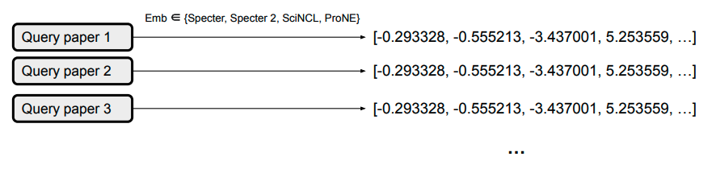
Time Period Prediction – Embeddings

Slide 14
Time Period Prediction – Embeddings Results
Method | Accuracy | Precision | Recall | F1 | MSE
Specter | 33.7
Specter 2 | 24.6
SciNCL | 21.5
ProNE | 35.5

Slide 15
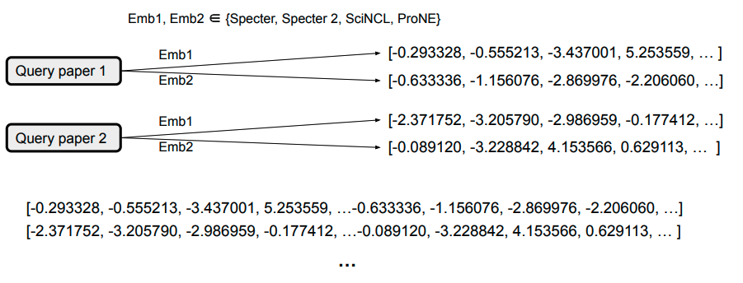
Time Period Prediction – Combinations

Slide 16
Time Period Prediction – Combinations Results
 | Specter | Specter 2 | SciNCL | ProNE
Specter |  |  |  | 72.1
Specter 2
SciNCL
ProNE | 72.1

Slide 17
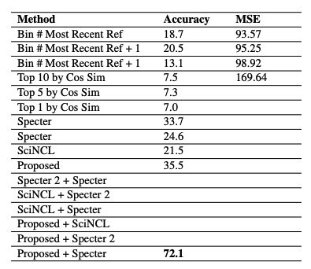
Bin Prediction – Summary
Baseline
Similar Papers
Embedding
Combinations

Slide 18
Time Period Prediction – Future work
Consider other features
Min / max / median of time bins of references
Distribution of time bins of references
Improve data preprocessing
Try other model types
Extend to other tasks
Venue prediction
Reviewer matching
Collaborator search
AI2 Bridger

