Slide 1
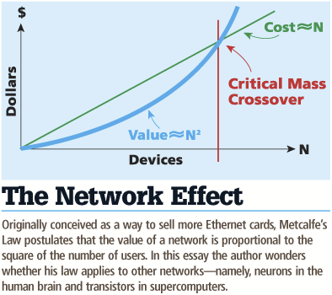
Network Effects: What is the Power of Scale?
Many benchmarks return a single number (figure of merit)
How performance scales with time and the size of the problem
Metcalfe's Law is a blessing
Cost scales in N, benefit scales in N^2
There is an opportunity for academics to benefit from the network effect

Slide 2
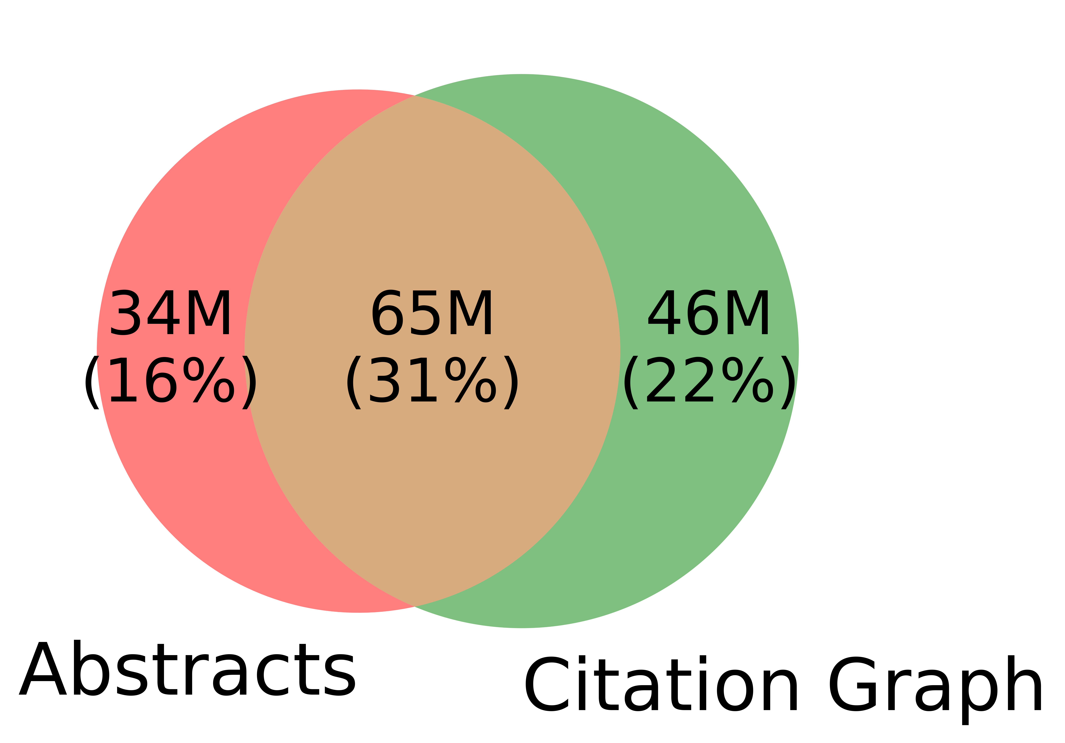
Spoiler Alert: Better-Together Conjectures
Multiple representations are helpful
for missing values (and bad values)
If abstracts are missing, use links
If links are missing, use abstracts
and for graphs of different sizes
When graphs are small:
Text >> Links
when graphs are large:
Links >> Text (Metcalfe’s Law)

Slide 3
What is the Effect of Scale and Time?
Encourage practical solutions to real problems
Recommendations: What should I read? Cite?
Too many benchmarks are unrealistic (small, clean)
Realities
Literature is large and growing (doubles every 9 years)
Dirty Data (many values are missing/incorrect)
Scale
How do space, time, and loss scale with size of citation graph?
Forecasting: short-term predictions are easier than long-term

Slide 4
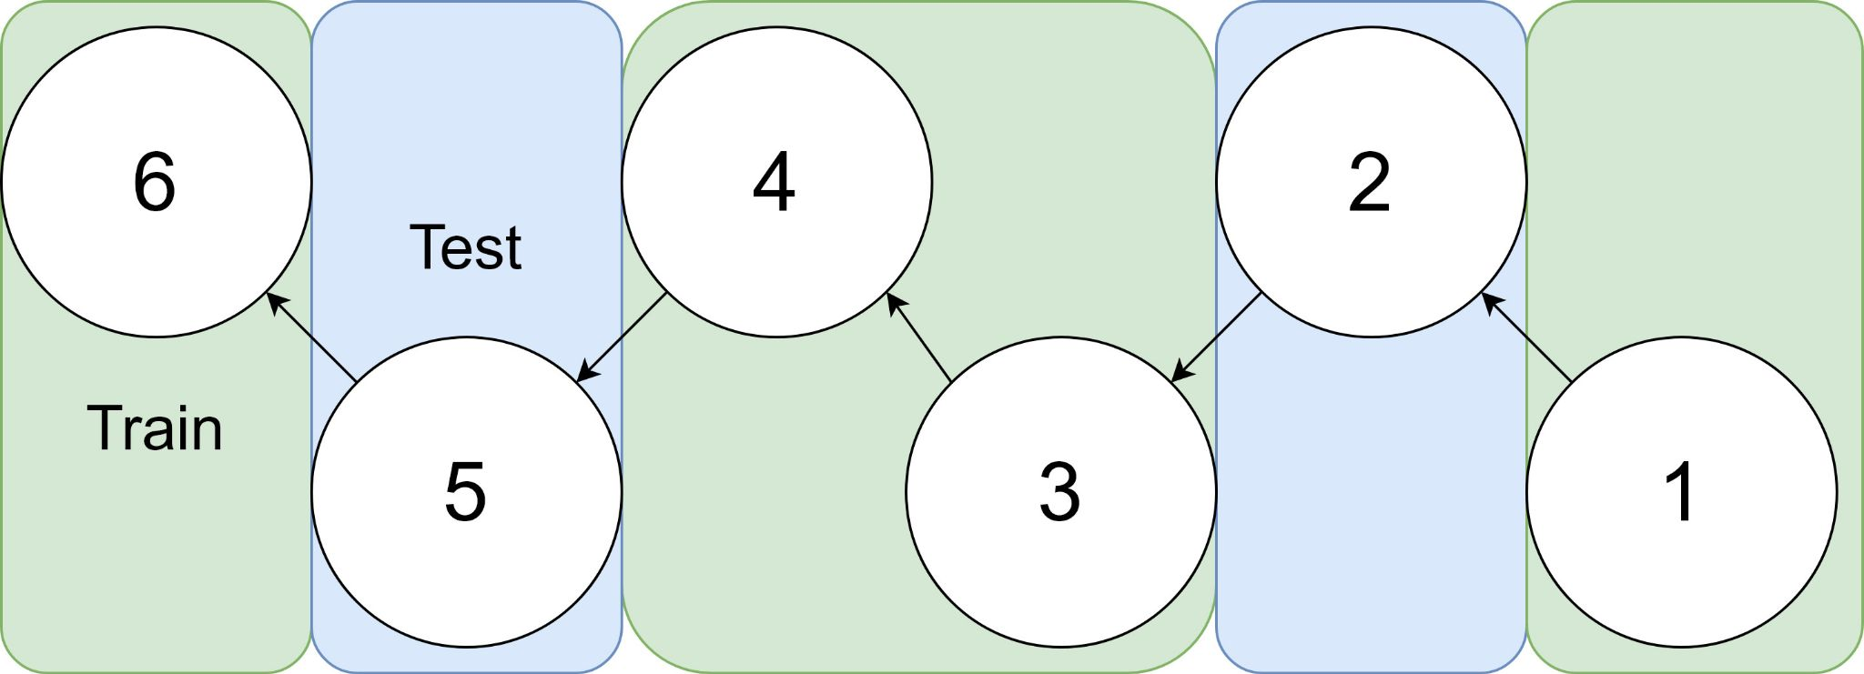
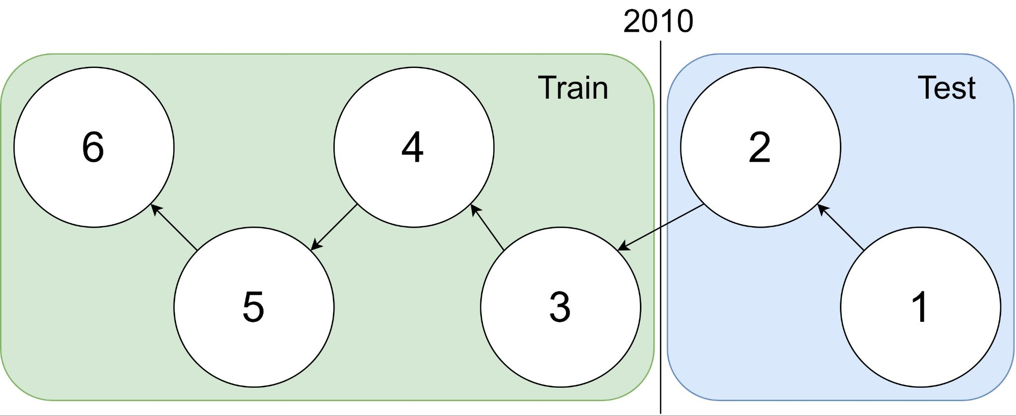
Example: 1 cites 2, 2 cites 3, … 5 cites 6
Traditional Train-Test Split (Non-Causal)
idx | Pub Year | Paper Title
1 | 2018 | [...] Photofragment imaging
2 | 2016 | Convenient probe of S(1D2)[...]
3 | 2005 | Megapixel ion imaging [...]
4 | 2003 | Direct current slice imaging [...]
5 | 1995 | profiles of Cl(2Pj) photofragments [...]
6 | 1988 | Adiabatic dissociation of [...]
Proposed Train-Test Splits (Causal)
Notes:
No asymmetry of time - how to reduce to a soundbite
Audience soundbites
‘Almost all studies in ml do test-train split’ that’s a bad idea when you have time

Slide 5
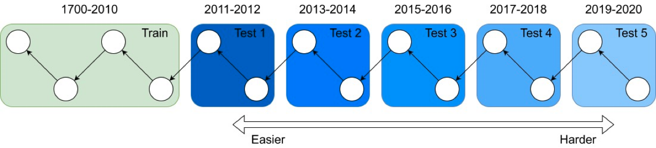
It's tough to make predictions, especially about the future. ― Yogi Berra
Forecasting: short-term predictions are easier than long-term

Slide 6
Bins Construction
Binning by time:
Input: 200M papers (nodes)
Output (split size): 2M papers per bin (100 bins)
The earlier bins contain a longer span of time (year of publications) compared to later bins
Bin 99
………
Bin 0
Time
Notes:
mention equal # papers
consider replacing w/ diagram

Slide 7
Graph Construction Subject to Bins
Graph construction:
Papers + their links
Split the graph into 100 subgraphs by time
Cumulative graphs: each graph includes itself and all previous graphs
Graph Representation:
Compute ProNE embeddings on cumulative graphs
Notes:
mention equal # papers
consider replacing w/ diagram

Slide 8
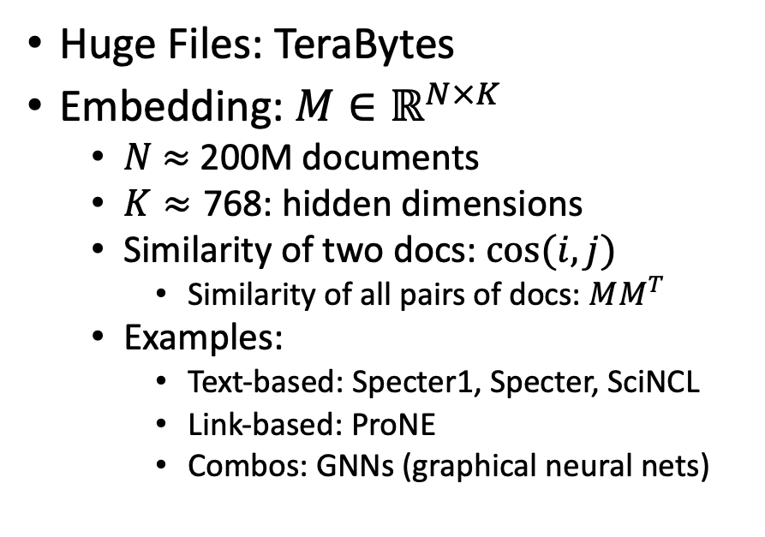
Scale: Both a Blessing and a Curse
Curse
Blessing
Huge Files: TeraBytes
Embedding: $M∈ℝ^{N×K}$
$N$ $≈$ 200M documents
$K≈\text{768}$: hidden dimensions
Similarity of two docs: $cos(i,j)⁡$
Similarity of all pairs of docs: $MM^{T}$
Examples:
Text-based: Specter1, Specter, SciNCL
Link-based: ProNE
Combos: GNNs (graphical neural nets)
Network Effects (Metcalfe’s Law)
Rich get richer
Approximate Nearest Neighbors
Works better on larger graphs
Citation Recommendation
Forecasting with text-based + link-base works better
Time period Prediction
Text-based + link-base works better

